Slide 1
Notes:
2013 – 40 years of McIDAS serving the atmospheric science community
2014 – 25 years of the McIDAS Users’ Group for maintaining and supporting the McIDAS users

Slide 2
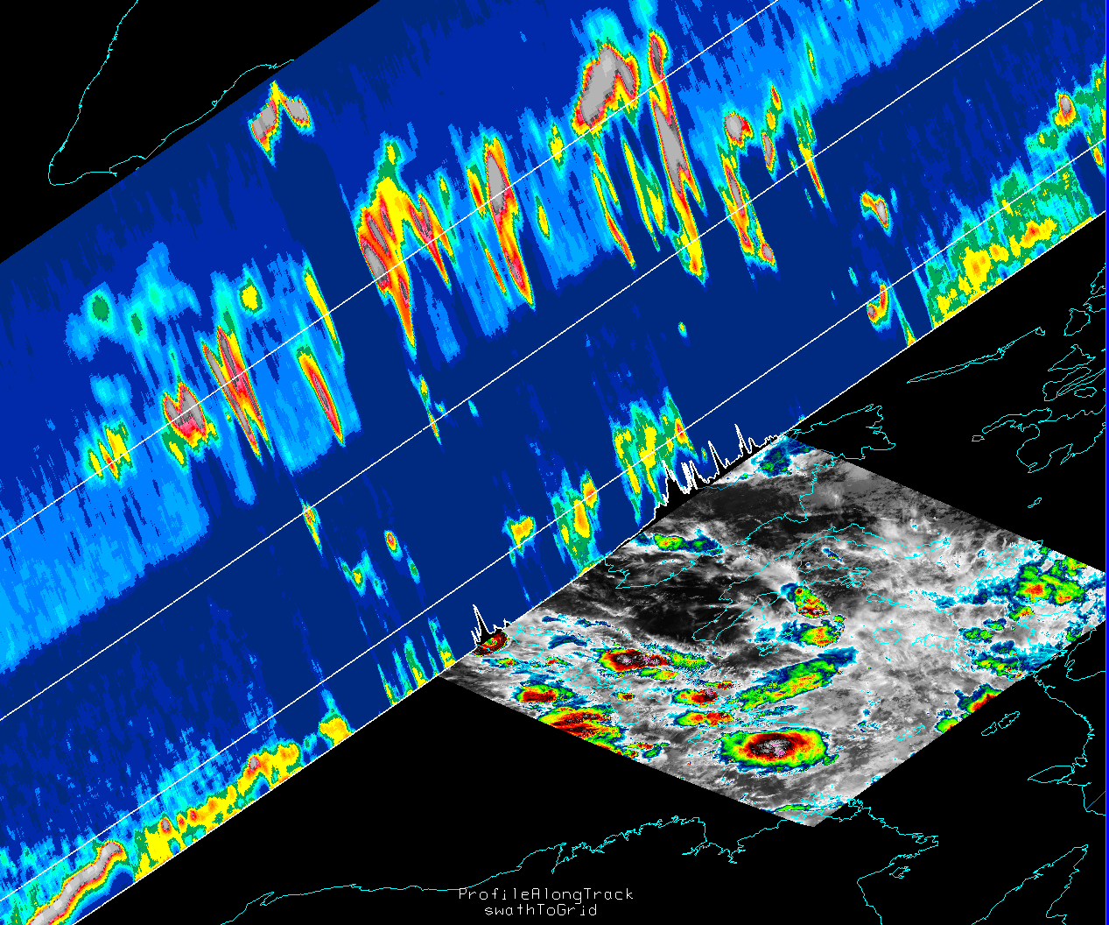
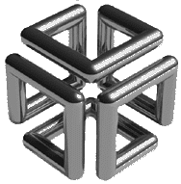
McIDAS then and now: 1999-2016
What were we doing in 1999? Worrying about Y2K, of course!
56 McIDAS modules updated
ZERO McIDAS systems crashed at 01-01-00 00:00:01
Big hardware then… much smaller hardware now…
But so much more power…
Notes:
McIDAS-V Image:
- Mt Kelud volcano eruption February, 2014
- Surface is Suomi NPP SVI05 IR temperatures
- Vertical curtain display is a Calipso pass showing backscatter

Slide 3
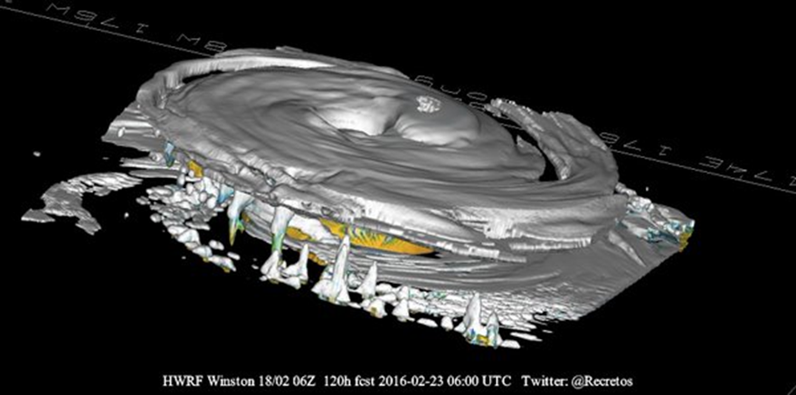

Slide 4
GFS 15/11/16 00z Polar vortex 4D animation

