Slide 1


GOES-R: What it means for the operational meteorologist
National Weather Association 2015 Broadcast Meteorology Workshop Edition
Jordan J. Gerth
Assistant Researcher, Liaison to NWS Pacific Region
Cooperative Institute for Meteorological Satellite Studies
University of Wisconsin at Madison
Timothy J. Schmit
Research Meteorologist
National Environmental Satellite, Data, and Information Service
Bill D. Ward
Environmental and Scientific Services Division Chief
National Weather Service Pacific Region Headquarters
Includes contributions from the community

Slide 2
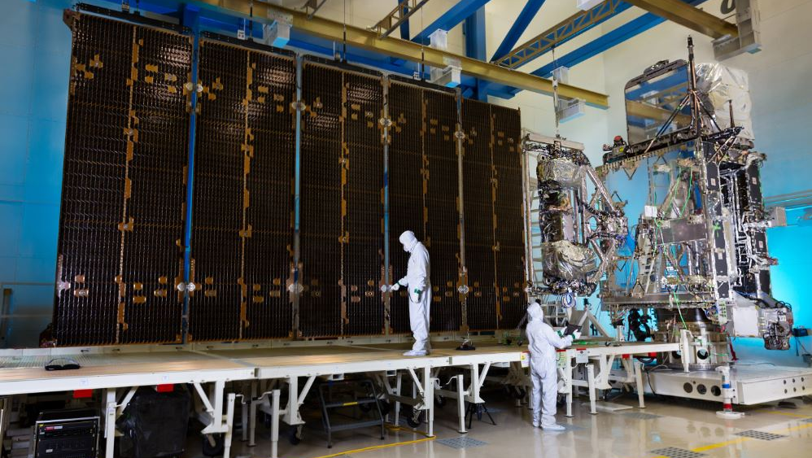
GOES-R spacecraft and solar panel

Slide 3
An update on GOES-R/S launch
GOES-R is tentatively scheduled to launch on October 14, 2016, in Cape Canaveral, Florida
GOES-S will launch approximately one year after the GOES-R launch
Post-launch testing will occur at 89.5 W and GOES-R will be positioned there for approximately one year
Operational location of GOES-R will depend on NWS priorities and the health of the existing GOES satellites

Slide 4
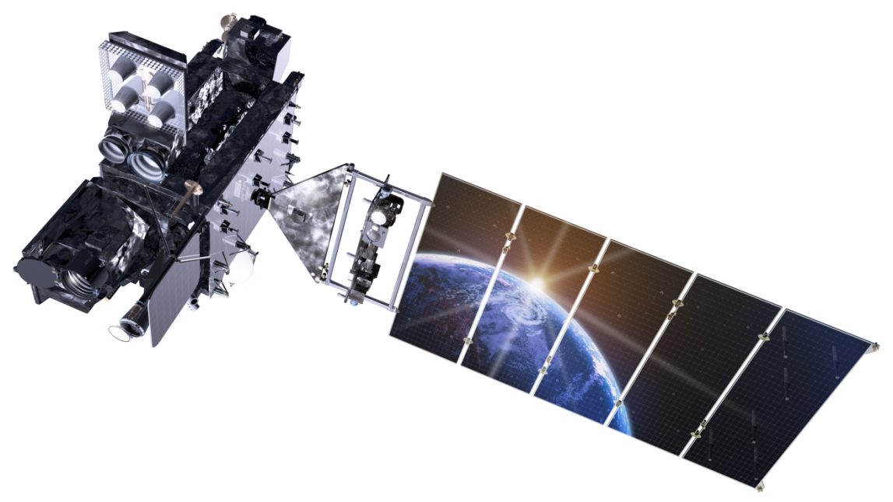
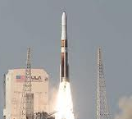
Continuity of GOES through 2036
Fiscal Year
09 | 10 | 11 | 12 | 13 | 14 | 15 | 16 | 17 | 18 | 19 | 20 | 21 | 22 | 23 | 24 | 25 | 26 | 27 | 28 | 29 | 30 | 31 | 32 | 33 | 34 | 35 | 36
GOES-13
GOES East
GOES-14
On-orbit spare
GOES-15
GOES West
Lockheed Martin
GOES-R
GOES-S
On-orbit storage
GOES-T
Test & Checkout
GOES-U
Operational
Fuel-Limited Lifetime
Launch & Orbit Raising
Post-launch Testing (PLT) - 180 Days
Operations -
<=5yrs Storage + >=8.4yrs Ops
Outgas
System Performance Operational Test (SPOT)
Ex-tended Val
PLT Cal/INR
PLPT
12 Days
30 Days
28 Days
60 Days
30 Days
32 Days
6 Mo
Post-launch Calibration, Instrument Navigation and Registration
Post-launch Product Testing

Slide 5
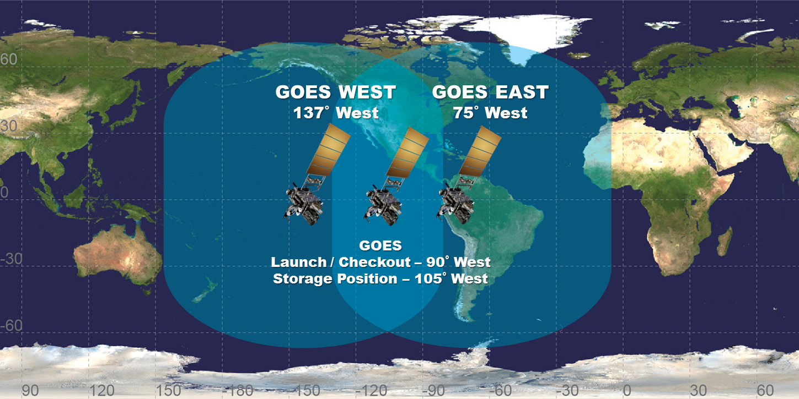
Future GOES-R/S constellation

Slide 6

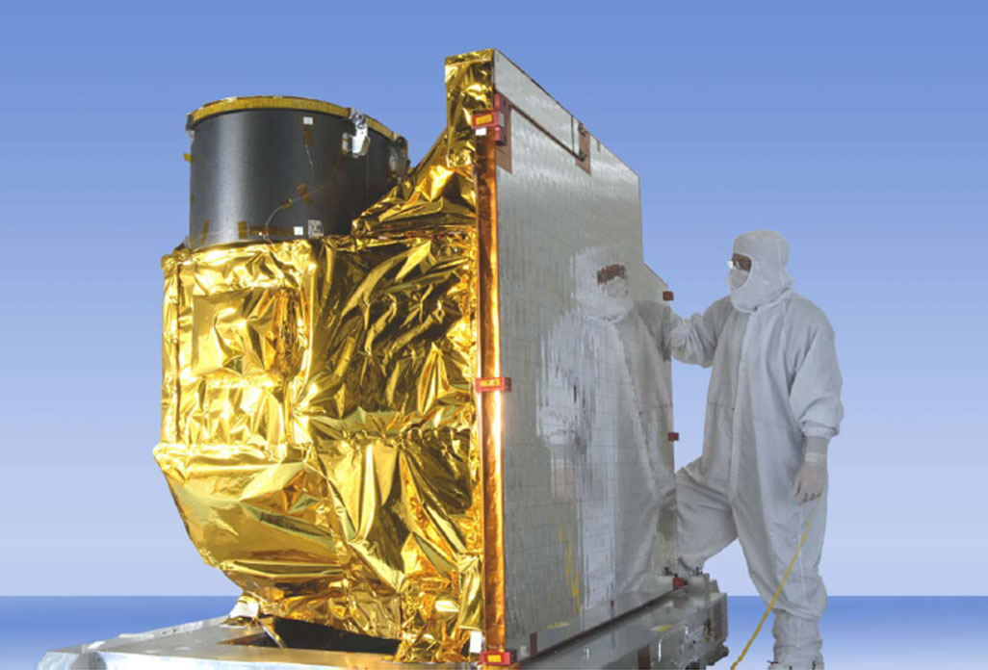
Advanced Baseline Imager (ABI)
5
4
3
X
Faster scanning
(5-minute full disk vs. 25-minute)
X
Improved spatial
resolution (2 km IR vs. 4 km)
X
More spectral bands (16 on ABI vs. 5)

Slide 7
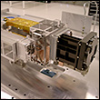
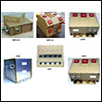
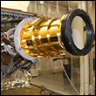
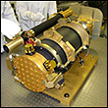
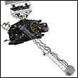
Other instruments
EXIS
Extreme Ultra Violet /
X-Ray Irradiance Sensor
Detects solar x-ray output
SEISS
Space Environmental In-Situ Suite
Measures proton, electron, and heavy ion fluxes to mitigate radiation risks to astronauts and damage to radio communication
GLM
Geostationary Lightning Mapper
Detects lightning
SUVI
Solar Ultra Violet Imager
Monitors the sun for solar flares and eruptions of filaments that may precede coronal mass ejections
MAG
Magnetometer
Measures the space environment
magnetic field

Slide 8

Two talks on GOES-R
Today
  Possible uses for GOES-R meteorological imagery and products as part of television segments and online content, geared toward broadcast meteorologists
Tomorrow
  How the Advanced Baseline Imager (ABI) can improve detectability of unique weather events and impact weather forecast decisions, with examples from the Advanced Himawari Imager (AHI)
Japan Meteorological Agency
Mascot “Harerun”

Slide 9
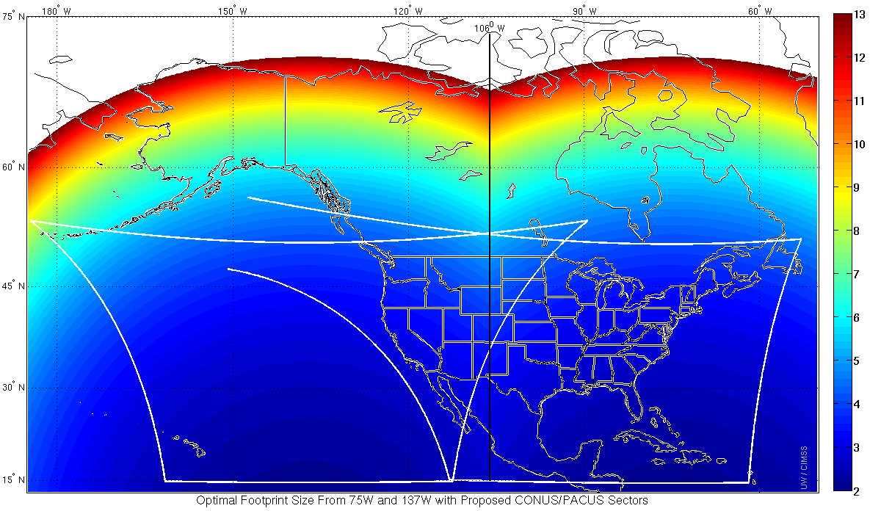
Improved spatial resolution
Highest infrared window spatial resolution from two GOES-R series satellite constellation

Slide 10
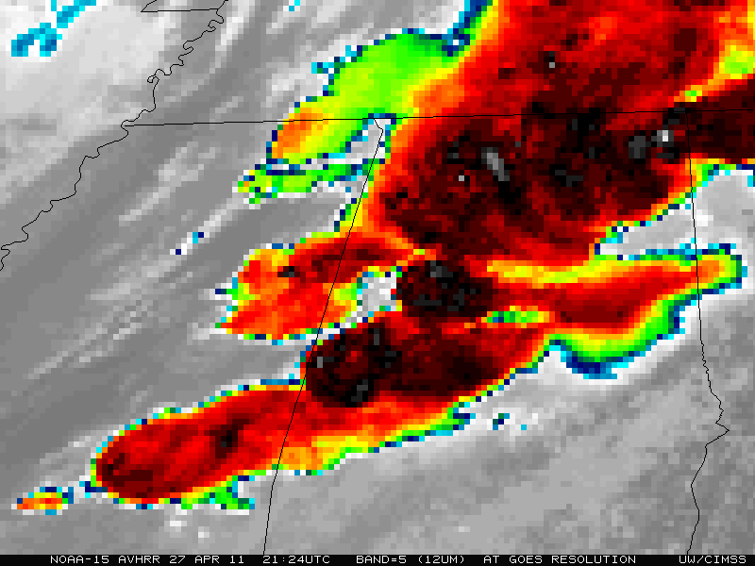
Improved spatial resolution

Slide 11

Improved spatial resolution

Slide 12
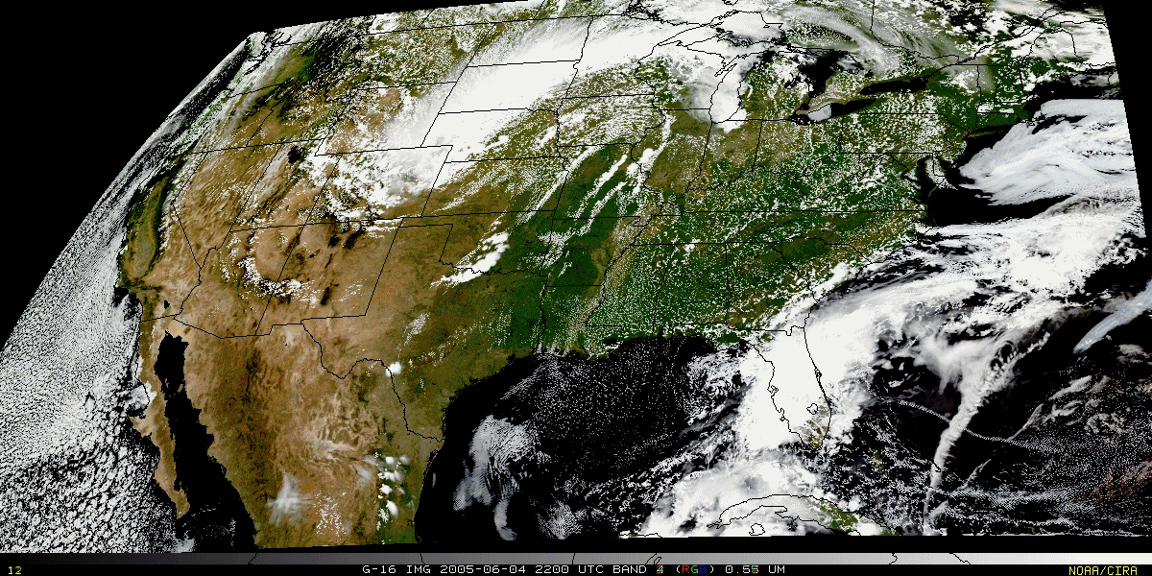
Pseudo-natural color imagery
Psuedo-natural color image with a “synthetic” green band from CIMSS-simulated ABI data. Source: Don Hillger, RAMMB.

Slide 13
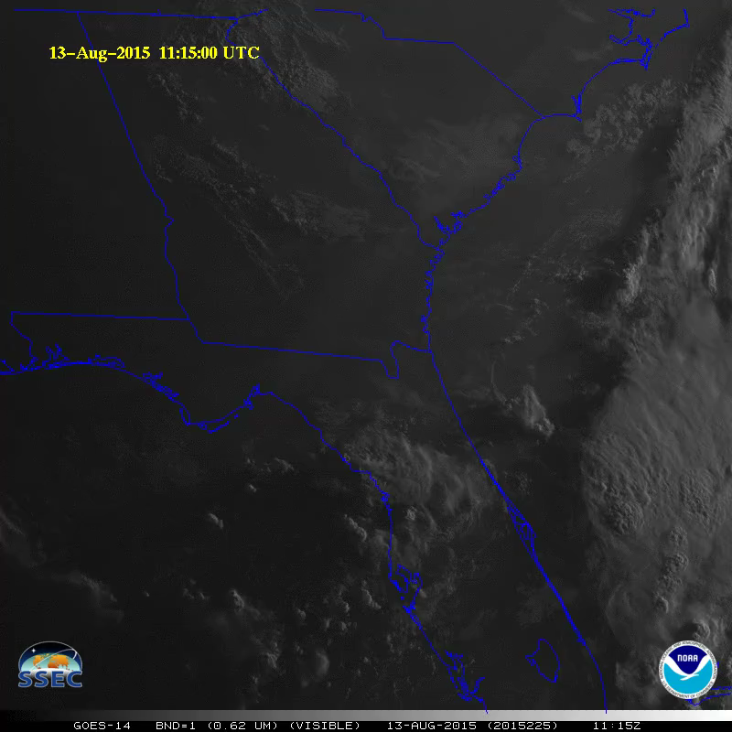
One-minute imagery
Instrument: Advanced Baseline Imager
Animations of one-minute imagery make boundary interactions, morning low cloud decay, convective development, and overshooting tops visually evident

Slide 14
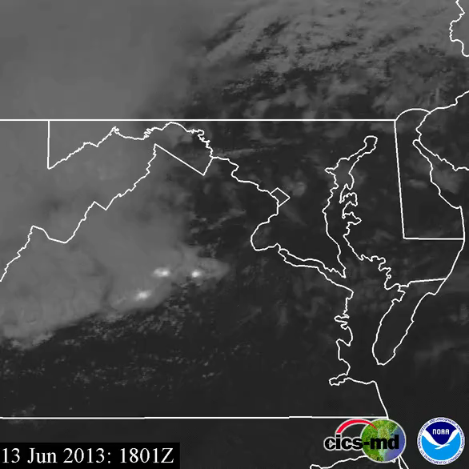
Lightning density
Instrument: Geostationary Lightning Mapper
Integrate lightning density with satellite imagery from the ABI to depict intense thunderstorms
Right: Tornado tracks in red

Slide 15
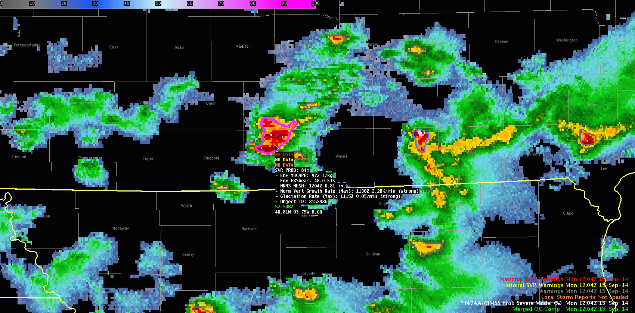
NOAA/CIMSS ProbSevere Model
IA
http://cimss.ssec.wisc.edu/severe_conv/probsev.html
MO
An example of data fusion in use at NWS offices today
Object-tracking in both GOES and radar imagery
Predictors from GOES-derived cloud products, MRMS products, and RAP-derived fields
Use trained statistical model to compute probability of future severe weather:
P(severe) = f (GOES, RAP, MRMS) + lightning

Slide 16
Ask your vendor…
…about the types of products and graphics that will be available in the GOES-R era
  Routine imaging
  Mesoscale imaging
    Severe thunderstorms
    Tropical cyclones
  Space weather products
…when GOES-R imagery and products will be available to you in relation to launch
…how they plan to handle the data rate

Slide 17
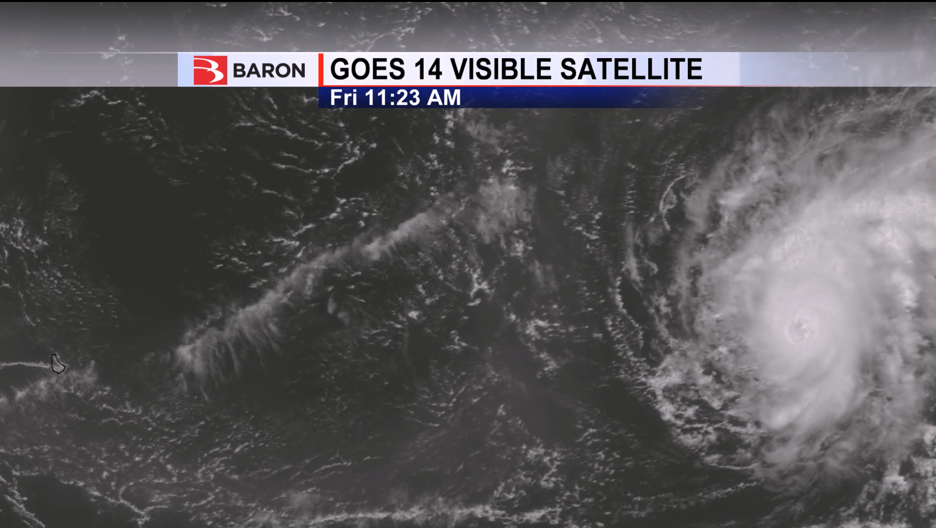

Baron plan for GOES-R rollout
Will operate GOES-R receiver on-site at Baron HQ in Huntsville, Alabama
Plan to initially make use of ABI (Advanced Baseline Imager) and GLM (Geostationary Lightning Mapper)
Since GOES-R will produce an order of magnitude more data than current generation, we must work to solve client-end bandwidth constraints by packing GOES-R data via most efficient compression methods available
Baron was the first to use GOES-14 SRSO natively in our weather display software
(October 2012 – Hurricane Sandy)
Here was Hurricane Danny on August 21, 2015 in Baron OMNI software:
Slide
courtesy
of

Slide 18
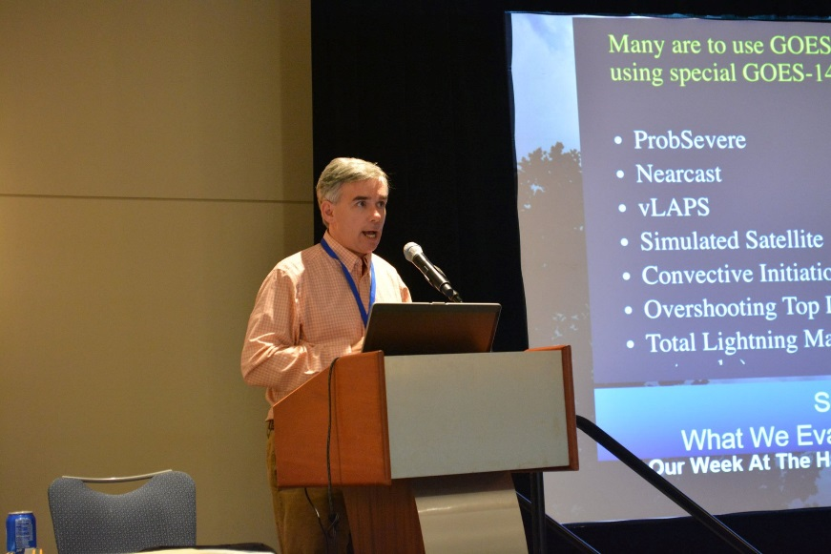
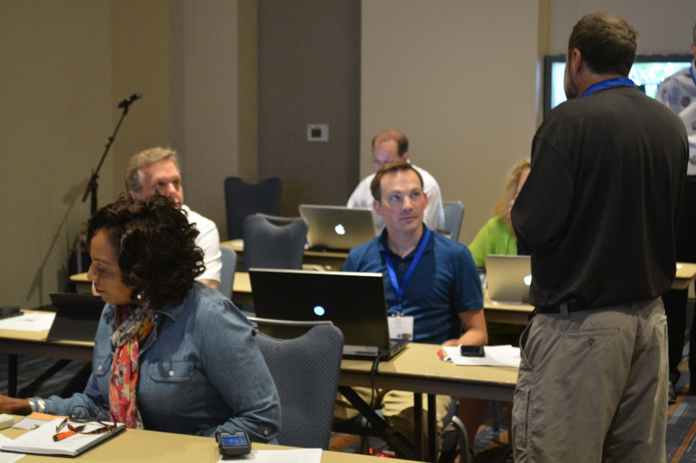
Learn more: Short courses
AMS Annual Meeting short course on GOES-R
  New Orleans, Louisiana
  January 10, 2016
  Participation cost is $50
Bring a laptop computer or tablet for interactive exercises
Other similar short courses planned (pending approval)
  2016 AMS Conference on Broadcast Meteorology
  2016 NWA Annual Meeting

Slide 19
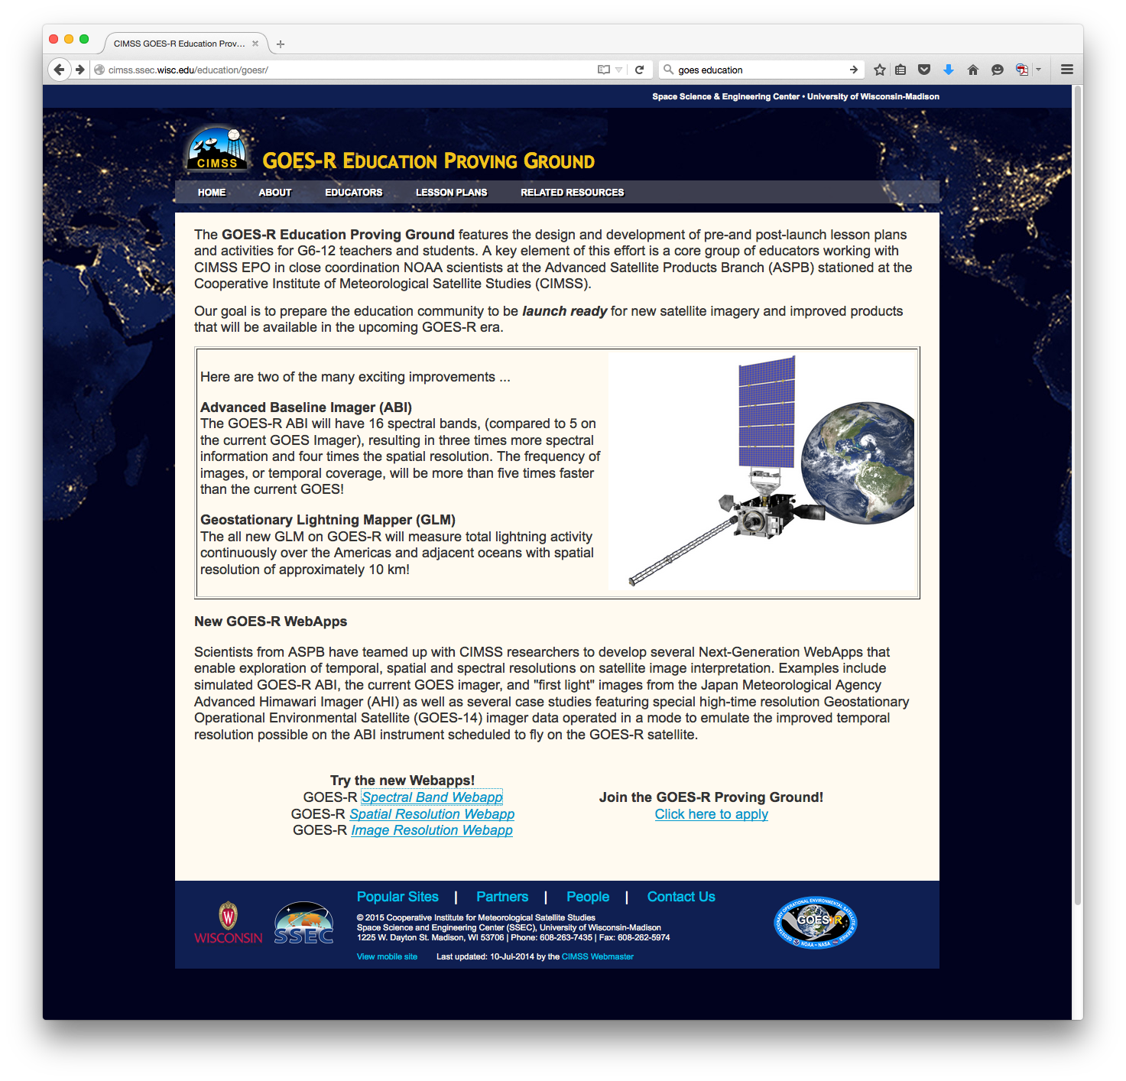
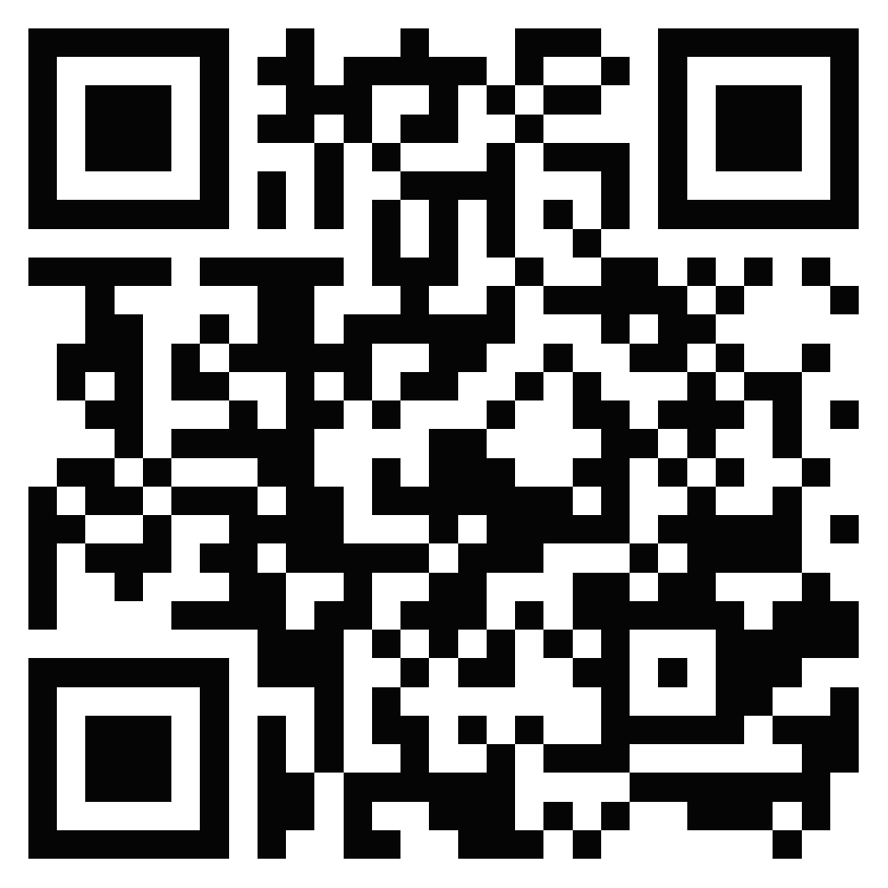
Learn more: Web applications
http://cimss.ssec.wisc.edu/education/goesr/

Slide 20
Points of emphasis
GOES-R is the most significant improvement to United States geostationary weather satellites in over 20 years.
The GOES-R ABI will improve detectability of subtle changes in the state of the atmosphere with increases to spatial, spectral, and temporal resolution.
Optical cloud-top lightning information from the GOES-R GLM will help assess storm severity.

Slide 21
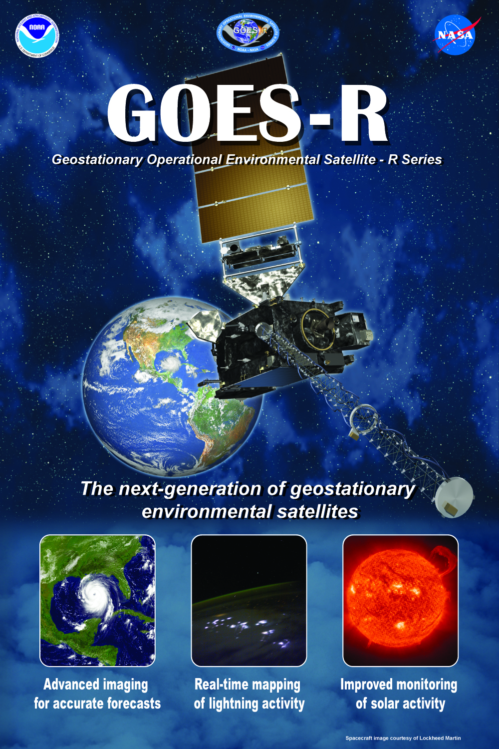


Thank you!
For more information, visit www.goes-r.gov
or e-mail
Jordan.Gerth@noaa.gov
www.facebook.com/GOESRsatellite
www.youtube.com/user/
NOAASatellites
twitter.com/NOAASatellites
www.flickr.com/photos/
noaasatellites

