Slide 1
Why the OCONUS is ready for the new generation of environmental satellites
Super Typhoon Noul as viewed from Himawari-8
Credit: Scott Bachmeier
Jordan Gerth, Cooperative Institute for Meteorological Satellite Studies

Slide 2
Outside Contiguous United States
The “OCONUS” geographically includes:
Alaska
Hawaii
Puerto Rico, USVI, Guam, CNMI, American Samoa, Micronesia
Coastal Areas and Open Waters
Challenges include:
In-situ data sparsity
Implementing and maintaining technical systems

Slide 3
NWS Pacific Region
Credit: Eric Lau

Slide 4
Keys to Success
Improved direct broadcast and rebroadcast capabilities
Leverage Himawari as much as possible to provide regionally relevant examples in preparation for GOES-R
Emphasize baseline and under-demonstrated products
Redundant delivery paths and formats

Slide 5
Honolulu Community College
L/X-band antenna installed in 2012 to track NPP, EOS, FY, MetOp, and POES satellites
Provided critical day-night band imagery of Tropical Storm Flossie that led meteorologists to reposition center and adjust track
VIIRS DNB remains popular with HFO forecasters
Raw data is freely available to download via HTTP
Supports research at the University of Hawaii

Slide 6
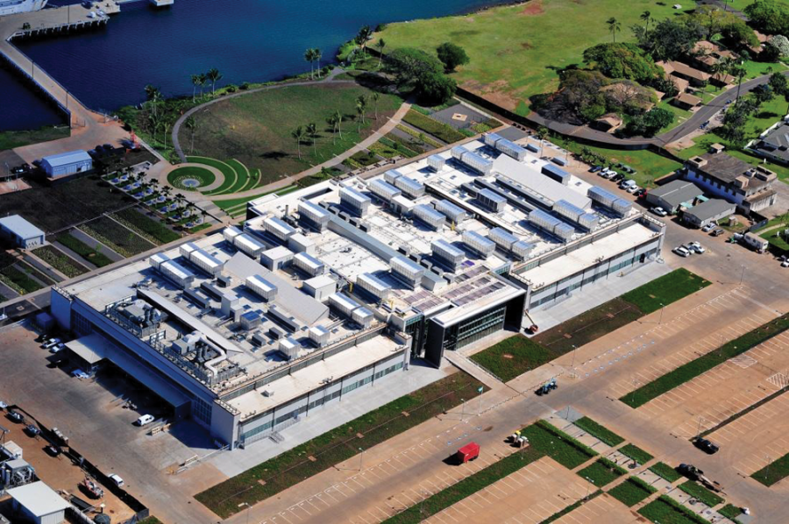
IRC Rooftop Antenna Farm
3.7 meter Himawari antenna 10/30/2015 WFO Guam
3.0 meter L/X Band antenna 2015/2016
WFO Guam
3.7 meter Himawari antenna
8/26/2015
3.7 meter GRB Antenna
11/4/2015
Rooftop shelter 2.4 meter L/X Band antenna
5/30/2015
Credit: Eric Lau

Slide 7
Himawari Imagery
Super Typhoon Maysak as viewed from Himawari-8
Credit: Scott Lindstrom
via SSEC’s RealEarth Web Map Service in near real-time:
http://realearth.ssec.wisc.edu/

Slide 8
Training Paradigm
Core
General
Specialized
“Himawari” in Japanese translates to “sunflower” in English.

Slide 9
Instructor-led Himawari Training
Three instructors on-site with five, four-hour learning blocks over 2.5 days (course run twice in one week)
Approximately 25% lecture, 75% interactive labs
For Guam, training will focus on:
Introduction to the AHI and remote sensing concepts
Band composites and RGBs
Satellite applications for aviation forecasting
Identifying weather systems and meteorological features
Tropical cyclones
Course delivery slated for November or December 2015

Slide 10
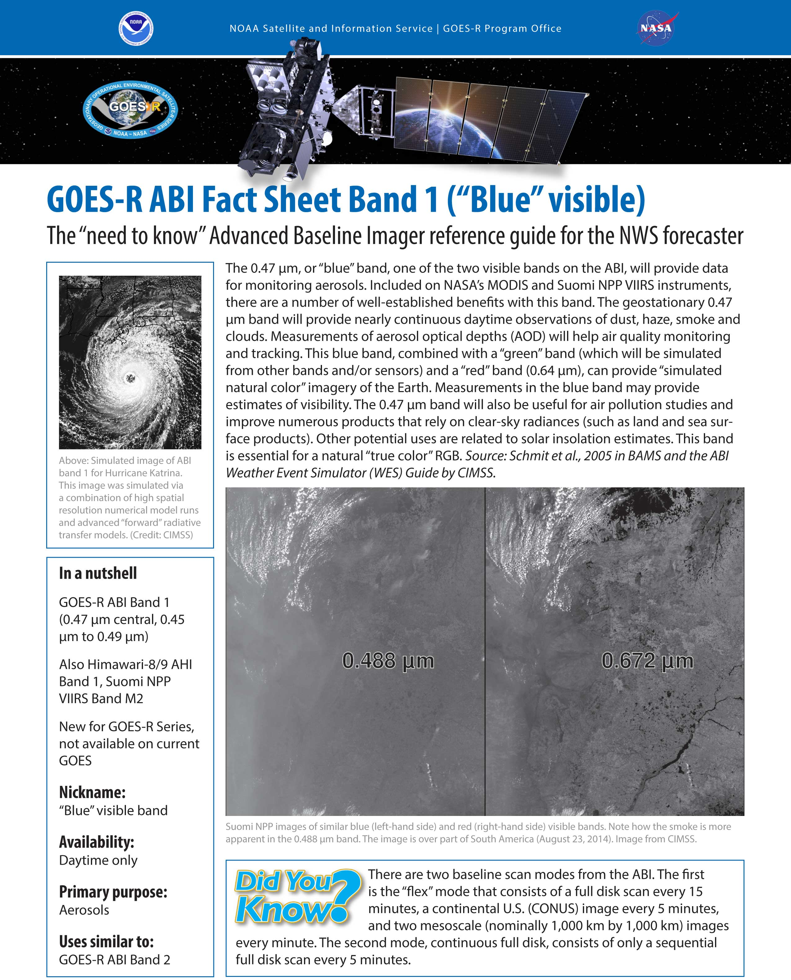
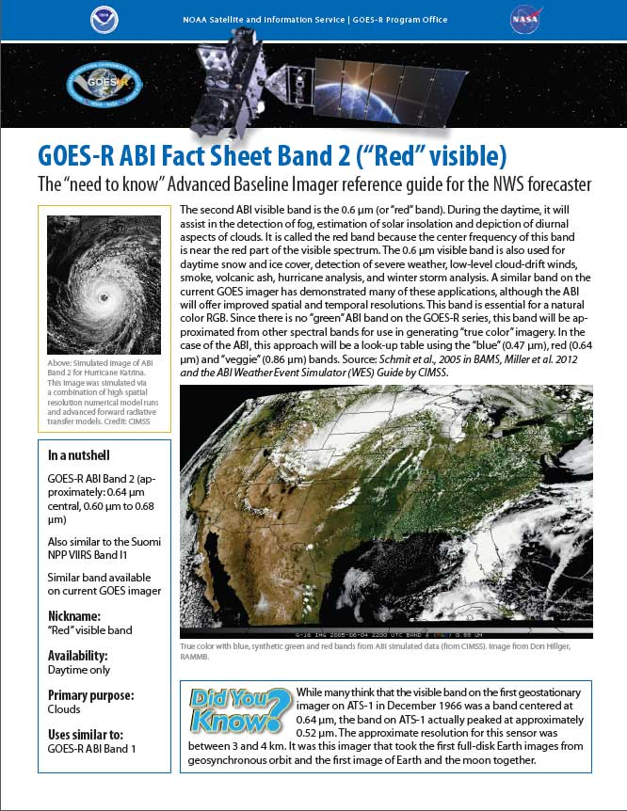
GOES-R ABI Band Fact Sheets
With examples from VIIRS
Thanks to Tim Schmit, George Tuggle, Michelle Smith, Carven Scott, and Bill Ward

Slide 11
Web Applications as Learning Tools
Tom Whittaker and Tim Schmit have developed web applications (“webapps”) to assist in learning about the spatial, spectral, and temporal improvements of the Advanced Baseline Imager (ABI)
A number of cases from the Advanced Himawari Imager (AHI) are included
New webapps focus on understanding RGB creation
Webapps are incorporated into proposed training course content and upcoming fact sheets

Slide 12
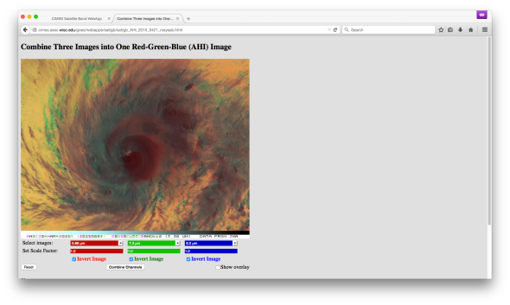
SatRGB Web Application
http://cimss.ssec.wisc.edu/goes/webapps/satrgb/overview_ahi.html

Slide 13
Imagery, products available to HFO
Aviation desk forecaster Leigh Anne Eaton uses geo and polar satellite imagery

Slide 14
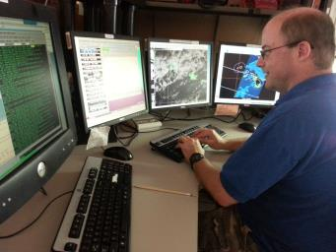
Imagery, products available to HFO
VIIRS EDR
I1, I2, I3, I4, I5
M1, M4, M9, M14, M15, M16
NCC
ATMS
90 GHz
Rain Rate (MIRS)
Right: SOO Bob Ballard

Slide 15
28 February 2015 11:49 UTC
Example of NPP-ATMS Rain Rate and 11.0 μm IR Window in AWIPS II

Slide 16
Imagery, products available to HFO
MODIS Imagery
Bands 1, 2, 7, 20, 26, 27, 31
MODIS Products
Cloud Top Temperature (CTT)
Fog Difference
Land Surface Temperature (LST)
Normalized Difference Vegetation Index (NDVI)
Sea Surface Temperature (SST)
Total Precipitable Water (TPW)

Slide 17
VIIRS candidate products for HFO
VIIRS Active Fires
VIIRS Aerosol Optical Thickness
VIIRS Suspended Matter
VIIRS Sea Surface Temperatures
VIIRS Normalized Difference Vegetation Index
VIIRS Enhanced Vegetation Index
VIIRS Land Surface Temperatures

Slide 18
Contributions are not OCONUS only
Delivered several enhancements to the AWIPS II baseline code, including:
additional true color capabilities for satellite and gridded data,
code to add satellite source and configurability to satellite legends,
code to capture frames with date and time in the filename,
code to make warning polygon outline settable in bundle file, and
code to ingest Lambert Conformal projections with two standard parallels using the “regionalsat” decoder

Slide 19
Arctic Satellite Composite Project
PSDI Project Lead: Matthew Lazzara
NWS End User: NCEP/OPC
Delivery Format: netCDF3

Slide 20
Recommendations for OCONUS
During Hurricane Iselle, we realized that OCONUS RSO sectors were unavailable

Slide 21
Recommendations for OCONUS
Advocate for northern hemisphere scan strategy from current GOES in case of satellite anomaly
New sector for the GOES-R era?
Implement procedures for field offices to test and request GOES rapid scan operations for OCONUS sectors
Create RGBs with AWIPS II directly, based on individual bands, instead of delivering pre-made, eight-bit RGBs

Slide 22
VIIRS Daytime Composite #2 (1.378 µm, 1.61 µm, 11.45 µm)

Slide 23
Recommendations for OCONUS
Install central server for processing Himawari files and creating imagery and products for AWIPS
Develop plan for how imagery from KMA’s Geo-KOMPSAT 2A AMI can support NWS operations in the Western Pacific
Maintain dedicated funding to support network of satellite data receiving stations as well as satellite-related meteorological research and development focused on OCONUS challenges

Slide 24
Visiting Scientist Program
Targets scientists with legitimate interest in working with NWS operations in the Central Pacific and establishing a long-term relationship
High priority given to scientists seeking to demonstrate baseline products, or new risk reduction products that solve tropical or subtropical forecast challenges or reduce workload
Scientists spend a week or more in Honolulu working alongside forecasters

Slide 25
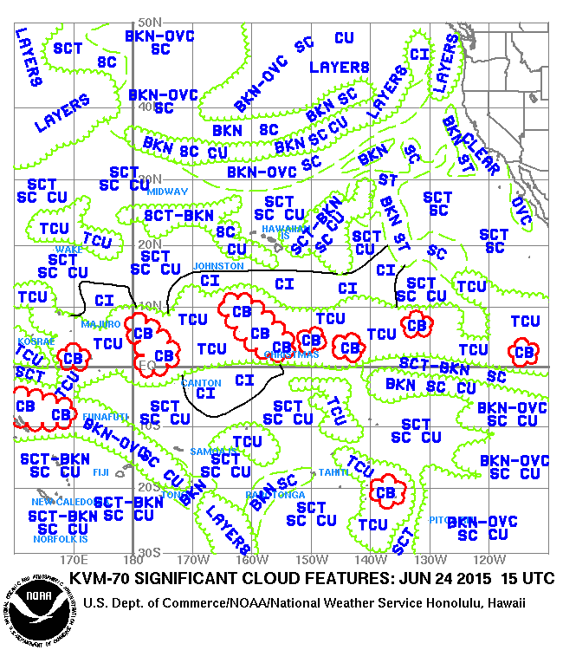
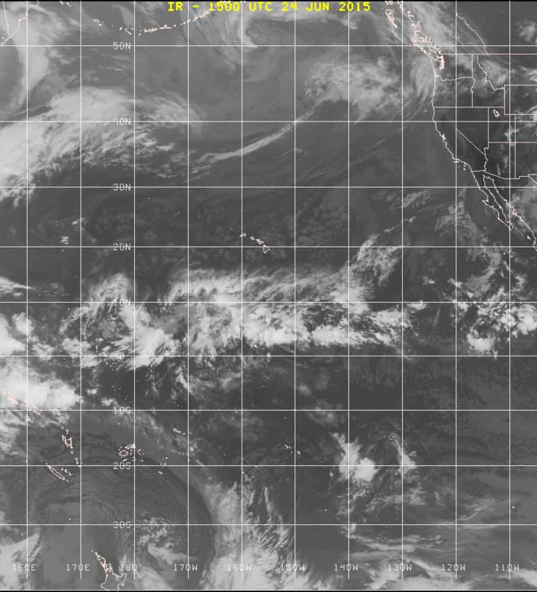
Significant Cloud Features

Slide 26
Questions? Comments?
Jordan.Gerth@noaa.gov
Thoughts to keep in mind:
Consistency and reliability
Ken Rizzo, former Meteorologist-In-Charge
“Be good at the things that don’t take talent.”
Bo Ryan aphorism
Join us in Honolulu!
2016 OCONUS Satellite Proving Ground Technical Interchange Meeting

