Slide 1
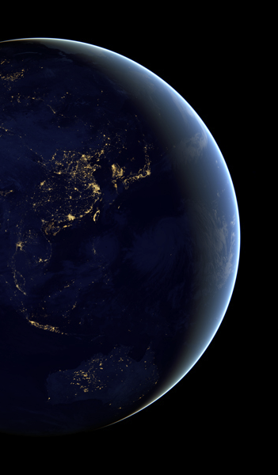
SIFT: A Python-based user interface for visualizing meteorological satellite imagery
Jordan Gerth, Dave Hoese, Scott Lindstrom, Tim Schmit, Ray Garcia
Cooperative Institute for Meteorological Satellite Studies Space Science and Engineering Center
University of Wisconsin – Madison 8 January 2019
@jjgerth
Ninth Symposium on Advances in Modeling and Analysis Using Python, American Meteorological Society 99th Annual Meeting, Phoenix, Arizona

Slide 2
Typical Software Complaints
Complex user interface
Simple tasks are not intuitive to complete
Difficult to find/create the right data format(s)
Cannot use the same software for different satellites or data sets
Cost
Poor performance
Cannot easily export images or animations for presentations or papers
International colleagues use different software
Not for all major operating systems

Slide 3
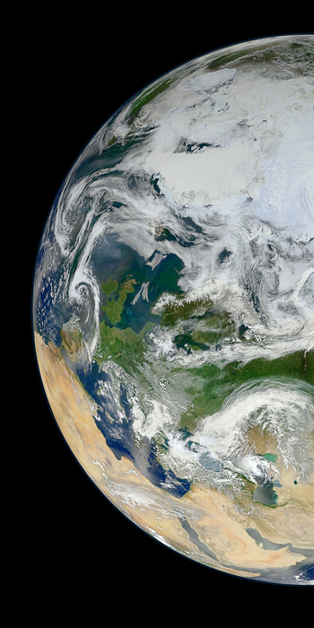
Satellite Information Familiarization Tool
An easy graphical user interface for meteorological satellite users

Slide 4
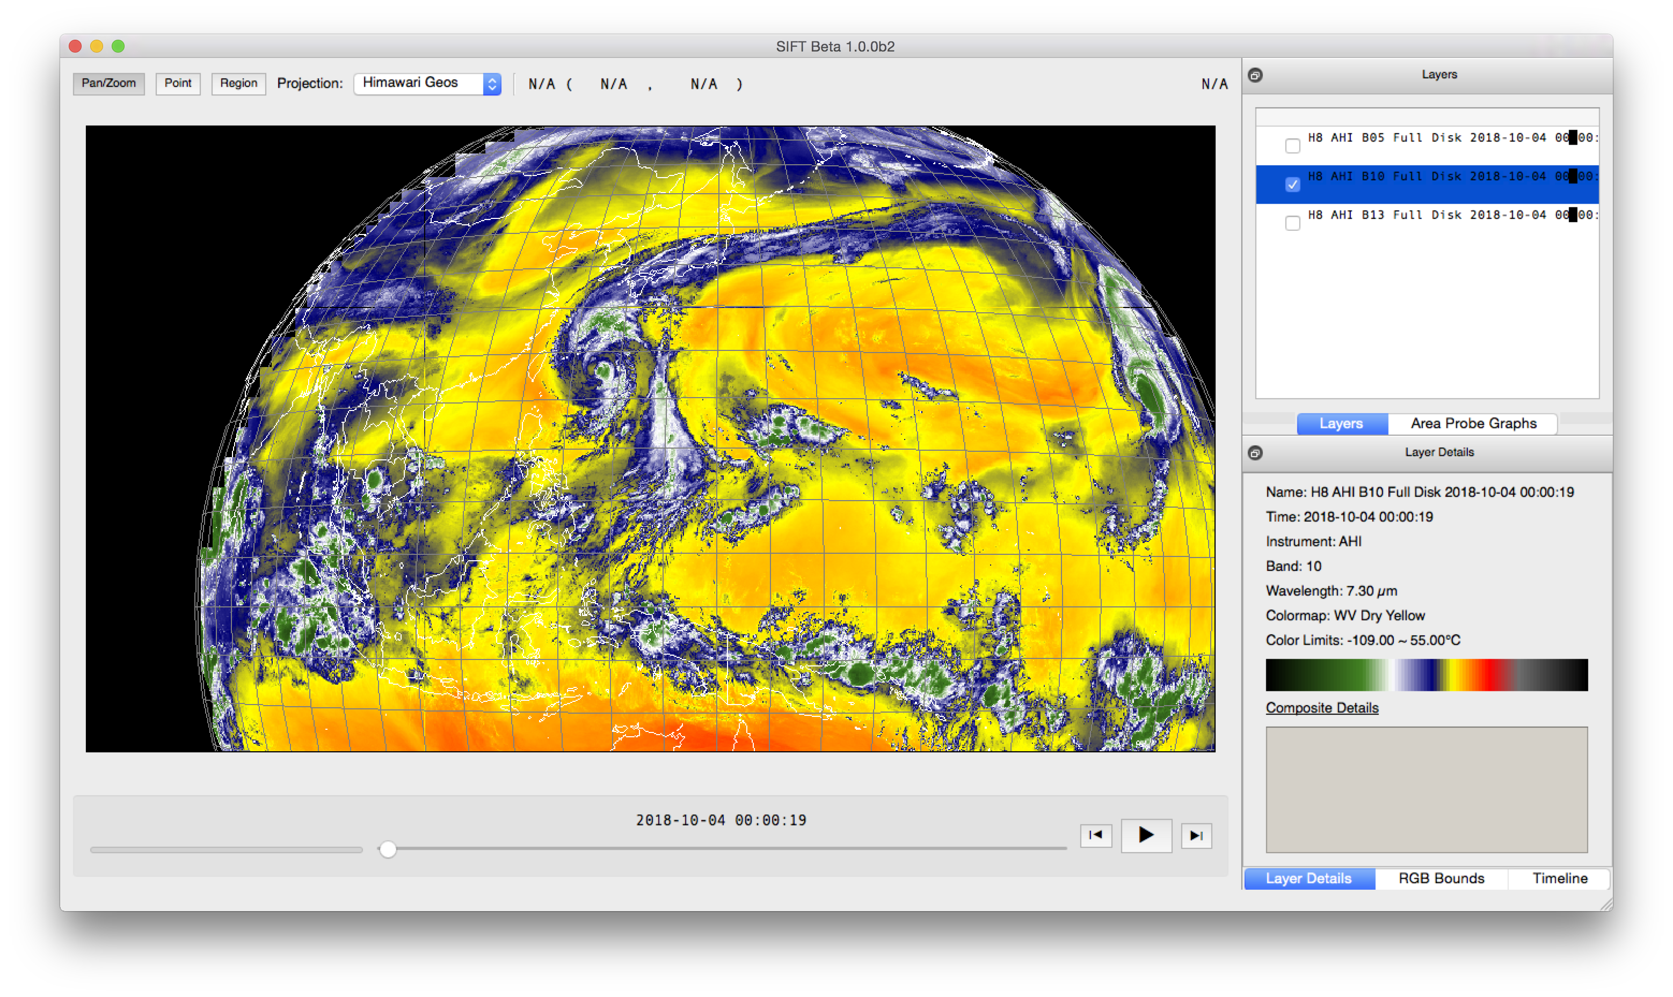

Slide 5
About SIFT
Open source
Based on Python
Originally developed for the United States National Weather Service (NWS) in 2015
Now open to community development
Free (GPLv3 license)

Slide 6
About SIFT
Current operating systems supported:
Windows
MacOS
CentOS/RedHat Linux
A developer version is also available.
Current data formats supported:
GOES-16/17 ABI L1b NetCDF
Himawari-8/9 AHI (after conversion to netCDF)
Gridded Binary (GRIB2)

Slide 7
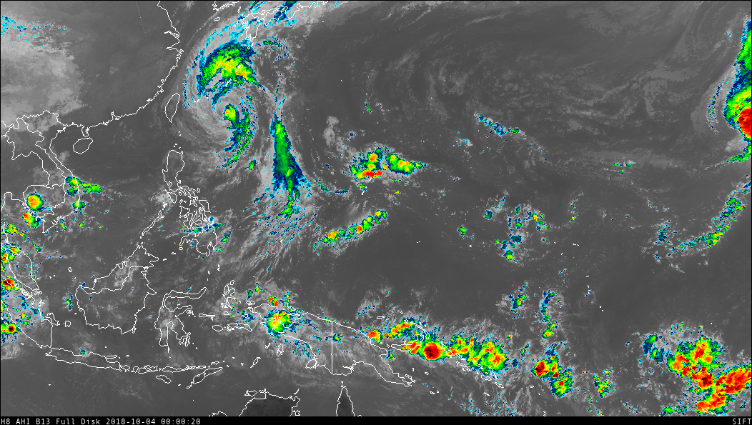
NetCDF
“Kong-Rey”
Notes:
AHI Band 13 IR Window

Slide 8
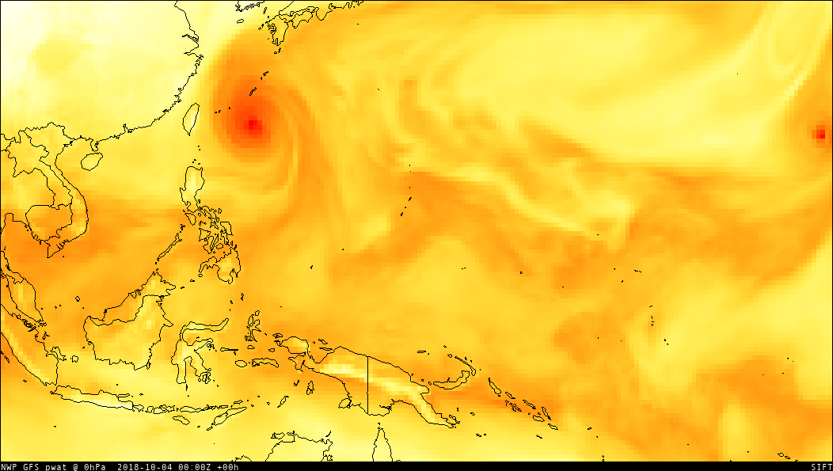
GRIB2
“Kong-Rey”
Notes:
GRIB2 GFS 1.0 deg PWAT (analysis)

Slide 9
SIFT Features
Loop across multiple bands or multiple times
Create Red-Green-Blue (RGB) composites
Calculate arithmetic composite for multiple bands
Change or customize color enhancements
Compare fields over a user-defined area using a density plot
Click to probe layers at a lat-lon coordinate

Slide 10
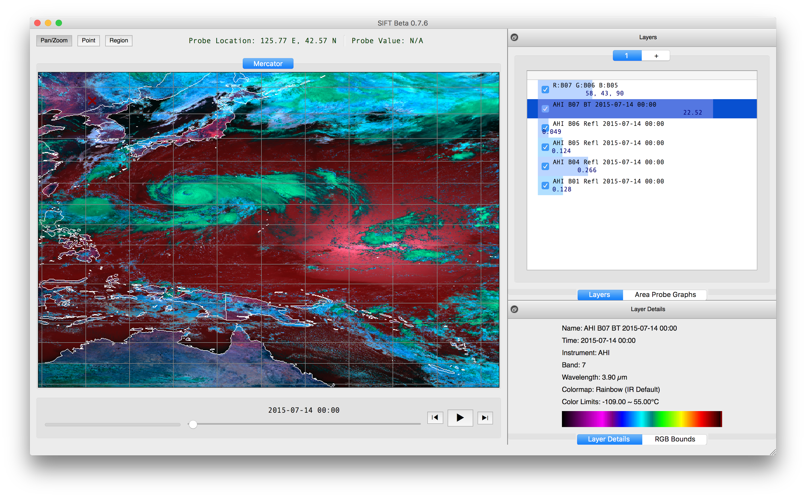
Point Probe Results
Tools
Pan/Zoom
Point Probe
Area Selector
Map Display
Powered by OpenGL/VisPy
Panning and Zooming
Dynamic Resolution
Configurable Outline Colors
Layer List
Reorder Layers
Toggle Visibility
Point Probe Histogram
Animation Control
Step-through or Autoplay
Adjustable Speed Control
Layer Metadata
Band Information
Color Bar and Limits
Background Task Status

Slide 11
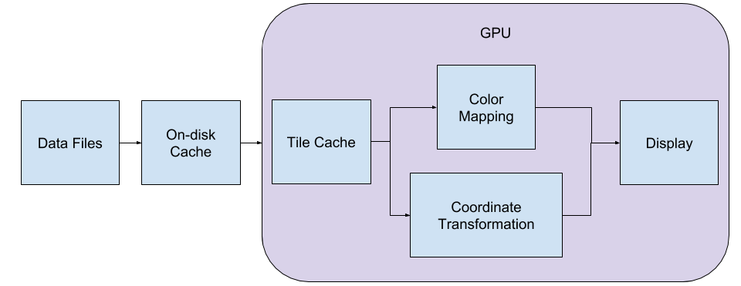

Slide 12
Science Package Dependencies
Name | Purpose | SIFT Usage
numpy | Efficient array and matrix math | Data array container and efficient calculations; fast memory-mapped data caching and access
vispy | High level OpenGL python library | Map and data visualization
numba | Numerical expression compiler | Efficient probe area extraction and data transforms
satpy | Meteorological satellite data processing python library | Read GRIB and other satellite data formats
imageio | Easy pythonic image and video generation | Export animations and images using ffmpeg and pillow
matplotlib | Interactive scientific plotting | Probe graphics
pyproj | Geographical Information System (GIS) map projection math | Coordinate systems transforms

Slide 13
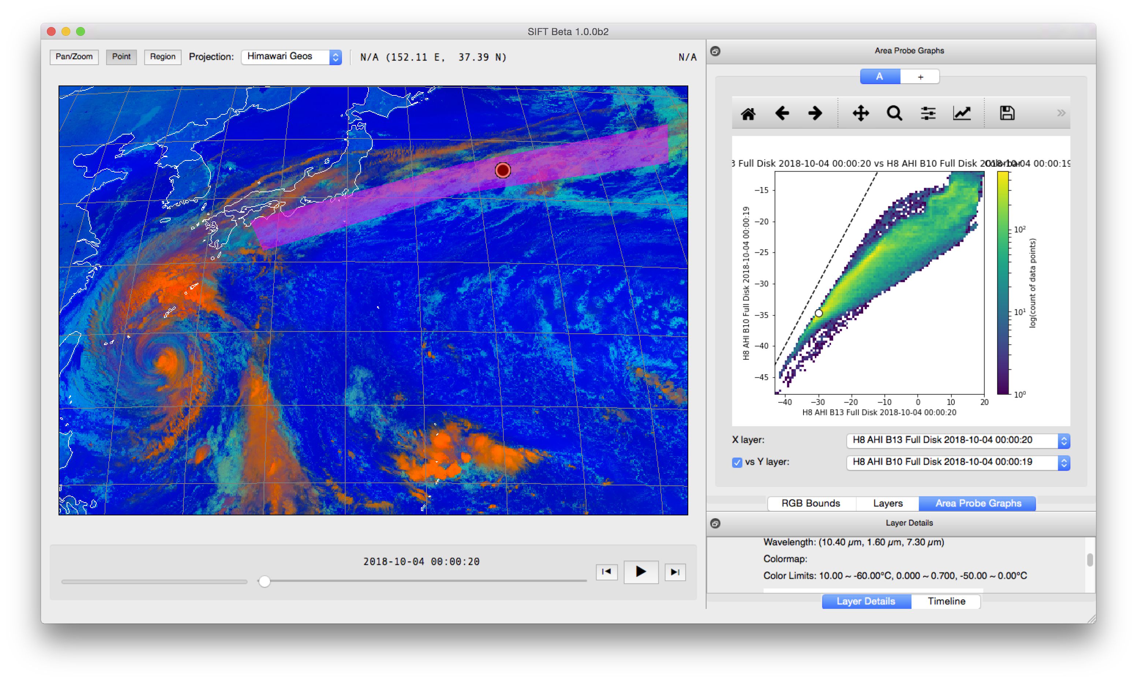
Region Selection
Denoted on map display Semi-transparent
Area Probe Graphs
Single Band Histogram Plot
Two Band Density Plot
Point Probe Indicator
Save Graph Image
Pan/Zoom Graph Image
Publication Ready

Slide 14
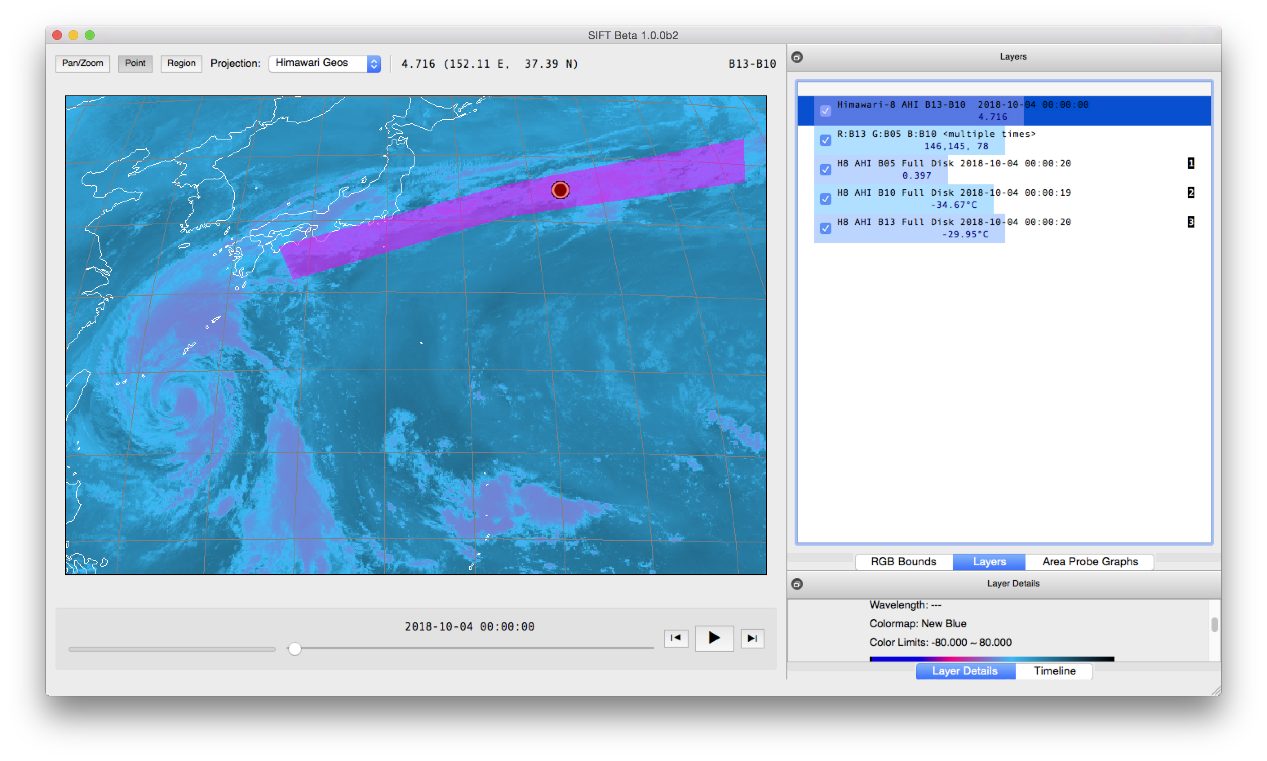
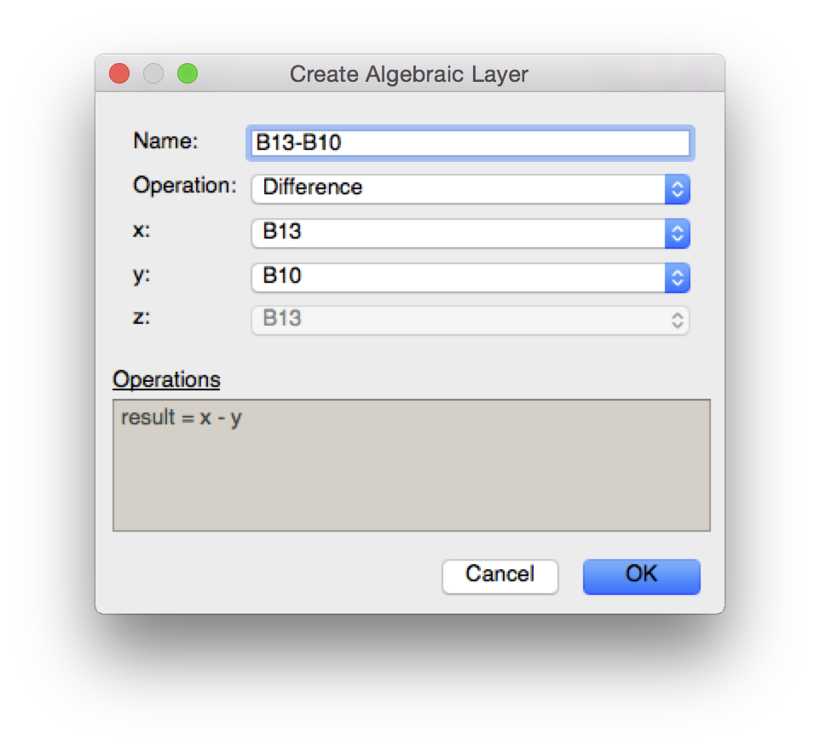

Slide 15
Download SIFT
1.0.4 installers are available
http://sift.ssec.wisc.edu/
“Very quick. Excellent resolution.”
“Great training tool overall.”

Slide 16
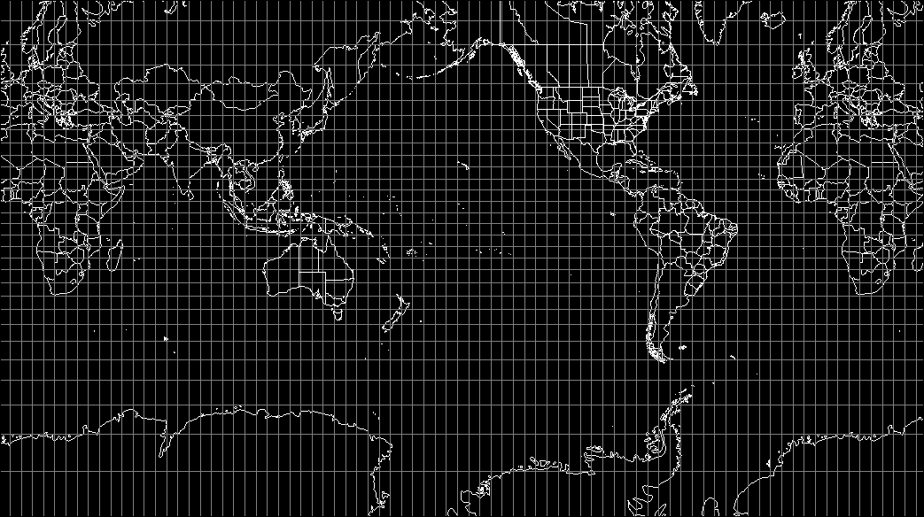
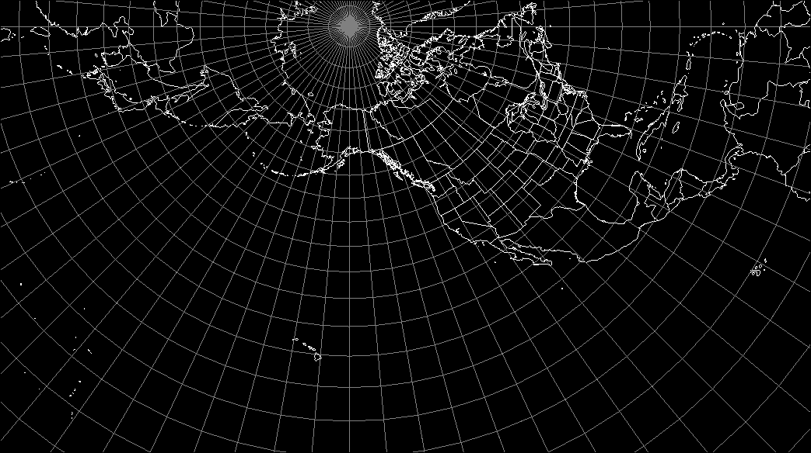
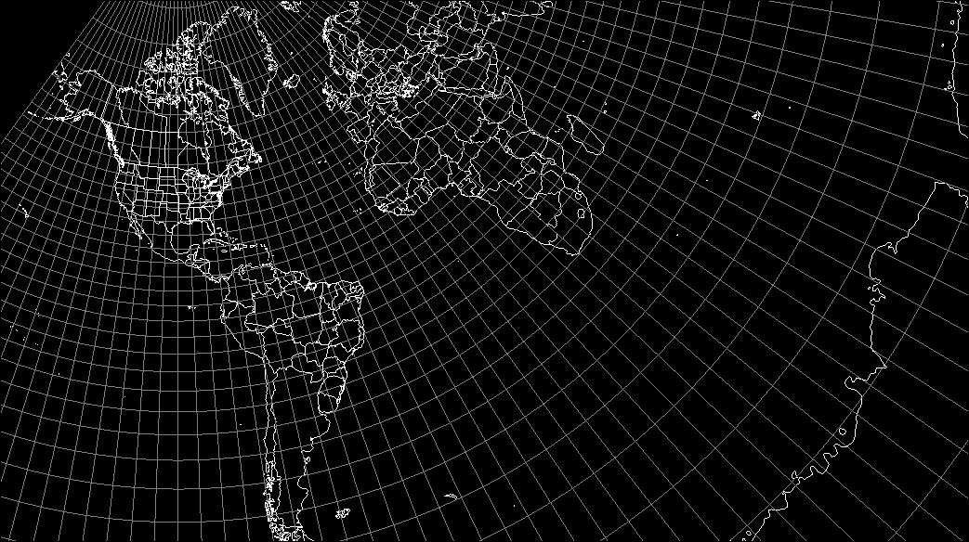
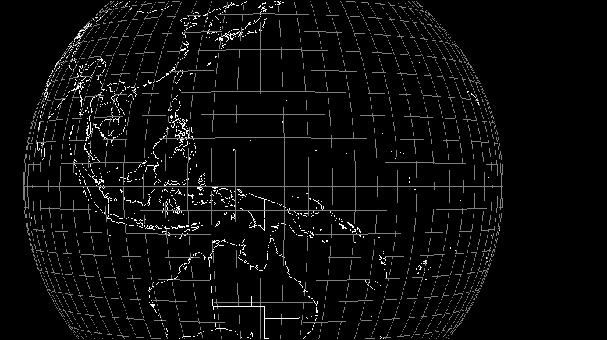
Supported Projections
Mercator
SEVIRI FES
SEVIRI IODC
LCC (CONUS)
Himawari Geos
GOES East
GOES Test
GOES Central
GOES West
Polar (Alaska)
Supported Projections
Mercator
SEVIRI FES
SEVIRI IODC
LCC (CONUS)
Himawari Geos
GOES East
GOES Test
GOES Central
GOES West
Polar (Alaska)
Supported Projections
Mercator
SEVIRI FES
SEVIRI IODC
LCC (CONUS)
Himawari Geos
GOES East
GOES Test
GOES Central
GOES West
Polar (Alaska)
Supported Projections
Mercator
SEVIRI FES
SEVIRI IODC
LCC (CONUS)
Himawari Geos
GOES East
GOES Test
GOES Central
GOES West
Polar (Alaska)
Supported Projections
Mercator
SEVIRI FES
SEVIRI IODC
LCC (CONUS)
Himawari Geos
GOES East
GOES Test
GOES Central
GOES West
Polar (Alaska)

Slide 17
Develop SIFT
Seeking new software developers
https://github.com/ssec/sift/ for code, issues, requests
No contributing guide yet
Make SIFT better, faster, and stronger
Contribute ideas or resources for new features
Long wish list
Desire to support all geostationary weather satellites
Help expand our user and support base

Slide 18
Thank You
Download SIFT: http://sift.ssec.wisc.edu/
Develop SIFT: https://github.com/ssec/sift/
Send inquiries: Jordan Gerth, jordan.gerth@ssec.wisc.edu
For a demonstration, visit Booth #233 University of Wisconsin Space Science and Engineering Center
The United States National Weather Service provided initial funding.

