Slide 1
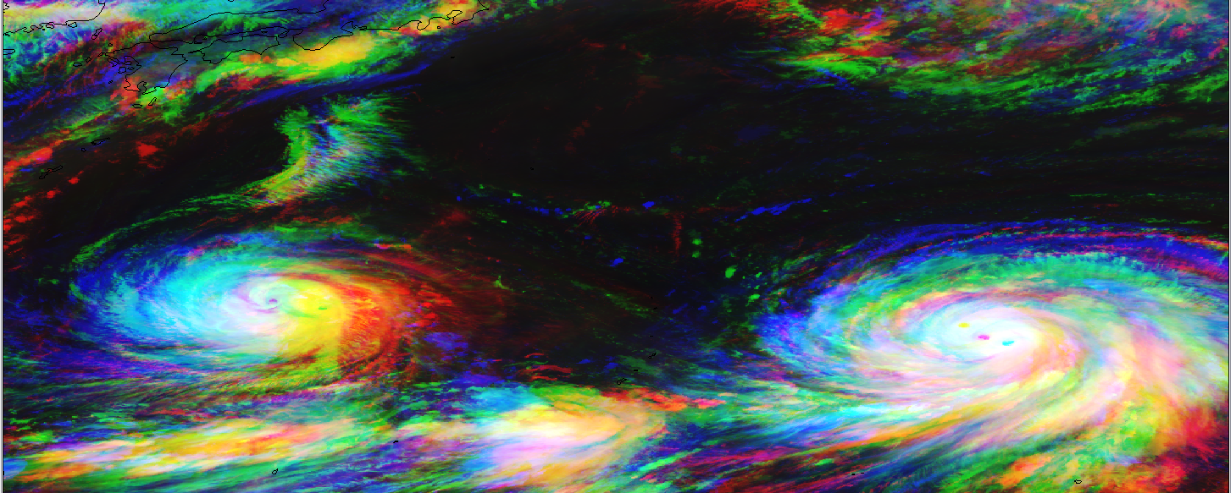
Visualizing new-generation
geostationary satellite imagery
with SIFT
Jordan J. Gerth
R. K. Garcia, D. Hoese, S. Lindstrom, K. Strabala
Cooperative Institute for Meteorological Satellite Studies
26 October 2016

Slide 2
The Satellite Information Familiarization Tool (SIFT)
Developed in Python using the PyQt Toolkit
Cross-platform (Windows, Mac, and Linux) graphical user interface (no command line)
Loads GeoTIFFs of archived Himawari-8 imagery stored locally (SSD recommended)
Available to download for free (GPLv3 license)
Development of the software and expansion of the capabilities is ongoing

Slide 3
Motivation for SIFT
Basic, modern, and standalone software to display, loop, and allow for the manipulation of new-generation geostationary satellite imagery was not available
The intended users are scientists, students, and operational meteorologists
It is a tool for both training and discovery
SIFT is part of the United States National Weather Service forecaster training program

Slide 4
SIFT Features and Functions
Point Probe Results
Tools
Pan/Zoom
Point Probe
Area Selector
Map Display
Powered by OpenGL/VisPy
Panning and Zooming
Dynamic Resolution
Configurable Outline Colors
Layer List
Reorder Layers
Toggle Visibility
Point Probe Histogram
Animation Control
Step-through or Autoplay
Adjustable Speed Control
Layer Metadata
Band Information
Color Bar and Limits
Background Task Status

Slide 5
SIFT Point Probe Feature
Loop Order
By band or by time
Point Probe
Denoted on map display
Coordinates and value shown
Layer List
Probe value shown for all other loaded layers

Slide 6
SIFT Region Selection Feature
Region Selection
Denoted on map display Semi-transparent

Slide 7
SIFT Region Selection Feature
Region Selection
Denoted on map display Semi-transparent
Layer Details
Change based on selected layer in the list

Slide 8
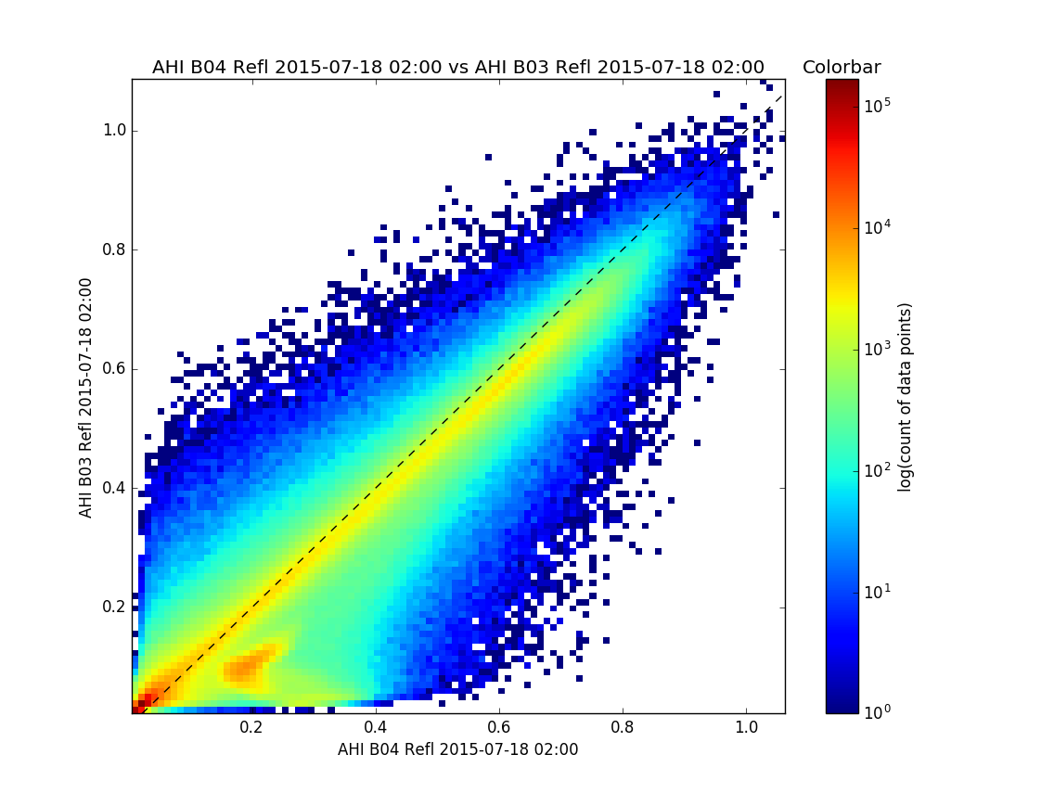
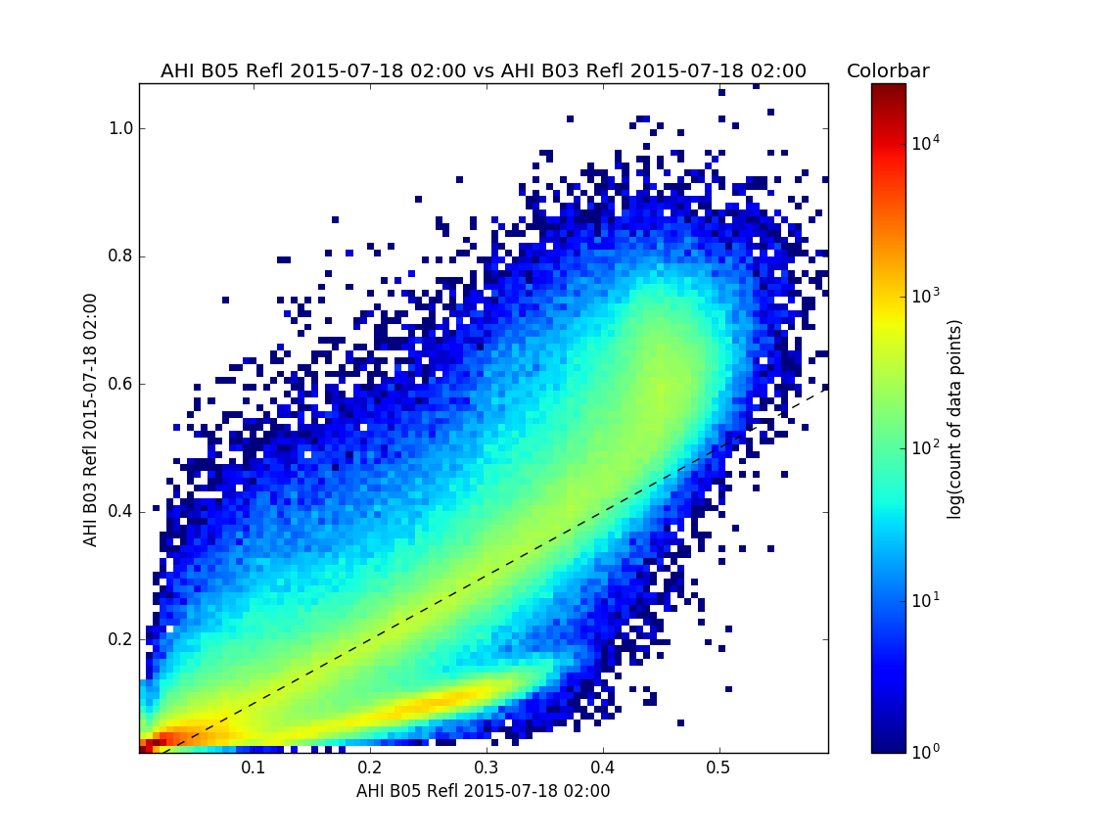
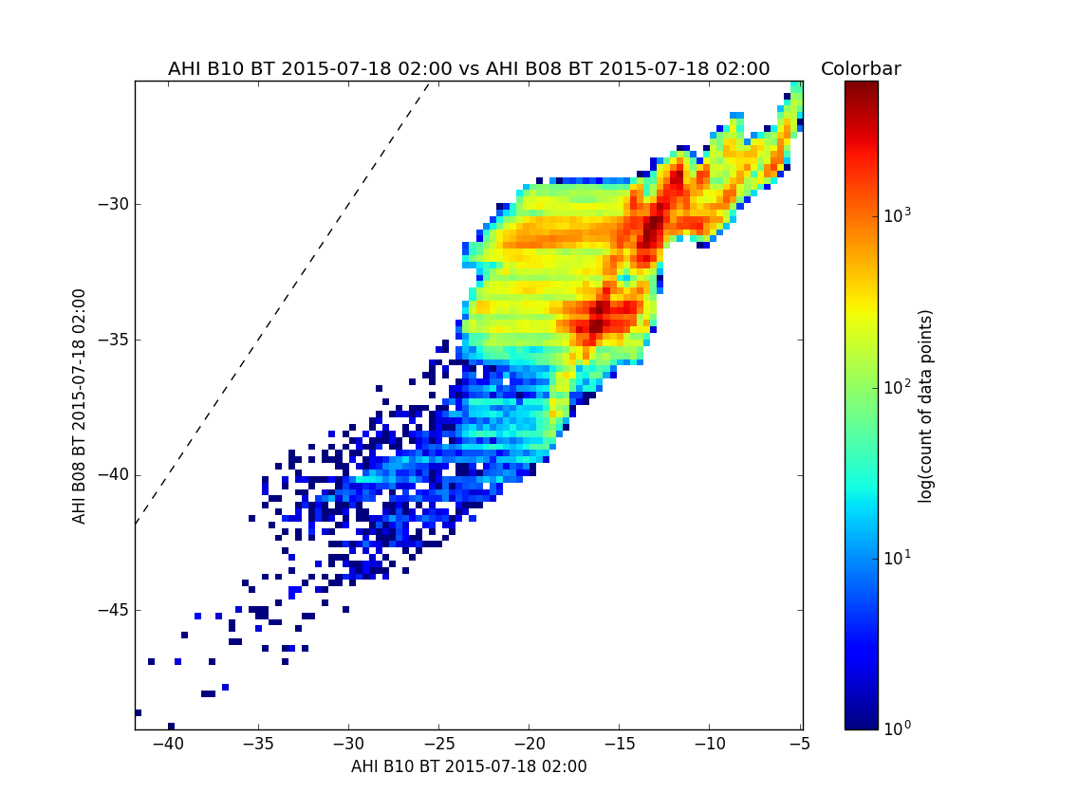
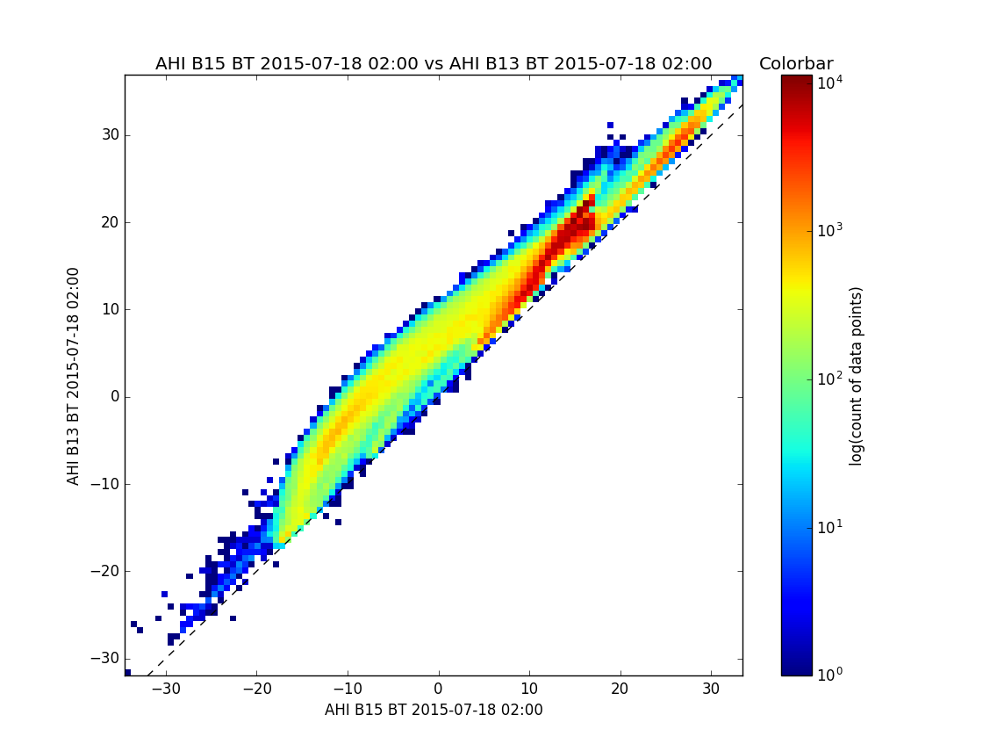
SIFT Area Probe Graphs

Slide 9
Science Training Takeaway:
Land surfaces at 0.86 μm are more reflective than at 0.64 μm
Ice clouds at 1.6 μm are less reflective than at 0.64μm
SIFT Area Probe Graphs
The 6.2 μm is cooler than the 7.3 μm
The 10.4 μm is warmer than the 12.4 μm

Slide 10
Applying Science Training
Science Training Takeaway | Prospective Application
Land surfaces at 0.86 μm are more reflective than at 0.64 μm | River flooding is more easily identified, but contrast between clouds and land is reduced in the 0.86 μm
Ice clouds at 1.6 μm are less reflective than at 0.64μm | Thick glaciated clouds can be indicative of thunderstorms
The 6.2 μm is cooler than the 7.3 μm | The water vapor channels can be used to assess the depth of certain tropospheric features
The 10.4 μm is warmer than the 12.4 μm | The difference in brightness temperature for clear fields of view is related to low-level water vapor concentration

Slide 11
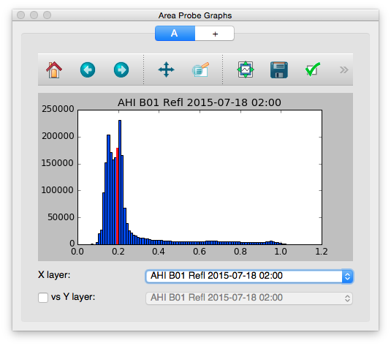
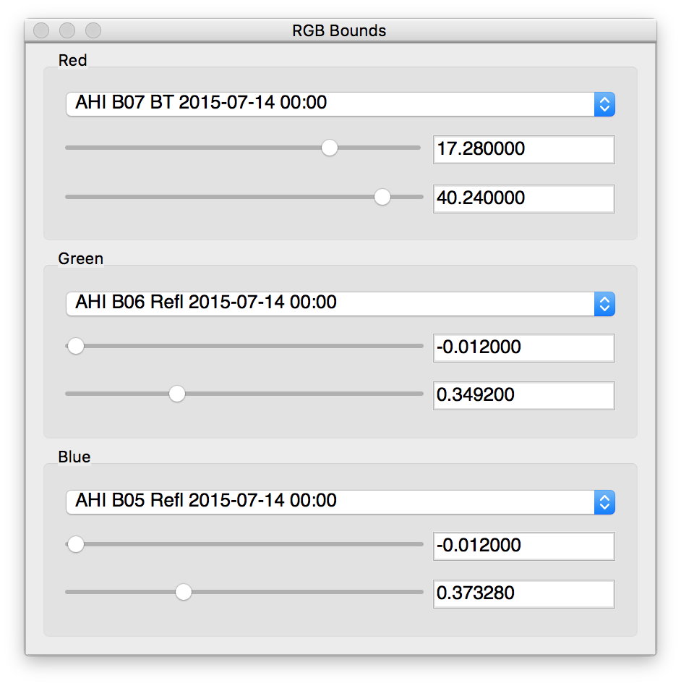
SIFT Features and Functions
RGB Bounds
RGB Channel Selection
Adjust Color Limits
Live Updates on Display
Area Probe Graphs
Single Band Histogram Plot
Two Band Density Plot
Point Probe Indicator
Save Graph Image
Pan/Zoom Graph Image
Publication Ready

Slide 12
Future Enhancements to SIFT
A selection window for users to load a given time range and subset of bands instead of individual files
Additional projections (Lambert Conformal and Polar Stereographic)
Better performance
Display and handling for derived products created with the geostationary satellite variant of the Community Satellite Processing Package
Improved experience for looping and selecting layers
Support for GOES-R imagery

Slide 13
SIFT Accolades from Users
“A very interesting way to look for cloud types and layers.”
“All seemed fine to me.”
“Great training tool overall.”
“Nice tool to look at many different channels.”
“SIFT is fast and does not crash.”
“Stable software.”
“Very quick. Excellent resolution.”
Excerpts from written survey results following Honolulu forecast office training workshop

Slide 14
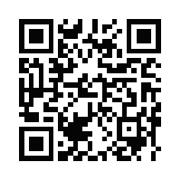
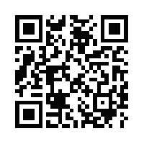
Download SIFT and Case Data
SIFT: ftp://ftp.ssec.wisc.edu/pub/jordang/pg/sift/
Windows 7+ (118 MB)
64-bit CentOS/RedHat Linux (278 MB)
Case Data: ftp://ftp.ssec.wisc.edu/ABI/sift_data/AHI/
SIFT
Case Data

Slide 15
Satellite Foundational Course for GOES-R (SatFC-G)
Access to training resources developed for operational meteorologists in the United States is available
Sections include:
Introduction to the spectral bands, operating mode, and baseline products
Lightning mapper
Evaluating convection and mesoscale features
Monitoring synoptic scale features
Numerical weather prediction
http://bit.ly/2ey7llY

Slide 16
Create RGB Composites Online
Real-Time Imagery
from Himawari-8
over western Pacific Ocean
http://bit.ly/2e5KrCY

Slide 17
Questions? Comments?
Super Typhoon Maysak as viewed from Himawari-8
Send me an e-mail:
Jordan.Gerth@noaa.gov

