Slide 1
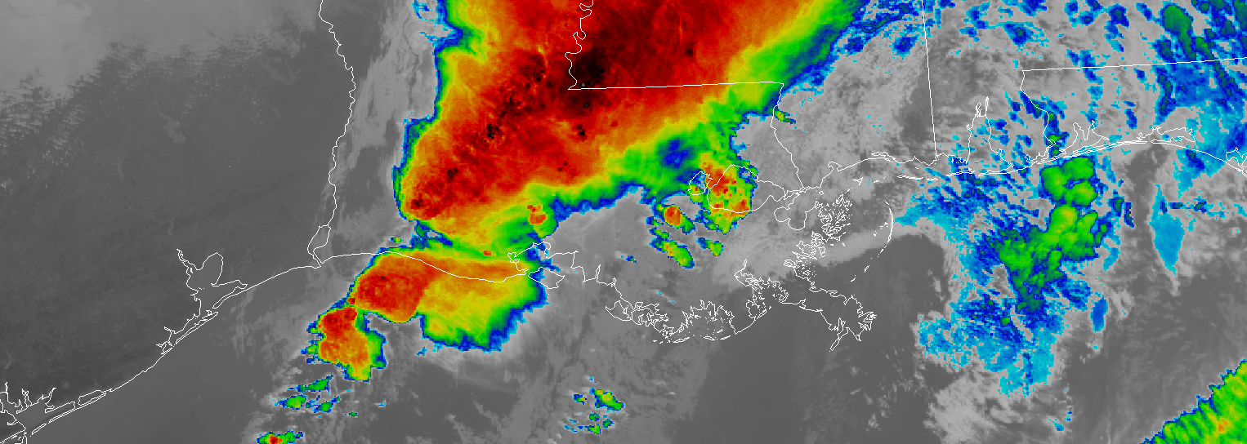
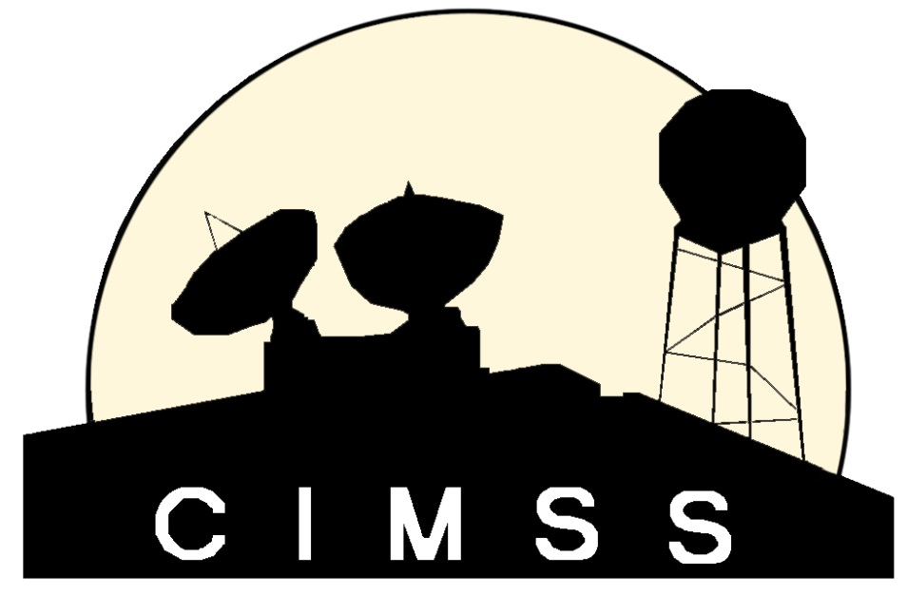
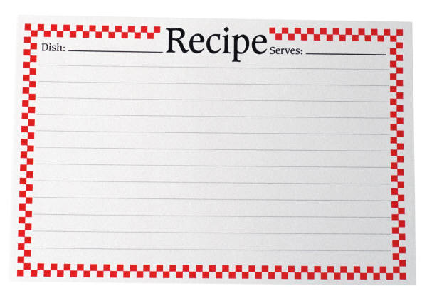
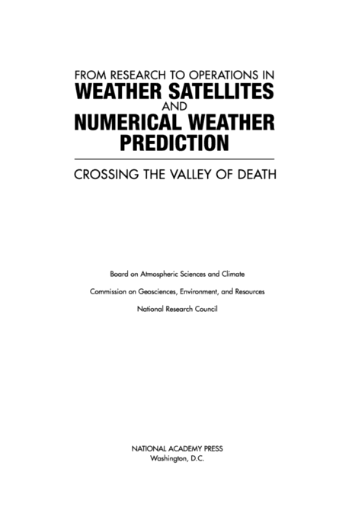
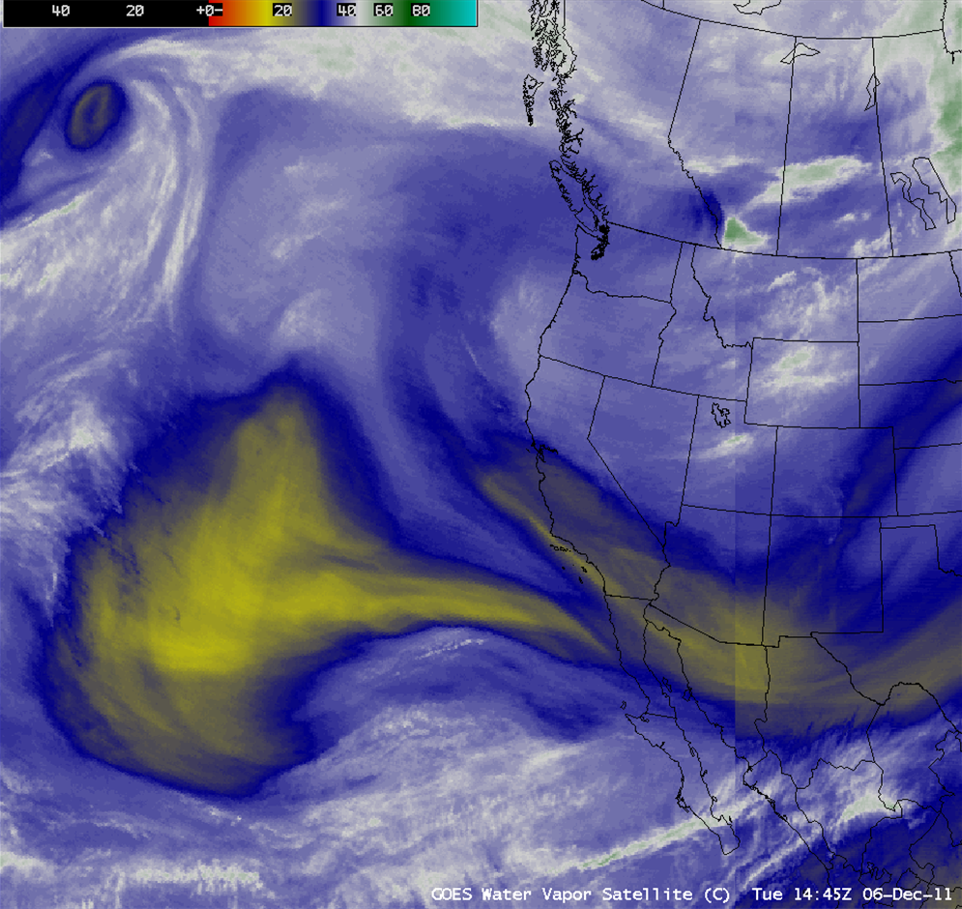
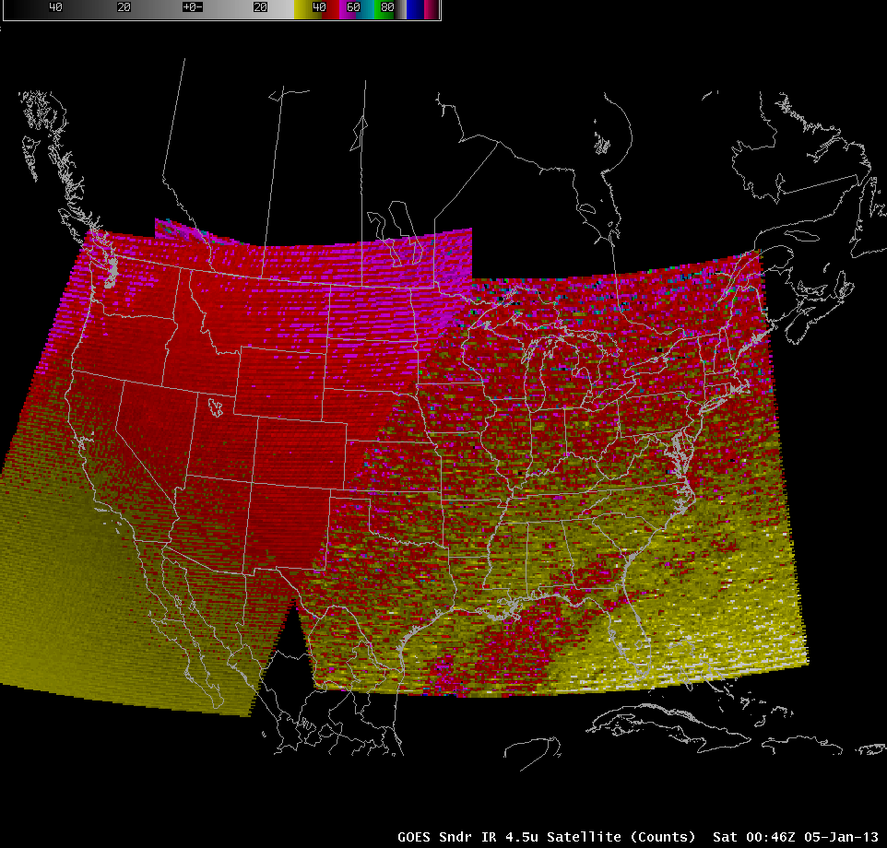
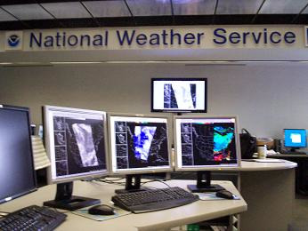
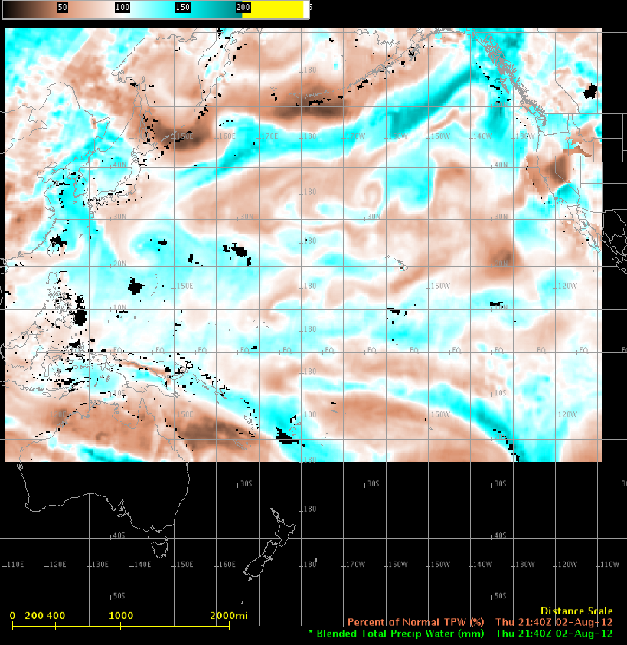
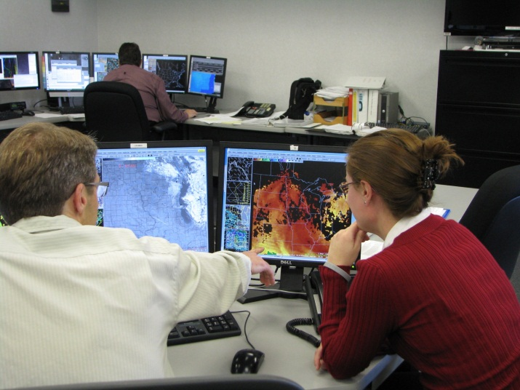
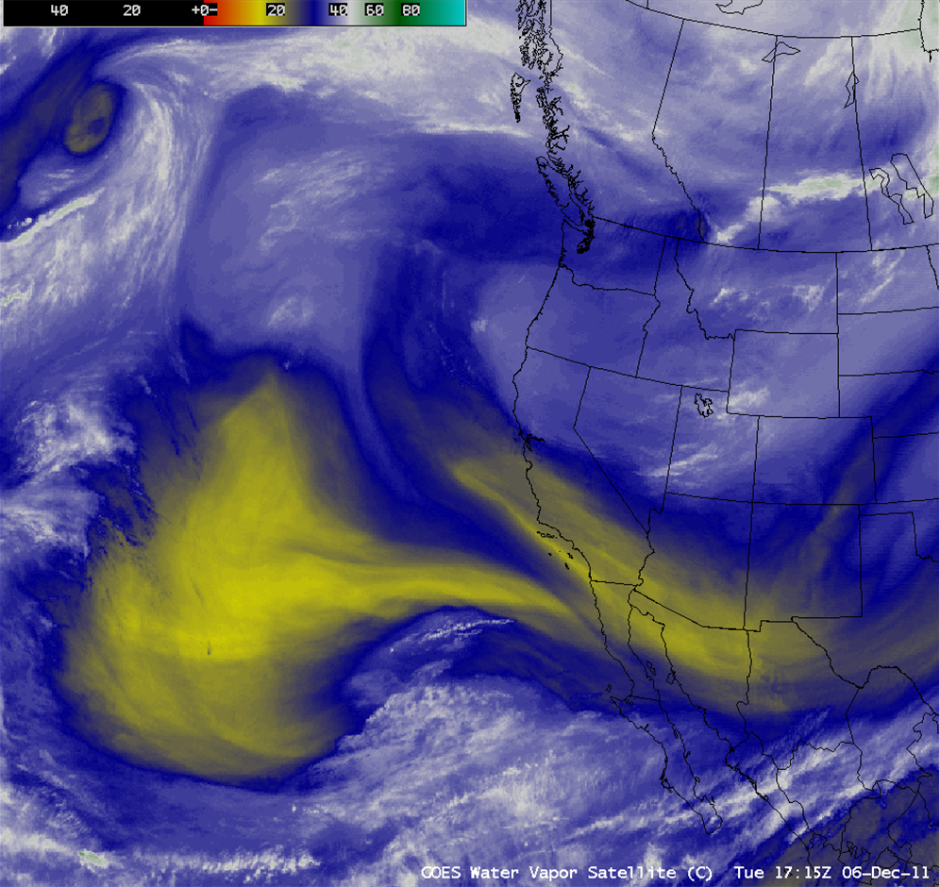
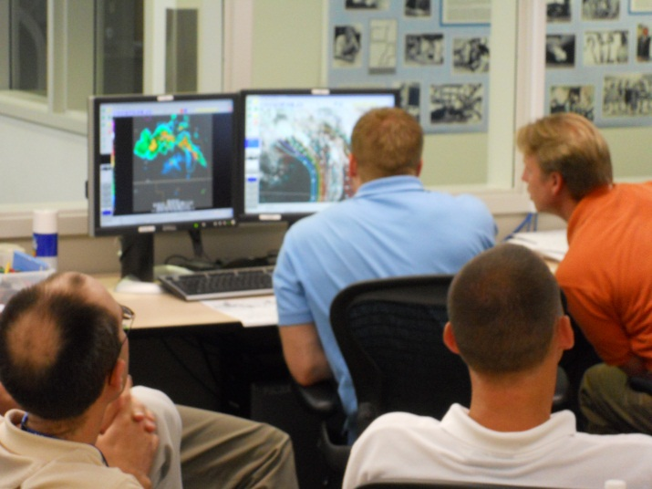
The ingredients for sustaining success in NOAA R2O for GOES-R
Jordan J. Gerth
Cooperative Institute for Meteorological Satellite Studies (CIMSS)
Space Science and Engineering Center (SSEC)
University of Wisconsin at Madison
Ingredients for Success
R2No – Popular Excuses
 | SPSRB | GRPG
Management | NOAA (NESDIS STAR and OSO Directors) | NOAA (GOES-R, STAR, NWS, and OAR)
Initiating action | User request, science improvement, or project manager development | Formal NOAA testbeds, local area demonstrations, grassroots efforts
Initiating source | NOAA only, excluding contractors and associates | NOAA, particularly NWS, and non-federal scientists and subject-matter experts
Operations | Represented by NOAA managers, particularly from NESDIS | Represented by NWS regional science chiefs
Research | Conducted prior to initiation | Ongoing as part of project
Process | Exhaustive, lengthy | Not articulated, short
Cost | Funds required, NOAA responsible | Covered largely via NOAA support to Cooperative Institutes
Limited Network Bandwidth
To disseminate new products operationally
Decreasing Budgets
Necessitates prioritization
Bureaucracy
Impedes progress and agility
Too Few Personnel
May not be in a position to identify points of failure
Who is the process owner?
Cumbersome IT Security Regulations
Personnel on the interagency interface who are conversant with requirements for facilitation across interagency gaps,
Sufficient and certain budget allocations, particularly for operational continuity,
Necessary information technology (IT) resources and infrastructure, including computing capabilities and telecommunication bandwidth, and
Emphasized mission-priority principles, where security and non-mission regulations are not restrictions
R2O2? – Is there life in the “valley of death”?
Research
Initial product improvement based on feedback from operations
Challenges include:
The operations floor may be disconnected from the researcher
Funds may not be available to support further research
Improvement
A transition to a better version of the operational product based on an enhancement to the observing capability or product inputs
Challenge:
Requires comprehensive knowledge of observing systems and inputs, as well as an understanding of how enhancements impact a product
Supersession/Retirement
A transition out of operations due to lack of applicability because of other products or change in mission
The implementation into AWIPS is an important component of completing the R2O chain.
Challenge:
Requires intimate knowledge of the operations floor
Satellite Products and Services Review Board (SPSRB)
The NESDIS SPSRB manages the life cycle of a product from research into operations, and once operational, through enhancements to retirement. All new satellite products must obtain approval through the SPSRB process, which contains six primary steps:
(1) User Request,
(2) Assessment,
(3) Analysis of Alternatives,
(4) Initial Project Plan,
(5) Operational Decision, and
(6) Product Divestiture or Retirement
GOES-R Proving Ground (GRPG)
A proving ground is designed to showcase future capabilities and identify possible gaps as a forward-thinking exercise to prepare the end user for upcoming science and technology and assure that the capabilities meet user requirements.
The GRPG is a collective effort between many NOAA and NOAA-supported agencies and universities.
The primary customer is the National Weather Service.
The GRPG leverages existing testbeds staffed by satellite liaisons and implements new demonstrations where they do not exist.
Maintenance
A transition to a different version of the operational product based on changes to the observing capability or product inputs
Challenge:
Requires comprehensive knowledge of observing systems and inputs
Community
A transition to widespread use beyond source organization, including general public or scientific community
Challenge:
Communicating changes to a product once made available to a broader community are difficult

