Slide 1
The ingredients for sustaining success in NOAA R2O for GOES-R
Jordan Gerth
Cooperative Institute for Meteorological Satellite Studies
University of Wisconsin at Madison
10 January 2013
93rd American Meteorological Society Annual Meeting
Ninth Annual Symposium on Future Operational Environmental Satellite Systems
Third Conference on Transition of Research to Operations
Themed Joint Session 49: Research to Operations Pathway for Satellite Data Retrieval Algorithms

Slide 2
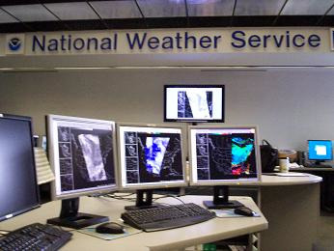
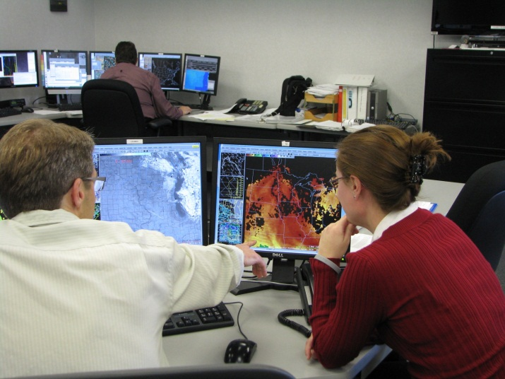
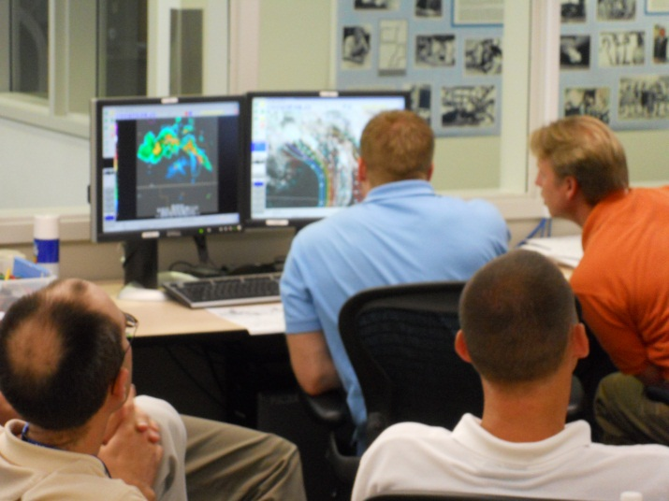
Background
The Cooperative Institute for Meteorological Satellite Studies (CIMSS) has developed a growing program in which new satellite imagery and products are developed for, collaborated in conjunction with, and delivered to National Weather Service (NWS) field weather forecast offices (WFOs) and national centers without invoking a formalized process or an operational provider. Over half of all WFOs nationwide receive satellite imagery or related products from CIMSS.

Slide 3
Operations
To introduce a new product to the NWS, it must be available in their visualization software, the Advanced Weather Interactive Processing System (AWIPS).
CIMSS has developed the technical expertise to produce, deliver, and display satellite images and products in AWIPS.
AWIPS is undergoing an upgrade. CIMSS is assisting its NWS partners with the transition process for the imagery and products that it provides.
CIMSS data is delivered via terrestrial networks.

Slide 4
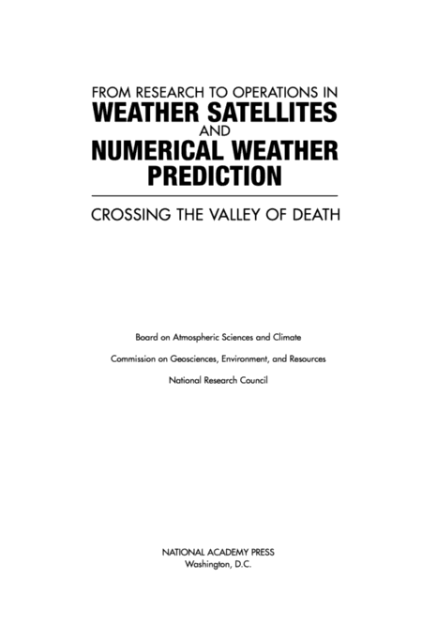
NRC Report
In 2000, a report from the National Research Council (NRC) read—
“Successful transitions from R&D to operational implementation always require:
(1) an understanding of the importance (and risks) of the transition,
(2) development and maintenance of appropriate transition plans,
(3) adequate resource provision, and
(4) a continuous feedback (in both directions) between R&D and operational activities.”

Slide 5
GOES-R Proving Ground
The valley of death

Slide 6
GOES-R Proving Ground
A proving ground is designed to showcase future capabilities and identify possible gaps as a forward-thinking exercise to prepare the end user for upcoming science and technology and assure that the capabilities meet user requirements.
The GOES-R Proving Ground (GRPG) is a collective effort between many NOAA and NOAA-supported agencies and universities.
The primary customer is the National Weather Service.
The GRPG leverages existing testbeds staffed by “satellite champions”, and implements new demonstrations where they do not exist.

Slide 7
SPSRB
The NESDIS Satellite Products and Services Review Board (SPSRB) manages the life cycle of a product from research into operations, and once operational, through enhancements to retirement. All new satellite products must obtain approval through the SPSRB process, which contains six primary steps:
(1) User Request,
(2) Assessment,
(3) Analysis of Alternatives,
(4) Initial Project Plan,
(5) Operational Decision, and
(6) Product Divestiture or Retirement.

Slide 8
Comparison
 | SPSRB | PG
Management | NOAA (NESDIS STAR and OSO Directors) | NOAA (GOES-R, STAR, NWS, and OAR)
Initiating action | User request, science improvement, or project manager development | Formal NOAA testbeds, local area demonstrations, grassroots efforts
Initiating source | NOAA only, excluding contractors and associates | NOAA, particularly NWS, and non-federal scientists and subject-matter experts
Operations | Represented by NOAA managers, particularly from NESDIS | Represented by NWS regional science chiefs
Research | Conducted prior to initiation | Ongoing as part of project
Process | Exhaustive, lengthy | Not articulated, short
Cost | Funds required, NOAA responsible | Covered largely via NOAA support to Cooperative Institutes

Slide 9
Improving the SPSRB and PG
The SPSRB could use:
An initiating mechanism from the PG, where a NOAA user, such as the NWS, could support a request to transition an experimental product to operations developed by a NOAA funded or affiliated entity
An interface for reporting issues with operational products, or suggesting products suitable for divestiture
Shorter transition/change period

Slide 10
Improving the SPSRB and PG
The PG could use:
A broader scope, with participation from all space-based observing system missions
An articulated process for evaluating demonstrations and the utility of PG products
A method for sustaining successful interactions beyond the scope of the PG projects
Increased NWS personnel strictly dedicated to monitoring the PG activities and providing technical support, particularly at NWS regions

Slide 11
GOES-15 Example
This is the GOES-West sub-CONUS sector that is currently scheduled and observed.
Image source: Tim Schmit

Slide 12
GOES-15 Example
The NWS would prefer a sub-CONUS sector that extends further out into the Pacific Ocean than what is currently observed.
Image source: Tim Schmit

Slide 13
Definitions
Product
Any data captured by observing system, output produced by algorithm or model, or combination thereof
Research
Organizations which develop science products to better meet their mission or the mission of another organization
Operations
Organizations with operational components
Operations Floor
Users within the organization that require products to support the organizational mission, often in a time-critical manner (e.g., NWS field offices)

Slide 14
R2O2?
Research
Initial product improvement based on feedback from operations
Maintenance
A transition to a different version of the operational product based on changes to the observing capability or product inputs
Improvement
A transition to a better version of the operational product based on an enhancement to the observing capability or product inputs
Supersession/Retirement
A transition out of operations due to lack of applicability because of other products or change in mission
Community
A transition to widespread use beyond source organization, including general public or scientific community

Slide 15
R2O2? Challenges
Research
The operations floor may be disconnected from the researcher
Funds may not be available to support further research
Maintenance
Requires comprehensive knowledge of observing systems and inputs
Improvement
Requires comprehensive knowledge of observing systems and inputs, as well as an understanding of how enhancements impact a product
Supersession/Retirement
Requires intimate knowledge of the operations floor
Community
Communicating changes to a product once made available to a broader community are difficult

Slide 16
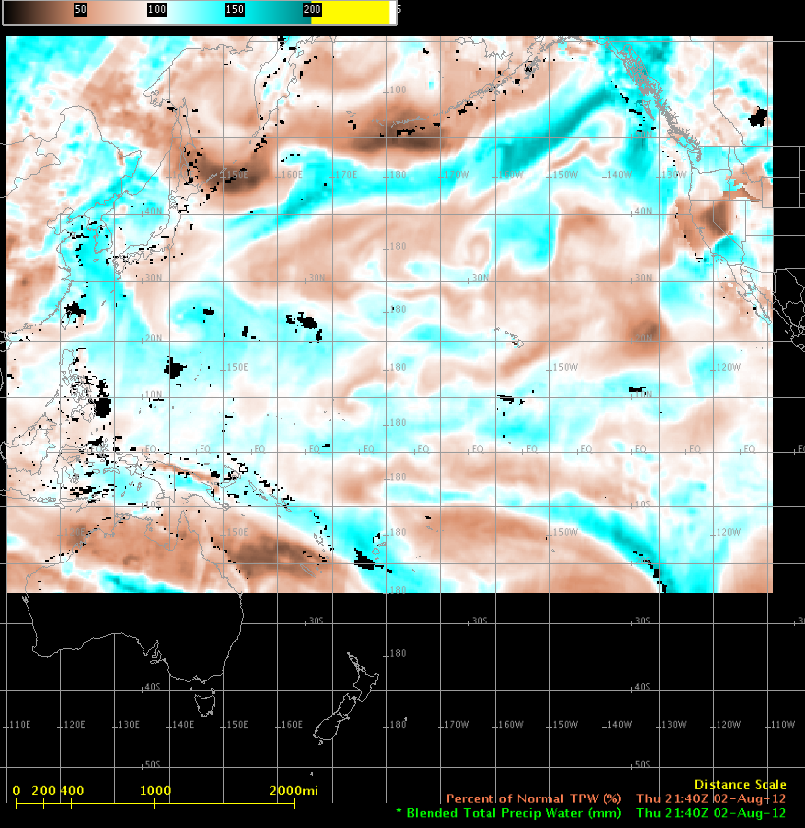
Example: Maintenance

Slide 17
Example: Improvement
When GOES-11 was replaced by GOES-15 as the operational GOES-West satellite, users should have experienced an improved water vapor channel (Imager channel 3).
Image source: CIMSS Satellite Blog, Scott Bachmeier

Slide 18
Example: Supersession/Retirement
This is the combined GOES Sounder 4.5 μm band as it is presented in AWIPS. Ideally, this channel would provide forecasters information about mid-tropospheric horizontal temperature gradients. Not only is the GOES-13 data noisy, but the default color scheme makes the information difficult to interpret.
The implementation into AWIPS is an important component of completing the R2O chain.

Slide 19
Example: Community
This is the GOES-East CONUS sector from GOES-13.
Image source: Tim Schmit

Slide 20
Satellite Services Division Special Bulletin
Topic: GOES-East RSO is scheduled for September 27, 2012
Date/Time Issued: September 27, 2012 1850 UTC
Product(s) or Data Impacted: GOES-East Imager Data and Products
Details/Specifics of Change: Requested by WFO Miami
Reason: WFO Puerto Rico issues - Miami backing them up - No radar.
There will be an increased number of GOES-East Rapid Sectors, with decreased coverage for the Southern Hemisphere and smaller Northern Hemisphere scans.

Slide 21
Example: Community
The problem was that GOES-14 was GOES-East and the CONUS sector did not cover Puerto Rico.
Image source: Tim Schmit

Slide 22
Popular Excuses (R2NO)
Why do R2O activities fall short?
Limited Bandwidth
To disseminate new products operationally
Decreasing Budgets
Necessitates prioritization
Bureaucracy
Impedes progress and agility
Too Few People
May not be in a position to identify points of failure
Who is the process owner?
Overbearing IT Security
Freezes R2O cold

Slide 23
Ingredients for Success
Personnel on the interagency interface who are conversant with requirements for facilitation across interagency gaps,
Sufficient and certain budget allocations, particularly for operational continuity,
Necessary information technology (IT) resources and infrastructure, including computing capabilities and telecommunication bandwidth, and
Emphasized mission-priority principles, where security and non-mission regulations are not restrictions

Slide 24
R2O Driving Future Capabilities
The SPSRB and PG processes begin after new satellite procurement has started.
Good recommendations resulting from the SPSRB and PG processes will not alter the specifications of current or future observing systems.
The SPSRB and PG need a follow-on process to continually monitor and assess implemented products as science, spacecraft, instruments, distribution strategies, and visualization systems evolve.
A closer relationship between product development and the operations floor will allow for organic and realistic user requests fueling the R2O loop.

Slide 25
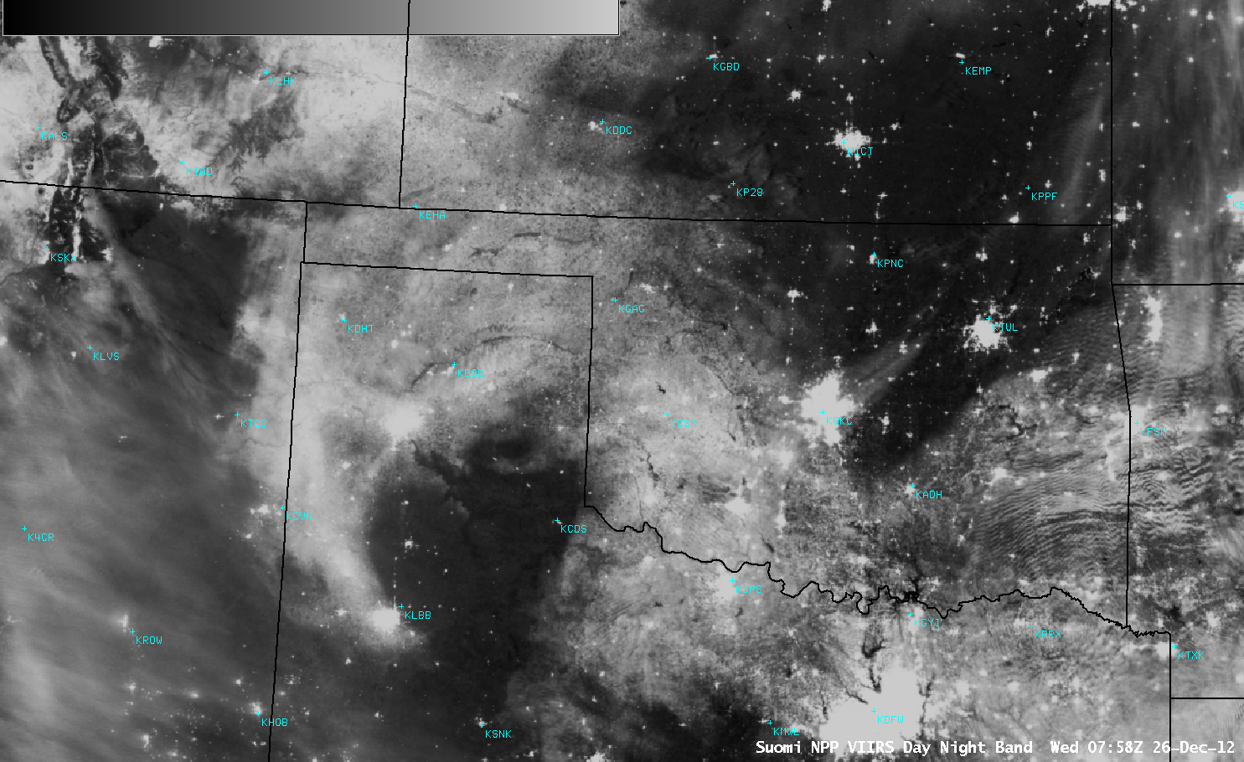
R2O Driving Future Capabilities
Source: CIMSS Satellite Blog, Scott Bachmeier

Slide 26
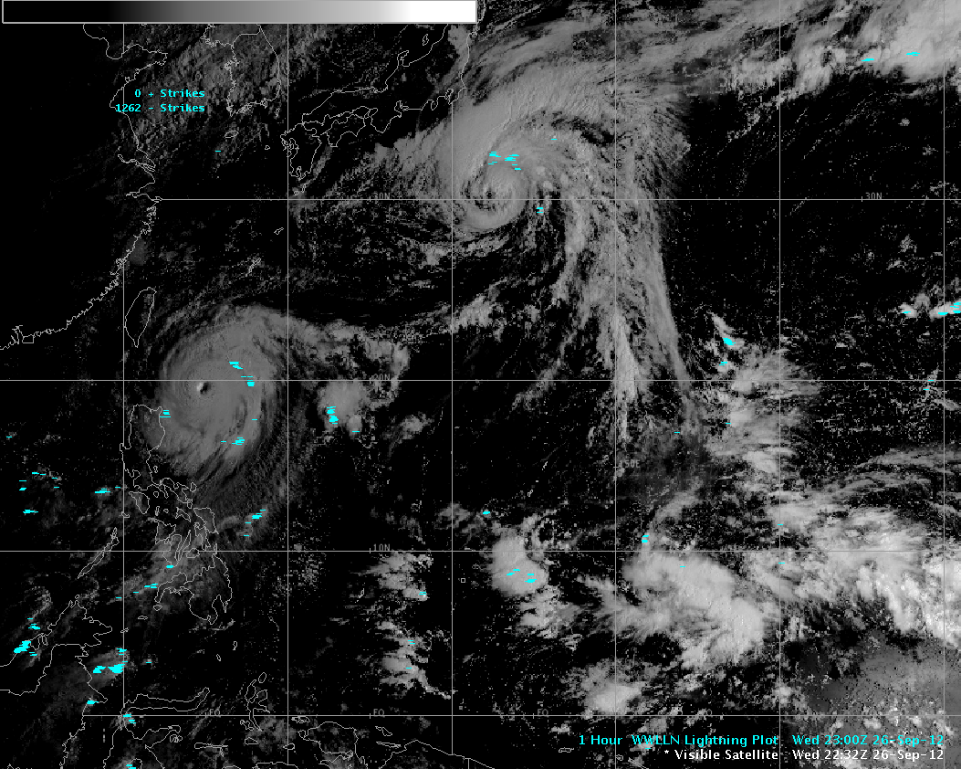
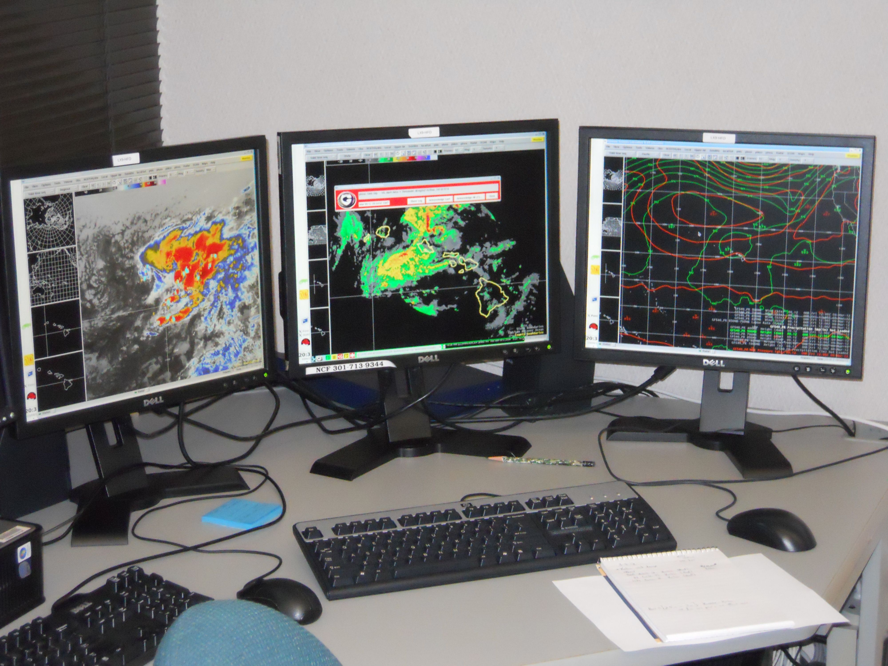
Developments at CIMSS
Participation in NOAA Testbeds
Personnel, products, technical support
Local area demonstrations
Alaska Region
Development of standalone software to produce polar-orbiting satellite imagery for AWIPS
Pacific Region
Aided satellite antenna acquisition for Honolulu Community College
AWIPS and AWIPS II support

Slide 27
Questions? Comments?
Contact me: Jordan.Gerth@noaa.gov
Previous presentations:
An Outline in Transferring Satellite Research Products to National Weather Service Operations
Talk, American Meteorological Society Annual Meeting—1st R2O Conference (Seattle, Washington)
January 27, 2011
Transitioning Satellite Products to National Weather Service Operations, and Future Directions for the GOES-R Era
Talk, American Meteorological Society Annual Meeting—16th SATMET Conference (Phoenix, Arizona)
January 14, 2009

