Slide 1
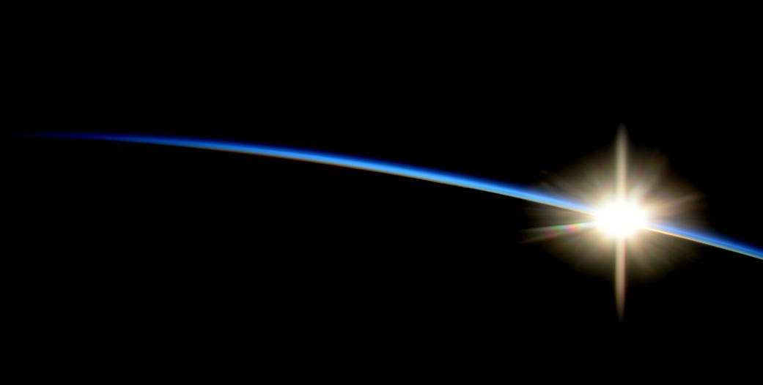
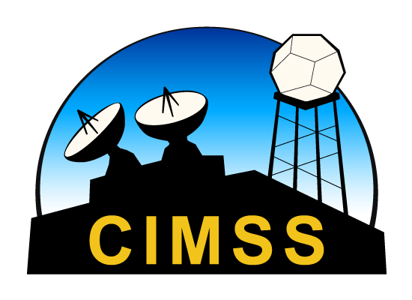
Sky Cover during the 2017 Solar Eclipse
@jjgerth
Jordan J. Gerth
Cooperative Institute for Meteorological Satellite Studies Space Science and Engineering Center University of Wisconsin – Madison
15th Annual Symposium on New Generation Operational Environmental Satellite Systems American Meteorological Society 99th Annual Meeting, Phoenix, Arizona
9 January 2019

Slide 2
21 August 2017 Solar Eclipse
Question: Were the National Weather Service (NWS) forecasts adequate in assessing the trend in sky cover during the course of the solar eclipse?
Totality in Nashville, TN, was around 18:30 UTC.
The NWS defines sky cover as “the expected amount of opaque clouds (in percent) covering the sky valid for the indicated hour.”

Slide 4
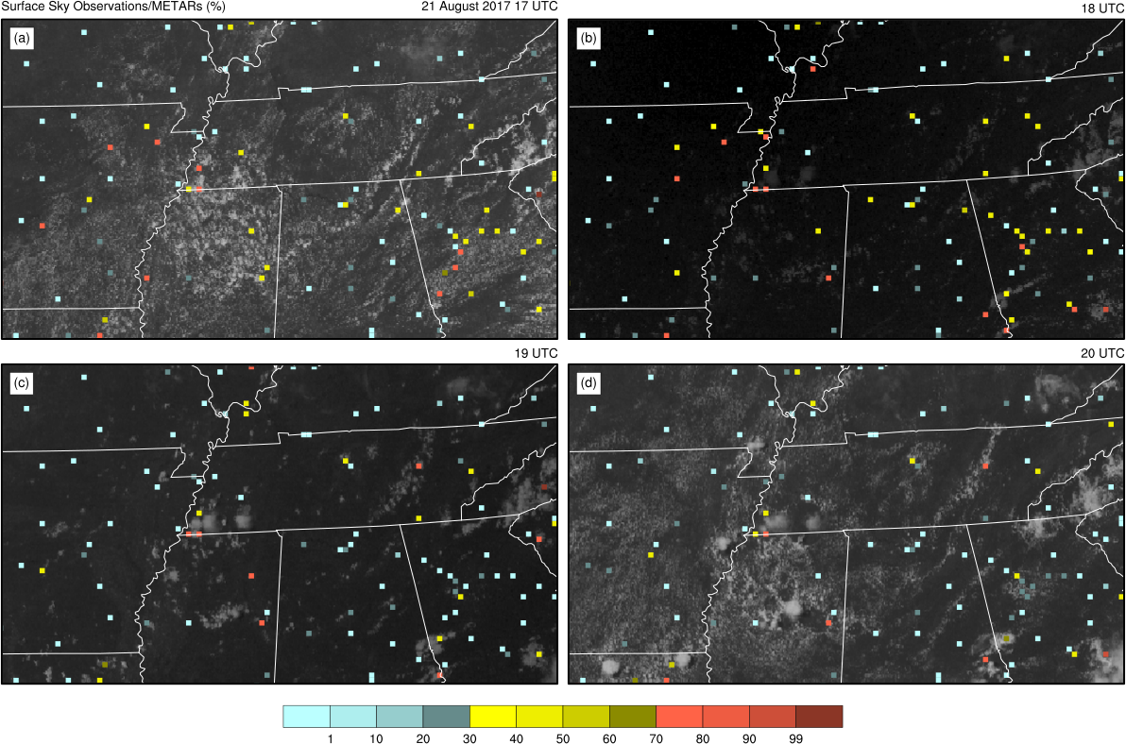
17 UTC
18 UTC
19 UTC
20 UTC

Slide 5
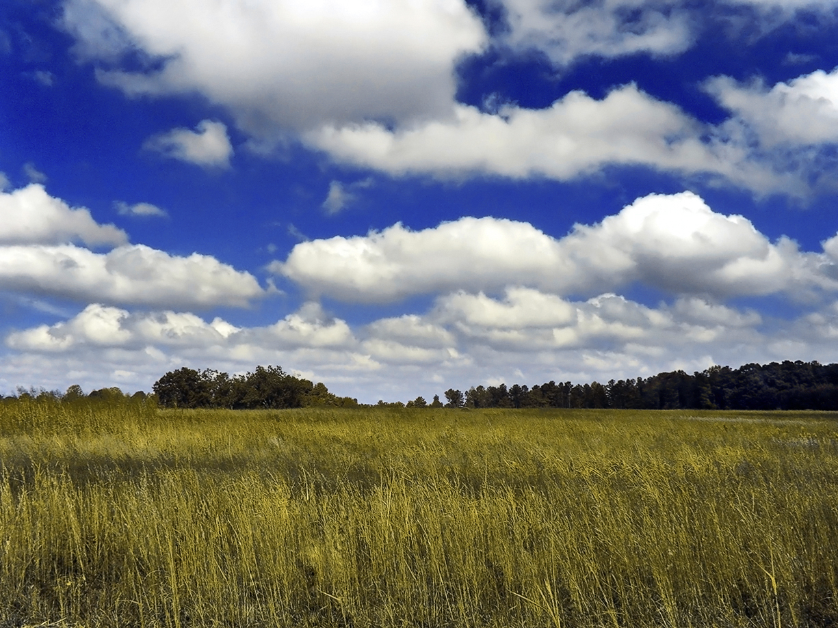
Source: Wikimedia
Notes:
https://upload.wikimedia.org/wikipedia/commons/3/3c/GoldenMedows.jpg

Slide 6
Imager SCP GOES-13 Imager Sky Cover Product
The GOES-13 Imager Sky Cover Product is a time-average of the celestial dome effective cloud amount (emissivity) within a one-hour window. The valid time begins at the indicated time. The average is all scans after the valid time, within one hour.
RTMA NCEP Real-Time Mesoscale Analysis
The RTMA is an assimilation system for near-surface weather observations that produces an hourly analysis with a spatial resolution of approximately 2.5 km. The GOES imager SCP is used in the RTMA as data of opportunity for sky cover.
NDFD NWS National Digital Forecast Database
The NDFD Total Cloud Cover is the human-produced one-hour cloud forecast valid for one hour beginning at the indicated time, usually with input from numerical weather prediction fields. This is an official NWS product and converted to text forecasts.

Slide 7
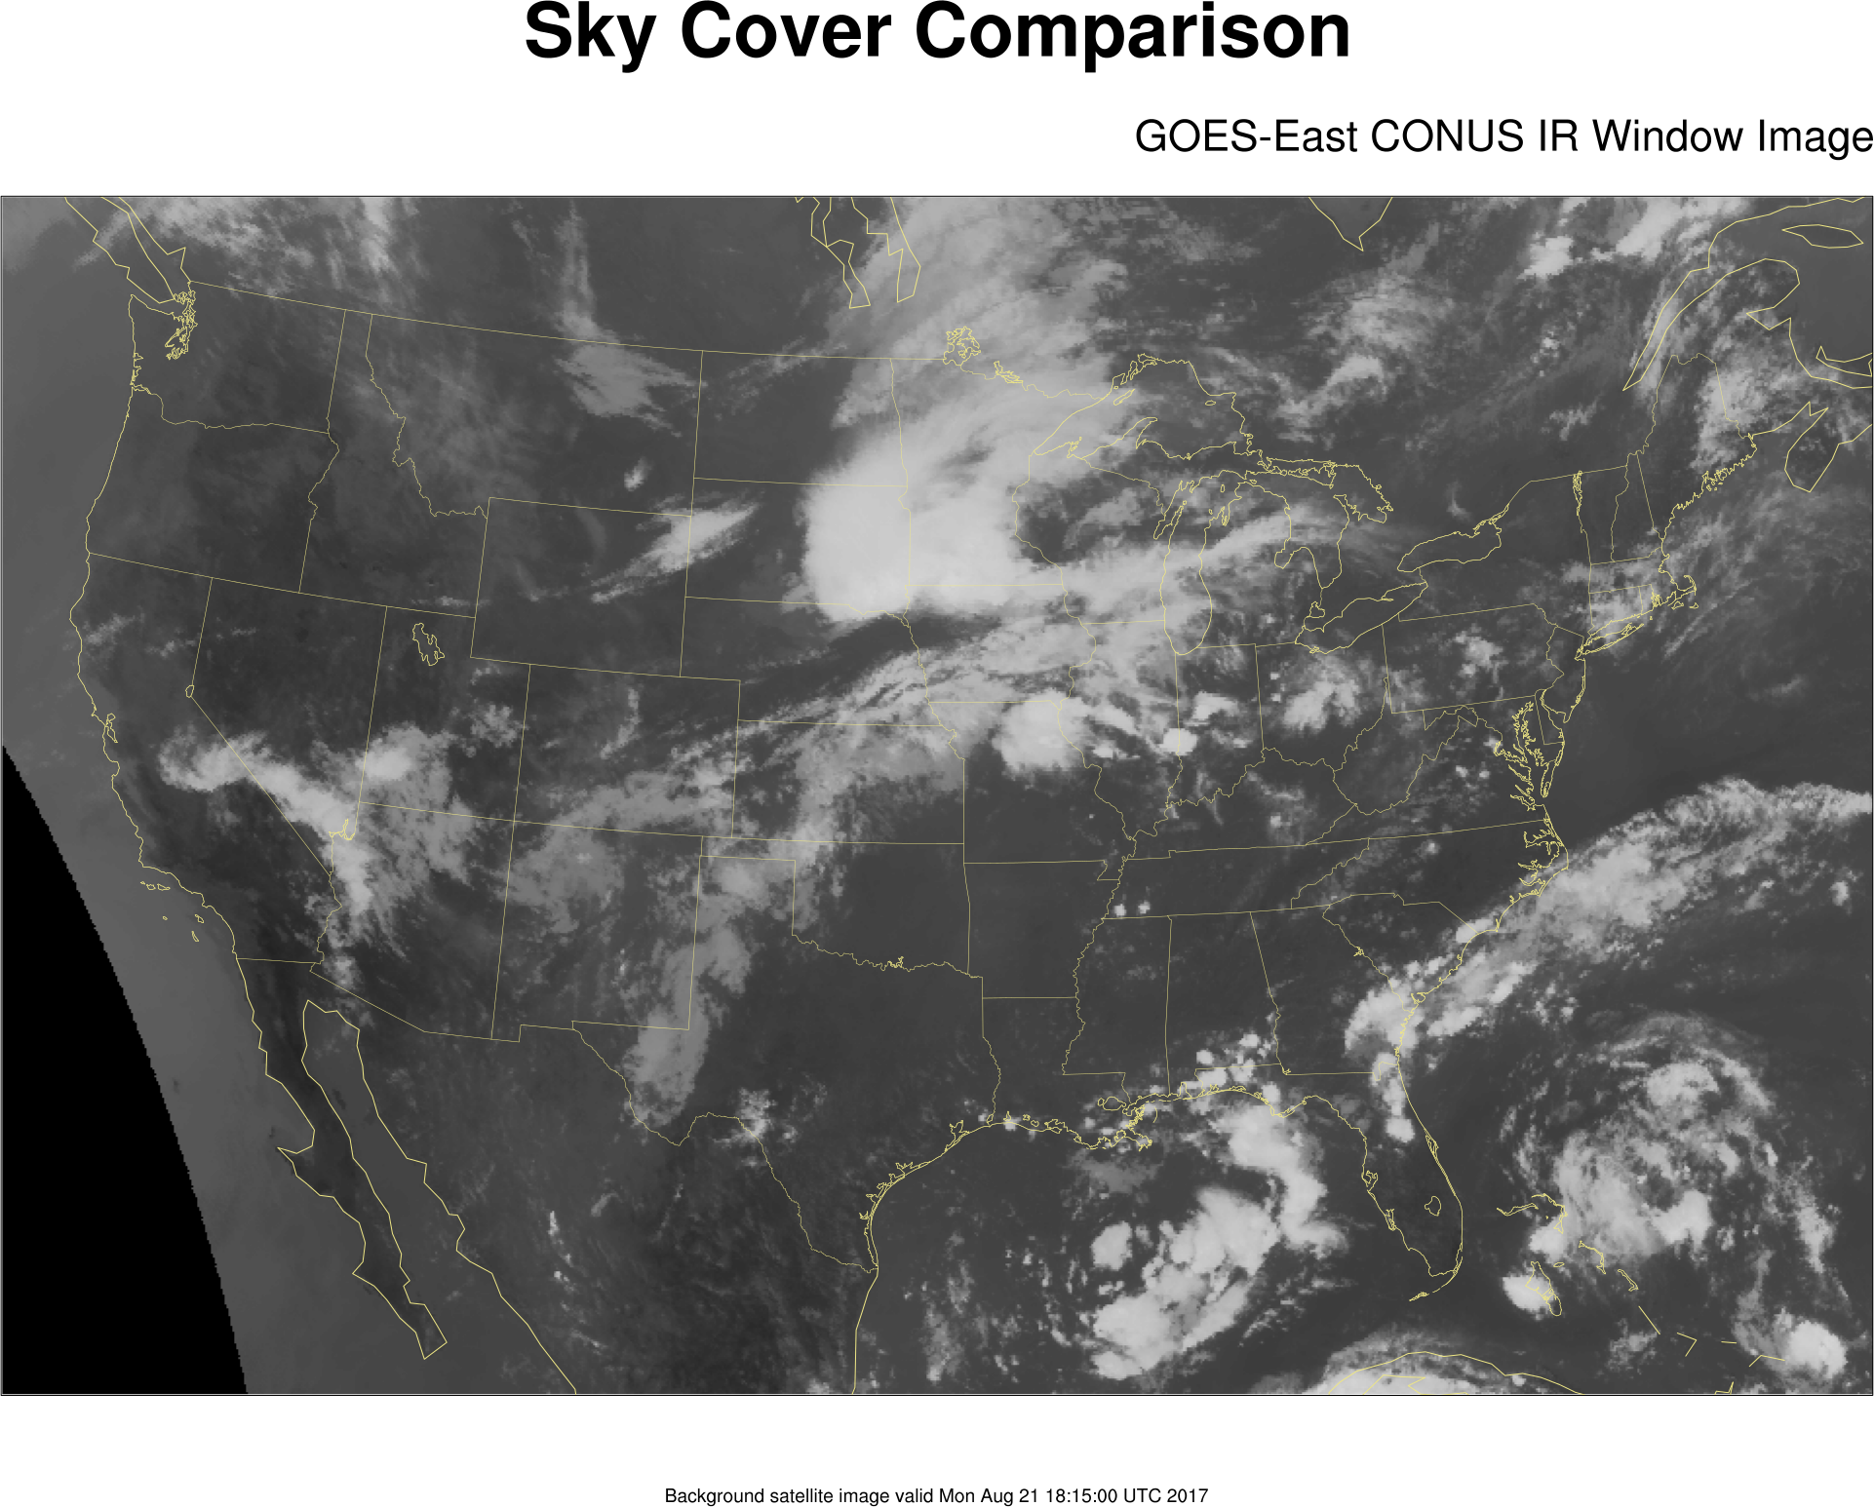

Slide 8
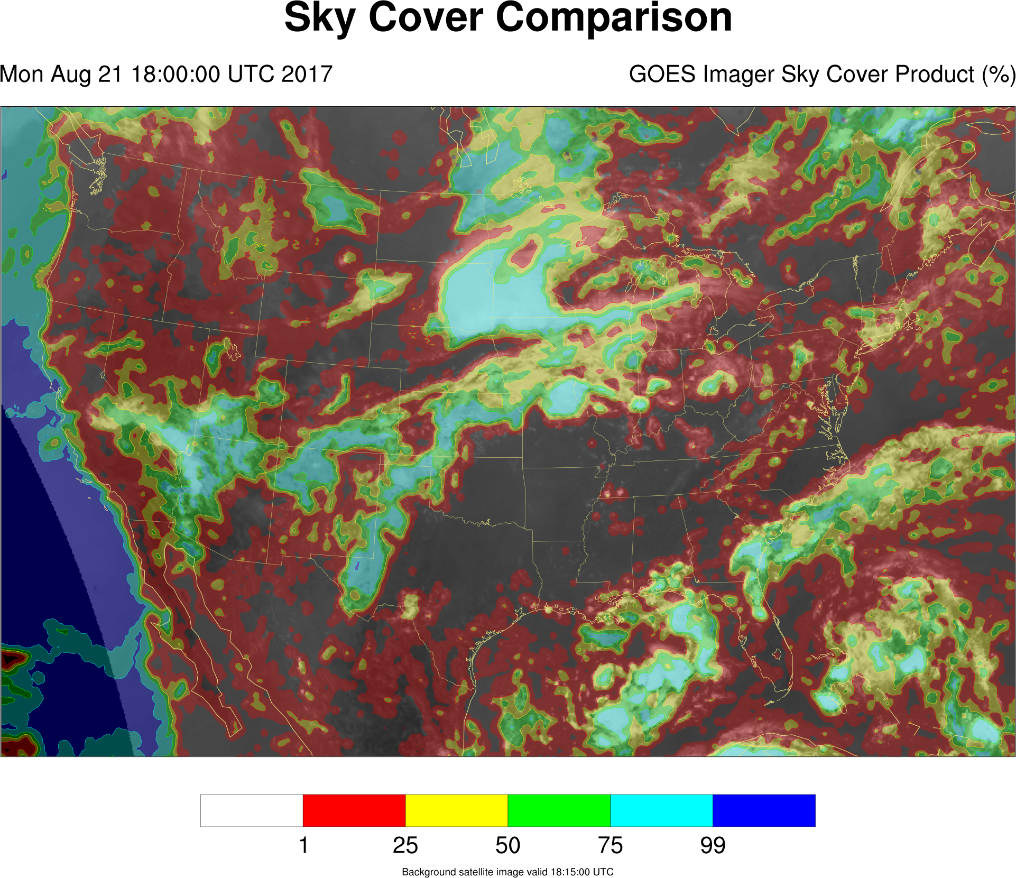

Slide 9
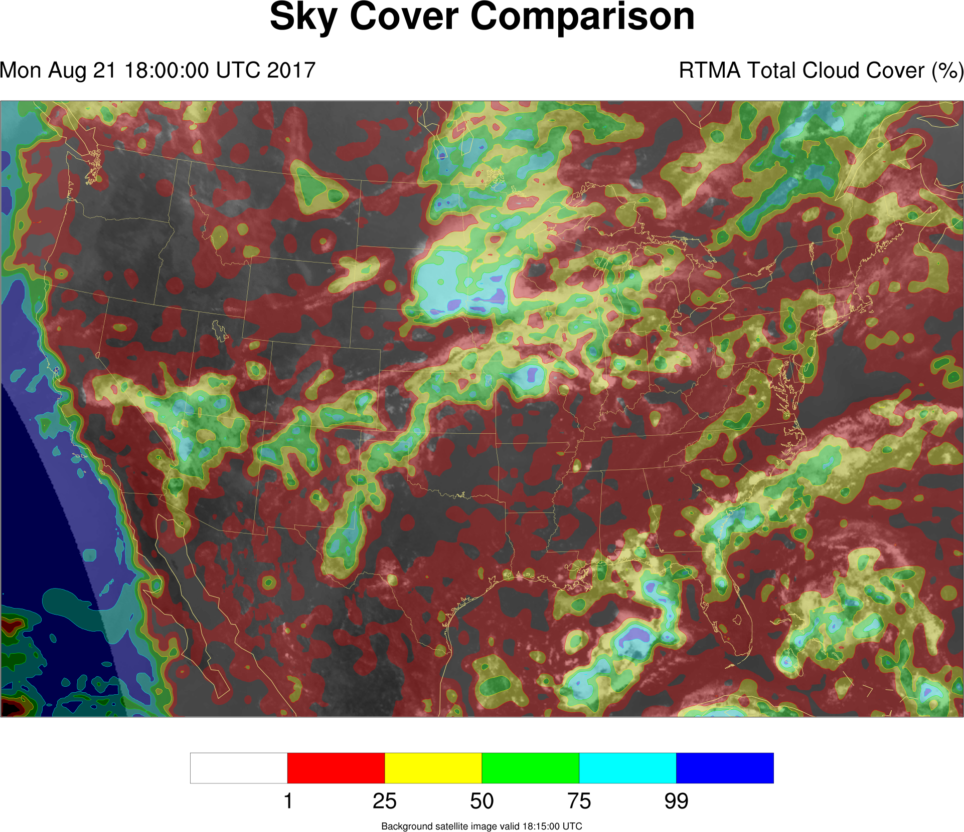

Slide 10
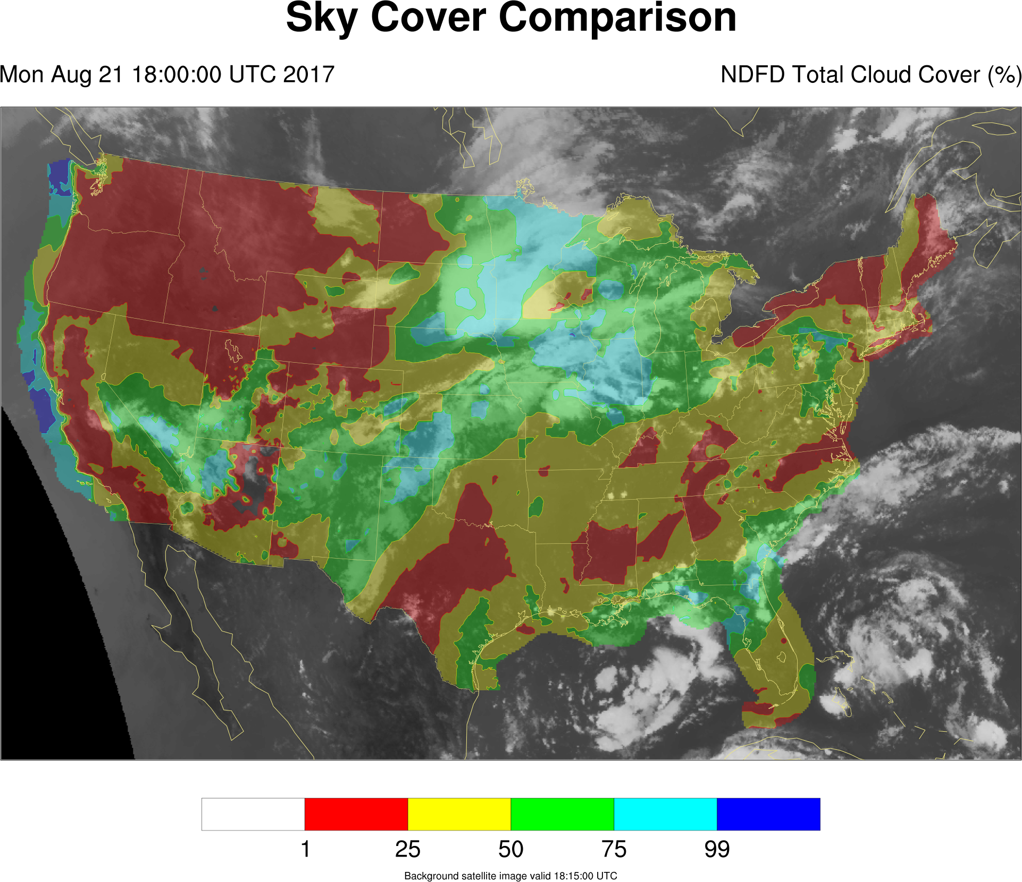

Slide 11
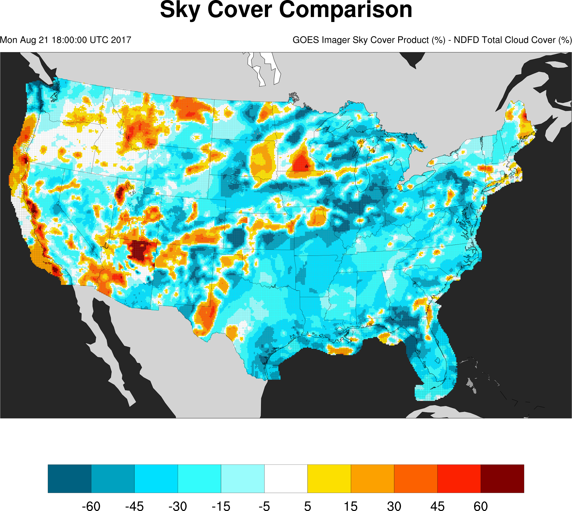

Slide 12
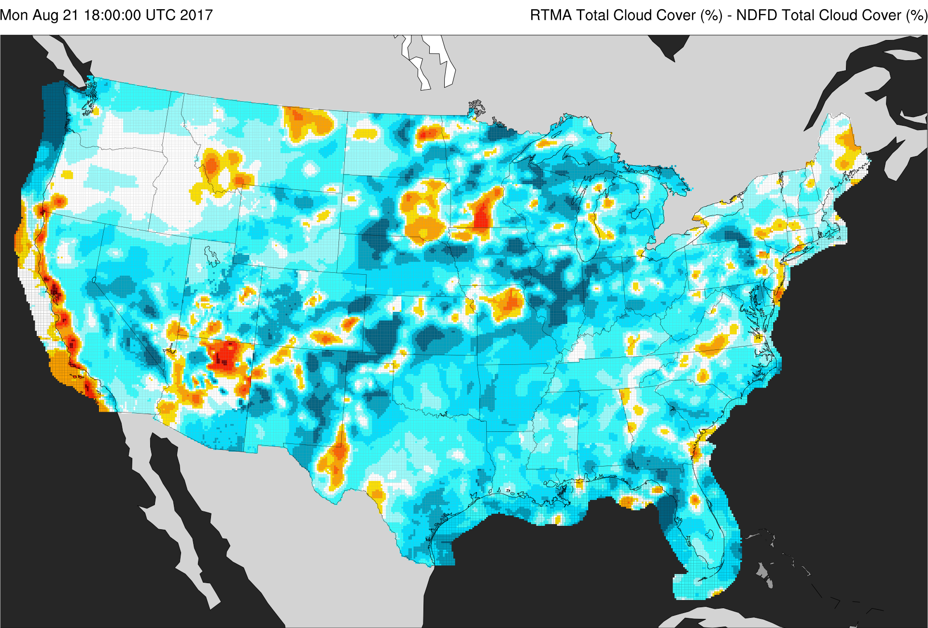

Slide 13
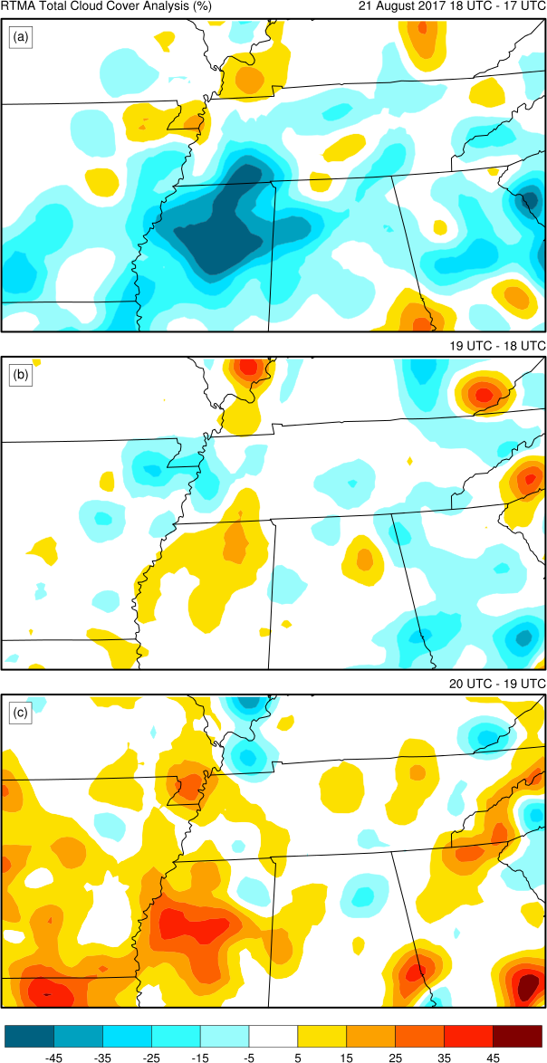
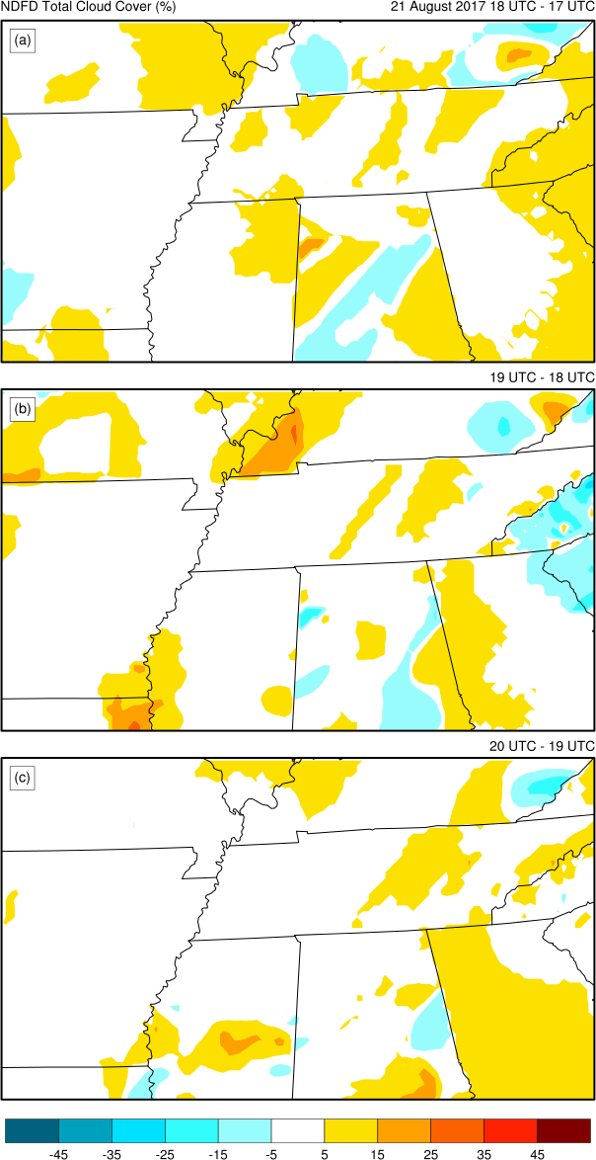
18 UTC – 17 UTC
18 UTC – 17 UTC
19 UTC – 18 UTC
19 UTC – 18 UTC
RTMA Total Cloud Cover Analysis (%)
NDFD Total Cloud Cover (%)
20 UTC – 19 UTC
20 UTC – 19 UTC

Slide 14
RTMA vs. NDFD, 17 ➔ 18 UTC

Slide 15
21 August 2017 Solar Eclipse
Conclusion: The cloudiness decreased ahead of totality, but NWS forecasts of sky cover for the Tennessee Valley did not predict it, even as solar eclipse totality was approaching.
Subsequent question: Does using imagery from GOES-16 change the calculation of the satellite-observed adjusted average cloud top emissivity?

Slide 16
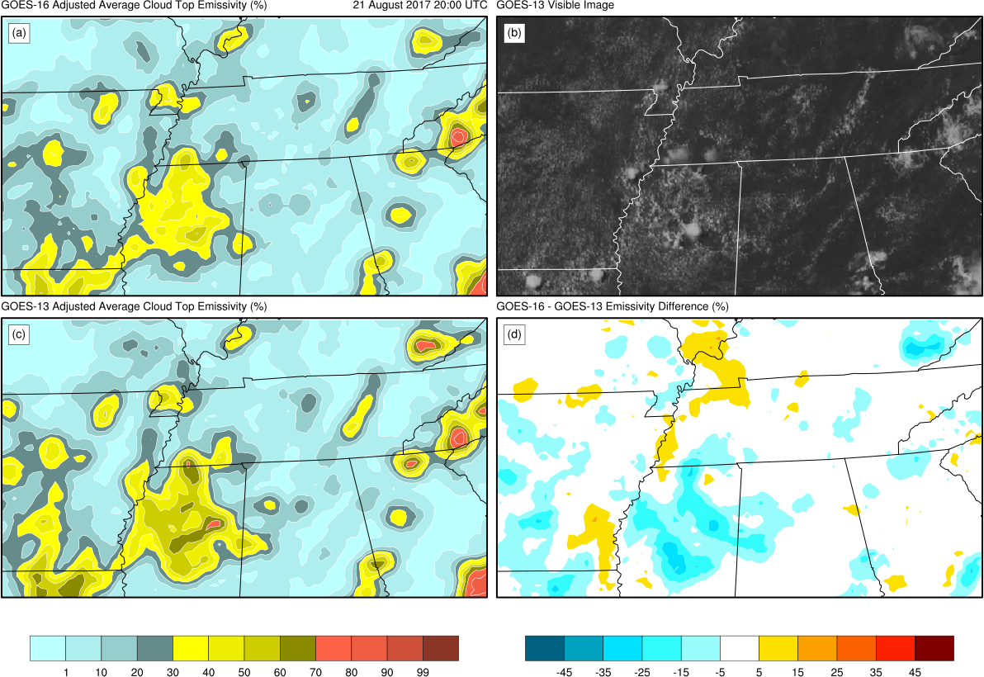
GOES-16 Adjusted Average Cloud Top Emissivity (%)
GOES-13 Visible Image
GOES-13 Adjusted Average Cloud Top Emissivity (%)
GOES-16 – GOES-13 Emissivity Difference (%)

Slide 17
21 August 2017 Solar Eclipse
Conclusion: There were minor changes in the magnitude of maxima and minima due to different the spectral and spatial resolutions of the GOES imagers.
Full article available online:
Jordan J. Gerth, “Shining light on sky cover during a total solar eclipse,” Journal of Applied Remote Sensing 12(2), 020501 (29 June 2018). https://doi.org/10.1117/1.JRS.12.020501.

Slide 18
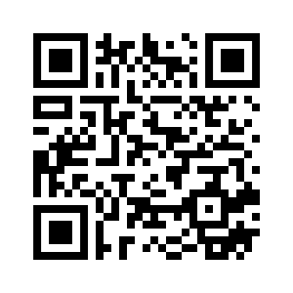
QUESTIONS? jordan.gerth@ssec.wisc.edu
Booth #233

