Slide 1
Sky Cover: Shining Light on a Gloomy Problem
Jordan J. Gerth
American Meteorological Society Annual Meeting
Session J1: Satellite data and technology for forecasting and responding to natural disasters
5 February 2014
@jjgerth

Slide 2
Problem Statement
Problem: There is the lack of an observational method through which to verify the behavior of cloud parameterizations in climate and weather models, which are useful in examining cloud feedbacks.
There are two parts to solving this problem.
Produce a sky cover analysis that is representative of current conditions and suitable for use as validation
Quantify the relationship between sky cover as purported by the analysis and related atmospheric quantities in a cloud-resolving model

Slide 3
Create an hourly sky cover analysis based on the following requirements:
The sky cover quantity is an average over an entire hour.
Satellite and in-situ surface observations of cloud cover are complementary.
The range of the sky cover quantity is between 0% and 100%.
Create an optimal sky cover forecast based on the following assumptions:
The relationship between sky cover and numerical weather prediction cloud/moisture variables is roughly linear.
The model variables adequately represent the atmosphere at the initial time and at times in the future.
Objective I
Objective II
Produce an operations-grade sky cover product for the field
Produce an operations-grade sky cover forecast for the field
Goal I
Goal II

Slide 4
Defining Sky Cover
Effective cloud amount (ECA), the product of fractional cloud cover within the field of view (FOV) and cloud emissivity, is the most common method to assess sky cover from satellite observations.
The United States Federal Meteorological Handbook (FMH) No. 1 defines sky cover as “the amount of the celestial dome hidden by clouds and/or obscurations”.

Slide 5
Observing the Sky
There are three primary sources of sky observations:
Space-based imagers (i.e., radiometers onboard low earth-orbiting and geostationary satellites)
Stationary, surface-based instrumentation (e.g., ceilometers)
Trained human observers (typically with aid of instrumentation)

Slide 6
Observing the Sky
There are issues with each observation type:
Satellites observe the atmosphere from the top, such that high clouds obscure low clouds.
Near surface clouds and clouds smaller than the satellite FOV may not be properly represented.
Satellite observations are instantaneous.

Slide 7
Observing the Sky
There are issues with each observation type:
Ceilometers fail to detect/report high cloud (over 12 kft) and do not observe the celestial dome.
The human observations require estimation and are not as precise.
Sky conditions reported as one of five coverage modes in coded surface observation reports.

Slide 8
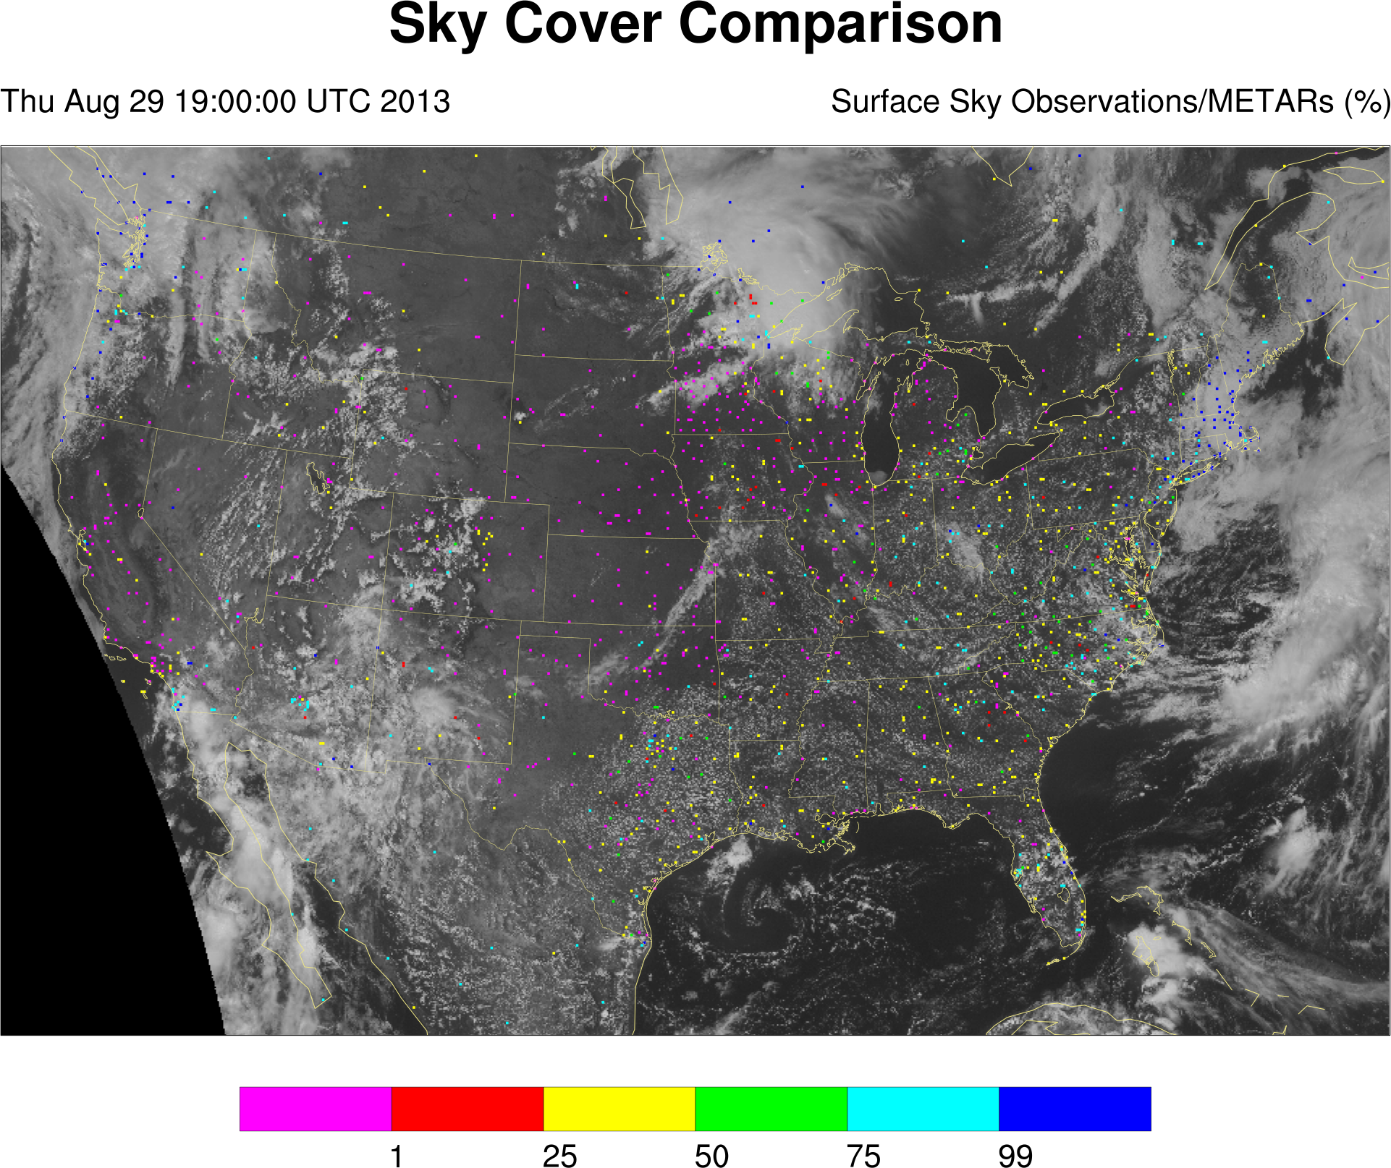

Slide 9
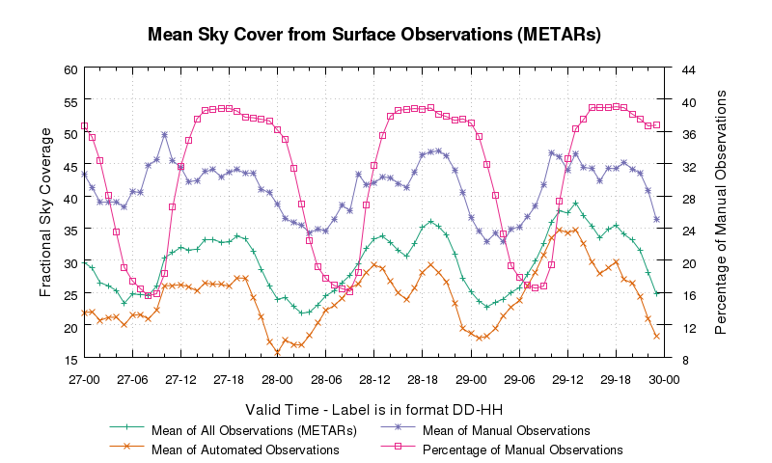

Slide 10
Satellite Sky Cover Product
Based on ECA obtained from the operational GOES imagers (East and West)
Corrected when high (low effective emissivity) cloud obscures underlying low cloud
High effective emissivity cloud is enhanced
Every scan is spatially averaged to produce an ad hoc celestial dome (pixel-centered 11 x 11 box)
Temporally averaged over a one-hour window

Slide 11
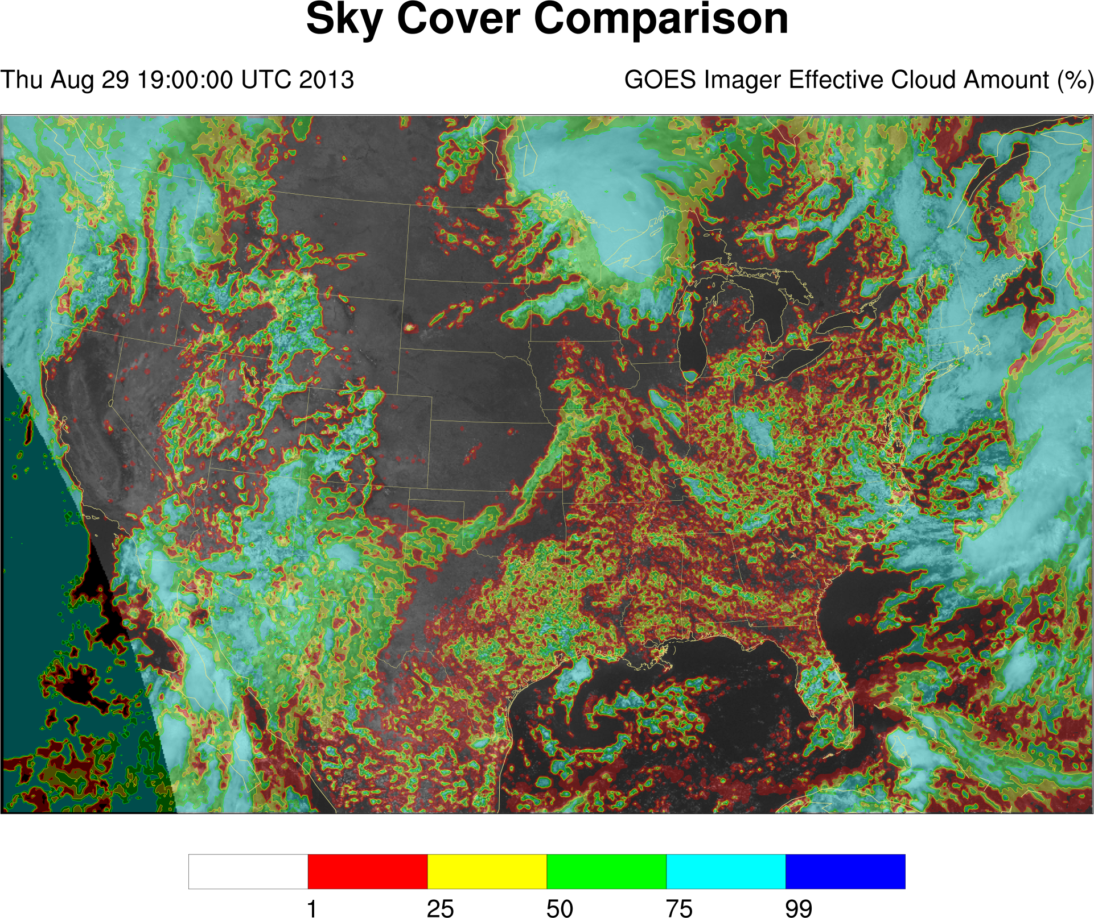

Slide 12
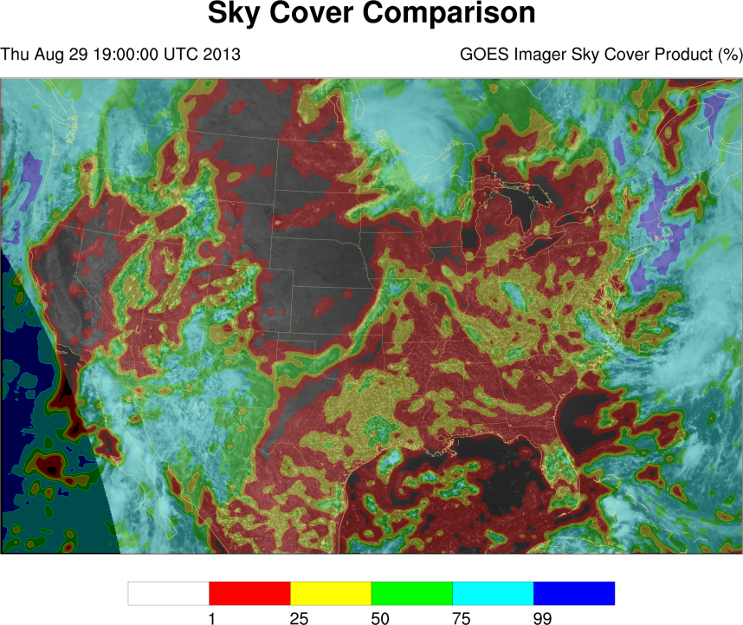

Slide 13
Blended Sky Cover Analysis
If the surface station observation reports clear (less than 5% celestial dome coverage), the satellite sky cover product value is used.
If the surface station observation reports some cloud (5% or better coverage of the celestial dome), the surface observation is used when the value is greater than that from the satellite.
In other situations where both observations are available, a weighted average is performed.

Slide 15
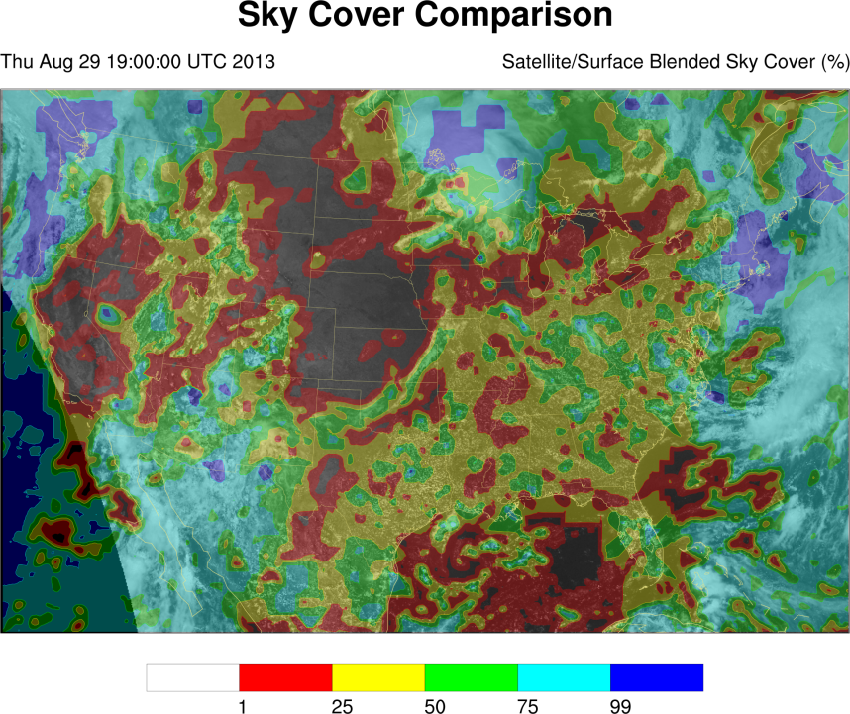

Slide 16
Blended Sky Cover Analysis
The advantages of the blended analysis creation process are that it:
Evaluates all available data and leverages strengths of multiple observational sources
Preserves cloud gradients
Adequately resolves diurnal cumulus fields (not missing, not bimodal)
Is a temporally continuous and spatially contiguous field (available hourly over the contiguous United States)

Slide 17
Create an hourly sky cover analysis based on the following requirements:
The sky cover quantity is an average over an entire hour.
Satellite and in-situ surface observations of cloud cover are complementary.
The range of the sky cover quantity is between 0% and 100%.
Create an optimal sky cover forecast based on the following assumptions:
The relationship between sky cover and numerical weather prediction cloud/moisture variables is roughly linear.
The model variables adequately represent the atmosphere at the initial time and at times in the future.
Objective I
Objective II
Produce an operations-grade sky cover product for the field
Produce an operations-grade sky cover forecast for the field
Goal I
Goal II

Slide 18
Forecasting Sky Cover
The National Weather Service (NWS) National Digital Forecast Database (NDFD) contains an operational sky cover forecast field. Issues with the national one-hour forecast include:
Clear areas with non-zero cloud cover
Vastly different cloud classifications for similar cloud scenes
Lack of spatial continuity between forecast areas
Temporal trends do not match observations
Update frequencies vary by forecast office
The NDFD is generally based on output from weather prediction models.

Slide 19
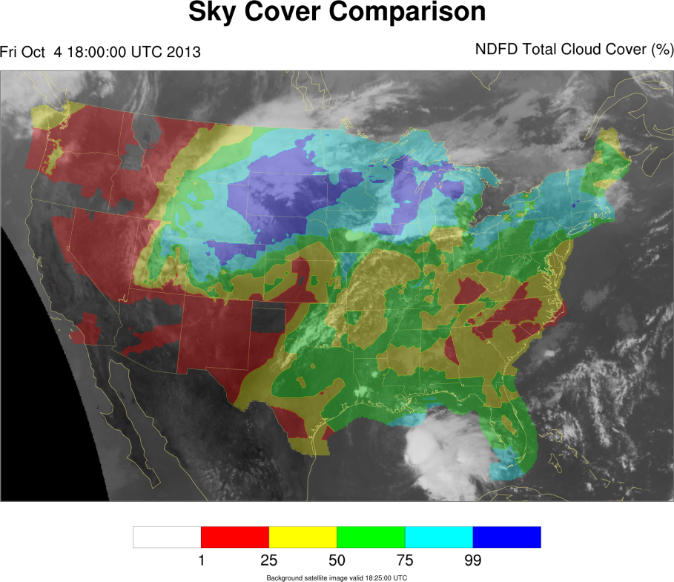

Slide 20
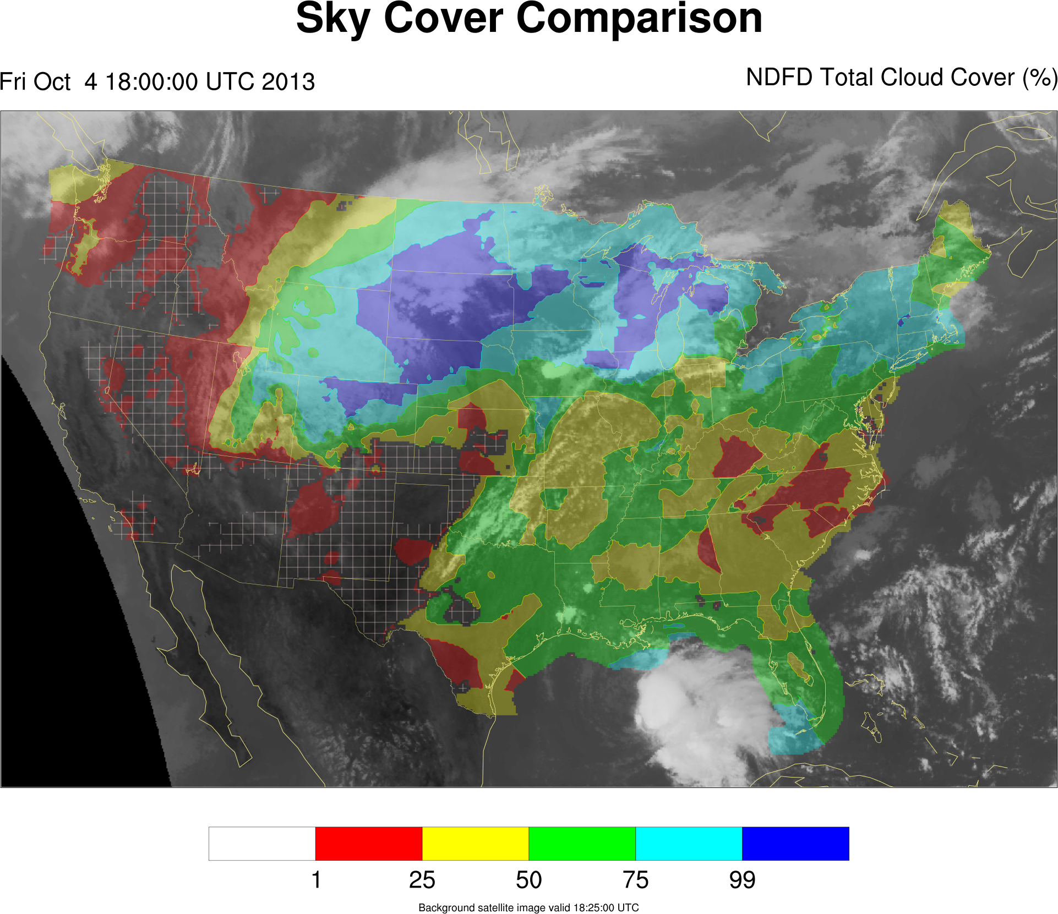

Slide 21
HRRR
High-Resolution Rapid Refresh (http://ruc.noaa.gov/hrrr/)
Horizontal resolution of 3 km, 50 vertical levels
Cloud-resolving model, no convective parameterization
Literature available for WRF framework which is the basis for the HRRR
Advanced Research WRF (ARW) core (v3.4.1+) with Thompson microphysics and RUC/Smirnova land-surface model
Assimilates GOES cloud products and METARs
Available hourly in real-time

Slide 22
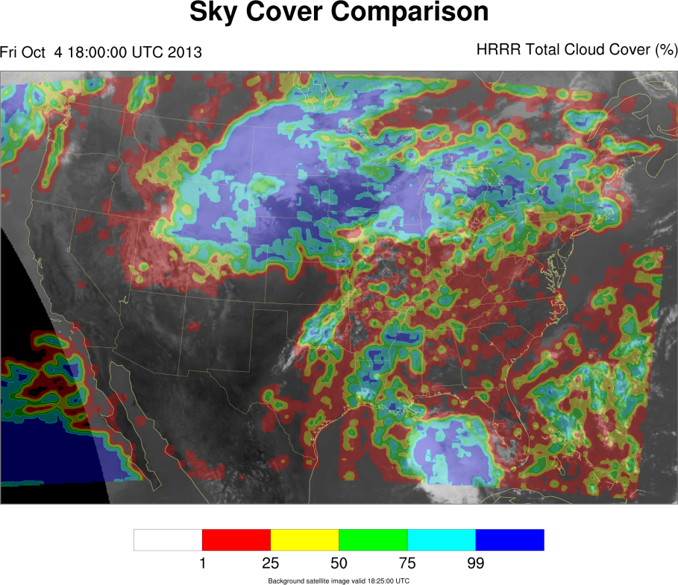

Slide 23
Optimizing Sky Cover
Input fields (subset of points)
Truth: Adjusted blended sky cover analysis
Components
Design model (formats: linear, mixed integer, others)
Objective using free variable, subject to constraints
Terms, matching variables and components
Constraints involving terms
Execute optimizer
Commercial solvers (free for academia)
CPLEX
Gurobi
Open source options (slower)

Slide 24
Optimizing Sky Cover
Components:
Relative Humidity (all levels)
Cloud Water Mixing Ratio, Cloud Ice Mixing Ratio, Rain Water Mixing Ratio, Snow Mixing Ratio (all levels)
Absolute Vorticity (200 hPa only), partitioned into positive and negative components
Pressure levels:
200 hPa
300 hPa
500 hPa
700 hPa
800 hPa
850 hPa
900 hPa
950 hPa
1000 hPa

Slide 25
Optimizing Sky Cover
Optimization objective: Minimize the mean absolute error between the affine expression of adjusted input fields and the truth field
Terms:
Coefficient allowed for 200 hPa positive and negative absolute vorticity (m₂₀₀AV₂₀₀)
Coefficient allowed for relative humidity quantities (m_{x}RH_{x})
Threshold allowed for applying coefficient to 1000 hPa relative humidity field (m₁₀₀₀RH₁₀₀₀ if RH₁₀₀₀ > RH_{T})
Coefficient and scalar allowed for non-zero mixing ratio quantities (m_{y}MR_{y}+b_{y} if MR_{y} > 0, otherwise m_{y}MR_{y})

Slide 26
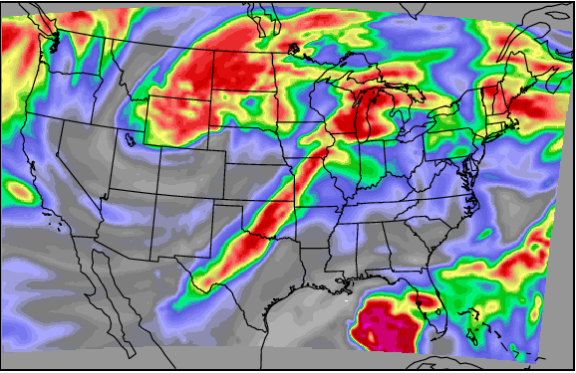
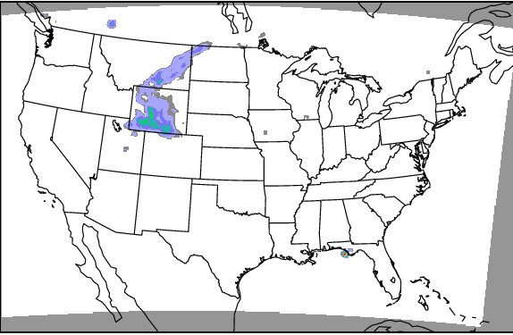
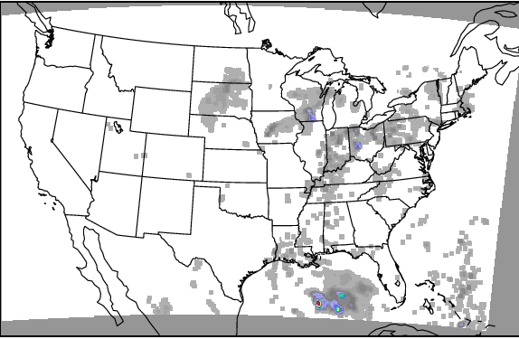
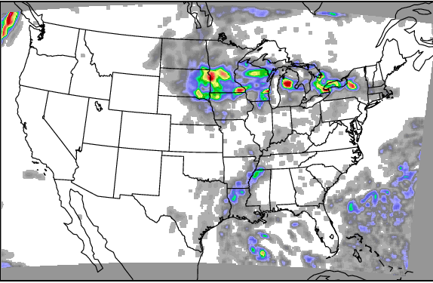
300 hPa Relative Humidity
500 hPa Cloud Ice Mixing Ratio
700 hPa Rain Water Mixing Ratio
900 hPa Cloud Water Mixing Ratio
All images are HRRR model analysis output valid at 18 UTC on 4 October 2013.

Slide 27
Optimizing Sky Cover
Constraints:
Enforce physical relationships
Range of acceptable values (0 to 100)
Extent of relative humidity and absolute vorticity correlating to cloud
Enforce thresholds (mixed integer)
Maintain similar mean value and approximate value distribution of output field to similarly match the truth field
Guide optimizer
Away from scalar adjustments, toward coefficient adjustments (maintain spatial gradients)

Slide 28
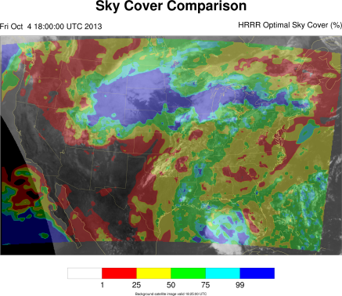
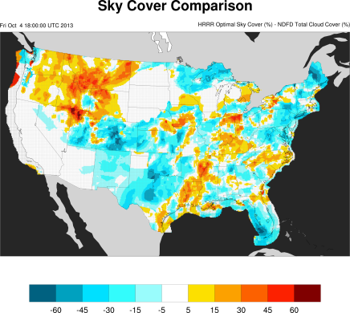
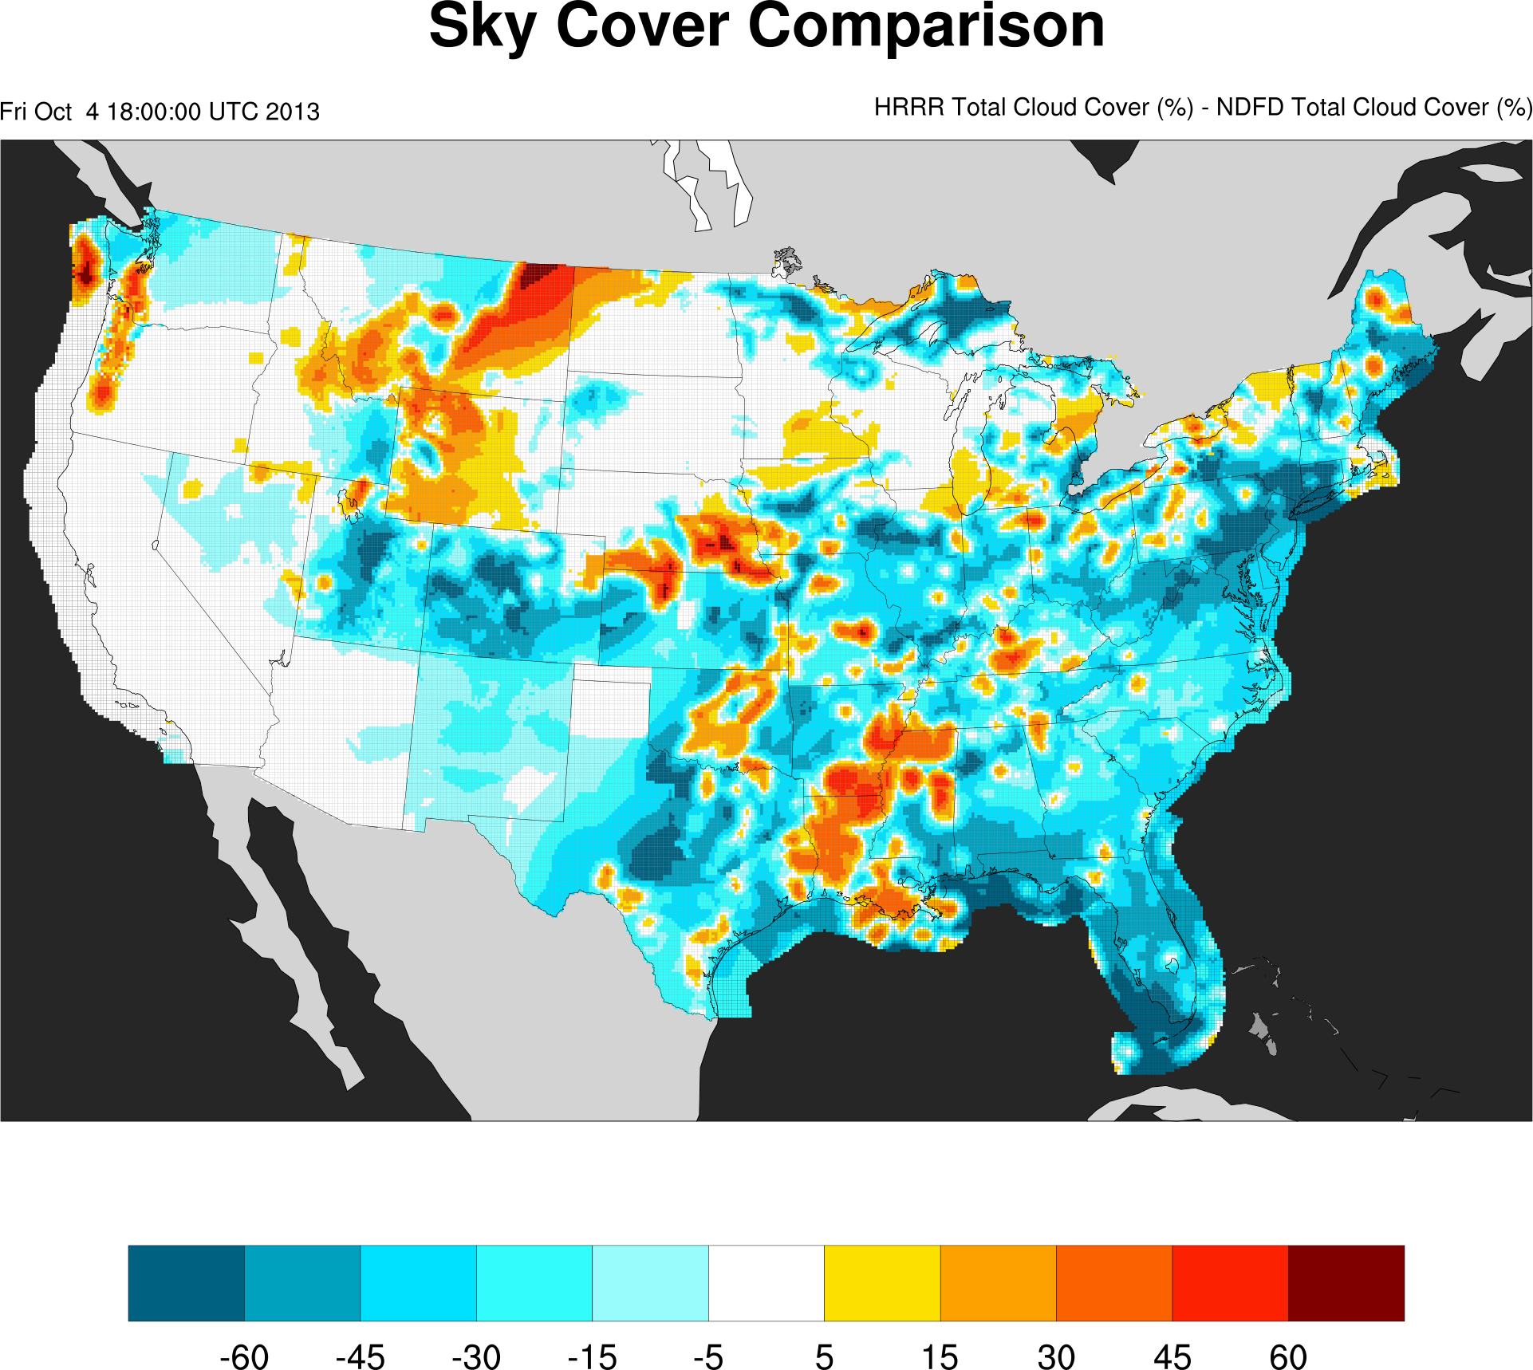

Slide 29
Case Study

Slide 30
Results
Forecasts valid between 21 September 2013, 0 UTC, and 1 November 2013, 23 UTC
Validated against NWS NDFD one-hour sky cover forecast
0-hour | Operational | Optimal | Improvement
Cases | 281 | 270
ME | -11.9% | -6.4% | 5.5%
MAE | 20.6% | 16.1% | 4.5%
RMSE | 28.4% | 22.4% | 4.0%
3-hour | Operational | Optimal | Improvement
Cases | 274 | 784
ME | -11.0% | -8.4% | 2.6%
MAE | 24.1% | 17.1% | 7.0%
RMSE | 32.7% | 23.8% | 8.9%

Slide 31
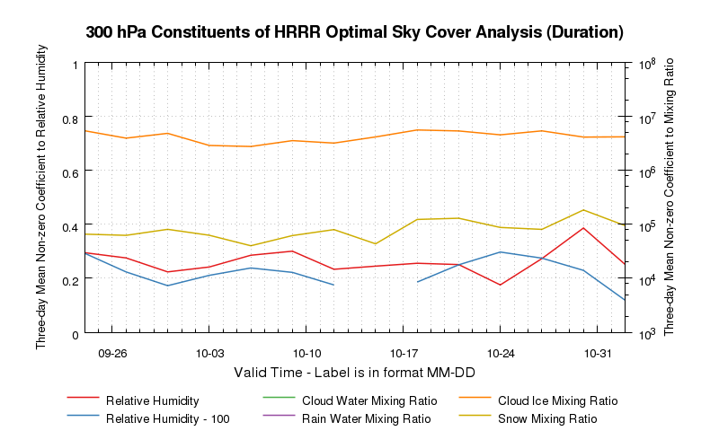
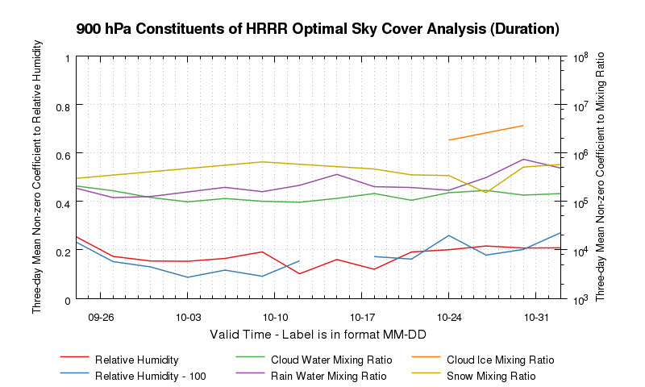
Results
300 hPa Quantity | Mean
Relative Humidity | 0.270
Relative Humidity - 100 | 0.228
Cloud Water Mixing Ratio | NA
Rain Water Mixing Ratio | NA
Cloud Ice Mixing Ratio | 4.21×10⁶
Snow Mixing Ratio | 9.61×10⁴
Means valid 1 UTC, 21 September 2013, through 23 UTC, 1 November 2013
900 hPa Quantity | Mean
Relative Humidity | 0.184
Relative Humidity - 100 | 0.182
Cloud Water Mixing Ratio | 1.38×10⁵
Rain Water Mixing Ratio | 3.11×10⁵
Cloud Ice Mixing Ratio | 2.88×10⁶
Snow Mixing Ratio | 4.23×10⁵

Slide 32
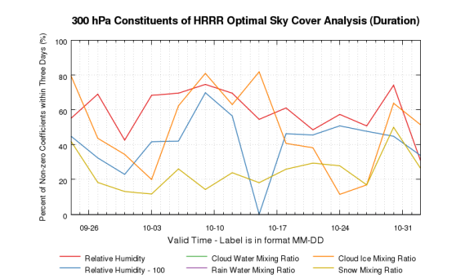
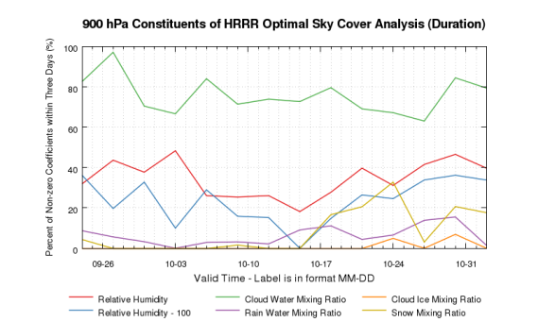
Results
300 hPa Quantity | Mean
Relative Humidity | 58.9%
Relative Humidity - 100 | 43.6%
Cloud Water Mixing Ratio | 0.0%
Rain Water Mixing Ratio | 0.0%
Cloud Ice Mixing Ratio | 47.2%
Snow Mixing Ratio | 25.0%
Means valid 1 UTC, 21 September 2013, through 23 UTC, 1 November 2013
900 hPa Quantity | Mean
Relative Humidity | 35.8%
Relative Humidity - 100 | 25.4%
Cloud Water Mixing Ratio | 76.3%
Rain Water Mixing Ratio | 6.1%
Cloud Ice Mixing Ratio | 0.8%
Snow Mixing Ratio | 8.9%

Slide 33
Results
Above the threshold, there is a non-zero coefficient or scalar which applies to the 1000 hPa relative humidity value in all optimizer solutions during the period.
Mean: 73.3%

Slide 34
Results
Results are from 21 September 2013 through 1 November 2013 over and near the contiguous United States.
950 hPa cloud water mixing ratio is the most frequently selected field in the solved affine relationship.
Cloud water mixing ratio from one or more levels in the lower troposphere is frequently correlated with sky cover.
Higher in the troposphere, there is less reliance on cloud water mixing ratio and more reliance on relative humidity.
Snow mixing ratio and rain mixing ratio are not commonly included in optimized formulations.
Indicates limited HRRR model skill on placement of convective precipitation processes

Slide 35
Summary
An hourly blended sky cover analysis was produced using multiple sources of sky cover observations.
The adjusted sky cover analysis was used to build better numerical weather prediction model output of sky cover, using a mixed integer optimization methodology.
The optimized numerical model output compared to the NDFD one-hour forecast consistently has less mean absolute error than the original/current output.
Future work will focus on interacting with the NWS to produce a sky cover analysis of record and validate short-term numerical model forecasts of sky cover.

Slide 36
Questions? Comments?
E-mail: Jordan Gerth, Jordan.Gerth@noaa.gov
@jjgerth

