Slide 1
Sky Cover: Shining Light on a Gloomy Problem
Jordan J. Gerth
National Weather Association Annual Meeting
Session VIIb: Remote Sensing – Satellite
15 October 2013

Slide 2
Objective
What
Improve the analysis and short-term forecasts of sky cover across the United States and adjacent coastal areas using geostationary satellite and in-situ surface station observations
How
Use linear and/or mixed integer optimization to minimize the mean absolute difference between multi-source sky cover observations and short-term numerical weather prediction forecasts of cloud and moisture variables

Slide 3
Create an hourly sky cover analysis based on the following requirements:
Sky cover is an average over an entire hour.
Satellite and in-situ surface observations of cloud are complementary.
The range of the sky cover output is between 0 and 100%.
Create an optimal sky cover forecast based on the following assumptions:
The relationship between sky cover and numerical weather prediction cloud/moisture variables is roughly linear
The model variables adequately represent the atmosphere at the initial time and at times in the future
Objective I
Objective II
Produce an operations-grade sky cover product for the field
Produce an operations-grade sky cover forecast for the field
Goal I
Goal II

Slide 4
Defining Sky Cover
Effective cloud amount (ECA), the product of fractional cloud cover within the field of view (FOV) and cloud emissivity, is the most common method to assess sky cover from satellite observations.
The United States Federal Meteorological Handbook (FMH) No. 1 defines sky cover as “the amount of the celestial dome hidden by clouds and/or obscurations”.

Slide 5
Observing the Sky
There are three primary sources of sky observations:
Space-based imagers (i.e., radiometers onboard low earth-orbiting and geostationary satellites)
Stationary, surface-based instrumentation (e.g., ceilometers)
Trained human observers (typically with aid of instrumentation)

Slide 6
Observing the Sky
There are issues with each observation type:
Satellites observe the atmosphere from the top, such that high clouds obscure low clouds.
Near-surface clouds and clouds smaller than the satellite field of view (FOV) may not be properly represented.
Satellite observations are instantaneous.

Slide 7
Observing the Sky
There are issues with each observation type:
Ceilometers fail to detect/report high cloud (over 12 kft) and do not observe the celestial dome.
The human observations require estimation and are not as precise.
Sky conditions reported as one of five coverage modes.

Slide 8
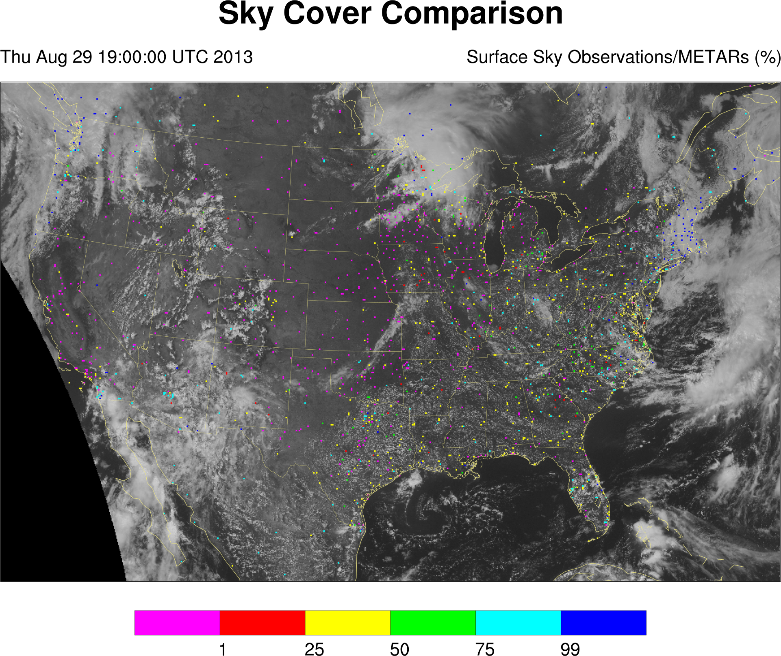

Slide 9
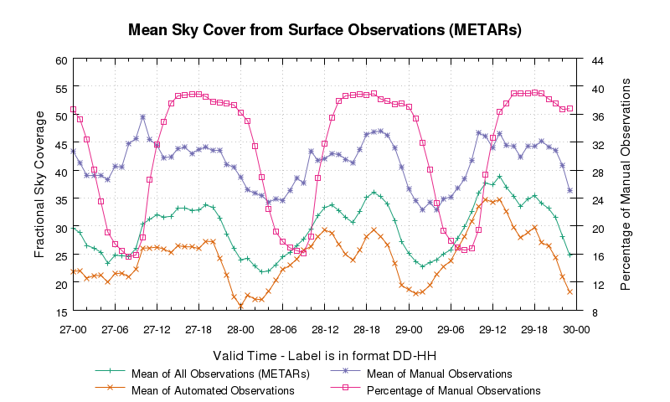

Slide 10
Satellite Sky Cover Product
Based on effective cloud amount obtained from GOES imagers
Corrected when high (low effective emissivity) cloud obscures underlying low cloud
High effective emissivity enhanced
Every scan is spatially averaged to produce an ad hoc celestial dome (pixel-centered 11 x 11 box)
Temporally averaged over a one-hour window

Slide 11
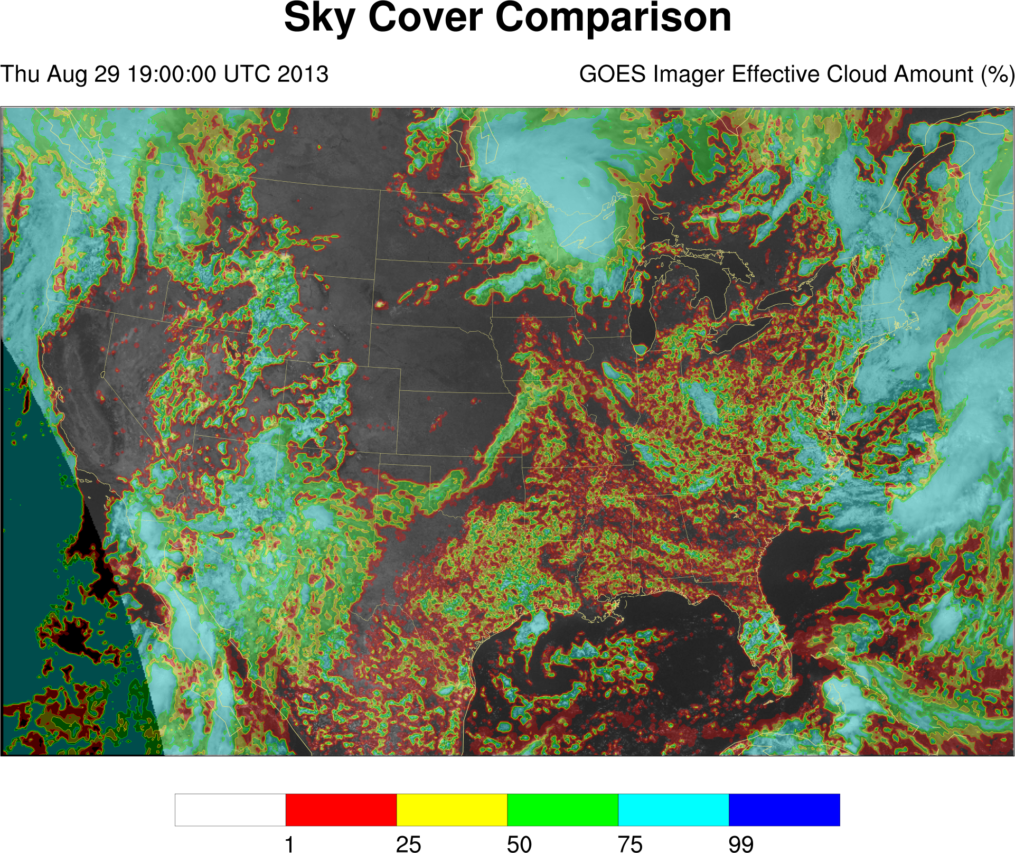

Slide 12
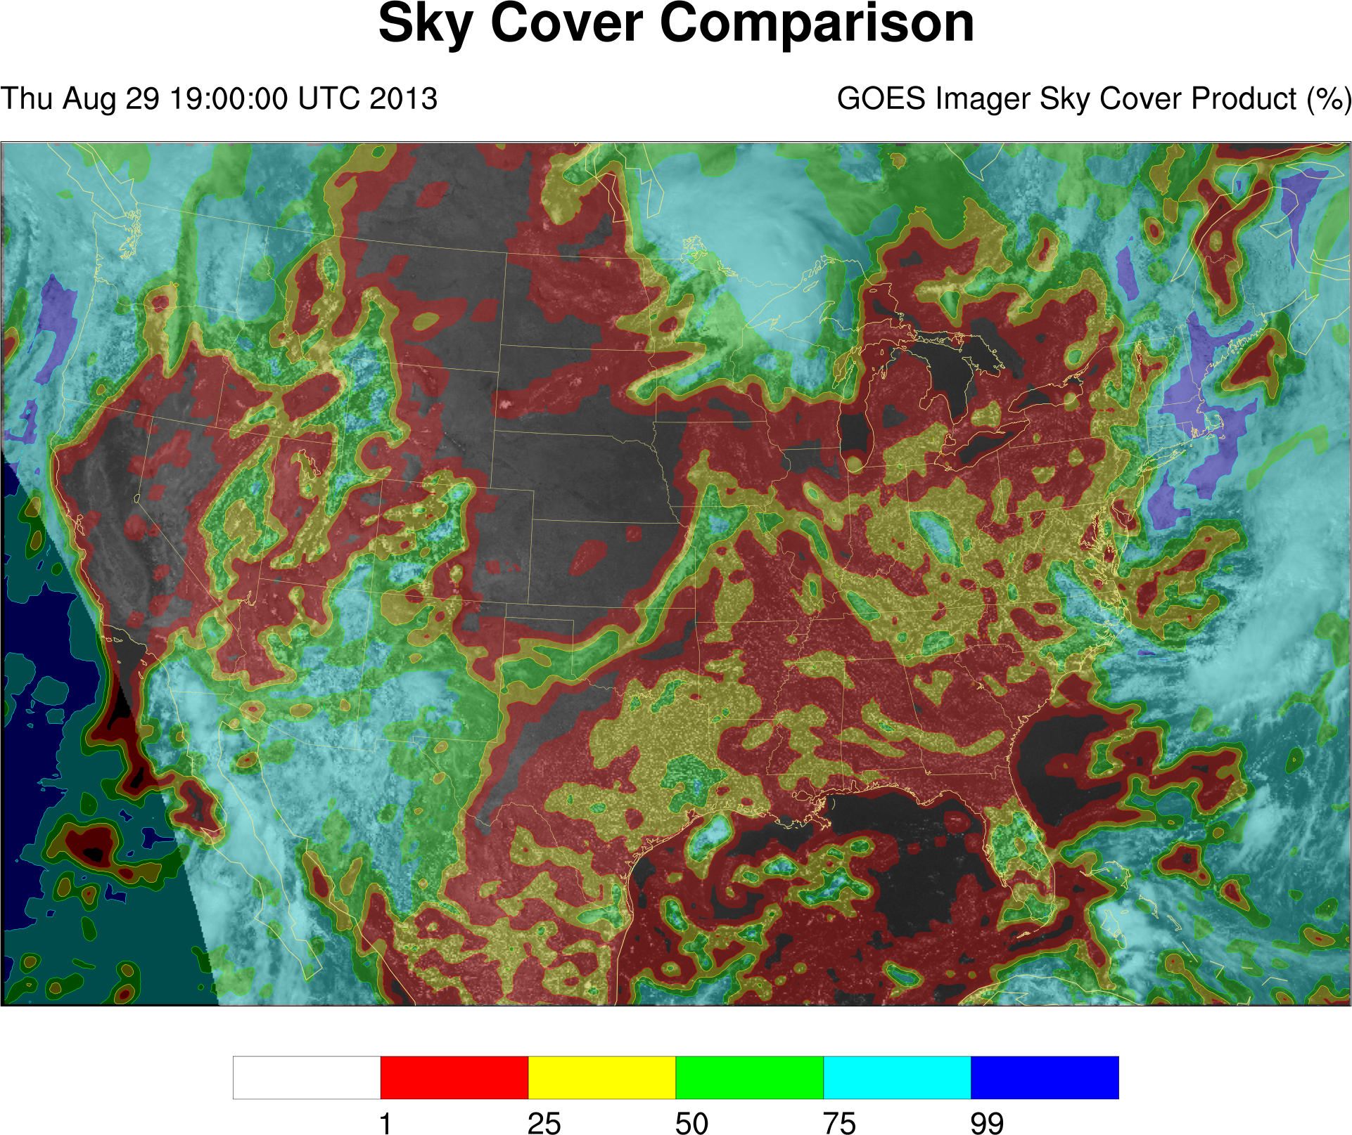

Slide 13
Blended Sky Cover Analysis
If the surface station observation reports clear (less than 5% celestial dome coverage), the satellite sky cover product value is used.
If the surface station observation reports some cloud (5% or better coverage of the celestial dome), the surface observation is used when the value is greater than that from the satellite.
In other situations where both observations are available, a weighted average is performed.

Slide 15
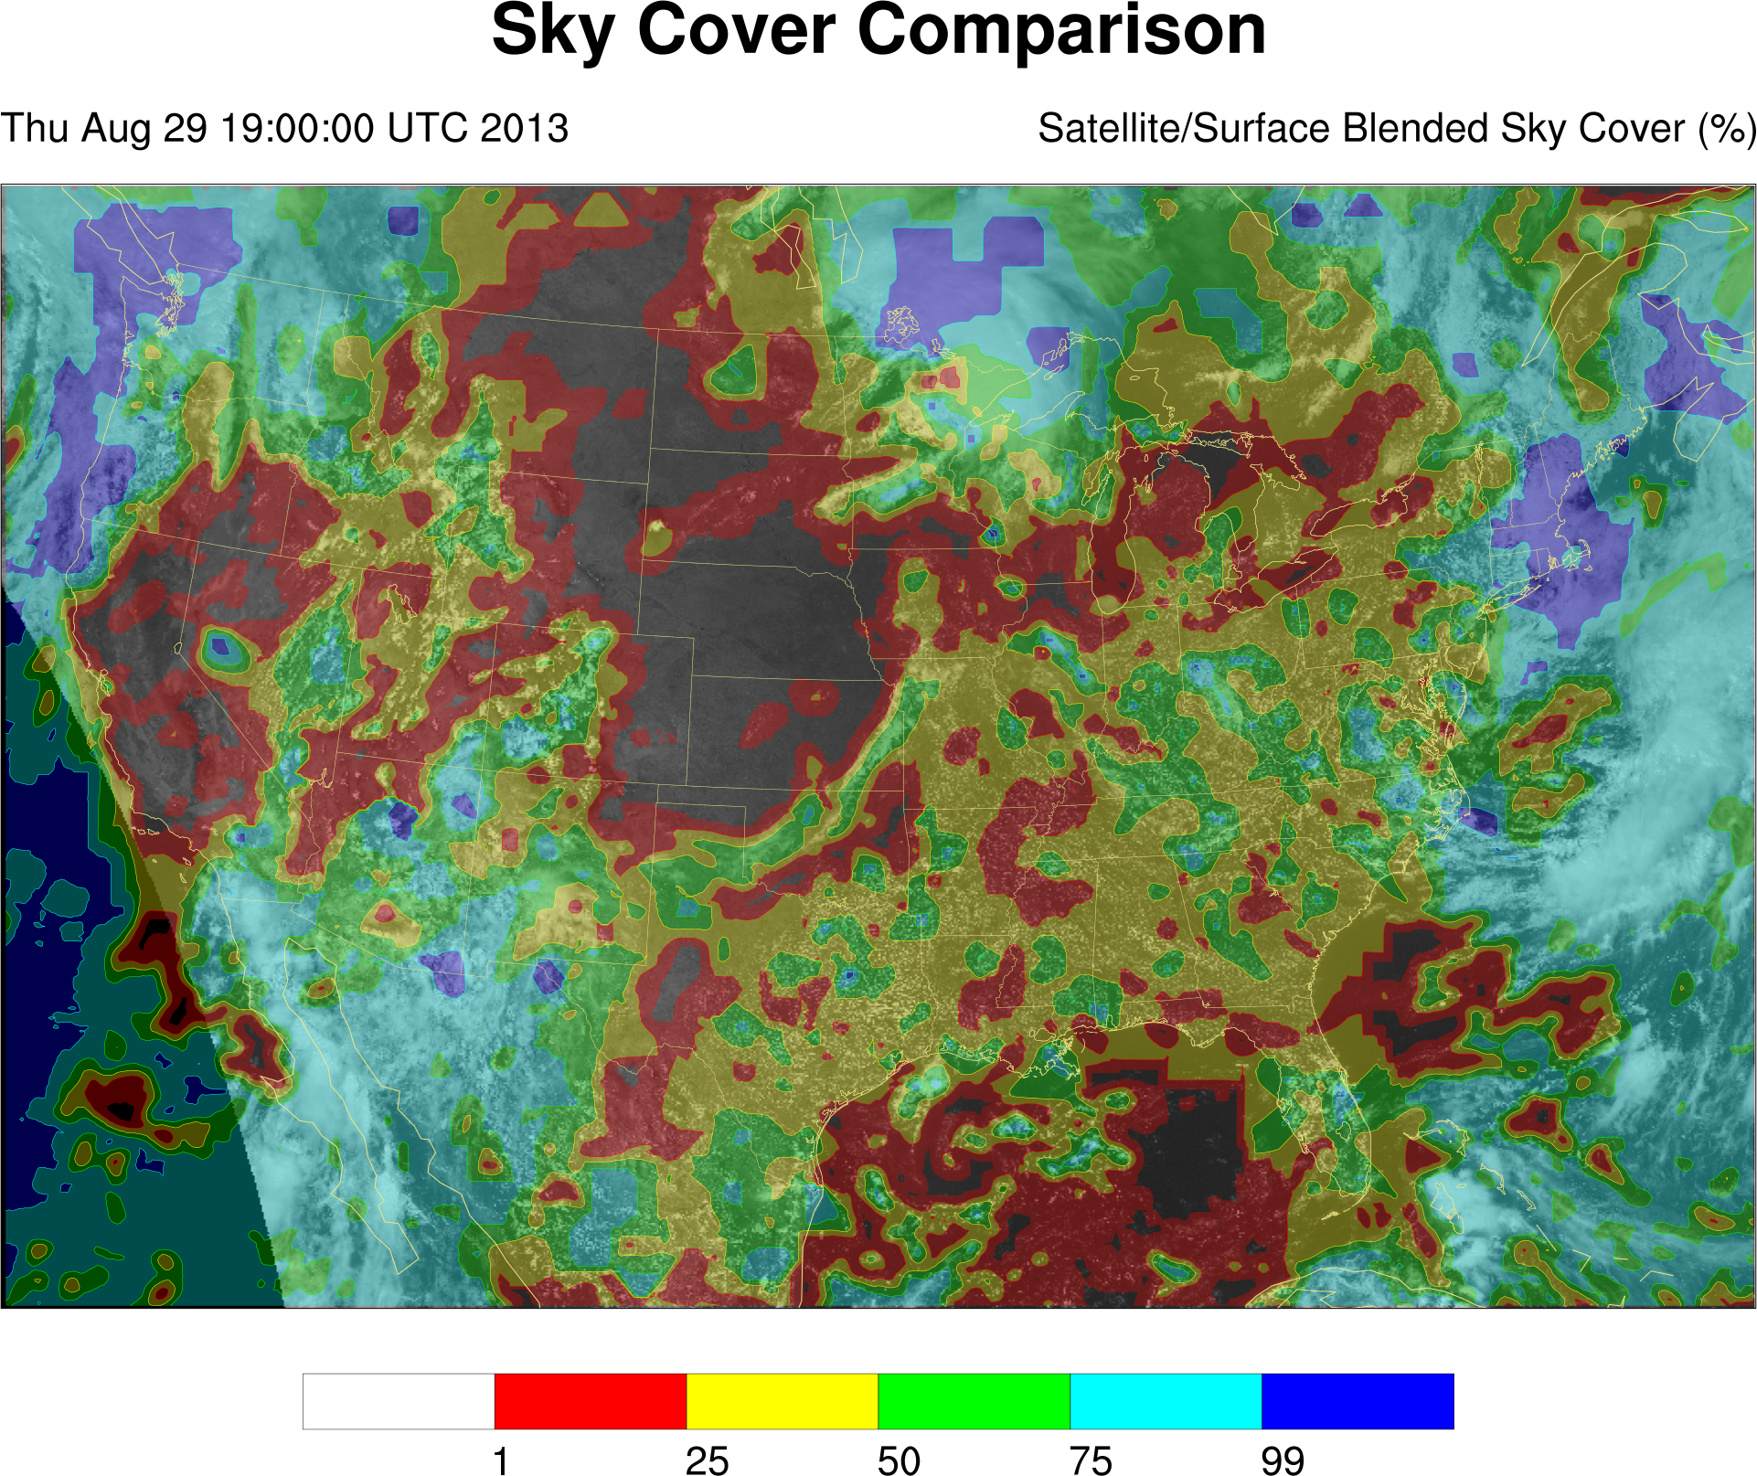

Slide 16
Blended Sky Cover Analysis
The advantages of the blended analysis creation process are that it:
Evaluates all available data and leverages strengths of multiple observational sources
Preserves cloud gradients
Adequately resolves diurnal cumulus fields (not missing, not bimodal)
Is a temporally continuous and spatially contiguous field (available hourly over the contiguous United States)

Slide 17
Create an hourly sky cover analysis based on the following requirements:
Sky cover is an average over an entire hour.
Satellite and in-situ surface observations of cloud are complementary.
The range of the sky cover output is between 0 and 100%.
Create an optimal sky cover forecast based on the following assumptions:
The relationship between sky cover and numerical weather prediction cloud/moisture variables is roughly linear
The model variables adequately represent the atmosphere at the initial time and at times in the future
Objective I
Objective II
Produce an operations-grade sky cover product for the field
Produce an operations-grade sky cover forecast for the field
Goal I
Goal II

Slide 18
Forecasting Sky Cover
The NWS’ National Digital Forecast Database (NDFD) contains the gridded operational forecast for sky cover. Issues with the national one-hour forecast include:
Clear areas with non-zero cloud cover
Vastly different cloud classifications for similar cloud scenes
Lack of spatial continuity between forecast areas
Temporal trends do not match observations

Slide 19
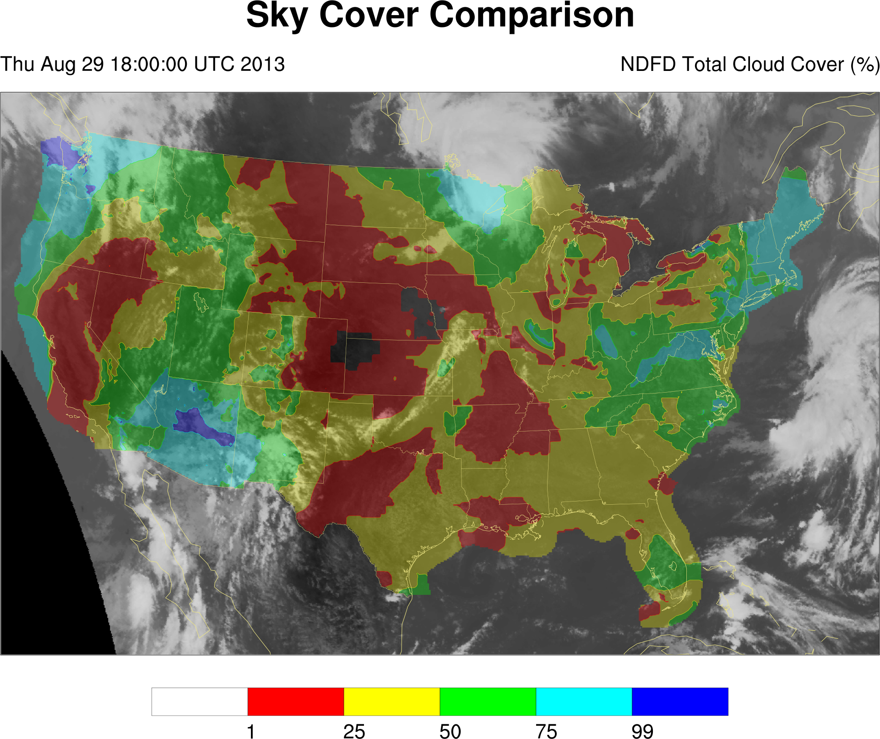

Slide 20
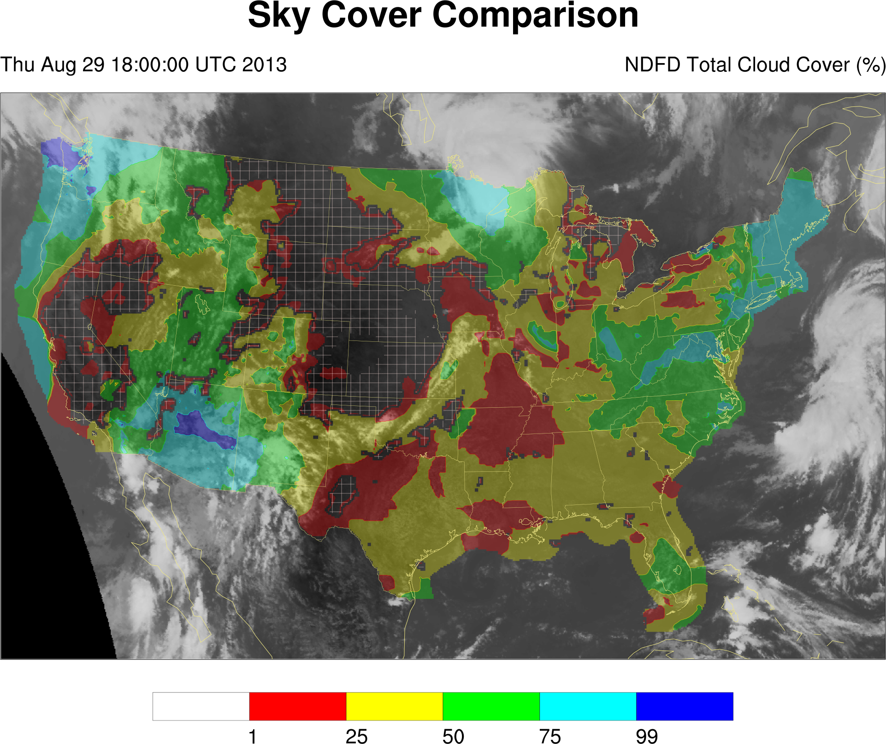

Slide 21
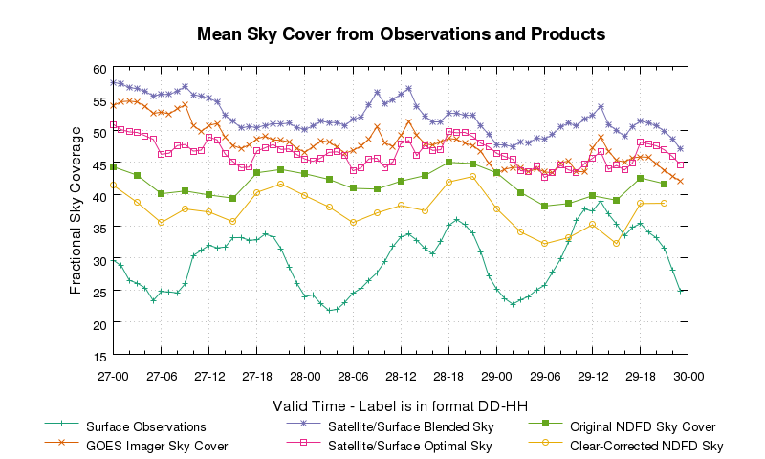

Slide 22
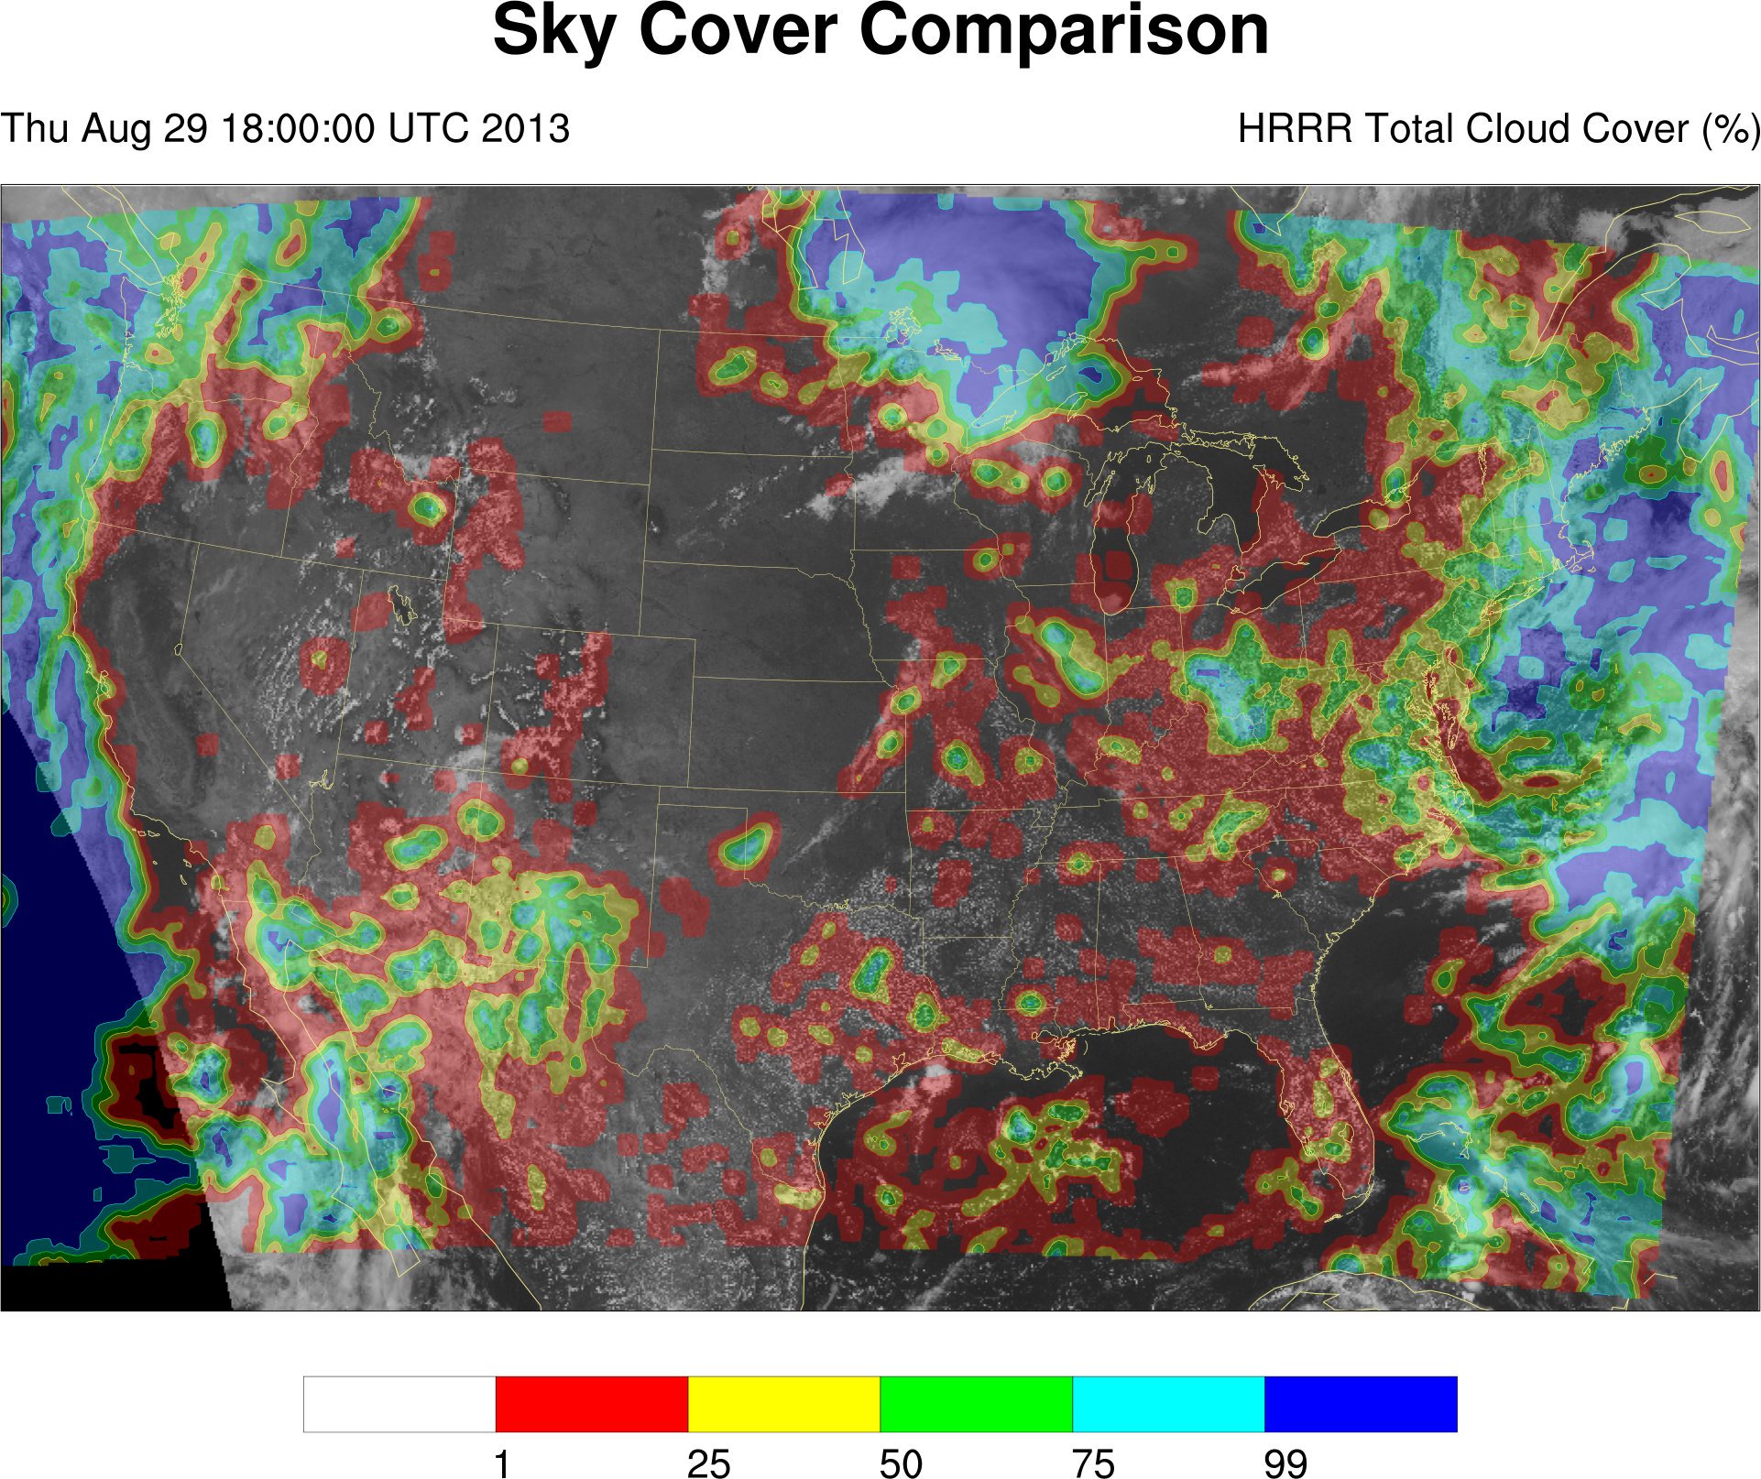

Slide 23
Optimizing Sky Cover
Input fields (subset of points)
Truth: Adjusted blended sky cover analysis
Components
Design model (formats: linear, mixed integer, others)
Objective using free variable, subject to constraint
Terms, matching variables and components
Constraints involving terms
Execute optimizer
Commercial solvers (free for academia)
CPLEX
Gurobi
Open source options (slower)

Slide 24
Optimizing Sky Cover
Components:
Relative Humidity (all levels)
Cloud Water Mixing Ratio, Cloud Ice Mixing Ratio, Rain Water Mixing Ratio, Snow Mixing Ratio (all levels)
Absolute Vorticity (200 hPa only), partitioned into positive and negative components
Pressure levels:
200 hPa
300 hPa
500 hPa
700 hPa
800 hPa
850 hPa
900 hPa
950 hPa
1000 hPa

Slide 25
Optimizing Sky Cover
Optimization objective: Minimize the mean absolute error between the affine expression of adjusted input fields and the truth field
Terms:
Coefficient allowed for 200 hPa positive and negative absolute vorticity (m₂₀₀AV₂₀₀)
Coefficient allowed for relative humidity quantities (m_{x}RH_{x})
Threshold allowed for applying coefficient to 1000 hPa relative humidity field (m₁₀₀₀RH₁₀₀₀ if RH₁₀₀₀ > RH_{T})
Coefficient and scalar allowed for non-zero mixing ratio quantities (m_{y}MR_{y}+b_{y} if MR_{y} > 0, otherwise m_{y}MR_{y})

Slide 26
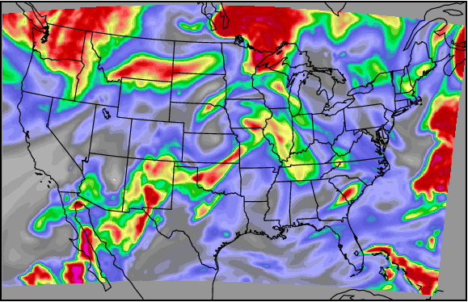
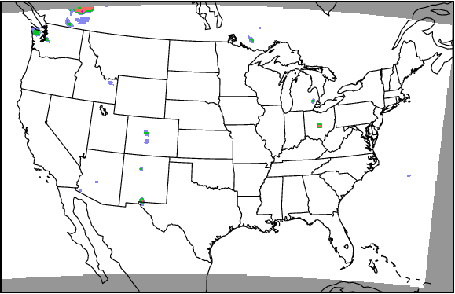
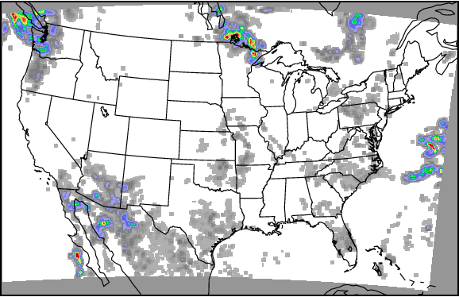
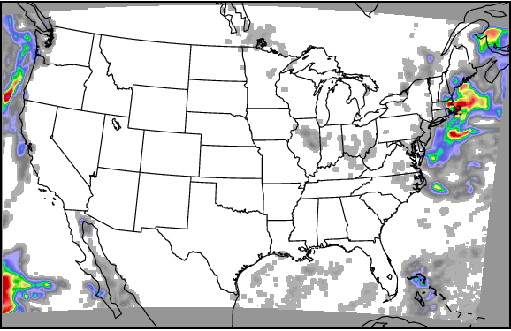
300 hPa Relative Humidity
500 hPa Cloud Ice Mixing Ratio
700 hPa Cloud Water Mixing Ratio
950 hPa Cloud Water Mixing Ratio

Slide 27
Optimizing Sky Cover
Constraints:
Enforce physical relationships
Range of acceptable values (0 to 100)
Extent of relative humidity and absolute vorticity correlating to cloud
Enforce thresholds (mixed integer)
Maintain mean and approximate value distribution of output field to similarly match truth field
Guide optimizer
Away from scalar adjustments, toward coefficient adjustments (maintain spatial gradients)

Slide 28
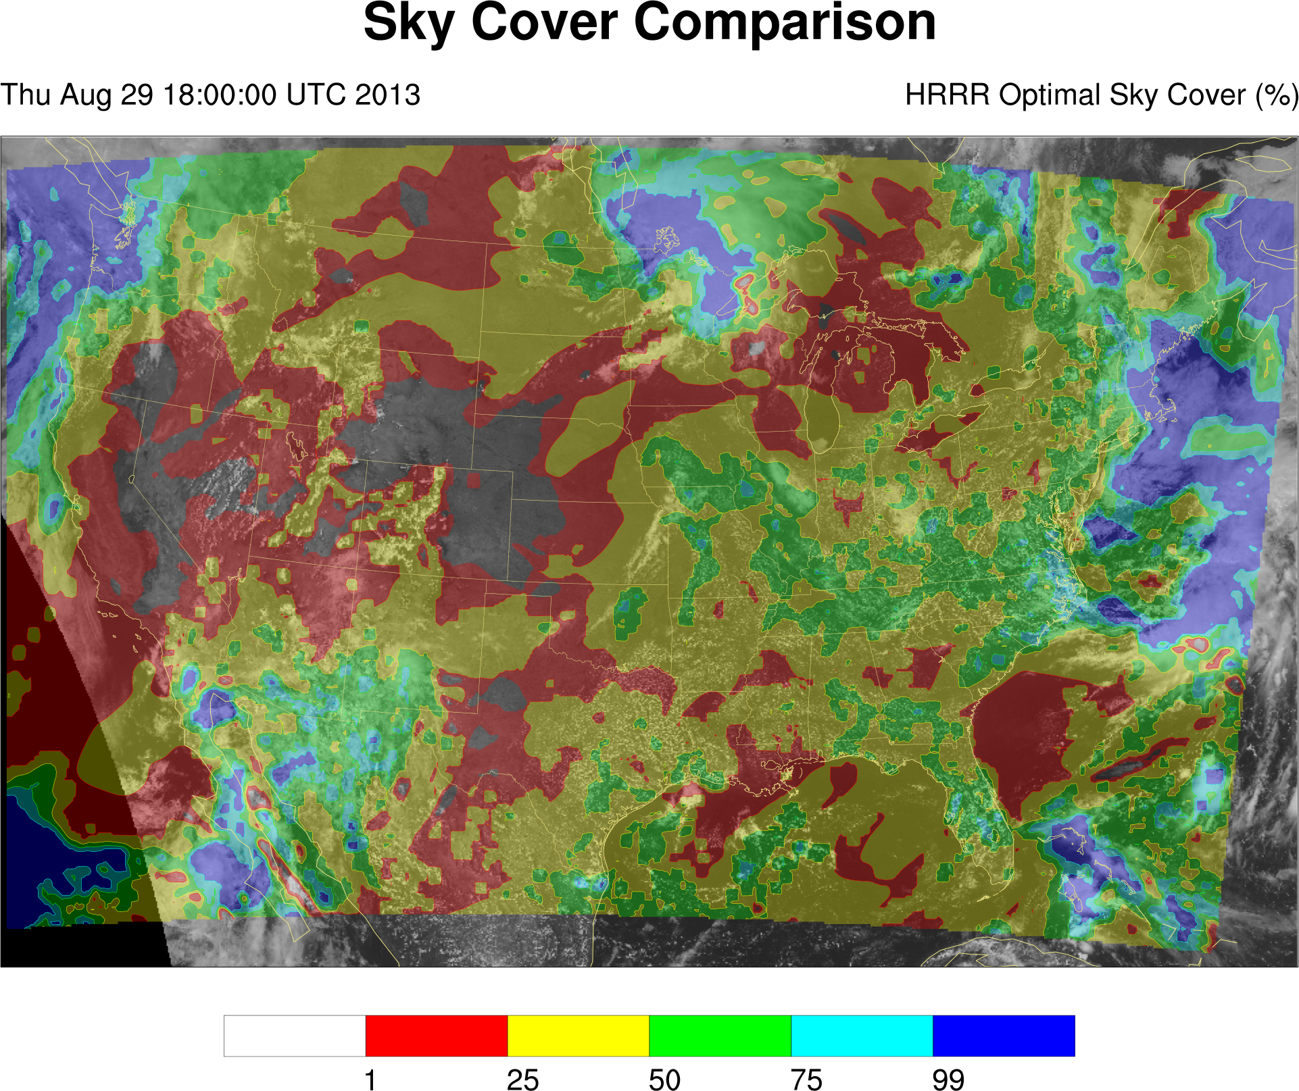

Slide 29
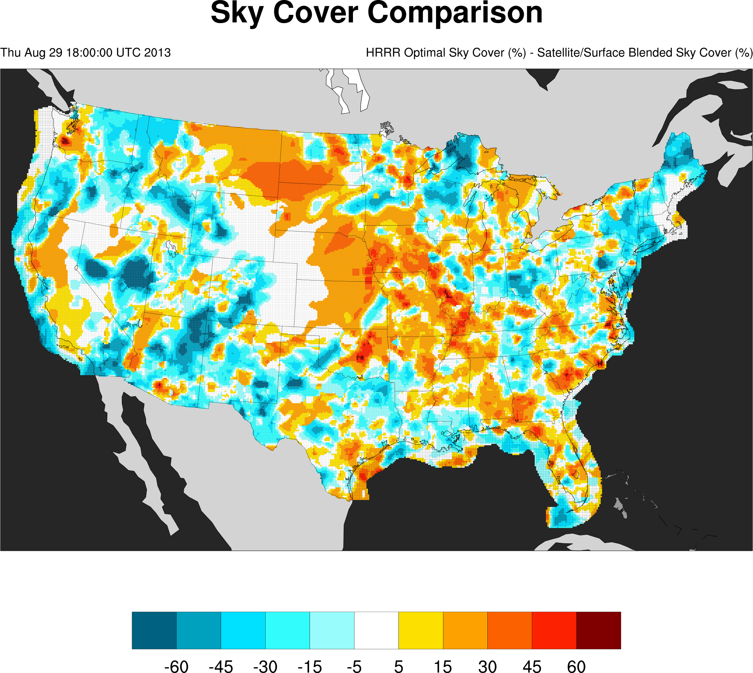
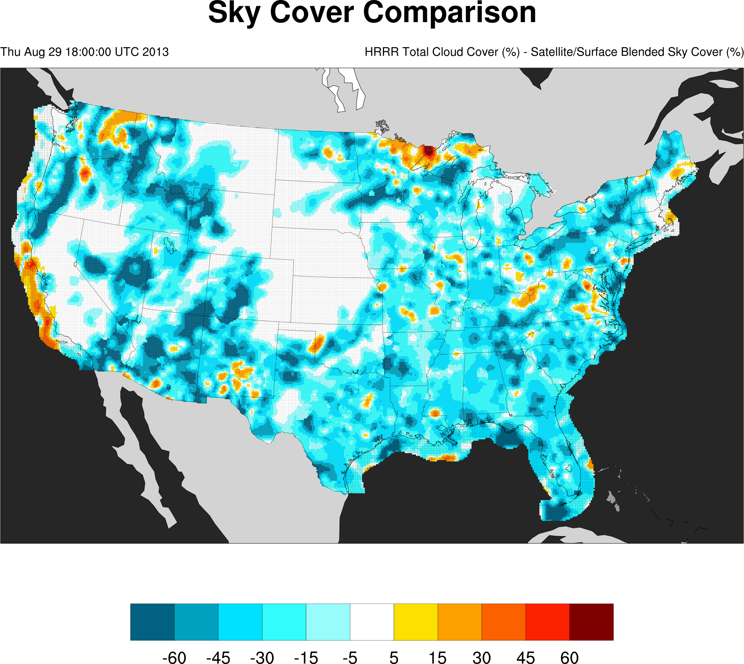

Slide 30
Preliminary Results

Slide 31
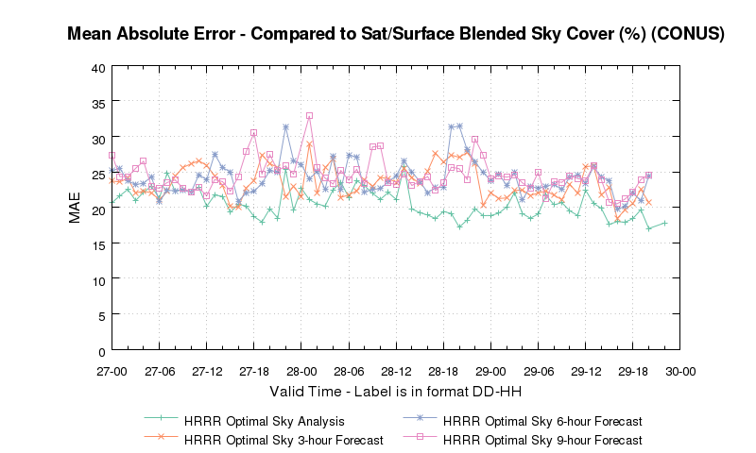
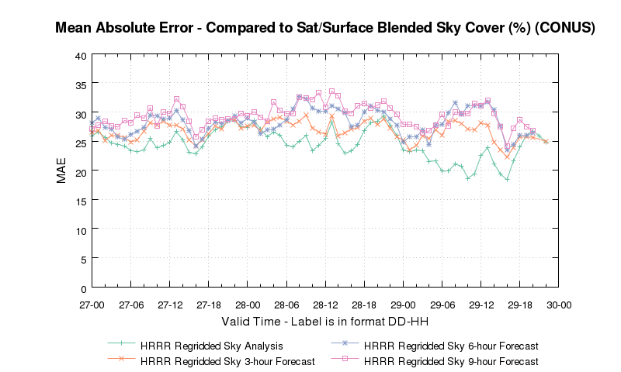
Optimizing Sky Cover
20
20
Preliminary Results

Slide 32
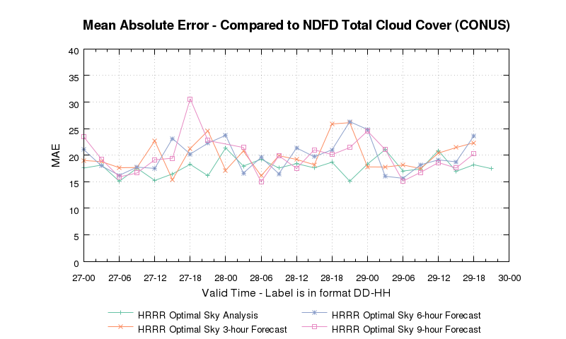
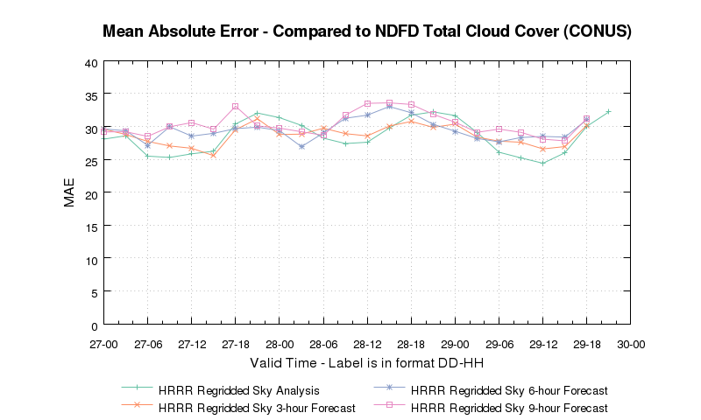
Optimizing Sky Cover
20
20
Preliminary Results

Slide 33
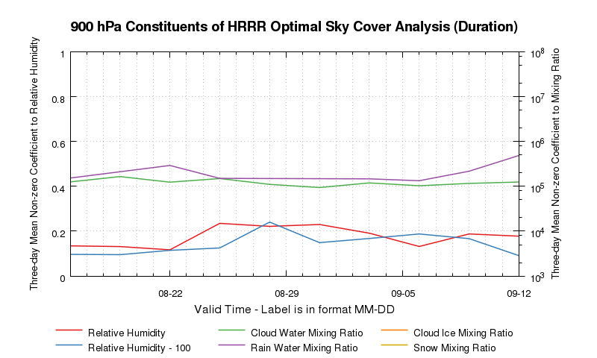
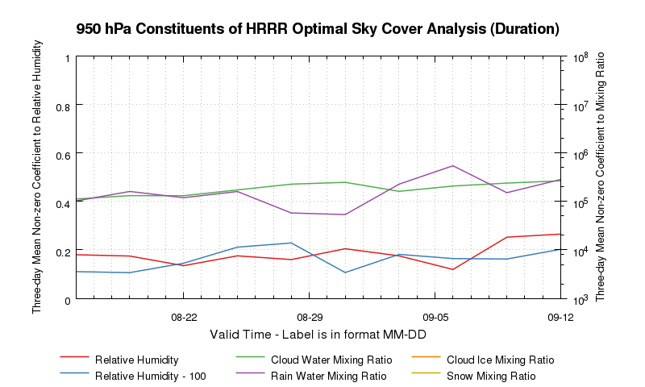
Optimizing Sky Cover
Preliminary Results

Slide 34
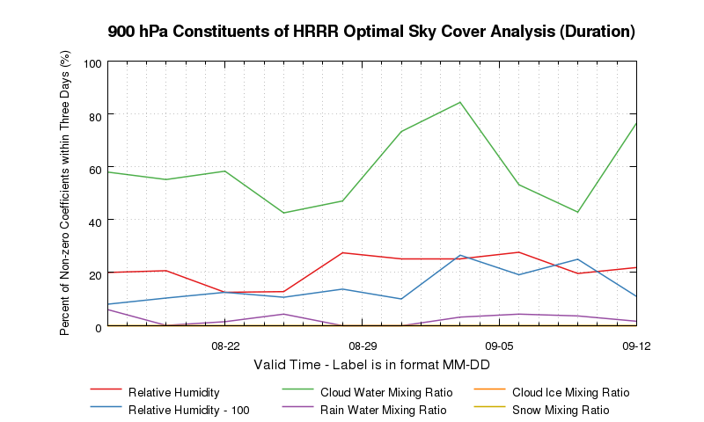
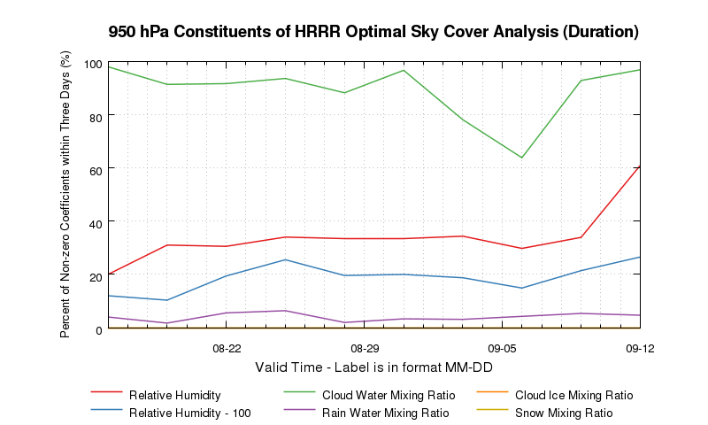
Optimizing Sky Cover
Preliminary Results

Slide 35
Preliminary Results
Results are from 13 August to 12 September 2013 over the United States.
950 hPa cloud water mixing ratio is the most frequently selected field in the solved affine relationship.
Cloud water mixing ratio from one or more levels in the lower troposphere is frequently correlated with sky cover.
Higher in the troposphere, there is less reliance on cloud water mixing ratio and more reliance on relative humidity.
Snow mixing ratio and rain mixing ratio are not commonly included in optimized formulations.
Indicates limited model skill on placement of summertime precipitation processes in input prediction model

Slide 36
Summary
An hourly blended sky cover analysis was produced using multiple sources of sky cover observations.
Depending on the dataset, the mean value of all observations varies.
Surface observations are the clearest.
The adjusted analysis was used to build better numerical weather prediction model output of sky cover, using an optimization methodology.
The new model output compared to the adjusted analysis (truth) and NDFD one-hour forecast consistently has less mean absolute error than the original/current output.
Future work will focus on the short-term forecasts.

Slide 37
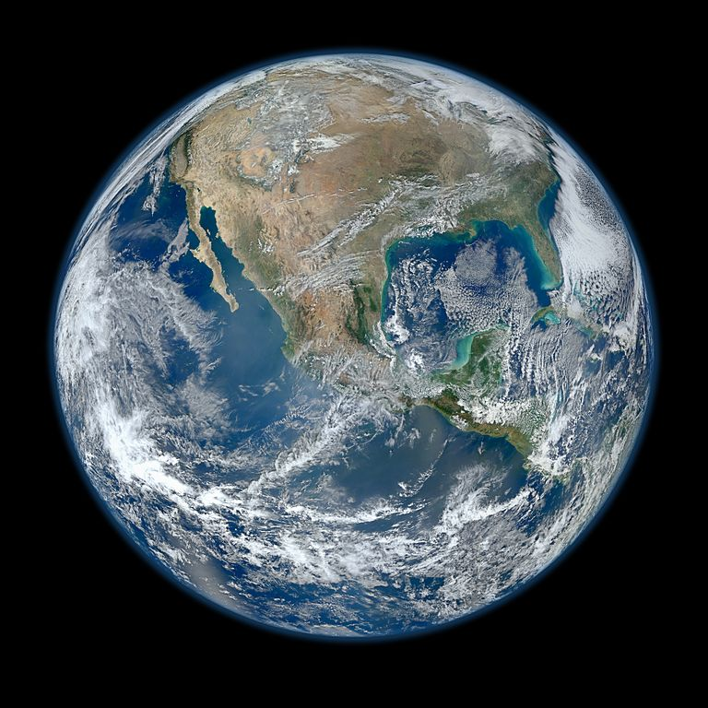
Questions? Comments?
E-mail: Jordan Gerth, Jordan.Gerth@noaa.gov
Notes:
http://visibleearth.nasa.gov/view.php?id=78314

