Slide 1
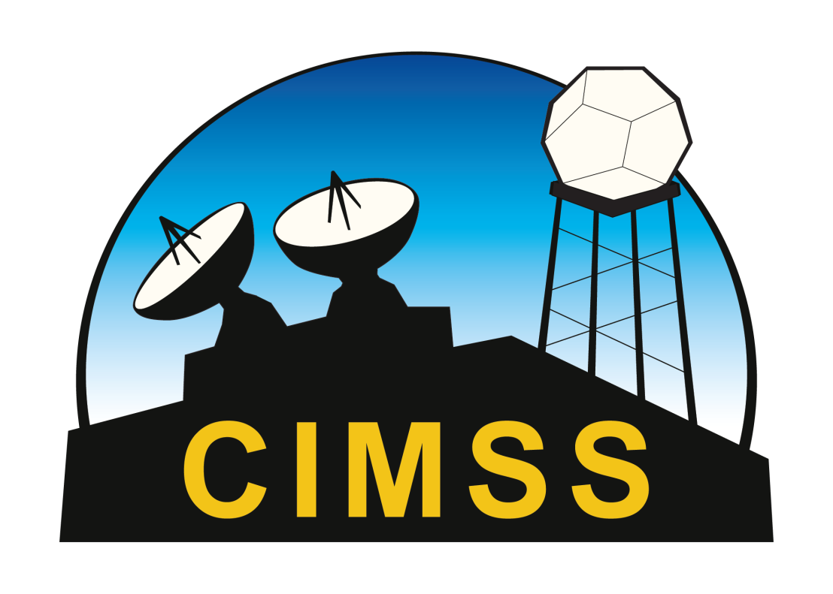
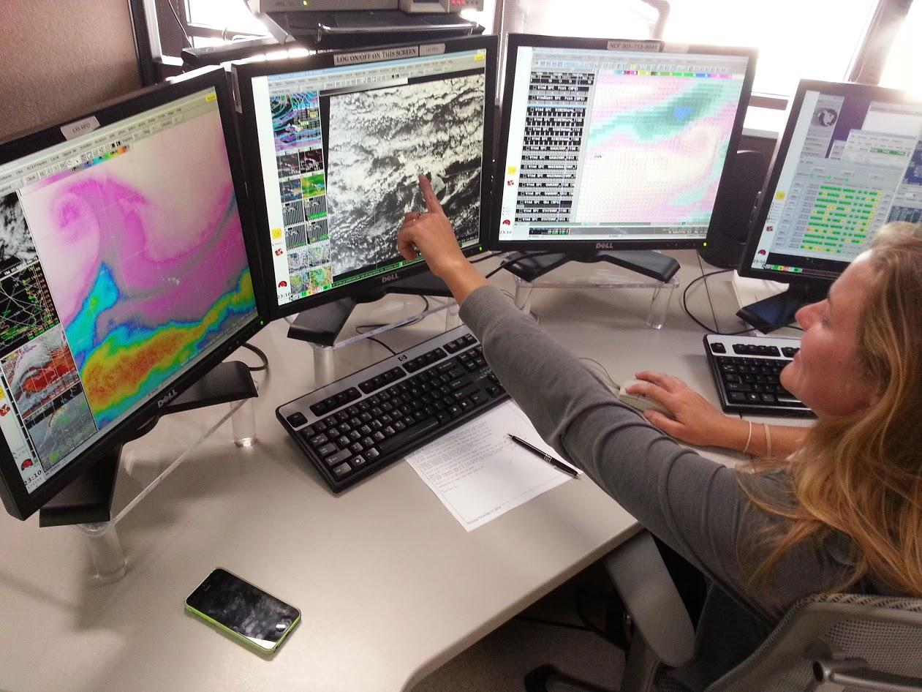
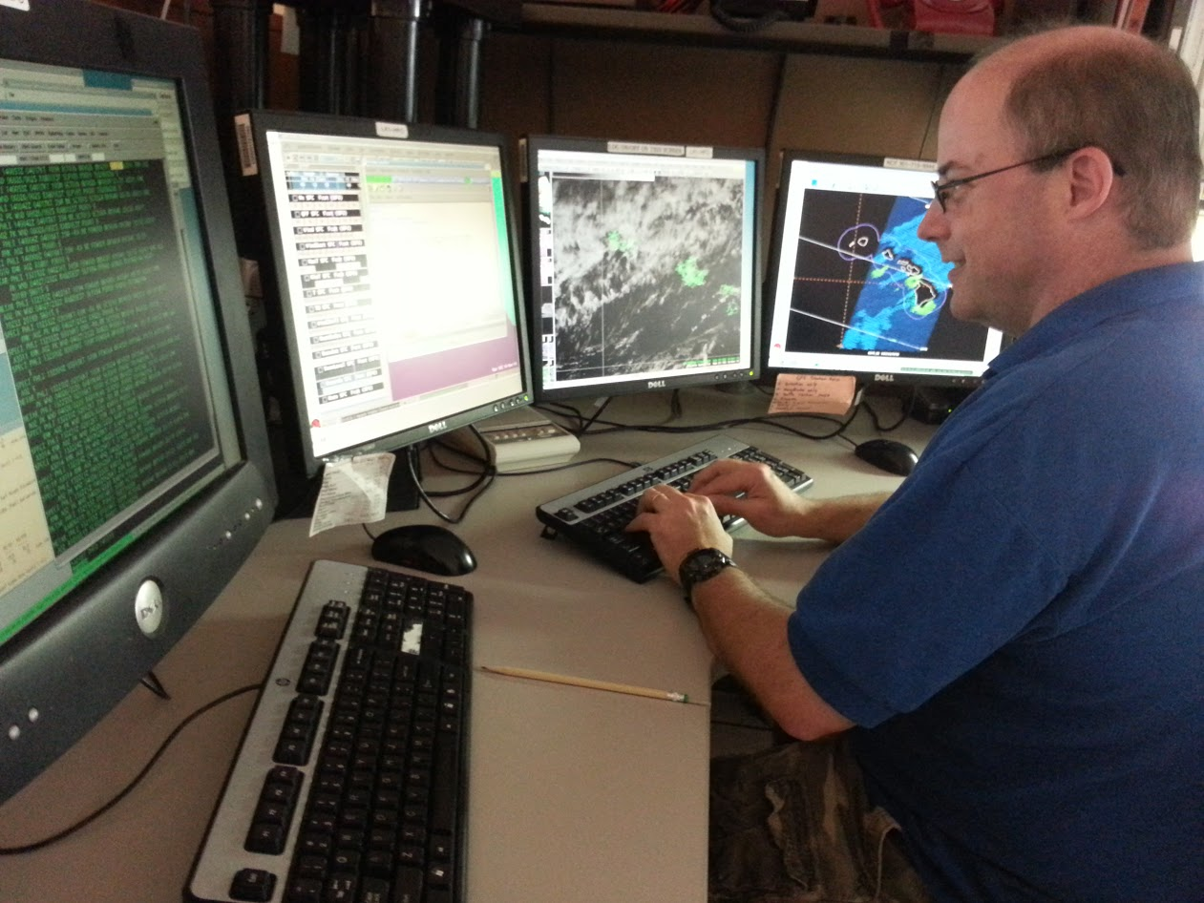
R2-Whoa
Jordan J. Gerth
Cooperative Institute for Meteorological Satellite Studies (CIMSS) Space Science and Engineering Center (SSEC), University of Wisconsin at Madison
Challenges and solutions for executing best practices in transferring NOAA’s research to NWS operations (825)
Jordan.Gerth@noaa.gov
@jjgerth
Oversight and Strategic Direction
Challenge
Risks
Centralizing priorities and developing a consistent vision for NOAA’s agencies, cooperative institutes, and private partners to function effectively
Lack of alignment between research portfolio and operational requirements
Delayed R2O process resulting from funding cycle
Operational Demonstrations
Solutions
Research Proposals
Appoint a coordinator of proving ground activities
Joint governance between the NWS Operational Advisory Team (NOAT) and research community
Assuring operational meteorologists stay current with subject-matter expertise in satellite remote sensing
Integrating new satellite products into the operational workflow
Collecting relevant feedback
Providing a pathway to operations following a successful demonstration
Does not necessarily replicate operational setting
Potential for inadequate training and misinformation
Unclear responsibility for integrating demonstrated products into software systems
Employ satellite liaisons to facilitate training exercises and work with operations to prepare meteorologists for capabilities of the new generation weather satellites
Hire technical liaisons and fund cooperative institutes to develop plug-ins for the Advanced Weather Interactive Processing System (AWIPS)
Building relationships with operations to discover worthy research topics
Understanding types of information that would add value to the operational mission
Developing an algorithm for a new instrument based on current capabilities
Maintaining an algorithm and/or product following completion of the original proposal
Funding research activities that do not return value to operations
Operationally-relevant research proposals with scientific merit may go unfunded if importance to operations is unclear or understated
Hold technical interchange meetings and working groups with both operational and research participants
Use proxy and simulated imagery from existing instruments and/or numerical models
Challenges
Challenges
Risks
Risks
R2-No – Popular Excuses
Solutions
Tight Budgets
Necessitate prioritization of products to transition
Rigid Policies
Impede R2O progress and agility
No Personnel on the Interface
No process owner to facilitate the “2” in R2O
Limited IT Infrastructure
Delays implementation of new products in the field
Cumbersome IT Security Regulations
Compromise the mission
Solutions

