Slide 1
Sky Cover
Ph.D. Defense
Jordan J. Gerth
18 December 2013

Slide 2
Special Thanks
Robert Aune
Jeffrey Craven
Andrew Heidinger
James Nelson III
Timothy Schmit
Anthony Schreiner

Slide 3
Motivation
Clouds, cloud evolution, and cloud feedbacks are
Correlated with
Radiation
Latent Heating
Temperature
Moisture
Precipitation Processes and Efficiency
Aerosols
Parameterized in climate and short-term weather prediction models

Slide 4
Motivation
“Cloud Feedbacks in the Climate System: A Critical Review” (G. Stephens 2005)
Global circulation and numerical weather prediction models are weakened through the use of cloud parameterizations.
Cloud parameterizations are built on assumptions and empirical formulations that are difficult to evaluate.
Using observational methods to assess the performance of cloud parameterizations is “important element in the road map to progress.”
“The blueprint for progress must follow a more arduous path that requires a carefully orchestrated and systematic combination of model and observations.”

Slide 5
Problem Statement
Problem: There is the lack of an observational method through which to verify the behavior of cloud parameterizations in climate and weather models, which are useful in examining cloud feedbacks.
There are two parts to solving this problem.
Produce a sky cover analysis which is representative of current conditions and suitable for use as validation
Determine the relationship between sky cover as purported by the analysis and related atmospheric quantities in a cloud-resolving model

Slide 6
Objective
What
Improve the analysis and short-term forecasts of sky cover across the continental United States, Hawaii, and adjacent coastal areas using geostationary satellite and in-situ surface observations
Understand relationship between sky cover and atmospheric quantities
How
Use linear and/or mixed integer optimization to minimize the mean absolute difference between multi-source sky cover observations and short-term numerical weather prediction forecasts of cloud and moisture variables

Slide 7
Defining Sky Cover
The Federal Meteorological Handbook (FMH) No. 1 defines sky cover as “the amount of the celestial dome hidden by clouds and/or obscurations”.
The National Weather Service (NWS) defines sky cover as “amount of opaque clouds (in percent) covering the sky” over a one-hour period.
The NWS produces their routine sky cover forecast as part of the National Digital Forecast Database (NDFD).
Notes:
http://www.ofcm.gov/fmh-1/pdf/I-CH9.pdf

Slide 8
Defining Sky Cover
Effective cloud amount (ECA), the product of fractional cloud cover within the field of view (FOV) and cloud emissivity, is the most common method to assess sky cover from satellite observations.
The Real-Time Mesoscale Analysis (RTMA) uses an ECA composite from the GOES Sounders as a sky cover analysis.

Slide 9
Observing the Sky
There are three primary types of sky observations:
Space-based imagers (i.e., radiometers onboard low earth-orbiting and geostationary satellites)
Stationary, surface-based instrumentation (e.g., ceilometers)
Trained human observer

Slide 10
In-Situ Observations
If a surface station reports cloudy, it’s cloudy.
Strengths:
Temporal availability
High detectability for low cloud (under 12 kft)
Weaknesses:
Spatial availability
Precision (five coverage categories)
Poor detectability of high cloud, particularly overnight
Automated equipment uses temporal average of detections at fixed point

Slide 11
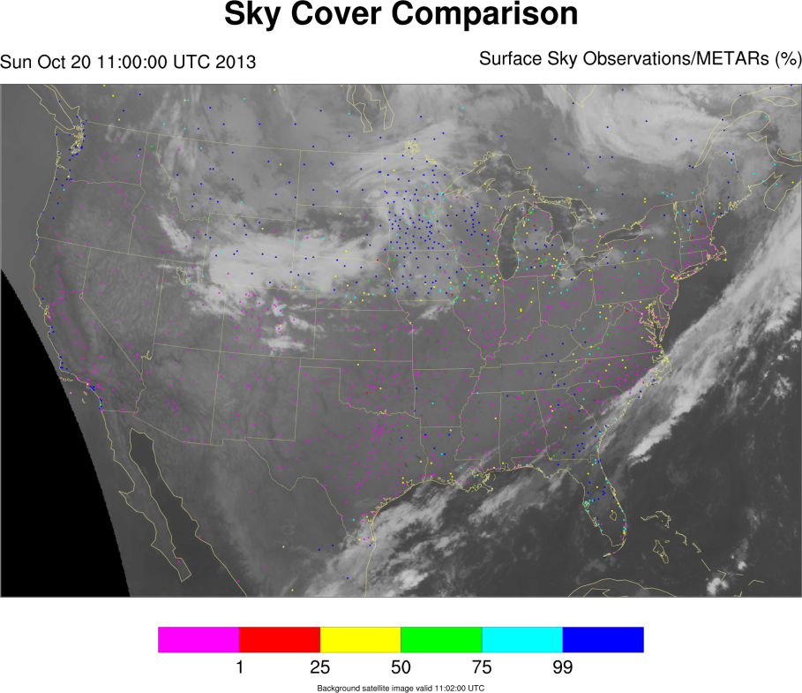

Slide 12
Satellite Observations
Strengths:
Spatial and temporal coverage (geostationary)
Daytime cloud detectability
Weaknesses:
High cloud (ice cloud) masking low cloud (water cloud)
Stray light (sunlight entering optics overnight resulting in artificially inflated shortwave bands)
Fog or low cloud where infrared brightness temperatures do not vary substantially from background land or water surface (nighttime)

Slide 13
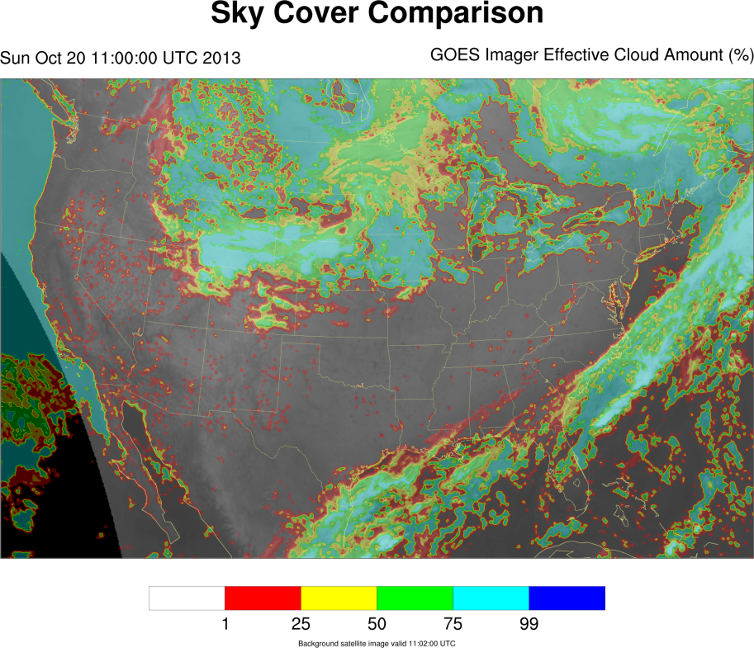

Slide 14
ECA to Sky Cover Product
Start with Effective Cloud Amount
For each imager (GOES-East and GOES-West) scan, create the celestial dome at each point
Average of the standard effective cloud emissivity within a box of 11 by 11 pixels, centered on each grid point
Apply corrections if necessary
Ice (low emissivity) cloud above water (high emissivity) cloud
Overcast scenes
Combine all imager scans from both satellites within a one-hour window and average (equal weight for each scan)
Notes:
One correction addresses thin high cloud above thick low cloud. In such situations, the GOES Imager ECA product output is the value for the high thin cloud, producing a sharp gradient in the ECA product despite a uniform lower cloud deck. To resolve this inconsistency, the Celestial Dome ECA is the product of the cloud fraction and cloud probability when:
Cloud emissivity is less than 50%,
Cloud fraction is greater than 95%,
Cloud probability is greater than 95%, and
Cloud type is opaque ice, cirrus, overlap, or overshooting.
Another correction addresses Celestial Dome ECA values of less than 100% for overcast scenes. In such situations, where the spatial standard deviation of the Celestial Dome ECA is less than 2.50, and the percent of liquid water clouds is above 95%, the Celestial Dome ECA is set to 100%. For each pixel, the spatial standard deviation is taken over the same 11 x 11 pixel box as used to produce the initial Celestial Dome ECA value.

Slide 16
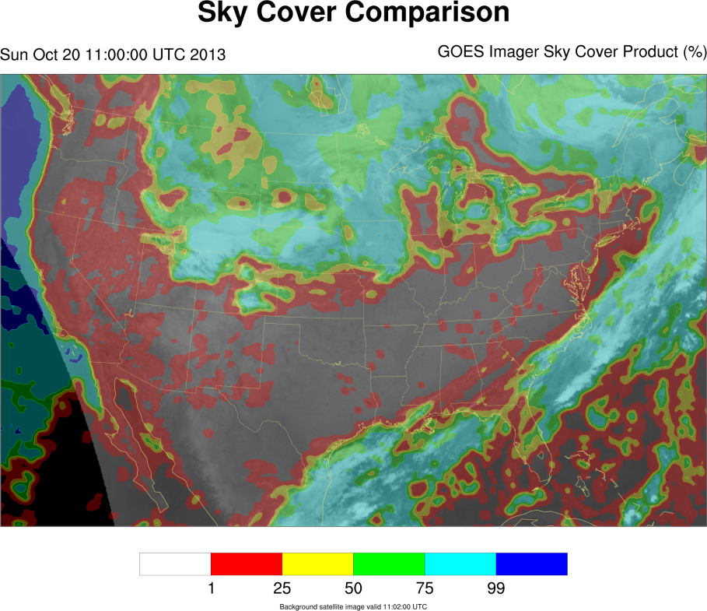

Slide 17
Blended Sky Cover Analysis
Where the observation of sky cover from the surface is clear, the blended analysis will assume the value from the satellite sky cover product depending on the corresponding satellite cloud top pressure (CTP). If the CTP value is sufficiently high (low cloud), then the satellite cloud detection is considered false.
Otherwise, if the value of the nearest surface observation of sky cover is greater than that of the satellite sky cover product, the sky cover value of the surface observation is used in the blended analysis.
In other instances where both observations are available, a weighted average is performed.

Slide 18
Blended Sky Cover Cases
Satellite Observation at Test Point | Satellite Observation at Closest Surface Station | Surface Observation at Closest Site | Blended Result
Clear | Clear | Clear | Clear
Clear | Clear | Cloudy | Cloudy
Clear | Cloudy | Clear | Clear/Satellite
Clear | Cloudy | Cloudy | Clear
Cloudy | Clear | Clear | Cloudy/Satellite
Cloudy | Clear | Cloudy | Cloudy
Cloudy | Cloudy | Clear | Cloudy/Satellite
Cloudy | Cloudy | Cloudy | Cloudy

Slide 19
Blended Sky Cover Cases
Satellite Observation at Test Point | Satellite Observation at Closest Surface Station | Surface Observation at Closest Site | Blended Result
Clear | Cloudy | Cloudy | Clear
Cloudy | Clear | Clear | Cloudy/Satellite
These cases occur when there is a spatial gradient in the sky cover.

Slide 20
Blended Sky Cover Cases
Satellite Observation at Test Point | Satellite Observation at Closest Surface Station | Surface Observation at Closest Site | Blended Result
Clear | Clear | Cloudy | Cloudy
This case occurs when the cloud is indistinguishable from the underlying or surrounding land or water surface, generally during overnight hours. This result is common in scenes involving low cloud.

Slide 21
Blended Sky Cover Cases
Satellite Observation at Test Point | Satellite Observation at Closest Surface Station | Surface Observation at Closest Site | Blended Result
Cloudy | Clear | Clear | Cloudy/Satellite
Cloudy | Cloudy | Clear | Cloudy/Satellite
These cases occur when there is high cloud at both the test site and closest surface station, which is above the height of detectability for ceilometers.

Slide 22
Blended Sky Cover Cases
Satellite Observation at Test Point | Satellite Observation at Closest Surface Station | Surface Observation at Closest Site | Blended Result
Clear | Cloudy | Clear | Clear/Satellite
This case occurs when there is high cloud at the closest surface station, which is above the height of detectability for ceilometers, but not at the test point. This is a spatial gradient in sky cover resulting from high cloud.

Slide 24
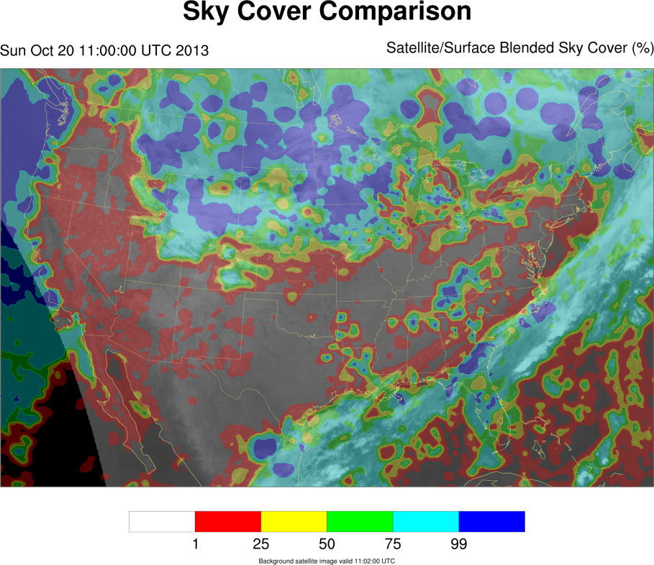

Slide 25
Value of Multiple Sources
Each panel in the three-panel plot is valid at 11 UTC on 20 October 2013.
The left panel shows the estimated sky cover from the GOES-West imager. The middle panel shows the point surface observations (both manual and automated). The right panel shows the blended product, using both satellite and in-situ observations (as shown In the two leftmost plots).

Slide 26
Case Study
Notes:
For high sky cover amounts (mostly cloudy skies) at points of the GOES Imager Sky Cover Product, the blended analysis is often an increase over that amount.

Slide 27
Case Study
Notes:
There is generally poor correspondence between the GOES Imager Sky Cover Product and surface observations of sky cover. However, the GOES Imager Sky Cover Product is still a significant contributor to the blended analysis.

Slide 28
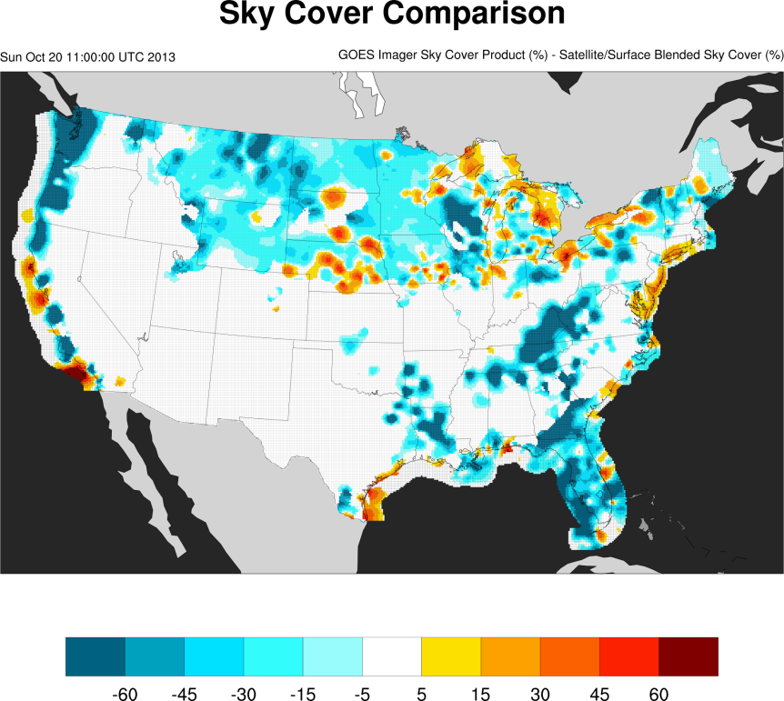

Slide 29
Blended Sky Cover Analysis
The advantages of the blended analysis creation process are that it:
Evaluates all available data and leverages strengths of multiple observational sources
Preserves cloud gradients
Adequately resolves diurnal cumulus fields (not missing, not bimodal)
Is a temporally continuous and spatially contiguous field (available hourly over the contiguous United States)

Slide 30
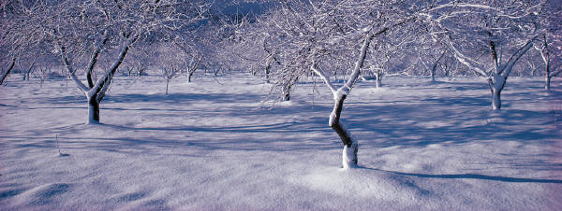
Influence of Snowpack on Blended Sky Cover Analysis
Case Study from 12 December 2013 and 13 December 2013

Slide 31
12 December 2013, 18 UTC
Other than along the snowpack edge, the satellite sky cover product does not contain false cloud detections over or near the snowpack.
The surface observations add detail to the blended analysis and add cloud cover where the satellite sky cover product does not indicate such.
Surface Observations of Sky Cover
Satellite Sky Cover Product
Blended Sky Cover Analysis

Slide 32
13 December 2013, 6 UTC
Surface Observations of Sky Cover
Satellite Sky Cover Product
Blended Sky Cover Analysis

Slide 33
13 December 2013, 6 UTC
Increase in blended analysis amounts due to inclusion of surface observations
Surface Observations of Sky Cover
Satellite Sky Cover Product
Blended Sky Cover Analysis

Slide 34
13 December 2013, 6 UTC
Satellite-detected high cloud over snowpack maintained in blended analysis
Surface Observations of Sky Cover
Satellite Sky Cover Product
Blended Sky Cover Analysis

Slide 35
13 December 2013, 6 UTC
?
?
?
Cloud detectability in isothermal troposphere over snowpack is challenging
Surface Observations of Sky Cover
Satellite Sky Cover Product
Blended Sky Cover Analysis

Slide 36
Comparison to CALIOP
Compared
Clear (0%) satellite sky cover product points
Valid between 18 UTC and 19 UTC on 4 October 2013
To corresponding CALIOP observations
Taken between 17 UTC and 20 UTC on 4 October 2013
Not converted to celestial dome
Considered clear of cloud when column feature fraction is zero or no cloud feature flag
94% in agreement (clear matched clear); 6% not in agreement (clear matched non-clear)
Notes:
CALIOP is Cloud-Aerosol Lidar with Orthogonal Polarization

Slide 37
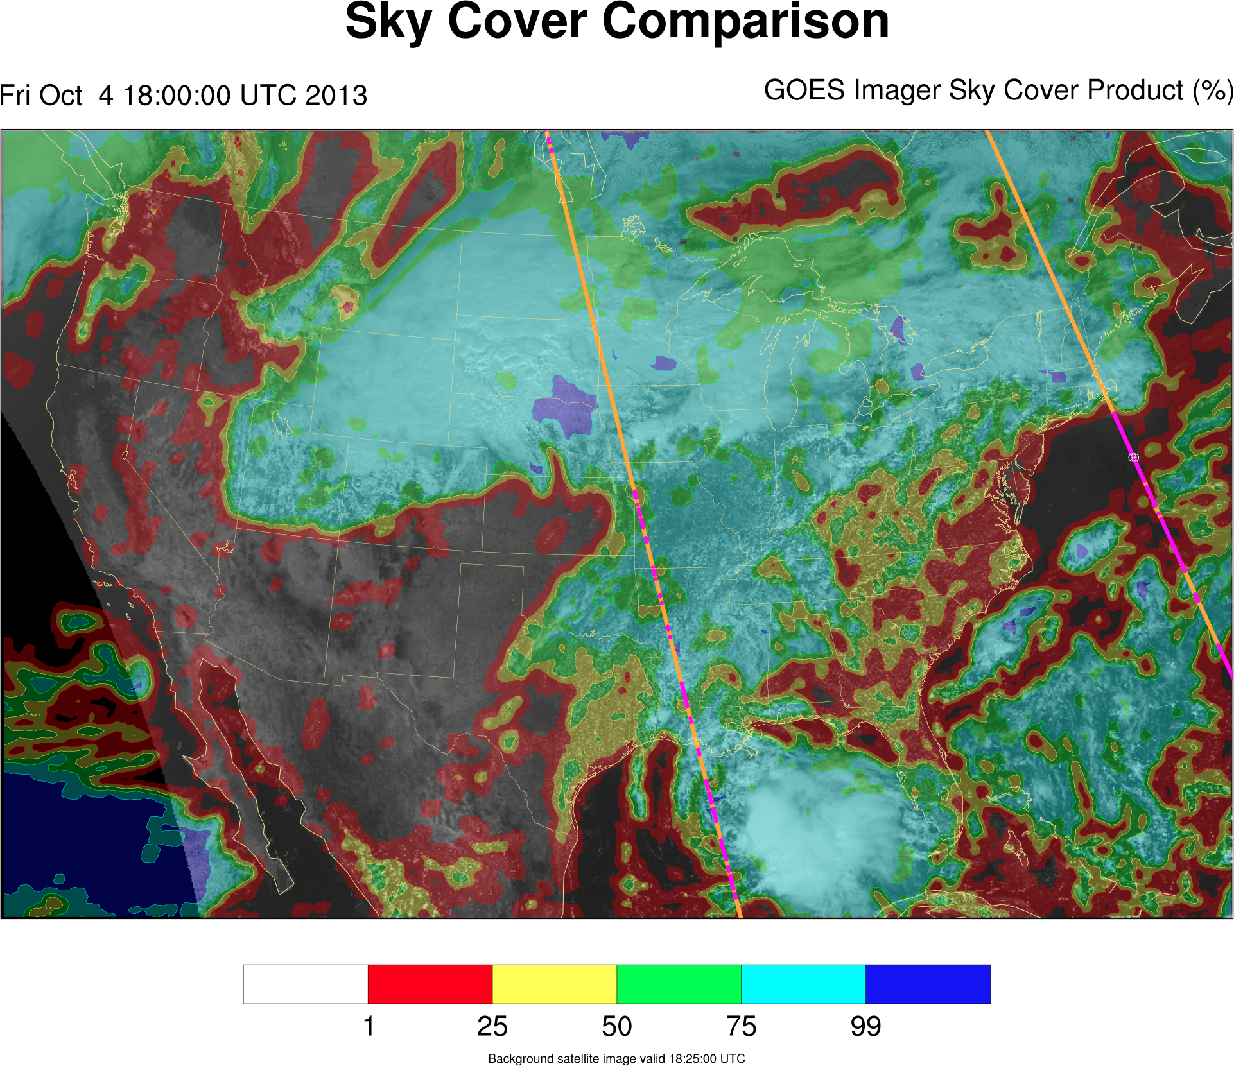
MISS
Column fraction
CALIOP non-clear CALIOP clear

Slide 38
Linear, Mixed Integer Optimization
Optimization is a broader toolset than a regression technique because they can be formulated intelligently (keep the results physical)
Solution is subject to linear constraint and/or decision structure controlled by integer/binary variable
Mathematical “tricks” exist to express some cases of non-linearity in linear (for example, absolute value)
Literature review suggests that the use of optimization in solving problems in the atmospheric sciences is not widespread

Slide 39
Optimizing Sky Cover
Input fields (subset of points)
Truth: Sky cover analysis
Components
Design model (formats: linear, mixed integer, others)
Objective using free variable, subject to constraint
Terms, matching variables and components
Constraints involving terms
Execute optimizer
Commercial solvers (free for academia)
CPLEX
Gurobi
Open source options (slower)
Notes:
Here, a binary (or “zero-one”) optimization problem, a case of the mixed integer optimization problems is formulated. While a mixed integer formulation is nonconvex by definition, and therefore difficult to solve, relaxation procedures can produce a convex linear optimization problem that can be solved relatively easily. However, because binary optimization problems fall in computational complexity case “NP-complete” (Karp 1972), there is not an efficient method for finding the solution. The larger the problem, the longer it takes to solve.
The “NP” in “NP-complete” refers to “nondeterministic polynomial time”.

Slide 40
Preparation Model

Slide 41
Case Study
Notes:
It is possible that the NDFD one-hour forecast is low bias for mostly cloudy or cloudy skies.

Slide 43
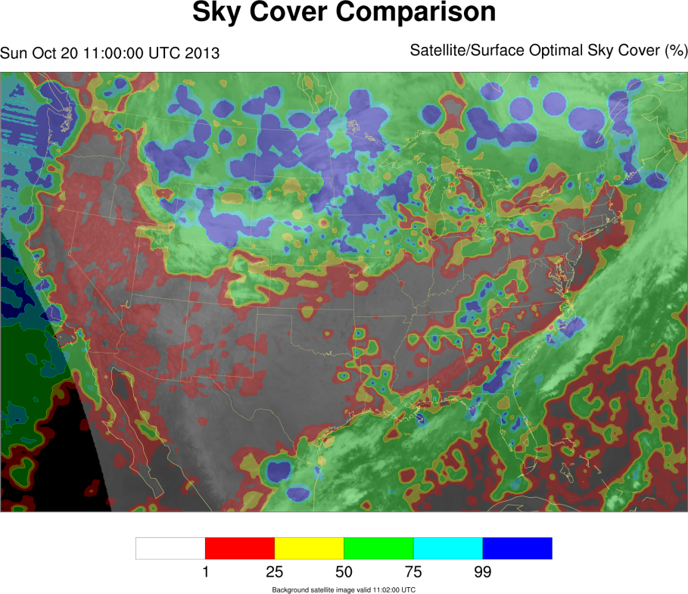

Slide 44
Forecasting Sky Cover
The NWS’ NDFD contains the gridded operational forecast for sky cover. Issues with the national one-hour forecast include:
Clear areas with non-zero cloud cover
Vastly different cloud classifications for similar cloud scenes
Lack of spatial continuity between forecast areas
Temporal trends do not match observations
Update frequencies vary by forecast office
The NDFD is generally based on output from weather prediction models.

Slide 45
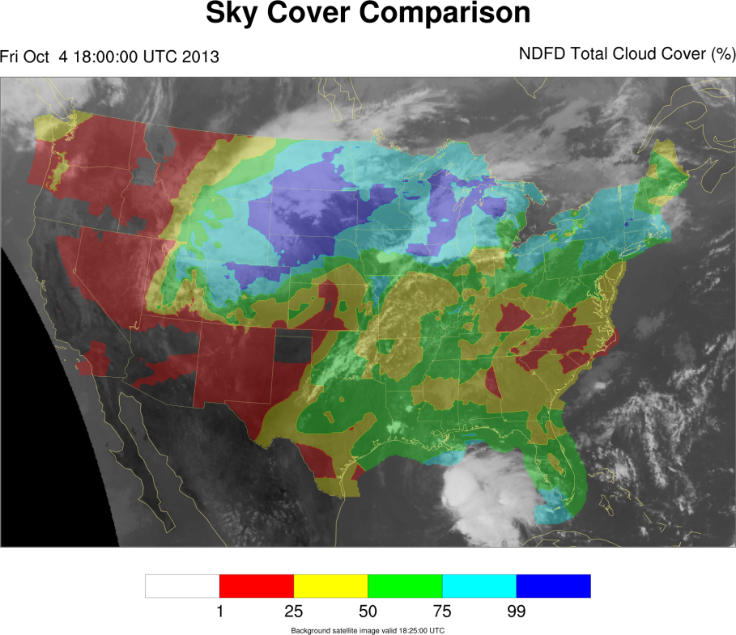

Slide 46
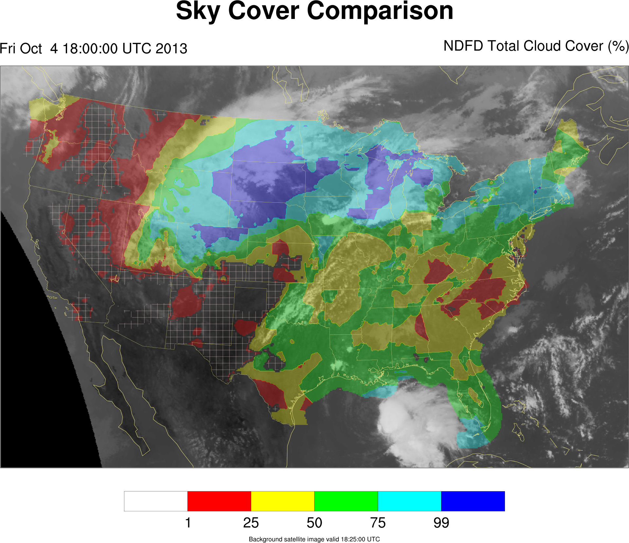

Slide 47
How can an optimization methodology contribute to solving problems in the atmospheric sciences?
An observational method for creating and validating analyses

Slide 48
Cloud Schemes
Diagnostic schemes
Cloud quantities are diagnosed from other model variables during model execution or post-processing
Prognostic schemes
Cloud cover, water vapor, and condensate variables are interconnected, dependent, and advanced/calculated during model execution
Hybrid scheme
Condensate variables are prognostic, but cloud cover is diagnostic
Global Forecast System (GFS) and Weather Research and Forecast (WRF) models

Slide 49
Cloud Schemes
Relative humidity schemes
Primary assumption is that cloudiness is represented through the sub-grid scale variability of the relative humidity field
Statistical schemes
Employ the use of a probability density function (PDF) with respect to total water (sum of mixing ratios)
Most PDFs are unimodal, varying shape and skewness
There is either a critical relative humidity threshold or assumption about the subgrid-scale temperature and/or humidity behavior that is a central component of the approach/scheme in all implementations.

Slide 50
Relative Humidity Schemes
Slingo (1980)
M = 0.80 for low and high clouds
M = 0.65 for mid-level clouds
Smith (1990)
RH_{crit} = 0.90 at surface
RH_{crit} = 0.70 at PBL height and above
Xu and Randall (1996)
p = 0.25, α₀ = 100, and γ = 0.49
Notes:
Slingo, J. M., 1980: A cloud parameterization scheme derived from GATE data for use with a numerical model. Quart. J. Roy. Meteor. Soc.,106, 899–927.
Smith, R. N. B., 1990: A scheme for predicting layer clouds and their water content in a general circulation model. Quart. J. Roy. Meteor. Soc.,116, 435–460.
Xu, K.-M., and D. A. Randall, 1996: A semi-empirical cloudiness parameterization for use in climate models. J. Atmos. Sci.,53, 3084–3102.

Slide 51
HRRR
High-Resolution Rapid Refresh (http://ruc.noaa.gov/hrrr/)
Horizontal resolution of 3 km, 50 vertical levels
Cloud-resolving model, no convective parameterization
Literature available for WRF framework which is the basis for the HRRR
Advanced Research WRF (ARW) core (v3.4.1+) with Thompson microphysics and RUC/Smirnova land-surface model
Assimilates GOES cloud products and METARs
Available hourly in real-time

Slide 52
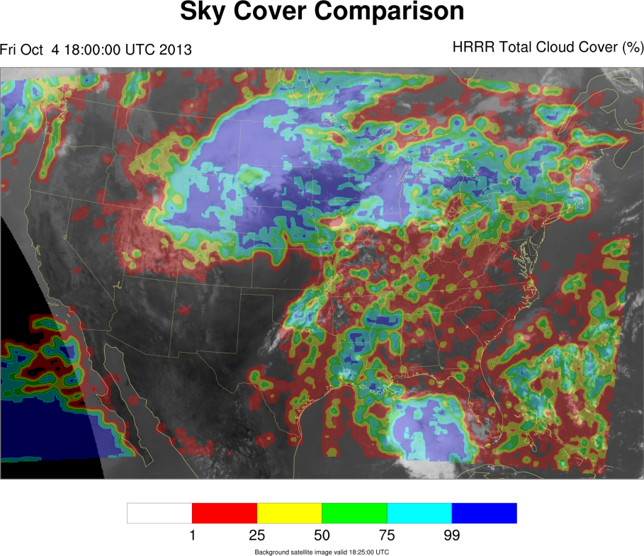

Slide 53
Optimizing Sky Cover
Components:
Relative Humidity (all levels)
Cloud Water Mixing Ratio, Cloud Ice Mixing Ratio, Rain Water Mixing Ratio, Snow Mixing Ratio (all levels)
Absolute Vorticity (200 hPa only), partitioned into positive and negative components
Pressure levels:
200 hPa
300 hPa
500 hPa
700 hPa
800 hPa
850 hPa
900 hPa
950 hPa
1000 hPa

Slide 54
Justification for Components
Relative humidity
Smagorinsky (1960); Williamson et al. (1987)
Cloud condensate
Wood and Field (2000)
Absolute vorticity at 200 hPa
Adjust the cloud cover based on the favorability of the environment for cloudiness from a dynamical perspective, particularly in cases of:
Gradients in cloudiness consistent with synoptic pattern
Synoptic scale subsidence (high pressure)
“Balances” relative humidity
Notes:
Absolute vorticity support:
Advection of geostrophic absolute vorticity by the geostrophic wind promotes upward vertical motion via the quasi-geostrophic omega equation (other term is thickness advection).

Slide 55
Maclaurin Series
Though the exponential function is nonlinear, the Maclaurin series (case of Taylor series) for the function e^{-x} is
where 0≤x≤1 for this application. If higher order terms, where n≥2, are disregarded, f(x)=1-e^{x} can be reduced to f(x)≈1-(1-x)=x, which is linear.
Such an adjustment is possible because significant error between the approximated value and the actual value arises for x>1, where the value of x becomes much larger than the approximated function.

Slide 56
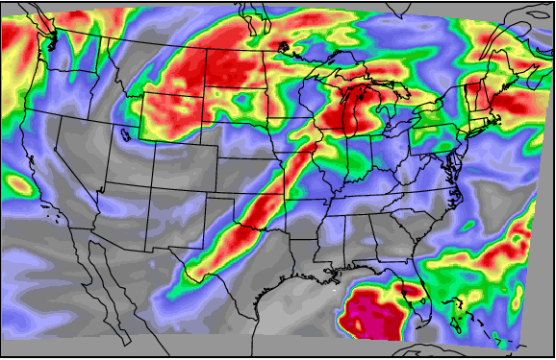
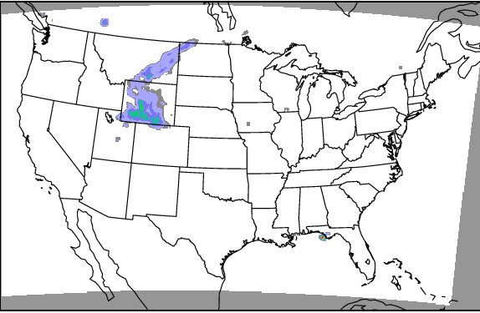
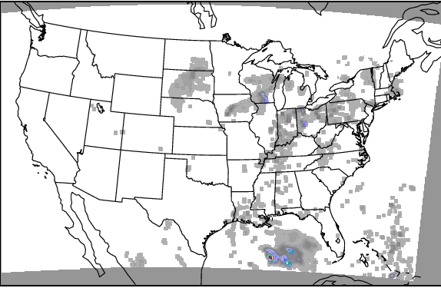
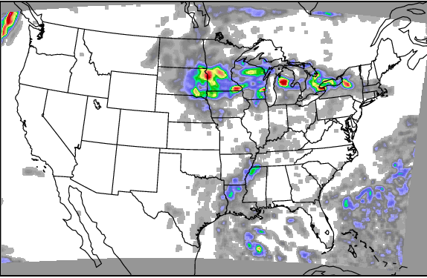
300 hPa Relative Humidity
500 hPa Cloud Ice Mixing Ratio
700 hPa Rain Water Mixing Ratio
900 hPa Cloud Water Mixing Ratio
All images are HRRR model analysis output valid at 18 UTC on 4 October 2013.

Slide 57
Quantities Not Included
Due to use of condensate terms
Temperature and lapse rates
Precipitable water
Convective Available Potential Energy
Other instability parameters
Due to terrain and local effects
Vertical velocity
Horizontal winds and related quantities with advection terms
Due to obvious lack of routine correlation
Geopotential heights and thicknesses

Slide 58
Relevant Literature
Kvamstø (1990)
Variables correlated with cloudiness:
Relative humidity
Variables not correlated with cloudiness:
Vertical velocity, advection of thickness, advection of equivalent potential temperature, relative vorticity, and stratification
Teixeira (2001)
For a high relative humidity value, there is not necessarily a trend toward high cloud fraction, nor is there a threshold of relative humidity where cloud is consistently absent

Slide 59
Relevant Literature
Zhang (2003)
Compared Rapid Update Cycle (RUC) output and GOES-8 cloud properties between 18 June and 18 July 1997
Cloud amount increased for more expansive cloud areas
Cloud amount dependence on relative humidity for low-level cloud is greater than at other, higher levels
Mean relative humidity values for cloudy areas were approximately between 30% and 70%

Slide 60
Addressing Cloud Layers
The exponential relationship between cloud cover and mixing ratio assumes the same form as absorbance absent scattering, 1-t, where transmittance t=e^{-τ}, and τ is the optical depth.
The Beer-Lambert law, or Beer’s law, provides that there is a linear relationship between absorbance and concentration of the absorber.
The transmittance through two adjacent atmospheric layers is the product of the transmittance through each layer individually. The geometric argument for cloud fraction is construed similarly.

Slide 61
Clear Sky Fraction
The clear sky through an atmospheric column is the product of the clear sky fraction for the layers within the column, such that
for i∈N layers in the column, where A_{i} is the clear sky fraction for layer i or the entire column for A_{Z}, and C_{i} is the cloud fraction for layer i or the entire column for C_{Z}.

Slide 62
Mixing Ratio and Cloud Fraction
Since
optical depth is a function of the extinction coefficient,
the extinction coefficient is proportional to mixing ratio, and
given there exists a direct relationship between absorbance and cloud fraction,
it is possible to define the cloud cover as the sum of adjusted relative humidity values and adjusted mixing ratio values within a column.
Therefore, the sum of adjusted mixing ratio quantities is approximated using the same Maclaurin series of e^{-x} as previously.

Slide 63
Optimizing Sky Cover
Optimization objective: Minimize the mean absolute error between the affine expression of adjusted input fields and the truth field
Terms:
Coefficient allowed for 200 hPa positive and negative absolute vorticity (m₂₀₀AV₂₀₀)
Coefficient allowed for relative humidity quantities (m_{x}RH_{x})
Threshold allowed for applying coefficient to 1000 hPa relative humidity field (m₁₀₀₀RH₁₀₀₀ if RH₁₀₀₀ > RH_{T})
Coefficient and scalar allowed for non-zero mixing ratio quantities (m_{y}MR_{y}+b_{y} if MR_{y} > 0, otherwise 0)

Slide 64
Optimizing Sky Cover
If there is condensed water in the integrated column, then for such a j:
If there is no condensed water in the integrated column (only water vapor), then for such a j:

Slide 65
Optimizing Sky Cover
The following constraints apply for all j:
where B_{L} is a threshold within field L (1000 hPa relative humidity).
The objective is:
where N is the number of objects in Y, and every and only y_{j}∈Y.

Slide 66
Optimizing Sky Cover
The distribution of the values in the output is also controlled as follows:
where γ is the mean value of the desired truth field and β is the tolerance and
There are also constraints enforcing the integrity of the acceptable range edges in order to preserve cloudy and clear areas.

Slide 67
Optimizing Sky Cover
Other terms include constraints for:
Setting an upper limit on scalar contributions to non-zero condensate values
Maintain spatial distributions in HRRR model fields
Not allowing a coefficient to result in a sky cover amount over 200%
Not allowing a coefficient for a vorticity quantity to result in a sky cover amount over 100%
Forcing columns with condensate to be non-clear
Trust HRRR model fields

Slide 68
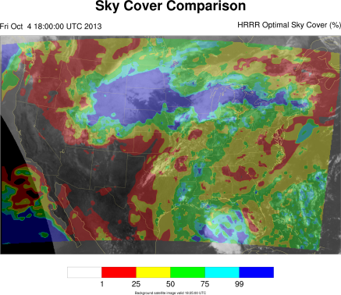
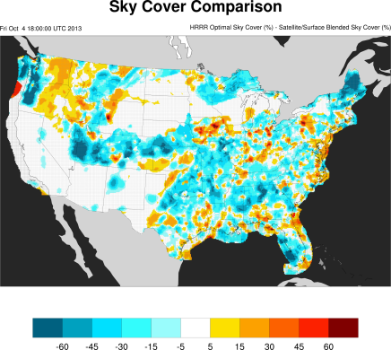
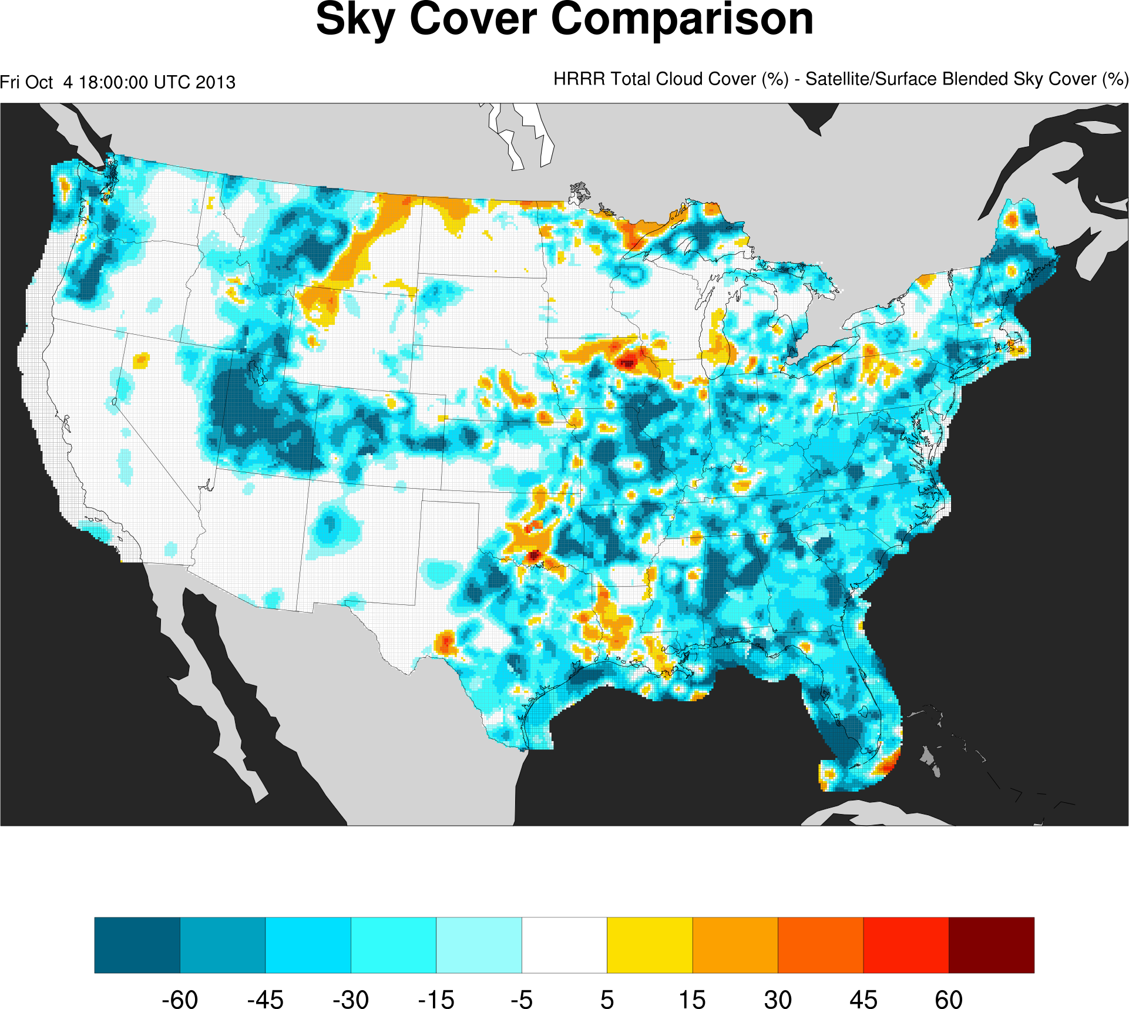

Slide 69
Case Study

Slide 70
Results
Forecasts valid between 21 September 2013, 0 UTC, and 1 November 2013, 23 UTC
Validated against blended sky cover analysis
0-hour | Operational | Optimal | Improvement
Cases | 823 | 793
ME | -13.1% | -7.6% | 5.5%
MAE | 17.3% | 17.5% | -0.2%
RMSE | 27.2% | 26.5% | 1.2%
3-hour | Operational | Optimal | Improvement
Cases | 810 | 784
ME | -12.4% | -9.6% | 2.8%
MAE | 23.9% | 20.3% | 3.6%
RMSE | 35.7% | 30.0% | 5.7%

Slide 71
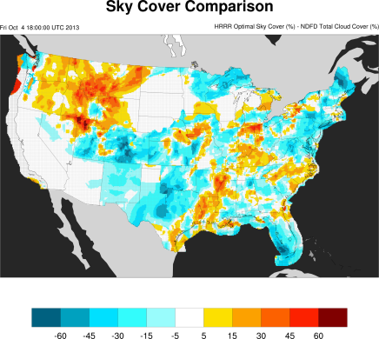
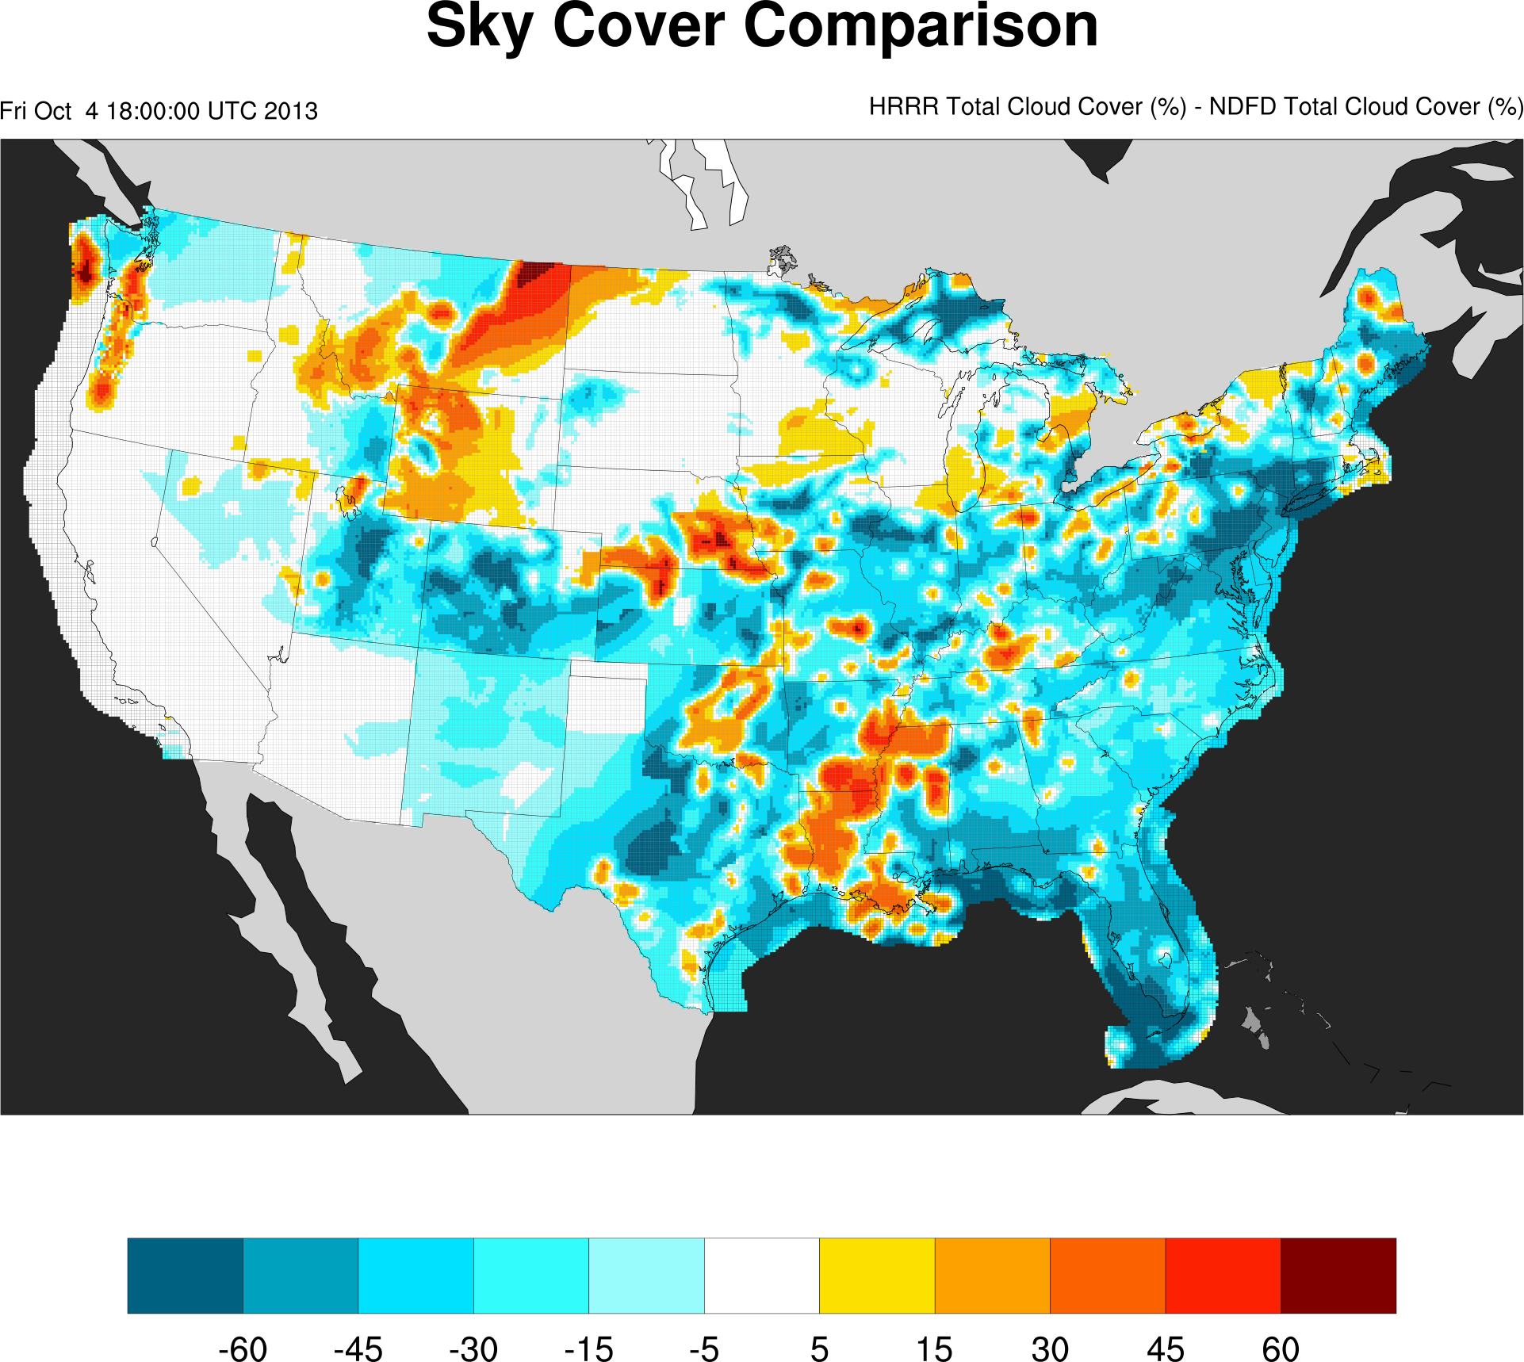

Slide 72
Case Study

Slide 73
Results
Forecasts valid between 21 September 2013, 0 UTC, and 1 November 2013, 23 UTC
Validated against NWS NDFD one-hour sky cover forecast
0-hour | Operational | Optimal | Improvement
Cases | 281 | 270
ME | -11.9% | -6.4% | 5.5%
MAE | 20.6% | 16.1% | 4.5%
RMSE | 28.4% | 22.4% | 4.0%
3-hour | Operational | Optimal | Improvement
Cases | 274 | 784
ME | -11.0% | -8.4% | 2.6%
MAE | 24.1% | 17.1% | 7.0%
RMSE | 32.7% | 23.8% | 8.9%

Slide 74
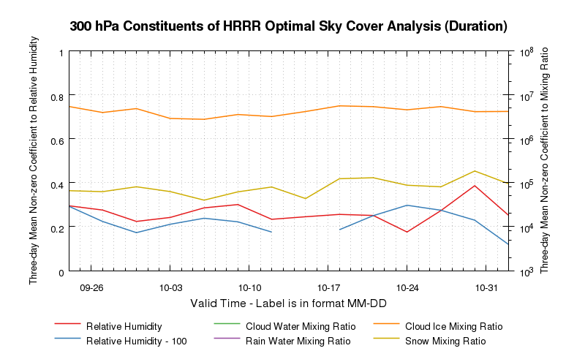
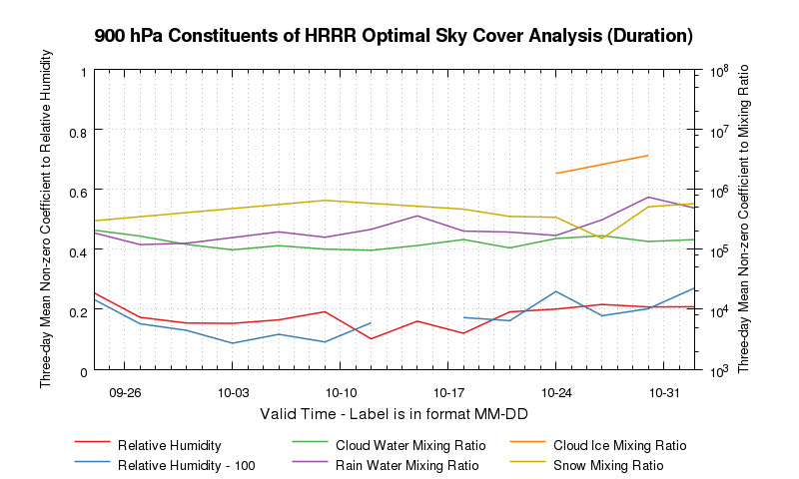
Results
300 hPa Quantity | Mean
Relative Humidity | 0.270
Relative Humidity - 100 | 0.228
Cloud Water Mixing Ratio | NA
Rain Water Mixing Ratio | NA
Cloud Ice Mixing Ratio | 4.21×10⁶
Snow Mixing Ratio | 9.61×10⁴
Means valid 1 UTC, 21 September 2013, through 23 UTC, 1 November 2013
900 hPa Quantity | Mean
Relative Humidity | 0.184
Relative Humidity - 100 | 0.182
Cloud Water Mixing Ratio | 1.38×10⁵
Rain Water Mixing Ratio | 3.11×10⁵
Cloud Ice Mixing Ratio | 2.88×10⁶
Snow Mixing Ratio | 4.23×10⁵

Slide 75
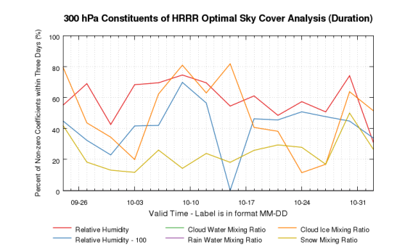
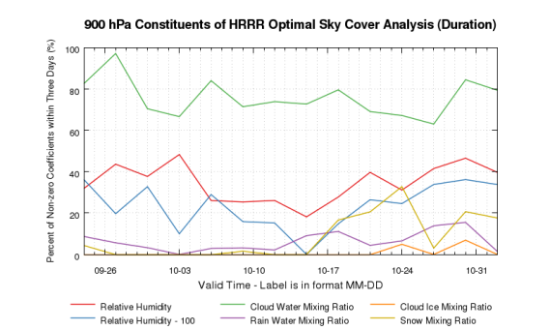
Results
300 hPa Quantity | Mean
Relative Humidity | 58.9%
Relative Humidity - 100 | 43.6%
Cloud Water Mixing Ratio | 0.0%
Rain Water Mixing Ratio | 0.0%
Cloud Ice Mixing Ratio | 47.2%
Snow Mixing Ratio | 25.0%
Means valid 1 UTC, 21 September 2013, through 23 UTC, 1 November 2013
900 hPa Quantity | Mean
Relative Humidity | 35.8%
Relative Humidity - 100 | 25.4%
Cloud Water Mixing Ratio | 76.3%
Rain Water Mixing Ratio | 6.1%
Cloud Ice Mixing Ratio | 0.8%
Snow Mixing Ratio | 8.9%

Slide 76
Results
Above the threshold, there is a non-zero coefficient or scalar which applies to the 1000 hPa relative humidity value in all optimizer solutions during the period.
Mean: 73.3%

Slide 77
Results
Results are from 21 September 2013 through 1 November 2013 over and near the contiguous United States.
950 hPa cloud water mixing ratio is the most frequently selected field in the solved affine relationship.
Cloud water mixing ratio from one or more levels in the lower troposphere is frequently correlated with sky cover.
Higher in the troposphere, there is less reliance on cloud water mixing ratio and more reliance on relative humidity.
Snow mixing ratio and rain mixing ratio are not commonly included in optimized formulations.
Indicates limited HRRR model skill on placement of convective precipitation processes

Slide 78
Shear and Curvature Vorticity
Updated the aforementioned optimization model to replace the absolute vorticity variables at 200 hPa with:
200 hPa curvature relative vorticity
Positive, negative
200 hPa shear relative vorticity
Positive, negative
Examined 19 cases between 29 October 2013 and 13 November 2013 (from 6 UTC and 18 UTC)
Negative curvature relative vorticity is a contributing but not controlling factor behind decreased cloudiness
Thermodynamics, low-level forcing mechanisms

Slide 79
Tasks Accomplished
It devises a blended sky cover analysis that incorporates the advantageous properties of surface observations of sky cover and geostationary satellite cloud products.
It defines a framework for optimizing the blended analysis based on the current near-term human-produced forecasts from the National Digital Forecast Database (NDFD).
It constructs an affine expression of High-Resolution Rapid Refresh (HRRR) relative humidity, mixing ratio, and vorticity analysis fields with adjustable coefficients and scalars that is optimized to decrease the absolute error compared to the “truth” analysis.

Slide 80
Primary Conclusions
The combination of surface observations and the satellite sky cover product improves the detection of nocturnal low cloud and general high cloud compared to a single source.
Relative humidity and cloud water mixing ratio are closely correlated with sky cover, particularly in the lowest levels of the troposphere.
The linear optimization approach produces an optimal sky cover product with decreased mean error, mean absolute error, and root-mean-square error when validated against the NDFD one-hour forecast, compared to the current operational HRRR output.

Slide 81
Possible Future Directions
Continue effort to validate blended analysis against CALIPSO and other independent sources
Investigate application of day-night band imagery from VIIRS (Suomi NPP) into blended analysis
Incorporate terrain information and additional in-situ surface observation fields into blended analysis to confine cloud decks to edges of terrain features
Work with NWS to produce a sky cover analysis of record and validate numerical model output of sky cover
Notes:
CALIPSO is Cloud-Aerosol Lidar and Infrared Pathfinder Satellite Observations
VIIRS is Visible Infrared Imaging Radiometer Suite
NPP is National Polar-orbiting Partnership

Slide 82
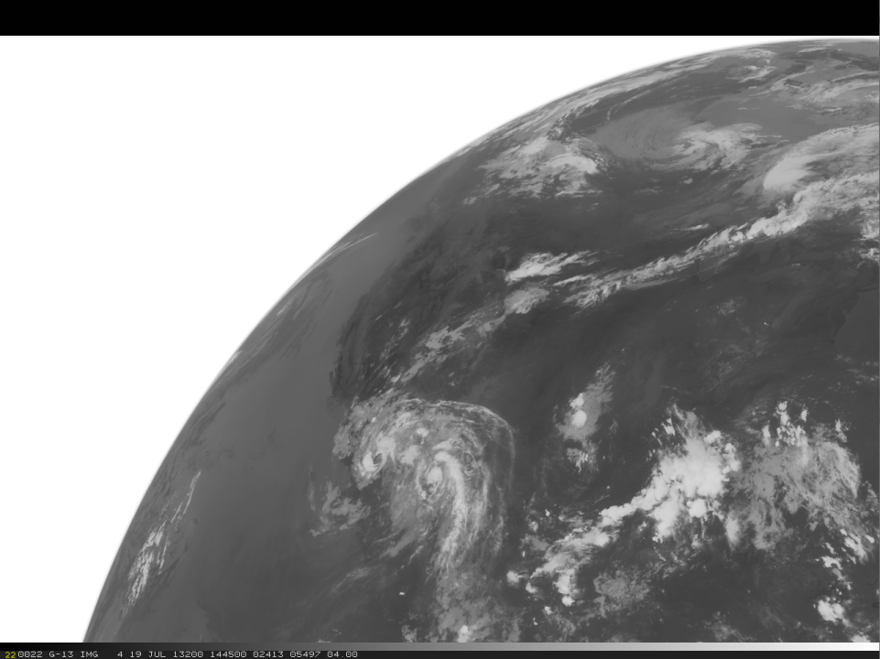
Questions? Comments?

