Slide 1
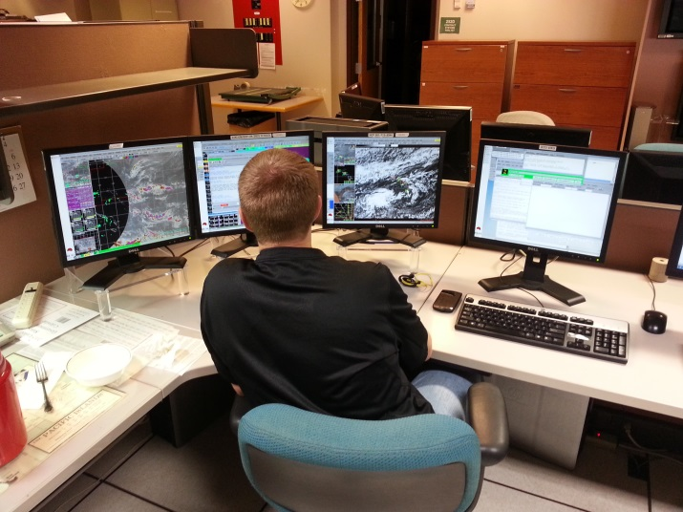
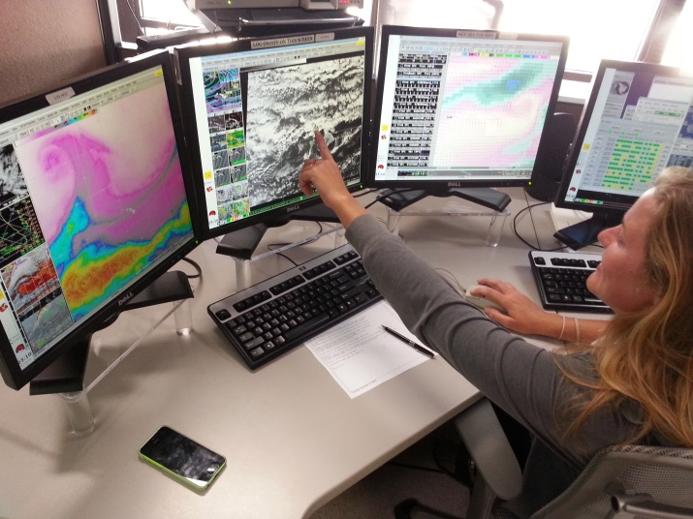
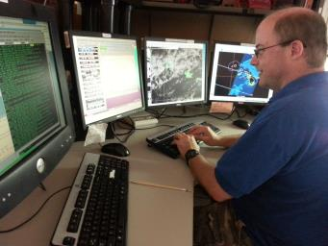
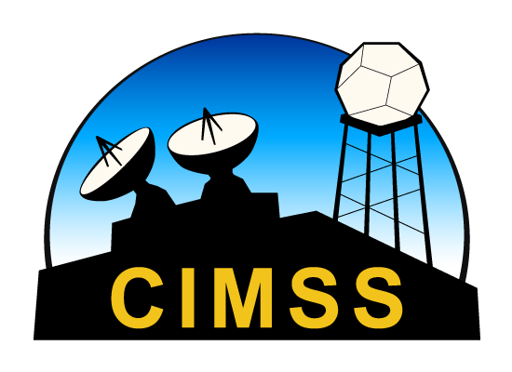
Nowcasting Applications
Jordan Gerth
University of Wisconsin
STAR JPSS Science Team Meeting
25 August 2015

Slide 2
Challenges
What NPP and JPSS spectral bands and science products have a direct application to operational responsibilities of NWS meteorologists?
How do we deliver polar satellite information so that it is timely enough for nowcasting?
How do we present that information in the field?

Slide 3
NPP and JPSS
King of Nowcasting Applications
What instruments/capabilities of NPP and JPSS provide added value over geostationary satellites for nowcasting applications?
VIIRS Day/Night Band
Higher spatial resolution for imaging (VIIRS), especially in polar regions
Microwave products (ATMS)
Additional spectral information (CrIS) for characterizing clear scenes

Slide 4
Deliver and Display
Timely delivery is facilitated by:
A network of L/X-band antennas across the United States to capture and produce imagery and products with the Community Satellite Processing Package (CSPP)
Improved bandwidth, especially in OCONUS, to reach NWS forecast offices
Imagery and science products arriving at NWS offices are displayable within the Advanced Weather Interactive Processing System (AWIPS)

Slide 5
The Early Days: Valley Fog
23 August 2013

Slide 6
The Early Days: Flossie
29 July 2013

Slide 7
The Early Days: Flossie
TROPICAL STORM FLOSSIE DISCUSSION NUMBER 19
NWS CENTRAL PACIFIC HURRICANE CENTER HONOLULU HI EP062013
500 AM HST MON JUL 29 2013
THE CENTER OF FLOSSIE WAS HIDDEN BY HIGH CLOUDS MOST OF THE NIGHT BEFORE VIRS NIGHTTIME VISUAL SATELLITE IMAGERY REVEALED AN EXPOSED LOW LEVEL CIRCULATION CENTER FARTHER NORTH THAN EXPECTED. WE RE-BESTED THE 0600 UTC POSITION BASED ON THE VISIBLE DATA. SUBJECTIVE DVORAK ANALYSES CONTINUED SHOW CURRENT INTENSITIES OF 3.0 BUT SATELLITE LOOPS SUGGEST A RAPID WEAKENING TREND WITH THE LOW LEVEL CENTER PULLING AWAY FROM A SMALL AREA OF CONVECTION SOUTHEAST OF THE CENTER. IT IS LIKELY THAT CONTINUED NORTHWEST SHEAR WILL MAINTAIN THIS WEAKENING TREND.
THE TRACK HAS BEEN SHIFTED NORTH TO REFLECT THE RE-LOCATED CENTER. THE TRACK GUIDANCE SHIFTED FOLLOWING THE TRACK CHANGE AND WAS CONSISTENT WITH A NEW TRACK FARTHER TO THE NORTH.
. . .

Slide 8
Recent Application: Fronts
10 February 2015

Slide 9
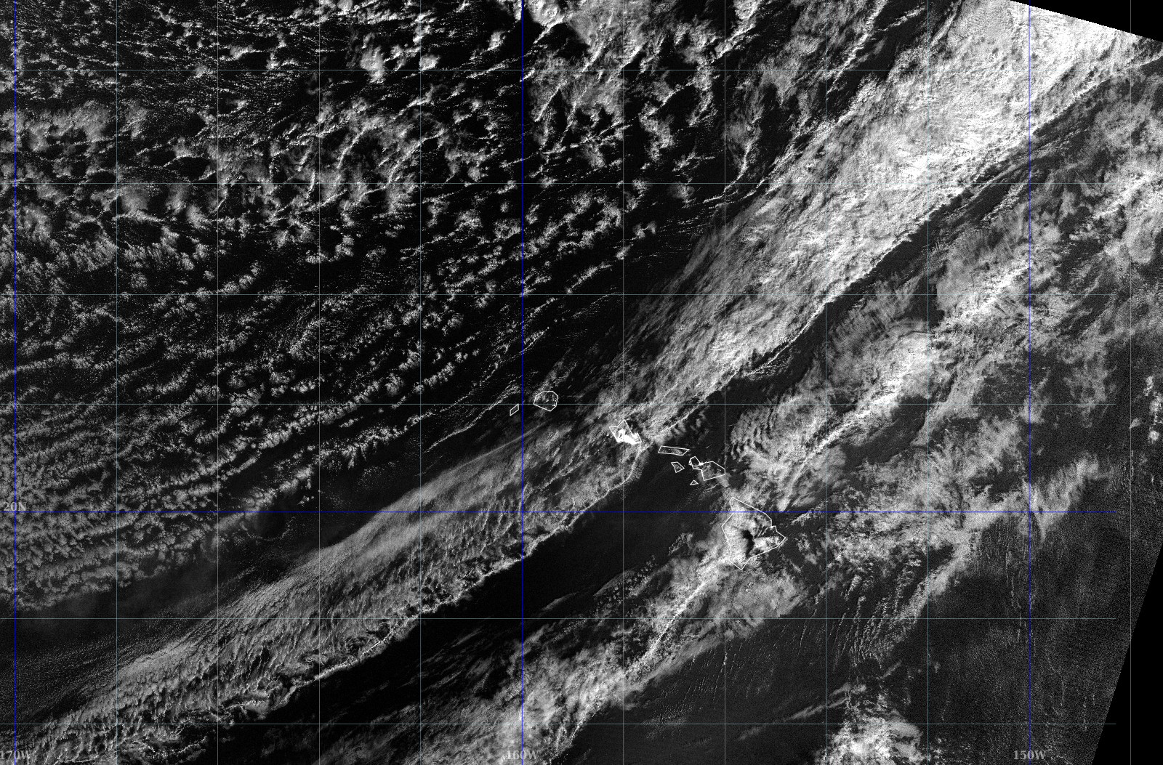
Frontal Passages in Hawaii
NWS Collaborator: Eric Lau

Slide 10
New Activities
Products for coastal forecasting applications
ASCPO Sea Surface Temperature
MIRS 90 GHz and Rain Rate
Full-resolution VIIRS imagery in AWIPS II
Enhancing AWIPS II and providing corrected reflectances for select VIIRS bands to support RGB multi-spectral applications

Slide 11
28 February 2015 11:49 UTC
Example of NPP-ATMS Rain Rate and 11.0 μm IR Window in AWIPS II

Slide 12
VIIRS True Color RGB in AWIPS II (Full Bit Depth)
Smoke on 20 August 2015
Composites with corrected reflectances enhance quality of meteorological features

Slide 13
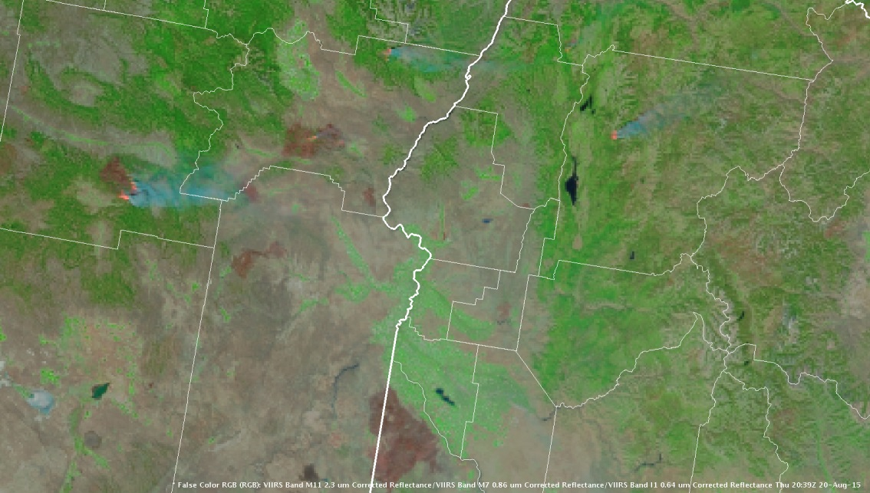
VIIRS False Color RGB in AWIPS II (Full Bit Depth)
Benefit: Easy to visually discriminate between fires, smoke, and burn scars

Slide 14
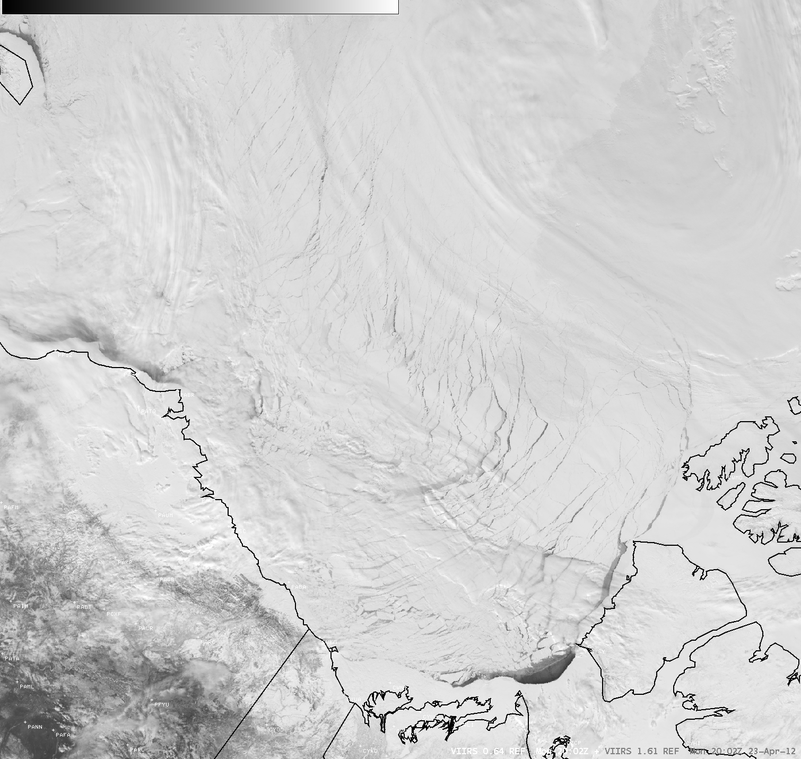
Other Applications
23 April 2012
Phenomena-based products:
Aerosols
Active fires
Land surface properties
River ice and flooding
Sea ice characterization and movement
Snow and ice cover
Volcanic ash detection
Comparing to short-term numerical weather prediction forecasts
Feature discrimination
0.64 µm vs. 1.61 µm
Source: CIMSS Satellite Blog

Slide 15
The Future
What can we assimilate into models, integrate into products, and combine with other observations while maintaining the integrity of the disparate sources?
How do we further improve the implementation of satellite imagery and products in our weather visualization tools (e.g., AWIPS II)?

Slide 16
Thank You
If you are interested in learning more about how NWS conducts operations in the OCONUS and have a science product with an application to demonstrate, consider the NWS Pacific Region Visiting Scientist Program.
Questions? Comments?
Jordan.Gerth@noaa.gov

