Slide 1
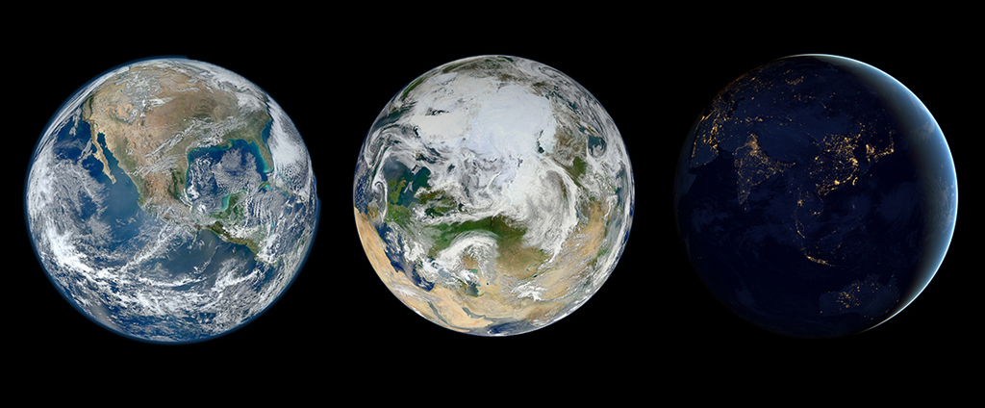
How NOAA Jump-Started the 2017 Satellite Conference to Engage the Audience
Mark Paese, Jordan Gerth, Mara Browne
American Meteorological Society Annual Meeting  27th Symposium on Education
6.1A  8:30 AM Wednesday, 10 January 2018

Slide 2
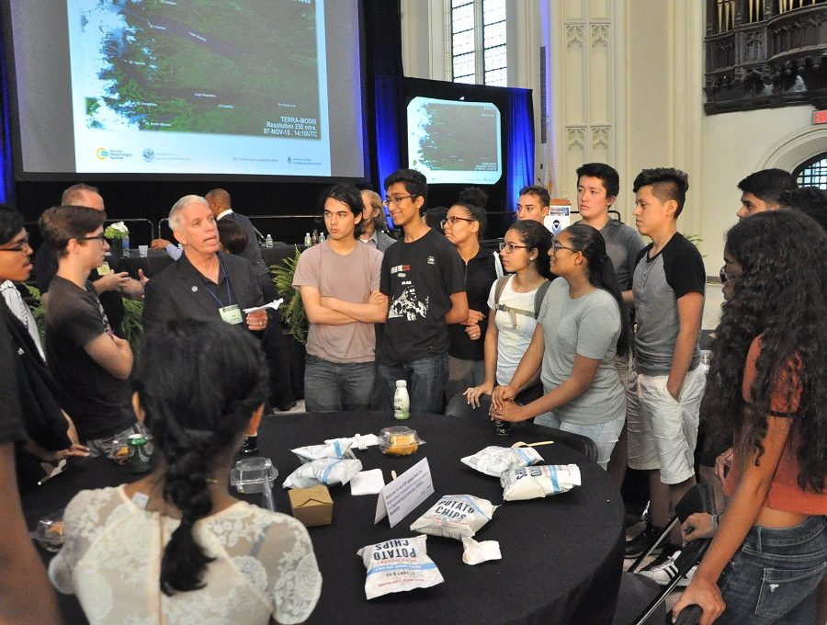

Slide 3
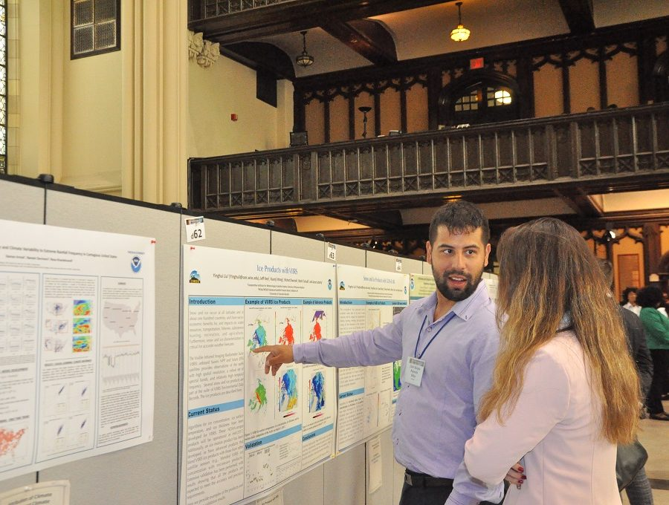

Slide 4
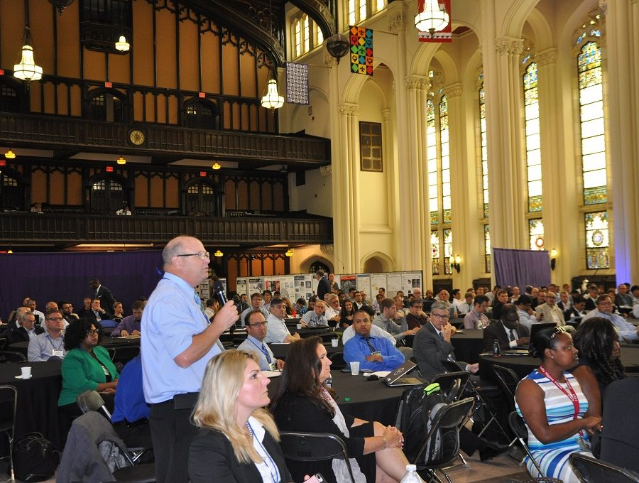

Slide 5
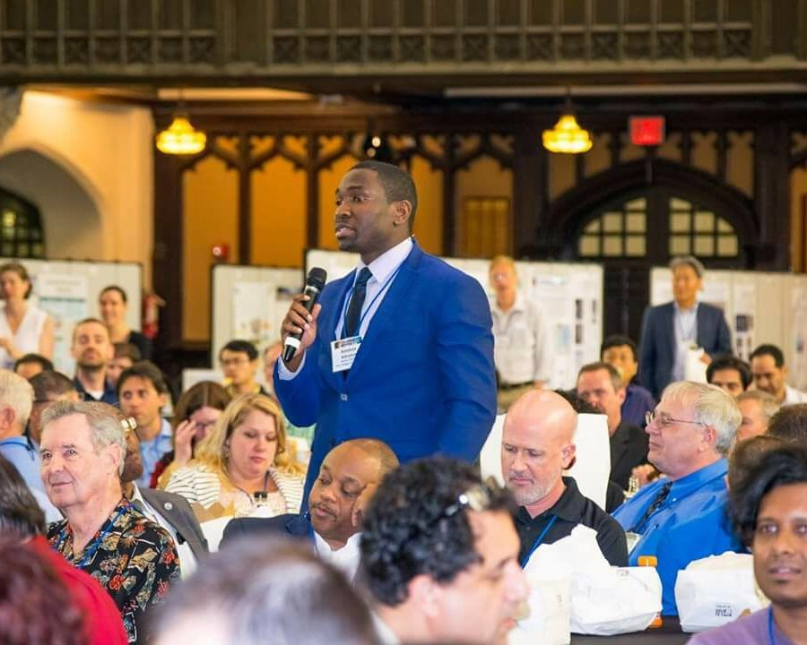

Slide 6
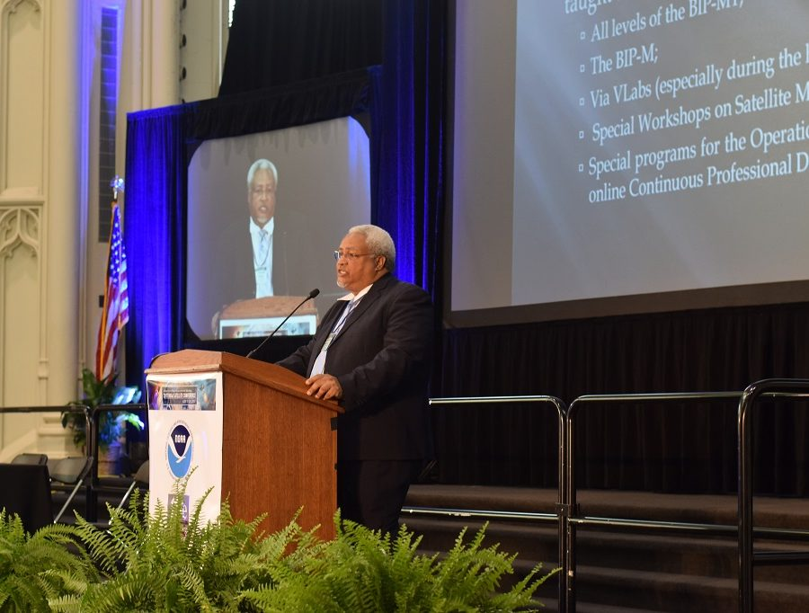

Slide 7
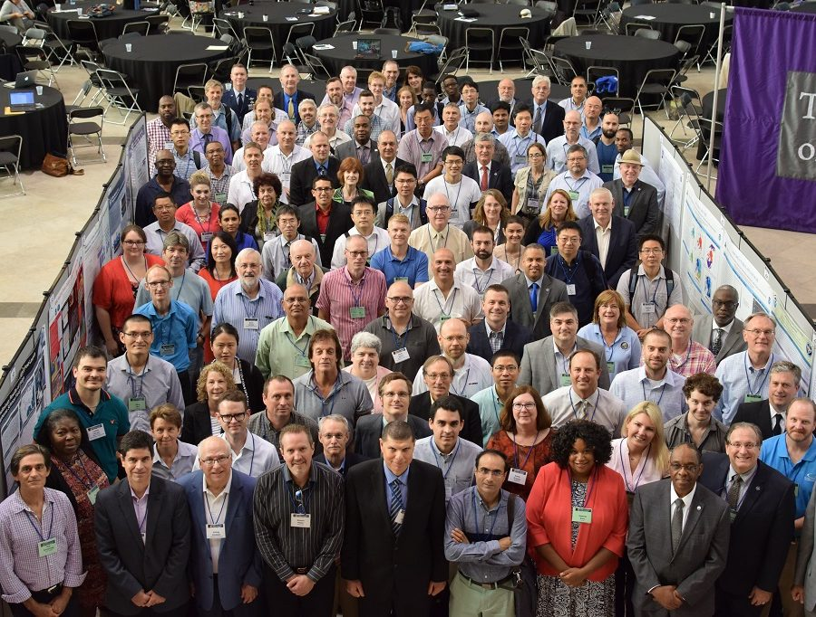

Slide 8
Bridging Information and Interaction
The Meeting
City College of New York
3.5 days
387 attendees (max)
The Platform
Sli.Do
277 active users (72%)
193 audience questions
24 polls
Go to Slido.com Event #AMSEDU
Any reference to a non-government entity, product, service, or information does not constitute an endorsement or recommendation by the National Oceanic and Atmospheric Administration (NOAA) or its employees or affiliates.

Slide 9
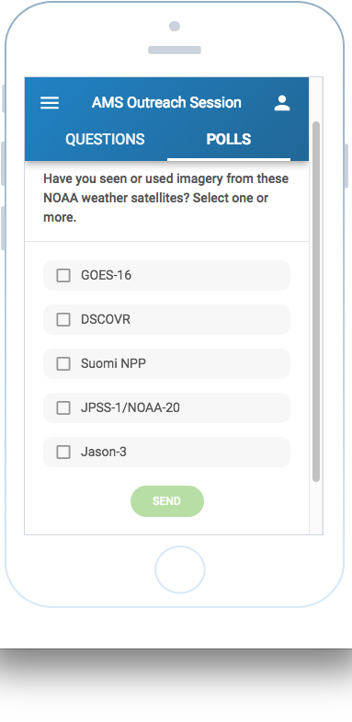
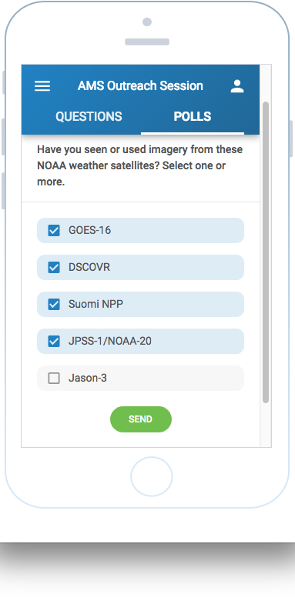
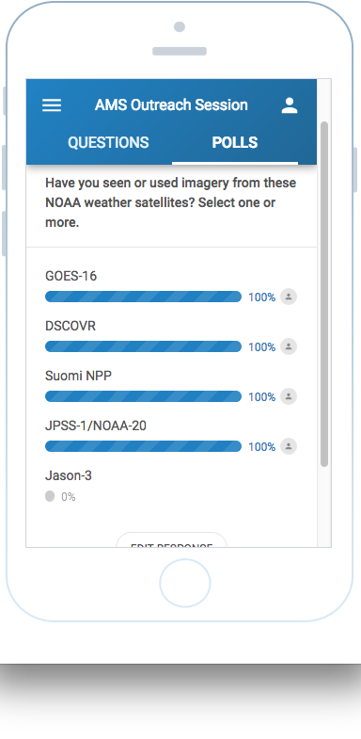
Slido.com #AMSEDU

Slide 10
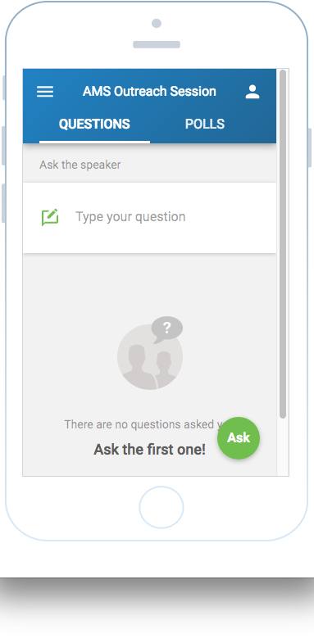
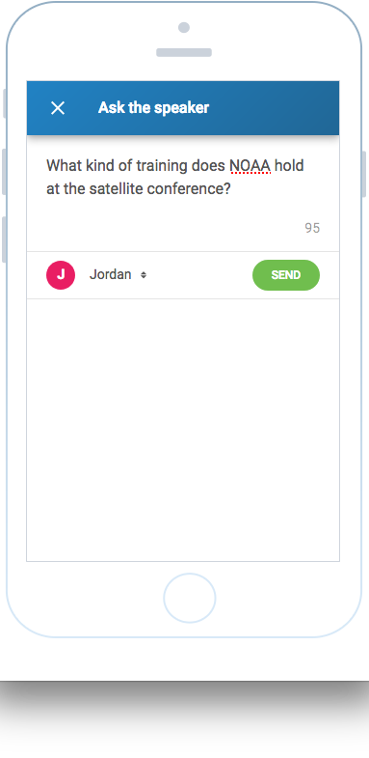
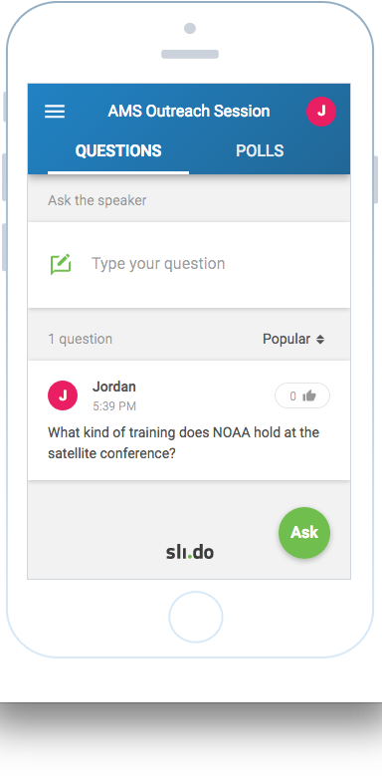
Slido.com #AMSEDU

Slide 11
Thanks to…
Alex Lamers Axel Graumann Jacob Inskeep
Eric Madsen Marc Moser Kelley Williams

Slide 12
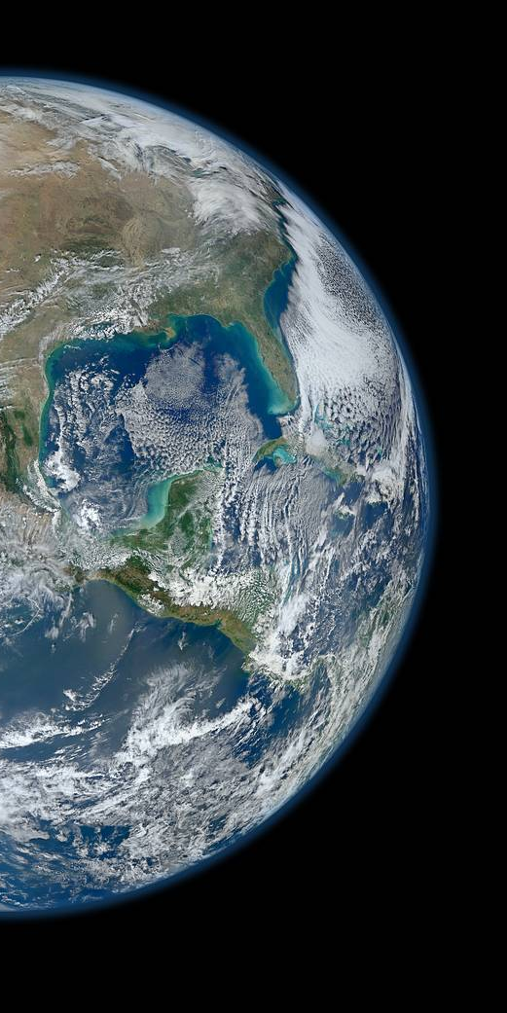
Questions?
How NOAA Jump-Started the 2017 Satellite Conference to Engage the Audience
Mark Paese, Jordan Gerth, Mara Browne
American Meteorological Society Annual Meeting
27th Symposium on Education
6.1A  8:30 AM Wednesday, 10 January 2018
Jordan.Gerth@noaa.gov  www.nsc2017.org

