Slide 1
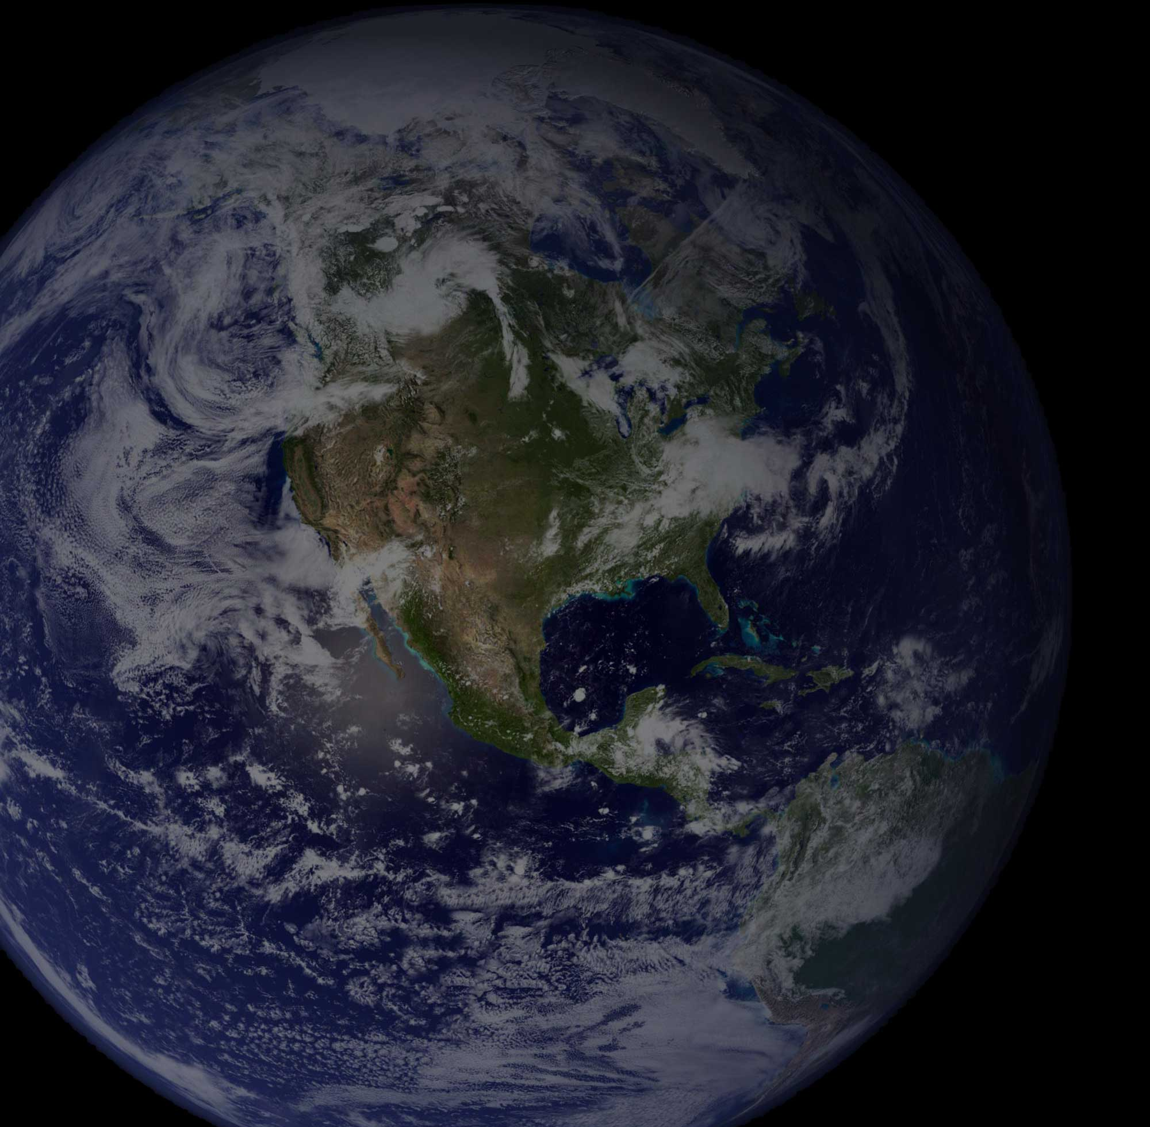
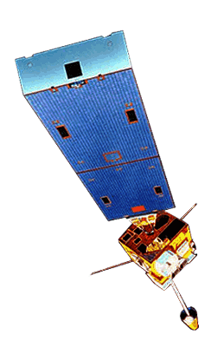
The Magic of Moisture in NWP
Jordan Gerth, Research Assistant
Cooperative Institute for Meteorological Satellite Studies
University of Wisconsin
Session V – Tuesday, October 18, 2011
National Weather Association Annual Meeting, Birmingham, Alabama

Slide 2
Basic Premise of NWP An Initial Value Problem
The following constrain the accuracy of numerical weather prediction (NWP) solutions:
Parameterizations and approximations within the model
Atmospheric features occurring on scales smaller than resolved by the model
Limited observations to populate the initial analysis (especially in the “upper air” and over oceans)
Quality, precision, and accuracy of the observations
Boundary conditions and domain size

Slide 3
Information Extracted from Satellites for Numerical Weather Prediction
Radiances
Direct assimilation (3Dvar)
Requires model errors, observation errors
Scale dependence
Surface type restrictions
Retrieved parameters
Dependent variable assimilation (1,3Dvar)
Requires model errors, retrieval errors
Physical accuracy, non-linearity
Bypass surface type restrictions
Motion
Cloud track, water vapor track
Height assignment errors
Radiance tracking (4Dvar)
The CIMSS Regional Assimilation System (CRAS) is used to assess the impact of space-based observations on numerical forecast accuracy.
CRAS is unique in that, since 1996, it’s development was guided by validating forecasts using information from GOES.
Output online:
http://cimss.ssec.wisc.edu/cras/
Slide credit: Robert Aune, NOAA/NESDIS

Slide 4
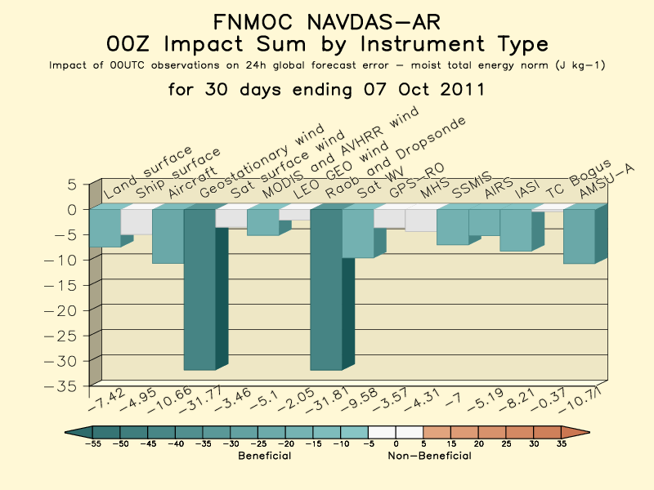
For Fleet Numerical Meteorology and Oceanography Center NOGAPS model
http://www.nrlmry.navy.mil/obsens/

Slide 5
US Operational Forecast Models Limited use of GOES Sounder observations
The North American Model (NAM) and Global Forecast System (GFS) do use brightness temperatures from the GOES Sounders (GOES-W/11 and GOES-E/13) over ocean as part of their radiance assimilation system.
However, they do not use retrievals, and they do not use GOES Sounder observations over land.
The Rapid Update Cycle (RUC) does use precipitable water (PW) retrievals over ocean from GOES-11 only.
Notes:
Source for NAM: http://www.emc.ncep.noaa.gov/mmb/data_processing/prepbufr.doc/table_4.htm
Source for GFS: http://www.emc.ncep.noaa.gov/mmb/data_processing/prepbufr.doc/table_2.htm
Source for RUC: http://www.emc.ncep.noaa.gov/mmb/data_processing/prepbufr.doc/table_5.htm
Additional source: http://www.emc.ncep.noaa.gov/mmb/data_processing/prepbufr.doc/table_18.htm

Slide 6
Assimilating GOES Sounder in CRAS
Cloud-top pressure and effective cloud amount are used adjust cloud water mixing ratio in the model. Cloud checks are performed for low, high, and multi-layer clouds.
Background GOES Operation
Clear Clear Do nothing (check RH)
Cloudy Cloudy Adjust cloud, RH, match top (up to two layers)
Cloudy Clear Clear cloud, adjust RH
Clear Cloudy Build new cloud, adjust RH
Water Vapor Adjustments using GOES 3-Layer Precipitable Water Retrievals.
1) Mean background mixing ratio profile is computed.
2) Perturbations are removed.
3) Mean profile is adjusted to match GOES 3-layer PW using 1D var (strong constraint).
4) Perturbations are added to adjusted profile.
5) RH profile checked for “clearness”.
A 12-hour spin-up forecast is used to initialize water vapor and clouds.
T-12 T-9 T-6 T-3 T=0
Forecast
………………………………... GOES Sounder PW and Cloud ……………………………
Slide credit: Robert Aune, NOAA/NESDIS

Slide 7
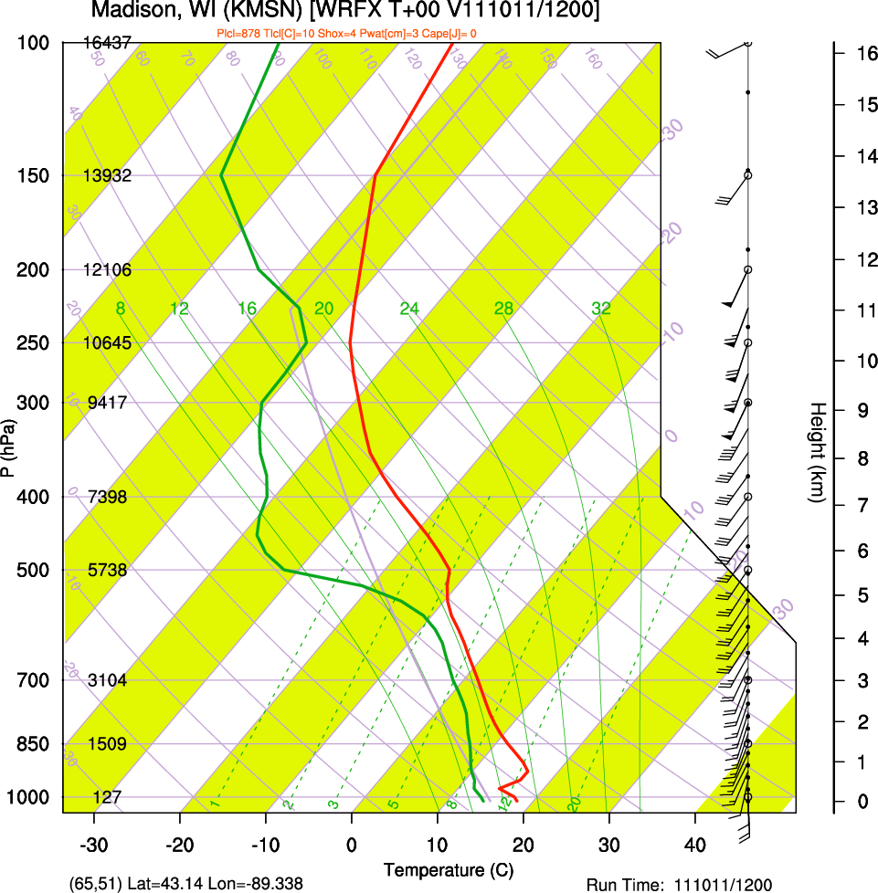
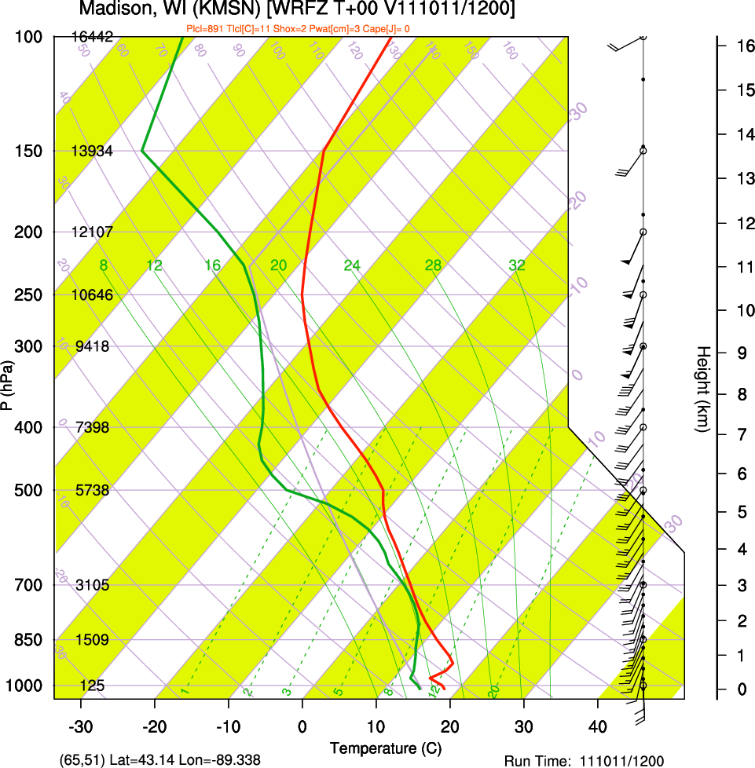
GOES-13 Moisture Correction Madison, WI; 11 October 2011, 12 UTC
This example shows how moisture is added to the background analysis ahead of approaching precipitation while the distribution is maintained.
Background
(GFS)
Sounder
adjusted

Slide 8
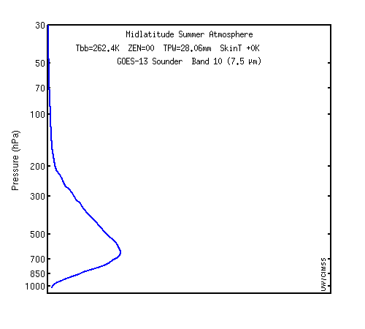
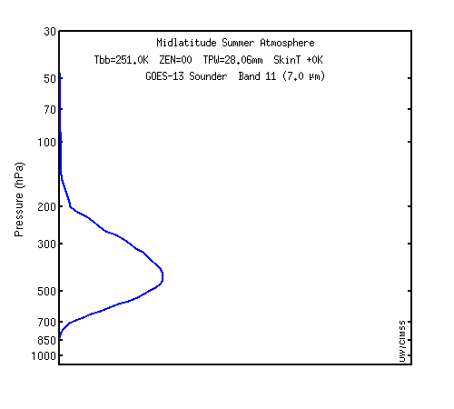
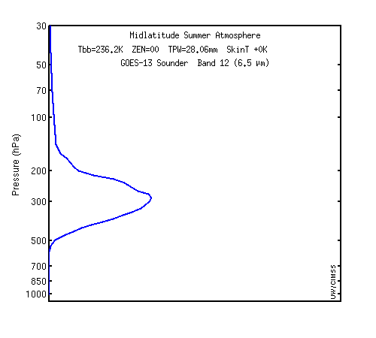
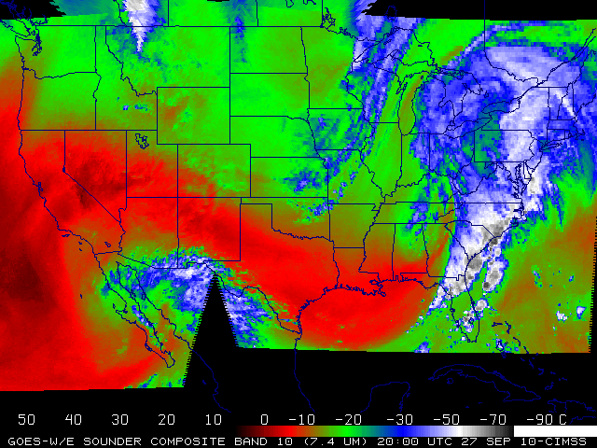
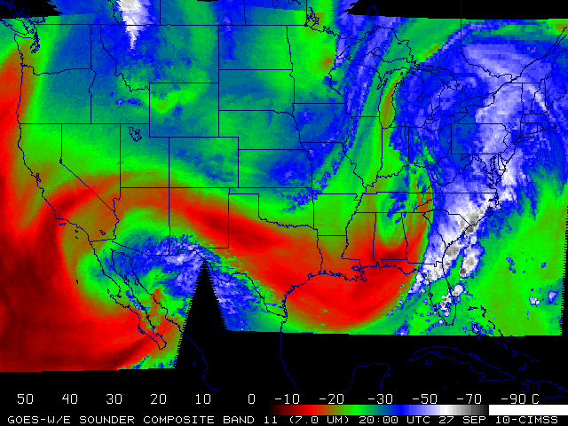
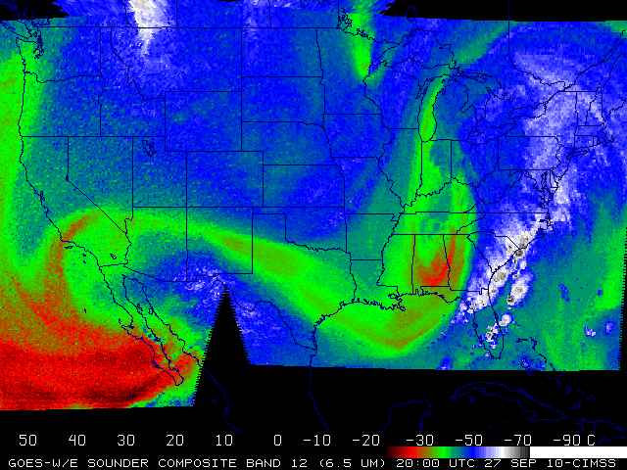
Current GOES-13 Sounder Weighting Functions
Geostationary satellites can provide information of mid-level water vapor.
7.5 µm
7.0 µm
6.5 µm
Plots courtesy of Mat Gunshor, CIMSS

Slide 9
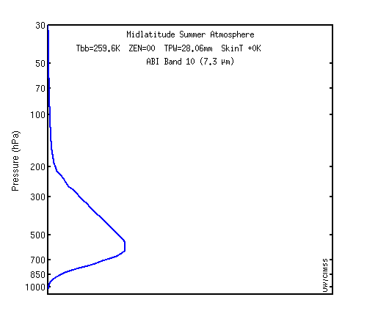
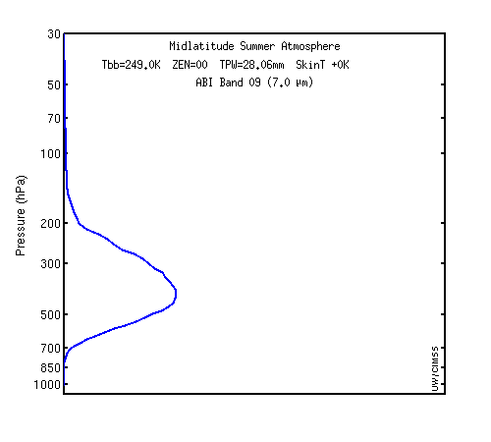
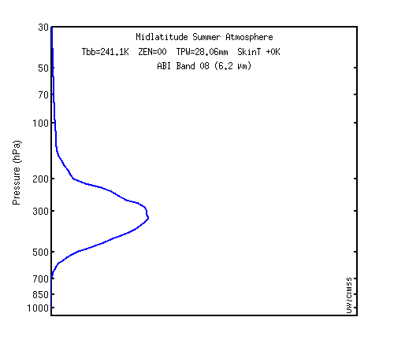
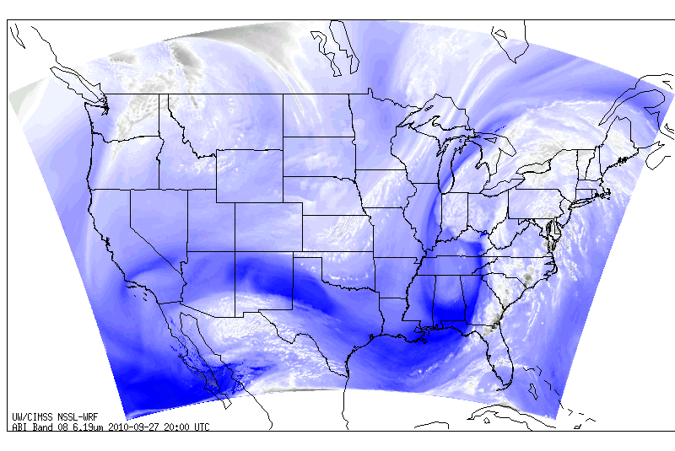
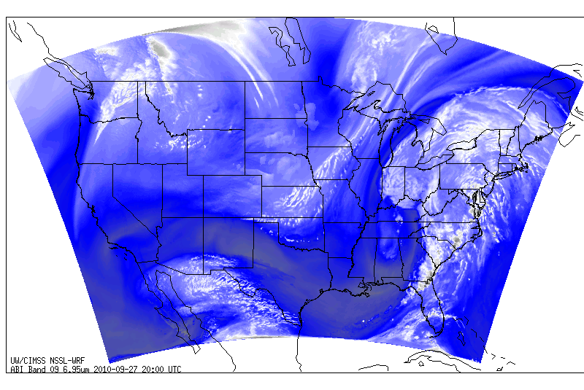
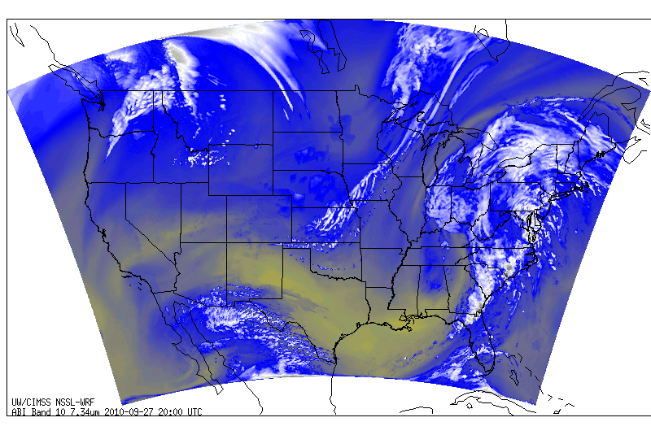
GOES-R ABI Weighting Functions
This capability will continue in the GOES-R era, but still no surface moisture resolution.
7.3 µm
7.0 µm
6.2 µm
Images courtesy of Justin Sieglaff, CIMSS
Simulated imagery

Slide 10
Experiment Design Objective: Understand NWP response to variable moisture concentrations.
Three Advanced Research Weather Research and Forecast (WRF-ARW) simulations are run twice daily (00/12Z):
WRFX – Initial conditions and boundary conditions from previous (06/18Z) GFS run
WRFY – Initial conditions and boundary conditions from initial hour CRAS20MKX run
WRFZ – Initial conditions of previous (06/18Z) GFS run modified with GOES-13 Sounder retrievals and GFS boundary conditions
Dynamics | Non-Hydrostatic with Gravity Wave Drag
Cumulus Scheme | Kain-Fritsch
Microphysics Scheme | WSM Single-Moment 5-Class
PBL Scheme | Yonsei University
Land Surface Scheme | Noah 4-Layer LSM
Surface Layer Physics | Monin-Obukhov with heat and moisture surface fluxes
Long Wave Radiation | RRTM
Short Wave Radiation | Dudhia Scheme
Time-Integration Scheme | Runge-Kutta 3rd Order
Damping | Rayleigh
Each 36-hour simulation used:
an adaptive time step,
20 km horizontal spacing on 100 x 100 square grid consisting of 45 vertical levels, with
50 hPa at the top of the model.

Slide 11
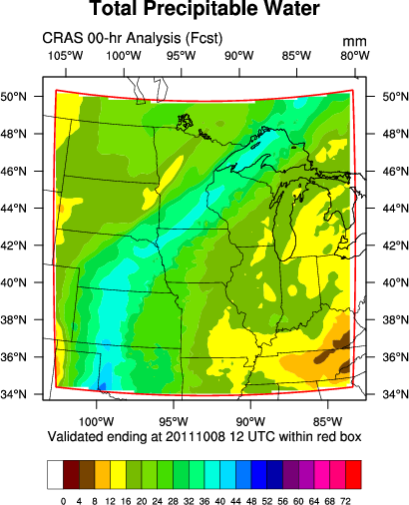
Experiment Domain Model and Verification
Model
Verification (non-precipitation)
Model Evaluation Tools (MET) v3 used for statistics.
The verification subset was chosen to discount any boundary condition influences from the results. In addition, the GOES Sounder does not scan above 50° N (approximately).
For point verification, approximately 70 GPS-TPW sites are within the red box.
For a mean flow speed of 20 knots, the domain is completely forced by boundary conditions after around 55 hours.

Slide 12
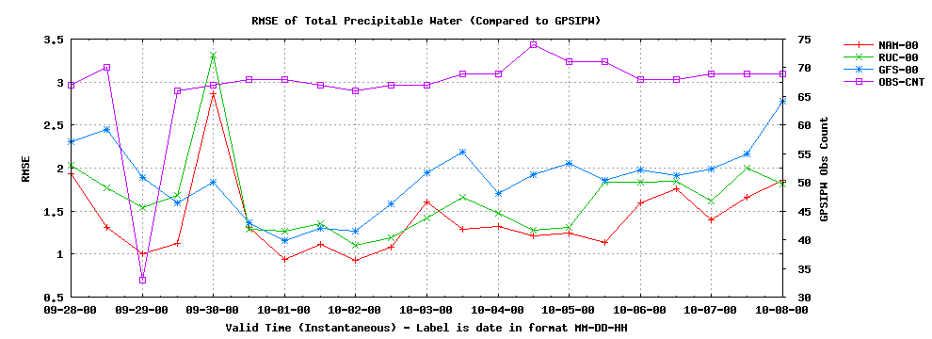
Total PW Mean Absolute Error Analyses verified against GPS-TPW
Model | Mean MAE
NAM | 1.04
RUC | 1.24
GFS | 1.43
The NAM and RUC assimilate GPS-TPW measurements, while the GFS does not.
Verified output every 12 hours between September 28, 2011, 00 UTC,
and October 8, 2011, 00 UTC, for a total sample of 21 times

Slide 13
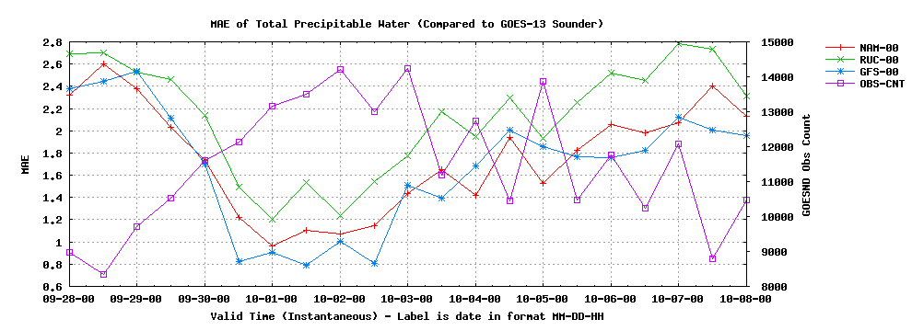
Total PW Mean Absolute Error Analyses verified against GOES-13 Sounder
Model | Mean MAE
GFS | 1.69
NAM | 1.76
RUC | 2.13
The GFS is used as the first guess for the GOES-13 Sounder retrievals, but not the GFS run it is verified against.
Verified output every 12 hours between September 28, 2011, 00 UTC,
and October 8, 2011, 00 UTC, for a total sample of 21 times
Low Obs, Cloudier

Slide 14
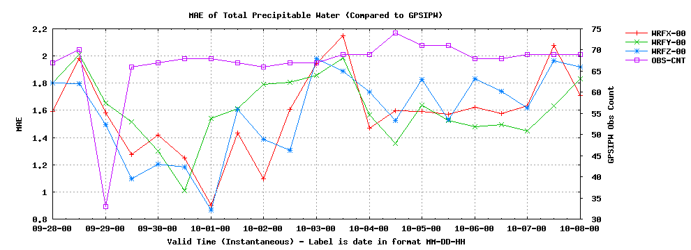
Total PW Mean Absolute Error Analyses verified against GPS-TPW
Model | Mean MAE
WRFX | 1.58
WRFZ | 1.59
WRFY | 1.61
Inconclusive results are due to the poor spatial heterogeneity of GPS sites across the domain compared to the magnitude of correction.
Verified output every 12 hours between September 28, 2011, 00 UTC,
and October 8, 2011, 00 UTC, for a total sample of 21 times

Slide 15
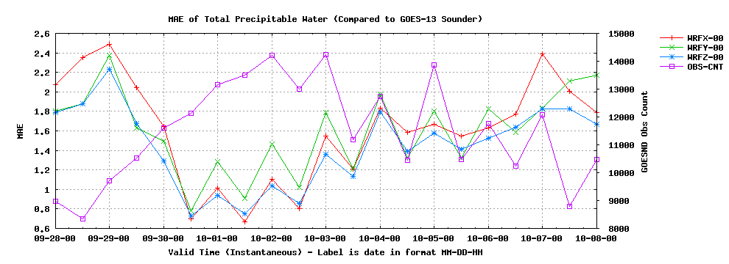
Total PW Mean Absolute Error Analyses verified against GOES-13 Sounder
Model | Mean MAE
WRFZ | 1.44
WRFY | 1.59
WRFX | 1.61
The WRFY and WRFZ contain Sounder retrievals which improve the MAE in clear fields of view.
Verified output every 12 hours between September 28, 2011, 00 UTC,
and October 8, 2011, 00 UTC, for a total sample of 21 times
Low Obs, Cloudier

Slide 16
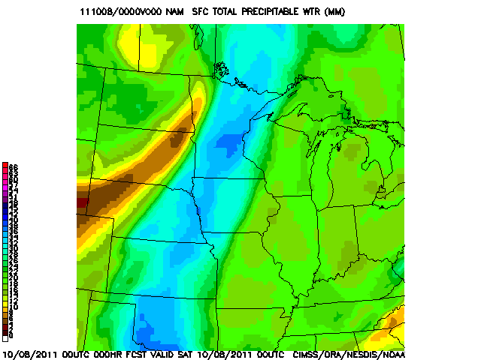
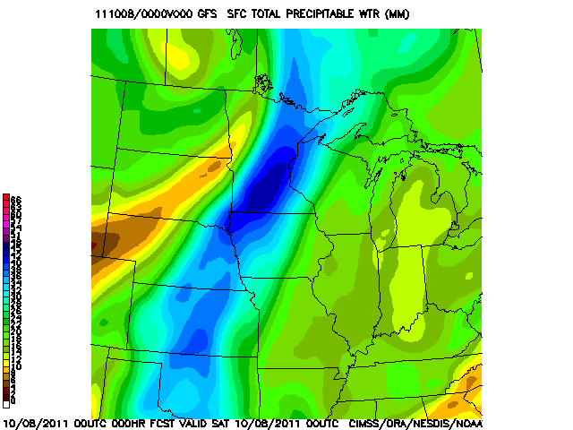
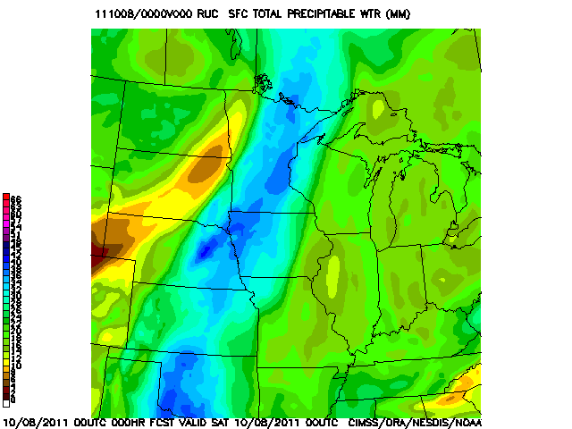
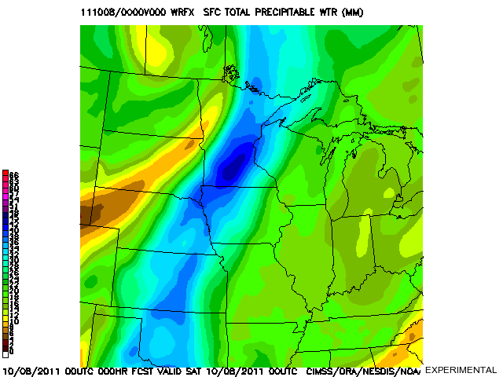
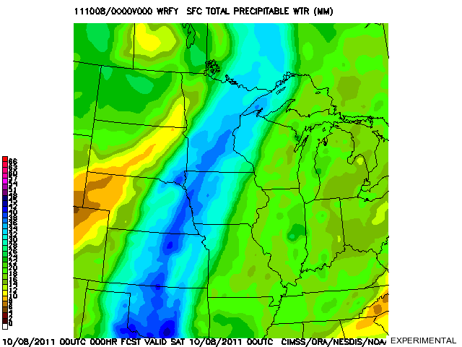
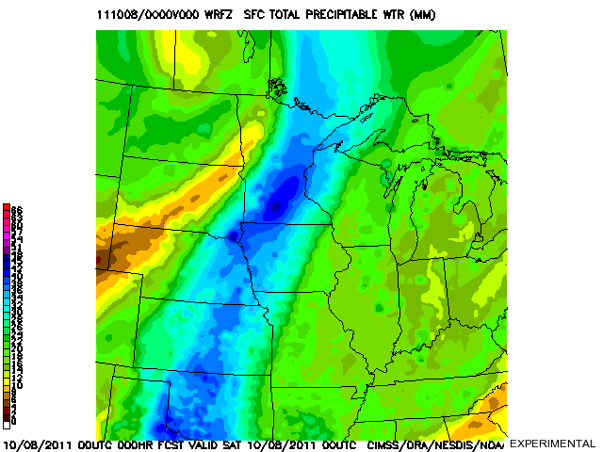
Total Precipitable Water Analyses for 8 October 2011, 00 UTC
NAM
T+0
GFS
T+0
RUC
T+0
WRFX
T+0
WRFY
T+0
WRFZ
T+0

Slide 17
Total Precipitable Water Analyses for 8 October 2011, 00 UTC

Slide 18
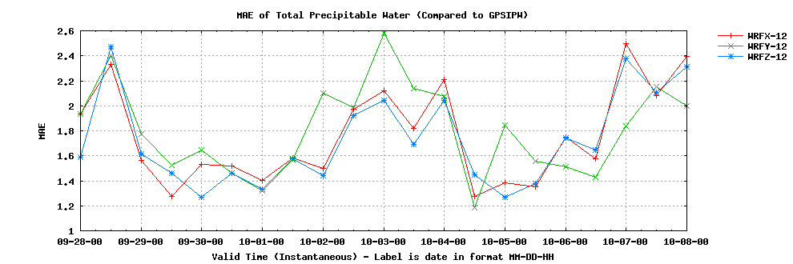
Total PW Mean Absolute Error Forecasts verified against GPS-TPW
12-hour
Model | Mean MAE
WRFZ | 1.72
WRFX | 1.77
WRFY | 1.81
24-hour
36-hour
Model | Mean MAE
WRFZ | 2.01
WRFX | 2.01
WRFY | 2.23
Model | Mean MAE
WRFX | 2.30
WRFZ | 2.31
WRFY | 2.79
Verified output every 12 hours between September 28, 2011, 00 UTC,
and October 8, 2011, 00 UTC, for a total sample of 21 times

Slide 19
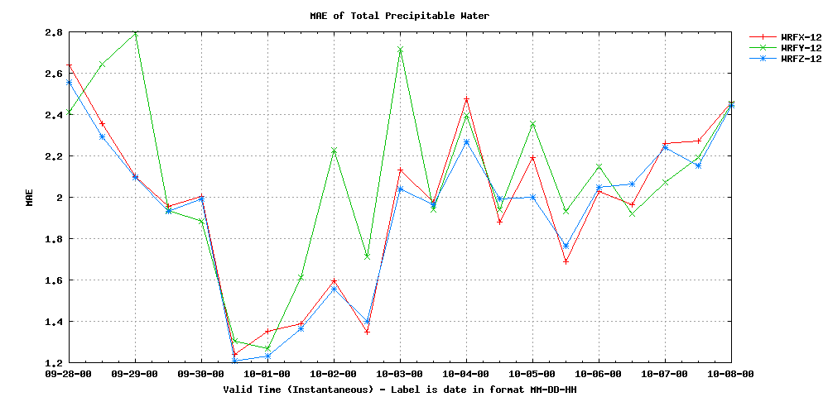
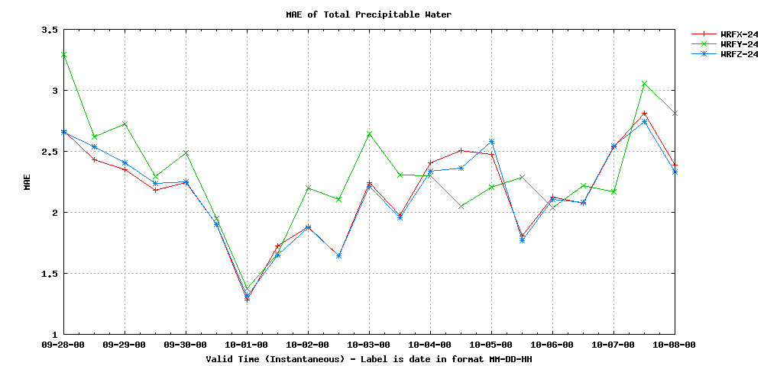
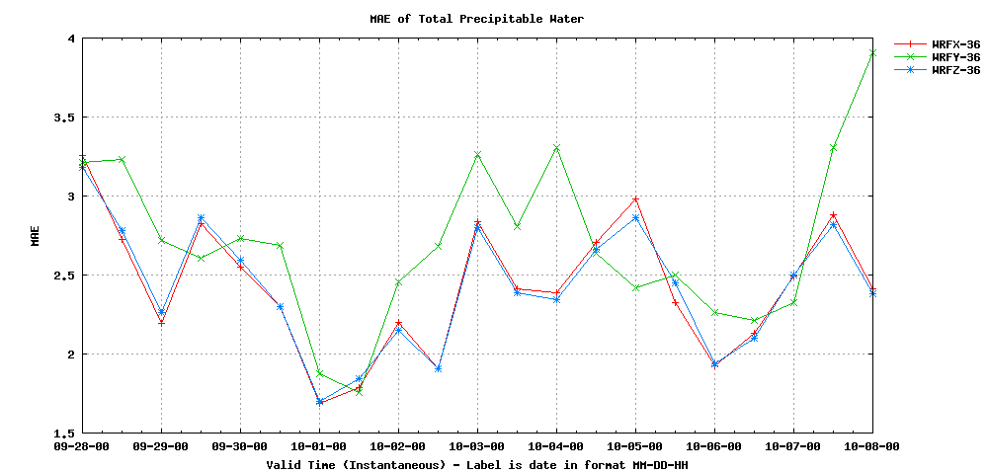
Total PW Mean Absolute Error Forecasts verified against NAM analysis
12-hour
Model | Mean MAE
WRFZ | 1.93
WRFX | 1.97
WRFY | 2.09
24-hour
36-hour
Model | Mean MAE
WRFZ | 2.17
WRFX | 2.17
WRFY | 2.32
Model | Mean MAE
WRFZ | 2.42
WRFX | 2.43
WRFY | 2.71
Verified output every 12 hours between September 28, 2011, 00 UTC,
and October 8, 2011, 00 UTC, for a total sample of 21 times

Slide 20
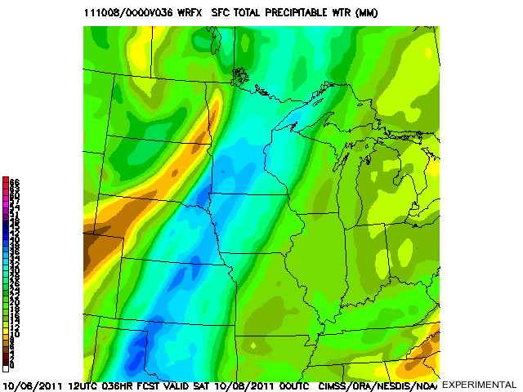
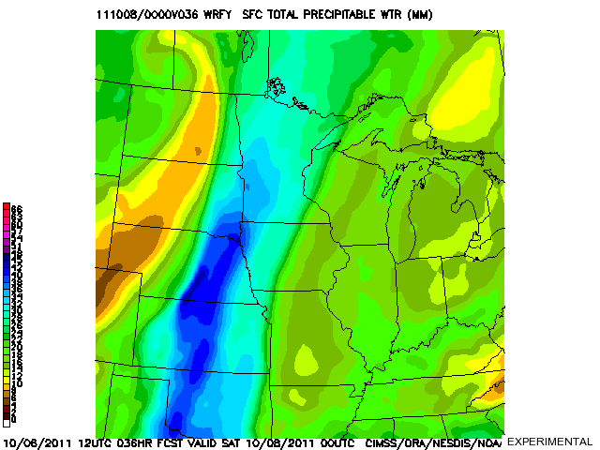
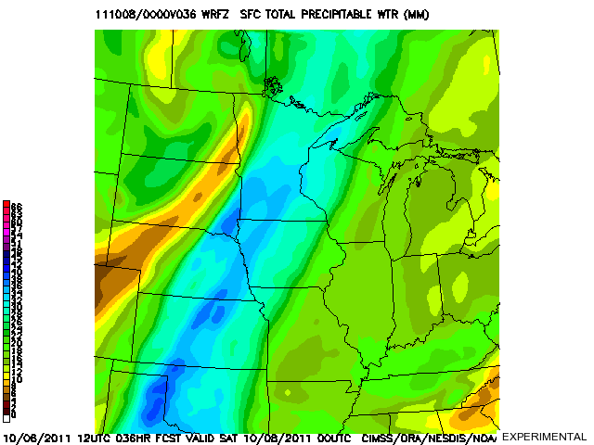
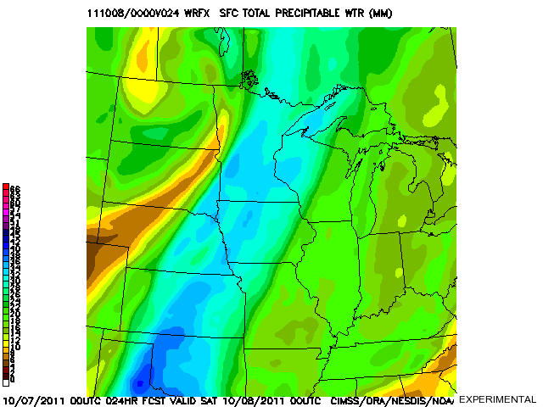
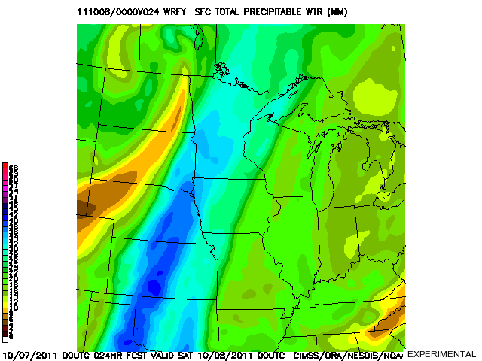
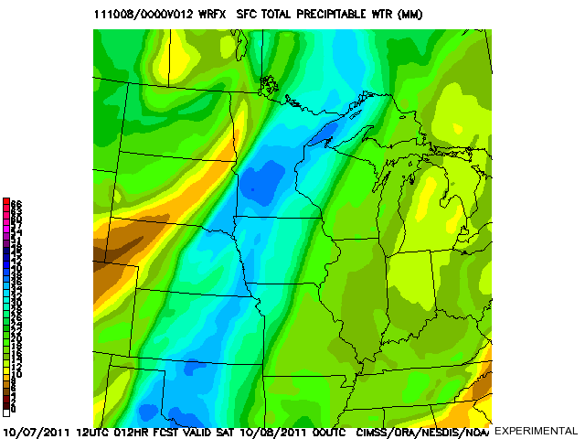
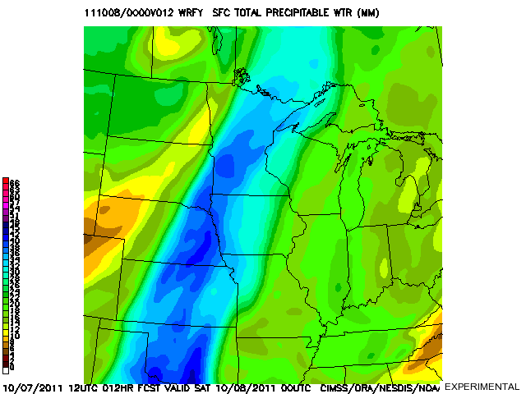
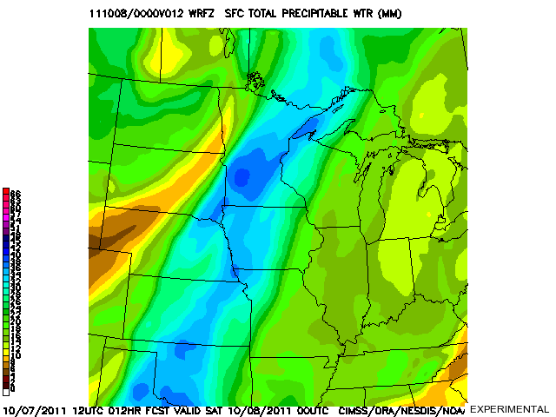
WRFX
T+36
WRFY
T+36
WRFZ
T+36
WRFX
T+24
WRFY
T+24
WRFZ
T+24
WRFX
T+12
WRFY
T+12
WRFZ
T+12

Slide 22
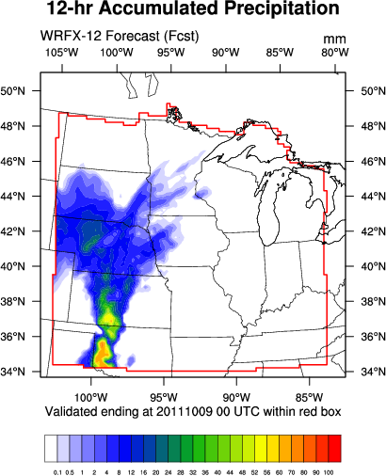
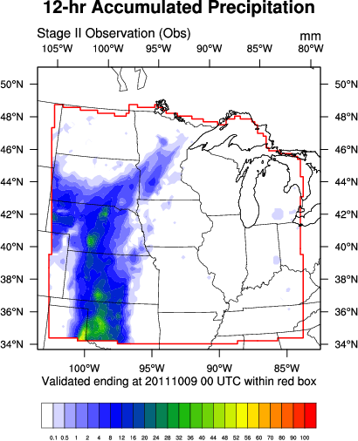
Precipitation: WRFX vs. WRFZ 12-hr Accumulation ending 9 October 2011, 00 UTC
Model | MAE (ST2)
WRFZ | 1.48
WRFX | 1.65
WRFX produced more precipitation than observed over south central Kansas.

Slide 23
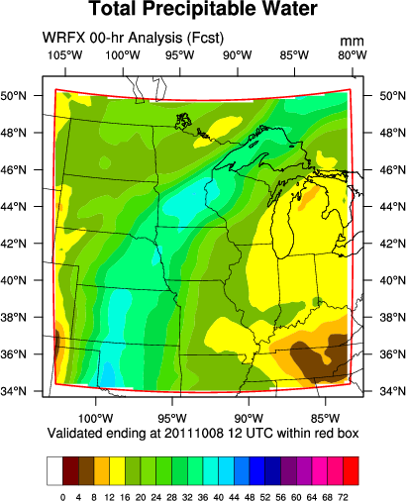
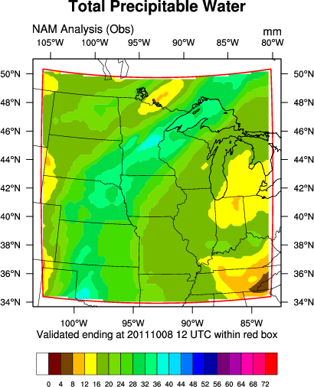
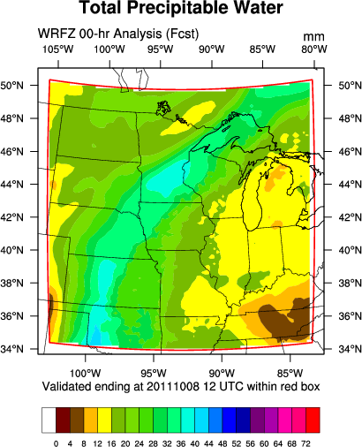
PW Analysis: WRFX vs. WRFZ Valid 8 October 2011, 12 UTC
WRFX started with PW up to 8 mm too moist over eastern Kansas, whereas the WRFZ exhibited less bias.

Slide 24
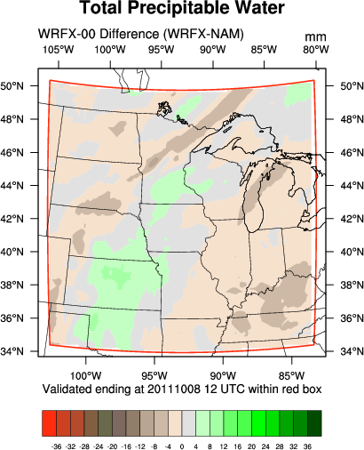
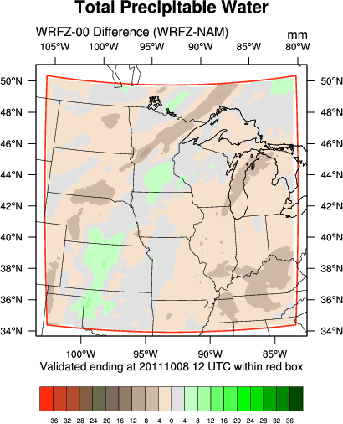
PW Analysis: WRFX vs. WRFZ Valid 8 October 2011, 12 UTC
Model | MAE (GPS)
WRFZ | 1.58
WRFX | 1.87
WRFX started with PW up to 8 mm too moist over eastern Kansas, whereas the WRFZ exhibited less bias.

Slide 25
Summary of Presented Results Runs from 28 September to 8 October 2011
Comparing WRFX and WRFZ, two sources of precipitable water verification confirm forecasts are better 12 hours after initialization if GOES-13 Sounder input is included.
This may produce better precipitation verification, but not in regimes favoring light precipitation or limited areal extent.
No substantial impact of added observations at 24 or 36 hours in the late September, early October flow regime.
Lesser performance of WRFY suggests that CRAS dynamics and physics are influencing the solution negatively.

Slide 26
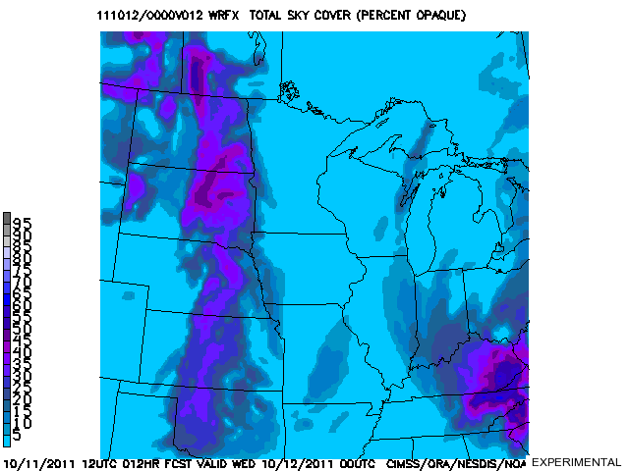
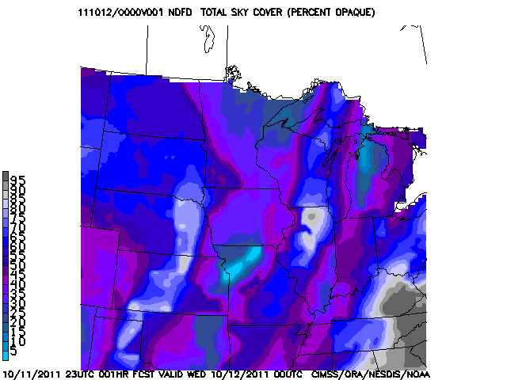
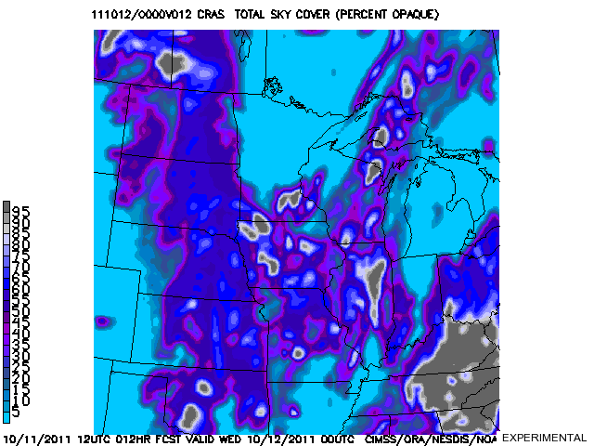
Advantages of CRAS Cloud Fraction Still Supreme
Default WRF cloud fraction takes the average of three primary layers (low, mid, and high). Maximum cloud fraction can be computed if those three layers are averaged (they can be output).
12-hr Cloud Cover Forecast MAE compared to the 1-hr NDFD is approximately 20% for CRAS, 25% for WRF with maximum cloud adjustment, and 30% for default WRF.
NDFD may overestimate clouds when actually clear.
These sample images, compared 12-hr forecasts to the NDFD, are valid at 12 October 2011, 00 UTC.
WRFX Default Cloud Fraction
NDFD 1-hr Cloud Cover Forecast
CRAS Cloud Fraction Default
WRFX Maximum Cloud Fraction
Notes:
CRAS multi-layer, multi-type approach described in NWA 2009 presentation (by Gerth and Aune): “A New Numerical Weather Prediction Approach to the NDFD's Sky Cover Grid”

Slide 27
Predictions for Winter Performance Statistics online at http://cimss.ssec.wisc.edu/cras/
More clouds means likely less Sounder observations.
Faster flow conditions will advect observations off the domain fairly early in the simulations.
In clear conditions, a drier upper troposphere will favor observed moisture contributions from lower in the atmosphere.
Dynamic weather systems resulting in well-forced precipitation may show impact of precipitable water assimilation on precipitation amounts better than weakly-forced, high-moisture convective precipitation regimes.

Slide 28
Example from CIMSS Satellite Blog: Wintertime Water Vapor
Calculated weighting functions based on
February 6, 2007, 00 UTC, radiosonde taken at Upton, NY.
Water vapor near the surface is detected by the GOES-12 Imager and Sounder due to very limited emission (low water vapor) in the upper troposphere.
http://cimss.ssec.wisc.edu/goes/blog/

Slide 29
Final Thoughts
Satellite observations play a fundamental role in NWP solutions.
Leveraging the GOES Sounder is one way to improve the accuracy of the WRF-ARW forecast within the first 12 to 24 hours, especially away from oceans, where TPW retrieval assimilation does not occur in operational models.
Subtle changes to the moisture field can impact NWP performance.
Graphical output and real-time statistics from experiment are available online, as well as BUFKIT profiles for select cities.
We are always interested in partners looking to engage in joint projects involving satellite meteorology and NWP.
Author Information:
Jordan Gerth, Jordan.Gerth@noaa.gov

