Slide 1
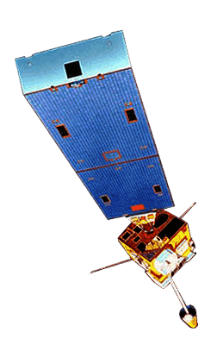

Improving Cloud and Moisture Representation by Assimilating GOES Sounder Products into Analyses for NWP
Jordan Gerth, Research Assistant
Cooperative Institute for Meteorological Satellite Studies
Department of Atmospheric and Oceanic Sciences
University of Wisconsin—Madison
CIMSS/SSEC Seminar – Wednesday, December 14, 2011

Slide 2
Basic Premise of NWP
An Initial Value Problem
The following constrain the accuracy of numerical weather prediction (NWP) solutions:
  Parameterizations and approximations within the model
  Atmospheric features occurring on scales smaller than resolved by the model
  Limited observations to populate the initial analysis (especially in the “upper air” and over oceans)
  Quality, precision, and accuracy of the observations
  Boundary conditions and domain size

Slide 3
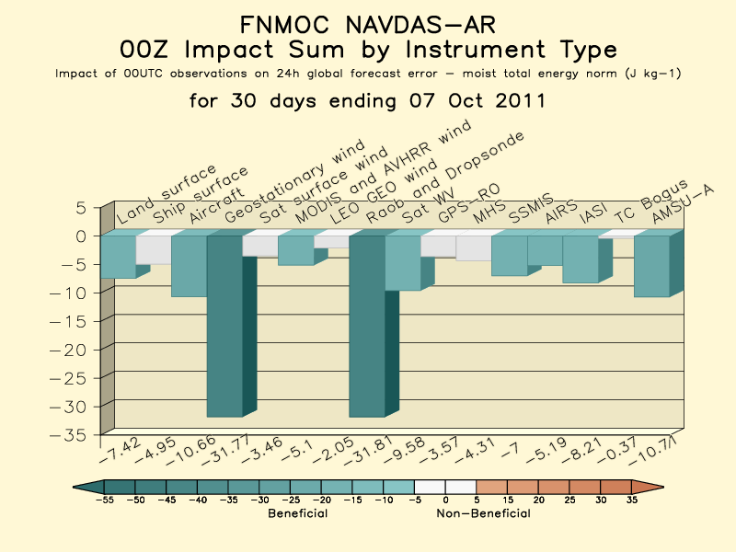
For Fleet Numerical Meteorology and Oceanography Center NOGAPS model
http://www.nrlmry.navy.mil/obsens/

Slide 4
Research Questions
What contribution can GOES Sounder cloud and moisture retrievals provide to improving the moisture analysis for regional NWP models with a horizontal grid length of approximately 20 km?
  Grid length considered for parameterizations and retrieval density
  NWS Milwaukee model configuration/domain used
How do these retrievals manifest into a better solution over the first 12 to 24 hours of the simulation?
How can cloud fraction be formulated from retrievals to better match the expectations of operational users?

Slide 5

Information Extracted from Satellites for Numerical Weather Prediction
Radiances
Direct assimilation (3Dvar)
Requires model errors, observation errors
Scale dependence
Surface type restrictions
Retrieved parameters
Dependent variable assimilation (1,3Dvar)
Requires model errors, retrieval errors
Physical accuracy, non-linearity
Bypass surface type restrictions
Motion
Cloud track, water vapor track
Height assignment errors
Radiance tracking (4Dvar)
The CIMSS Regional Assimilation System (CRAS) is used to assess the impact of space-based observations on numerical forecast accuracy.
CRAS is unique in that, since 1996, it’s development was guided by validating forecasts using information from GOES.
Output online:
http://cimss.ssec.wisc.edu/cras/
Slide credit: Robert Aune, NOAA/NESDIS

Slide 6
CIMSS Regional Assimilation System (CRAS)
The 12-hour spin-up currently uses:
3-layer precipitable water (mm) from the GOES-13/15 sounders
Cloud-top pressure (hPa) and effective cloud amount (%) from the GOES-13/15 sounders
4-layer thickness (m) from the GOES-13/15 sounders
Cloud-top pressure (hPa) from MODIS
Gridded hourly precipitation amounts from NCEP
Cloud-track and water vapor winds (m/s) from the GOES-13/15 imagers
Cloud-top pressure (hPa) and effective cloud amount (%) from the GOES-13 imager
Surface temperature (C), dew points (C) and winds (m/s)
Sea surface temperature (C) and sea ice coverage (%) from NCEP rtg analysis

Slide 7
US Operational Forecast Models
Limited use of GOES Sounder observations
The North American Model (NAM) and Global Forecast System (GFS) do use brightness temperatures from the GOES Sounders (GOES-W/15 and GOES-E/13) over ocean as part of their radiance assimilation system.
However, they do not use retrievals, and they do not use GOES Sounder observations over land.
The Rapid Update Cycle (RUC) does use precipitable water (PW) retrievals over ocean from GOES-15 only.
Notes:
Source for NAM: http://www.emc.ncep.noaa.gov/mmb/data_processing/prepbufr.doc/table_4.htm
Source for GFS: http://www.emc.ncep.noaa.gov/mmb/data_processing/prepbufr.doc/table_2.htm
Source for RUC: http://www.emc.ncep.noaa.gov/mmb/data_processing/prepbufr.doc/table_5.htm
Additional source: http://www.emc.ncep.noaa.gov/mmb/data_processing/prepbufr.doc/table_18.htm

Slide 8
Cloud and Moisture Assimilation
Methodology and Examples

Slide 9
Assimilating GOES Sounder in CRAS
Cloud-top pressure and effective cloud amount are used adjust cloud water mixing ratio in the model. Cloud checks are performed for low, high, and multi-layer clouds.
Background GOES Operation
Clear Clear Do nothing (check RH)
Cloudy Cloudy Adjust cloud, RH, match top (up to two layers)
Cloudy Clear Clear cloud, adjust RH
Clear Cloudy Build new cloud, adjust RH
Water Vapor Adjustments using GOES 3-Layer Precipitable Water Retrievals (Li).
1) Mean background mixing ratio profile is computed.
2) Perturbations are removed.
3) Mean profile is adjusted to match GOES 3-layer PW using 1D var (strong constraint).
4) Perturbations are added to adjusted profile.
5) RH profile checked for “clearness”.
A 12-hour spin-up forecast is used to initialize water vapor and clouds.
T-12 T-9 T-6 T-3 T=0
Forecast
…………………………… GOES Sounder PW and Cloud ……………………………
Slide credit: Robert Aune, NOAA/NESDIS

Slide 10
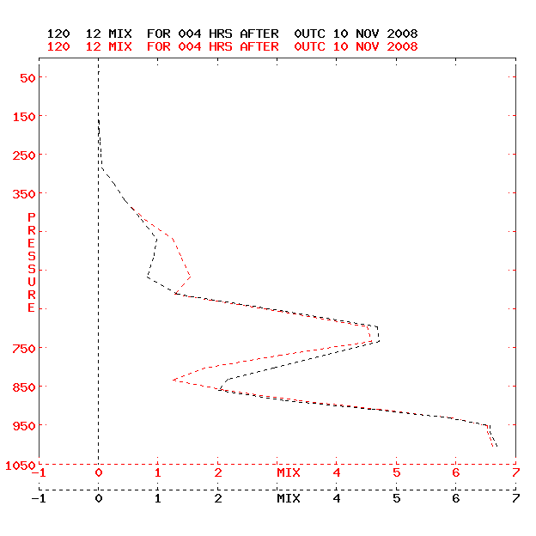
Assimilating 3-Layer Precipitable Water from GOES
CRAS water vapor adjustments using GOES 3-layer precipitable water retrievals are performed for clear fields-of-view only. This slide describes the procedure.
Mixing ratio profile before (red) and after (black) assimilating total precipitable water from the GOES sounder
* Smith, W.L., 1966: Note on the relationship between total precipitable water and surface dew point. J. Appl. Meteor., 5, 726-727.
Slide credit: Robert Aune, NOAA/NESDIS

Slide 11
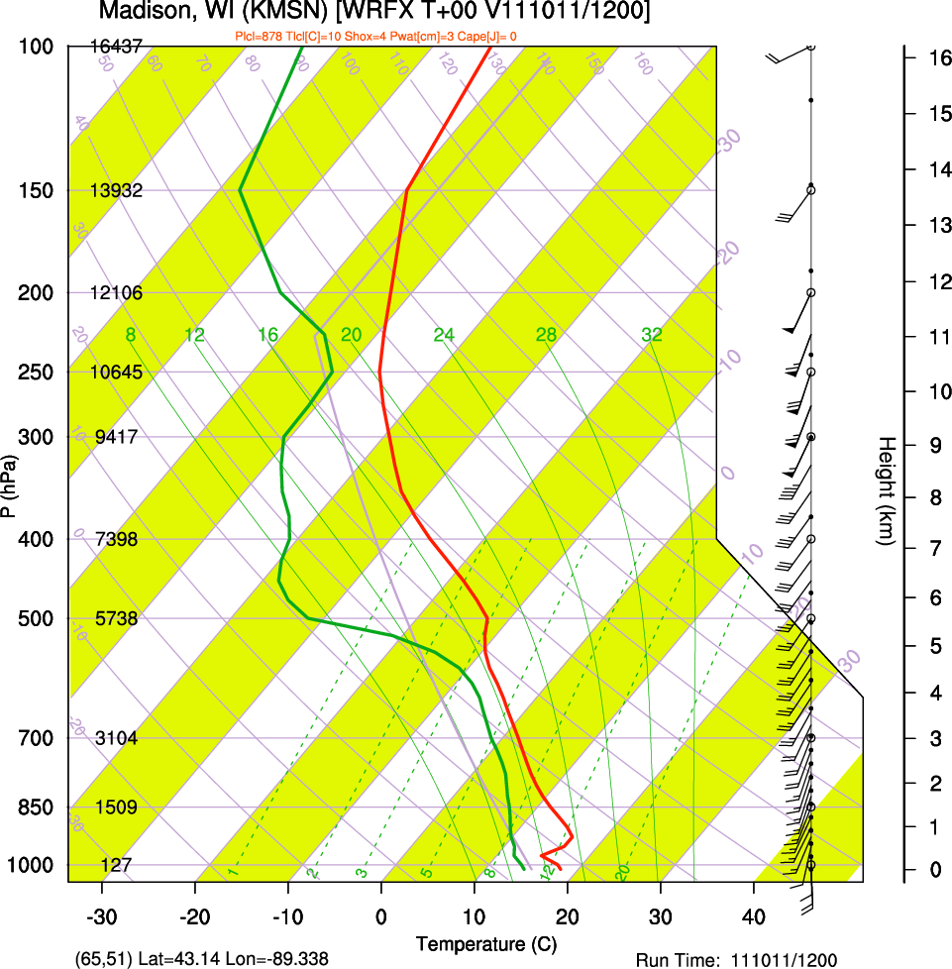
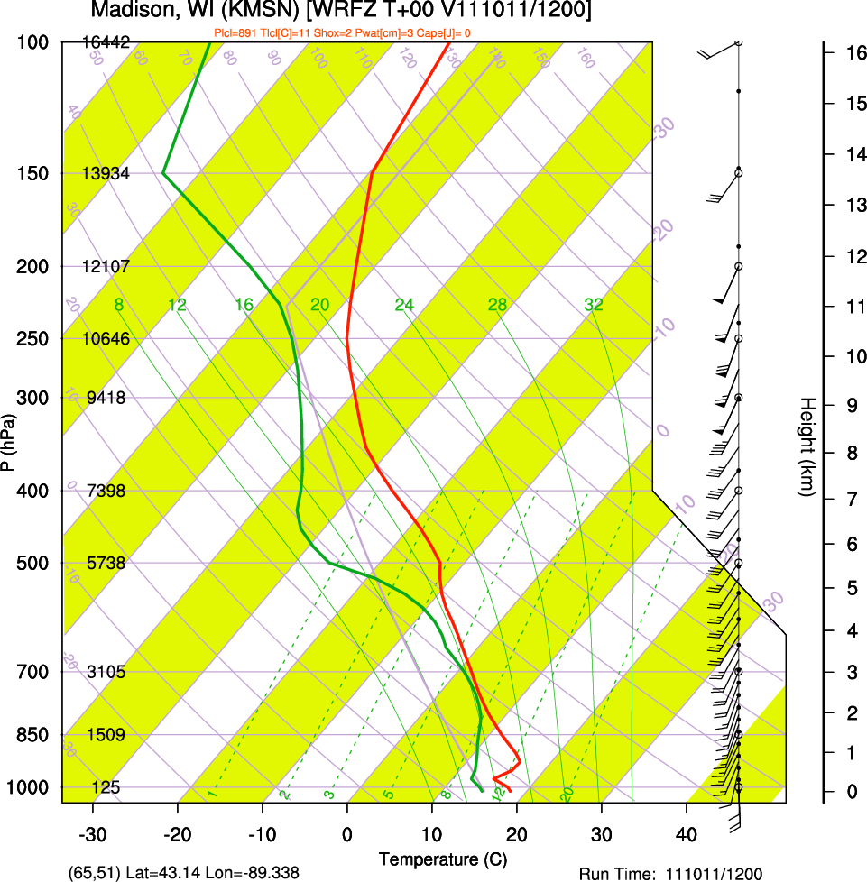
GOES-13 Sounder Moisture Correction
Madison, WI; 11 October 2011, 12 UTC
This example shows how moisture is added to the background analysis ahead of approaching precipitation while the distribution is maintained.
Background
(GFS)
Sounder
adjusted

Slide 12
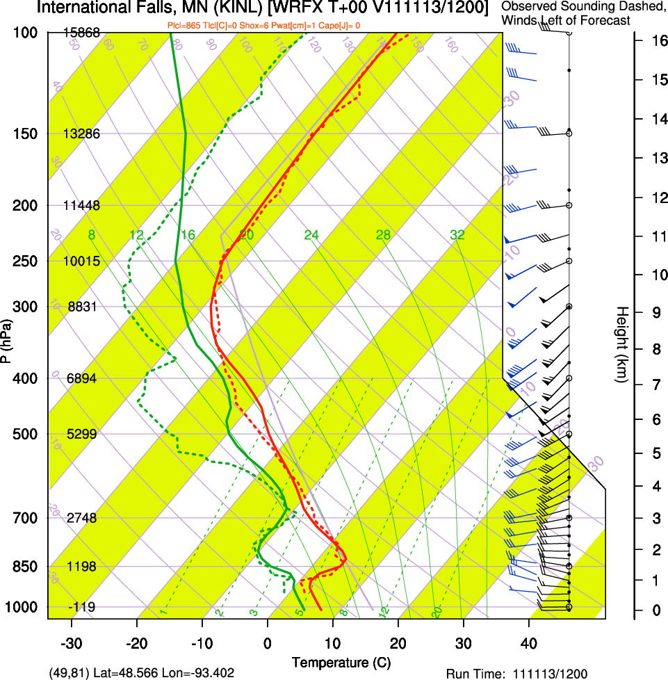
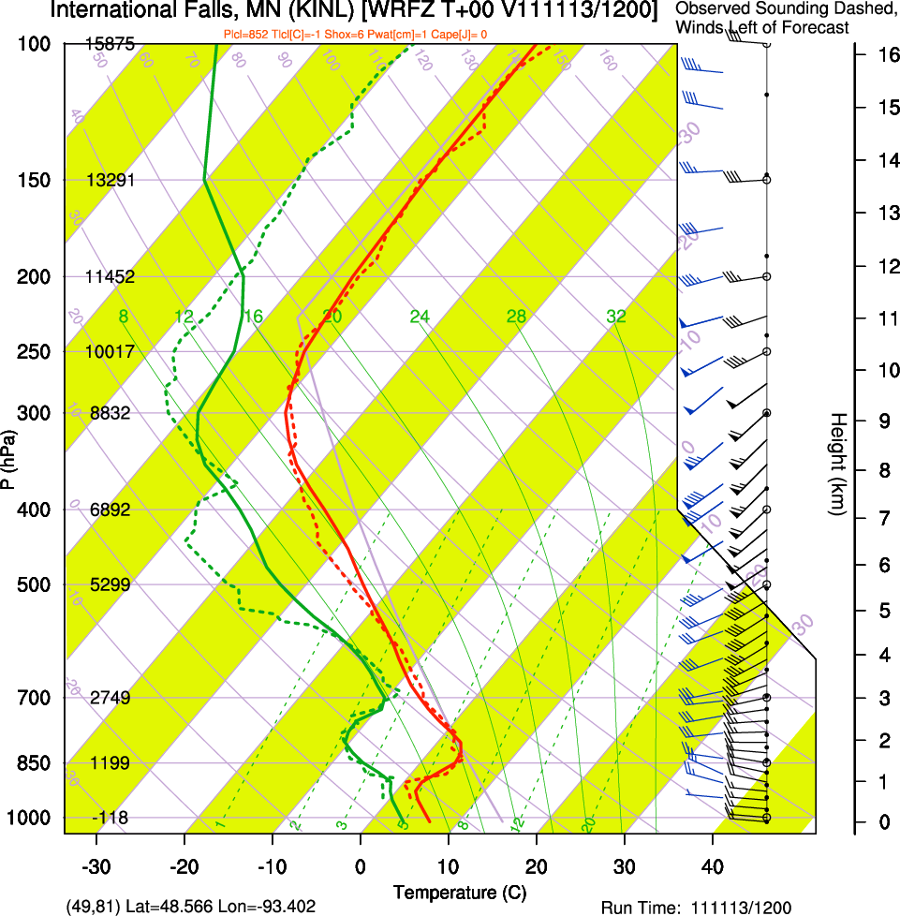
GOES-13 Sounder Moisture Correction
International Falls, MN; 13 November 2011, 12 UTC
This example shows the improvement to the background (left) by the GOES Sounder retrieval (right), compared to a radiosonde (dashed).
Background
(GFS)
Sounder
adjusted

Slide 13
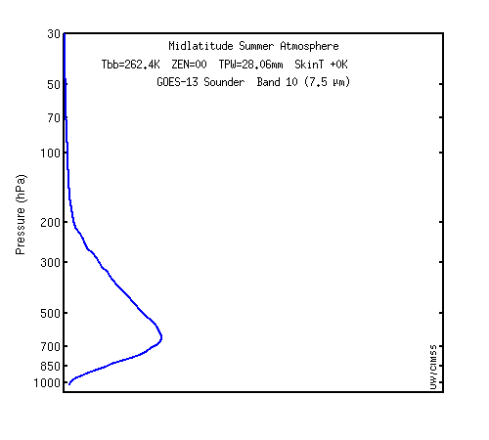
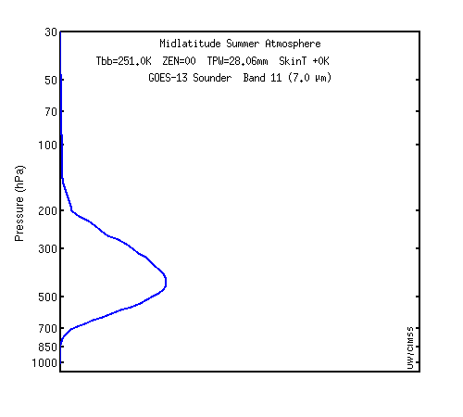
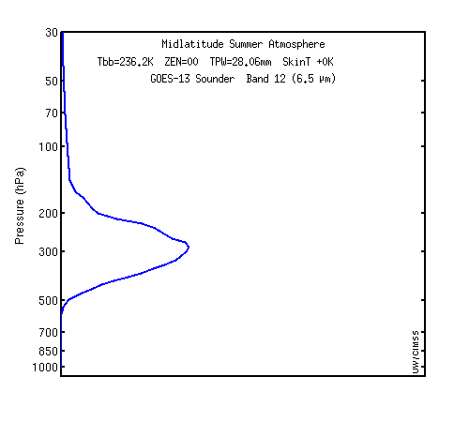
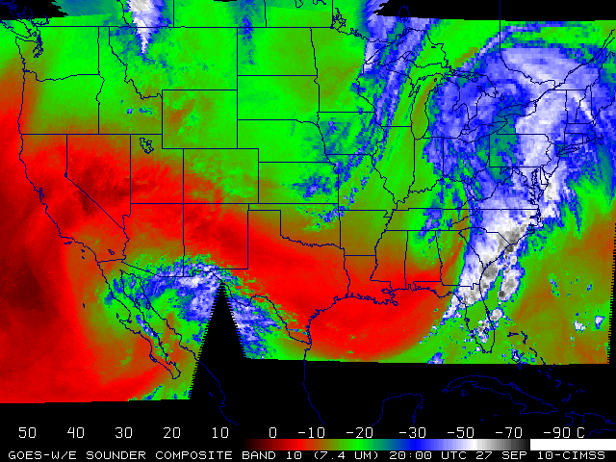
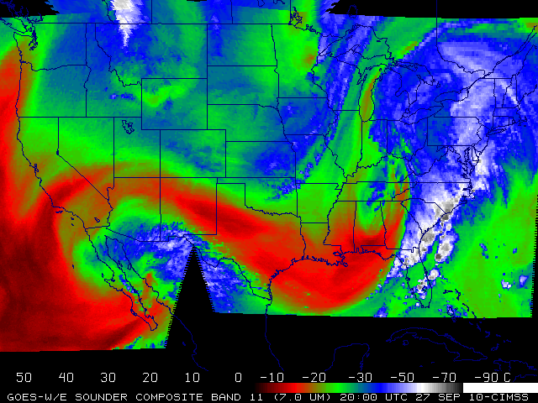
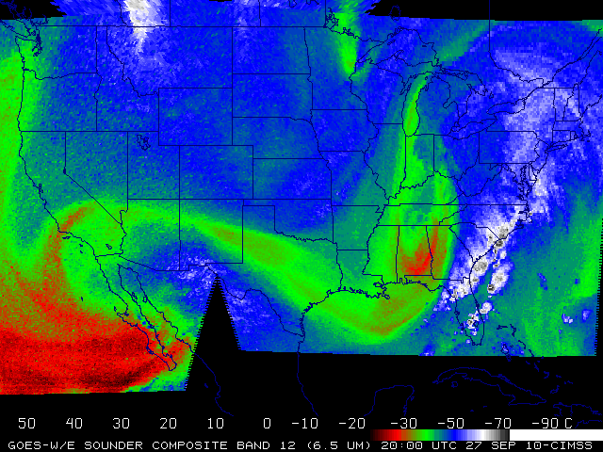
Current GOES-13 Sounder Weighting Functions
Geostationary satellites can provide information of mid-level water vapor.
7.5 µm
7.0 µm
6.5 µm
Plots courtesy of Mat Gunshor, CIMSS

Slide 14
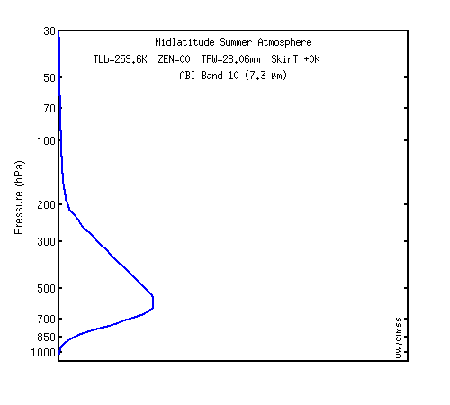
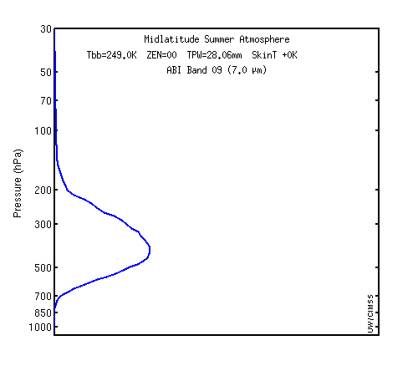
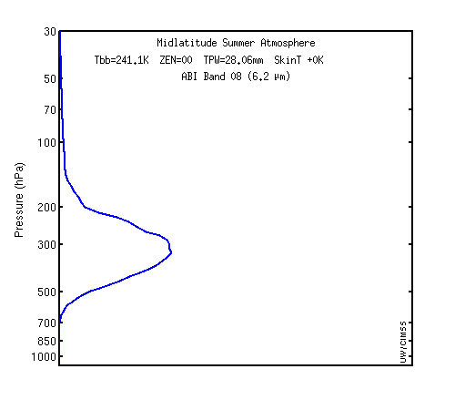
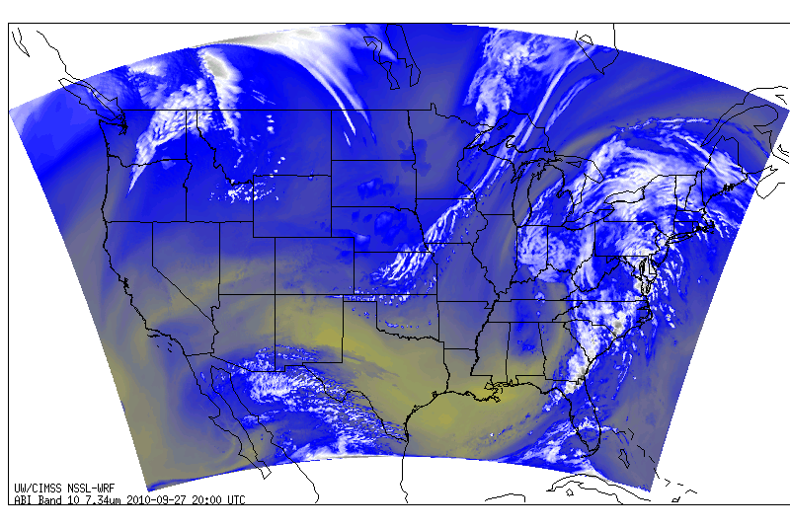
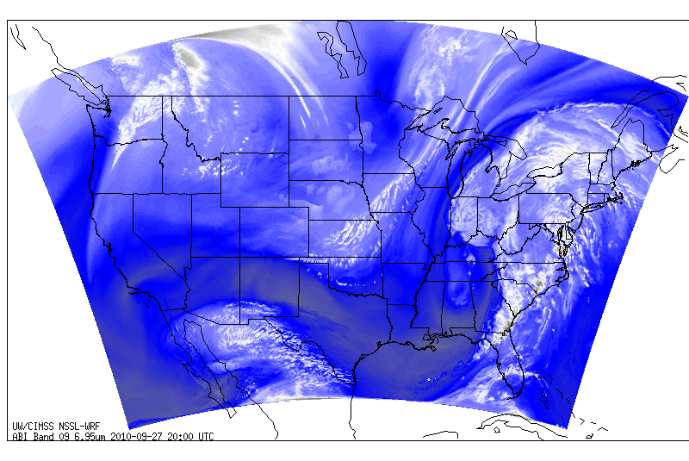
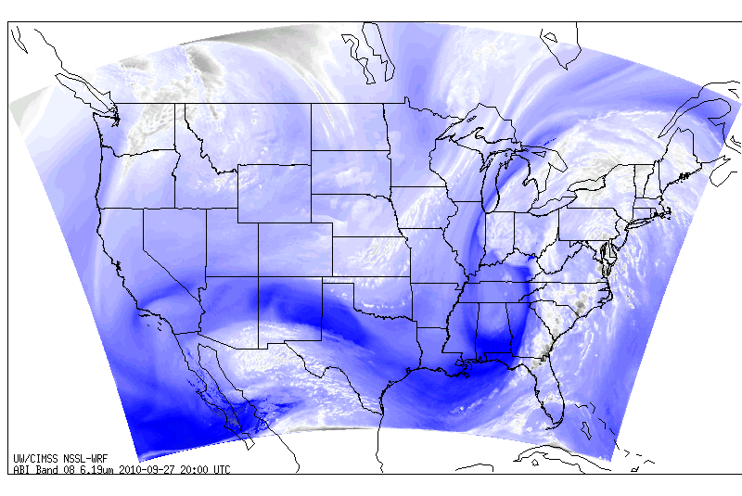
GOES-R ABI Weighting Functions
This capability will continue in the GOES-R era, but still no surface moisture resolution.
7.3 µm
7.0 µm
6.2 µm
Images courtesy of Justin Sieglaff, CIMSS
Simulated imagery

Slide 15
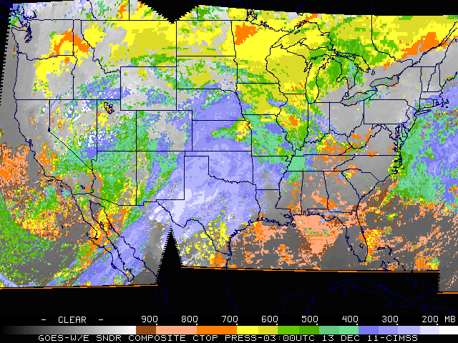
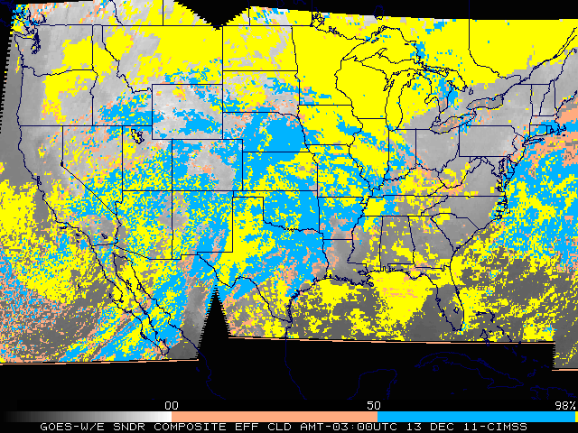
Assimilating Clouds from GOES
Retrievals of cloud-top pressure (CTP) and effective cloud amount (ECA) from GOES are used to adjust cloud water mixing ratio in the CRAS spin-up forecast. (Similar to Bayler et.al., 2000, Mon. Wea. Rev. 128, 3911-3920.)
Cloud Modification Options
Background GOES Operation
Clear Clear Check RH
Cloudy Clear Clear cloud, adjust RH
Clear/Cloudy Cloudy Build cloud, adjust RH, match top
Procedure
Given:
CTP_{M}(n) = GOES cloud-top pressure vector at grid cell, n = count
ECA_{M}(n) = GOES effective cloud amount vector at grid cell, n = count
q_{c}(k) = cloud mixing ratio at model level k
q*_{c}(T) = Max cloud mixing ratio (Auto-conversion)
n(k) = # GOES retrievals per model grid cell
Bin 5km CTP_{M}(n) onto a model grid cell
Sort grid cell CTP_{M} and ECA_{M} onto model pressure levels
If RH(k) > RH_{evap}(k) – 20%, proceed
Clear cloud above CTP_{M} , q_{C}(k) | (CTP_{M} , top) = 0
For layers above 600 hPa: q_{c}(k) = [ Σ_{n} ECA_{M}(k) ] / n(k) x q*_{c}(T)
For layers below 600 hPa: q_{c}(k) = n_{cld}(k) / n(k) x q*_{c}(T)
Slide credit: Robert Aune, NOAA/NESDIS

Slide 16
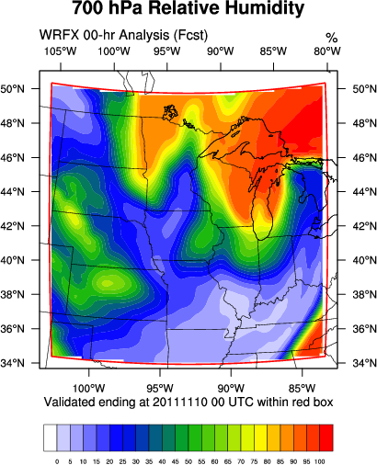
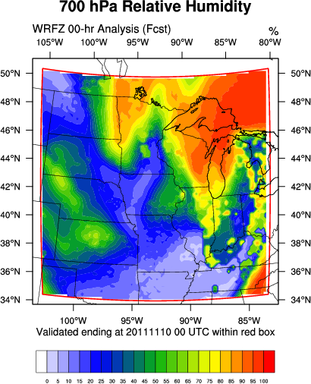
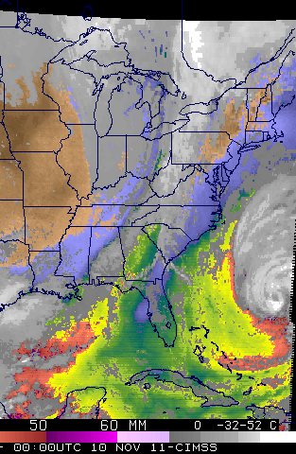
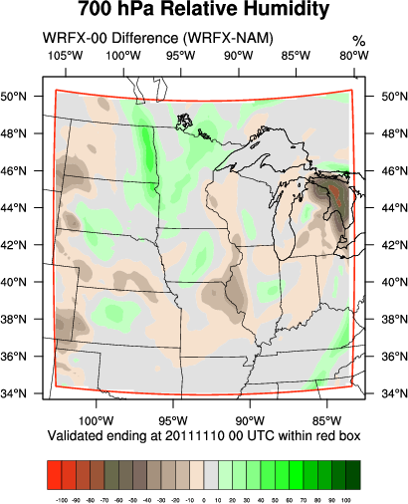
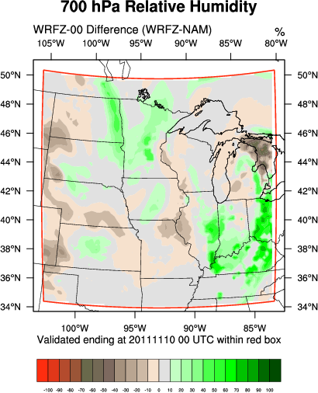
700 hPa Relative Humidity Adjustments from Cloud Assimilation

Slide 17
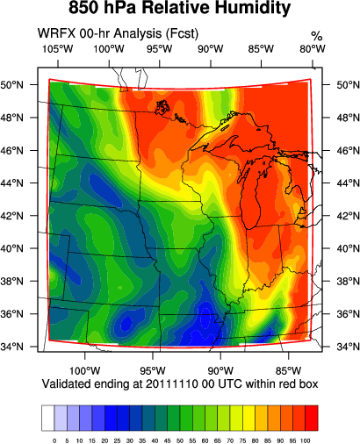
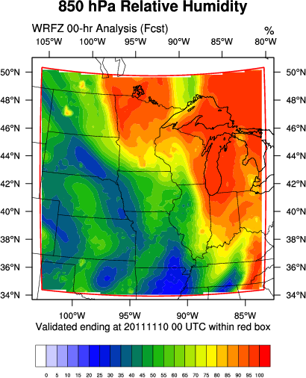
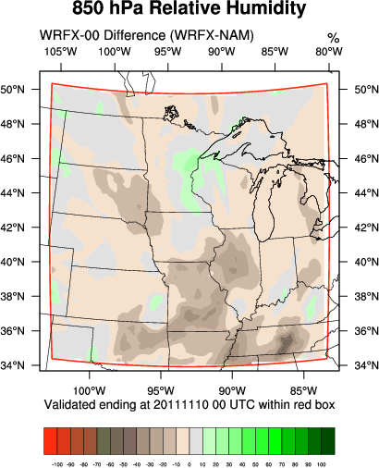
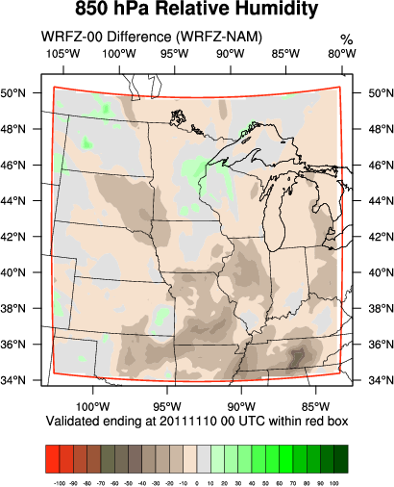
850 hPa Relative Humidity Adjustments from Cloud Assimilation

Slide 18
Response of kain-fritsch convective scheme to different moisture concentrations
Part A

Slide 19
Kain-Fritsch (KF) Convective Scheme
The WRF simulations in this experiment all utilize the Kain-Fritsch convective parameterization, which
  is a mass flux scheme
  requires an adjusted response based on the grid scaling
The closure for the KF scheme is convective available potential energy (CAPE).
  This is an important source for
    latent heat release
    accumulated convective precipitation

Slide 20
Kain-Fritsch (KF) Convective Scheme
It has been shown in Kain and Fritsch (1990) that the normalized vertical mass flux varies significantly
  by a factor of two in the upper troposphere for changes of relative humidity between 50% and 90%.
This sensitivity is critical because, for cold temperatures, the amount of water vapor mixing ratio required to adjust the relative humidity is not particularly substantial.

Slide 21
Experiment I Design
Objective: Understand NWP response to different moisture concentrations.
Approximate change in mixing ratio from GFS initial conditions
Six simulations:
GFS Initial Conditions
Dynamics | Non-Hydrostatic
Cumulus Scheme | Kain-Fritsch
Microphysics Scheme | WSM Single-Moment 5-Class
PBL Scheme | Yonsei University
Land Surface Scheme | 5-Layer Thermal Diffusion LSM
Surface Layer Physics | Monin-Obukhov with heat and moisture surface fluxes
Long Wave Radiation | RRTM
Short Wave Radiation | Dudhia Scheme
Time-Integration Scheme | Runge-Kutta 3rd Order
Damping | Rayleigh
CRAS Initial Conditions
∆w_{EA} = 0.23 g/kg
GFS Initial Conditions with 90% of Original RH
∆w_{LYR} = 1.25 g/kg
GFS Initial Conditions with 90% of Original Relative Humidity at and below 800 hPa
∆w_{LYR} = 0.30 g/kg
GFS Initial Conditions with 90% of Original Relative Humidity between 400 and 750 hPa
∆w_{LYR} = 0.01 g/kg
GFS Initial Conditions with 90% of Original Relative Humidity between 100 and 350 hPa
Each simulation shared the same:
Adaptive time step
20 km spacing on 100 x 100 square grid consisting of 45 vertical levels
100 hPa top of model
Model start at 31 August 2010 at 00:00 UTC
36-hour length with a boundary update every three hours

Slide 22
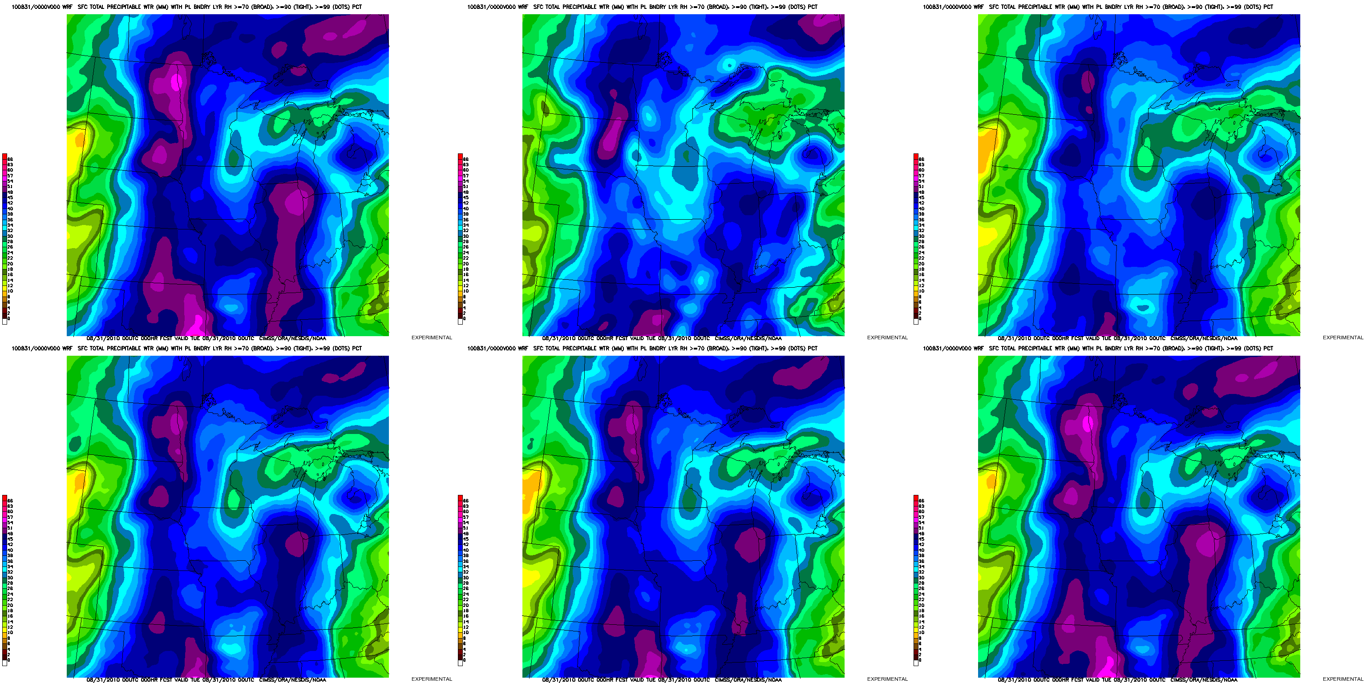
Comparison of Total Precipitable Water (Entire Atmosphere)
Initialized: 31 August 2010, 00 UTC
Interval: 3 hourly Duration: 36 hours
GFS Initial Conditions
CRAS Initial Conditions
GFS Initial Conditions with 90% of Original RH
GFS Initial Conditions with 90% of Original Relative Humidity at and below 800 hPa
GFS Initial Conditions with 90% of Original Relative Humidity between 400 and 750 hPa
GFS Initial Conditions with 90% of Original Relative Humidity between 100 and 350 hPa

Slide 23
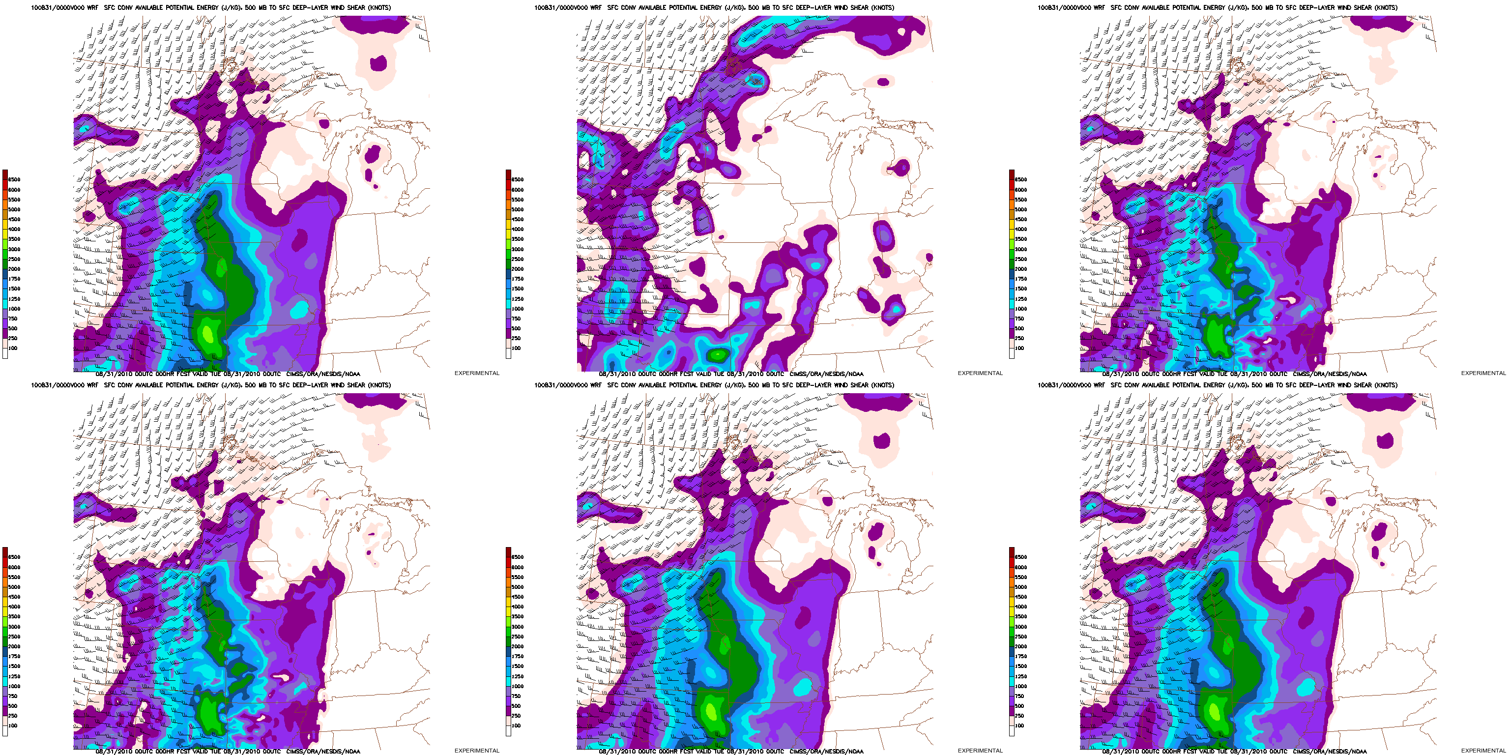
Comparison of SBCAPE, Deep-Layer Wind Shear
Initialized: 31 August 2010, 00 UTC
Interval: 3 hourly Duration: 36 hours
GFS Initial Conditions
CRAS Initial Conditions
GFS Initial Conditions with 90% of Original RH
GFS Initial Conditions with 90% of Original Relative Humidity at and below 800 hPa
GFS Initial Conditions with 90% of Original Relative Humidity between 400 and 750 hPa
GFS Initial Conditions with 90% of Original Relative Humidity between 100 and 350 hPa

Slide 24
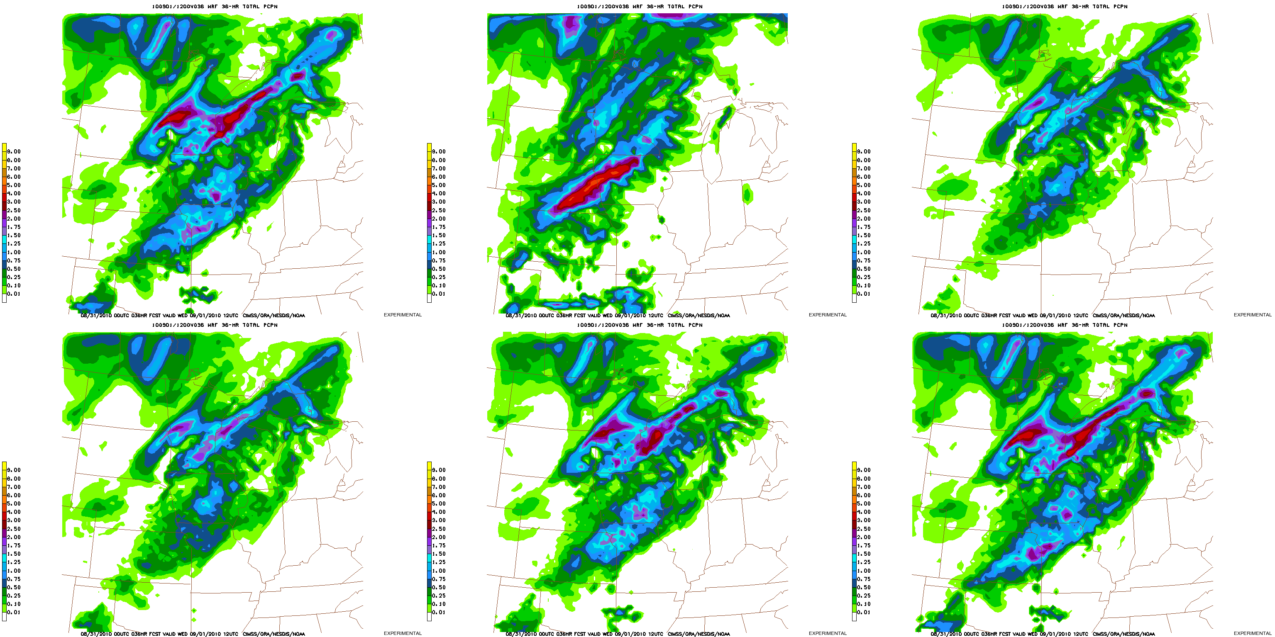
Comparison of 36-hour Accumulated Precipitation
Initialized: 31 August 2010, 00 UTC
Forecast valid: 1 September 2010, 12 UTC
GFS Initial Conditions
CRAS Initial Conditions
GFS Initial Conditions with 90% of Original RH
GFS Initial Conditions with 90% of Original Relative Humidity at and below 800 hPa
GFS Initial Conditions with 90% of Original Relative Humidity between 400 and 750 hPa
GFS Initial Conditions with 90% of Original Relative Humidity between 100 and 350 hPa

Slide 25
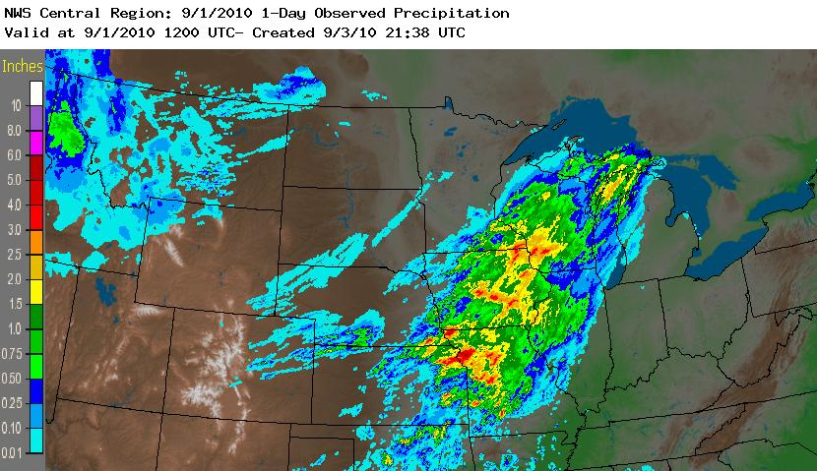
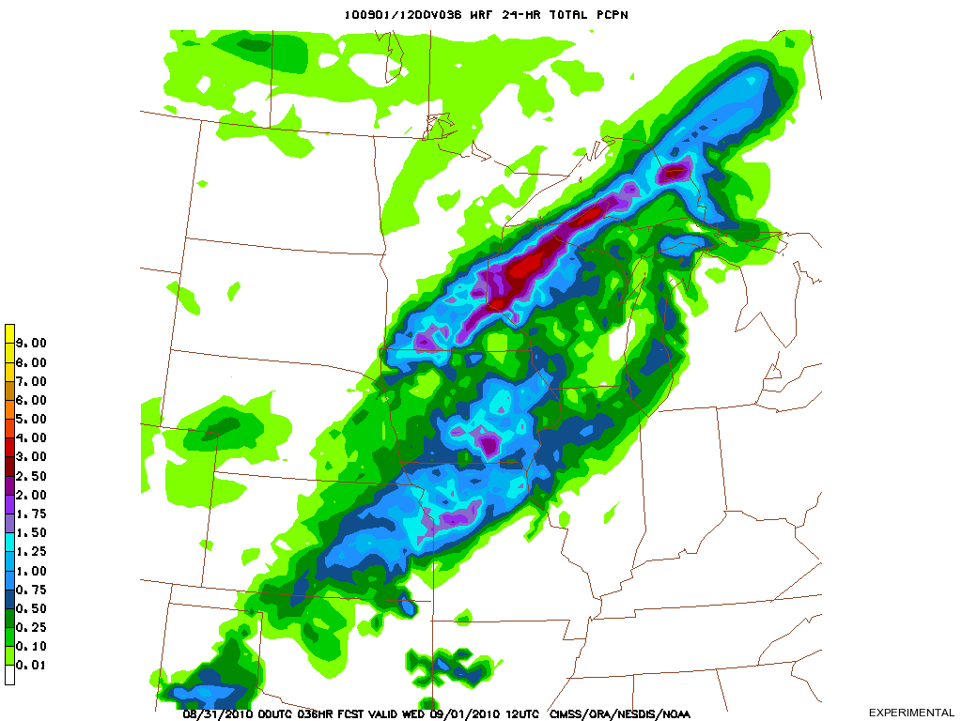
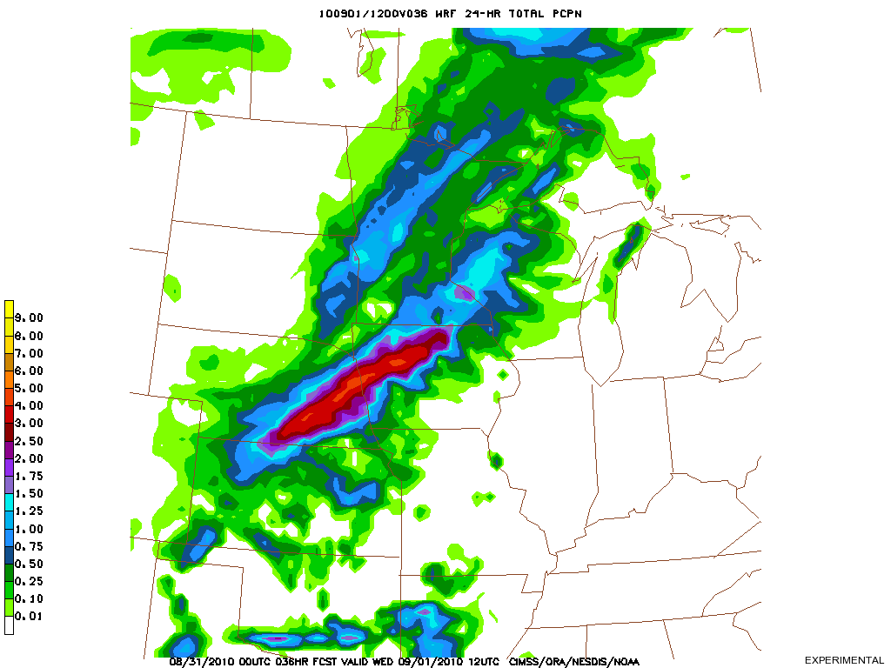
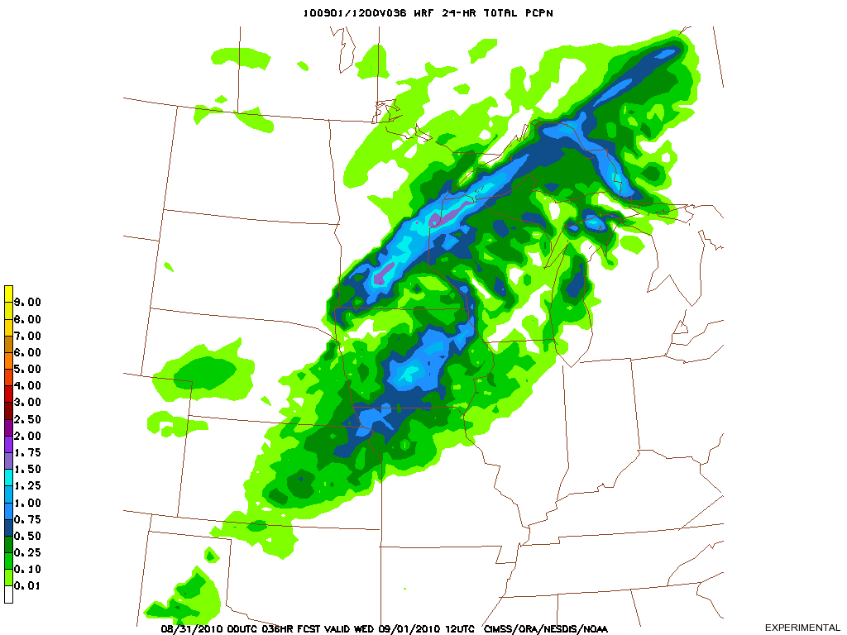
Precipitation
Precipitation output from NWP models is traditionally spatially distributed and lacking in sharp, reliable definition, even in some high resolution models
Precipitation often falls as the result of convective parameterizations which keep the model numerically stable, or for the wrong reasons (not due to local moisture convergence)
Source: NWS/AHPS
24-hour accum precip prior to 1200 UTC on 1 Sept
24-hour accum precip prior to 1200 UTC on 1 Sept
24-hour accum precip prior to 1200 UTC on 1 Sept
GFS Initial Conditions
CRAS Initial Conditions
GFS Initial Conditions with 90% of Original RH

Slide 26
performance of moisture representation in current operational models and wrf runs with GOES-13 Sounder retrievals in analyses
Part B

Slide 27
Experiment II Design
Objective: Quantify NWP response to GOES-13 Sounder-adjusted moisture concentrations.
Three Advanced Research Weather Research and Forecast (WRF-ARW) simulations are run twice daily (00/12Z):
WRFX – Initial conditions and boundary conditions from previous (06/18Z) GFS run
WRFY – Initial conditions and boundary conditions from initial hour CRAS20MKX run
WRFZ – Initial conditions of previous (06/18Z) GFS run modified with GOES-13 Sounder retrievals and GFS boundary conditions
Dynamics | Non-Hydrostatic with Gravity Wave Drag
Cumulus Scheme | Kain-Fritsch
Microphysics Scheme | WSM Single-Moment 5-Class
PBL Scheme | Yonsei University
Land Surface Scheme | Noah 4-Layer LSM
Surface Layer Physics | Monin-Obukhov with heat and moisture surface fluxes
Long Wave Radiation | RRTM
Short Wave Radiation | Dudhia Scheme
Time-Integration Scheme | Runge-Kutta 3rd Order
Damping | Rayleigh
Each 36-hour simulation used:
an adaptive time step,
20 km horizontal spacing on 100 x 100 square grid consisting of 45 vertical levels, with
50 hPa at the top of the model.

Slide 28
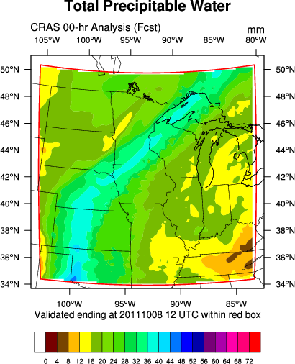
Experiment Domain
Model and Verification
Based on NWS Milwaukee regional domain
Model
Verification (non-precipitation)
Model Evaluation Tools (MET) v3 used for statistics.
The verification subset was chosen to discount any boundary condition influences from the results. In addition, the GOES Sounder does not scan above 50° N (approximately).
For point verification, approximately 70 GPS-TPW sites are within the red box.
For a mean flow speed of 20 knots, the domain is completely forced by boundary conditions after around 55 hours.

Slide 29
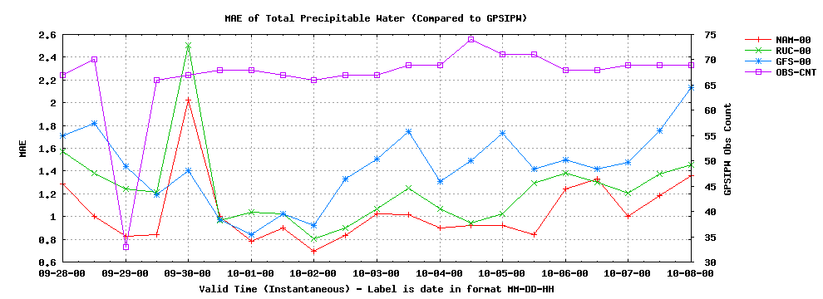
Total PW Mean Absolute Error
Analyses verified against GPS-TPW
Model | Mean MAE
NAM | 1.04
RUC | 1.24
GFS | 1.43
The NAM and RUC assimilate GPS-TPW measurements, while the GFS does not.
Verified output every 12 hours between September 28, 2011, 00 UTC,
and October 8, 2011, 00 UTC, for a total sample of 21 times

Slide 30
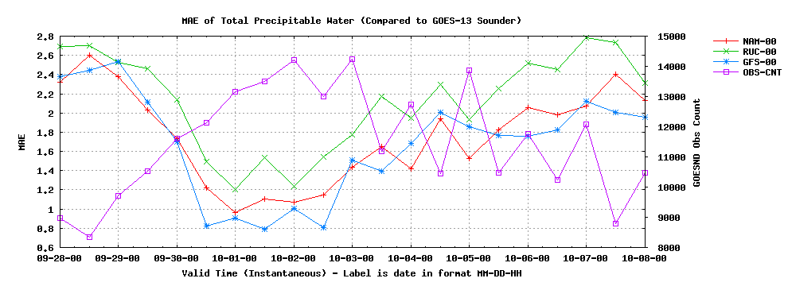
Total PW Mean Absolute Error
Analyses verified against GOES-13 Sounder (Ma retrievals)
Model | Mean MAE
GFS | 1.69
NAM | 1.76
RUC | 2.13
The GFS is used as the first guess for the GOES-13 Sounder retrievals, but not the GFS run it is verified against.
Verified output every 12 hours between September 28, 2011, 00 UTC,
and October 8, 2011, 00 UTC, for a total sample of 21 times
Low Obs, Cloudier

Slide 31
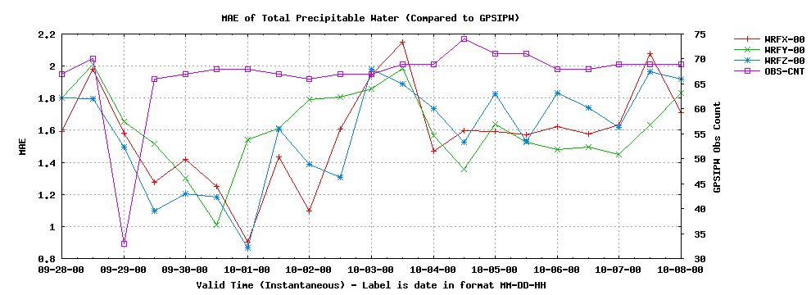
Total PW Mean Absolute Error
Analyses verified against GPS-TPW
Model | Mean MAE
WRFX | 1.58
WRFZ | 1.59
WRFY | 1.61
Inconclusive results are due to the poor spatial heterogeneity of GPS sites across the domain compared to the magnitude of correction.
Verified output every 12 hours between September 28, 2011, 00 UTC,
and October 8, 2011, 00 UTC, for a total sample of 21 times

Slide 32
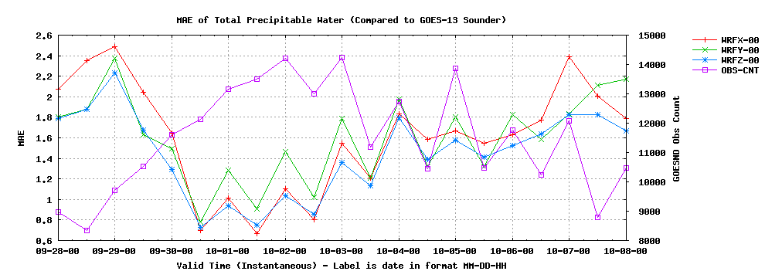
Total PW Mean Absolute Error
Analyses verified against GOES-13 Sounder (Ma retrievals)
Model | Mean MAE
WRFZ | 1.44
WRFY | 1.59
WRFX | 1.61
The WRFY and WRFZ contain Sounder retrievals which improve the MAE in clear fields of view.
Verified output every 12 hours between September 28, 2011, 00 UTC,
and October 8, 2011, 00 UTC, for a total sample of 21 times
Low Obs, Cloudier

Slide 33
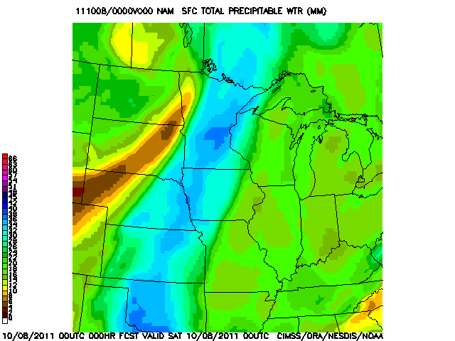
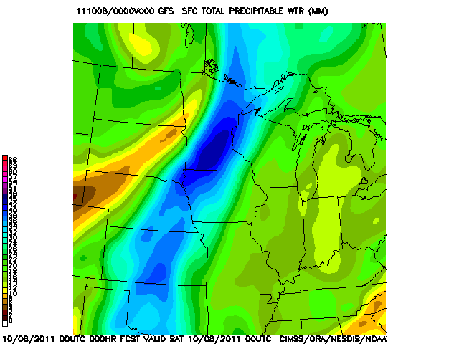
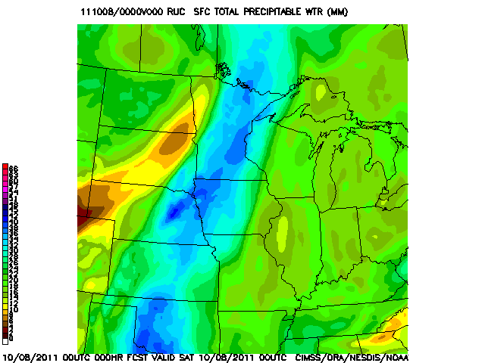
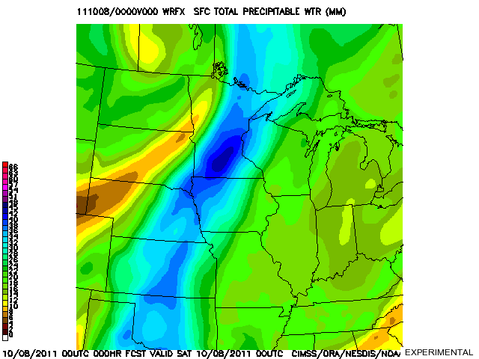
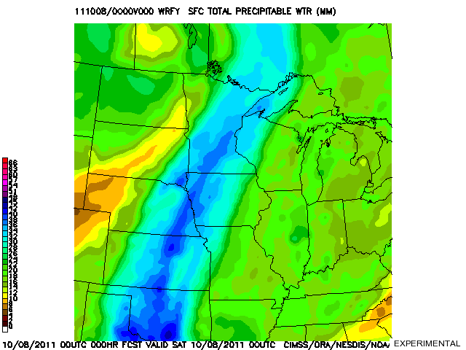
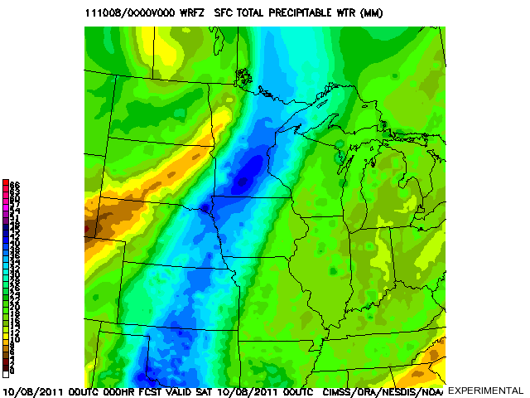
Total Precipitable Water
Analyses for 8 October 2011, 00 UTC
NAM
T+0
GFS
T+0
RUC
T+0
WRFX
T+0
WRFY
T+0
WRFZ
T+0

Slide 34
Total Precipitable Water
Analyses for 8 October 2011, 00 UTC

Slide 35
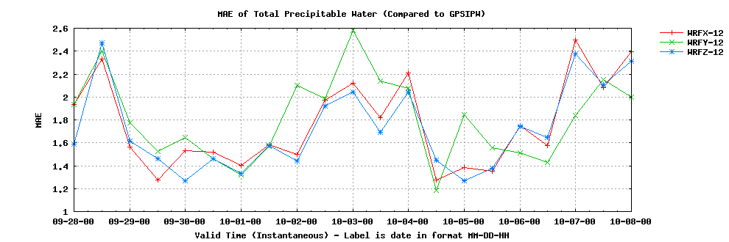
Total PW Mean Absolute Error
Forecasts verified against GPS-TPW
12-hour
Verified output every 12 hours between September 28, 2011, 00 UTC,
and October 8, 2011, 00 UTC, for a total sample of 21 times
Model | Mean MAE
WRFZ | 1.72
WRFX | 1.77
WRFY | 1.81
24-hour
36-hour
Model | Mean MAE
WRFZ | 2.01
WRFX | 2.01
WRFY | 2.23
Model | Mean MAE
WRFX | 2.30
WRFZ | 2.31
WRFY | 2.79

Slide 36
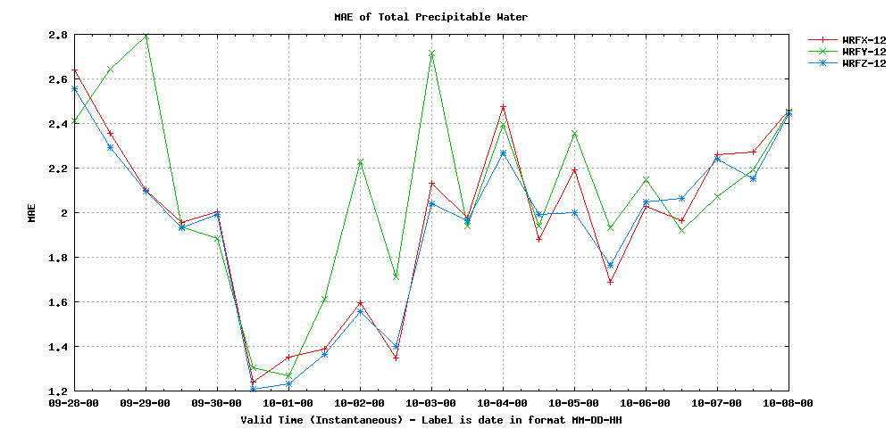


Total PW Mean Absolute Error
Forecasts verified against NAM analysis
12-hour
Verified output every 12 hours between September 28, 2011, 00 UTC,
and October 8, 2011, 00 UTC, for a total sample of 21 times
Model | Mean MAE
WRFZ | 1.93
WRFX | 1.97
WRFY | 2.09
24-hour
36-hour
Model | Mean MAE
WRFZ | 2.17
WRFX | 2.17
WRFY | 2.32
Model | Mean MAE
WRFZ | 2.42
WRFX | 2.43
WRFY | 2.71

Slide 37









WRFX
T+36
WRFY
T+36
WRFZ
T+36
WRFX
T+24
WRFY
T+24
WRFZ
T+24
WRFX
T+12
WRFY
T+12
WRFZ
T+12

Slide 39



Precipitation: WRFX vs. WRFZ
12-hr Accumulation ending 9 October 2011, 00 UTC
Model | MAE (ST2)
WRFZ | 1.48
WRFX | 1.65
WRFX produced more precipitation than observed over south central Kansas.

Slide 40



PW Analysis: WRFX vs. WRFZ
Valid 8 October 2011, 12 UTC
WRFX started with PW up to 8 mm too moist over eastern Kansas, whereas the WRFZ exhibited less bias.

Slide 41


PW Analysis: WRFX vs. WRFZ
Valid 8 October 2011, 12 UTC
Model | MAE (GPS)
WRFZ | 1.58
WRFX | 1.87
WRFX started with PW up to 8 mm too moist over eastern Kansas, whereas the WRFZ exhibited less bias.

Slide 42
Summary of Presented Results
Runs from 28 September to 8 October 2011
Comparing WRFX and WRFZ, two sources of precipitable water verification confirm forecasts are statistically better, albeit slightly, 12 hours after initialization if GOES-13 Sounder input is included.
  This may produce better precipitation verification, but not in regimes favoring light precipitation or limited areal extent.
No substantial impact of added observations at 24 or 36 hours in the late September, early October flow regime.
Lesser performance of WRFY suggests that CRAS dynamics and physics are influencing the solution negatively.

Slide 43
Predictions for Winter Performance
Statistics online at http://cimss.ssec.wisc.edu/cras/
More clouds means likely less Sounder observations of precipitable water.
Faster flow conditions will advect observations off the domain fairly early in the simulations.
In clear conditions, a drier upper troposphere will favor observed moisture contributions from lower in the atmosphere.
Dynamic weather systems resulting in well-forced precipitation may show impact of precipitable water assimilation on precipitation amounts better than weakly-forced, high-moisture convective precipitation regimes.

Slide 44


Example from CIMSS Satellite Blog: Wintertime Water Vapor
Calculated weighting functions based on
February 6, 2007, 00 UTC, radiosonde taken at Upton, NY.
Water vapor near the surface is detected by the GOES-12 Imager and Sounder due to very limited emission (low water vapor) in the upper troposphere.
http://cimss.ssec.wisc.edu/goes/blog/

Slide 45
Cras total sky cover algorithm and performance compared to WRF cloud fraction
Part C

Slide 46
CRAS Total Sky Cover Algorithm
Motivation
Sky cover composites from the National Digital Forecast Database (NDFD) lack sufficient integrity from weak office-to-office consistency, and are relatively smooth definition within individual forecast areas.
Since sky conditions alone are never hazardous, and NDFD text output translates a percent into categorical terms (cloudy, partly cloudy, etc.), forecasters generally place more attention on the other forecast elements.

Slide 47
CRAS Total Sky Cover Algorithm
WRF Cloud Fraction Formulation
Xu and Randall (1996) developed the cloud fraction computation for the WRF based on the notion that grid-averaged condensate mixing ratio, consisting of cloud water and cloud ice, is a better diagnostic for stratiform cloudiness than grid-averaged relative humidity.
This formulation indicates that the cloud amount varies exponentially according to the grid-averaged condensate mixing ratio.
  The rate of variation is a function of the grid-averaged relative humidity.

Slide 48

CRAS Total Sky Cover Algorithm
WRF Cloud Fraction Formulation
The result is a coupling between the cloud fraction, C_{fraction}, condensate mixing ratio, and relative humidity, RH:
q_{l} is the large-scale liquid water mixing ratio
q_{vs} is the saturation water vapor mixing ratio
The values of k, β₀, and τ were determined empirically to be 0.25, 100, and 0.49, respectively

Slide 49

CRAS Total Sky Cover Algorithm
Motivation
Example operational output

Slide 50
CRAS Total Sky Cover Algorithm
Definition
The NWS/NOAA web site defines “sky cover” as “the expected amount of opaque clouds (in percent) covering the sky valid for the indicated hour.”
No probabilistic component.
No definition of “opaque cloud” or “cloud”.
The implication is cloud coverage of the celestial dome (all sky visible from a point observer).

Slide 51

CRAS Total Sky Cover Algorithm
Cloudy?
Cirrostratus (Cs) covering the whole sky
http://www.srh.weather.gov/srh/jetstream/synoptic/h7.htm

Slide 52
CRAS Total Sky Cover Algorithm
Methodology Outline
Compute a cloud concentration profile.
Average the profile for the upper and lower troposphere based on the number of cloud layers.
Determine the local sky cover.
Combine adjacent grid points to form an upper and lower celestial dome, then combine the two domes, giving the lower celestial dome preference.

Slide 53
CRAS Total Sky Cover Algorithm
Methodology
For every grid point at each vertical level, if cloud mixing ratio is greater than or equal to 0.01 g/kg, then a ratio is computed of this mixing ratio to the auto-conversion limit (based solely on the temperature at that grid point).
The resulting ratio, generally between 0 and 1, is the fraction of cloud water to the maximum cloud water possible at the point without precipitation.
A ratio greater than one means the cloud at that point (on the level) is precipitating.

Slide 54
CRAS Total Sky Cover Algorithm
Auto-Conversion Limit
Let ACL be the auto-conversion limit in g/g, and T the temperature in K. The limit is approximated based solely on temperature in four piecewise functions:
  T > 273: ACL = 0.001
  261 < T < 273: ACL = 0.001 - 0.005((273-T)/12)³
  249 < T < 261: ACL = 0.0001 + 0.004((T-249)/12)³
  T < 249: ACL = 0.0001
The ACL(T) is greatest and constant for warm clouds (liquid).
The slope of ACL(T) is steepest at 261 K, the temperature at which there is maximum ice growth, and the typical average cloud transition from liquid to ice.

Slide 55

CRAS Total Sky Cover Algorithm
Auto-Conversion Limit

Slide 56
CRAS Total Sky Cover Algorithm
Example Atmosphere
0.35
0.35
0.70
0.10
0.35
0.70
0.10
0.35
1.05
0.10
Ratios displayed inside clouds

Slide 57
CRAS Total Sky Cover Algorithm
Methodology
Essentially, the fraction of mixing ratio to ACL is a first guess at how much each test point is attenuating sunlight due to cloud.
If the sigma level of the test point is greater than 0.5 (roughly 500 hPa), then the ratio is half of the original value.
  This ad hoc approach prevents ice cloud from producing overcast conditions. Since the upper half of the troposphere is largely cold and dry, the fraction of mixing ratio to ACL is not an ideal approximation.
The next step is to vertically average the ratios at each grid point. One average is done for all test points at or above σ=0.5, another is done for those below.

Slide 58
CRAS Total Sky Cover Algorithm
Methodology
If any of the layers averaged below σ=0.5 has a cloud mixing ratio greater than the auto-conversion limit, then the cloud cover ratio is 1 (100%).
  We assume overcast conditions in areas of precipitation.
For the layers averaged at or above σ=0.5, if the vertical average is greater than 0.5 (50%), then the cloud cover is lowered to 0.5 (for the upper troposphere component).
  Ice cloud reflectivity typically greater than for water cloud.
The next step is to combine the two ratio averages into a sky cover.

Slide 59
CRAS Total Sky Cover Algorithm
Example Atmosphere
0.27
0.11
0.27
0.11
0.18
1.00
0.10
0.35
1.00
0.10
Ratios displayed inside clouds

Slide 60
CRAS Total Sky Cover Algorithm
Methodology
To create the upper celestial dome for ice cloud for every grid point, the ratio average for each adjacent grid point contributes to 20% of the total. The final 20% contribution comes from the ratio average of the grid point itself.
To create the lower celestial dome for water cloud for every grid point, the ratio average for each adjacent grid point contributes to 10% of the total. The final 60% contribution comes from the ratio average of the grid point itself.
This approach was implemented because the upper celestial dome is spatially larger to the observer than the lower celestial dome.

Slide 61
CRAS Total Sky Cover Algorithm
Example Atmosphere
0.11
0.27
0.11
0.27
0.11
0.18
0.16
1.00
0.10
0.35
1.00
0.10
Sky cover displayed per dome

Slide 62
Methodology
Finally, to produce sky cover output (SC, in %) at each vertical column in model resolution, the result from the lower celestial dome computation (LCD, in %) is added to the upper celestial dome computation (UCD, in %) over the lower dome area left uncovered by the water cloud (1-LCD, in %).
  Upper cloud will not contribute to a sky cover fraction if it is obstructed by lower cloud.
Thus, SC = LCD + (1-LCD)(UCD)
If the resulting sky cover is less than 5%, we will assume 0%, due to the limited predictability.

Slide 63
Example Atmosphere
0.11
0.27
0.11
0.27
0.11
0.18
0.16
1.00
0.10
0.35
1.00
0.10
0.25 (25%)
Mostly Clear
Sky cover displayed per dome

Slide 64

CRAS Total Sky Cover Algorithm
GOES-East IR Window
12:15 UTC 19 October 2009

Slide 65

CRAS Total Sky Cover Algorithm
CRAS Sky Cover Analysis
12:00 UTC 19 October 2009

Slide 66


CRAS Total Sky Cover Algorithm
Forecast Comparison
CRAS 45 km Sky Cover 24-hour Forecast
NDFD Official Sky Cover 15-hour Forecast
12:00 UTC 19 October 2009

Slide 67


CRAS Total Sky Cover Algorithm
Comparison to Analysis
CRAS 45 km Sky Cover 24-hour Forecast
NDFD Official Sky Cover 15-hour Forecast
12:00 UTC 19 October 2009

Slide 68

CRAS Total Sky Cover Algorithm
WRF vs. CRAS Comparisons
Default WRF cloud fraction takes the average of three primary layers (low, mid, and high). Maximum cloud fraction can be computed if those three layers are averaged (they can be output).
12-hr Cloud Cover Forecast MAE compared to the 1-hr NDFD is approximately 20% for CRAS, 25% for WRF with maximum cloud adjustment, and 30% for default WRF.
NDFD may overestimate clouds when actually clear.
These sample images, compared 12-hr forecasts to the NDFD, are valid at 12 October 2011, 00 UTC.

Slide 69

CRAS Total Sky Cover Algorithm
WRF vs. CRAS Performance
Mean absolute error for total sky cover (%) over the period from 00 UTC 28 September 2011 to 00 UTC 8 October 2011. Error is calculated based on the NAM analysis.

Slide 70

CRAS Total Sky Cover Algorithm
WRF vs. CRAS Performance
Mean absolute error for total sky cover (%) over the period from 00 UTC 28 September 2011 to 00 UTC 8 October 2011. Error is calculated based on the NDFD 1-hour forecast.

Slide 71
Final Thoughts on results and future directions
Conclusions

Slide 72
Final Thoughts
Improvement not as large as hypothesized
  Number of data sets assimilated into operational models continues to grow, so finding improvement without new instrumentation difficult
Moisture retrievals slightly beneficial to regional NWP within first 12 hours of forecast in best cases, but largely inconsequential over experiment period
  Bulk of moisture exists in lower troposphere during the summer and fall months, where GOES Sounder is “blind”
  Bias of GOES Sounder retrievals is not consistently less than background, when compared to GPS-TPW
  A 1D-var assimilation scheme on a high spatial resolution grid is likely to weight individual retrievals more, increasing absolute error by decreasing the spatial average
  Need to investigate techniques which conserve and redistribute moisture on medium horizontal scales O(10²) km, preserving gradients

Slide 73
Final Thoughts
Unable to certify that assimilation scheme and CRAS are functioning efficiently/optimally
  Comparatively poor performance of WRFY suggests that shortcomings in CRAS dynamics/physics dominating benefit of upstream moisture observations
  Assimilation technique applied here requires several interpolations between retrieval and WRF analysis since interface is not direct
Cloud-top pressure occasionally too high in background profiles with substantial inversions
  New technique necessary to place low cloud based on likely vertical position; trust modeled atmosphere over product?
WRF cloud fraction performs contrary to NWS expectations
  Improved cloud cover formulation necessary for short-term NWP models which break from large-scale climate model paradigm
Notes:
WRF radiation schemes are one-dimensional. Columns are treated independently and fluxes are in infinite horizontally uniform planes. This approximation is not appropriate for simulations in which the vertical thickness of model layers starts to approach the horizontal grid length.

Slide 74

Final Thoughts
Satellite observations play a fundamental role in NWP solutions.
Leveraging the GOES Sounder is one way to improve the accuracy of the WRF-ARW forecast within the first 12 to 24 hours, especially away from oceans, where TPW retrieval assimilation does not occur in operational models.
Subtle changes to the moisture field can impact NWP performance.
Graphical output and real-time statistics from experiment are available online.
Author Information: Jordan Gerth, jordan.gerth@ssec.wisc.edu

