Slide 1
Linear Optimization as a Solution to Improve the Sky Cover Guess, Forecast
Jordan Gerth
Cooperative Institute for Meteorological Satellite Studies
University of Wisconsin at Madison
Contributions by
Robert Aune
Advanced Satellite Products Branch
National Environmental Satellite, Data, and Information Service
Madison, Wisconsin
Session E14 – Wednesday, October 10, 2012
National Weather Association Annual Meeting, Madison, Wisconsin

Slide 2
Defining Sky Cover
The National Weather Service (NWS) web site defines “sky cover” as “the expected amount of opaque clouds (in percent) covering the sky valid for the indicated hour.”
No probabilistic component.
No definition of “opaque cloud” or “cloud”.
The implication is cloud coverage of the celestial dome (all sky visible from a point observer).

Slide 3
Cirrostratus
How would the NWS classify sky cover for this scene?
Photo source: National Weather Service JetStream, http://www.srh.noaa.gov/jetstream/synoptic/h7.htm

Slide 4
Defining Sky Cover
Meteorologists have requested a new sky cover product because
purely numerical weather prediction (NWP) methods do not account for radiative transparency of clouds and
current satellite-based techniques and algorithms, used alone or in existing analysis tools, do not match the forecasters’ interpretation of the NWS-established definition.

Slide 5
Questions to Answer
How are cloud scenes represented in a NWP model? How does that compare to the National Digital Forecast Database (NDFD)?
How are cloud scenes observed on satellite imagery and represented on satellite products?
What is the predictive skill of NWP model cloud fields? How can that be improved?

Slide 6
Defining Sky Cover
How are cloud scenes represented in a numerical weather prediction (NWP) model? How does that compare to the NDFD?

Slide 7
Sky Cover Representation
Xu and Randall (1996) developed the semi-empirical cloud fraction formulation found in the Weather Research and Forecast (WRF) model.
Cloud fraction varies exponentially according to the grid-averaged condensate mixing ratio.
When the grid-averaged relative humidity is 100%, so is the cloud fraction.
Total cloud fraction is produced through averaging the maximum fractions from three primary layers (642 hPa, 350 hPa, 150 hPa).
Notes:
Xu, K.-M., and D. A. Randall, 1996: A semiempirical cloudiness parameterization for use in climate models. J. Atmos. Sci., 53, 3084–3102.

Slide 8
Sky Cover Representation
NAM Analysis
NDFD 1-hour Forecast
Projected onto a 20 km Lambert Conformal grid
Both images valid at 00 UTC on 3 October 2012

Slide 9
Defining Sky Cover
How are cloud scenes observed on satellite imagery and represented on satellite products?

Slide 10
Sky Cover Representation
IR Window, Band 8 (11.0 µm)
Effective Cloud Amount
GOES-14/15 (East/West) Sounder Composite
A measure of the opacity (“radiative thickness”) of a cloud
Both images valid at 00 UTC on 3 October 2012

Slide 11
Sky Cover Representation
CRAS Analysis
Effective Cloud Amount
CIMSS Regional Assimilation System
Both images valid at 00 UTC on 3 October 2012

Slide 12
Defining Sky Cover
What is the predictive skill of NWP model cloud fields? How can that be improved?

Slide 13
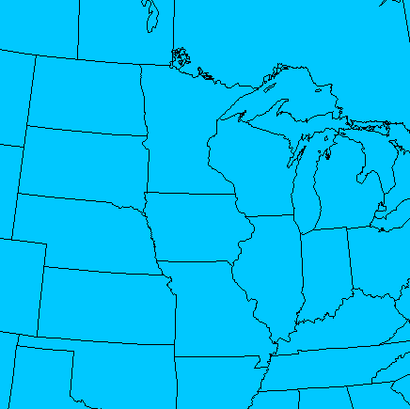
Performance (3—24 Sept. 2012)

Slide 14
Performance (3—24 Sept. 2012)
Current WRF Output
Maximum Fraction Output
Mean RMSE: 37.5%
Mean RMSE: 32.4%
Both images valid at 12 UTC on 3 October 2012
Notes:
The WRF maximum cloud fraction is the greatest value between the lower, middle, and upper cloud layers. This will generally be greater than the default fraction outputted by the WRF. This is from WRF v3.1.1.

Slide 15
Defining Sky Cover
What is the predictive skill of NWP model cloud fields? How can that be improved?

Slide 16
Types of Numerical Tools
Numerical Weather Prediction
Mathematical models which predict the future state of the atmosphere
Statistical Model
Relates random variables to other variables
Linear Programming/Optimization (LP)
Applies mathematical method to a linear model in an attempt to find the ideal solution
Solves an objective function
Requires a list of linear relationships

Slide 17
Linear Model
$$\text{min} w=\sum_{i=1}^{n}{\left|x_{j}a_{i}^{j}+z_{j}−b_{i}\right|} \\ 0≤x_{j}a_{i}^{j}+z_{j}≤100 \\ x_{j}≥0$$
The LP objective is to minimize the absolute difference between the human-produced “truth” (the NDFD 1-hour forecast) and the NWP 12-hour forecast (no NWP analysis available).

Slide 18
WRF Total Sky Cover Output
$a_{i}$ is a point on a two-dimensional grid of the 12-hour sky cover forecast, obtained from a WRF model.
$$\text{min} w=\sum_{i=1}^{n}{\left|x_{j}a_{i}^{j}+z_{j}−b_{i}\right|} \\ 0≤x_{j}a_{i}^{j}+z_{j}≤100 \\ x_{j}≥0$$

Slide 19
NDFD Sky Cover 1-hr Forecast
$b_{i}$ is a point on a re-projected two-dimensional grid of the 1-hour sky cover forecast (analysis) obtained from the human-produced NDFD.
$$\text{min} w=\sum_{i=1}^{n}{\left|x_{j}a_{i}^{j}+z_{j}−b_{i}\right|} \\ 0≤x_{j}a_{i}^{j}+z_{j}≤100 \\ x_{j}≥0$$

Slide 20
Linear Model
$$\text{min} w=\sum_{i=1}^{n}{\left|x_{j}a_{i}^{j}+z_{j}−b_{i}\right|} \\ 0≤x_{j}a_{i}^{j}+z_{j}≤100 \\ x_{j}≥0$$
$b_{i}$ is used as truth to calculate the coefficient $x_{j}$ and scalar $z_{j}$ adjustments (variables) for each cloud classification (six total at approximately 20% increments).

Slide 21
Linear Model
$$\text{min} w=\sum_{i=1}^{n}{\left|x_{j}a_{i}^{j}+z_{j}−b_{i}\right|} \\ 0≤x_{j}a_{i}^{j}+z_{j}≤100 \\ x_{j}≥0$$
The value of the adjusted sky cover fraction must fall within physical meteorological values (between 0% and 100%). The value of the coefficient must be nonnegative.

Slide 22
Apply Results: Procedure
The process employed in this project for staging and using background data is as follows:
Initialize the WRF model at time t = -12 (hours).
Obtain the 12-hour forecast from the model initialized at t = -12.
Obtain the analysis from t = 0.
Run linear program to minimize the objective function comparing the 12-hour forecast and analysis both valid at t = 0.
Initialize the WRF model at time t = 0.
Apply fixed variable values from the linear program (a coefficient and scalar) to WRF model output at t = 12, t = 24, and t = 36. Calculate skill.

Slide 23
Apply Results: Test Case
$$x_{j}a_{i}^{j}+z_{j}$$
Fraction (%) | Coefficient (x) | Scalar (z)
0 ≤ a_{i} < 20 | 4.4 | 12.0
20 ≤ a_{i} < 40 | 0 | 93.0
40 ≤ a_{i} < 60 | 1.0 | 0
60 ≤ a_{i} < 80 | 1.0 | 0
80 ≤ a_{i} < 95 | 1.0 | 0
95 ≤ a_{i} ≤ 100 | 1.0 | 0
Applied to forecast output from model initialized at 00 UTC on 3 October 2012

Slide 24
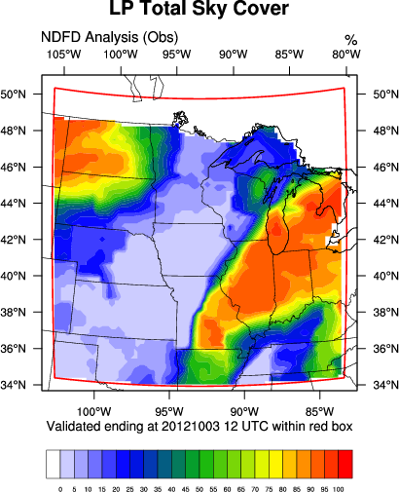
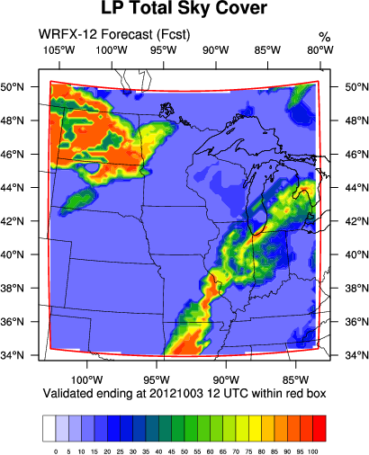
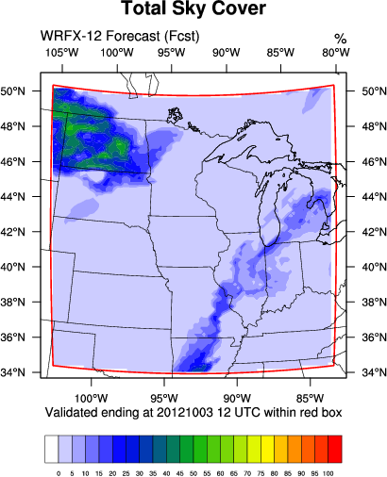
Test Case: Local WRF Model
RMSE: 30.5%
RMSE: 45.0%
LP produces net RMSE improvement of 14.5%

Slide 25
Performance (3—24 Sept. 2012)
Mean RMSE net decrease of 15.8%
Mean RMSE: 21.7%

Slide 26
Improving Results
Decreased performance is a consequence of:
Lacking sky cover congruity between forecast areas on NDFD domain
Assumption that relative horizontal distribution of model-developed cloud fraction matches NDFD
No qualification for cloud forcing or air mass regimes within NWP model (parameterizations and performance)
No corroboration between other NWP model output parameters or variables

Slide 27
Cloud Top Pressure (CTP)
Considering the best matches, for which 200 hPa deep layer does the effective cloud amount (ECA) analysis best correspond to the NDFD sky cover 1-hr forecast?
The CTP composite from the GOES Sounders provides a cloud height for each corresponding ECA value.
Image valid at 00 UTC on 3 October 2012

Slide 28
Gridded CTP
This can be solved through implementing another linear model:
Objective function is to minimize absolute error between ECA and NDFD.
At least 250 ECA/NDFD matches must be used. This is approximately 2.5% of all points on the grid (but not all points are considered).
Clear points are excluded.
The set of points contributing to the objective function must be within 100 hPa of central pressure level.
Image valid at 00 UTC on 3 October 2012

Slide 29
Improving Results
Examined ECA-NDFD pairs producing the least amount of collective absolute error
Trial period suggests lower MAE associated with higher cloud tops (thicker cloud?)
Available CTPs can vary according to weather scenario and subject to Sounder bias
Mean central pressure over trial period was 437 hPa (layer from 537 hPa to 337 hPa)
Mean MAE was 1.7 (%)

Slide 30
Summary of Results
Sky cover definitions are inconsistent. Model output needs major adjustment to match the NDFD result. The NDFD needs more congruity.
Linear optimization of model output leads to a reduction in RMSE for subsequent forecasts.
ECA skill is in question for verifying the NDFD sky cover grid in low-topped cloud regimes.
Future work will focus on building a celestial dome and time-averaging new geostationary satellite cloud products over a one-hour window.
Author information: Jordan Gerth, Jordan.Gerth@noaa.gov
Notes:
Build your own linear models with PuLP (an LP modeler in Python):
http://code.google.com/p/pulp-or/

