Slide 1
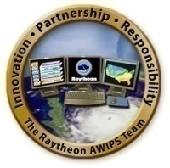
How AWIPS II is a Tool to Further R2O in the GOES-R Era
Jordan Gerth, Research Assistant
Cooperative Institute for Meteorological Satellite Studies, University of Wisconsin at Madison
First Joint AMS-Asia Satellite Meteorology Conference
Thursday, January 26, 2012
American Meteorological Society Annual Meeting, New Orleans, Louisiana

Slide 2
Presentation Overview
Outline
Contributors
NRC Report on R2O
CIMSS MODIS R2O History
AWIPS II and Improved R2O
GOES-R Proving Ground
Data Fusion with AWG Products
RGB/RGBA Image Combinations
Potential AWIPS II Capabilities and Wish List
Conclusions and Future Directions
Kaba Bah, Lee Cronce, Mat Gunshor, and Justin Sieglaff, CIMSS at University of Wisconsin
Robert Aune and Tim Schmit, NESDIS ASPB
Bill Campbell, Tom Kretz, and Ed Mandel, NWS OST
Paul Stanko, NWS Guam
Philip Ardanuy, Frank Griffith, and programmers at Raytheon

Slide 3
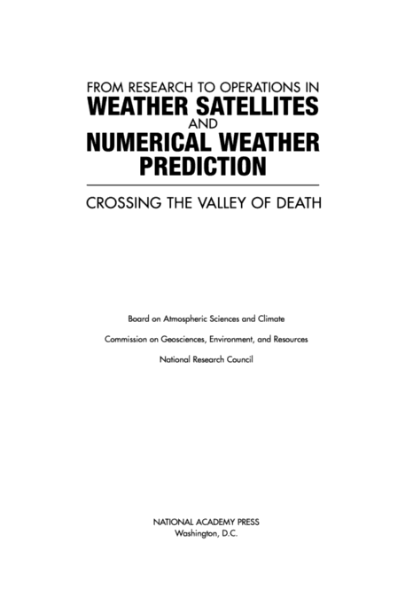
NRC Report
In 2000, a report from the National Research Council (NRC) read—
“Successful transitions from R&D to operational implementation always require:
(1) an understanding of the importance (and risks) of the transition,
(2) development and maintenance of appropriate transition plans,
(3) adequate resource provision, and
(4) a continuous feedback (in both directions) between R&D and operational activities.”

Slide 4
MODIS R2O History at CIMSS
CIMSS grassroots effort to share the latest satellite imagery and products with the National Weather Service (NWS) began with a Research to Operations (R2O) project involving the Moderate Resolution Imaging Spectroradiometer (MODIS) instrument to two NASA satellites.
2006 – CIMSS begins distribution of a subset of MODIS channels in netCDF3 to AWIPS I for use at the NWS forecast office in Milwaukee.
2008 – CIMSS successfully displays MODIS channels in early AWIPS II Task Orders.
2011 – CIMSS’ direct distribution of MODIS imagery and products reaches 50 NWS offices, influencing more than 250 documented forecast decisions in about 5.5 years. Plans emerge to distribute VIIRS imagery.
2012 – CIMSS will transition MODIS distribution to data storage formats compliant with AWIPS II.
Notes:
netCDF is network Common Data Format

Slide 5
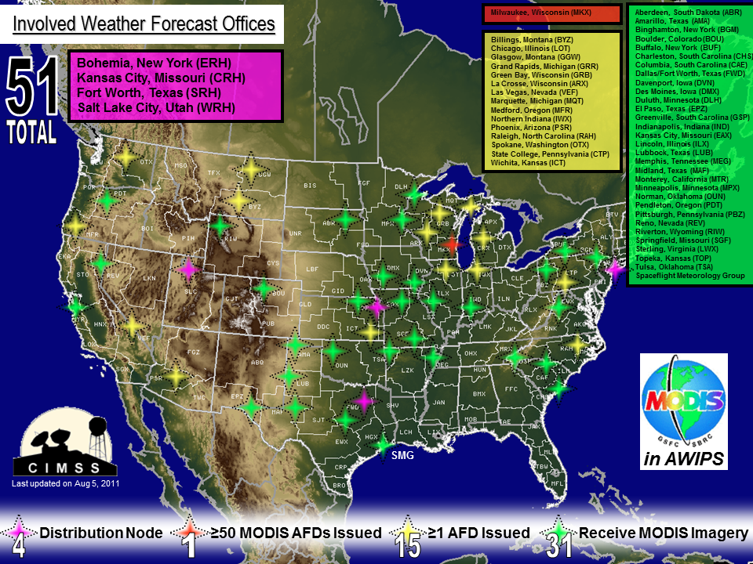

Slide 6
AWIPS “II” (2012+) The Advanced Weather Interactive Processing System
Service-oriented, client-server architecture, plug-in enabled
Two primary components which can standalone
Environmental Data EXchange (EDEX); HDF5 data store
Common AWIPS Visualization Environment (CAVE)
Code arranged in object-oriented Java design
Scalable to multiple platforms, computing systems
Some C and FORTRAN used to optimized performance
Configuration through eXtensible Markup Language (XML) and Python with numpy
Employs shader language for on-GPU calculations
Raytheon-developed code is non-proprietary with unlimited Government purpose rights and eventually will be available to the community through Unidata
Notes:
GPU is Graphical Processing Unit

Slide 7
How AWIPS II will Improve R2O
Compared to geostationary satellites, polar satellites provide observations on greater spatial and spectral scales, while geostationary satellites provide more expansive coverage over a short time interval, ideal for operational meteorologists in the mid-latitudes and tropics
Legacy AWIPS did not allow multi-layer image combinations
SPoRT initially built a combined MODIS and GOES product prior to transmitting it to legacy AWIPS
By supporting dynamic image data array manipulations, AWIPS II:
allows for more timely creation of this product,
promotes a single, fused source for satellite information, and
decreases bandwidth usage while increasing value of imagery to the forecasters.
Notes:
SPoRT is Short-term Prediction Research and Transition Center

Slide 8
Image Layering in AWIPS II
Coverage of 1 km MODIS visible imagery swath, 20:15 UTC 20 January 2012

Slide 9
Image Layering in AWIPS II
GOES-13 (East) imagery only, 20:15 UTC 20 January 2012

Slide 10
Image Layering in AWIPS II
Combination of MODIS and GOES visible imagery, 20:15 UTC 20 January 2012

Slide 11
AWIPS II Strategy at CIMSS
Leverage existing AWIPS II plug-ins (GRIB2, McIDAS AREA, GINI), update configuration tables, and reformat current AWIPS satellite imagery and products from CIMSS to a plug-in-compliant format
Improve and guide development of existing and new AWIPS II plug-ins (netCDF3/4)
Expand data array structure
Currently byte values
Add advanced map projections, additional geospatial support
Pursuing strategies to add satellite perspectives (polar and geostationary)
Currently limited to Mercator, Lambert Conformal, and Polar Stereographic

Slide 12
MODIS TPW in AWIPS II
CIMSS legacy Total Precipitable Water (TPW) product, 21:09 UTC 19 January 2012

Slide 13
GOES-R/S Series (2017 to 2028) The Geostationary Operational Environmental Satellite
Launching in 2015, GOES-R is expected to be GOES-West
Two meteorological instruments
The Advanced Baseline Imager (ABI) will provide
5x more frequent scans (5 minute for full disk, 30 second refresh for single mesoscale sector),
4x improved temporal resolution (2 km at sub-satellite point, except 0.5 km visible), and
3x more spectral channels (16 total, including 4 in the near-IR and 10 in the IR)
than currently on GOES-13/14/15 (N/O/P)
An optical sensor on the Geostationary Lightning Mapper (GLM) will provide continuous lightning flash rates
No Sounder

Slide 14
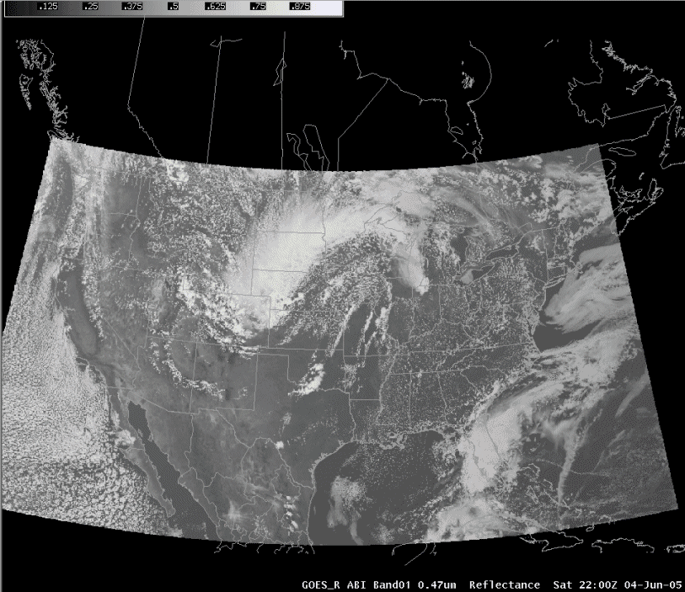
Images from Weather Event Simulator (WES) case available to NWS sites

Slide 15
GOES-R Proving Ground
A proving ground is designed to showcase future capabilities and identify possible gaps as a forward-thinking exercise to prepare the end user for upcoming science and technology and assure that the capabilities meet user requirements.
The GOES-R Proving Ground is a collective effort between many NOAA and NOAA-supported agencies and universities.
The primary customer is the National Weather Service. To assure widespread evaluation and readiness across the NWS, the GOES-R Proving Ground is leveraging existing testbeds at the National Centers, and starting new ones where they do not exist, as well as hiring “satellite champions”.
NWS Weather Forecast Offices can participate in the Proving Ground because all imagery and products are formatted for AWIPS, N-AWIPS, and eventually AWIPS II.

Slide 16
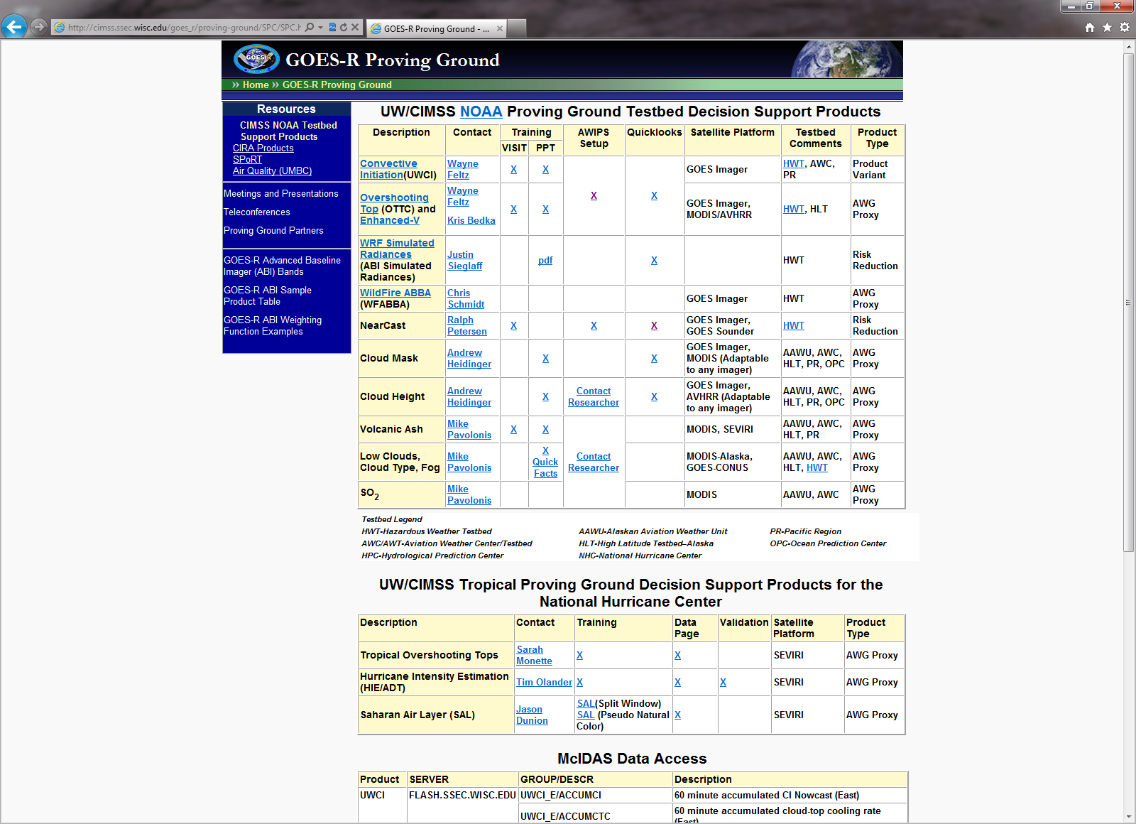
GOES-R Proving Ground
CIMSS supports over 70 NWS sites across the country.
http://cimss.ssec.wisc.edu/goes_r/proving-ground/SPC/SPC.html

Slide 17
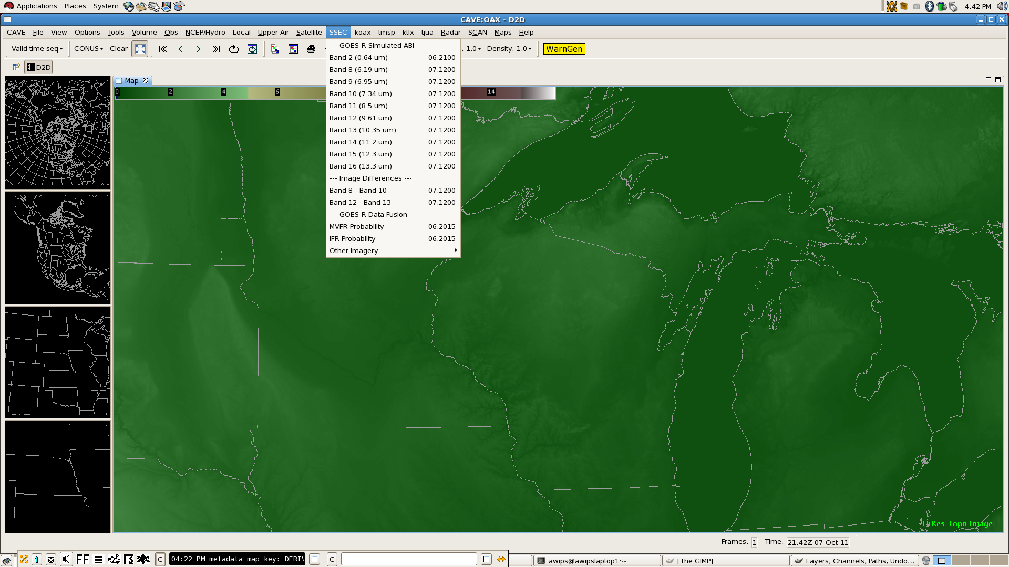
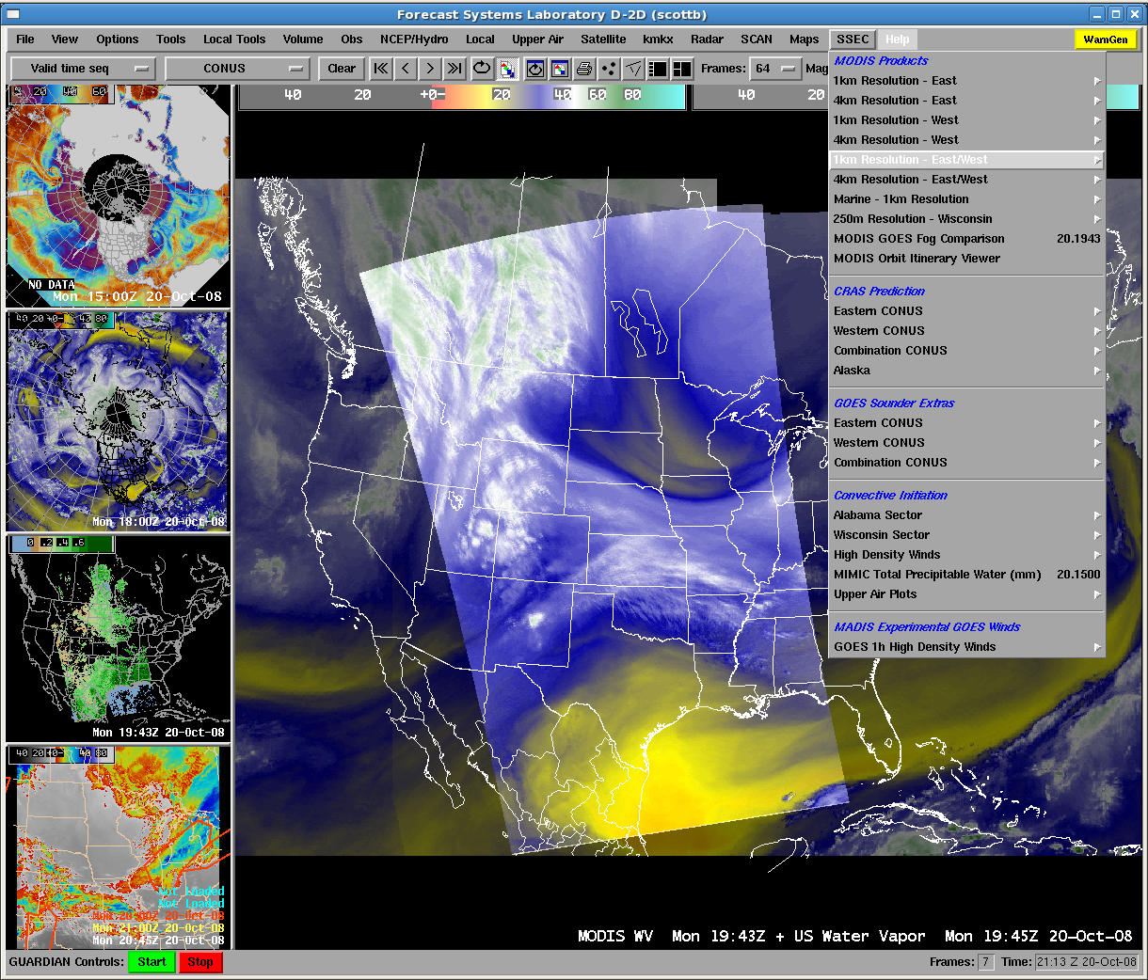
The Challenge: Assuring CIMSS products are available in AWIPS “II”

Slide 18
The Roadmap
GOES-R
Launch
New functionality
New configuration
New data distribution format

Slide 19
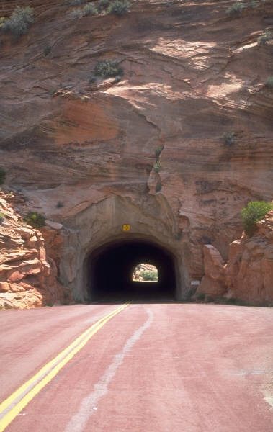
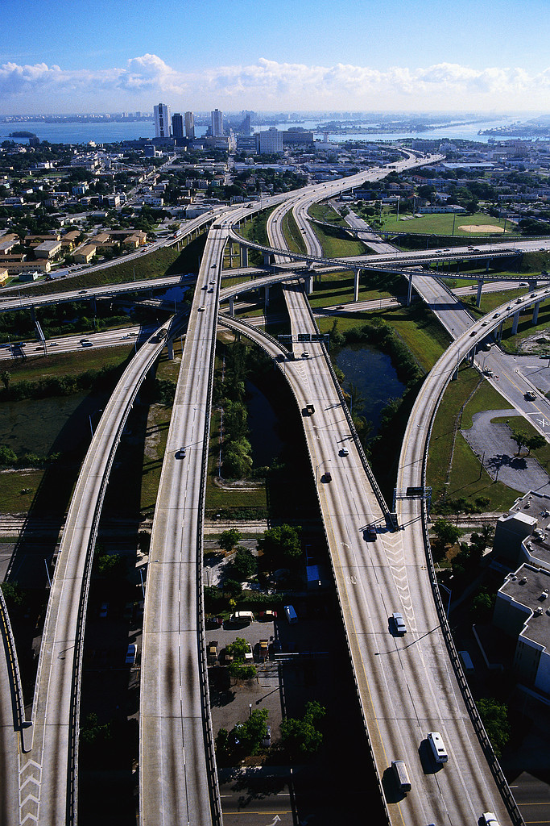
Diversification of paths for data delivery required
Subscription
Future
Narrow pass
Broadcast
Broadcast
Multiple paths

Slide 20
Data Fusion as a Solution
Data fusion is a methodology current under investigation by NWS OST as a way to solve future information overload by combining different data sets into a more complete, actionable product than any one component separately
Some GOES-R Algorithm Working Group (AWG) products are already considered fused because they use model output in addition to satellite observations from multiple bands
If the users are unfamiliar with the inputs into the fused product, misinterpretation of results and underestimate of error may result
Data fusion can appear more absolute than it is
AWIPS II is the ideal tool for data fusion because it can quickly combine disparate data types into a single product and allow for interrogation of original components
Data fusion should be user developed and controlled

Slide 21
Example: Low Cloud Ceiling Probability
GOES-R participation in testbeds has indicated that forecasters are interested in evaluating components to assess magnitude, error, and probability rather than a single deterministic solution
Convective initiation product
Interest in cooling rate as an indicator of realized buoyancy
Trend toward model blends and ensembles
Evaluating the envelope of solutions
This summer, NWS Sullivan evaluated the GOES-R AWG Low Cloud Ceiling Probability products, created with existing bands on GOES-East and GOES-West for every scan
Developed by Mike Pavolonis and Corey Calvert
Daytime fog probability is a function of the spatial uniformity of the 11 μm brightness temperature of the clouds, the temperature difference between the cloud and the surface, and the modeled RH
AWIPS II ready
Notes:
RH is relative humidity

Slide 22
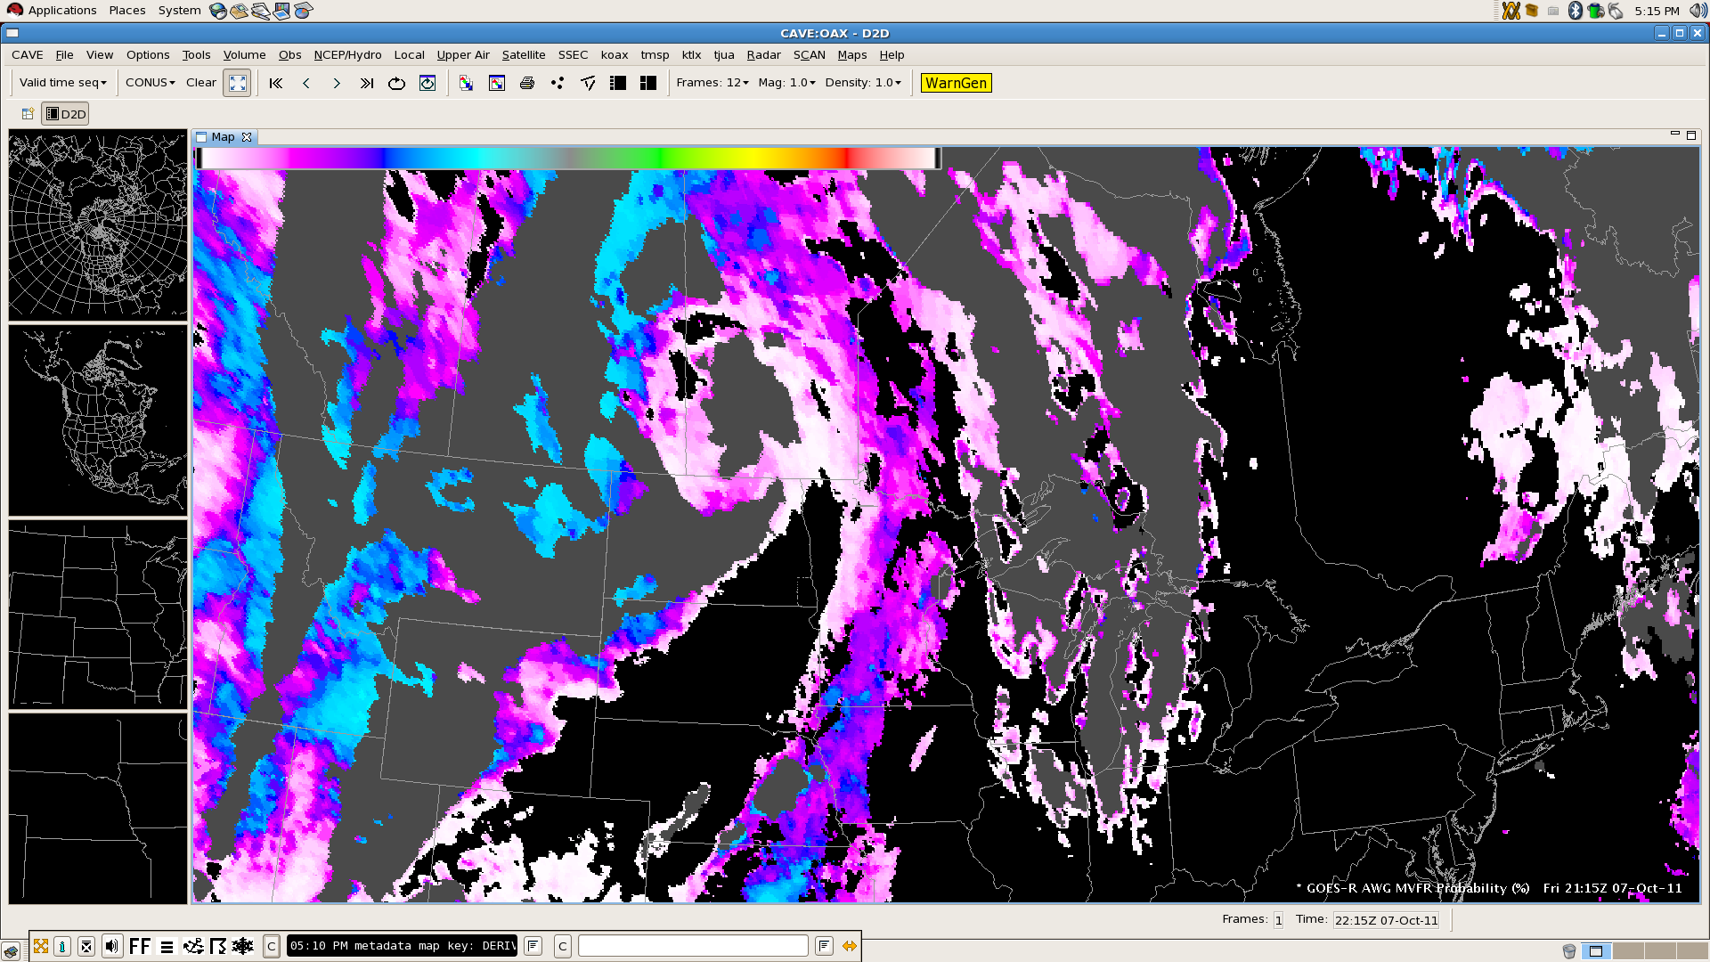
Example: AWG MVFR Probability (Day)
The probability of MVFR product reports the probability that the cloud ceiling is < 3000 feet, regardless of surface visibility.

Slide 23
RGB/RGBA Image Compositing
It is necessary to integrate and support a flexible bit depth data format and user-driven three-way or four-way (with an alpha channel) image blending functionality into the AWIPS II software.
Maximizes the use of current and future satellite imagery and products, as well as leverages a red-green-blue-alpha (RGBA) capability in pre-release versions of the migrated software
The implementation of a data format and display system allowing for bit depths greater than the current specification has numerous applications useful to operational weather analysis and forecasting beyond current capabilities and techniques.
To support data fusion, image differences, individual bands, and other band manipulations can be assigned to a color in the RGB triplet.

Slide 24
Simulated ABI Longwave Bands
Bands 8 through 16 are produced from the National Severe Storms Laboratory (NSSL) Weather Research and Forecast (WRF) model output.
CompactOPTRAN computes optical depths at each model layer based on temperature and water vapor mixing ratio.
36-hour simulation at 4 km spatial resolution is started once per day at 00 UTC, with imagery available by 12 UTC.
Currently limited distribution in AWIPS and N-AWIPS to select NWS forecast offices and National Centers.
Output available online at http://www.nssl.noaa.gov/wrf/ with imagery at
http://cimss.ssec.wisc.edu/goes_r/proving-ground/nssl_abi/nssl_abi_rt.html

Slide 25
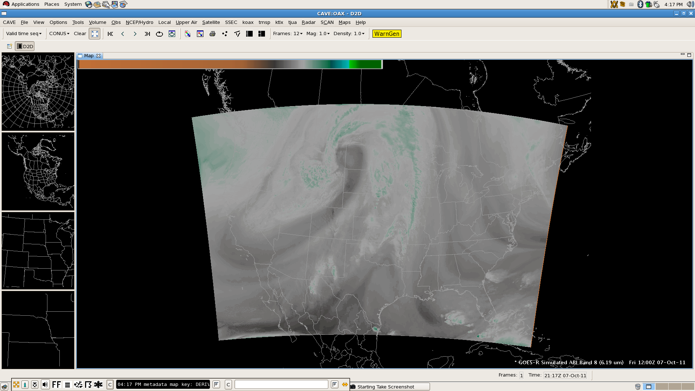
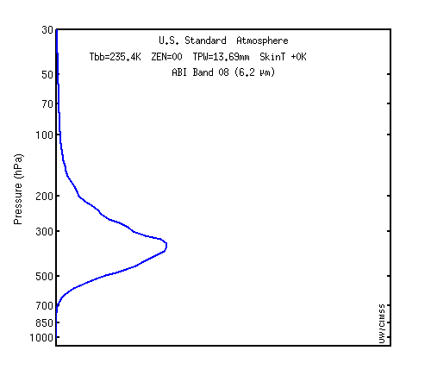
Simulated ABI Band 8 (6.19 µm)
Weighting function for US Standard profile indicates sensitivity to upper tropospheric moisture

Slide 26
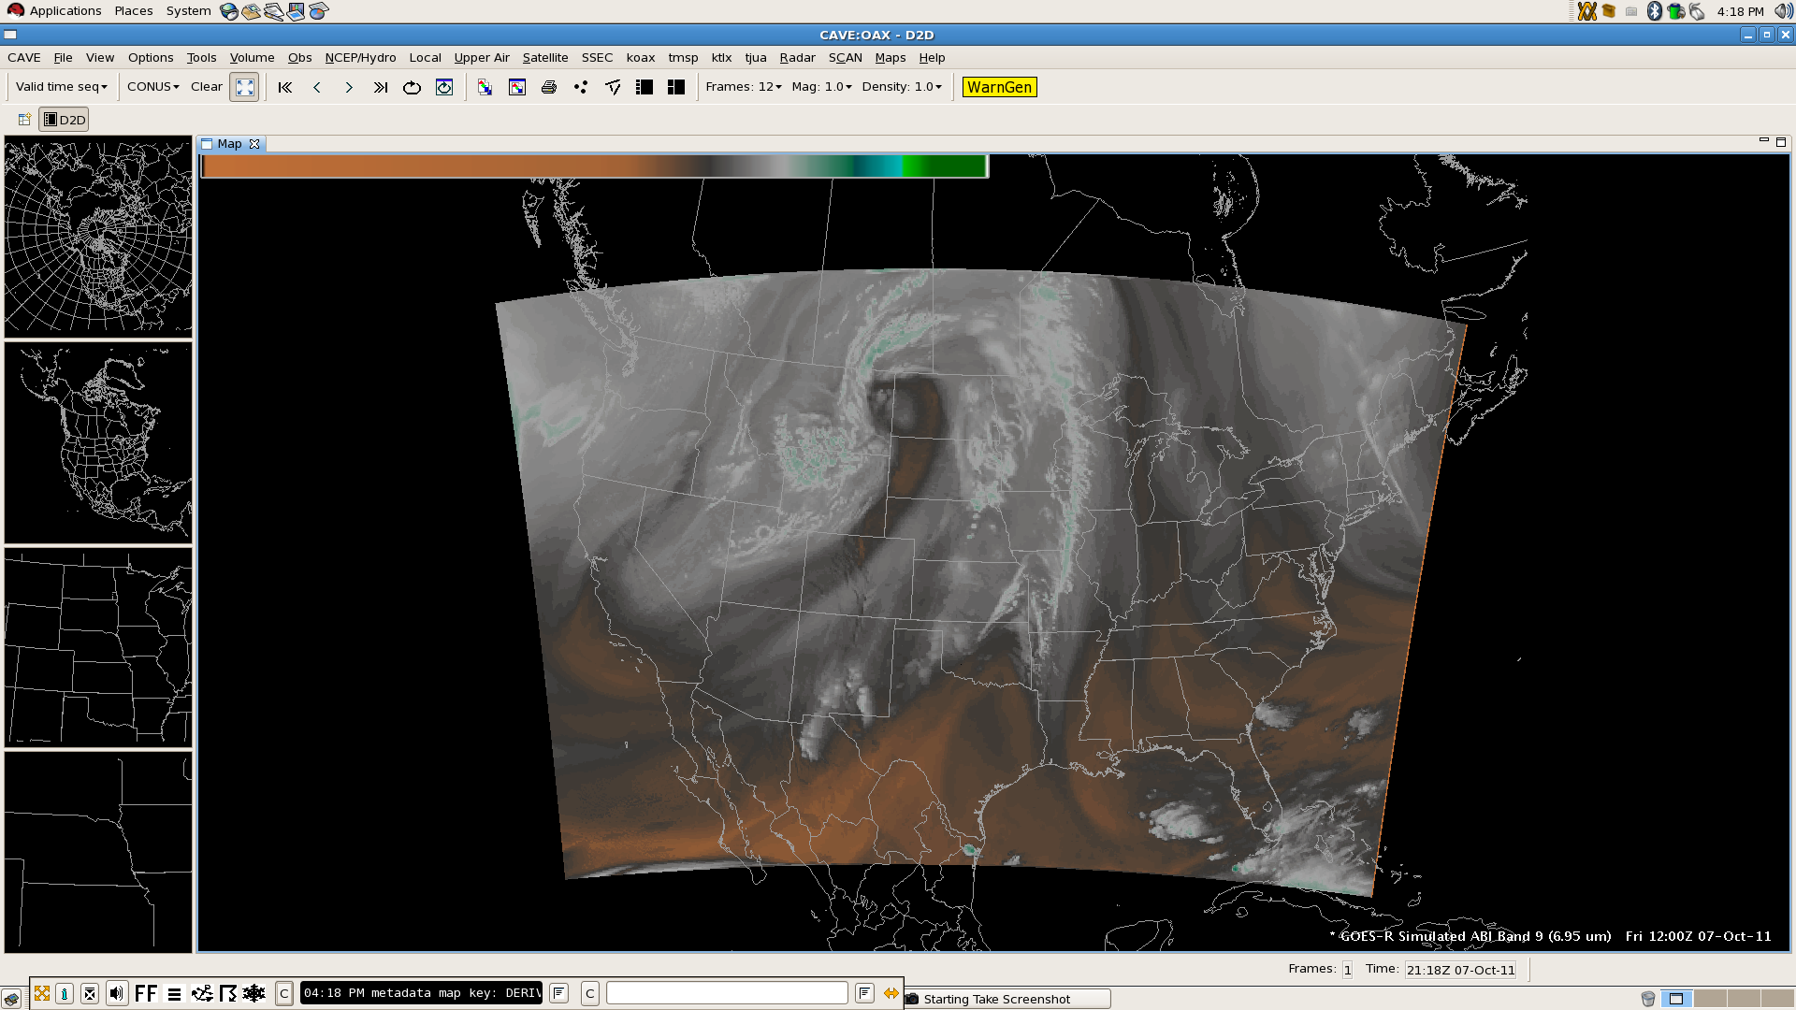
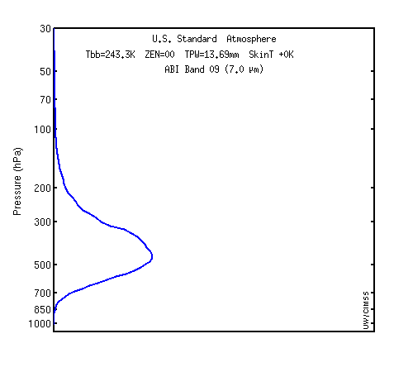
Simulated ABI Band 9 (6.95 µm)
Weighting function for US Standard profile indicates sensitivity to upper middle tropospheric moisture

Slide 27
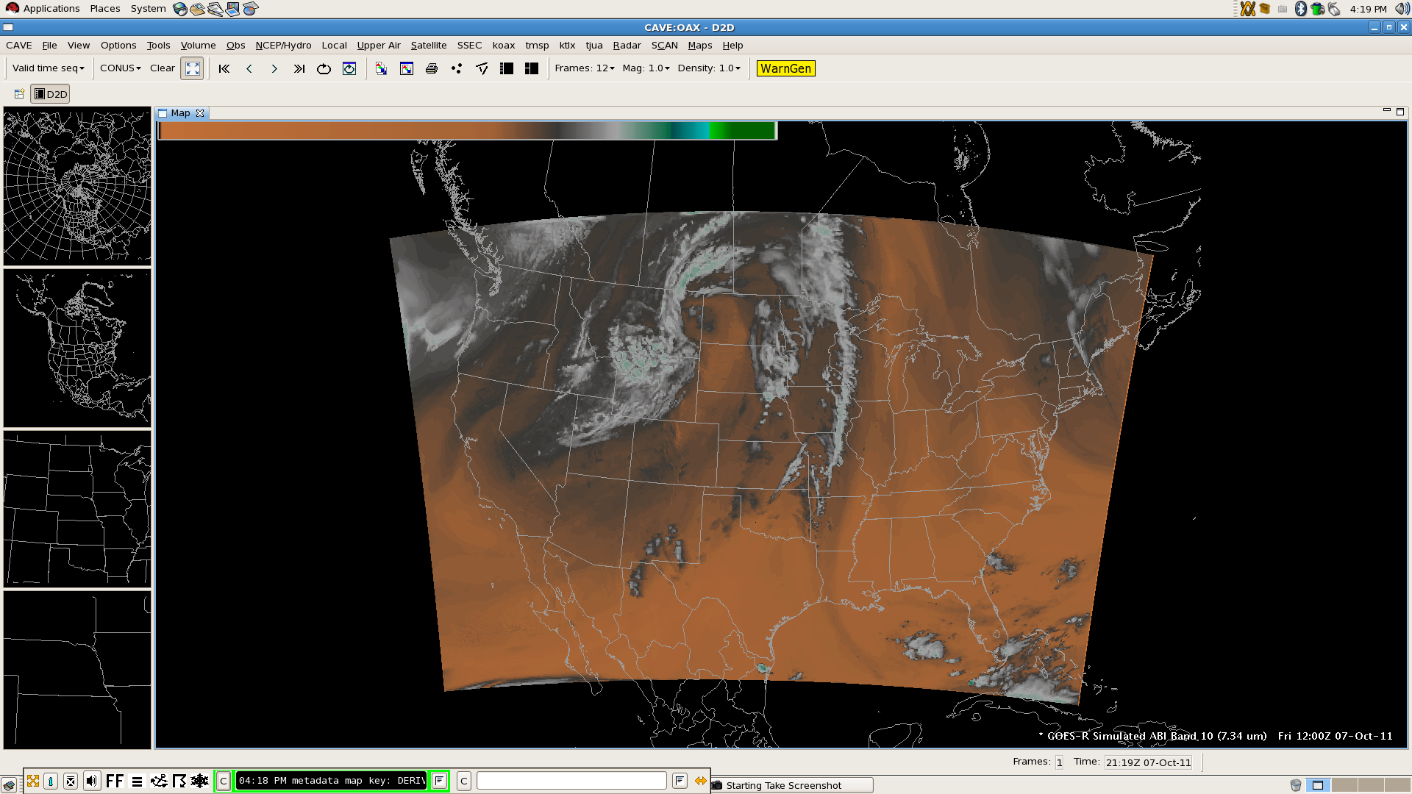
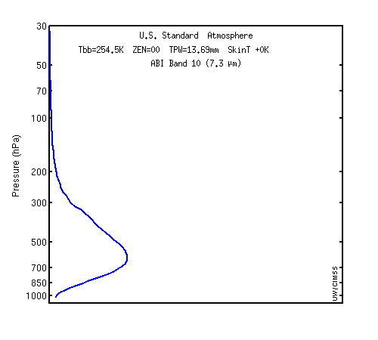
Simulated ABI Band 10 (7.34 µm)
Weighting function for US Standard profile indicates sensitivity to lower middle tropospheric moisture

Slide 28
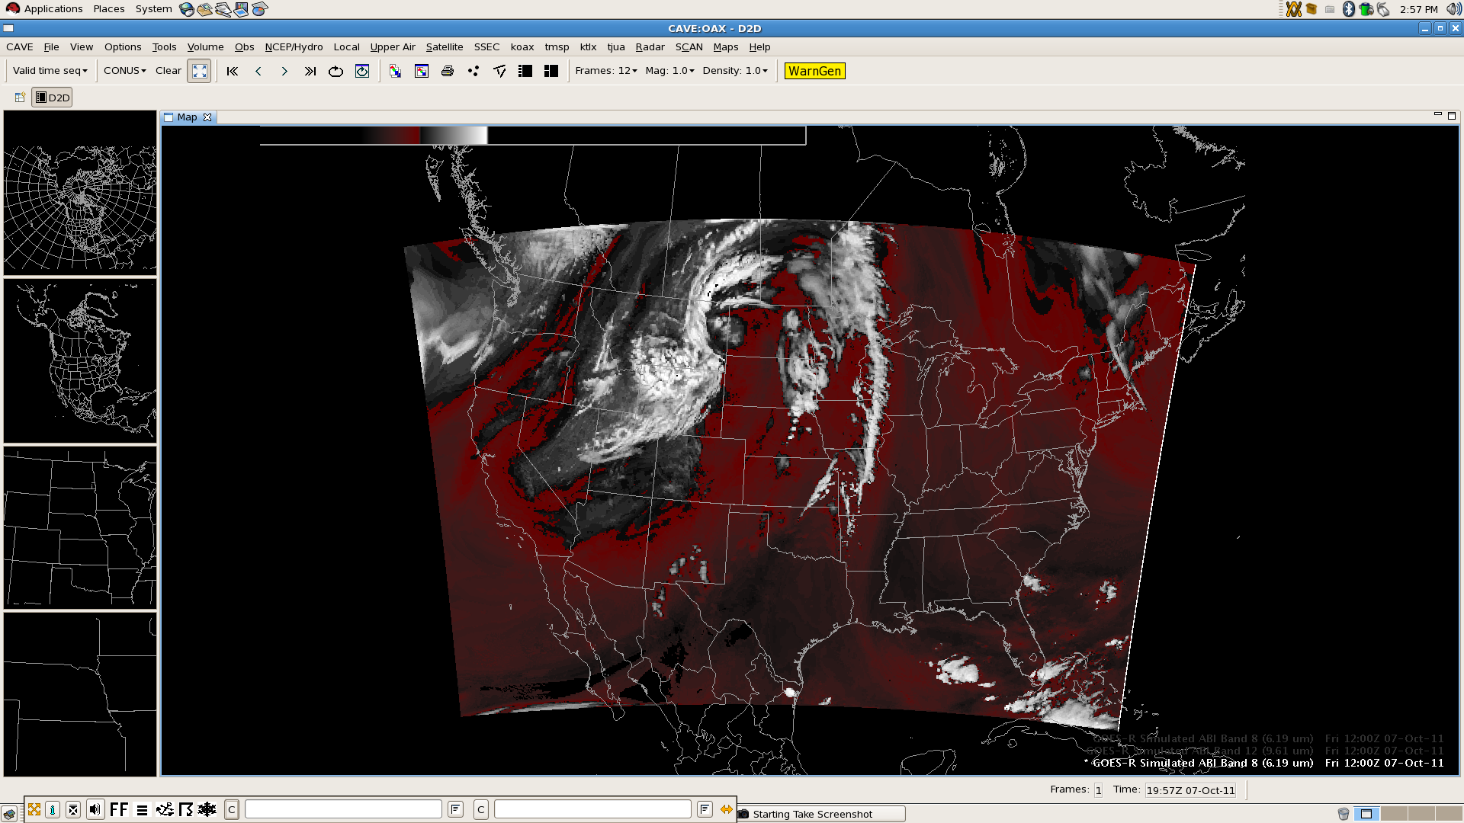
Building an RGB: Band 8 – Band 10
Red with alpha gradient (upper–lower tropospheric moisture difference), white clouds with alpha gradient
Notes:
Red, -50 to -27; White -27 to 0

Slide 29
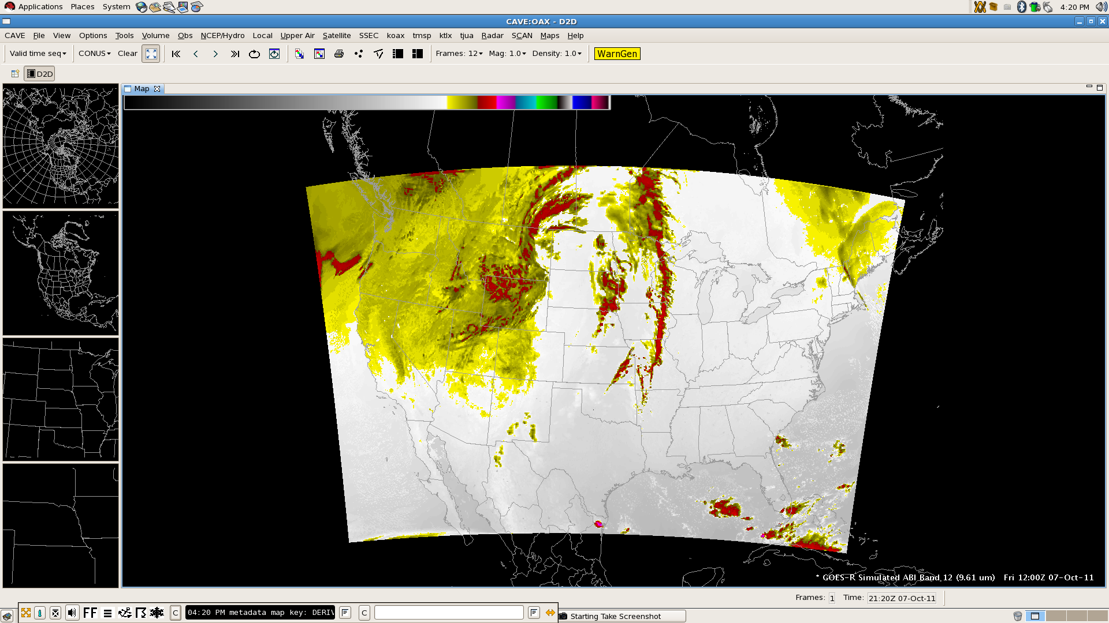
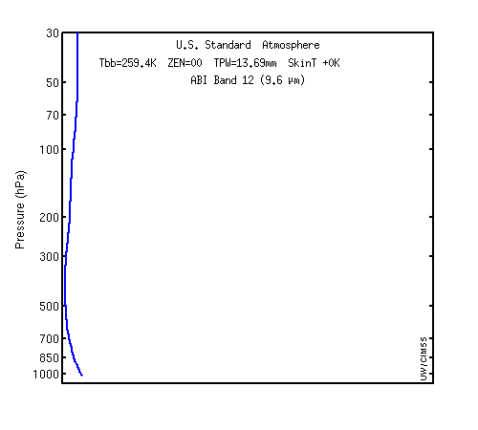
Simulated ABI Band 12 (9.61 µm)
Weighting function for US Standard profile indicates sensitivity to ozone

Slide 30
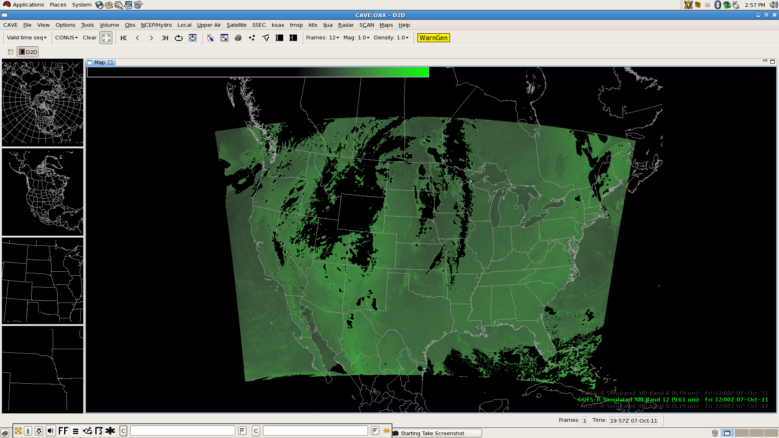
Building an RGB: Band 12 – Band 13
Green with alpha gradient (brighter high ozone concentration indicative of low potential vorticity surfaces)
Notes:
Green 27 to 127

Slide 31
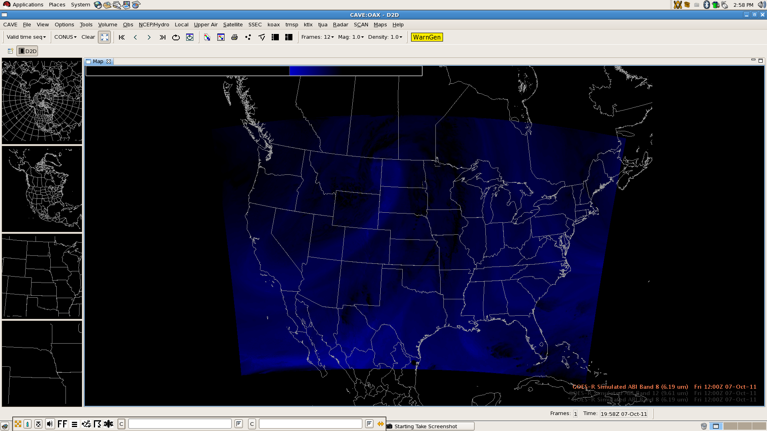
Building an RGB: Band 8 Inverted
Blue with alpha gradient (brighter blues indicate dryer upper tropospheric air, dry slot)
Notes:
Blue 27 to 67

Slide 32
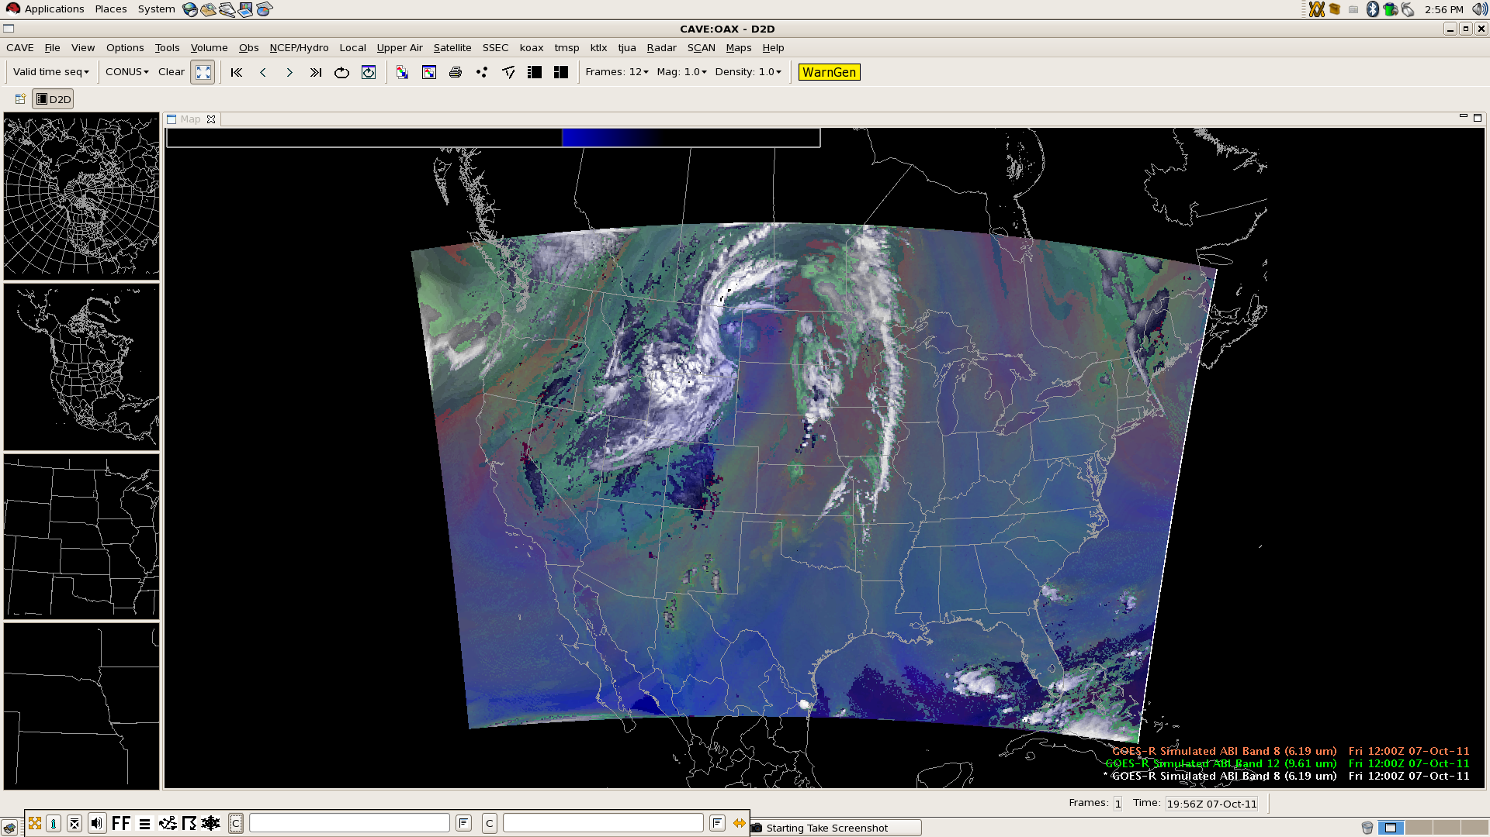
Building an RGB: Composite
Composite shows an amplified weather pattern, synoptic dry slot, and differential tropospheric moisture

Slide 33
Potential AWIPS II Capabilities
Point display of satellite-retrieved atmospheric properties
Atmospheric Infrared Sounder (AIRS) example
Click-to-load profiles?
User interface for the multi-channel RGB color capability
Implement with GPU Shader Language for quick display time, a strength of AWIPS II
Updated user controls and color scheme selection
New color table widget for developing color tables with more than 256 colors (current AWIPS I transmission format and software limitation)
Product browser capability (Raytheon concept)
Redesign the volume browser?

Slide 34
AIRS Retrievals in AWIPS II
Point retrievals of total precipitable water from AIRS, 8:40 UTC 1 August 2011

Slide 35
Potential AWIPS II Capabilities
Expanded capability for derived parameters
User control of image differencing and scaling
Permit operations in value space instead of data storage space
EDEX plug-in to handle ingest of GOES-R sectorized Cloud and Moisture Imagery (CMI) products in netCDF4
CAVE plug-in for displaying bit depths greater than eight
Partial re-factoring of EDEX plug-ins may be necessary
Additional configurability via XML
Legends, scaling, purging, etc.

Slide 36
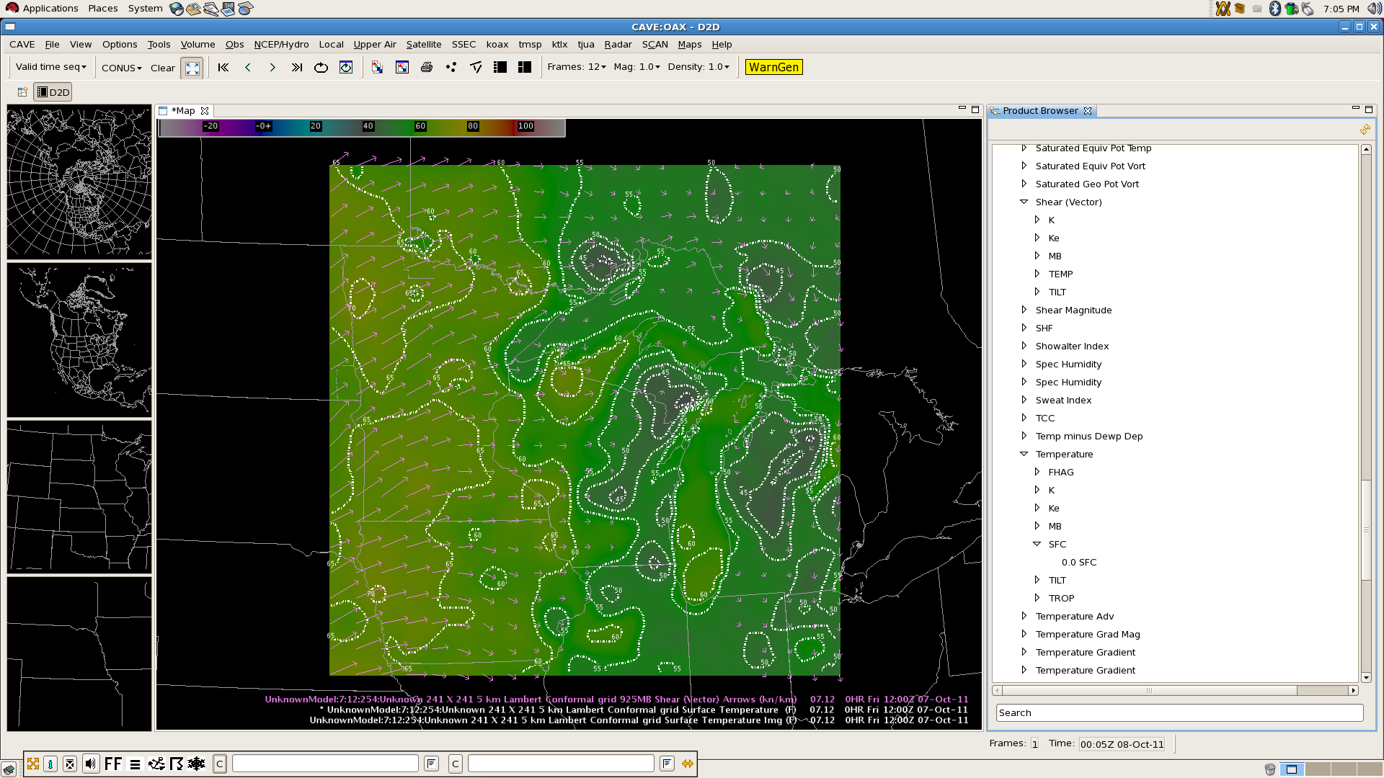
Example: Raytheon’s Product Browser
CIMSS Real-Time Mesoscale Analysis (CRTMA) using MODIS SST composite
Notes:
MODIS is Moderate Resolution Imaging Spectroradiometer, SST is Sea Surface Temperature

Slide 37
AWIPS II Capabilities Wish List
Product-push deployment, quick display capability, and direct display sharing with remote users
Ability to introduce new or special products just in time for use with high-impact or evolving weather events
Facilitate direct communication in training exercises to allow for interaction and quick answers to questions on data or products
Incorporation of scientific programming languages to leverage display and data store
Increase use in research sector and academia
Allow for more efficient techniques development
Decrease amount of time for training in new language

Slide 38
Conclusions and Future Directions
The GOES-R Proving Ground is an orchestrated activity which is advancing the use and knowledge of satellite imagery and future products in operational meteorology (NRC requirement #2) borne out of a need to mitigate risk in preparing users for upcoming capabilities (NRC requirement #1).
AWIPS II will play a significant role in promoting the capabilities of GOES-R and new polar-orbiting satellites (Suomi National Polar-orbiting Partnership) because of
New capabilities and flexibility in the software;
Expanded distribution and development group/strategy;
Ongoing implementation of additional features
Maximize the utility of satellite imagery and products in concert with other in-situ observations and model output.
AWIPS II exceeds NRC resource adequacy requirement #3.

Slide 39
Conclusions and Future Directions
AWIPS II will also allow for the efficient transfer of new science and technology into NWS operations without delay, so long as sufficient bandwidth is provided.
Limited broadcast, increased subscriptions for smart push/pull
Our future AWIPS will not be confined to NWS offices, but extend to universities and other agencies, becoming an integral communication tool and stimulating research to operations activities, sustaining a continuous feedback loop (NRC requirement #4).
Unique applications of the software will increase
Facing future data overload, a methodology is necessary which optimizes the use of data, imagery, products, and tools which are situation and scenario relevant, leading the decision support thought process.
Don’t let data fusion become data confusion
Questions? Comments? Contact me: Jordan Gerth, Jordan.Gerth@noaa.gov

