Slide 1
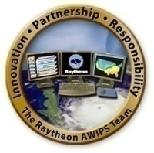
How AWIPS II will bring GOES-R Capabilities and Science to the Field, both Pre- and Post-Launch
Jordan Gerth, Research Assistant
Cooperative Institute for Meteorological Satellite Studies, University of Wisconsin
Joint NWA/GUC Session I – Thursday, October 20, 2011
National Weather Association Annual Meeting, Birmingham, Alabama

Slide 2
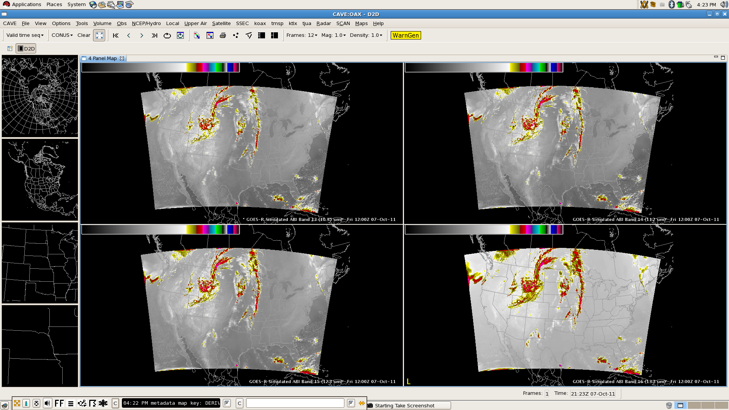
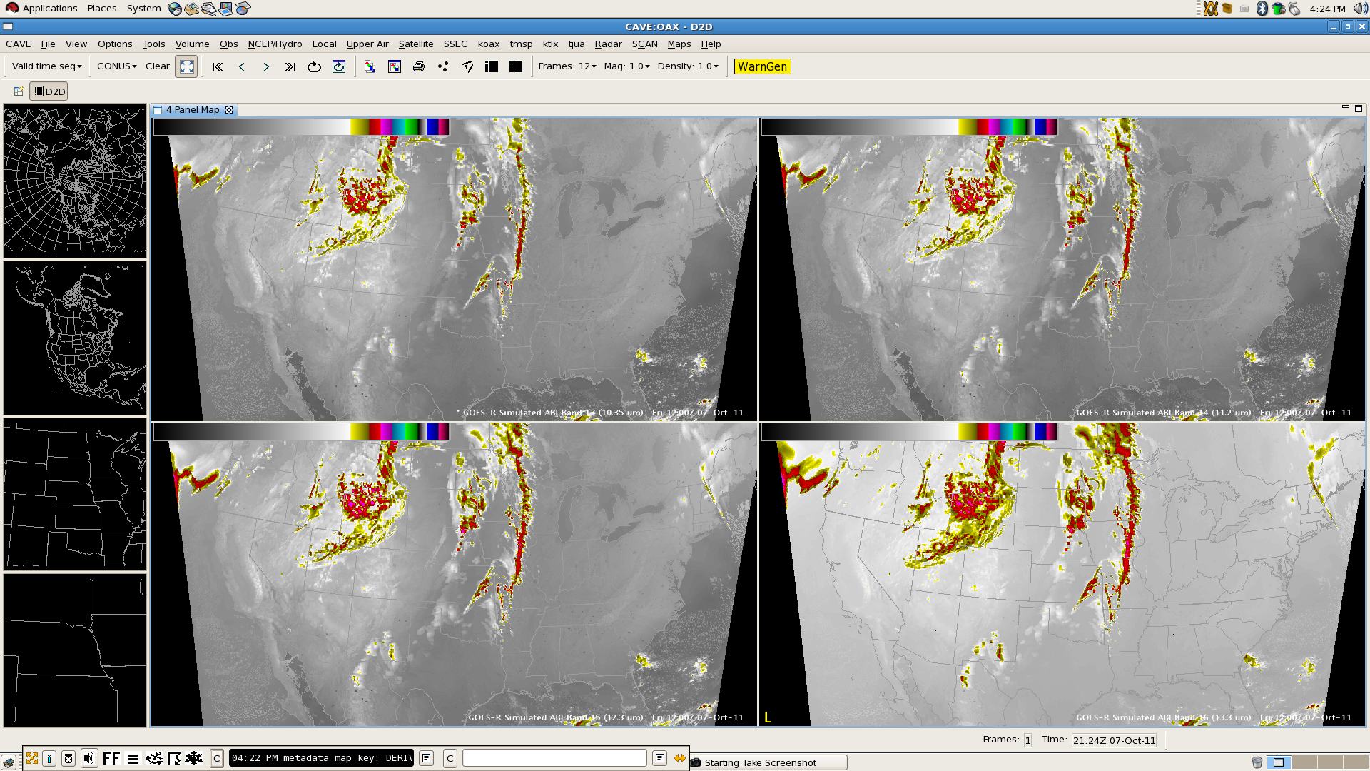
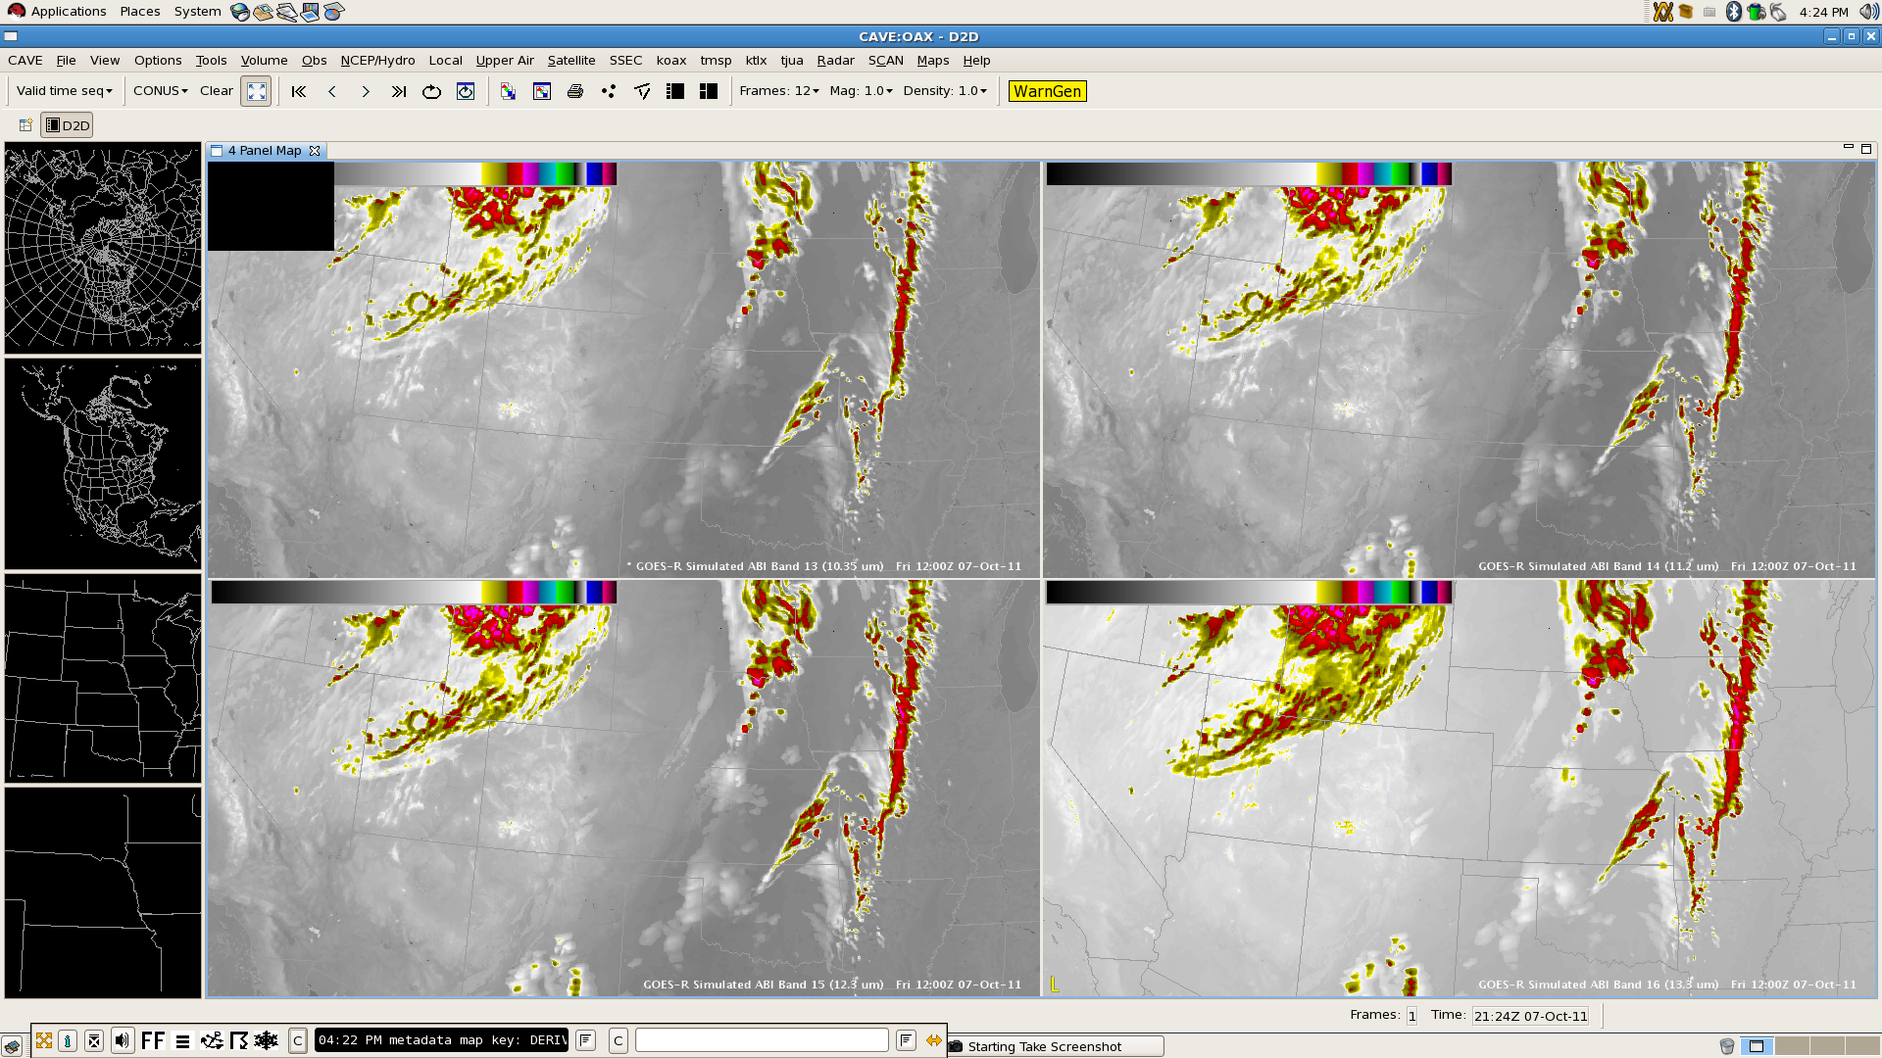
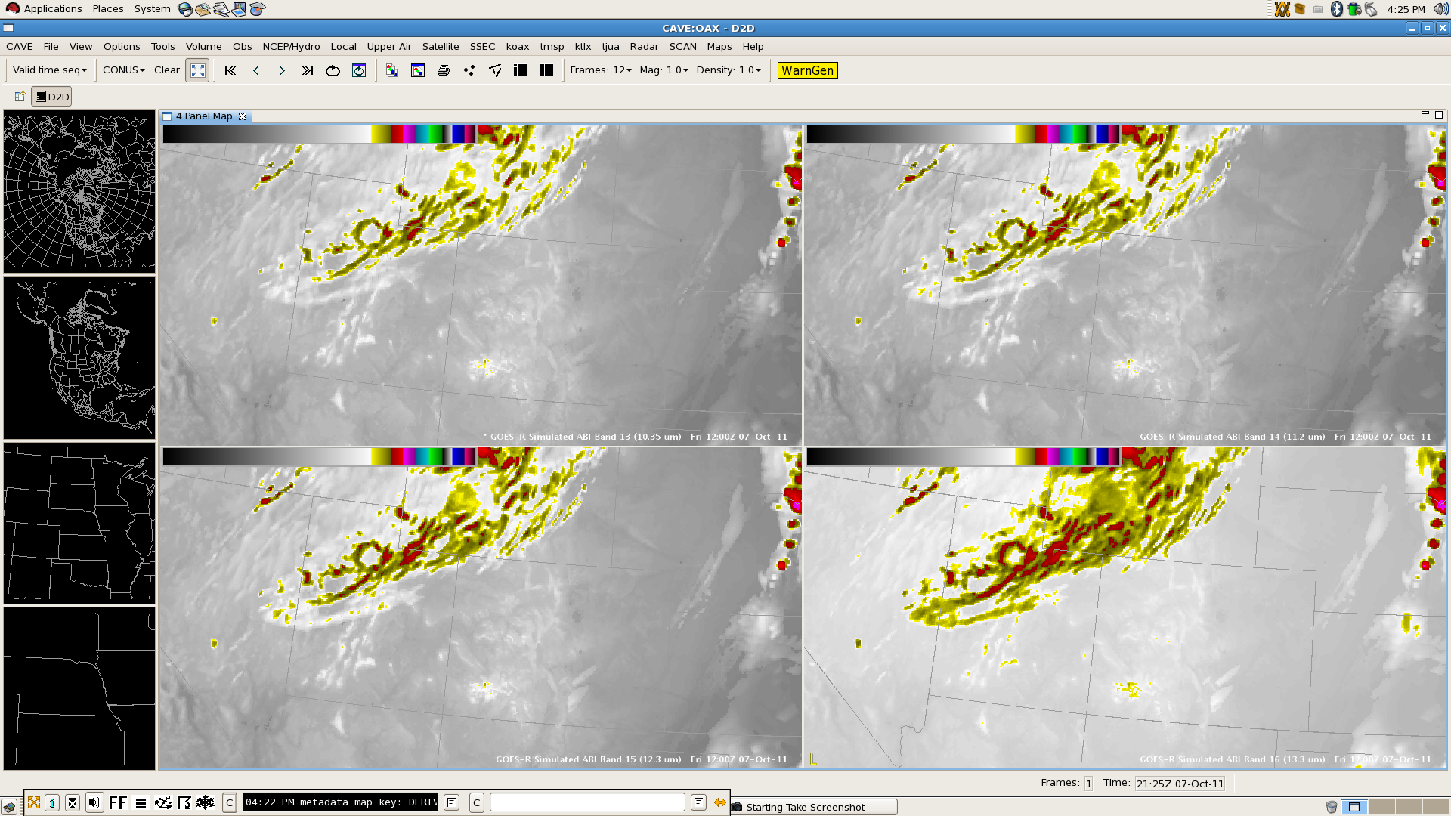
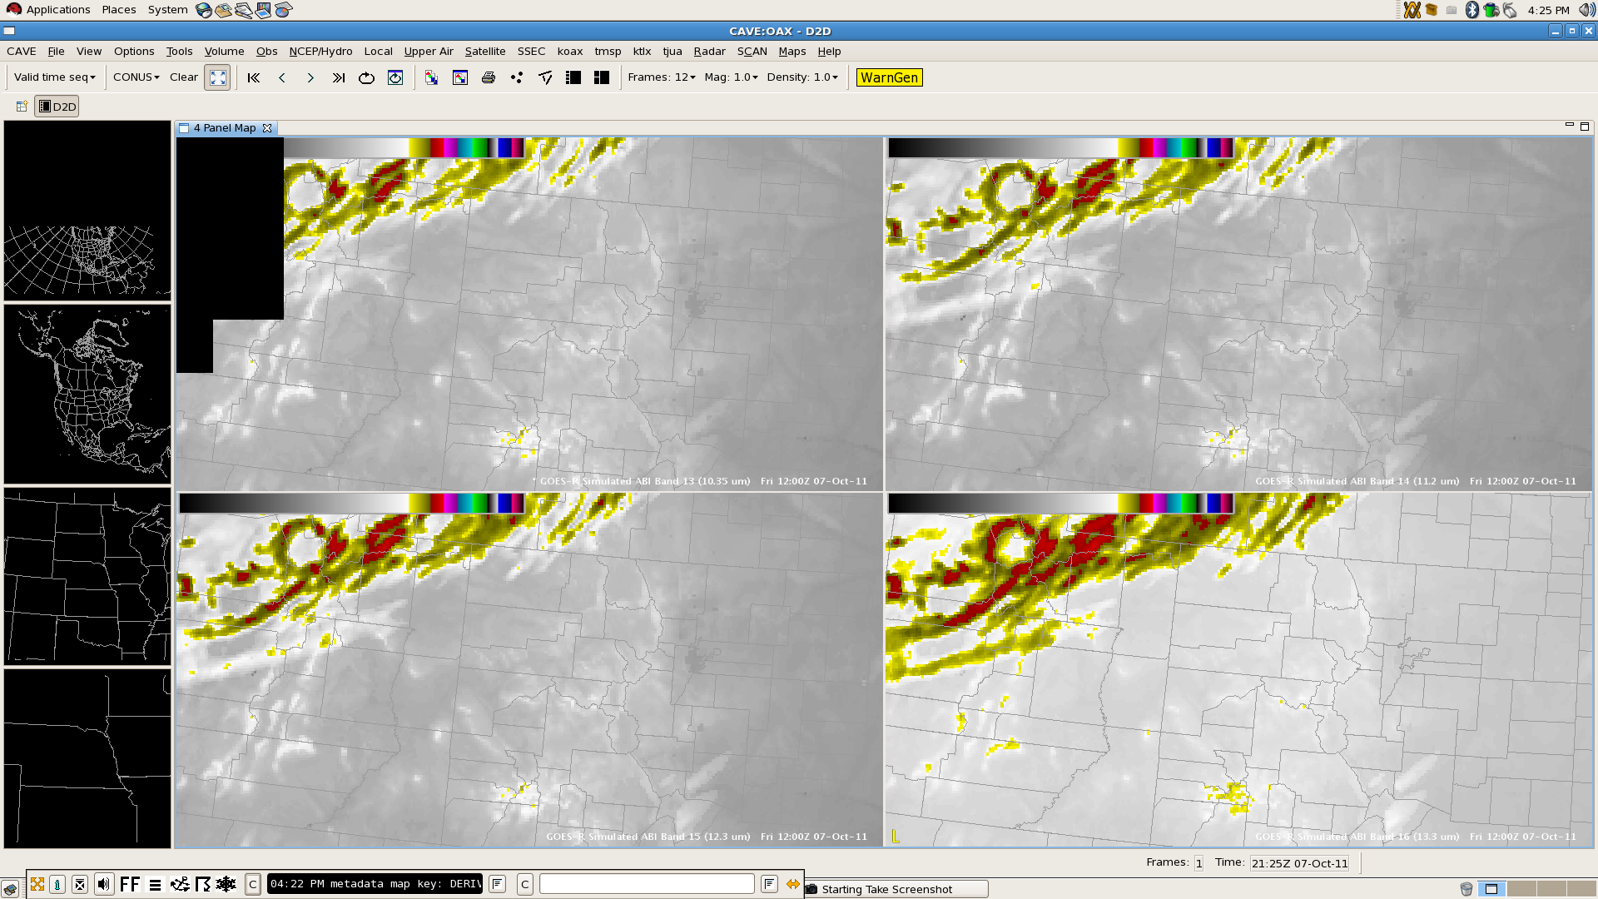
Panning and Zooming in AWIPS II
with GOES-R Simulated ABI Channels 13 through 16

Slide 3
Contributors to this Presentation
Kaba Bah, Lee Cronce, Mat Gunshor, and Justin Sieglaff, CIMSS
Robert Aune and Tim Schmit, NESDIS ASPB
Bill Campbell, Tom Kretz, and Ed Mandel, NWS OST
Frank Griffith and programmers at Raytheon
For more information on cloud and moisture imagery (CMI) delivery in the GOES-R era, see the “GOES-R Sectorized Cloud and Moisture Imagery Products” poster P4.18 in the NWA/GUC Joint Poster Session
Sectorized CMI data streaming from GOES-R Ground Segment (GS) into AWIPS.
Each netCDF4 file holds one tile.
Each tile is a subset of a complete satellite image.
Tile size will be configurable (e.g., 1024X1024 pixels).

Slide 4
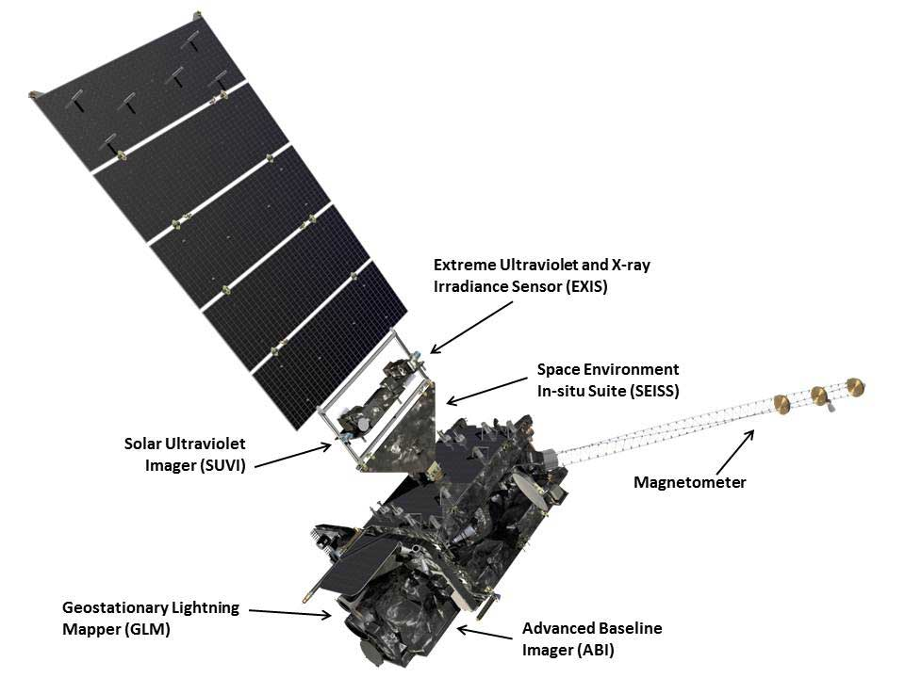
Presentation Outline
Current capabilities (GOES-N/O/P)
GOES-R/S Series
GOES-R Proving Ground
AWIPS and AWIPS II
Data Fusion
GOES-R AWG, AWIPS II Examples
RGB/RGBA Image Combinations
Simulated ABI Longwave Channels
Potential AWIPS II Capabilities
Conclusions and Future Directions

Slide 5
GOES-13/14/15 (N/O/P, 2010 to 2020)
Geostationary Operational Environmental Satellite
GOES-13 is currently GOES-East
Imager has five channels
Visible at 1 km spatial resolution
Shortwave IR, Water Vapor, Clean IR Window at 4 km
Dirty IR Window at 8 km on 13, 4 km on 14/15
Depending on scan strategy, new CONUS image every 15 minutes
Sounder has nineteen channels
One visible channel, 18 infrared channels for temperature and moisture soundings, including 3 water vapor channels and one ozone channel, all at approximately 8 km resolution
Available approximately once per hour, US only

Slide 6
GOES-R/S Series (2017 to 2028)
Launching in 2015, GOES-R is expected to be GOES-West
Two meteorological instruments
The Advanced Baseline Imager (ABI) will provide
5x more frequent scans (5 minute for full disk, 30 second refresh for single mesoscale sector),
4x improved temporal resolution (2 km at sub-satellite point, except 0.5 km visible), and
3x more spectral channels (16 total, including 4 in the near-IR and 10 in the IR)
than currently on GOES-13/14/15 (N/O/P)
An optical sensor on the Geostationary Lightning Mapper (GLM) will provide continuous lightning flash rates
No Sounder

Slide 7
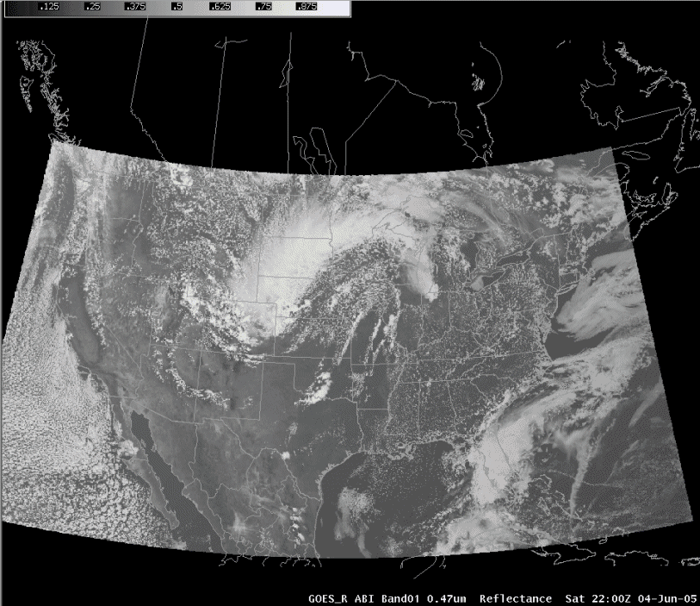
Images from Weather Event Simulator (WES) case available to NWS sites

Slide 8
GOES-R Proving Ground
A proving ground is designed to showcase future capabilities and identify possible gaps as a forward-thinking exercise to prepare the end user for upcoming science and technology and assure that the capabilities meet user requirements.
The GOES-R Proving Ground is a collective effort between many NOAA and NOAA-supported agencies and universities.
The primary customer is the National Weather Service.
To assure widespread evaluation and readiness across the NWS, the GOES-R Proving Ground is leveraging existing testbeds at the National Centers, and starting new ones where they do not exist, as well as hiring “satellite champions”.
NWS Weather Forecast Offices can participate in the Proving Ground because all imagery and products are formatted for AWIPS, N-AWIPS, and eventually AWIPS II.

Slide 9
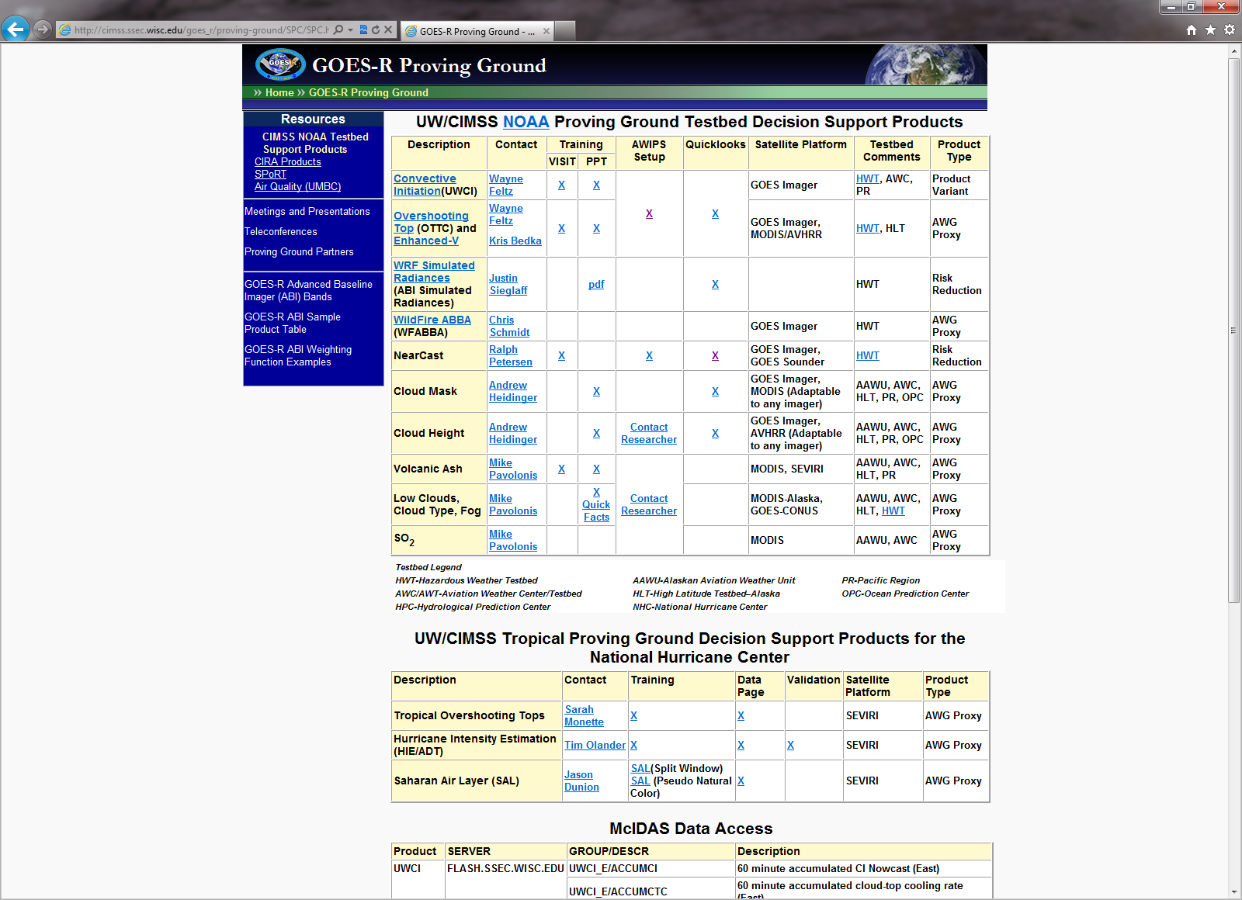
GOES-R Proving Ground
CIMSS supports over 70 NWS sites across the country.
http://cimss.ssec.wisc.edu/goes_r/proving-ground/SPC/SPC.html

Slide 10
AWIPS “I” (1998 to 2011)
Advanced Weather Interactive Processing System
Modular, discretized architecture
Numerous components, each of which was essentially standalone and responsible for a different function
Different decoder for each ingest data type; netCDF3 data store
Display Two-Dimensions (D2D), graphical frontend
Notification server and purge process
Built specifically for National Weather Service multiple server, multiple workstation hardware configuration
Predominantly C and FORTRAN code, with some Tcl for GUI
Flat text, pipe-delimited localization files
Basic visualization functionality
Not community software with source code generally not available, even at NWS field offices
Notes:
netCDF is network Common Data Format

Slide 11
AWIPS “II” (2012+)
Service-oriented, client-server architecture, plug-in enabled
Two primary components which can standalone
Environmental Data EXchange (EDEX); HDF5 data store
Common AWIPS Visualization Environment (CAVE)
Code arranged in object-oriented Java design
Scalable to multiple platforms, computing systems
Some C and FORTRAN used to optimized performance
Configuration through eXtensible Markup Language (XML) and Python with numpy
Employs shader language for on-GPU calculations
Raytheon-developed code is non-proprietary with unlimited Government purpose rights and eventually will be available to the community through Unidata
EDEX has McIDAS AREA ingest capability for satellite data
Notes:
GPU is Graphical Processing Unit

Slide 12
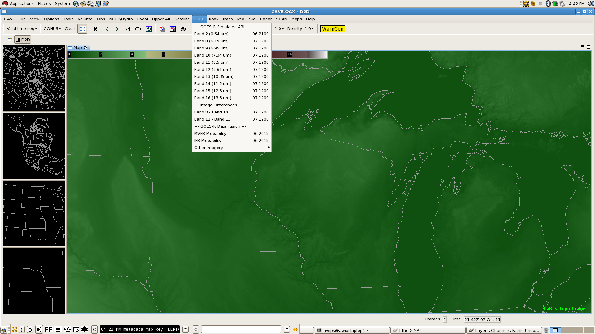
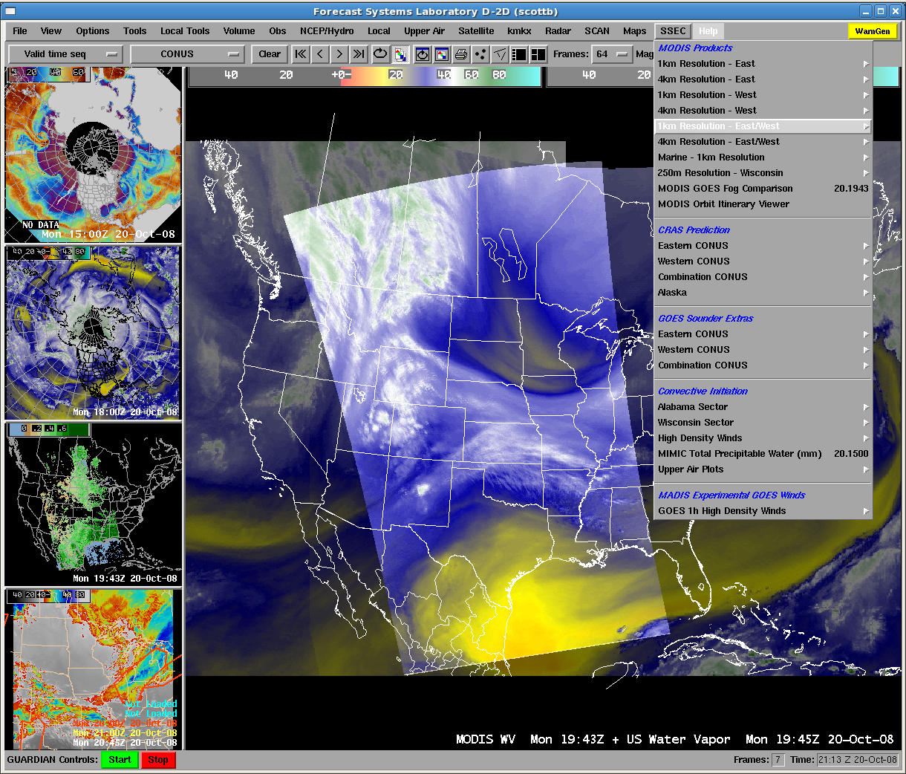
The Challenge: Assuring CIMSS products are available in AWIPS “II”

Slide 13
The Roadmap
GOES-R
Launch
New functionality
New configuration
New data distribution format

Slide 14
Data Fusion
Data fusion is a methodology current under investigation by NWS OST as a way to solve future information overload by combining different data sets into a more complete, actionable product than any one component separately
Some GOES-R Algorithm Working Group (AWG) products are already considered fused because they use model output in addition to satellite observations from multiple bands
If the users are unfamiliar with the inputs into the fused product, misinterpretation of results and underestimate of error may result
Data fusion can appear more absolute than it is
AWIPS II is the ideal tool for data fusion because it can quickly combine disparate data types into a single product and allow for interrogation of original components
Data fusion should be user developed and controlled

Slide 15
Example: Low Cloud Ceiling Probability
GOES-R participation in testbeds has indicated that forecasters are interested in evaluating components to assess magnitude, error, and probability rather than a single deterministic solution
Convective initiation product
Interest in cooling rate as an indicator of realized buoyancy
Trend toward model blends and ensembles
Evaluating the envelope of solutions
This summer, NWS Sullivan evaluated the GOES-R AWG Low Cloud Ceiling Probability products, created with existing bands on GOES-East and GOES-West for every scan
Developed by Mike Pavolonis and Corey Calvert
Daytime fog probability is a function of the spatial uniformity of the 11 μm brightness temperature of the clouds, the temperature difference between the cloud and the surface, and the modeled RH
Nighttime fog probability is a function of cloud emissivity at 3.9 μm, the temperature difference between the cloud and the surface, and the modeled RH
Notes:
RH is relative humidity

Slide 16
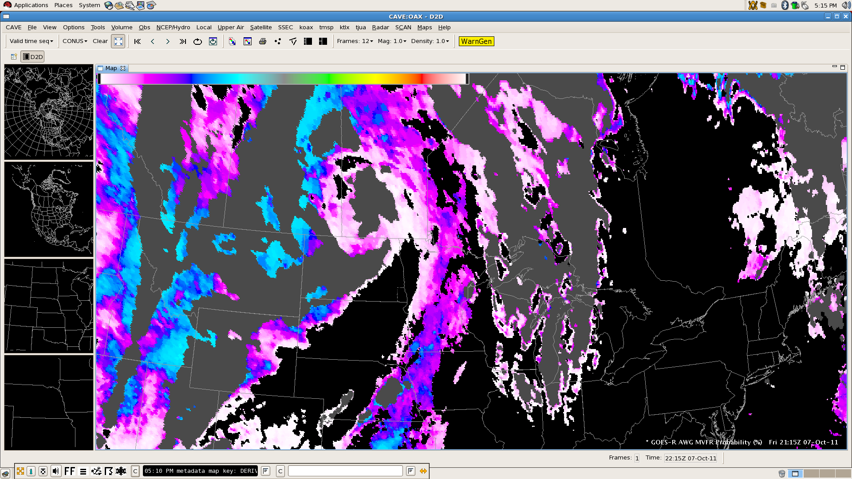
Example: AWG MVFR Probability (Day)
The probability of MVFR product reports the probability that the cloud ceiling is < 3000 feet, regardless of surface visibility.

Slide 17
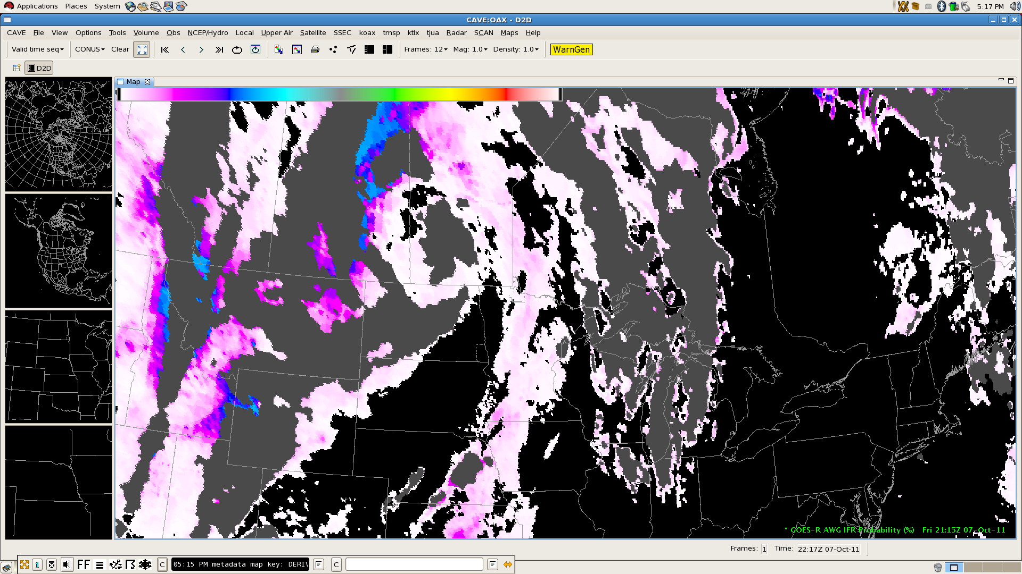
Example: AWG IFR Probability (Day)
The probability of IFR product reports the probability that the cloud ceiling is < 1000 feet, regardless of surface visibility.

Slide 18
RGB/RGBA Image Compositing
In order to maximize the use of current and future satellite imagery and products, as well as the software display, it is necessary to integrate and support a flexible bit depth data format and user-driven three-way or four-way (with an alpha channel) image blending functionality into the AWIPS II software.
This would leverage a red-green-blue-alpha (RGBA) capability in pre-release versions of the migrated software.
The implementation of a data format and display system allowing for bit depths greater than the current specification has numerous applications useful to operational weather analysis and forecasting beyond current capabilities and techniques.
To support data fusion, image differences, individual bands, and other band manipulations can be assigned to a color in the RGB triplet. RGB products are currently undergoing evaluation at the Hydromet Prediction Center and National Hurricane Center.

Slide 19
Simulated ABI Longwave Bands
Bands 8 through 16 are produced from the National Severe Storms Laboratory (NSSL) Weather Research and Forecast (WRF) model output.
CompactOPTRAN computes optical depths at each model layer based on temperature and water vapor mixing ratio.
36-hour simulation at 4 km spatial resolution is started once per day at 00 UTC, with imagery available by 12 UTC.
Currently limited distribution in AWIPS and N-AWIPS to select NWS forecast offices and National Centers.
Output available online at
http://www.nssl.noaa.gov/wrf/
with imagery at
http://cimss.ssec.wisc.edu/goes_r/proving-ground/nssl_abi/nssl_abi_rt.html

Slide 20
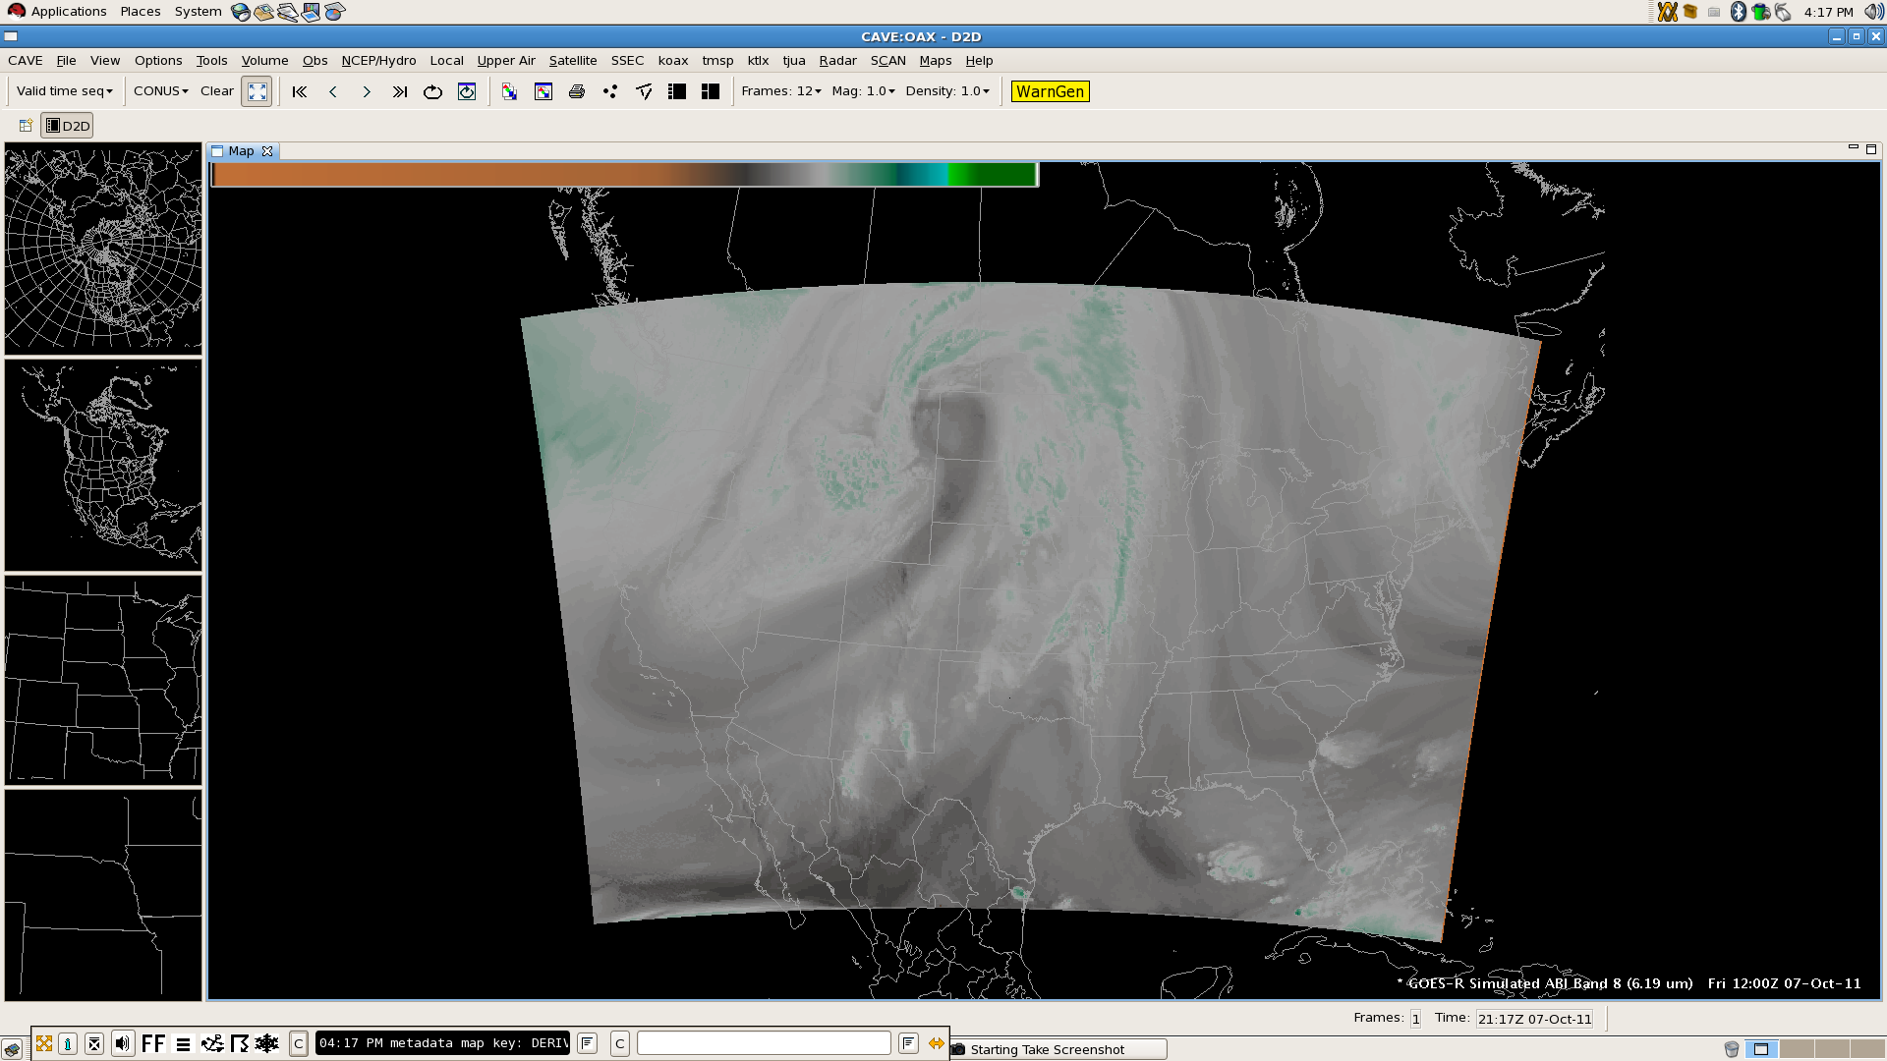
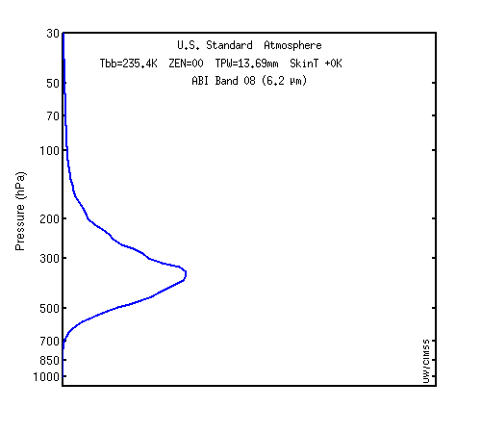
Simulated ABI Band 8 (6.19 µm)
Weighting function for US Standard profile indicates sensitivity to upper tropospheric moisture

Slide 21
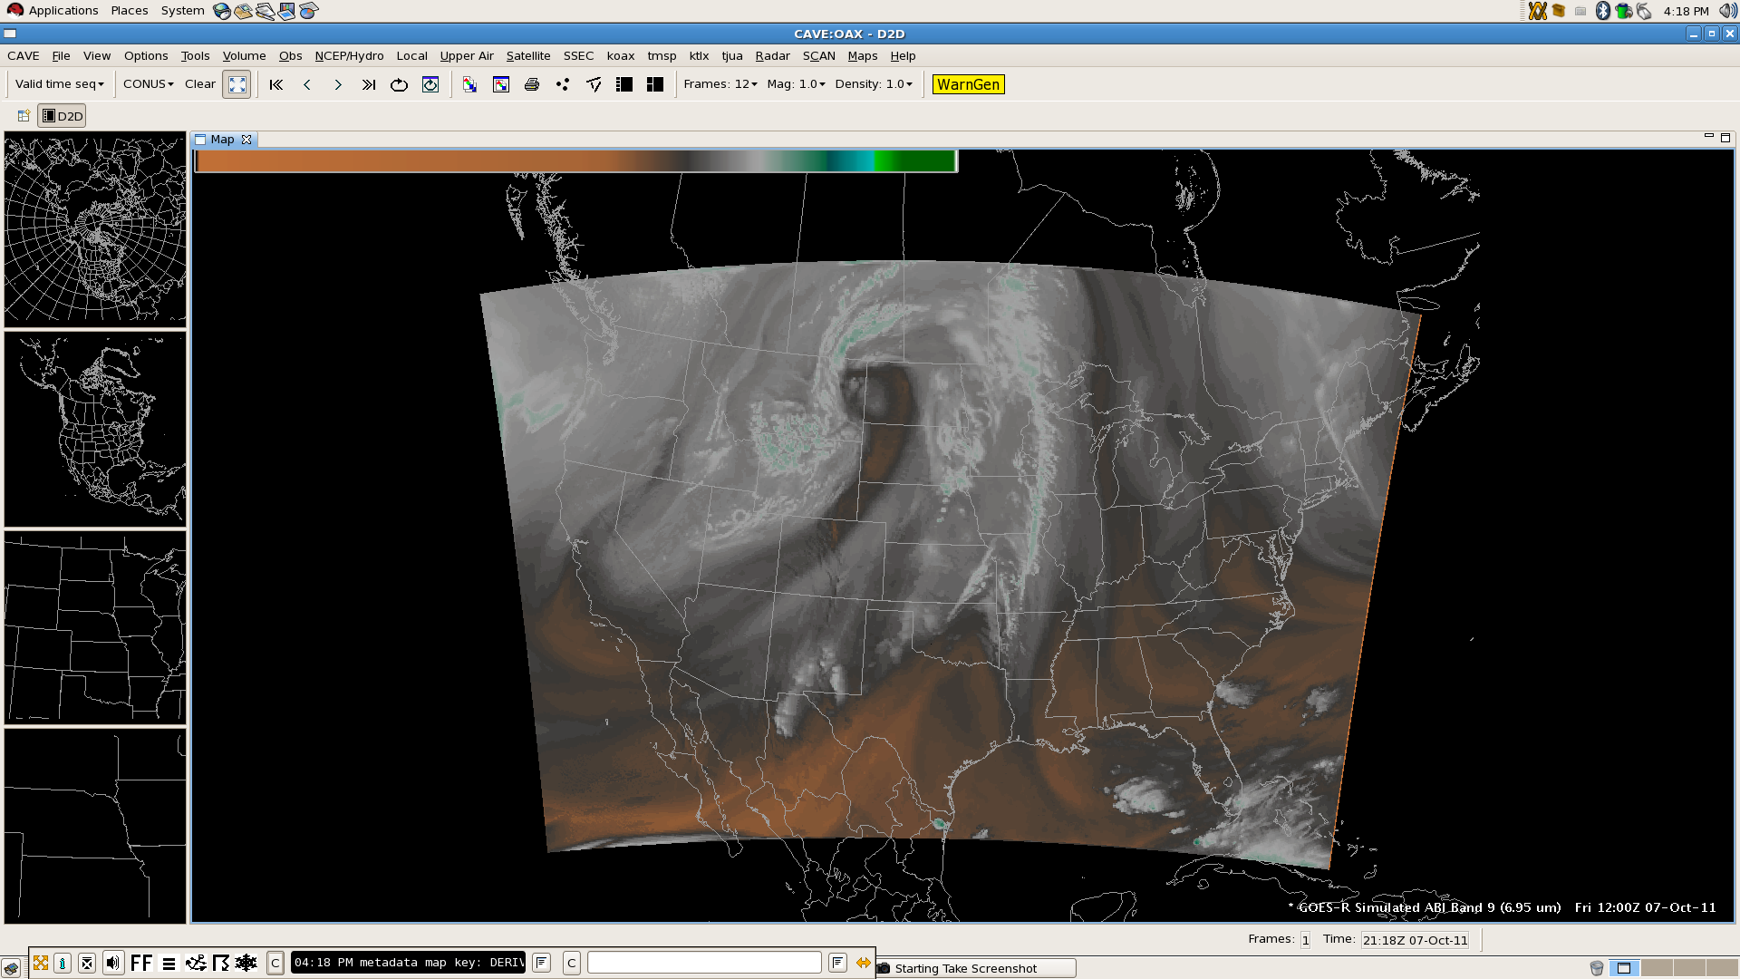
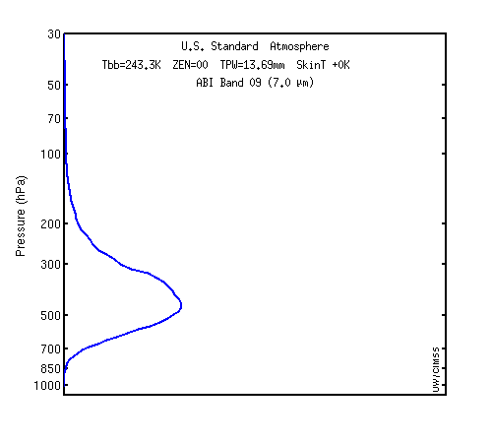
Simulated ABI Band 9 (6.95 µm)
Weighting function for US Standard profile indicates sensitivity to upper middle tropospheric moisture

Slide 22
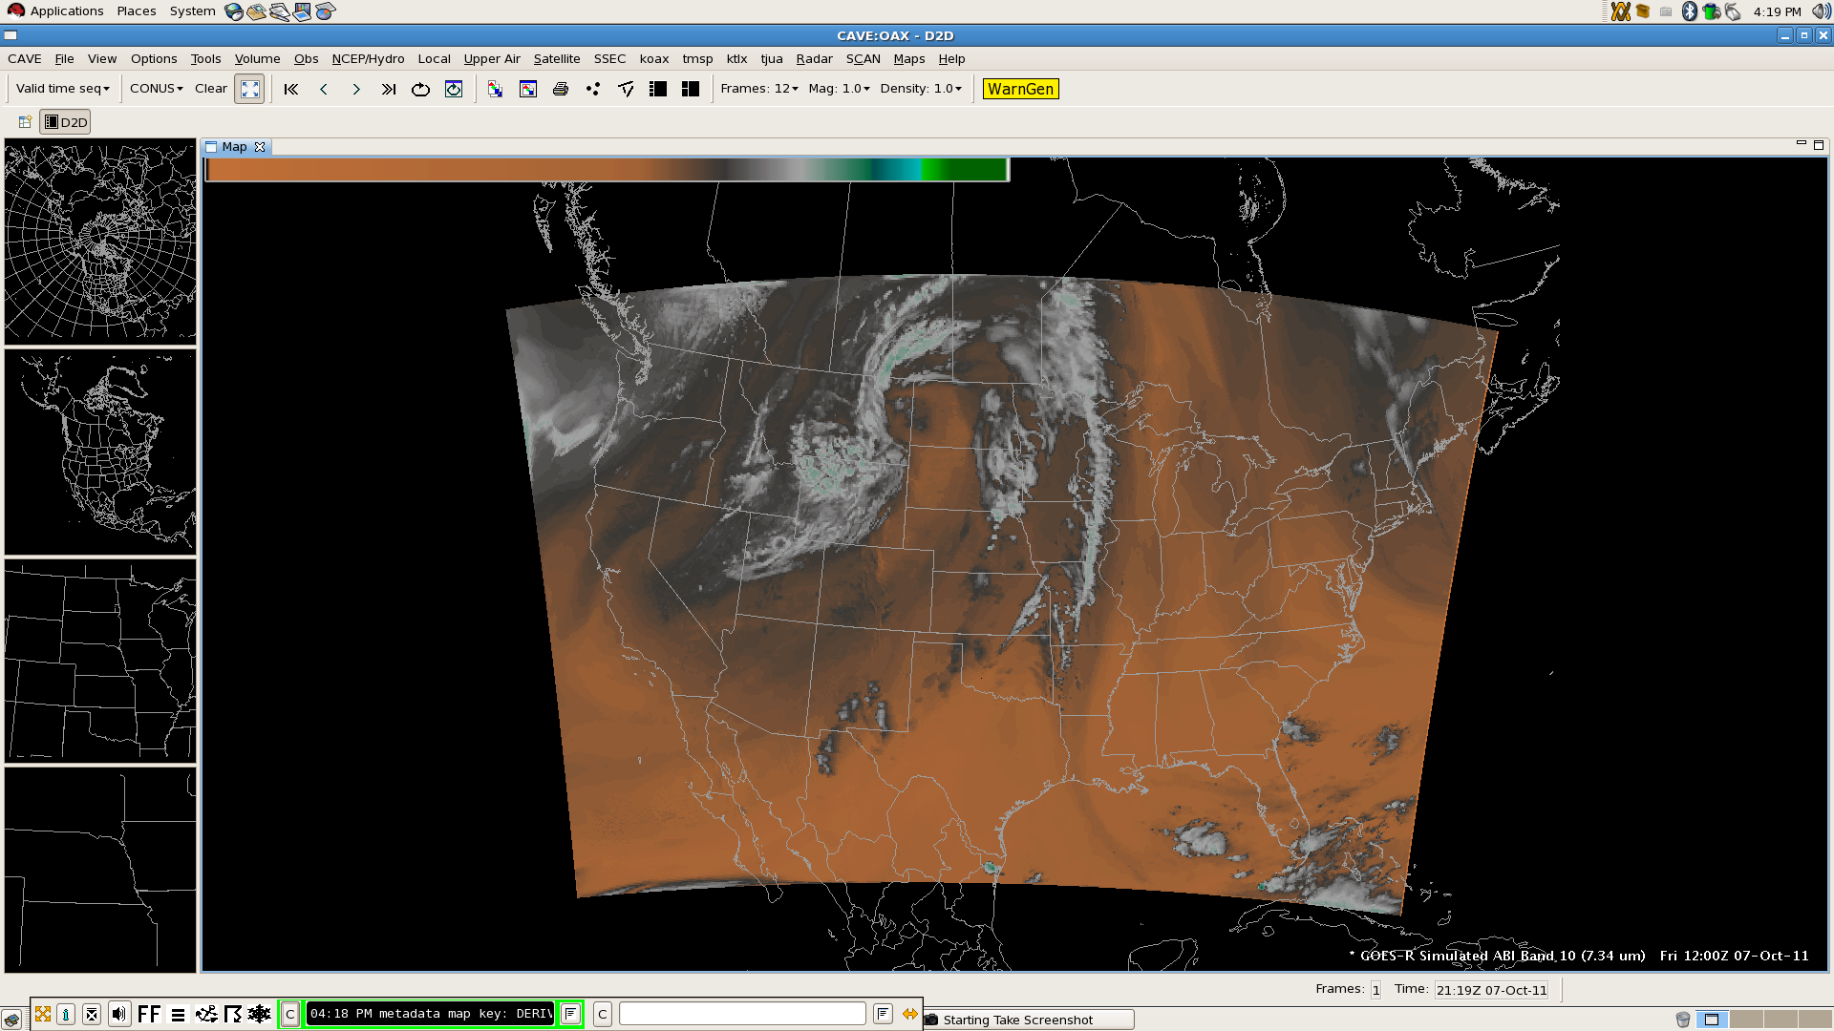
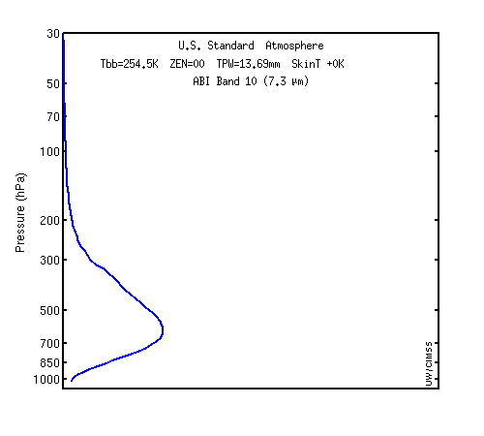
Simulated ABI Band 10 (7.34 µm)
Weighting function for US Standard profile indicates sensitivity to lower middle tropospheric moisture

Slide 23
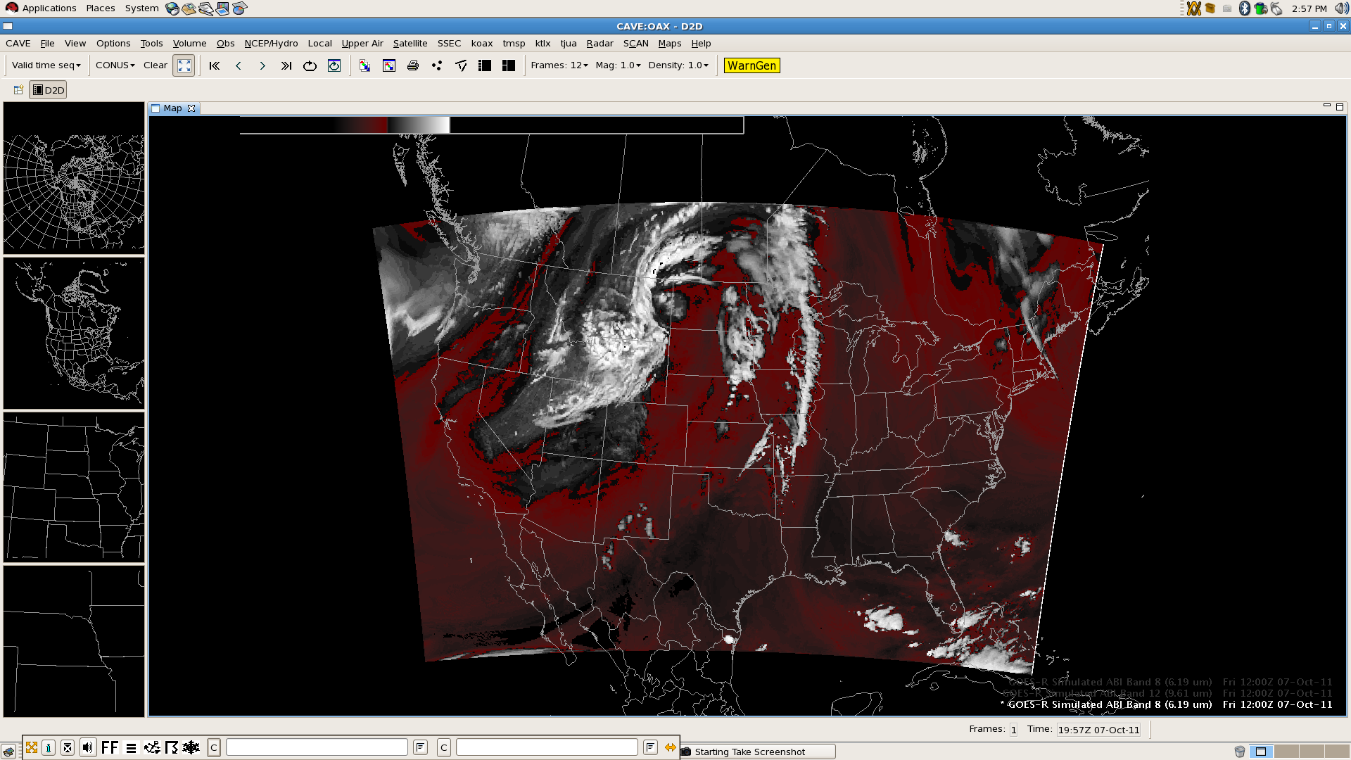
Building an RGB: Band 8 – Band 10
Red with alpha gradient (upper – lower tropospheric moisture difference), white with alpha gradient (clouds)
Notes:
Red, -50 to -27; White -27 to 0

Slide 24
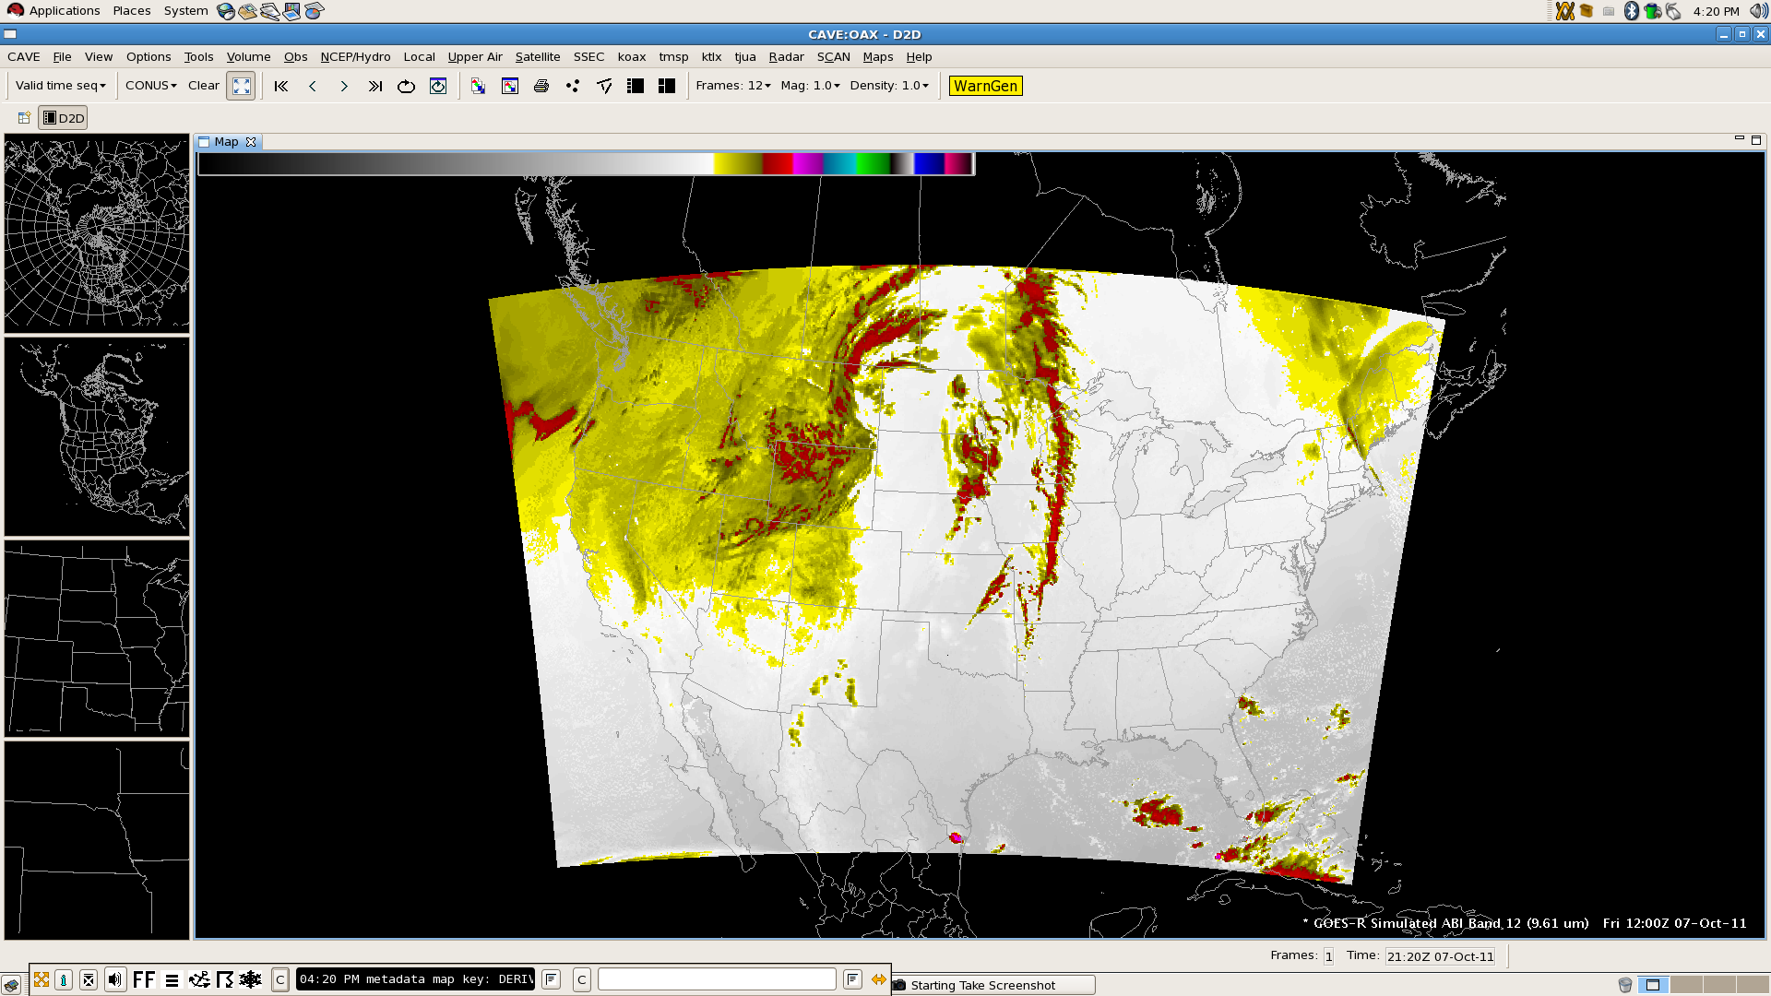
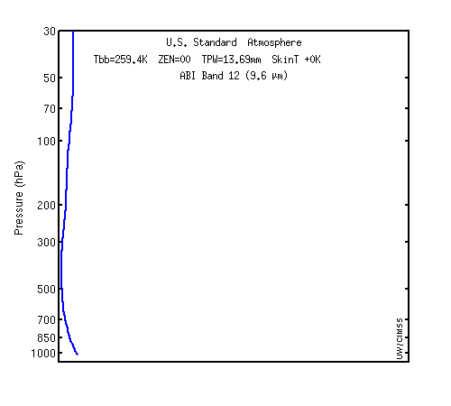
Simulated ABI Band 12 (9.61 µm)
Weighting function for US Standard profile indicates sensitivity to ozone

Slide 25
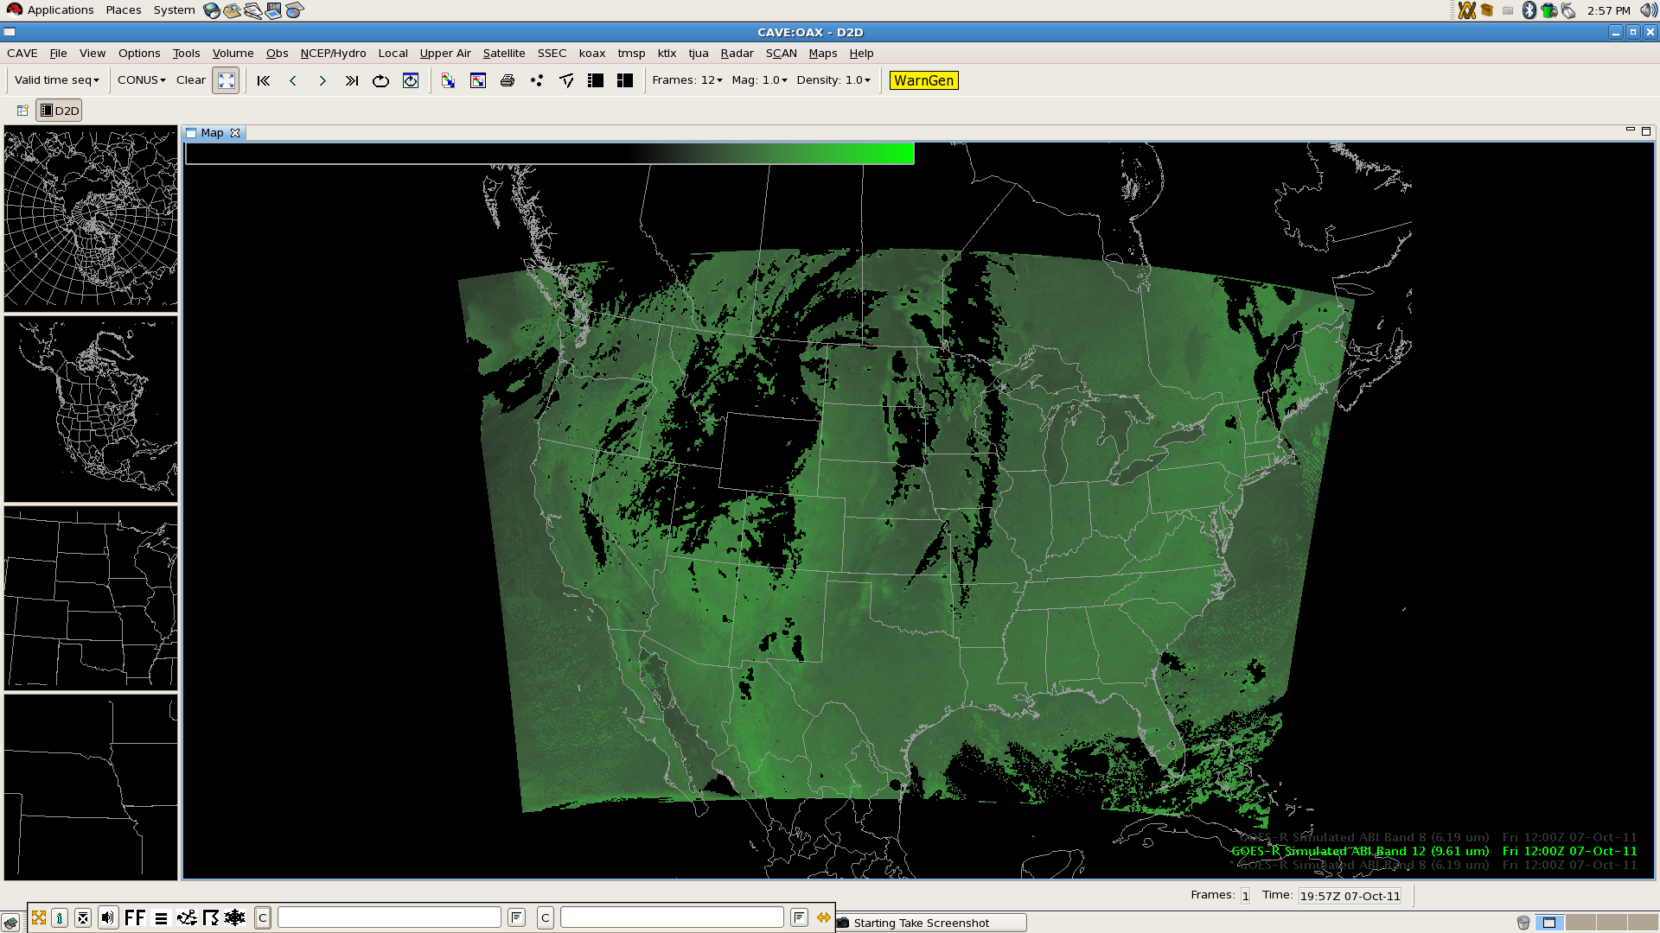
Building an RGB: Band 12 – Band 13
Green with alpha gradient (brighter high ozone concentration indicative of lower potential vorticity surfaces)
Notes:
Green 27 to 127

Slide 26
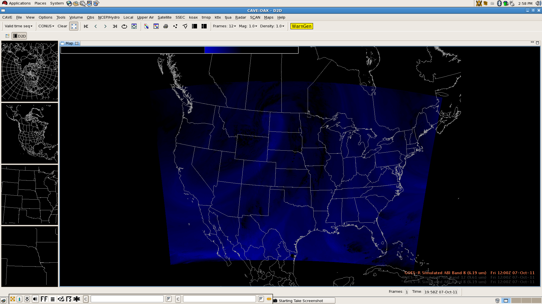
Building an RGB: Band 8 Inverted
Blue with alpha gradient (brighter blues indicate dryer upper tropospheric air, dry slot)
Notes:
Blue 27 to 67

Slide 27
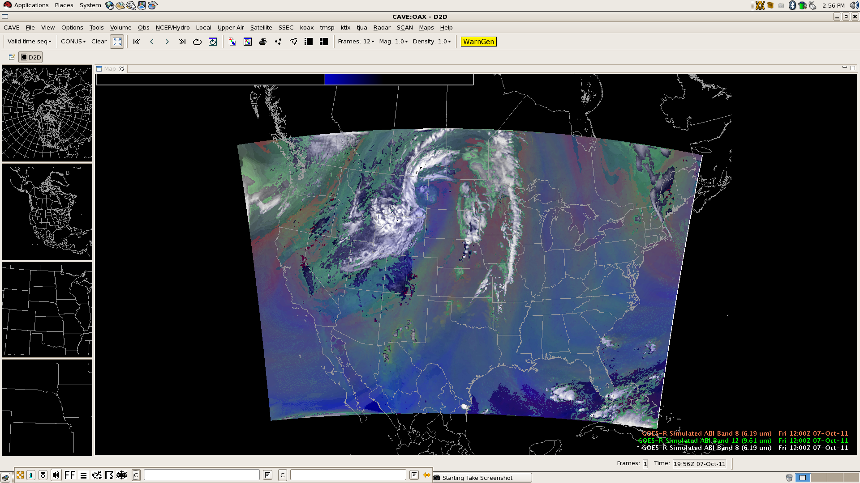
Building an RGB: Composite
Composite clearly indicates trough over western United States, dry slot, and differential tropospheric moisture

Slide 28
Potential AWIPS II Capabilities
User interface for the multi-channel RGB color capability
Implement with GPU Shader Language for quick display time
Updated user controls and color scheme selection
New color table widget for developing color tables with more than 256 colors (current AWIPS I transmission format and software limitation)
Product browser capability (Raytheon concept)
Redesign the volume browser?
Expanded capability for derived parameters
User control of image differencing and scaling
Permit operations in value space instead of data storage space
EDEX plug-in to handle ingest of GOES-R sectorized CMI products in netCDF4
CAVE plug-in for displaying bit depths greater than 8
Additional configurability via XML
Legends, scaling, etc.

Slide 29
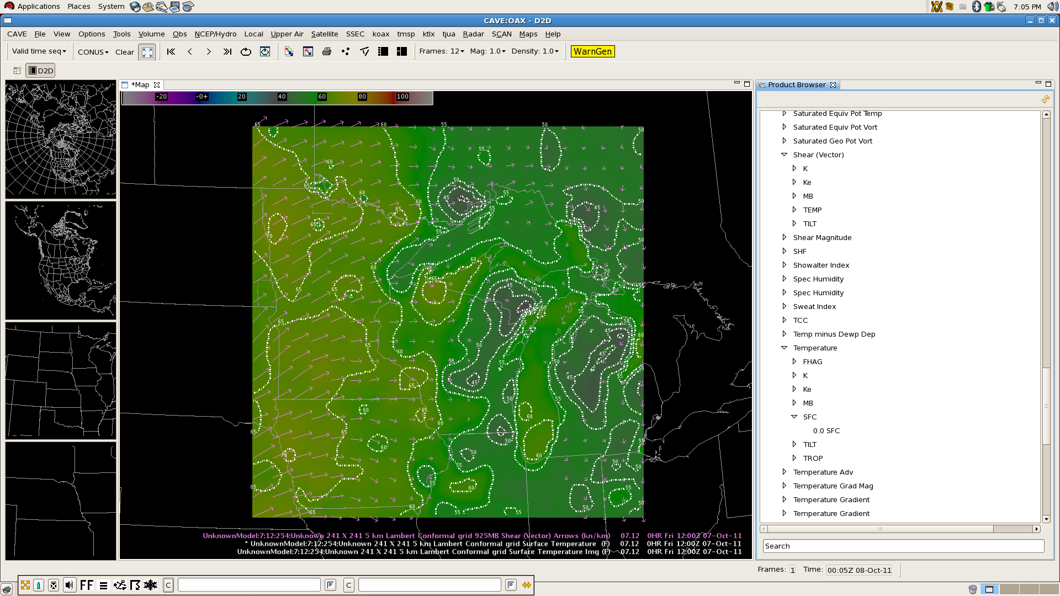
Example: Raytheon’s Product Browser
CIMSS Real-time Mesoscale Analysis (CRTMA) using MODIS SST composite
Notes:
MODIS is Moderate Resolution Imaging Spectroradiometer

Slide 30
Delivery Mechanisms Today, Tomorrow
NOAAPort: This year, the delivery bandwidth increased from 10 Mbps to 30 Mbps. NOAAPort will remain the primary delivery mechanism through at least 2013. (Source: Brian Gockel, NWS OST SEC)
Increased bandwidth will accommodate transmission of dual-polarization radar data, bias-corrected SREF, other NCEP model output, and new satellite imagery/products from polar orbiters (NPP) over the next two years.
LDM: The LDM will facilitate the raw data ingest from NOAAPort into AWIPS II (no longer confined to the LDAD), such that terrestrial data delivery could be a strong candidate without significant retooling if sufficient Internet bandwidth exists at field offices.
Repository: “Push-pull” and “on-request” technology has been investigated as a way to deliver weather data to remote locations (AWIPS II Thin Client), and could be expanded to alleviate NOAAPort bandwidth for regional data and products.
Use regional headquarters as hubs to receive GOES-R broadcast?
Web mapping services (WMS) framework to geographically partition data?
Notes:
NPP is NPOESS Preparatory Project

Slide 31
Conclusions and Future Directions
The GOES-R Proving Ground is advancing the use of satellite imagery in operational meteorology.
AWIPS II will play a significant role in promoting the capabilities of GOES-R and new polar-orbiting satellites (NPP) because the expanded distribution and development group will lead to an implementation of additional features which maximize the utility of satellite imagery and products in concert with other in-situ observations and model output.
Blended and combined products
It will also allow for the efficient transfer of new science and technology into NWS operations without delay.
To accomplish this, we will have to investigate and utilize delivery mechanisms outside of NOAAPort, such as LDM

Slide 32
Conclusions and Future Directions
Our future AWIPS will not be confined to NWS offices, but extend to universities and become an integral part of the increasing research to operations activities.
Unique applications of the software will increase
Now is the time to start investigating data overload, and developing methodology which optimizes the use of data, imagery, products, and tools which are situation and scenario relevant, and leads the decision support thought process.
Too focused situational awareness decreases overall awareness
Don’t let data fusion become data confusion
Questions? Comments?
Contact me: Jordan Gerth, Jordan.Gerth@noaa.gov

