Slide 1
Developing AWIPS to support forecaster demands in the new generation of satellites
AWIPS System Updates, Part II
32nd Conference on Environmental Information Processing Technologies
96th American Meteorological Society Annual Meeting
New Orleans, Louisiana
11 January 2016
Jordan J. Gerth
Assistant Researcher
Cooperative Institute for Meteorological Satellite Studies
University of Wisconsin at Madison
Includes contributions from colleagues

Slide 2
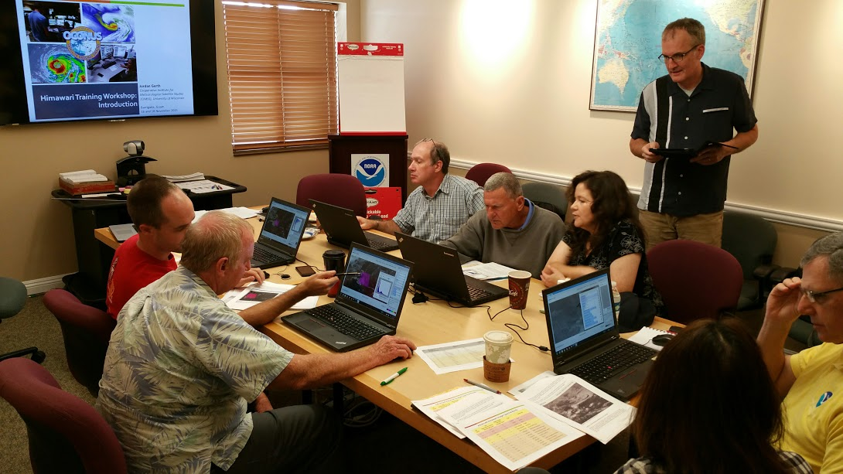
The challenge is to prepare operational meteorologists for new generation weather satellites.

Slide 3
The Challenge
Practically, this means building capacity.
Ensuring technical systems are capable of delivering and displaying imagery and products at the full spatial, spectral, and temporal resolution
Infusing imagery and products into the operational forecast process
Integrating new satellite data into predictive models (numerical weather prediction and otherwise)

Slide 4
New Generation Satellites
Geostationary Operational Environmental Satellite R-Series (GOES-R)
Advanced Baseline Imager (ABI)
Geostationary Lightning Mapper (GLM)
National Polar-orbiting Project (NPP) and Joint Polar Satellite System (JPSS)
Advanced Technology Microwave Sounder (ATMS)
Visible Infrared Imaging Radiometer Suite (VIIRS)
Cross-track Infrared Sounder (CrIS)
International missions

Slide 5
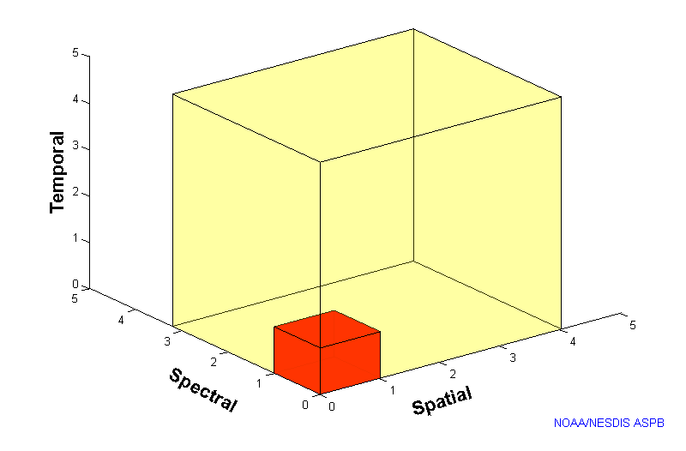
GOES-R
ABI
Compared to today’s geostationary imager
5
4
3
X
Faster scanning (5-minute full disk vs. 25-minute)
X
Improved spatial resolution (2 km IR vs. 4 km)
X
More spectral bands (16 on ABI vs. 5)

Slide 6
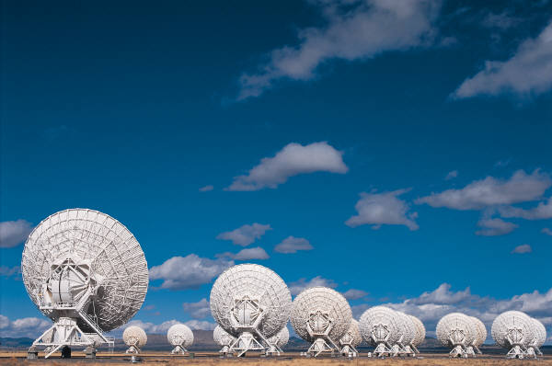
Value of Observations
Value =
Quality of Actionable Information (Statements) –
Amount of Factual Information (Data)

Slide 7
Value of Observations
Value decreases when data increases without impacting a decision process.
In this era of “big data”, the amount of data is endlessly increasing.
Unfortunately, the time duration allocated to make a decision is generally fixed.
Modernizing weather forecast services hinges on the practitioner leveraging the right data at the right time.

Slide 8
AWIPS Now and Then
The Advanced Weather Interactive Processing System (AWIPS) is the weather data ingestion, visualization, and dissemination platform for National Weather Service meteorologists.
The majority of the software has been recoded to modern and maintainable standards over the past decade.
The user concept (“look and feel”) is similar today as it was 20 years ago.
There are some new features and capabilities.

Slide 9
AWIPS and New Generation Satellites
The Total Operational Readiness – Satellites (TOWR-S) project is focused on integrating new generation satellite data in AWIPS.
TOWR-S is confronting technical challenges, such as data delivery and visualization.
For more information:
6.3 Weather Ready Nation: NWS Exploitation of New Satellite Data
Wednesday, 13 January 2016: 2:00 PM
Room 255/257
Mike W. Johnson, NOAA/NWS, Silver Spring, MD; and J. K. Zajic, E. Guillot, W. Campbell, and L. Byerle

Slide 10
28 February 2015 11:49 UTC
Example of NPP ATMS Rain Rate and 11.0 μm IR Window in AWIPS
New AWIPS “II” capability:
Layering multiple images and controlling transparency of certain portions of the color map
Benefit to meteorologists:
Helps corroborate different variables to determine sensible weather and impact on forecast

Slide 11
20 August 2015 18:57 UTC
Example of NPP VIIRS Red-Green-Blue (RGB) composite of three bands:
1.378 μm Ref
1.61 μm Ref
11.45 μm BT
New AWIPS “II” capability:
Displaying a 24-bit RGB composite of three disparate images through the graphics card
Benefit to meteorologists:
Ability to recognize spatial patterns relative to quantitative products for corroborating atmospheric phenomena

Slide 12
Examples of Evolving AWIPS
CIMSS has developed two plug-ins that visualize data-to-statement model output.
NOAA/CIMSS ProbSevere Model
VIIRS Active Fire Product
The actionable information that these products provide makes this possible.
The software enhancement enables access to the important information relative to the users’ constraints.

Slide 13
NOAA/CIMSS ProbSevere Model
An unfilled shape is plotted for each identified object.
Intended to overlay on radar imagery
The line width and color of the shape is based on the probability that the storm corresponding to the object is severe.
The user can change the colors of the shapes using the traditional editor.

Slide 14
NOAA/CIMSS ProbSevere Model
If users hover over a shape while sampling is enabled, the values of select storm attributes are shown.
This plug-in is part of the AWIPS II baseline but the ProbSevere model output is pre-operational and only available to select users from CIMSS.
For more information:
8.2 The NOAA/CIMSS ProbSevere Model – Integration of NWP, Satellite, Lightning, and Radar data for Improved Severe Weather Warnings
Thursday, 14 January 2016: 8:45 AM
Room 225
Michael J. Pavolonis, NOAA/NESDIS, Madison, WI; and J. L. Cintineo, J. Sieglaff, and D. T. Lindsey

Slide 15
VIIRS Active Fire Product
A circle is plotted at the latitude and longitude of each fire.
The size and color of the circle is based on the power, and the confidence is shown by the width of the circle edge.
The circle is filled if the confidence is over 90%.
The user can change the colors of the circles using the traditional editor.

Slide 16
VIIRS Active Fire Product
If users hover over a circle while sampling is enabled, the values of select fire attributes are shown.
This plug-in was first developed as part of the NASA Experimental Products Development Team (EPDT). It is not yet part of the AWIPS II baseline.
For more information:
11.6 The New Operational VIIRS Active Fire Product in NOAA's NDE System
Thursday, 14 January 2016: 2:45 PM
Room 225
Ivan A. Csiszar, NOAA/NESDIS, College Park, MD; and L. Giglio, W. Schroder, W. Wolf, M. Tsidulko, and V. Mikles

Slide 17
Benefits of New Visualizations
Decrease number of clicks (amount of time) to load new information
Reduce number of layers on the display
Only supply imagery when spatial recognition is necessary
Not a “black box”
Contributing information is available to the user

Slide 18
Working Groups
Considering concept of operations
How to composite current and new generation geostationary satellites
Confirming cursor value for reflectances and brightness temperatures
Developing new color maps to enhance new generation satellite spectral bands that have higher bit depths than today
11 to 14 bits (2048 to 16384 unique values)

Slide 19
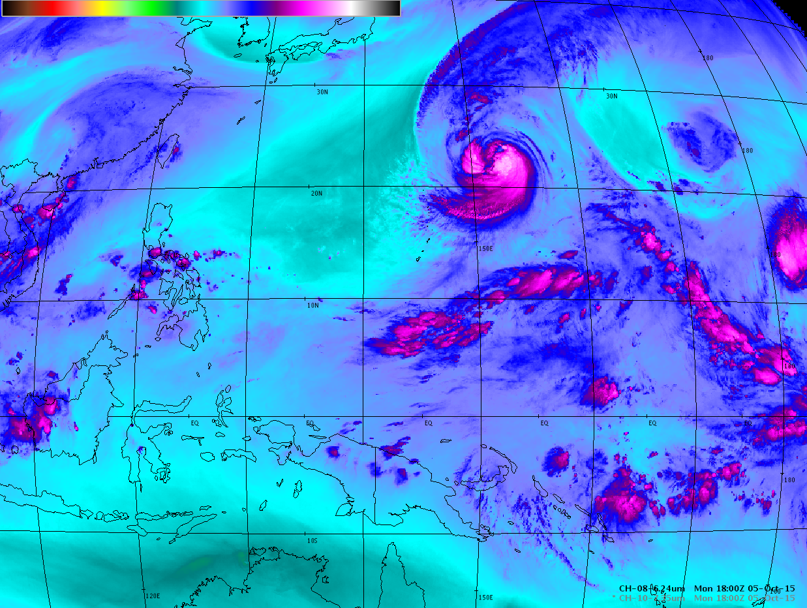
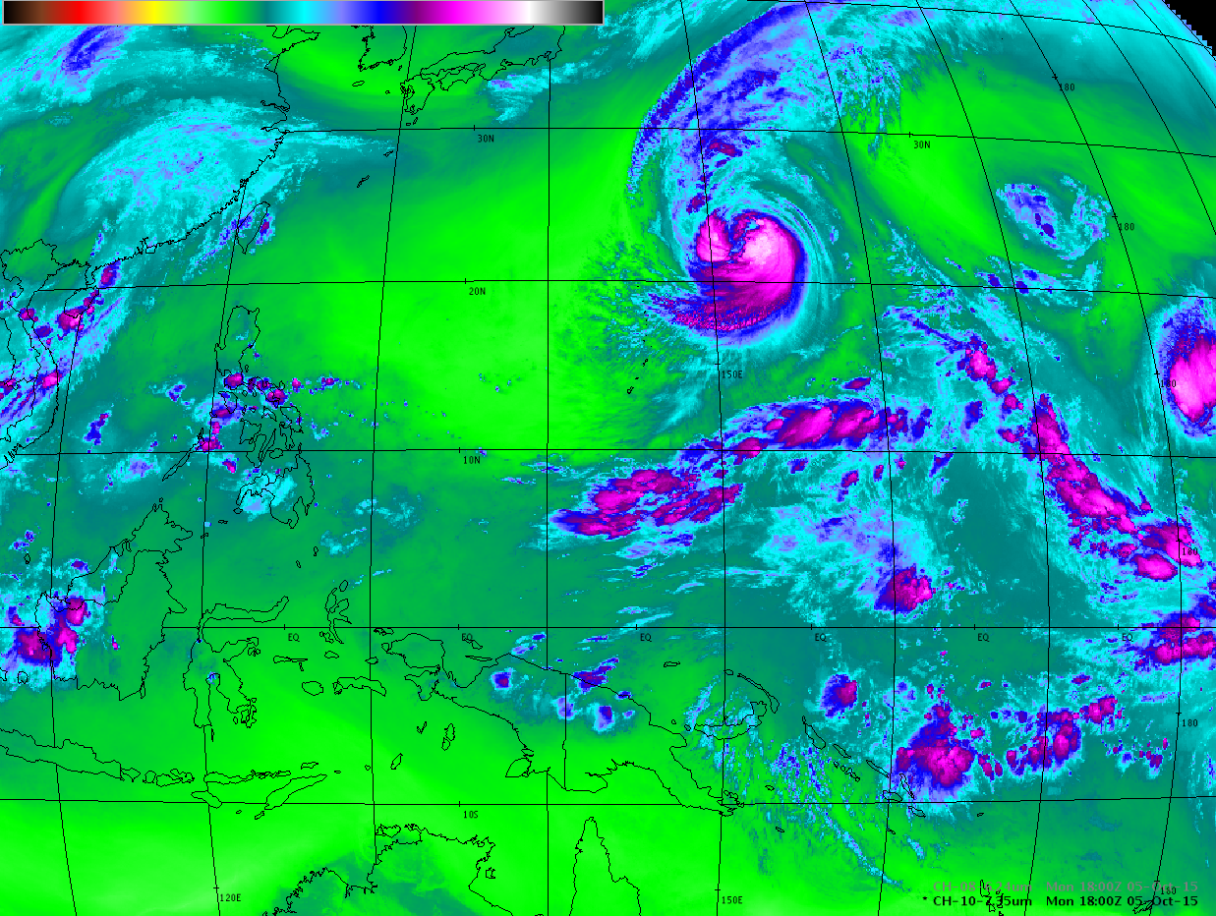
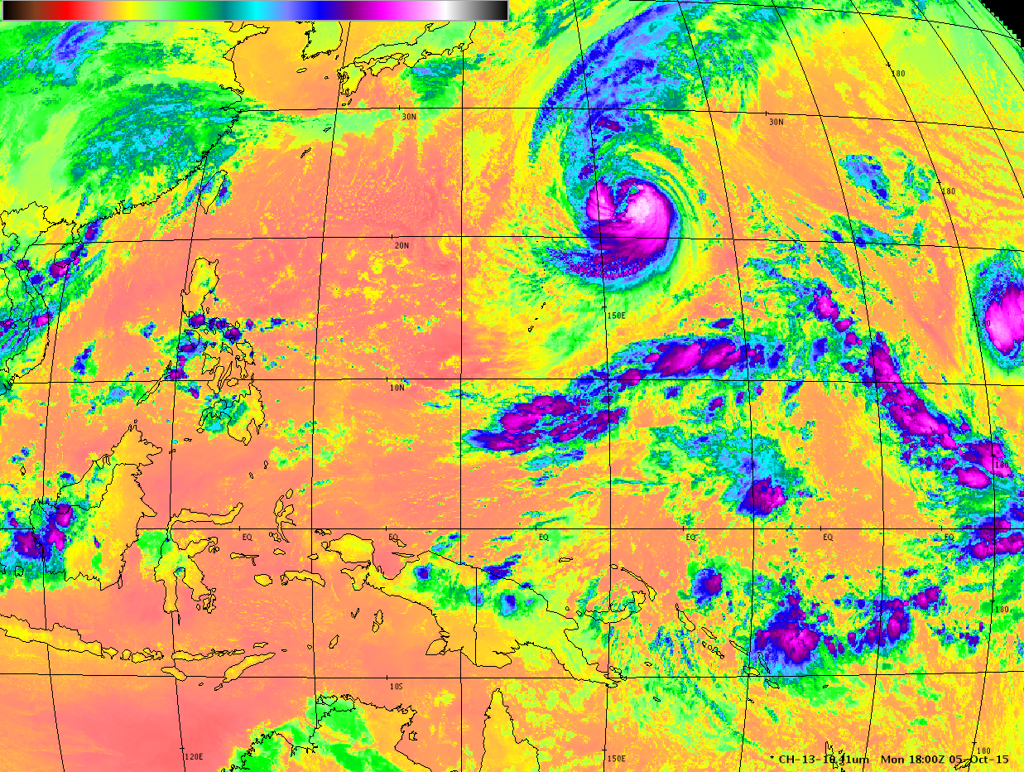
New color maps applied
to Himawari-8 imagery

Slide 20
Other Enhancements Under Development
Automatic transition between a visible or near-infrared band and an infrared band when both are loaded, depending on the solar illumination of the scene
User-controlled gamma correction for components of RGB composites
Click-to-load aircraft soundings with moisture profile distinction on a plan view
New derived products from satellites

Slide 21
Questions? Comments? Jordan Gerth Jordan.Gerth@noaa.gov Related upcoming presentations: J9.2 Increased Satellite Reception and Utilization Capabilities in NWS Pacific Region Tuesday, 12 January 2016: 3:45 PM Room 252/254 Jordan J. Gerth, CIMSS/Univ. of Wisconsin, Madison, WI; and B. Ward and E. Lau 12.4 The Himawari Training Program for NWS Pacific Region Meteorologists Thursday, 14 January 2016: 4:15 PM Room 252/254 Bill Ward, NOAA/NWS, Honolulu, HI; and J. J. Gerth

