Slide 1
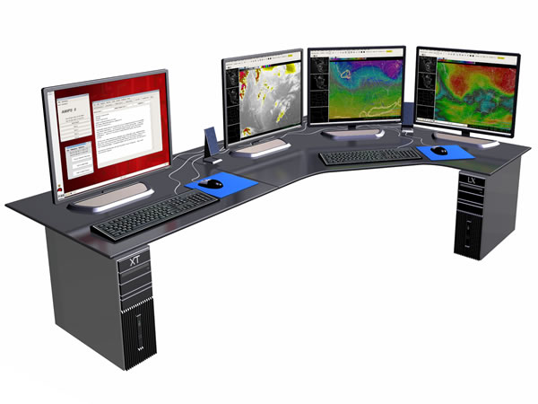
CIMSS AWIPS II Activities
Jordan Gerth, Research Assistant
Cooperative Institute for Meteorological Satellite Studies
University of Wisconsin, Madison
3 May 2012
NOAA Satellite Science Week
Notes:
AWIPS is Advanced Weather Interactive Processing System, Workstation image from Raytheon (http://www.raytheon.com/capabilities/rtnwcm/groups/public/documents/image/rtn_iis_awips_photo5.jpg)

Slide 2
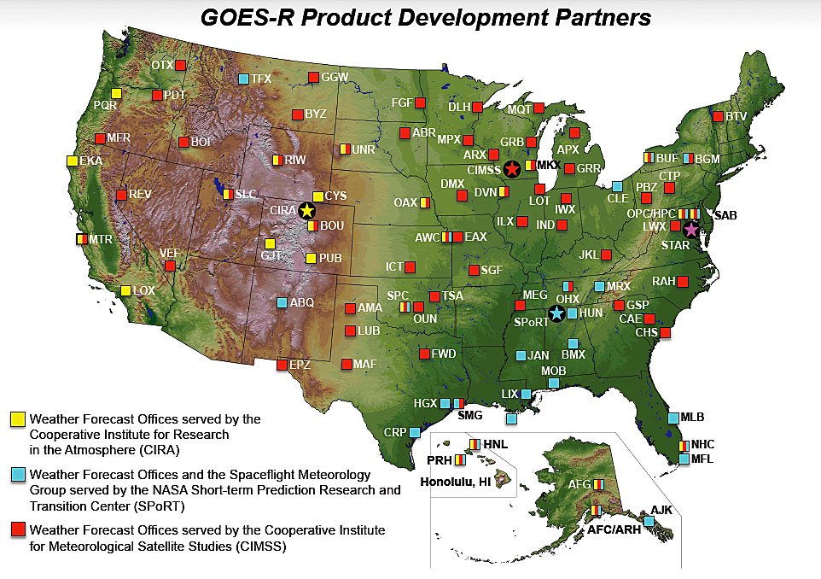
The real-time distribution of CIMSS and STAR ASPB experimental satellite imagery and products has grown to 70 NWS WFOs, Headquarters, and Centers. The imagery and products have contributed toward more than 440 forecast decisions, based on unique Area Forecast Discussion (AFD) references.
Notes:
CIMSS is Cooperative Institute for Meteorological Satellite Studies, ASPB is Advanced Satellite Products Branch, WFO is Weather Forecast Office

Slide 3
How AWIPS II will Improve R2O
Compared to geostationary satellites, polar satellites provide observations on greater spatial and spectral scales, while geostationary satellites provide more expansive coverage over a short time interval, ideal for operational meteorologists in the mid-latitudes and tropics
Legacy AWIPS did not allow multi-layer image combinations
SPoRT initially built a combined MODIS and GOES product prior to transmitting it to legacy AWIPS
By supporting dynamic image data array manipulations, AWIPS II:
allows for more timely creation of this product,
promotes a single, fused source for satellite information, and
decreases bandwidth usage while increasing value of imagery to the forecasters.
Notes:
R2O is Research to Operations, MODIS is MODerate-resolution Imaging Spectroradiometer, GOES is Geostationary Operational Environmental Satellite, SPoRT is Short-term Prediction Research and Transition Center

Slide 4
Image Layering in AWIPS II
Coverage of 1 km MODIS visible imagery swath, 20:15 UTC 20 January 2012

Slide 5
Image Layering in AWIPS II
GOES-13 (East) imagery only, 20:15 UTC 20 January 2012

Slide 6
Image Layering in AWIPS II
Combination of MODIS and GOES visible imagery, 20:15 UTC 20 January 2012

Slide 7
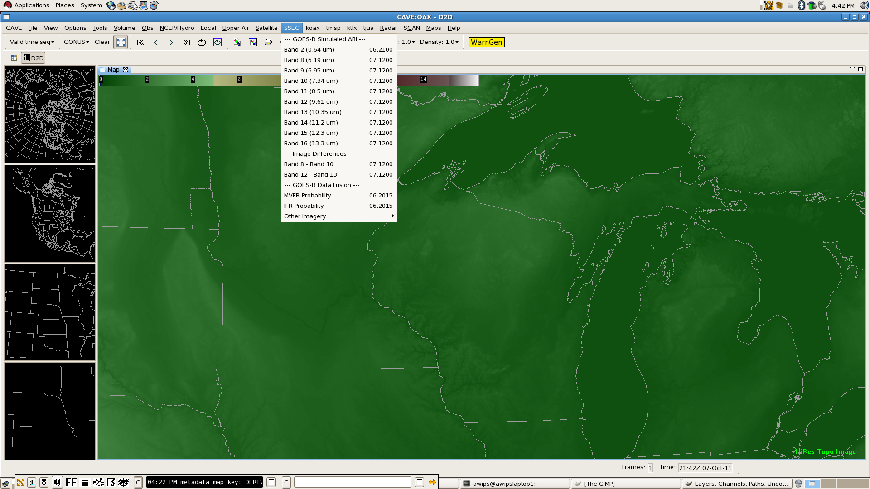
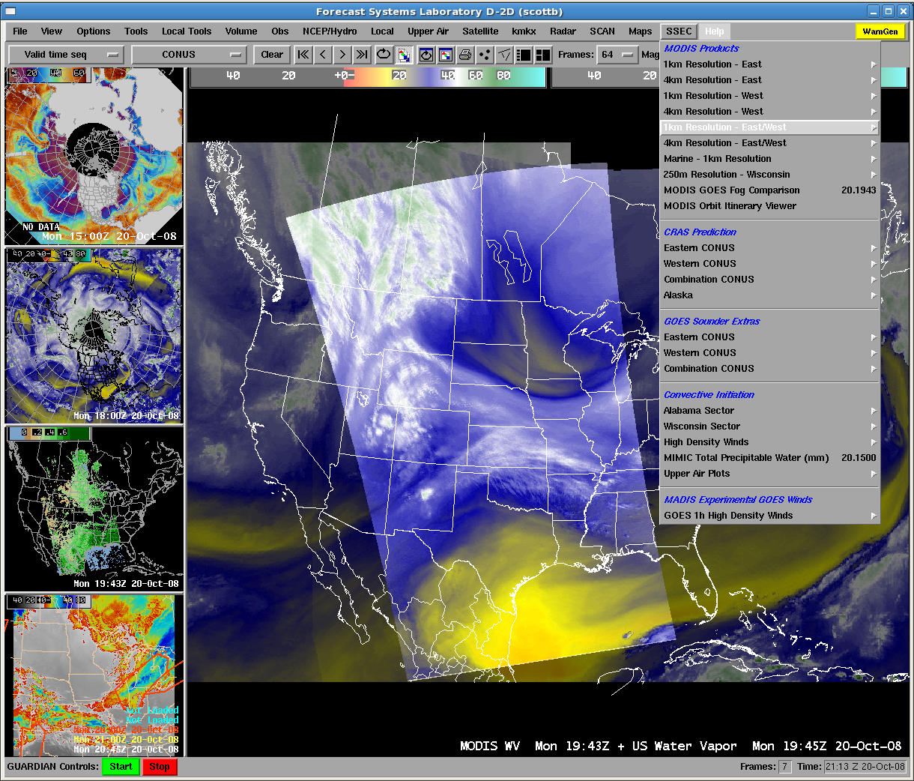
The Challenge: Assuring CIMSS products are available in AWIPS “II”

Slide 8
The Roadmap
GOES-R
Launch
New functionality
New configuration
New data distribution format

Slide 9
Successfully Tested
Satellite Imagery/Products (GINI/AREA/netCDF3)
MODIS (First in 2008)
AVHRR (GINI sector for Pacific Region is too large for baseline plug-in)
Morphed Integrated Microwave Imagery at CIMSS - Total Precipitable Water (MIMIC-TPW)
Atmospheric Infrared Sounder (AIRS)
Simulated ABI (from NSSL WRF)
MVFR/IFR (Flight Rules) Probabilities
Suomi National Polar-orbiting Partnership (NPP)
Gridded (GRIB2)
CIMSS Regional Assimilation System (CRAS)
Simulated imagery
Pacific Region domain (Subset of NCEP Grid 254)
CIMSS Convective Initiation and Cooling Rates
CIMSS GOES-East/West Nearcasting
Notes:
AVHRR is Advanced Very High Resolution Radiometer

Slide 10
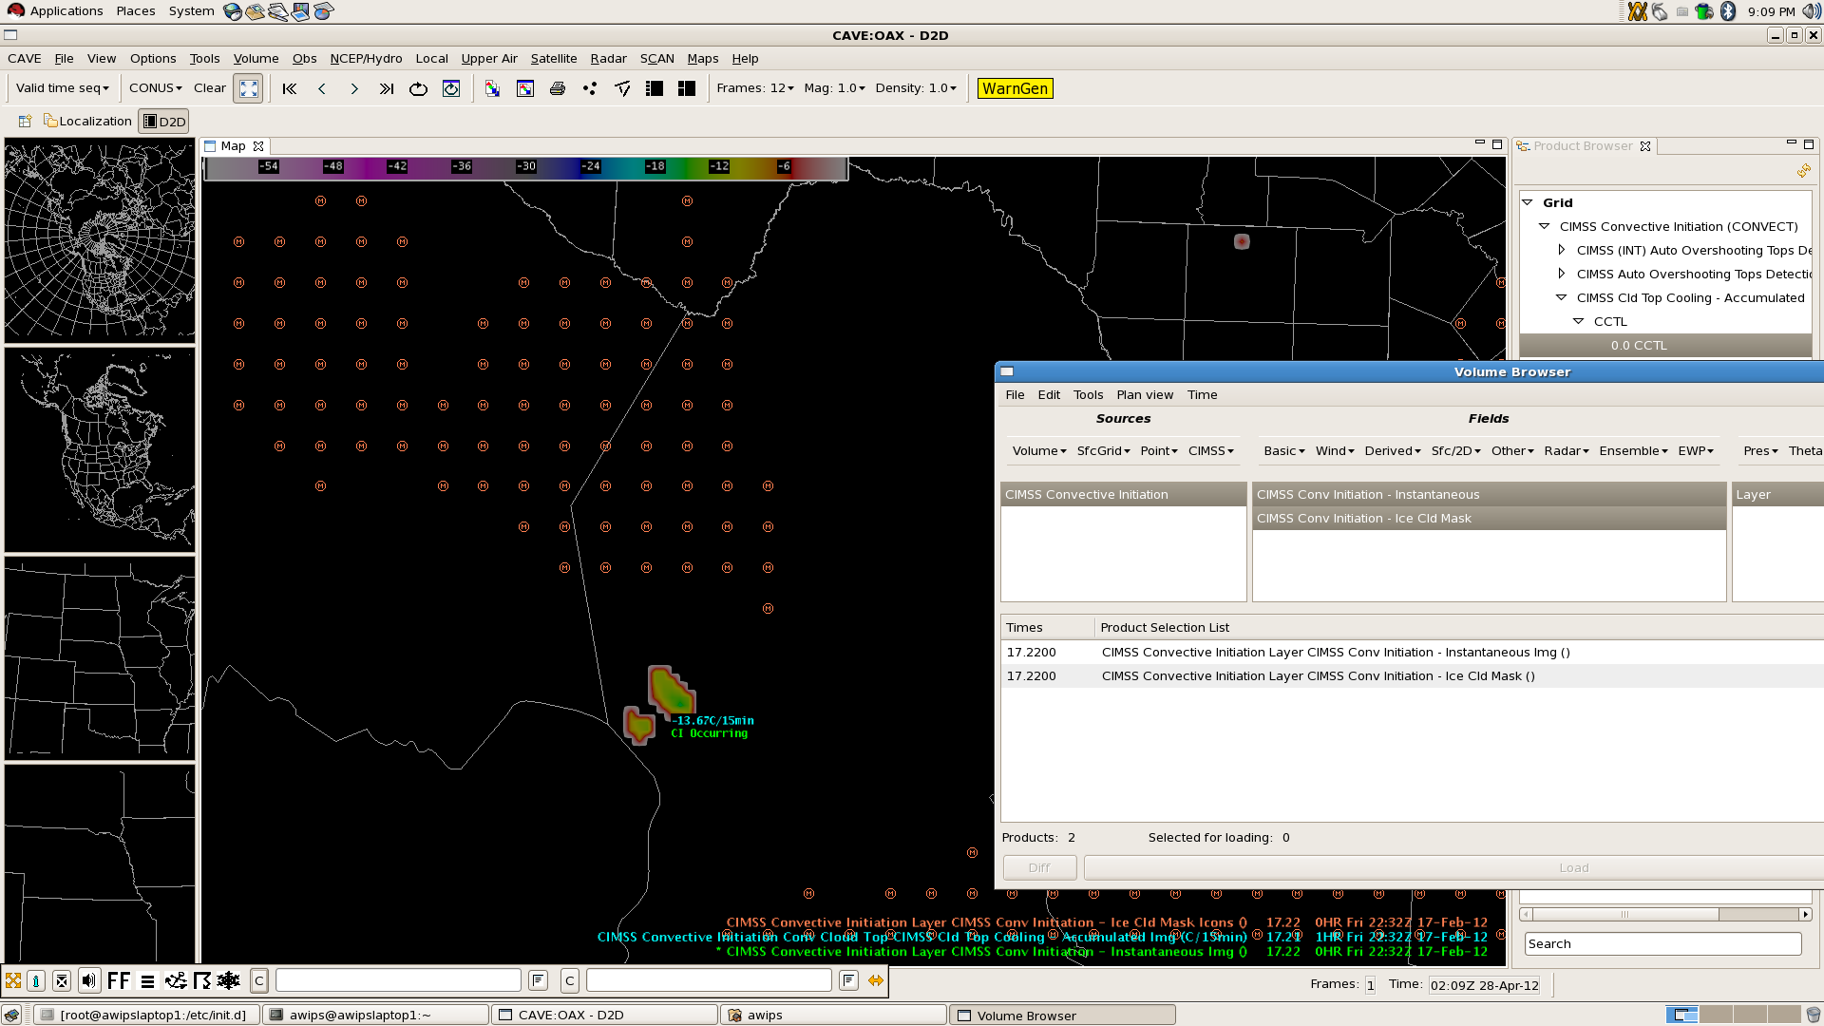
CIMSS Convective Initiation
Product browser
Volume browser

Slide 11
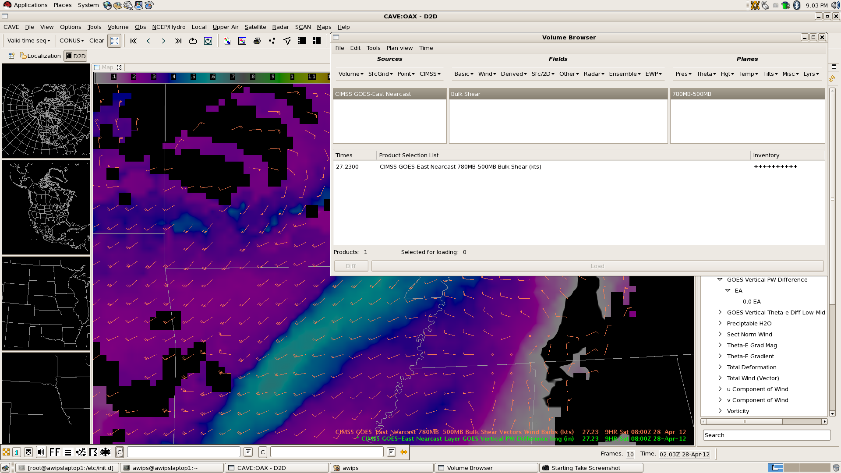
CIMSS GOES-East Nearcasting
New menus built with XML
Notes:
XML is Extensible Markup Language

Slide 12
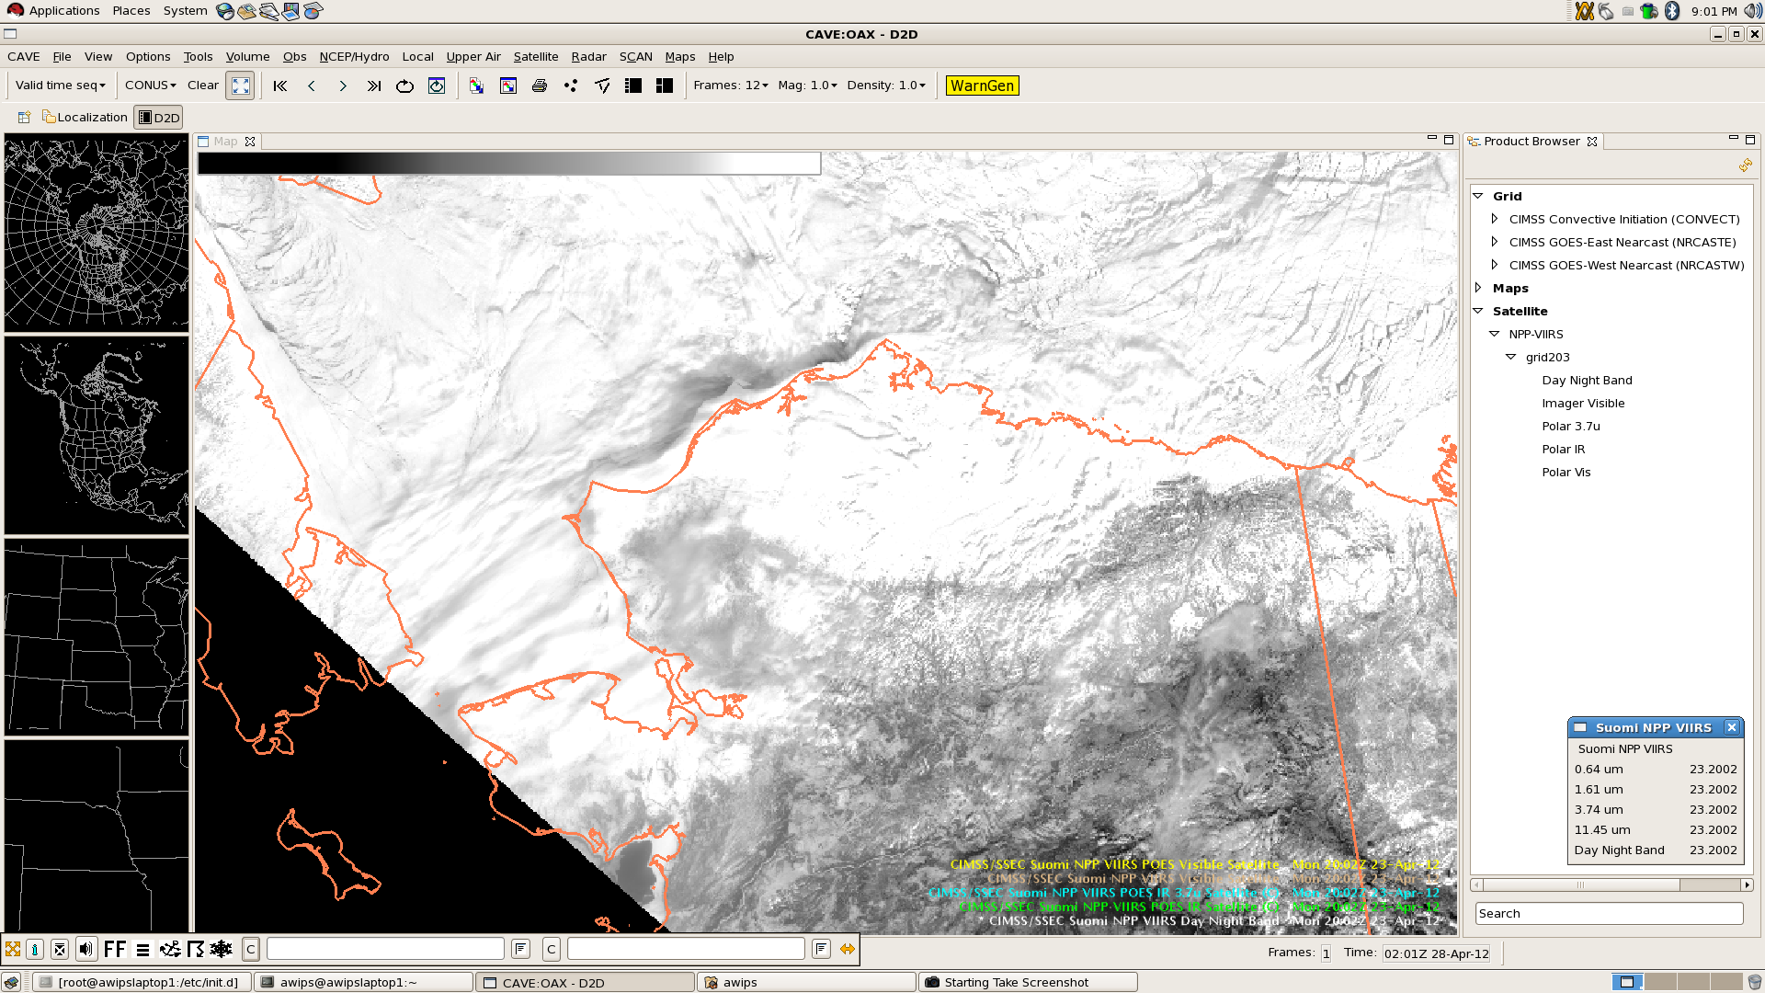
Suomi NPP (0.64 µm)
netCDF3 ingested with regionalsat (Kretz)
New menus built with XML
Viz.satellite plug-in re-built to support

Slide 13
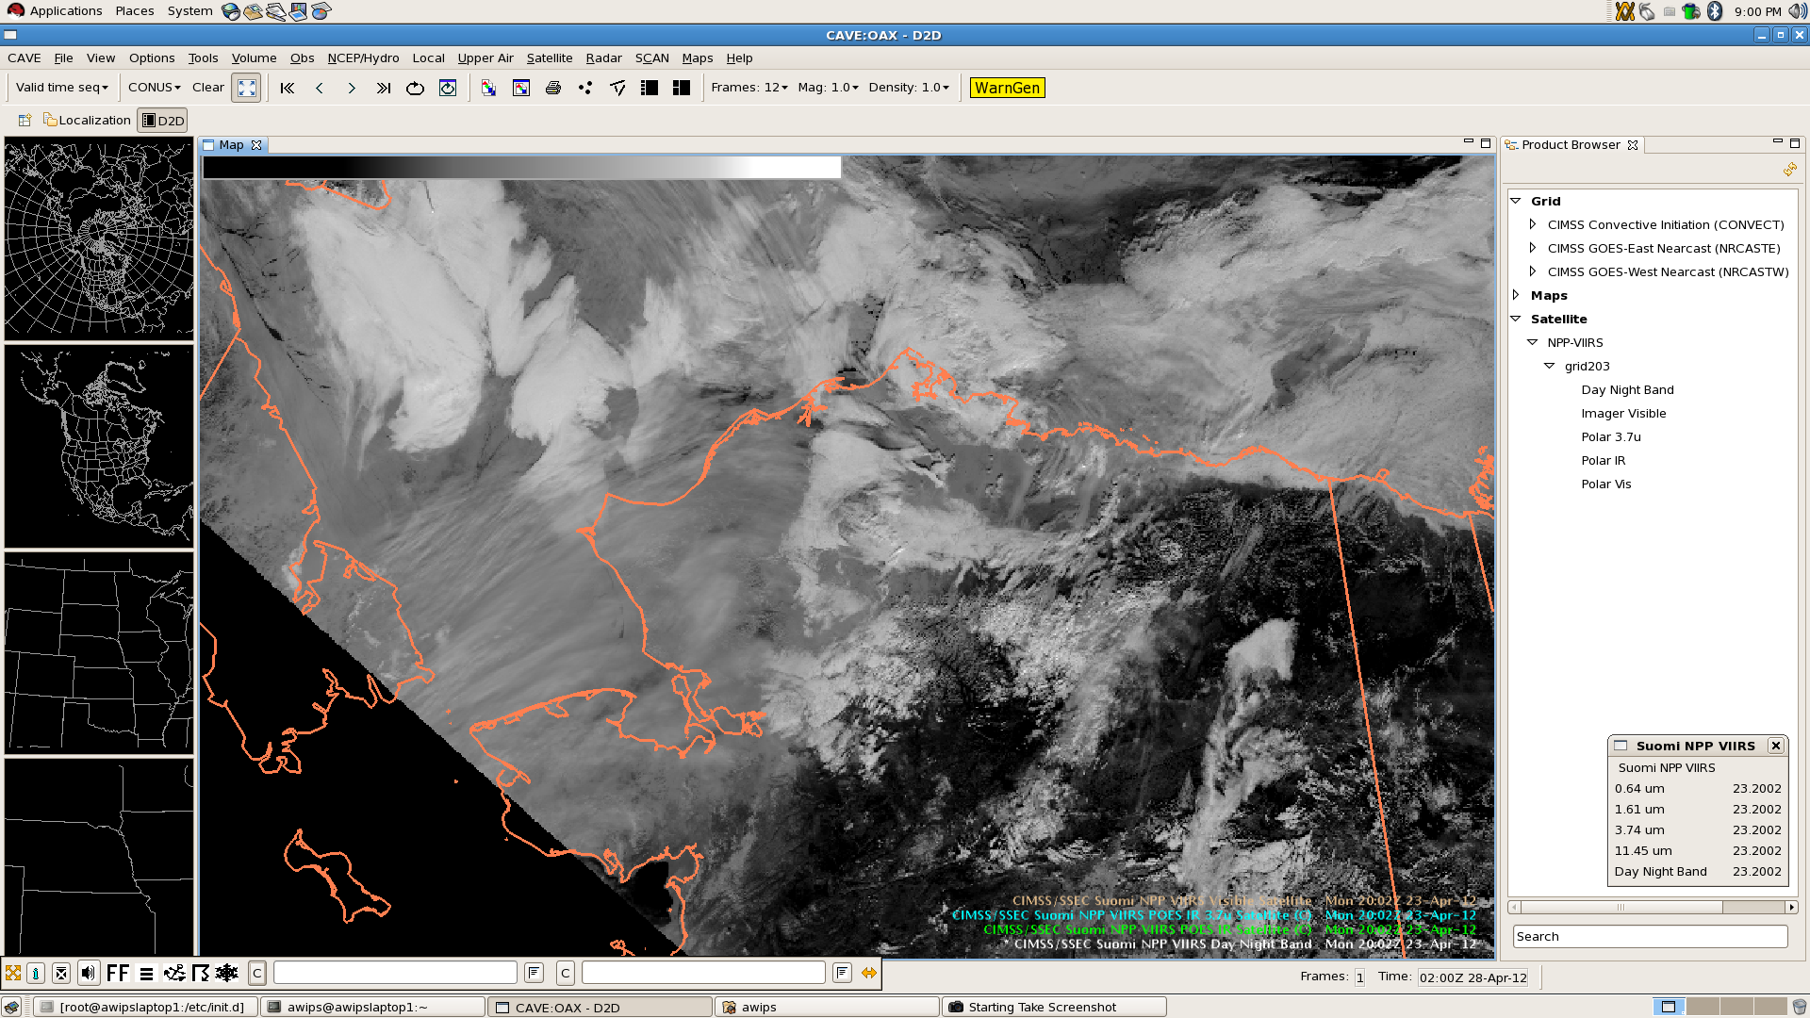
Suomi NPP (1.61 µm)

Slide 14
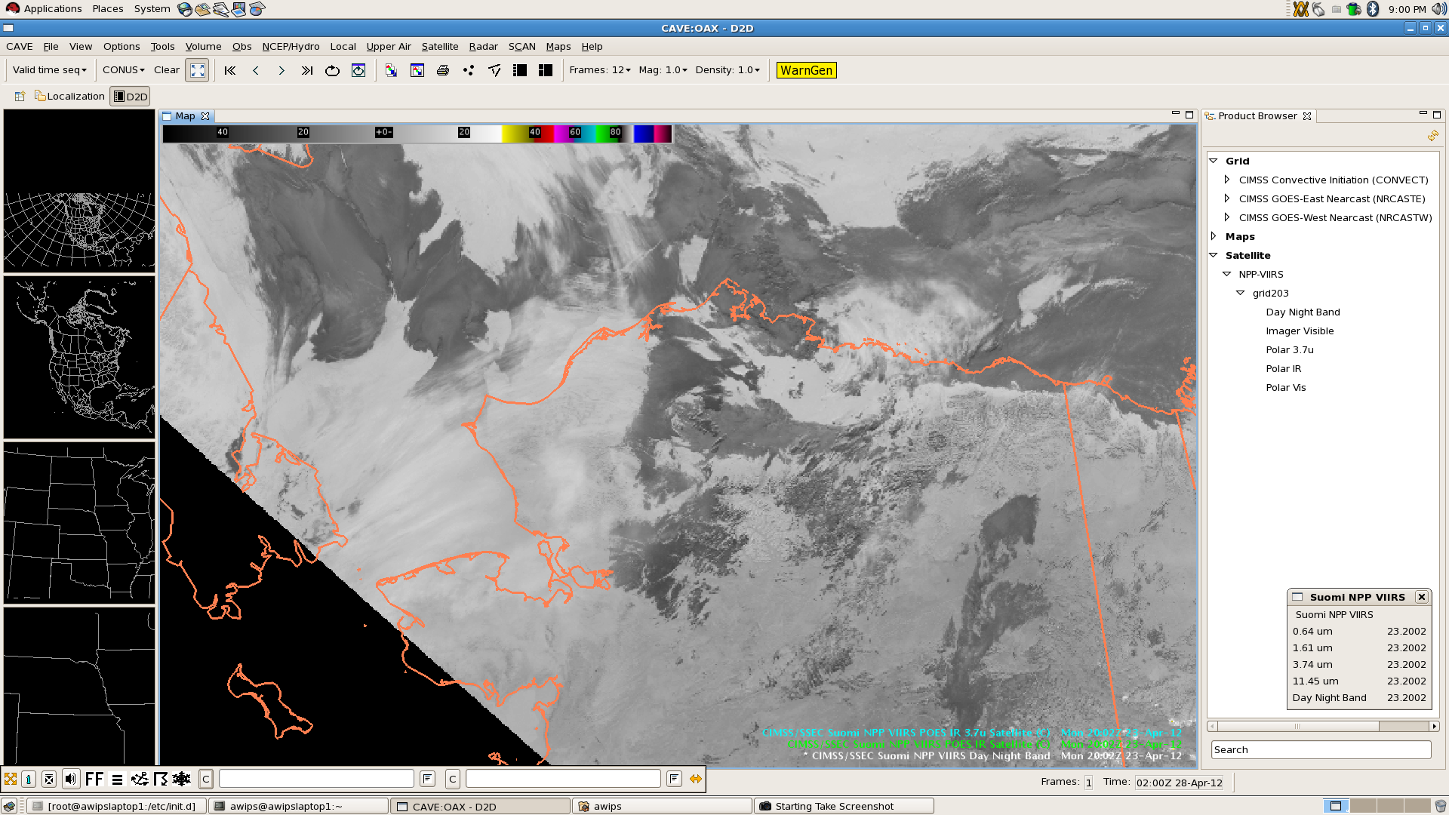
Suomi NPP (3.74 µm)

Slide 15
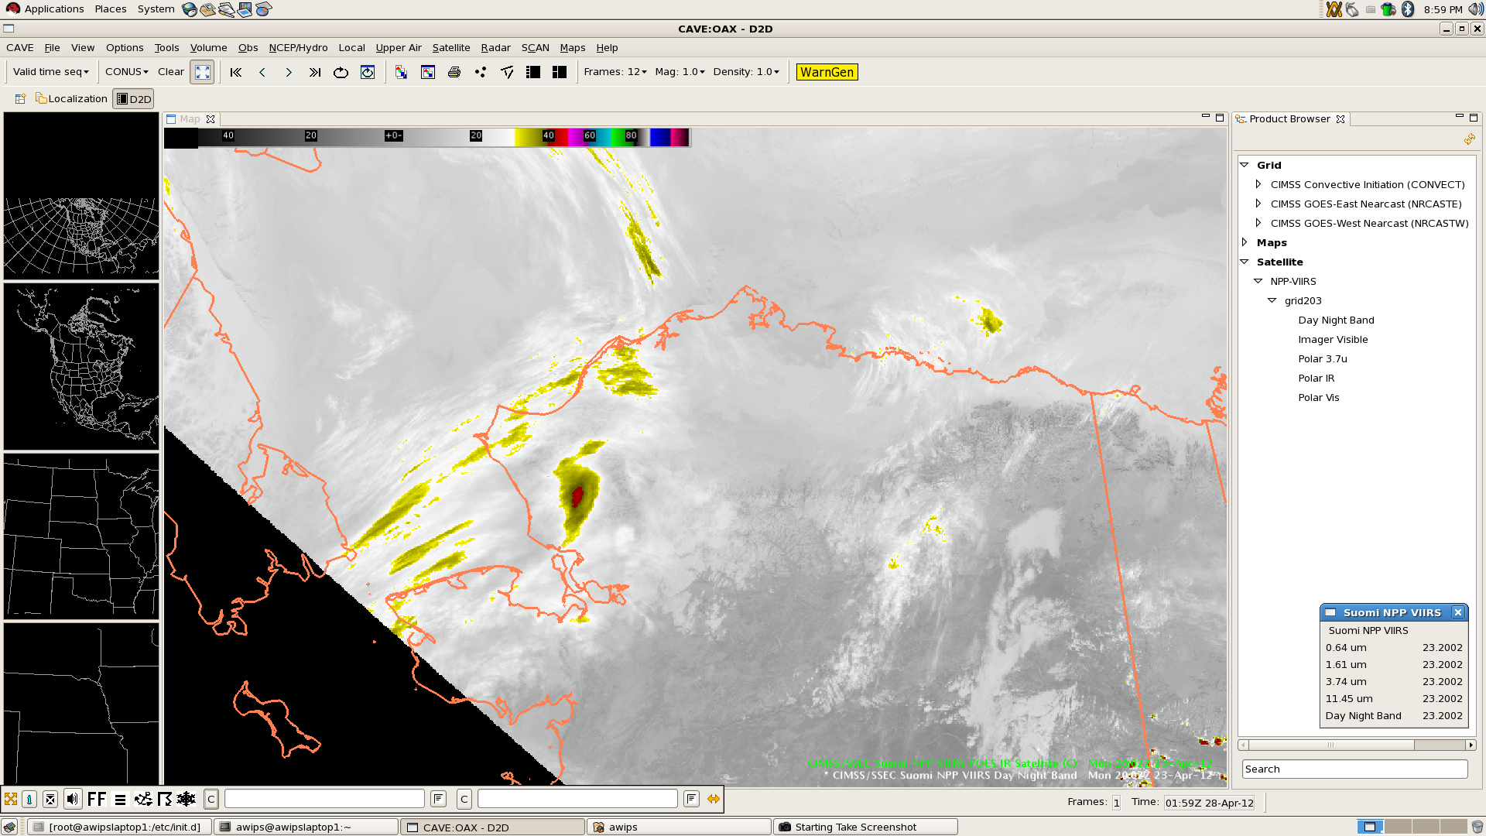
Suomi NPP (11.45 µm)

Slide 16
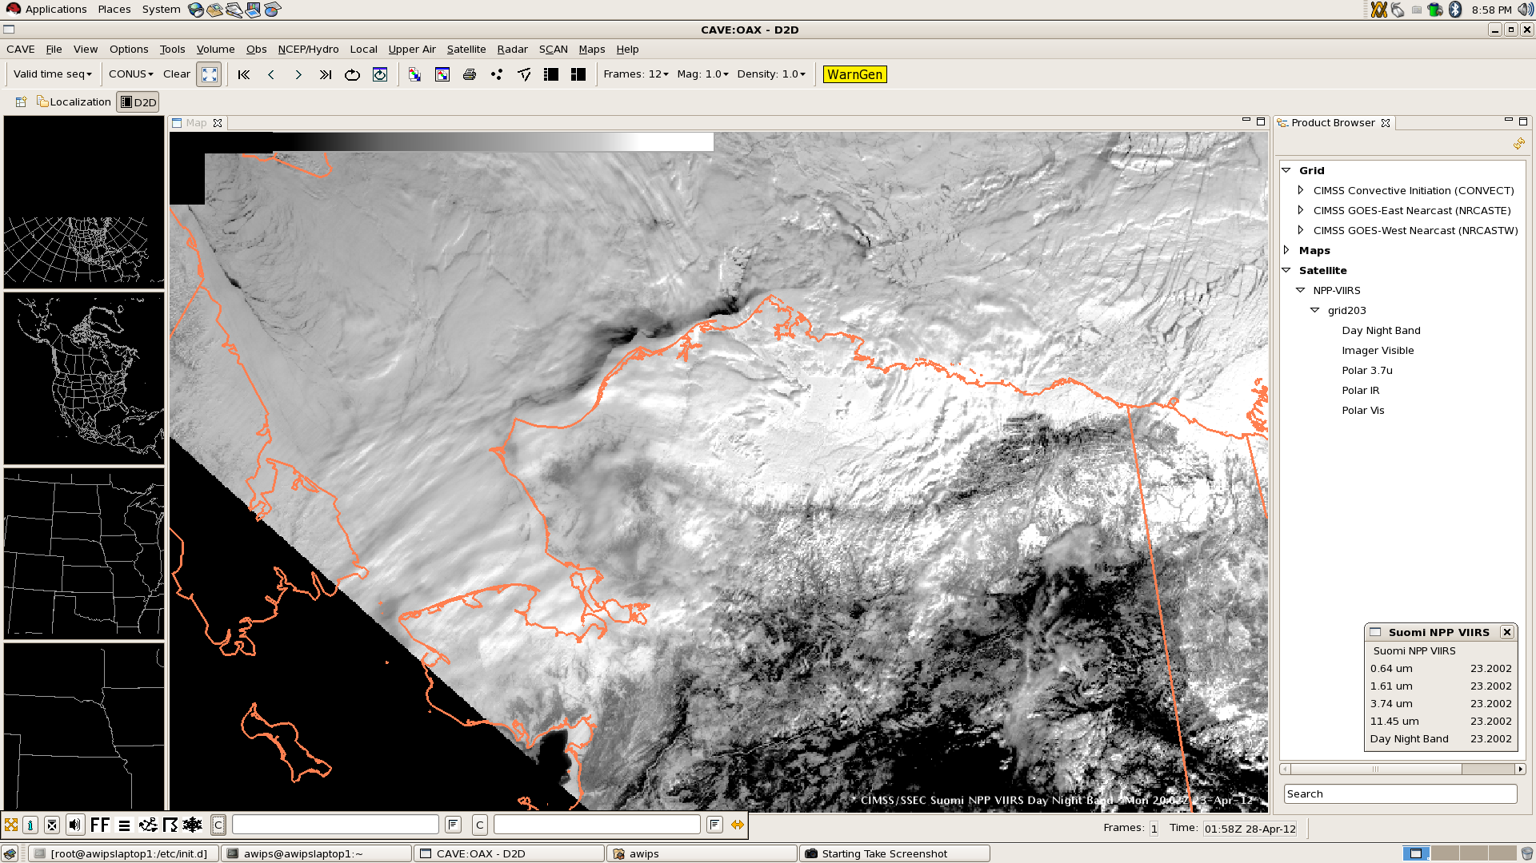
Suomi NPP (Day Night Band)

Slide 17
CIMSS Strategy
Guide and review development of netCDF3 plug-in to meet needs of GOES-R Proving Ground (GRPG)
Leverage the code base in the software as it exists
Adapt to current AWIPS II plug-ins (GRIB2, McIDAS AREA, GINI), update configuration tables, and reformat current AWIPS satellite imagery and products from CIMSS to a plug-in-compliant format
Repurposing functionality is the essence of a service-oriented architecture
Lower chance of adverse impact on system
Easier to assure functionality across builds
Create, modify, and extend plug-ins only when necessary to meet legacy AWIPS capabilities
Wait for major code development and refactoring to subside
Notes:
McIDAS is Man computer Interactive Data Access System

Slide 18
CIMSS Strategy
Recommend changes to baseline code base for tomorrow’s capabilities
Accomplished via Technical Interchange Meetings (TIMs)
RGBA discussed tomorrow
Proposing new capabilities
Expand data array structure
Currently byte values
Add advanced map projections, additional geospatial support
Pursuing strategies to add satellite perspectives (polar and geostationary)
Currently limited to Mercator, Lambert Conformal, and Polar Stereographic
Additional configurability via XML
Legends, scaling, purging, etc.

Slide 19
Moving Forward
Comfort with software and code base is increasing for a limited number of developers
Abbreviated but formalized AWIPS II technical skills training necessary for GRPG liaisons to complete tasks expeditiously
Governance strategy still needed
Joint academia-government-industry AWIPS II developers’ workgroup not established
NWS has held developer outreach teleconferences with some success but they not completely integrated across the enterprise
Documentation better but incomplete in some important areas (e.g., use of derived parameters, XML tags involving displays styling)
Developer-level software features not perfect
TIMs with teeth?

Slide 20
Moving Forward
NOAA lacks permanent satellite advocates at the sub-agency interface between NWS and NESDIS
Limited inter-agency communication produces a sub-standard incremental implementation of new satellite imagery/product enhancements into AWIPS, as evident in switch to GOES-15
Responsibility for affirming satellite capabilities of AWIPS II unclear
CIMSS currently performs task in ad hoc capacity
Transitional avenue to operations not identified for successful demonstrations within the GRPG
GRPG providers cannot access the AWIPS LAN at WFOs, which increases frustration and time when troubleshooting ingest and display problems involving experimental PG products

Slide 21
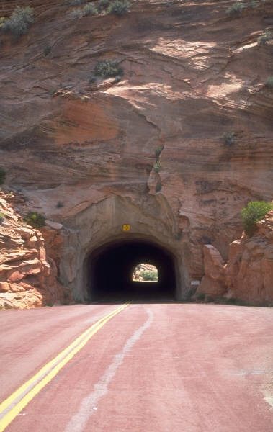
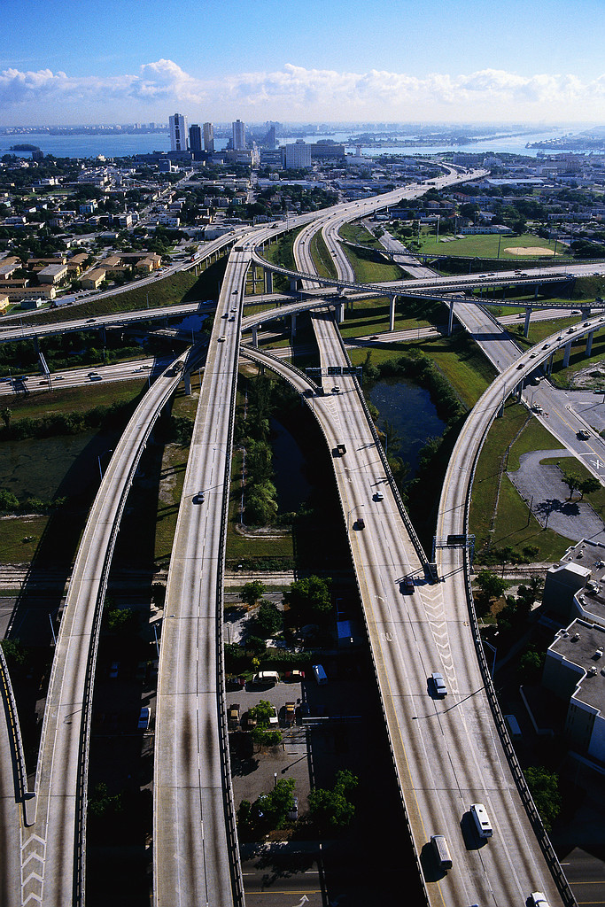
Diversification of paths for data delivery required
Subscription
Future
Narrow pass
Broadcast
Broadcast
Multiple paths

Slide 22
Capabilities Wish List
Product-push deployment, quick display capability, and direct display sharing with remote users
Ability to introduce new or special products just in time for use with high-impact or evolving weather events
Facilitate direct communication in training exercises to allow for interaction and quick answers to questions on data or products
Incorporation of scientific programming languages to leverage display and data store
Increase use in research sector and academia
Allow for more efficient techniques development
Decrease amount of time for training in new language
CAVE plug-in for displaying bit depths greater than eight
Partial re-factoring of EDEX plug-ins may be necessary
Notes:
CAVE is Common AWIPS Visualization Environment, EDEX is Environmental Data EXchange

Slide 23
Questions/Comments?
Contact me: Jordan Gerth, Jordan.Gerth@noaa.gov
Thanks to…
Tom Kretz, Darrel Kingfield, John Olsen, Ed Mandel, Bill Campbell, and Frank Griffith
All of my Facebook friends, LinkedIn connections, and Twitter followers

