Slide 1
Evolving R2O in the Era of “Big Data” Meteorology
Jordan J. Gerth Research Meteorologist Cooperative Institute for Meteorological Satellite Studies Space Science and Engineering Center, University of Wisconsin
@jjgerth
American Meteorological Society Annual Meeting Seventh Conference on Transition of Research to Operations 2.2  24 January 2017

Slide 2
Principles for Accessible Data
Science benefits from more data
Data should be reasonably accessible
Government scientific data should be free
Data should be managed before collection begins
Data should be compatible over common technical platforms
Data should be available promptly
Data policies should encourage collaboration
Principles for Promoting Access to Federal Government-Supported Scientific
Data and Research Findings through International Scientific Cooperation
Interagency Working Group on Open Data Sharing Policy, December 2016
Notes:
https://www.whitehouse.gov/sites/default/files/microsites/ostp/NSTC/iwgodsp_principles_0.pdf

Slide 3
“Big Data” Meteorology
New environmental satellites
“Better, better, better”
Improved numerical weather prediction capabilities
Resolution, skill, and ensembles
Big Data = More Data
More Data = More Science

Slide 4
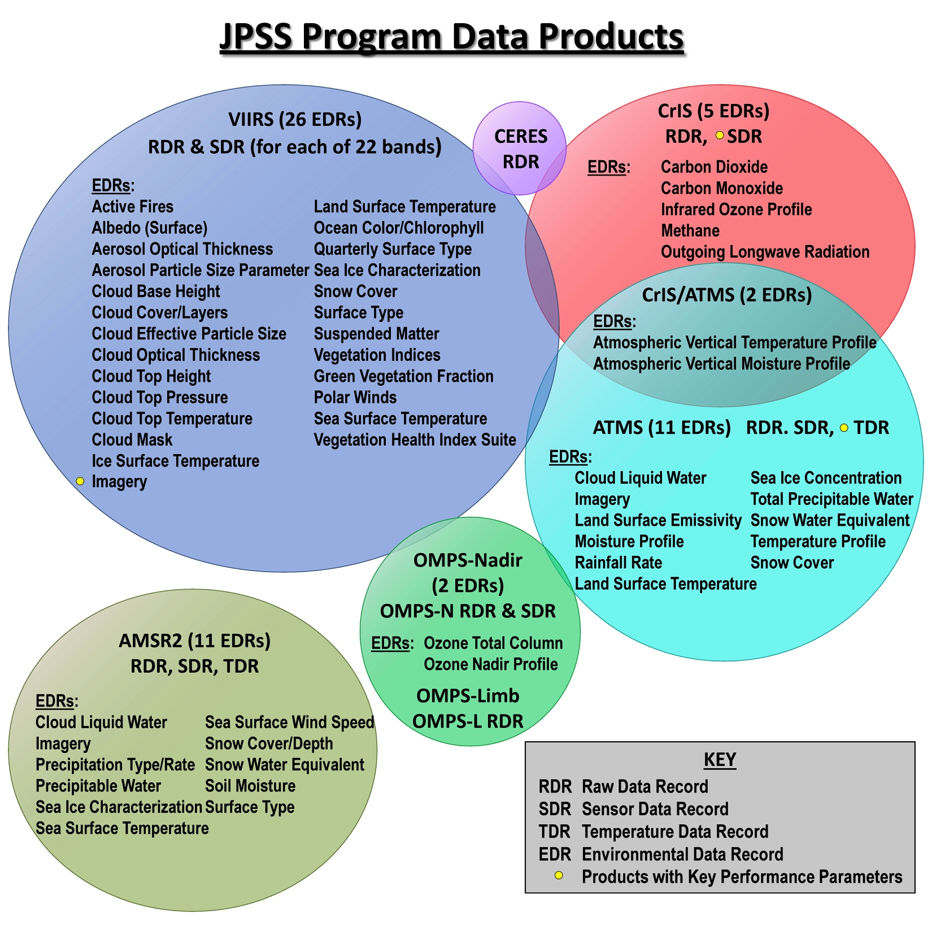
Source: STAR JPSS
Notes:
https://www.star.nesdis.noaa.gov/jpss/JSTAR.php

Slide 5
Two Types of “Big Data”
“Big data” sets can be characterized as either
similar to existing data sets, but with better coverage or resolution, or from a new observing platform,
More voluminous
or unlike anything seen or used before.
A new method of measuring/detecting a quantity or phenomena

Slide 6
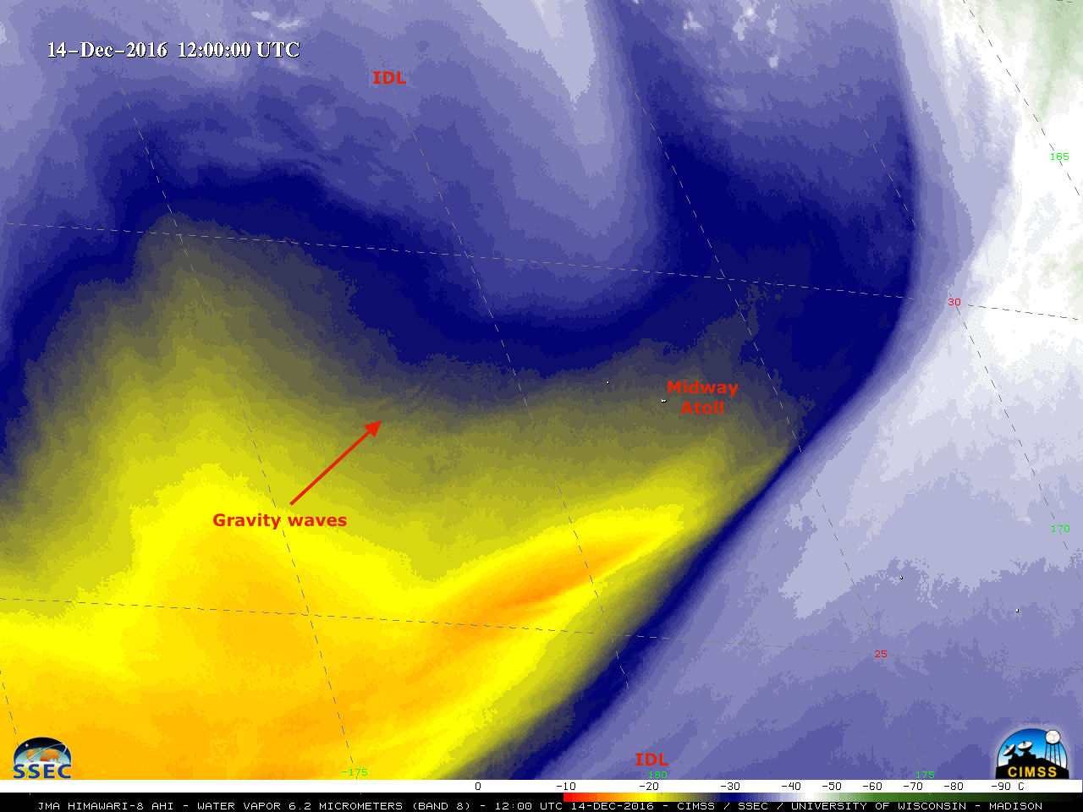

Slide 7
Constraints on “Big Data”
Today’s operational meteorologist has the same amount of time to consider all available data!
Technical systems and communications bandwidth must evolve to support access and timeliness requirements.
Determining how to present new data to the analyst and formally assessing its relative value is challenging.

Slide 8
Data-Information Continuum
Raw Data
Converted/Relational Quantities
Derived Quantities
Visualization Techniques
Blended/Combined/Multi-Source
Information

Slide 9
How Data Becomes Skill
Data
Knowledge
Information
Analyst Mental Representation
Skill

Slide 10
Human Data Integrator
The operational meteorologist is still largely responsible for condensing raw data to information, and then making a decision from that information.
The more data that is available, the more they have to review, evaluate, and compare.
There is a risk of decreased situational awareness and solution awareness.

Slide 11
Personal Awareness
Situational
Awareness
Solution
Awareness

Slide 12
What Expert Forecasters Do
Determine what aspects of the forecast are challenging
Examine the situation with a larger lens
Observe weather conditions directly
Alter methods depending on the scenario
Have a mental representation that incorporates the dynamical and physical basis for weather phenomena
Use their mental representation to complete different deliverables
“Understanding Skilled Weather Forecasting: Implication
for Training and the Design of Forecasting Tools”
Pliske et al., June 1997

Slide 13
Severe Storm Monitoring
Feature Monitoring
Environment Monitoring
Adjacent Radar
Model Output
Adjacent Radar
Lightning Networks
Model Output
Supplemental Information
GOES-R GLM
GOES-R ABI
Surface Obs

Slide 14
Severe Storm Monitoring
Feature Monitoring
Environment Monitoring
Multi-Radar Multi-Sensor
ProbSevere
Model Blend
Historical Analogs

Slide 15
Best R2O in “Big Data” Era
Start with a gap in the analyst mental representation.
Work backwards to connect the data to the gap.
Create integrated information from the data.
Determine which improvements can lead to the most sizable skill impacts through an iterative process.

Slide 16
Conclusions
The use of “big data” requires better training for analysts to understand new intermediary quantities and integrate them into their mental representations.
“Big data” must provide congruent derived products from observing systems and output fields from numerical weather prediction models.
Focus on “use-inspired” science for the best R2O.

Slide 17
Conclusions
Remember the “fit for use” value proposition. More “big data” is not necessarily better.
Understanding the decision and the decisional inputs is critical to leveraging the value within “big data”.
R2O must stop the “big data” DRIP.
Data Rich, Information Poor
We need a Weather Data Ready Nation.

Slide 18
Contact Information
E-Mail: jordan.gerth@ssec.wisc.edu
Twitter: @jjgerth

