Slide 1
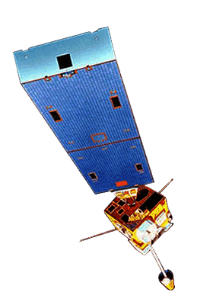

Best Practices for NWP: The Nexus of Satellite Observations and Initial Conditions
Jordan Gerth, Research Assistant
Cooperative Institute for Meteorological Satellite Studies
University of Wisconsin
Session VII – Tuesday, October 5, 2010
National Weather Association Annual Meeting, Tucson, Arizona

Slide 2
Basic Premise of NWP
Numerical weather prediction (NWP) is an initial-value problem.
The following constrain the accuracy of numerical weather prediction solutions:
  Parameterizations and approximations within the model
  Atmospheric features occurring on scales smaller than resolved by the model
  Limited observations to populate the initial analysis (especially in the “upper air” and over oceans)
  Quality, precision, and accuracy of the observations
  Boundary conditions and domain size

Slide 3
Précis
Through satellite data assimilation, this presentation investigates how subtle changes to land/sea surface properties and moisture content in the boundary layer (and other levels of the troposphere) alter the solution of mesoscale and synoptic-scale modeled weather phenomena and associated precipitation
Two cases will be discussed:
  December 2009 Winter Storm/Blizzard
  August 2010 Central US Frontal Passage

Slide 4

Information Extracted from Satellites for Numerical Weather Prediction
Radiances
Direct assimilation (3Dvar)
Requires model errors, observation errors
Scale dependence
Surface type restrictions
Retrieved parameters
Dependent variable assimilation (1,3Dvar)
Requires model errors, retrieval errors
Physical accuracy, non-linearity
Bypass surface type restrictions
Motion
Cloud track, water vapor track
Height assignment errors
Radiance tracking (4Dvar)
The CIMSS Regional Assimilation System (CRAS) is used to assess the impact of space-based observations on numerical forecast accuracy.
CRAS is unique in that, since 1996, it’s development was guided by validating forecasts using information from GOES.
Output online:
http://cimss.ssec.wisc.edu/cras/
Slide credit: Robert Aune, NOAA/NESDIS

Slide 5
Do the Great Lakes “attract” mid-latitude cyclones?
Using the CRAS in a sensitivity study
Can remote sensing improve marine weather forecasts?
The Great Lakes Pneumonia Front: A New Study of Land-Sea Interactions
Talk, National Weather Association Annual Meeting—General Session Marine (Norfolk, Virginia)
October 22, 2009

Slide 6
Motivation for Research
There are abundant studies of lake-effect snowstorms, but limited literature on the interactions between the Great Lakes and regional scale disturbances
There are a few studies which have examined the influence of the Great Lakes on synoptic scale cyclones, as well as some intensive studies of wintertime boundary layer dynamic and thermodynamic process exchanges with sub-synoptic scale features (Danard, 1972)
In-situ observations of marine boundary layer properties are limited, remote sensing can help
Do only extreme surface heterogeneities matter? What kind of exchanges occur between the water surface and boundary layer? Do any of these exchanges impact the synoptic scale?
Cox (1917) suggested that the combined heating from the Great Lakes “attracted” synoptic scale toward the Midwest and increase in intensity
Calabrese (1959) found Great Lakes collectively reduce sea level pressure (SLP) by 6-7 hPa. SLP reductions of 5 hPa were confirmed by numerical studies from Danard and Boudra (1981).
Notes:
Boudra, D. B., 1981: A study of the early winter effects of the Great Lakes. I: Comparison of very fine scale numerical simulations with observed data. Mon. Wea. Rev., 109:2507–2526.
Chuang, H-Y. and P. J. Sousounis. 2003. The impact of the prevailing synoptic situation on the lake-aggregate effect. Mon. Wea. Rev., 131:990–1010.
Cox, H. J., 1917: Influence of the Great Lakes upon movement of high and low pressure areas. Proc. Second Pan Amer. Sci. Congr., 2:432–459.
Craven, J. P., 2010. Personal communication.
Danard, M. B. and G. V. Rao, 1972: Numerical study of the effects of the Great Lakes on a winter cyclone. Mon. Wea. Rev., 100:374–382.
Petterssen, S. and P. A. Calabrese, 1959: On some weather influences due to warming of the air by the Great Lakes in winter. J. Meteor., 16:646–652.
Kristovich, D. A R. and N. F. Laird. 1998. Observations of widespread lake-effect cloudiness: Influences of lake surface temperatures and upwind conditions. Wea. Forecasting 13:811–821.
Sousounis, P. J. and J. M. Fritsch, 1994: Lake aggregate mesoscale disturbances. Part II: A case study of the effects on regional and synoptic-scale weather systems. Bull. Amer. Meteor. Soc., 75:1793–1812.

Slide 7
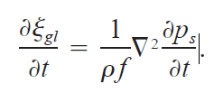
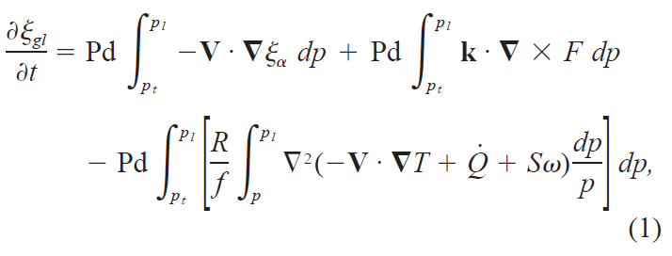
Theory
Zwack-Okossi Equation (Simplified form of Vasilj and Smith, 1997)
Chuang (2003) attempted to determine the effects of idealized warm lakes on flow regimes, motivated by storms moving across Great Lakes in the fall and winter
The Zwack-Okossi (ZO) equation was applied to simulation results to determine the physical processes altered by the Great Lakes to enhance cyclone development
Results indicated that an idealized lake aggregate reduced local surface pressure through surface sensible heating, and found that the warm lake air encouraged large-scale surface pressure deepening by enhancing the surface warm front
Time derivative of geostrophic vorticity
ZO surface pressure tendency equation
Vorticity advection
Frictional forcing
Thermal forcing:
Temperature advection
Diabatic heating
Adiabatic heating

Slide 8
8-9 December 2009
Winter storm of 8-9 December 2009 led to discussion about the influence of the Great Lakes on development of large-scale synoptic low pressure systems.
Despite a unfavorable horizontal and vertical scale comparison between the Great Lakes and these winter storms, theories continue to circulate regarding the draw of the Great Lakes on synoptic storm tracks, particularly during the fall and early winter.
Does the decreased friction or increased heat flux in the boundary layer over the Great Lakes really drive the development and track of strong winter storms?
Is the perceived northward trend with consecutive model runs (dprog/dt) a function of model performance or a lack of sensitivity to Great Lakes air-sea interactions?
“All lows go to Chicago.” (Joe Shipps, 1993)

Slide 9
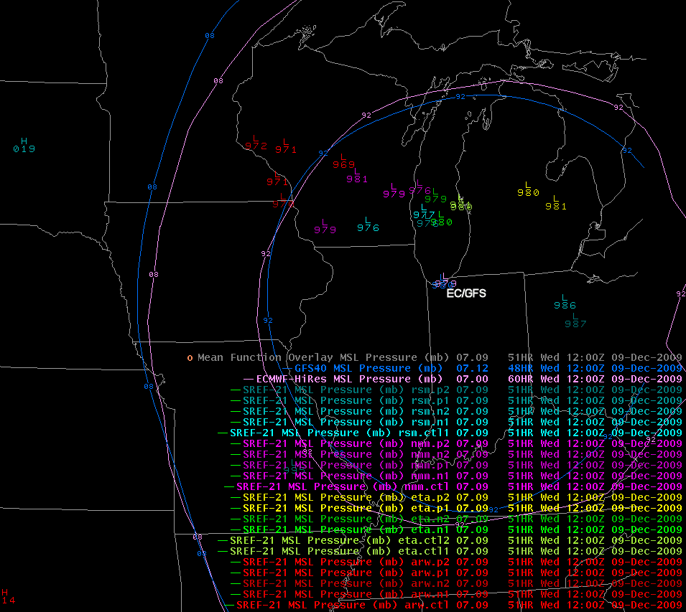
Solution clustering by dynamical core
Image credit:
Dan Baumgardt, NOAA/NWS ARX

Slide 10
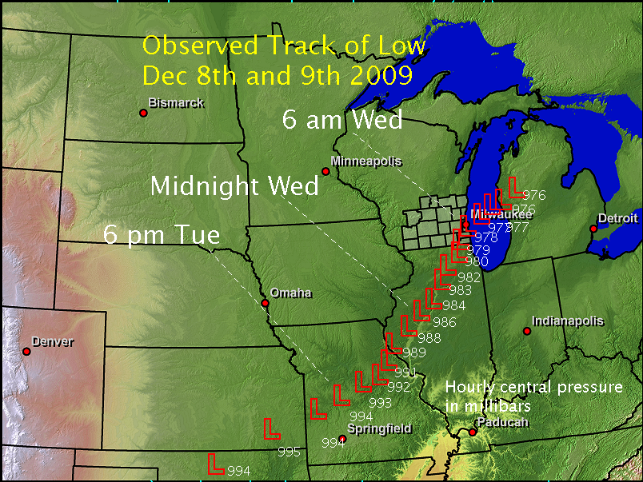
Experiment Design
Image credit: Jeff Craven, NOAA/NWS MKX
CRAS model initialized on December 7, 2009, 12:00 UTC, using GFS boundary conditions and GFS initial conditions with GOES Sounder assimilated in a 12-hour spin-up.
CRAS chosen for experiment due to moisture correction, control performance, and surface low development on northern end of track envelope consisting of operational models (over Lake Michigan instead of Lower Michigan).
Spatial model resolution of 45 kilometers chosen in order to assess impact of Great Lakes on the synoptic scale.
Control run: Sea surface (skin) temperatures based on observations of roughly 4 degrees Celsius (39 degrees Fahrenheit). The skin temperature does not change during the simulation.
Ice run: Model water grid points of the Great Lakes changed to ice.
Hot run: Sea surface temperature of Great Lakes increased systematically 5 K from the observation.

Slide 11


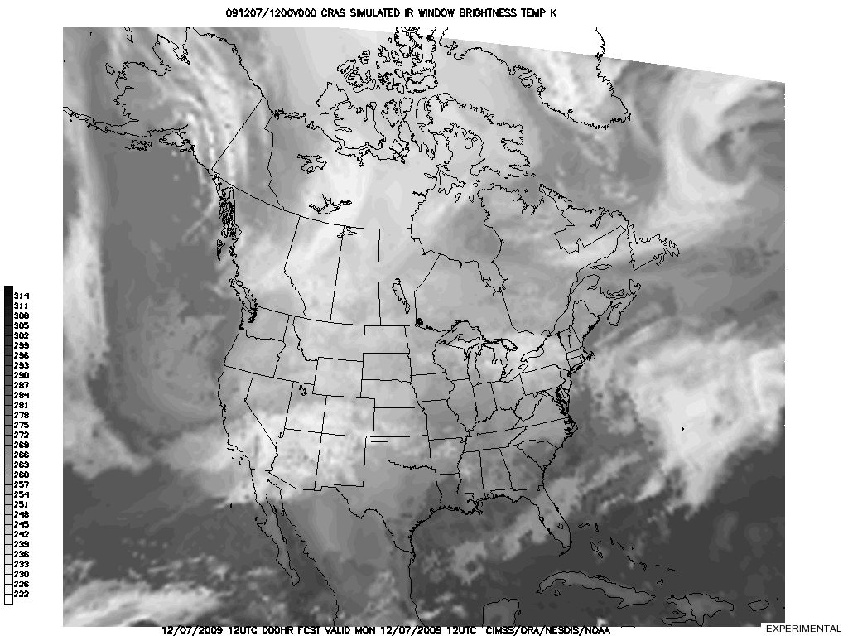
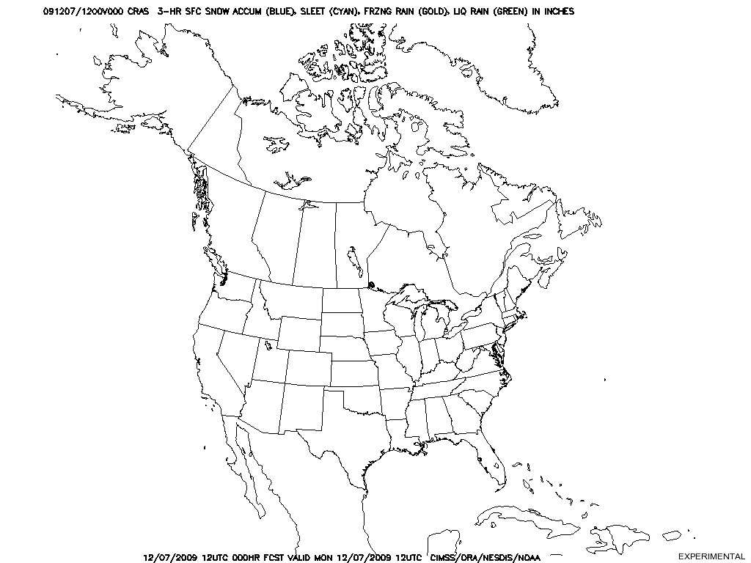
Results of CRAS “Ice” Run
3-hourly Simulated Infrared Window
11 micron brightness temperature
Loop duration: 60 hours
3-hourly Accumulated Precipitation
Snow (blue), sleet (cyan), freezing rain (yellow), and liquid rain (green) included
Diagnosed from model thermal profile

Slide 12
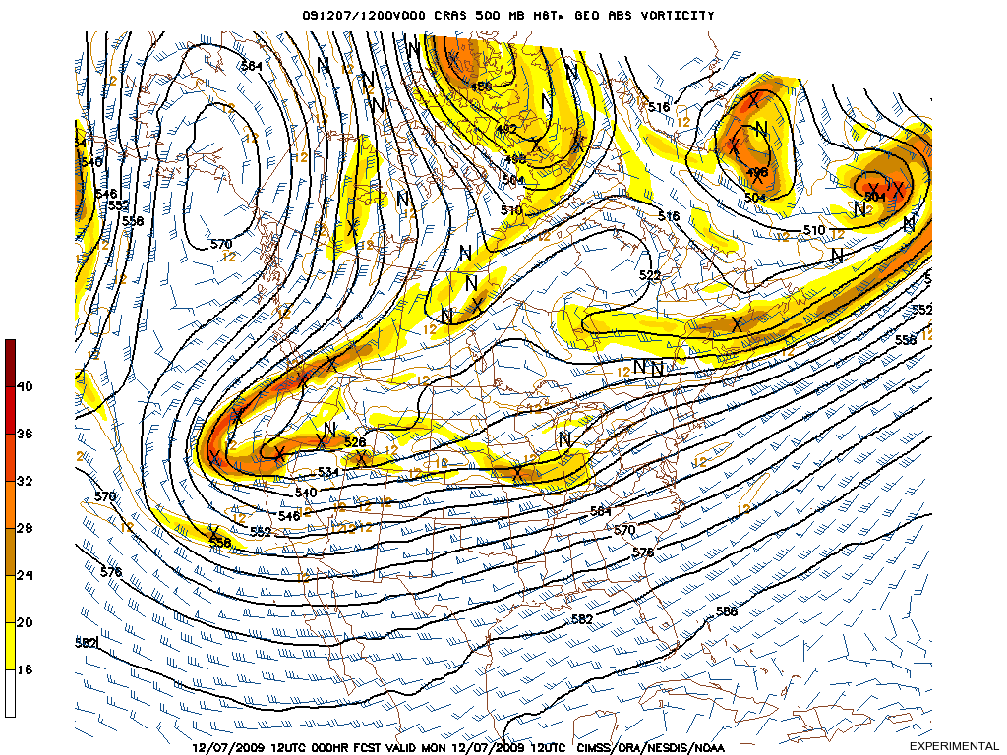
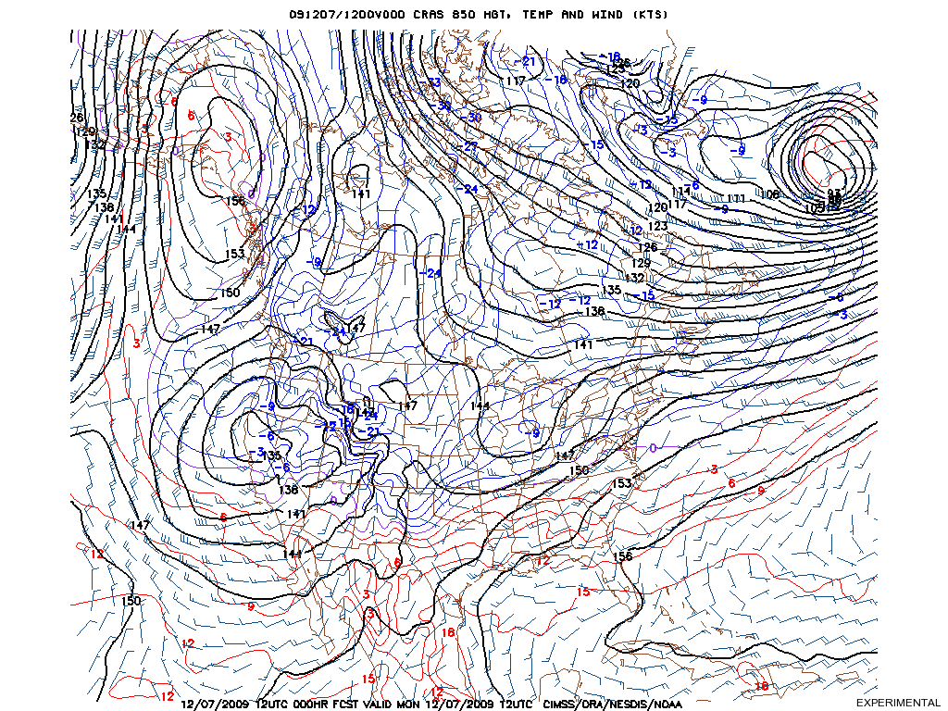
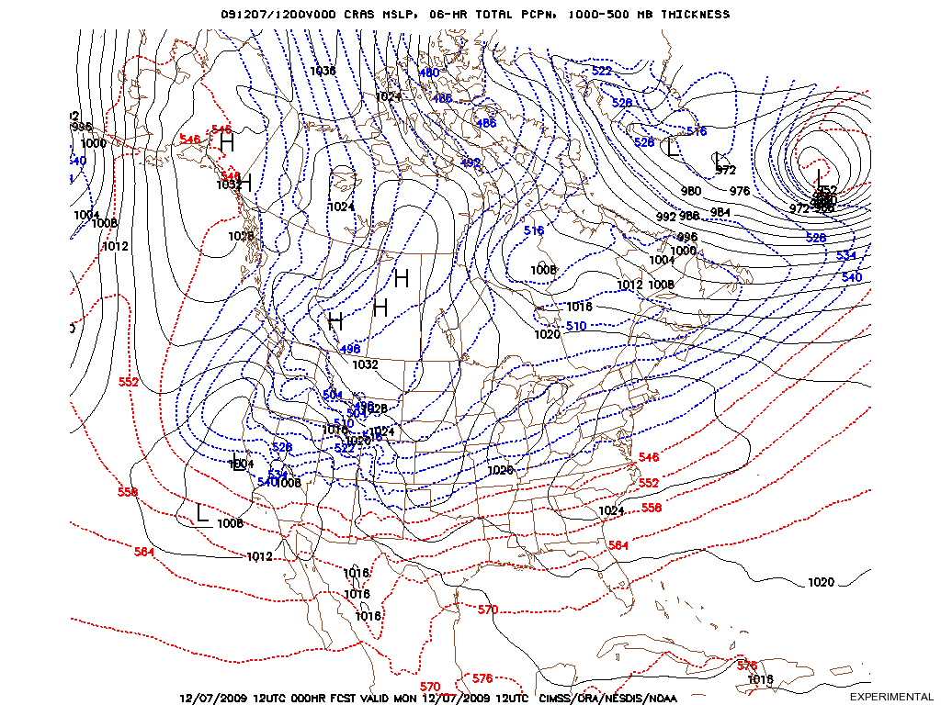
CONTROL
ICE
HOT
CONTROL
ICE
HOT
500 hPa
850 hPa
6hr Pcp
500 hPa
850 hPa
6hr Pcp
500 hPa
850 hPa
6hr Pcp

Slide 13
Some Thoughts on the Results
In this case, the change in the skin temperature (heat flux) did not meaningfully or significantly alter the track or development of the low pressure system.
Some minor differences in the precipitation amounts likely resulted from a mesoscale contribution (lake enhancement processes).
With systems of this spatial scale, advecting significant amounts of moisture, the Great Lakes do not change the evolution in theory. Extremely anomalous and persistent temperature differences between the Great Lakes skin temperature and the air temperature may result in a synoptic adjustment for systems with a smaller radius of influence (Northwest flow clippers, perhaps).

Slide 14
Transitioning to the WRF
The most recent advances in numerical weather prediction have come with the advent and widespread distribution to the Weather Research and Forecast (WRF) model to both the field and academia.
The WRF has two dynamical cores (ARW/NCAR and NMM/NCEP), one with customizable physics, and a 3-dimensional variational (3DVAR) assimilation system. The goal is flexibility and extensibility.
The WRF model has recently grown as an effective and easy-to-use local real-time modeling tool at National Weather Service forecast offices through the Environmental Modeling System (EMS) project.
Important to the success of these modeling efforts is accurately resolving mesoscale phenomena (traditionally moist convective systems) on dense grid scales.

Slide 15
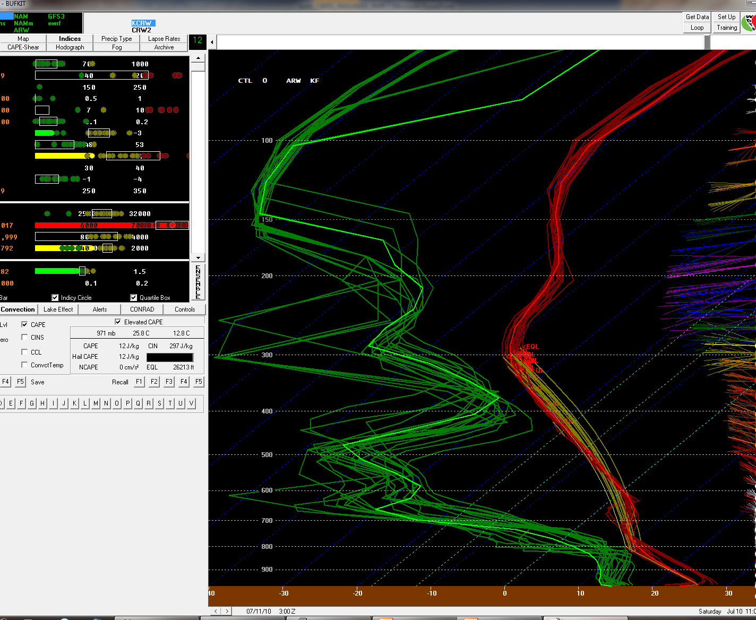
More moisture, more problems
Using the WRF in a sensitivity study
Increased use of ensemble models has emphasized the limited grasp of our initial conditions on tropospheric moisture content.

Slide 16
Interfacing CRAS and WRF
Lack of consistent, statistical verification efforts to validate CRAS output, in combination with an aging dynamical core and desire to use high-resolution output, has hampered expansion
Assimilating GOES Sounder retrievals is still a valuable exercise, and particularly important for improving forecast accuracy on dense grids
Work is underway to combine the CRAS assimilation code with the WRF front-end to produce initial conditions on a comparable scale to the model grid
Boundary conditions will eventually drive solution if run duration is sufficiently long (depends on grid dimensions)
  Use CRAS for lateral forcings?
Specific Objective:
Expand the benefits of valuable moisture Information contained in GOES Sounder Derived Product Images (DPI)
Robert Aune, NOAA/NESDIS

Slide 17
Assimilating GOES Sounder in CRAS
Cloud-top pressure and effective cloud amount are used adjust cloud water mixing ratio in the model. Cloud checks are performed for low, high, and multi-layer clouds.
Background GOES Operation
Clear Clear Do nothing (check RH)
Cloudy Cloudy Adjust cloud, RH, match top (up to two layers)
Cloudy Clear Clear cloud, adjust RH
Clear Cloudy Build new cloud, adjust RH
Water Vapor Adjustments using GOES 3-Layer Precipitable Water Retrievals.
1) Mean background mixing ratio profile is computed.
2) Perturbations are removed.
3) Mean profile is adjusted to match GOES 3-layer PW using 1D var (strong constraint).
4) Perturbations are added to adjusted profile.
5) RH profile checked for “clearness”.
A 12-hour spin-up forecast is used to initialize water vapor and clouds.
T-12 T-9 T-6 T-3 T=0
Forecast
………………………………... GOES Sounder PW and Cloud ……………………………
Slide credit: Robert Aune, NOAA/NESDIS

Slide 18
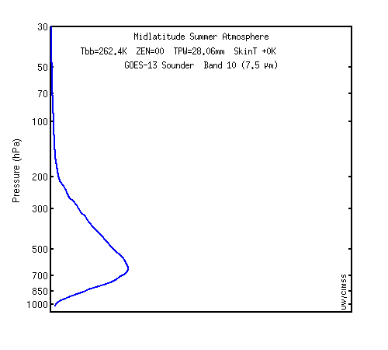
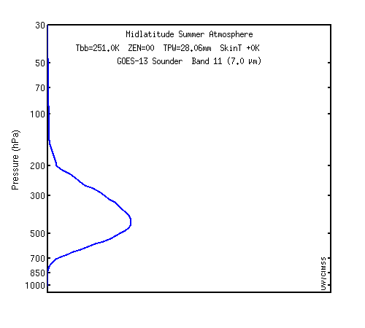
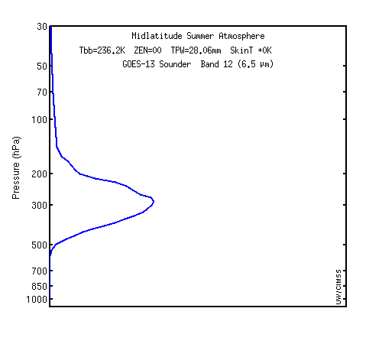
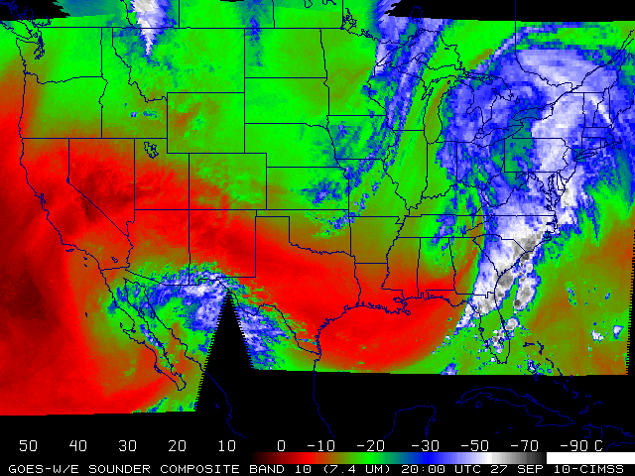
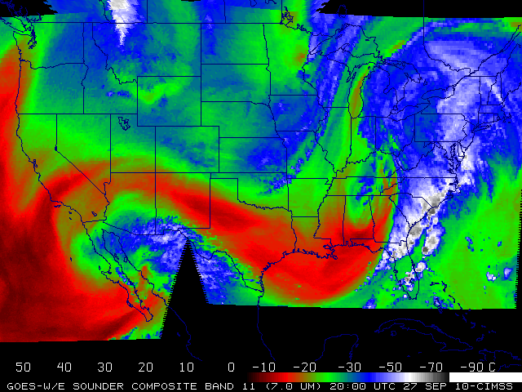
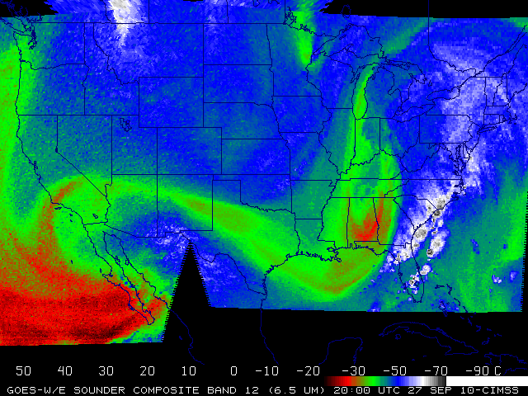
Current GOES-13 Sounder Weighting Functions
Geostationary satellites can provide information of mid-level water vapor.
7.5 µm
7.0 µm
6.5 µm
Plots courtesy of Mat Gunshor, CIMSS

Slide 19
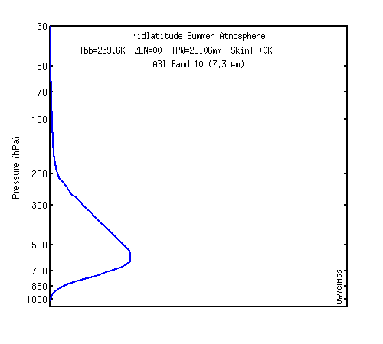
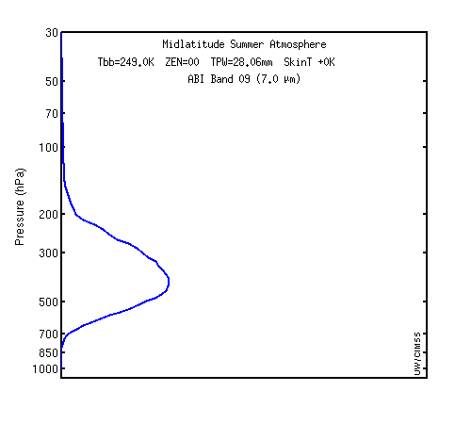
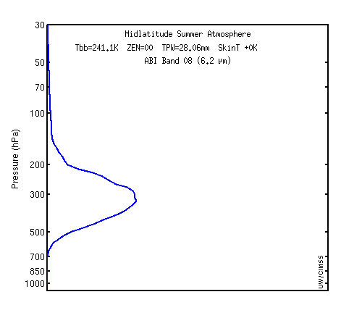
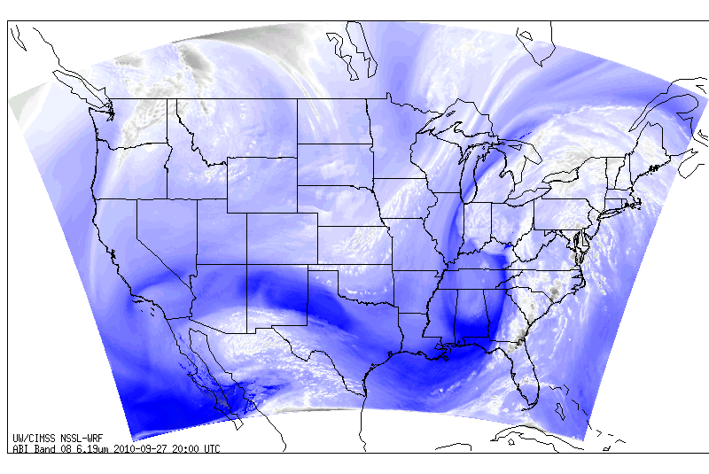
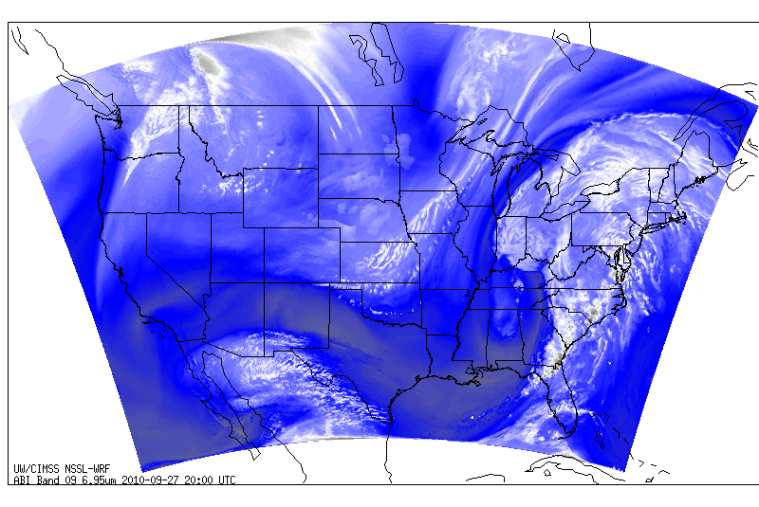
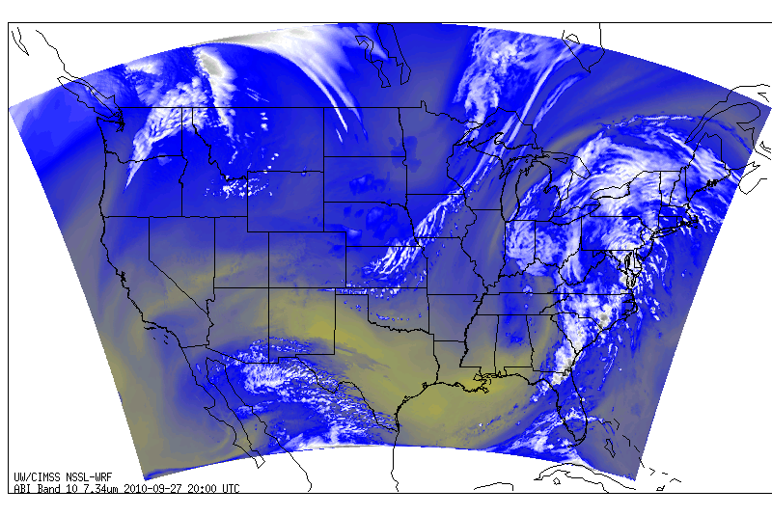
GOES-R ABI Weighting Functions
This capability will continue in the GOES-R era.
7.3 µm
7.0 µm
6.2 µm
Images courtesy of Justin Sieglaff, CIMSS
Simulated imagery

Slide 20
Experiment Design
Objective: Understand NWP response to variable moisture concentrations.
Approximate change in mixing ratio from GFS initial conditions
Six simulations:
GFS Initial Conditions
CRAS Initial Conditions
Dynamics | Non-Hydrostatic
Cumulus Scheme | Kain-Fritsch
Microphysics Scheme | WSM Single-Moment 5-Class
PBL Scheme | Yonsei University
Land Surface Scheme | 5-Layer Thermal Diffusion LSM
Surface Layer Physics | Monin-Obukhov with heat and moisture surface fluxes
Long Wave Radiation | RRTM
Short Wave Radiation | Dudhia Scheme
Time-Integration Scheme | Runge-Kutta 3rd Order
Damping | Rayleigh
∆w_{EA} = 0.23 g/kg
GFS Initial Conditions with 90% of Original RH
∆w_{LYR} = 1.25 g/kg
GFS Initial Conditions with 90% of Original Relative Humidity at and below 800 hPa
∆w_{LYR} = 0.30 g/kg
GFS Initial Conditions with 90% of Original Relative Humidity between 400 and 750 hPa
∆w_{LYR} = 0.01 g/kg
GFS Initial Conditions with 90% of Original Relative Humidity between 100 and 350 hPa
Each simulation shared the same:
Adaptive time step
20 km spacing on 100 x 100 square grid consisting of 45 vertical levels
100 hPa top of model
Model start at 31 August 2010 at 00:00 UTC
36-hour length with a boundary update every three hours

Slide 21
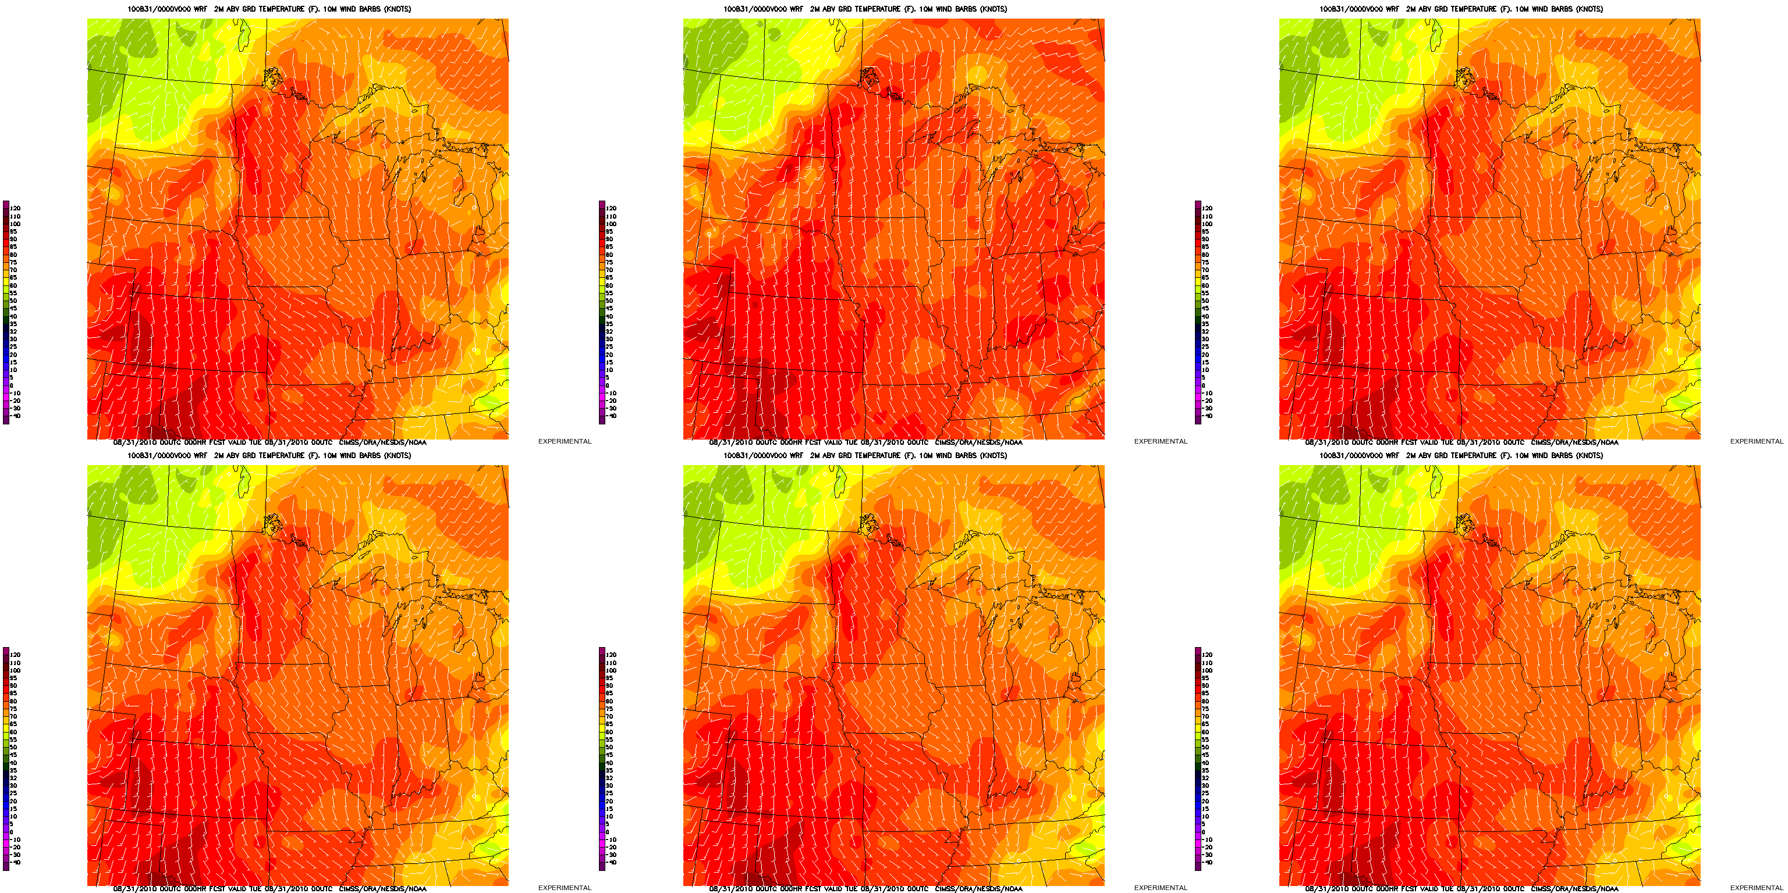
Comparison of 2m Temperature, 10m Wind
Initialized: 31 August 2010, 00 UTC
Interval: 3 hourly Duration: 36 hours
GFS Initial Conditions
CRAS Initial Conditions
GFS Initial Conditions with 90% of Original RH
GFS Initial Conditions with 90% of Original Relative Humidity at and below 800 hPa
GFS Initial Conditions with 90% of Original Relative Humidity between 400 and 750 hPa
GFS Initial Conditions with 90% of Original Relative Humidity between 100 and 350 hPa

Slide 22
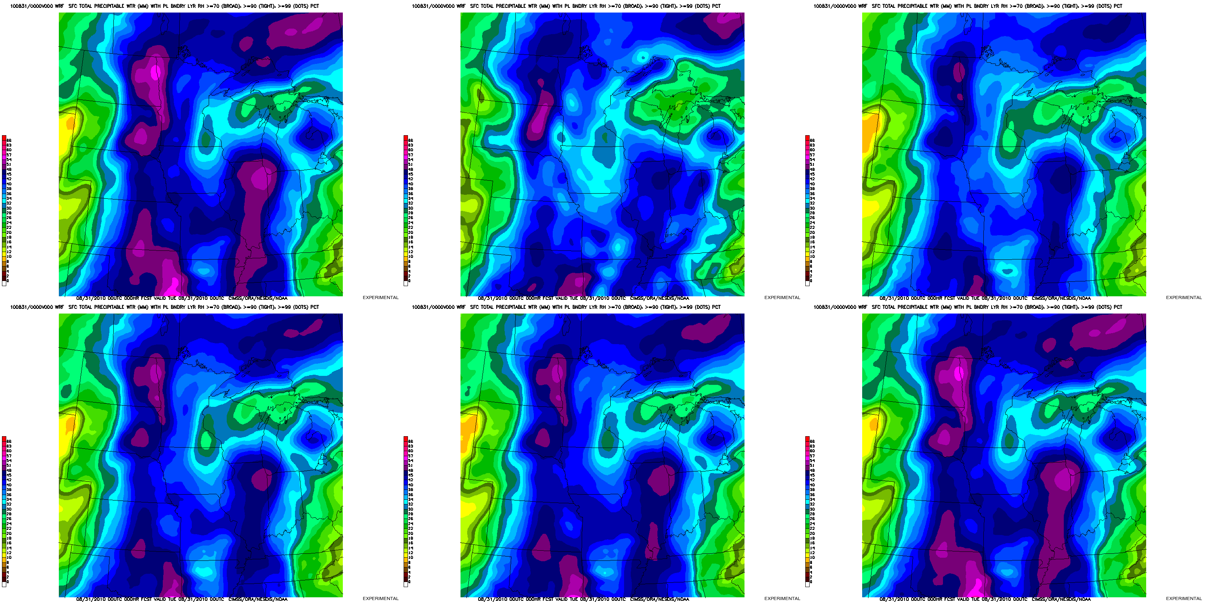
Comparison of Total Precipitable Water (Entire Atmosphere)
Initialized: 31 August 2010, 00 UTC
Interval: 3 hourly Duration: 36 hours
GFS Initial Conditions
CRAS Initial Conditions
GFS Initial Conditions with 90% of Original RH
GFS Initial Conditions with 90% of Original Relative Humidity at and below 800 hPa
GFS Initial Conditions with 90% of Original Relative Humidity between 400 and 750 hPa
GFS Initial Conditions with 90% of Original Relative Humidity between 100 and 350 hPa

Slide 23
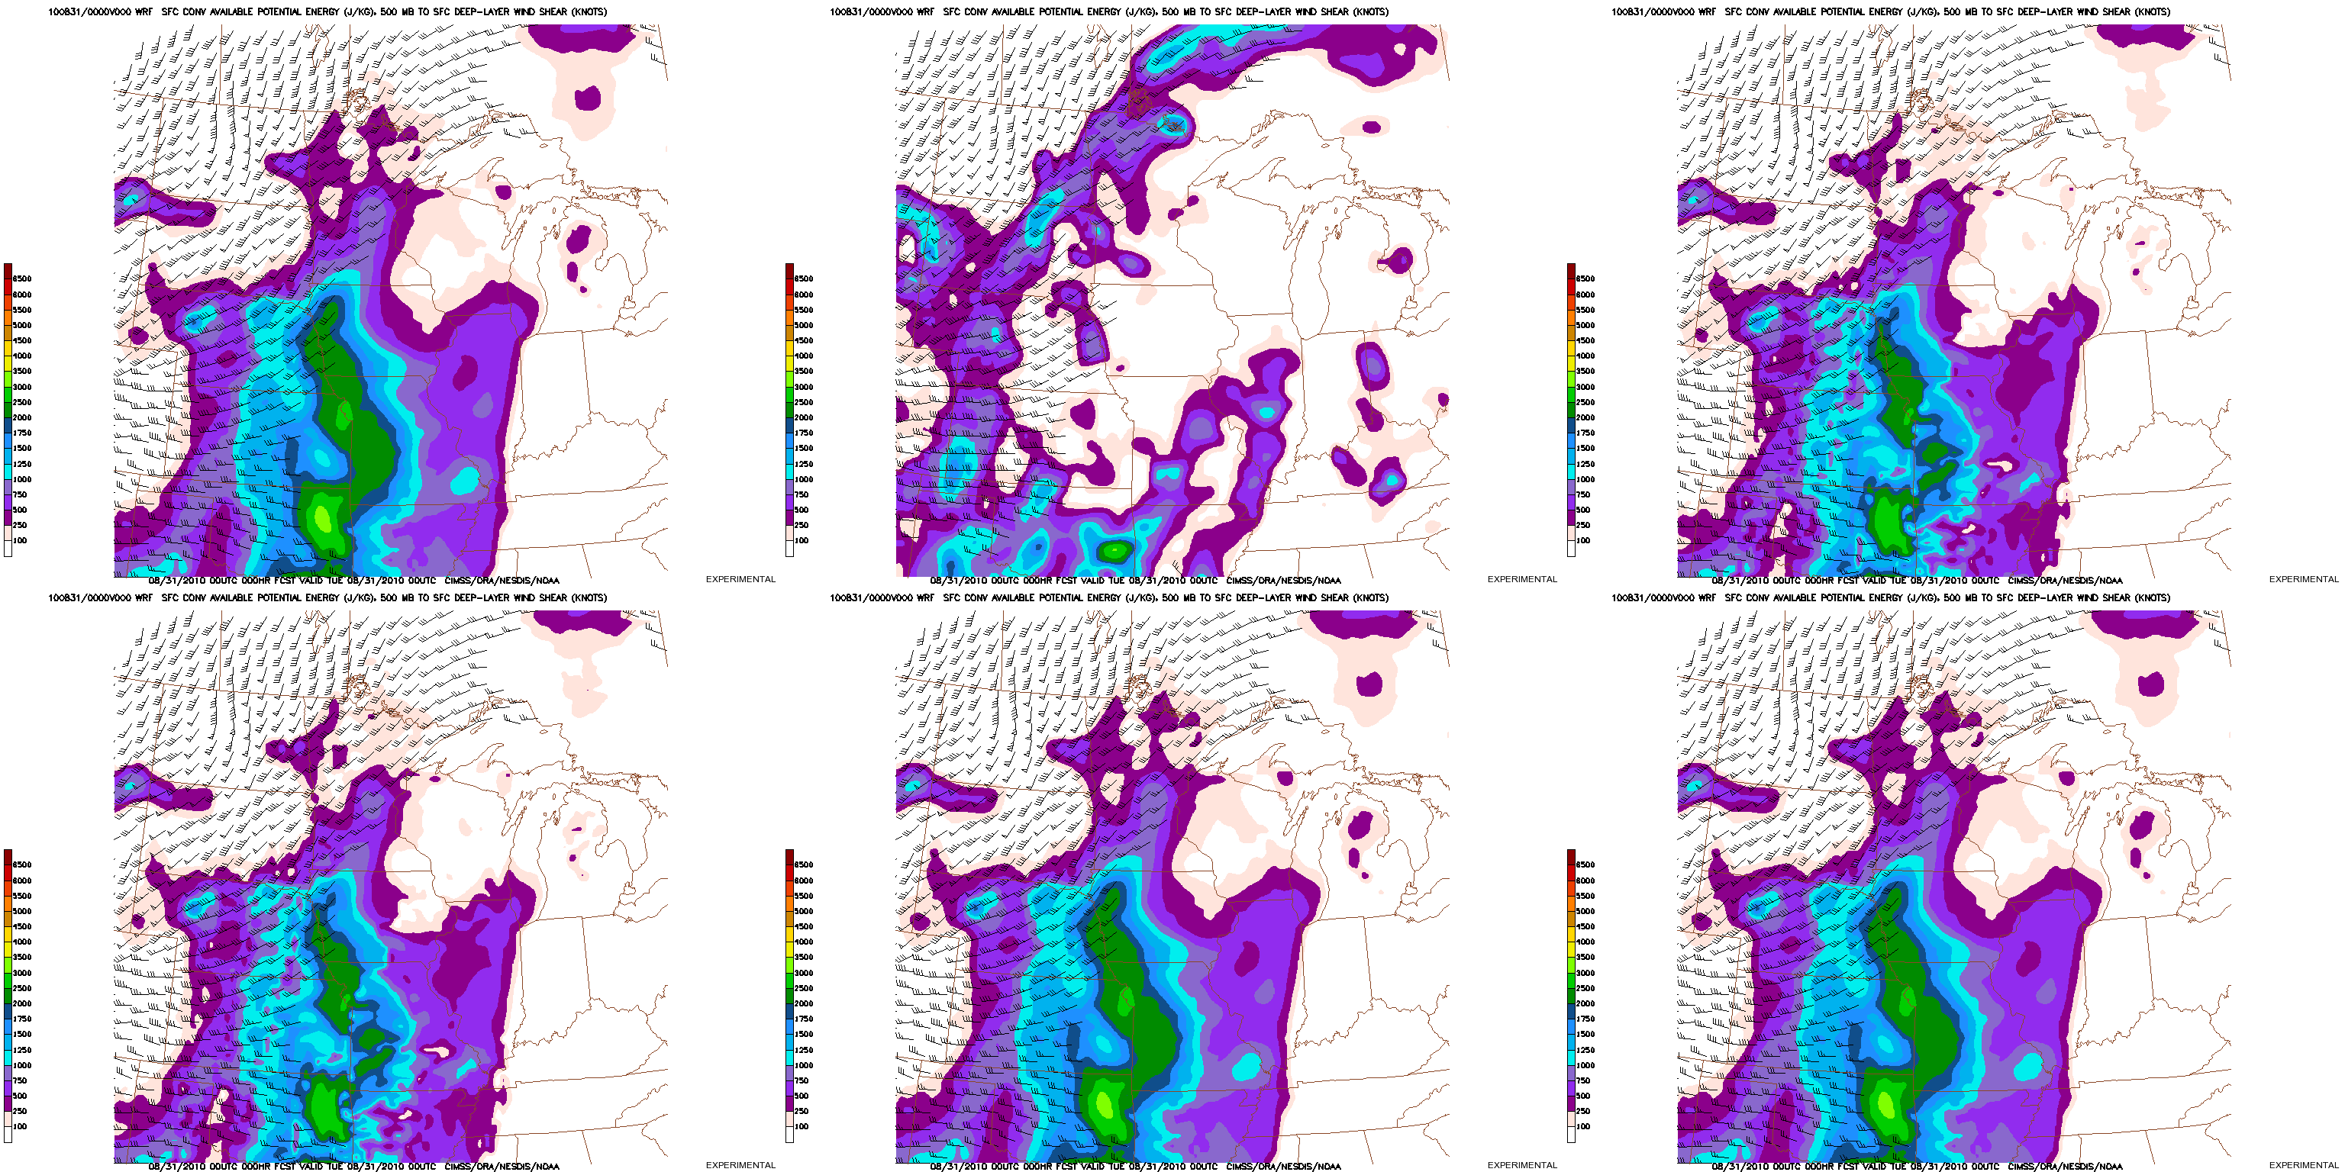
Comparison of SBCAPE, Deep-Layer Wind Shear
Initialized: 31 August 2010, 00 UTC
Interval: 3 hourly Duration: 36 hours
GFS Initial Conditions
CRAS Initial Conditions
GFS Initial Conditions with 90% of Original RH
GFS Initial Conditions with 90% of Original Relative Humidity at and below 800 hPa
GFS Initial Conditions with 90% of Original Relative Humidity between 400 and 750 hPa
GFS Initial Conditions with 90% of Original Relative Humidity between 100 and 350 hPa

Slide 24
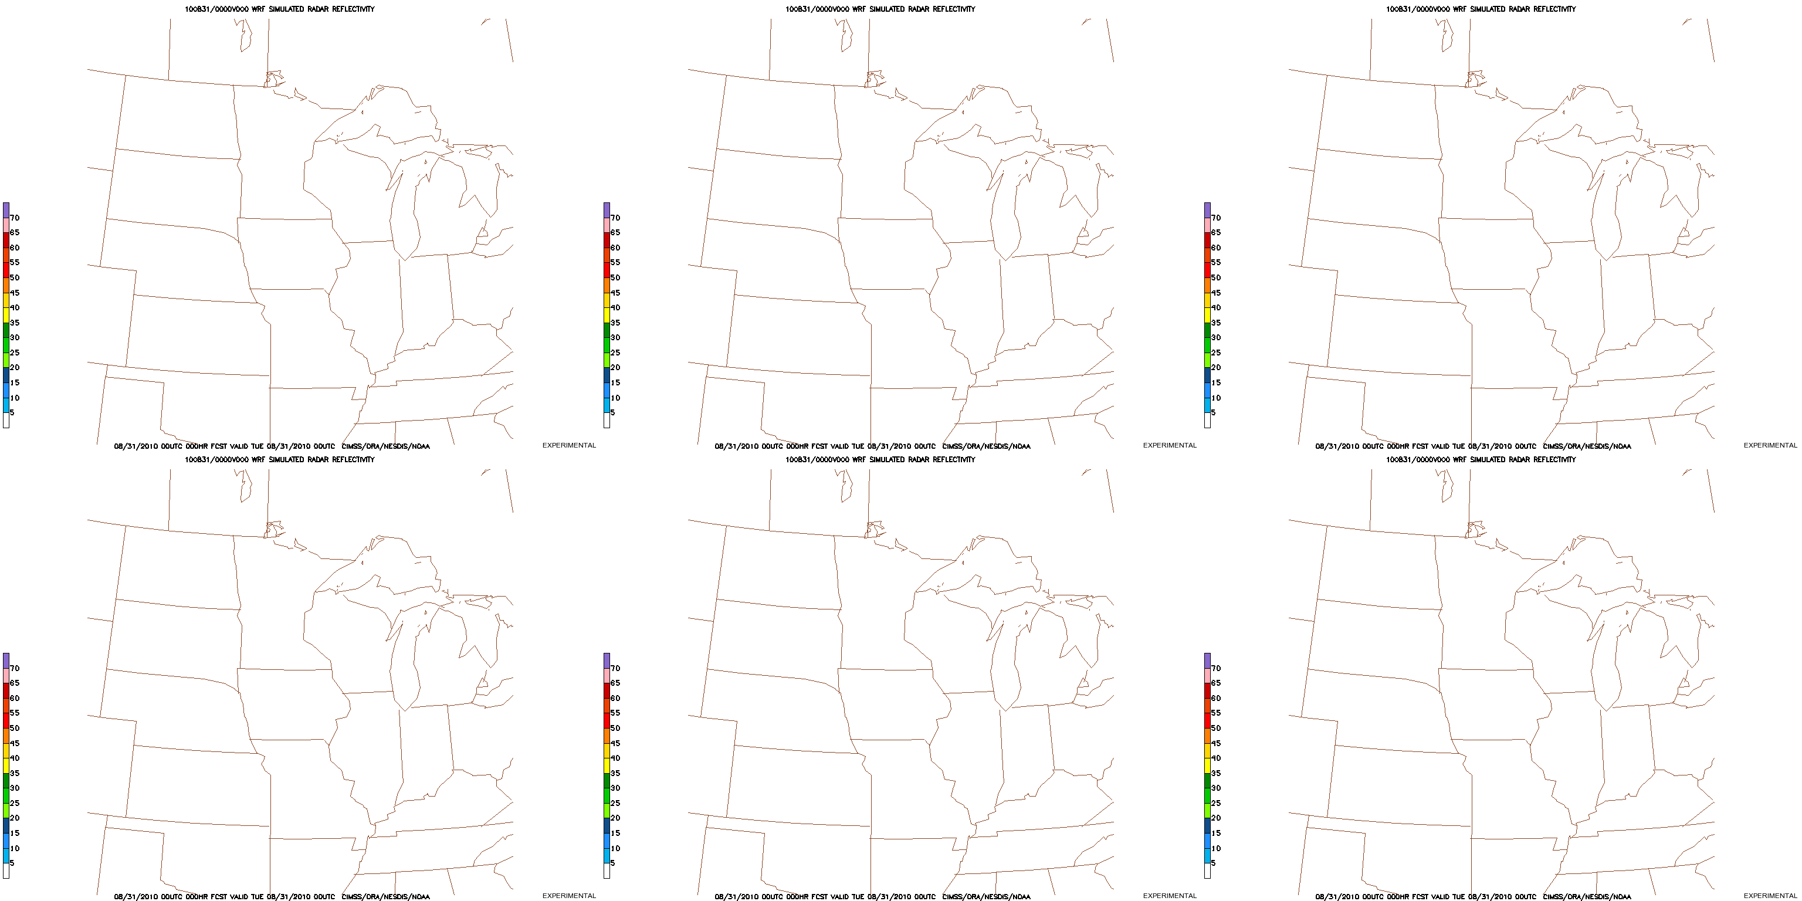
Comparison of Simulated Radar Reflectivity
Initialized: 31 August 2010, 00 UTC
Interval: 1 hourly Duration: 36 hours
GFS Initial Conditions
CRAS Initial Conditions
GFS Initial Conditions with 90% of Original RH
GFS Initial Conditions with 90% of Original Relative Humidity at and below 800 hPa
GFS Initial Conditions with 90% of Original Relative Humidity between 400 and 750 hPa
GFS Initial Conditions with 90% of Original Relative Humidity between 100 and 350 hPa

Slide 25
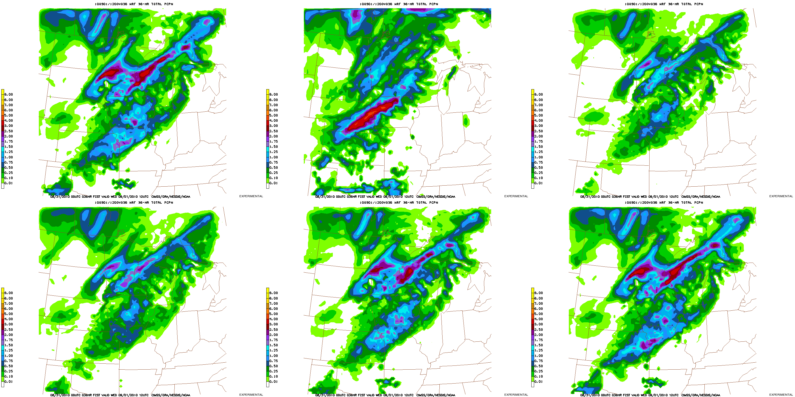
Comparison of 36-hour Accumulated Precipitation
Initialized: 31 August 2010, 00 UTC
Forecast valid: 1 September 2010, 12 UTC
GFS Initial Conditions
CRAS Initial Conditions
GFS Initial Conditions with 90% of Original RH
GFS Initial Conditions with 90% of Original Relative Humidity at and below 800 hPa
GFS Initial Conditions with 90% of Original Relative Humidity between 400 and 750 hPa
GFS Initial Conditions with 90% of Original Relative Humidity between 100 and 350 hPa

Slide 26
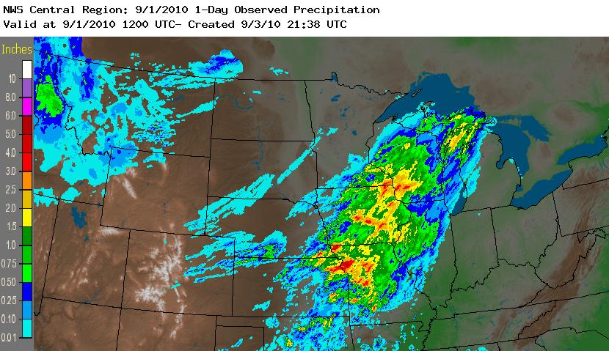
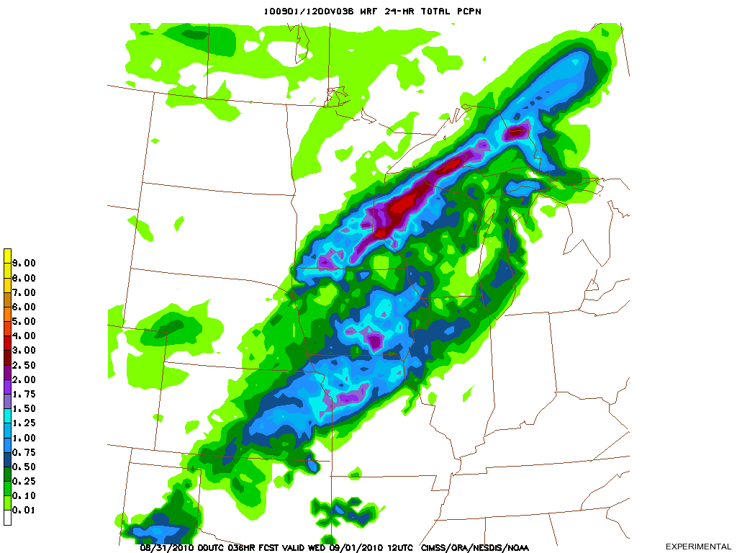
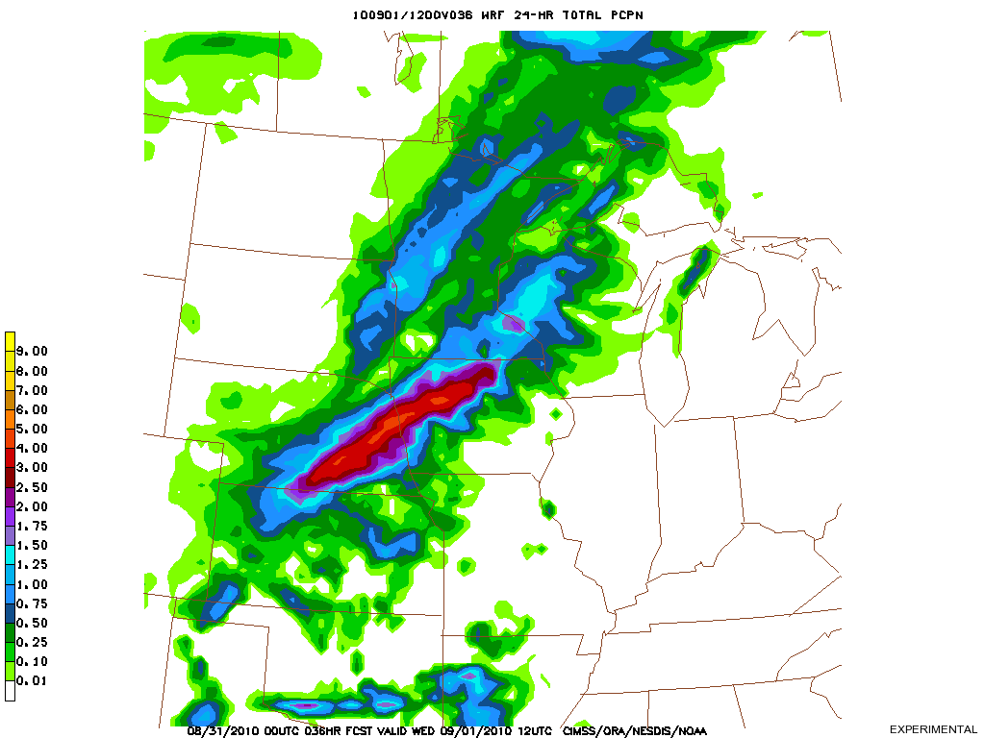
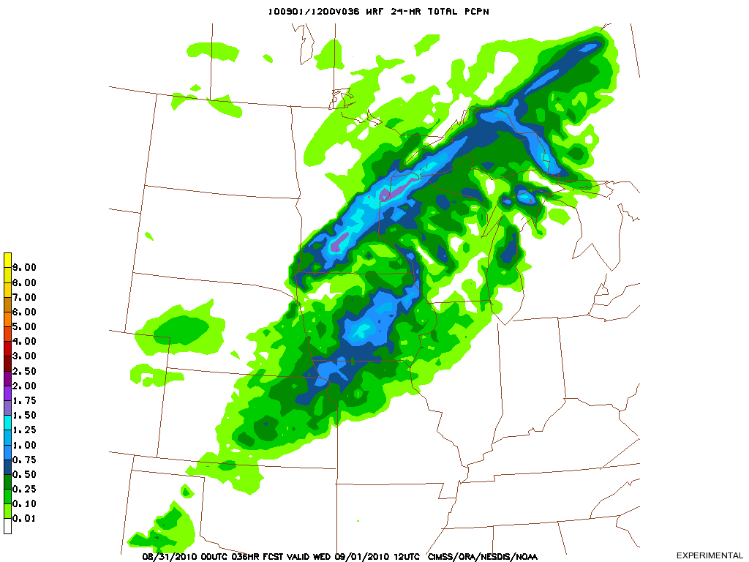
Precipitation
Precipitation output from NWP models is traditionally spatially distributed and lacking in sharp, reliable definition, even in some high resolution models
Precipitation often falls as the result of parameterizations which keep the model numerically stable, or for the wrong reasons (not due to local moisture convergence)
Source: NWS/AHPS
24-hour accum precip prior to 1200 UTC on 1 Sept
24-hour accum precip prior to 1200 UTC on 1 Sept
24-hour accum precip prior to 1200 UTC on 1 Sept
GFS Initial Conditions
CRAS Initial Conditions
GFS Initial Conditions with 90% of Original RH

Slide 27
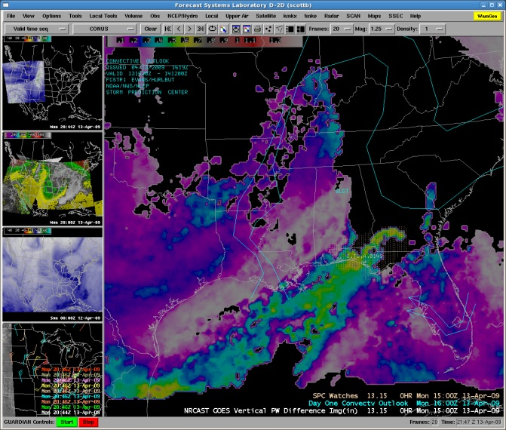
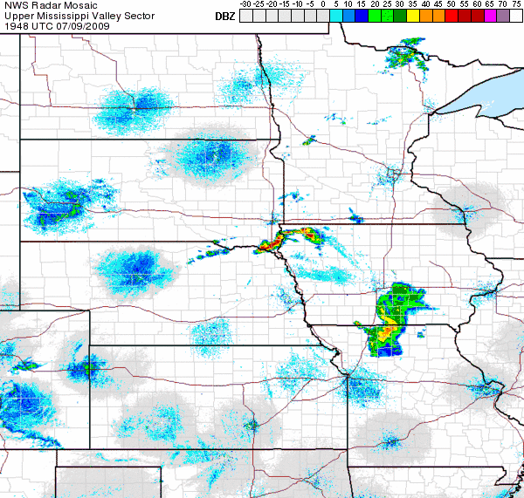
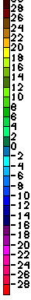
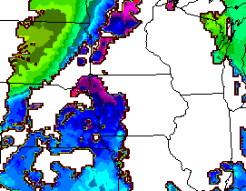
Nearcasting Equivalent Potential Temperature Lapse Rate
Available online and for AWIPS:
http://cimss.ssec.wisc.edu/model/nrc/
CIMSS has developed a “near-casting” model that uses retrieved parameters from the GOES sounder to predict severe weather up to 6 hours in advance!
Parameters such as precipitable water, or equivalent potential temperature are projected forward in time on Lagrangian trajectories at multiple levels. Forcing is provided using a simple balance equation. These “trajectory observations”, along with those from the previous 6 hours, are mapped onto a grid and processed for visualization. The lapse rate of equivalent potential temperature (thetaE) which measures the total moist energy of the column has proven to be a useful indicator of severe weather potential.
P2.15 GOES-R Proving Ground: The CIMSS/NWS Sullivan 2010 Testbed
Jeffrey P. Craven and Marcia R. Cronce, NOAA/National Weather Service, Dousman, WI; Wayne F. Feltz and Jordan J. Gerth, University of Wisconsin/CIMSS, Madison, WI
Negative vertical Theta-E Differences predict complete convective instability by 2100 UTC.
Intense convection occurs as predicted
6-hour NearCast for 2100 UTC
Low to Mid level Theta-E Differences
Rapid Development of Convection over NE IA
between 2000 and 2100 UTC 9 July 2009
Robert Aune (NOAA/NESDIS) and Ralph Petersen (CIMSS)

Slide 28
Convective Parameterizations
NWP models typically ‘limit’ the amount of convective instability that can be present.
The role of the convective parameterizations is not be produce realistic thunderstorms, but rather to remove excessive thermal instabilities and “vertically misplaced” latent heating which could adversely affect the model during an extended prediction.
Once the convective parameterization has been active for a period of time, even if incorrectly, boundary layer flows produced as a result of the parameterization often become dominant in the area around the storms, leading to further forecast errors.
Robert Aune (NOAA/NESDIS) and Ralph Petersen (CIMSS)

Slide 29
Future Directions
Expand study to compare different WRF (ARW) convective parameterizations with variable moisture concentrations.
Use Model Evaluation Tools (MET) v3 to compute additional statistics and quantify the result.
Generate CRAS-WRF ensembles of moisture, using the uncertainty in the satellite retrievals as the limit to the perturbation extent.
Incorporate GOES Sounder data assimilation into the WRF EMS and make CRAS initial conditions available to “plug and play”.
Support NWS local modeling efforts.
Continue sky cover and simulated radiances work with WRF.

Slide 30

Summary
Author Information:
Jordan Gerth
http://cimss.ssec.wisc.edu/~jordang/
Jordan.Gerth@noaa.gov
Questions? Comments?
Basic principles of NWP are restricting the development and usability of high-resolution weather forecast models and the output.
Required are initial condition grids at the model resolution in order to increase the accuracy of the output compared to a simulation run with a coarser grid spacing and input data set.
Incorporating satellite data into the initial and boundary conditions is essential to meeting this requirement.
While satellite data is available for effectively estimating standard atmospheric parameters in the middle and upper troposphere, atmospheric information from the boundary layer and lower troposphere is difficult to ascertain from satellite data, though techniques to extract more information over what is presently available are under development.
There are no plans to put a hyperspectral sounder, an instrument which could better quantify tropospheric moisture, into operational geostationary orbit over the United States until at least 2028 (GOES-U).

