Slide 1
ABI Mode 3 “CONUS” Coverage:
What is and What May Be
Timothy J. Schmit (tim.j.schmit@noaa.gov)
NOAA/NESDIS
Satellite Applications and Research
Advanced Satellite Products Branch (ASPB)
Madison, WI
Jordan Gerth, Mat Gunshor, and several others
CIMSS
March 21, 2014

Slide 2
Concerns
Current plans for the ABI on GOES-R call for all of the CONUS to be scanned by both the GOES-West and –East, while not scanning important parts of the Pacific (as we scan today)
Consider optimizing the planned ABI CONUS sector
(e.g., moving the GOES-West ‘CONUS’ sector towards the west and GOES-East ‘CONUS’ sector slightly east)
Time is of the essence if these are to modified

Slide 3
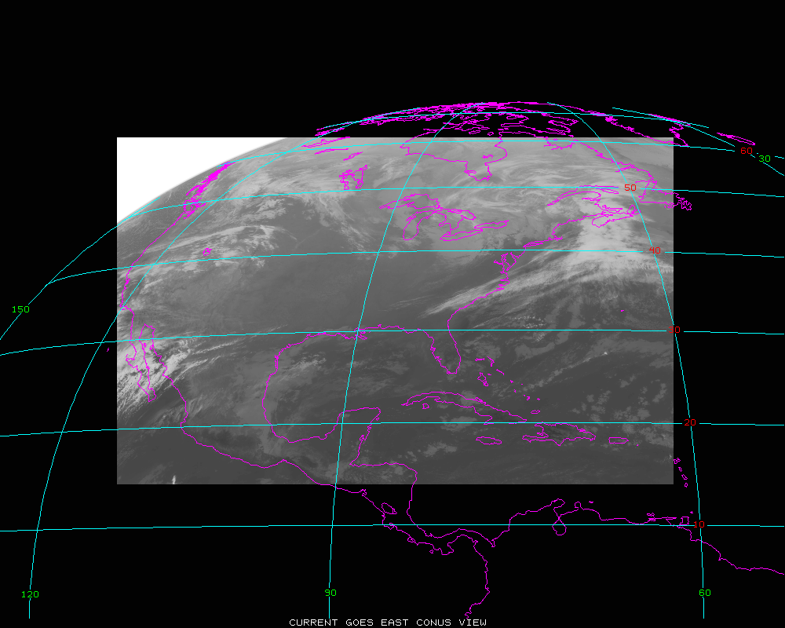
Current GOES CONUS

Slide 4
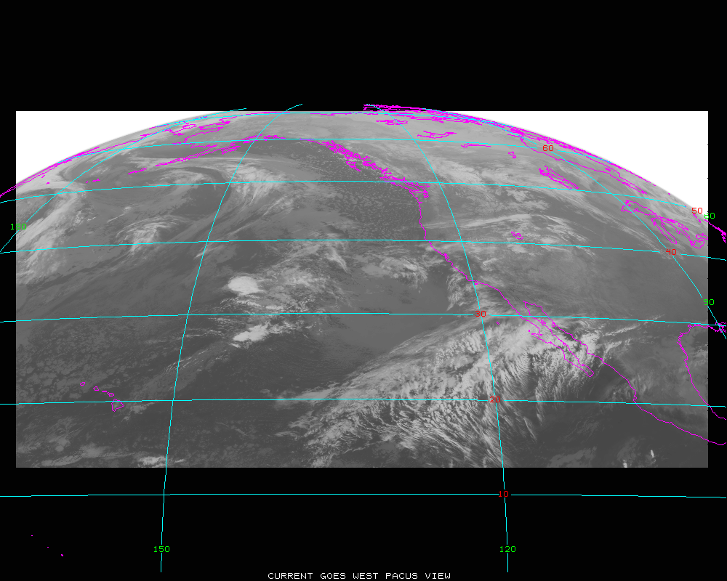
Current GOES PACUS

Slide 5
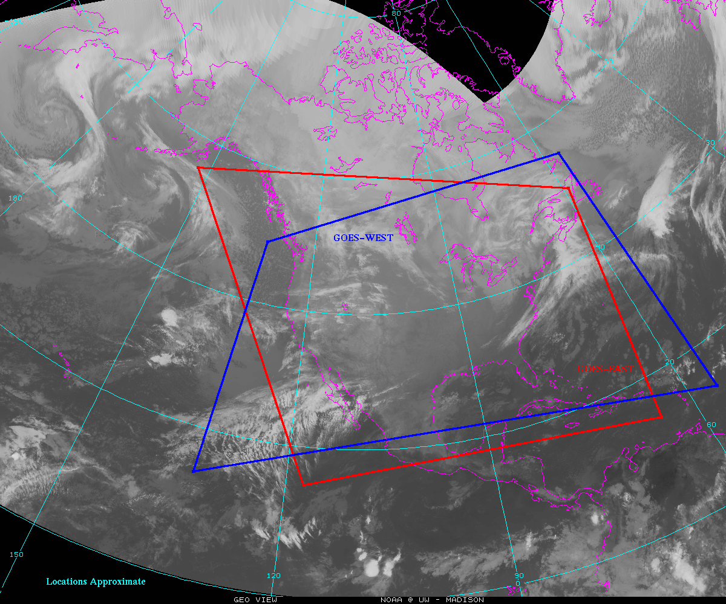
Current Plans for ABI CONUS sectors
space
space
space

Slide 6
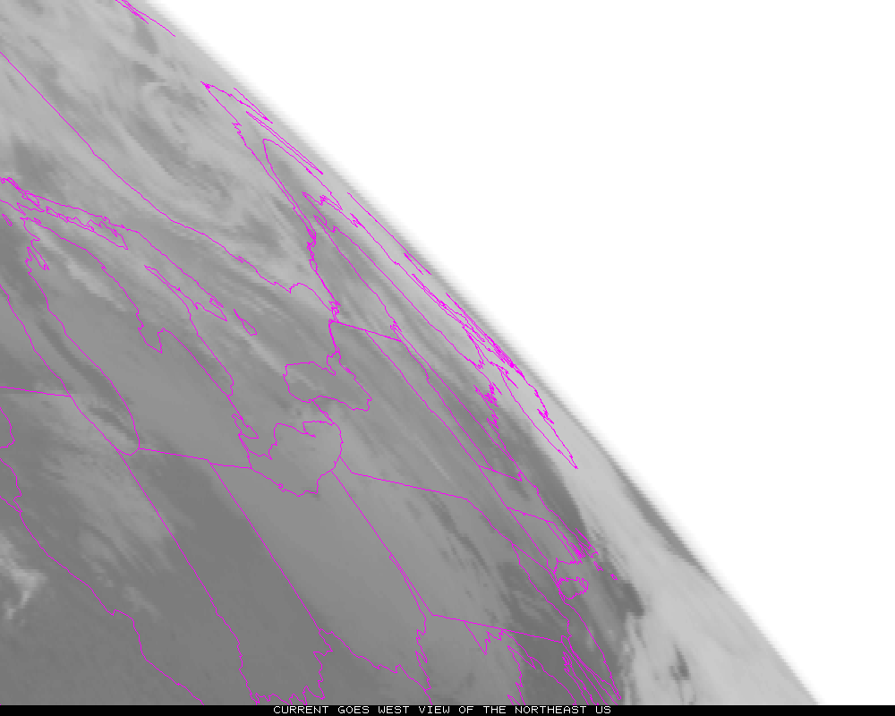
Current view of Northeast US from 135W

Slide 7
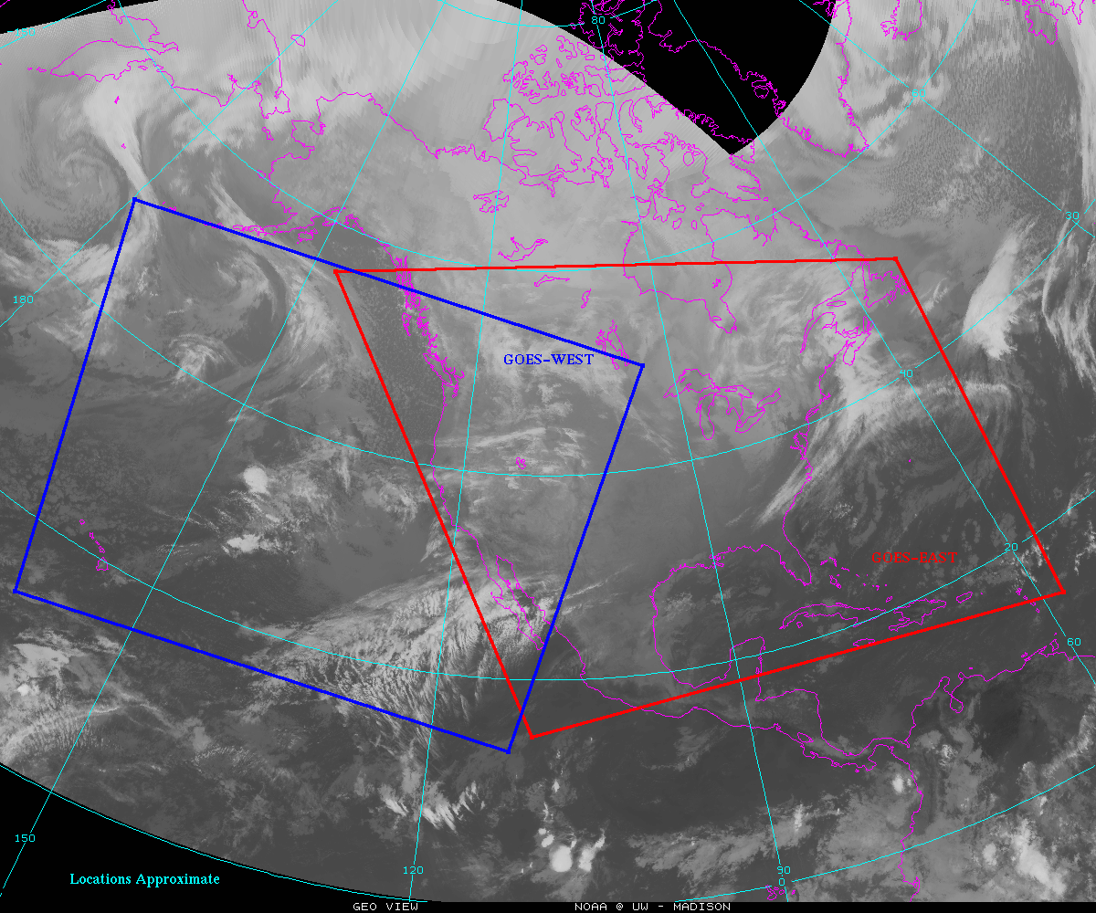
Option for moving ABI from GOES-West to the West (and East sector to the East)
PROPOSED

Slide 8
Option for moving ABI from GOES-West to the West (and East sector to the East) with potential Alaska one-minute mesoscale sector (approximate coverage)
PROPOSED

Slide 9
Option for moving ABI from GOES-West to the West (and East sector to the East) with potential Alaska one-minute mesoscale sector (approximate coverage)
and additional sector for Hawaii or American Samoa
PROPOSED

Slide 10
Current Plans for ABI CONUS sectors
space
space
space

Slide 11
Summary
Consider to move the GOES-West ‘CONUS’ sector to the west, to get less overlap over CONUS and extend coverage over North Pacific (including Hawaii)
Consider to move the GOES-East CONUS sector to the east, to get less overlap and more coverage to the east of Puerto Rico
Consider to reshape ‘PACUS’ or the ‘mesoscale’ to be a more efficient system (i.e., half mesoscale, double wide)

Slide 12
Combined AWIPS image
The seam in AWIPS for combined imagery over CONUS is at approximately 115W.
This means that the data on the far edge isn’t used in the composites for AWIPS.

Slide 13
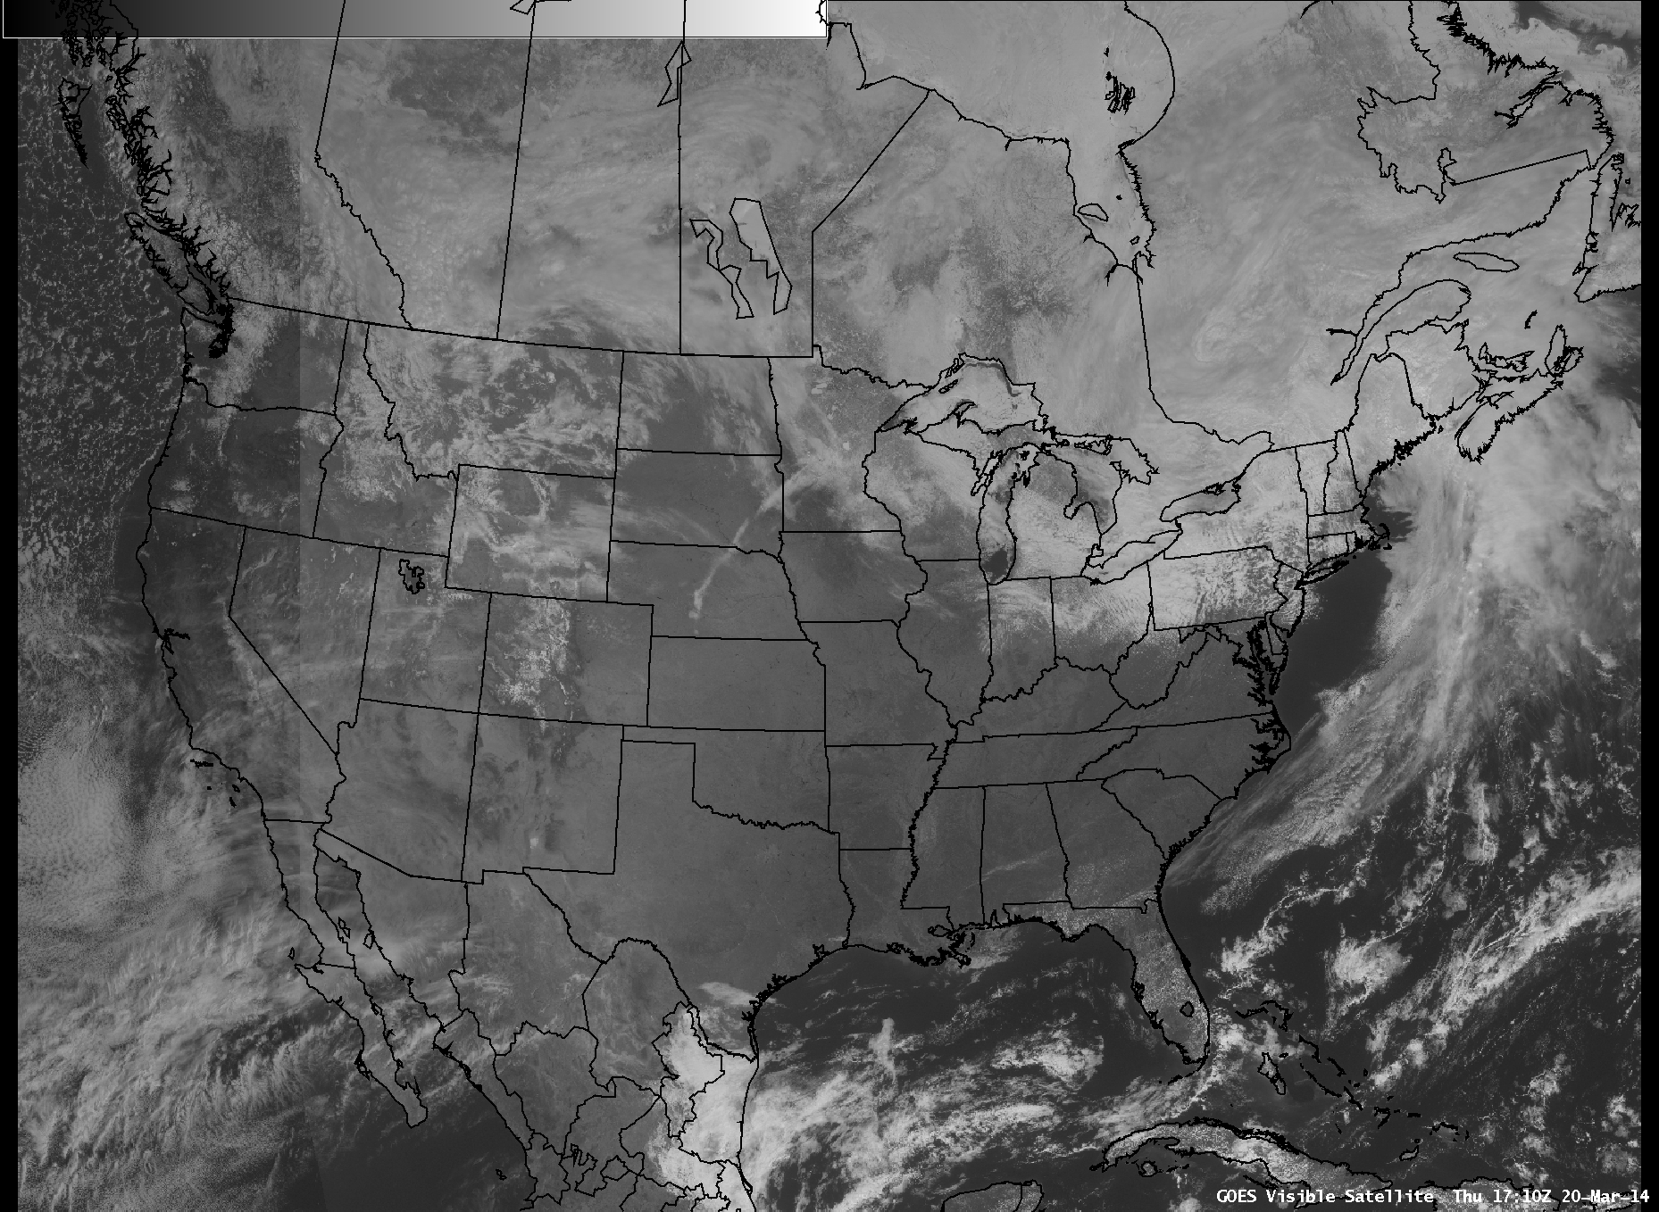

Slide 14
