Slide 1
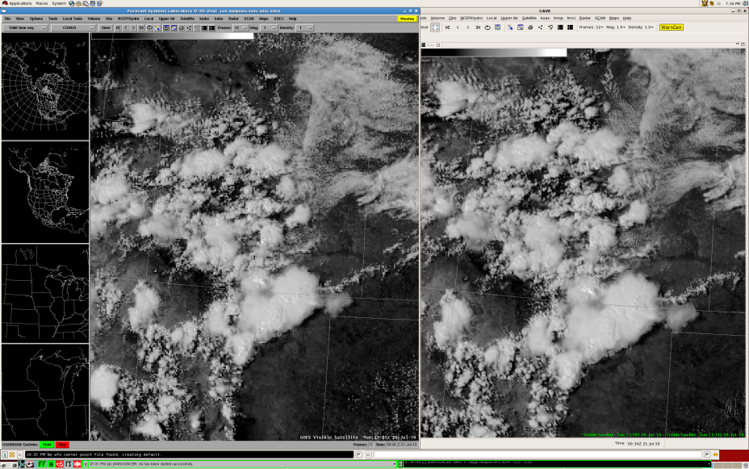
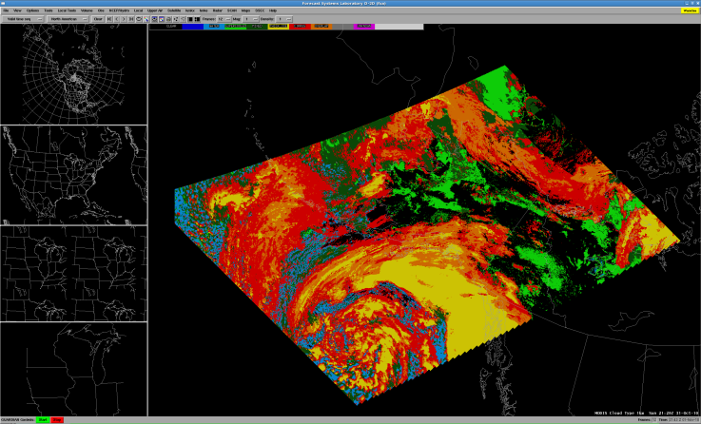
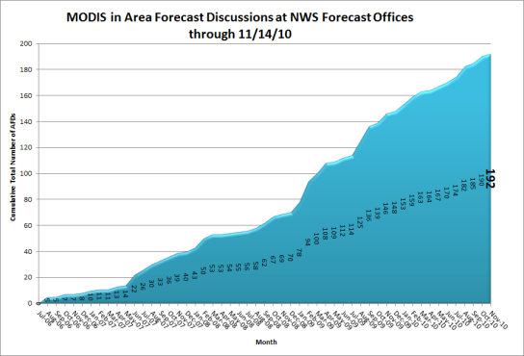
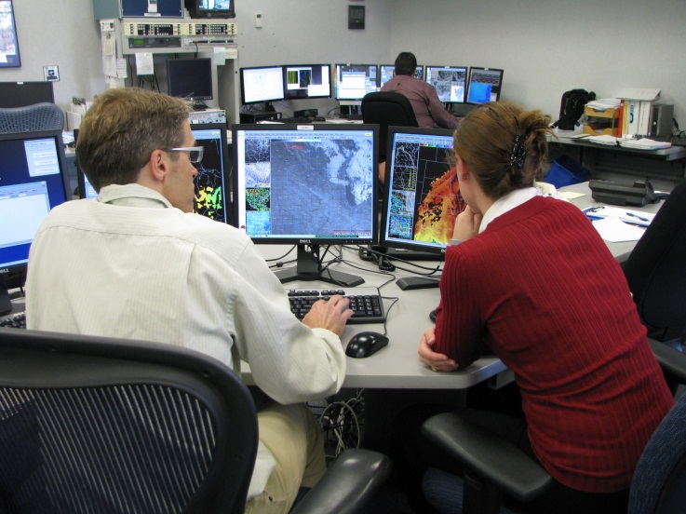
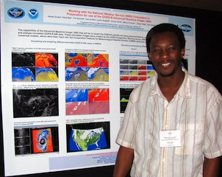
Research to Operations Activities
CIMSS’ unique use of the Advanced Weather Interactive Processing System (AWIPS) continues to produce satellite training and products which directly support National Weather Service (NWS) operations. We are actively transitioning to AWIPS II as we further support our users.
New imagery and products from MODIS and AVHRR were made available to the NWS in 2010
Nearly 200 NWS forecast discussions have mentioned MODIS since 2006
Over 250 hours of direct one-on-one interaction with local NWS Sullivan forecasters in the summer of 2010
CIMSS involvement with the National Weather Association continues to reach many operational meteorologists
Notes:
Slide Author: J. Gerth; Date: November 24, 2010

