Slide 1
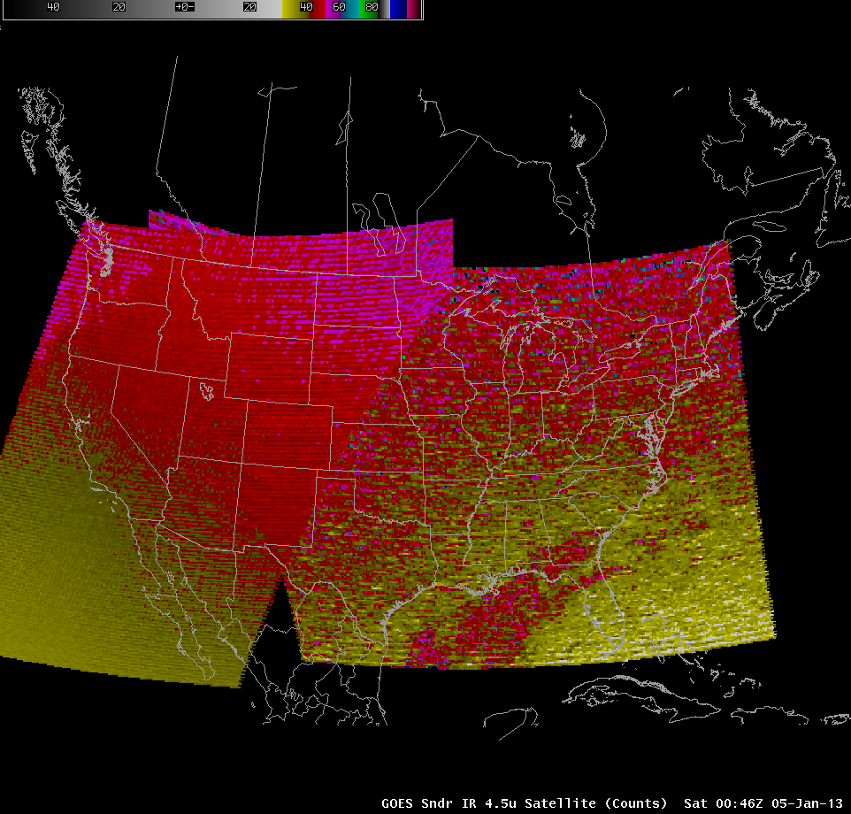
The ingredients for sustaining success in NOAA R2O for GOES-R
Jordan Gerth
CIMSS/SSEC/Univ. of Wisconsin
Madison, WI
Learn how NOAA Cooperative Institutes and a consolidation of oversight in satellite research to operations (R2O) programs can improve the value of NOAA’s scientific portfolio and provide a foundation for enhancing NOAA’s operational services through:
Decreasing the time to negotiate the R2O process
Leveraging existing relationships and infrastructure on the R2O interface
This GOES Sounder imagery is sent to forecasters hourly

