Slide 1


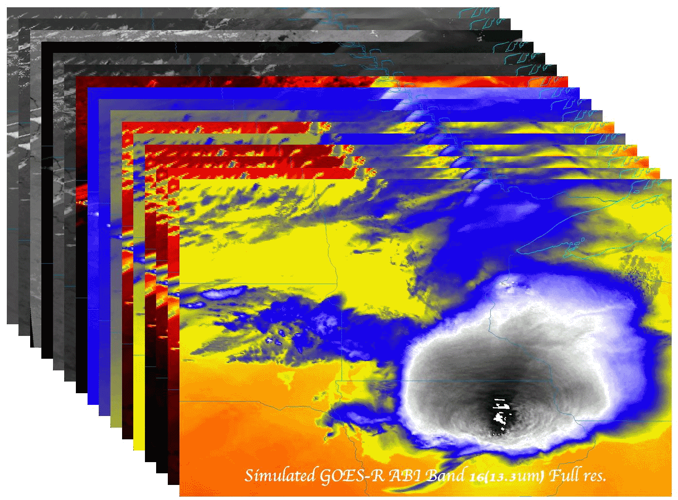

GOES-R ABI
  Timothy J. Schmit (tim.j.schmit@noaa.gov)
NOAA/NESDIS/Satellite Applications and Research
Advanced Satellite Products Branch (ASPB)
  Scott Lindstrom
CIMSS
Madison, WI
GOES-R Short Course
AMS Broadcasters Conference
Raleigh, NC
June 9, 2015
UW-Madison

Slide 2

Thanks to…
Paul Menzel, Steven J. Goodman, Daniel T. Lindsey, Robert M. Rabin, Kristopher M. Bedka, John L. Cintineo, Christopher S. Velden, A. Scott Bachmeier, Mat Gunshor, Chris Schmidt
Kaba Bah, Joleen Feltz, Tom Whittaker, Jordan Gerth, Margaret Mooney, Andy Heidinger, William Straka, Jun Li, Steve Ackerman, Bob Aune, Don Hillger, Tony Schreiner, Justin Sieglaff, Jim Jung, Elaine Prins, Brad Pierce, Wayne Feltz, Jean Phillips, Linda Hedges, Jim Nelson, Gary Wade, Don Hillger, Jinlong Li, Jing Zheng, Allen Huang, Bob Rabin, the SSEC data center, Mike Pavolonis, Jaime Daniels, ASPB, STAR, NESDIS, NSSL, MUG, Kevin Ludlum, GOES operators, GOES shift supervisors, Mark DeMaria, Dave Martin, Joe Schmit and many others!
GOES-R Program Office, Greg Mandt, NASA, Exelis Industries, Lockheed Martin, and other industry partners, etc.
You.

Slide 3
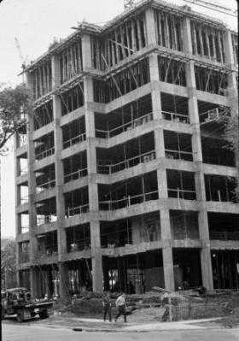
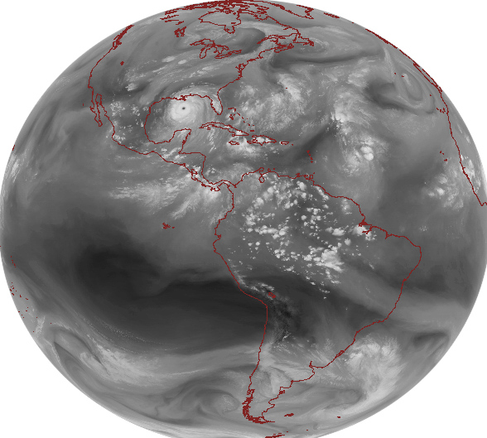
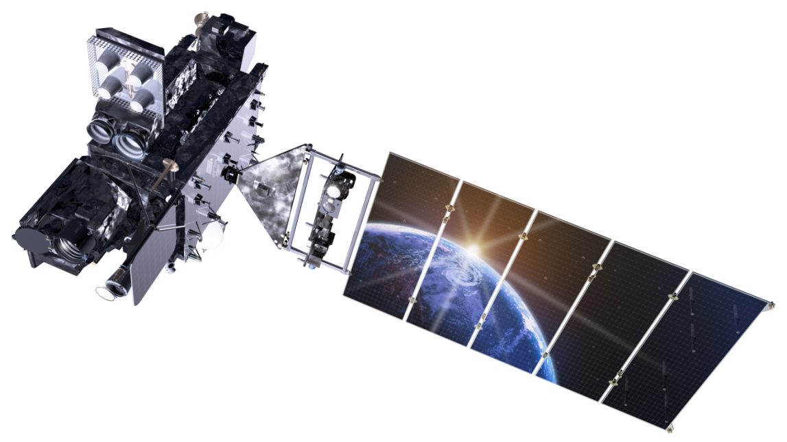
Outline
GOES History
GOES-R ABI
  Spectral
  Spatial
  Temporal
Summary
Lockheed Martin

Slide 4
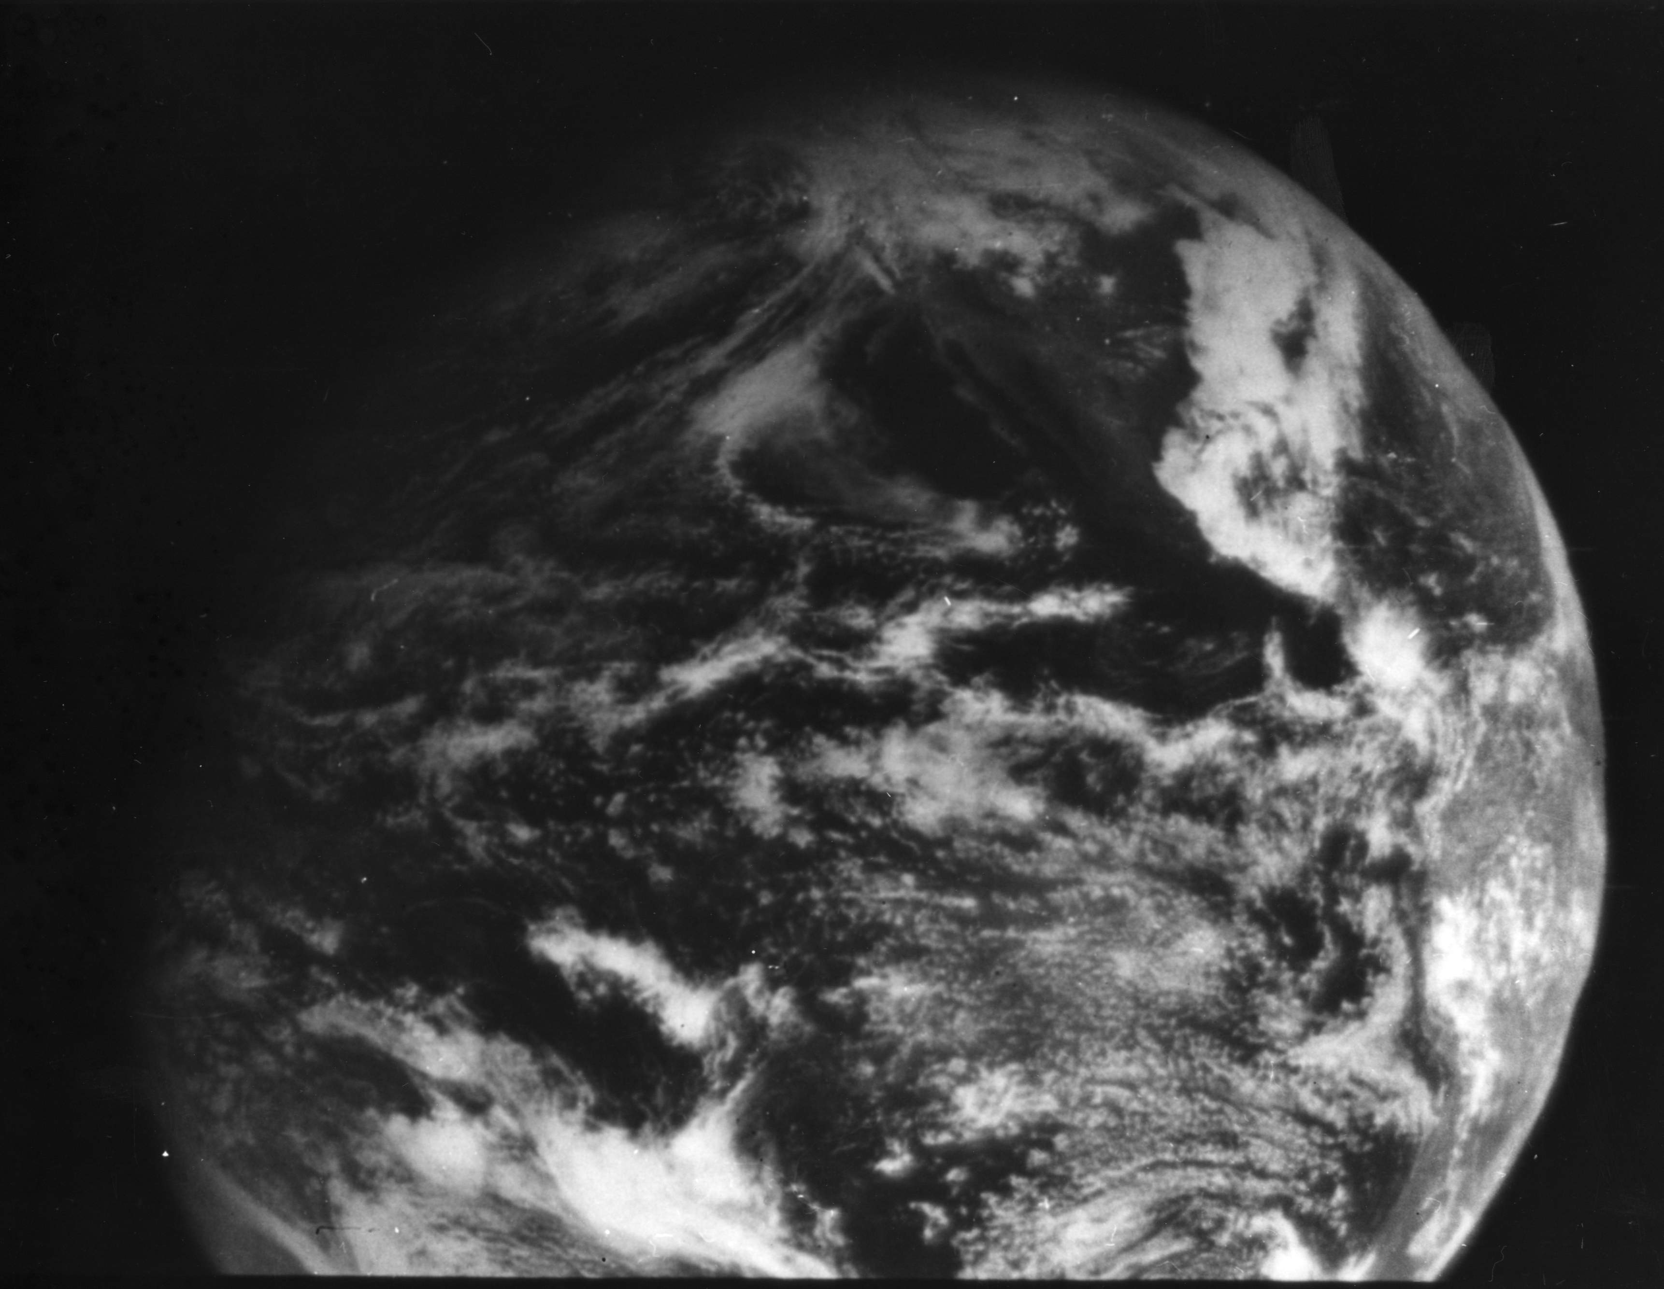
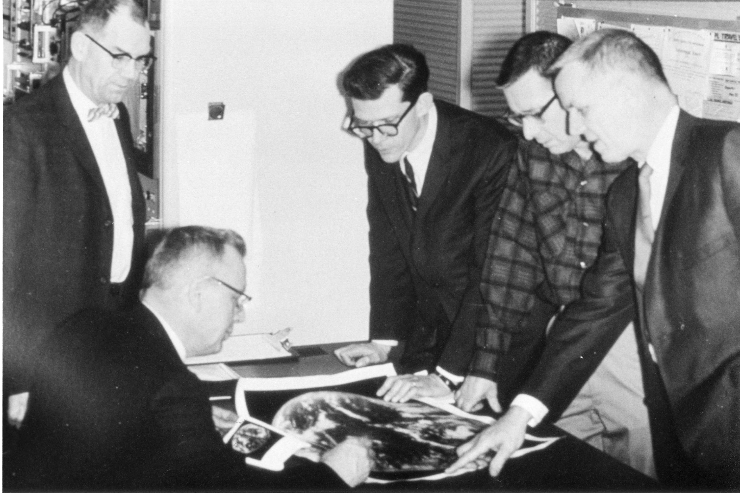
1966: ATS-1 launched
Applications Technology Satellite (ATS)-1 was the first geostationary imager, launched 6 December 1966. Imaging instrument designer and SSEC co-founder, Verner E. Suomi, proclaimed, “the clouds move, not the earth”.
11 December 1966
Notes:
http://cimss.ssec.wisc.edu/news/geo_image_anniversary.html

Slide 5
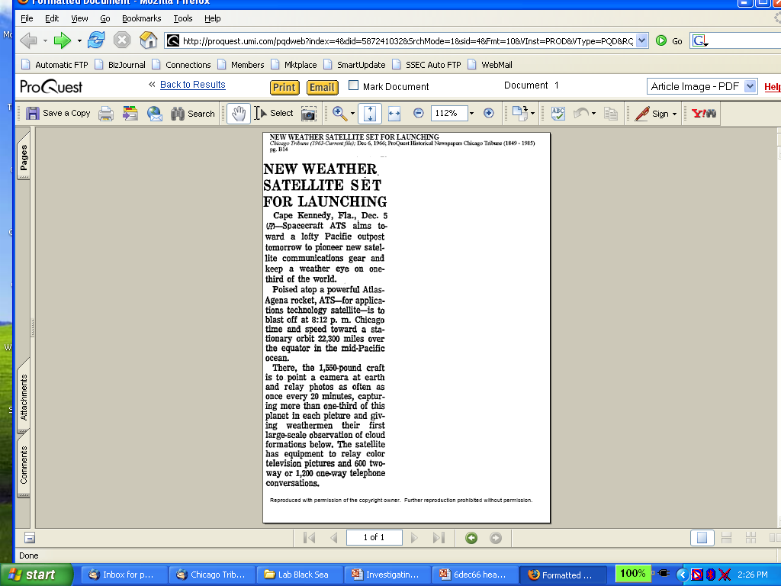
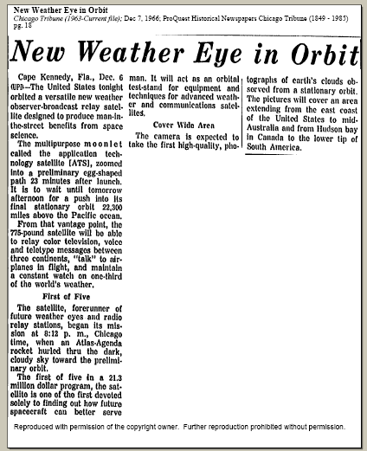
Suomi Introduced Time Continuous Imaging
Chicago Tribune
makes cautious
announcement
on 5 Dec 1966
of pending new
“weather eye”
On 7 Dec 1966 Tribune
declares
“multipurpose moonlet”
successfully launched
Notes:
Slide from Dr. Paul Menzel.

Slide 6
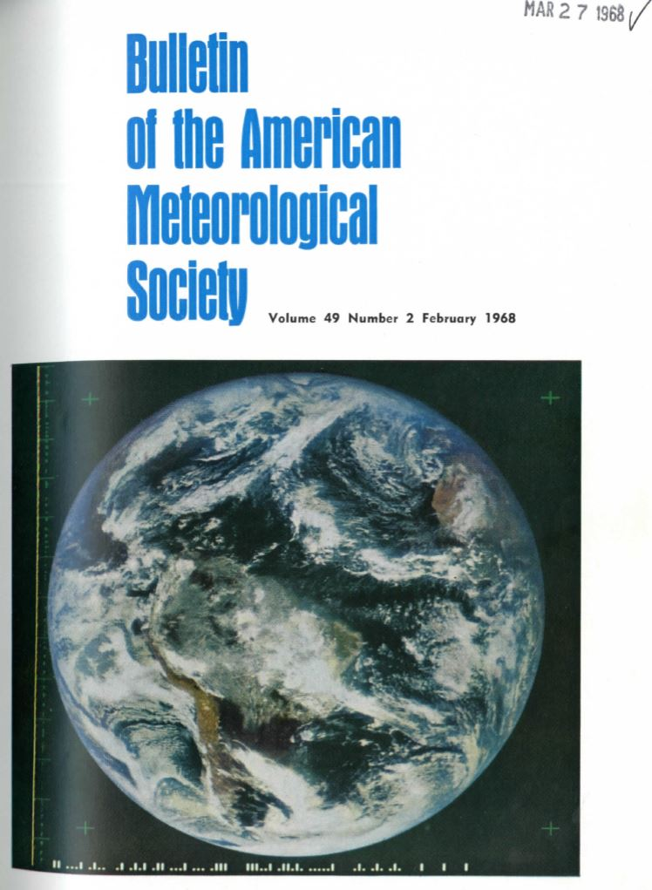
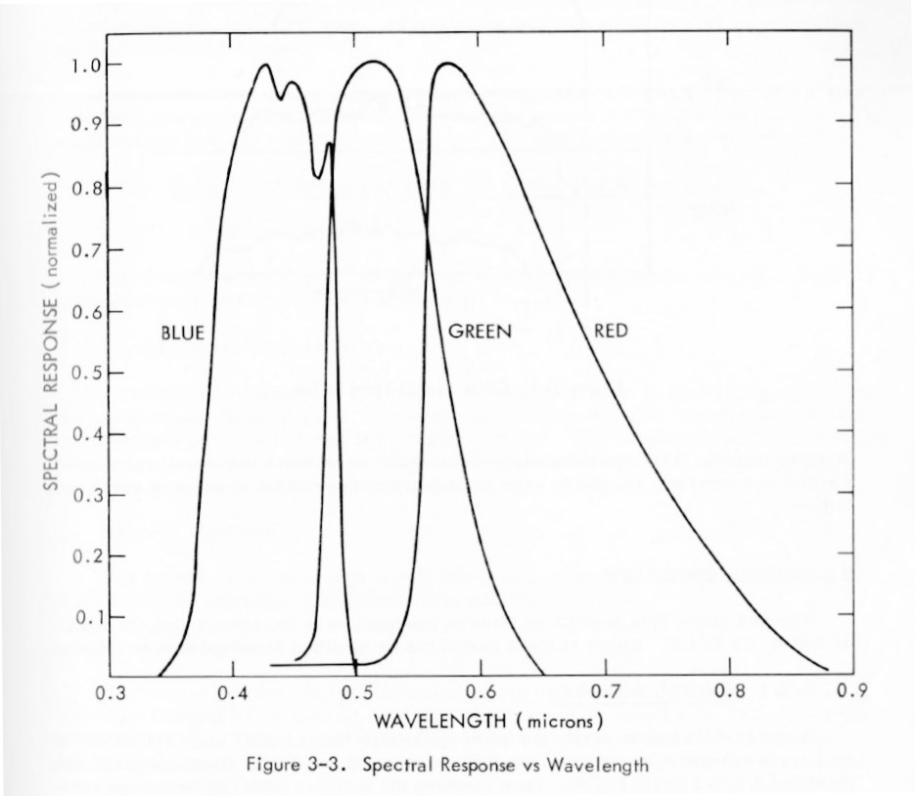
ATS-3
Cover photograph: The Earth in full color as seen from 35,800 km altitude. This photograph was taken by the Multicolor Spin-Scan Cloud Camera Experiment aboard the third Applied Technology Satellite (ATS-3) on 10 November 1967, when the satellite was located in a geosynchronous orbit over the equator north of the Amazonas Delta (see articles by V. E. Suomi and R. J. Parent, and G. Warnecke and W. S. Sunderlin on
pages 74 and 75). (NASA Photograph).
Notes:
http://journals.ametsoc.org/toc/bams/current

Slide 7
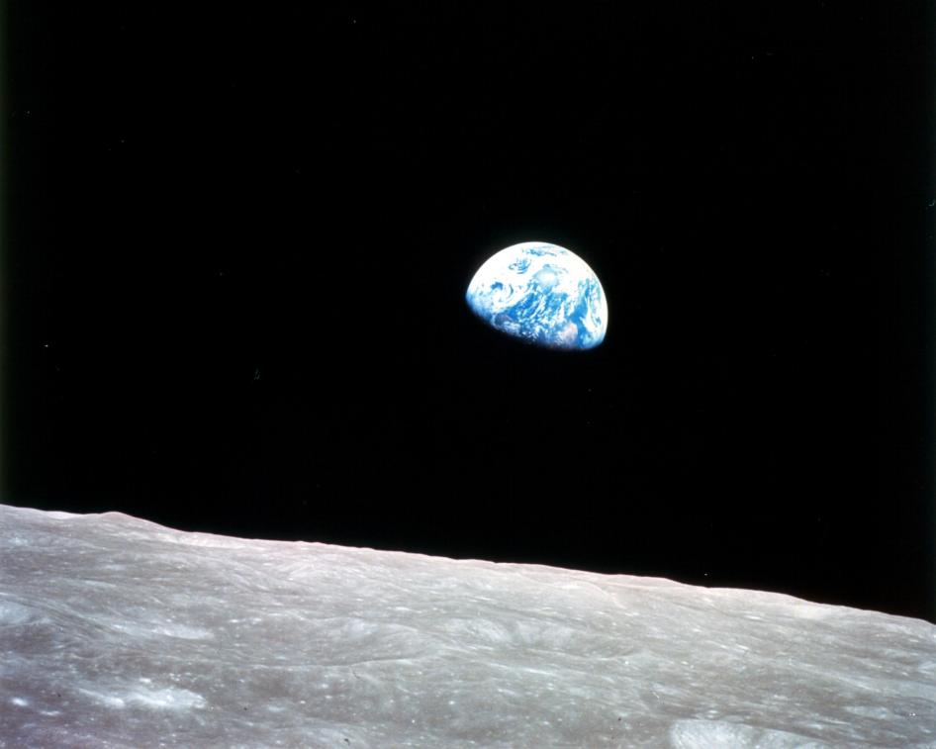
Apollo 8
December 24, 1968
Notes:
http://www.nasa.gov/multimedia/imagegallery/image_feature_1249.html#.VP4KiuGLXEM

Slide 8
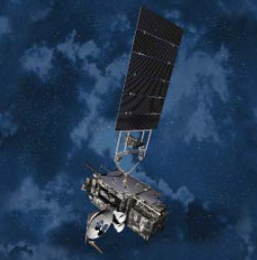
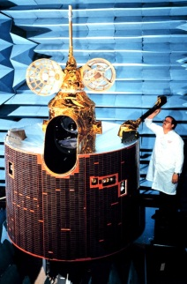
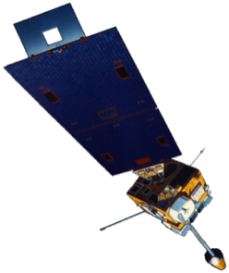
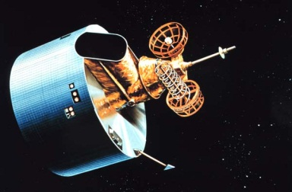
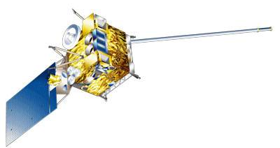
GOES History
GOES-1/3
Launched
1975
1977
1978
One visible and one infrared .
Operational.
GOES-4/7
Launched
1980
1981
1983
1987
VISSR–VAS visible, 12 IR. MSI (visible, IRW, and 2 additional IR channels)
GOES-8/12
Launched
1994
1995
1997
2000
2001
3-axis stabilized.
Imager Bands: 4 IR; 1 visible.
Operational Sounder
(18 IR bands)
GOES-13/14/15
Launched
2005
2009
2010
Better navigation and calibration.
No eclipse outages.
Better spatial resolutions for the 6.5 um on GOES-12+ and the 13.3 um band on GOES-14/15.
Operational Sounder
GOES-R/S/T/U
Planned Launch
2016
2017
2020
2025
Faster coverage.
16 Imager Bands.
Improved spatial.
No sounder.
GLM
Notes:
The circles represent an estimate of the impact of GOES on regional scale numerical models.

Slide 9
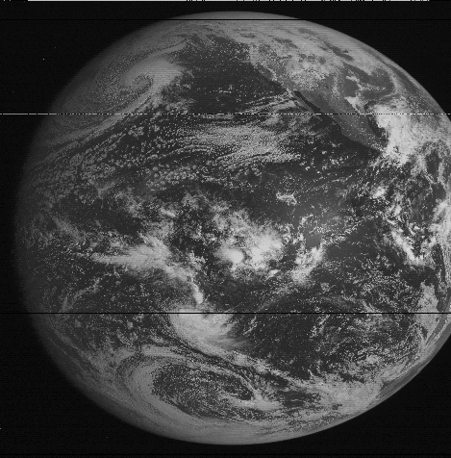
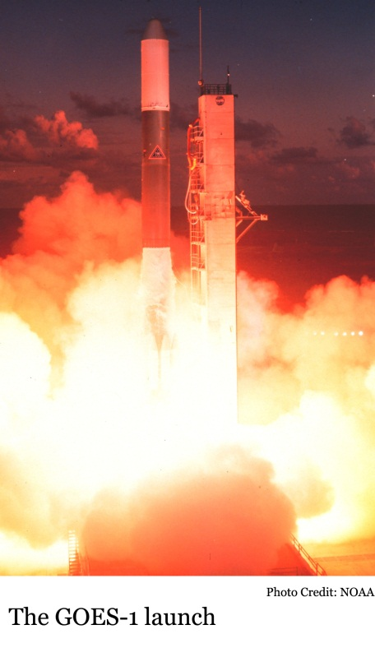
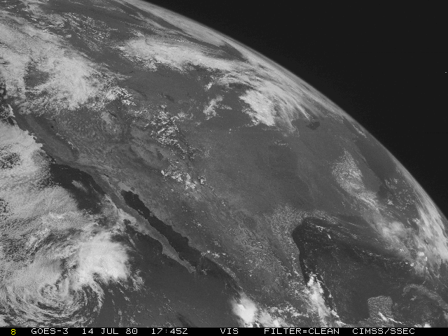
GOES-1 (1975)
GOES-1 launched on 16 October 1975
  One visible and One infrared (IR) band
GOES-1
GOES-3
Notes:
http://science.nasa.gov/missions/sms/

Slide 10
Outline
GOES History
GOES-R ABI
  Spectral
  Spatial
  Temporal
Summary
Lockheed Martin

Slide 11
The Advanced Baseline Imager:
ABI Current
Spectral Coverage
16 bands 5 bands
Spatial resolution
0.64 μm Visible 0.5 km Approx. 1 km
Other Visible/near-IR 1.0 km n/a
Bands (>2 μm) 2 km Approx. 4 km
Spatial coverage
Full disk 4 per hour Scheduled (3 hrly)
CONUS 12 per hour ~4 per hour
Mesoscale Every 30 sec n/a
Visible (reflective bands)
On-orbit calibration Yes No
Notes:
The ABI allows more bands, finer spatial resolution, faster refresh rates and on-orbit calibration of all bands!

Slide 12

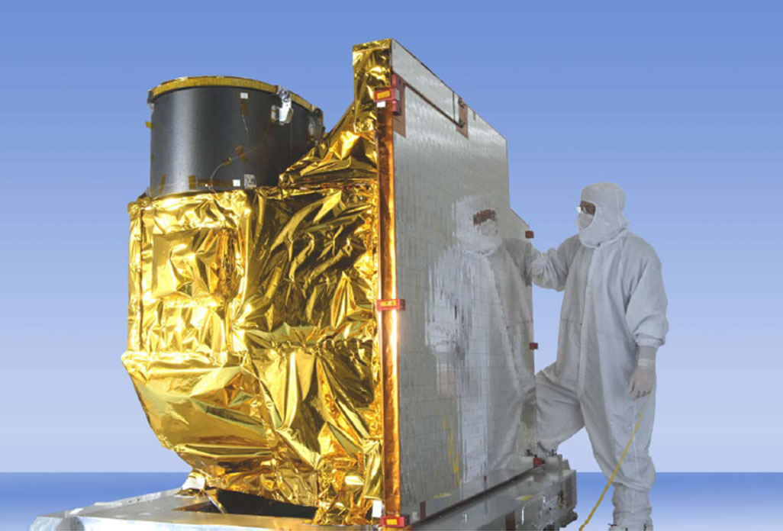
Advanced Baseline Imager
5
4
3
X
Faster coverage
(5-minute full disk vs. 25-minute)
X
Improved spatial
resolution
(2 km IR vs. 4 km)
X
More spectral bands (16 on ABI vs. 5 on the current imager)
Notes:
Slide from J. Gerth, CIMSS.

Slide 13
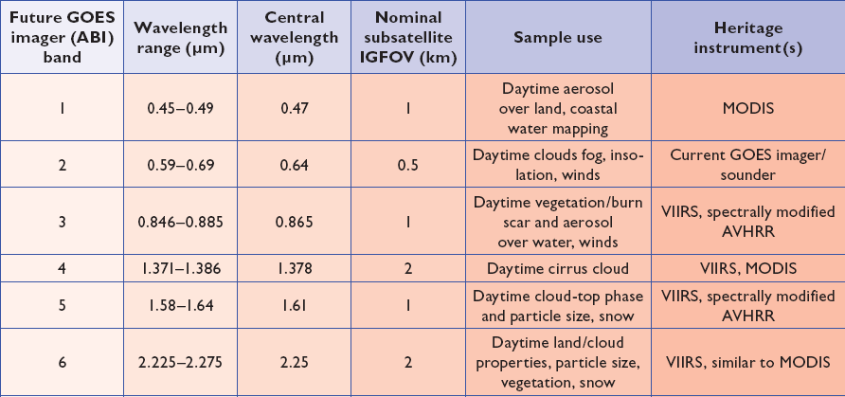
ABI bands 1-6
6 visible or near infrared bands on the ABI, compared to only one on today’s imager
Notes:
Final column added: heritage. The ABI band 1 was suggested by Dr. Fred Mosher at a GOES Users' Conference.
The ABI band 3 was suggested by the late Dr. C. Rao (of the then ORA).
Some of these bands have been shifted to more closely match those on the VIIRS.

Slide 14
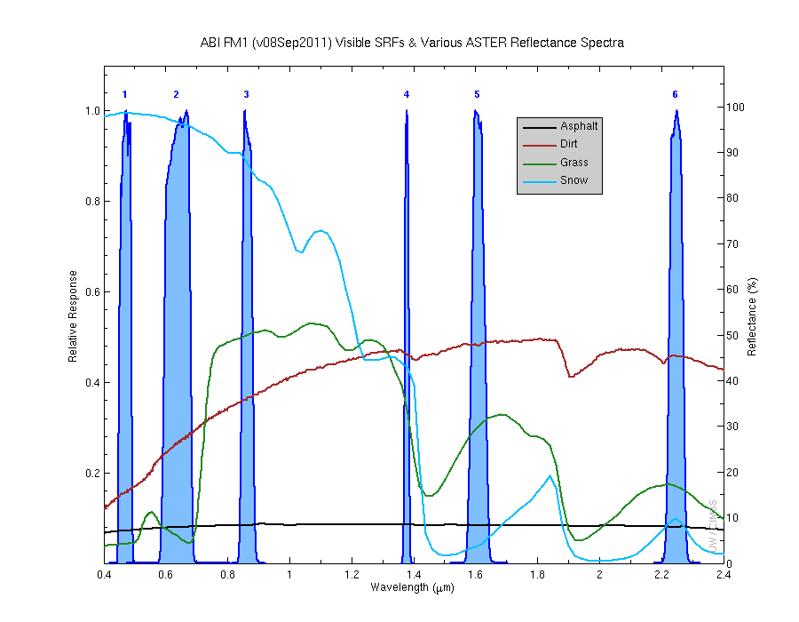
Visible and near-IR channels on the ABI
Aerosols, Insolation
Clouds, Snow
Vegetation, Imagery
Cloud mask, Suspended matter
Snow, Phase
Cloud Particle size
Sample use only, many other uses
The ABI visible and near-IR bands have many uses.
Notes:
Schmit, T. J., M. M. Gunshor, W. P. Menzel, J. J. Gurka, J. Li, and A. S. Bachmeier, 2005: Introducing the next-generation Advanced Baseline Imager on GOES-R. Bull. Amer. Meteor. Soc., 86, 1079-1096.

Slide 15
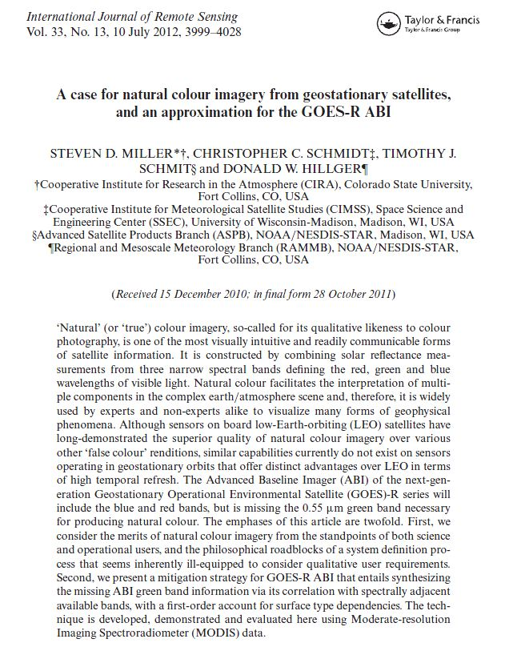
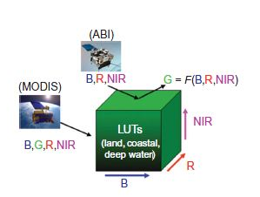
Build a “green” band on the ABI
Miller, Steven D.; Schmidt, Christopher C.; Schmit, Timothy J. and Hillger, Donald W. A case for natural colour imagery from geostationary satellites, and an approximation for the GOES-R ABI. International Journal of Remote Sensing, Volume 33, Issue 13, 2012, pp.3999-4028.

Slide 16
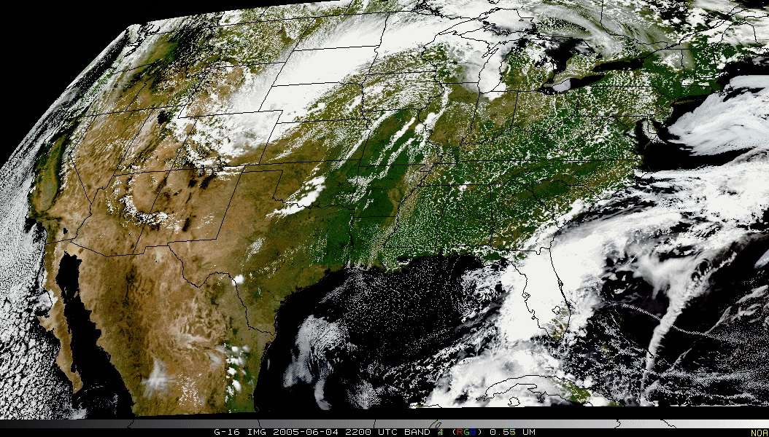
Pseudo-Natural Color

Slide 17
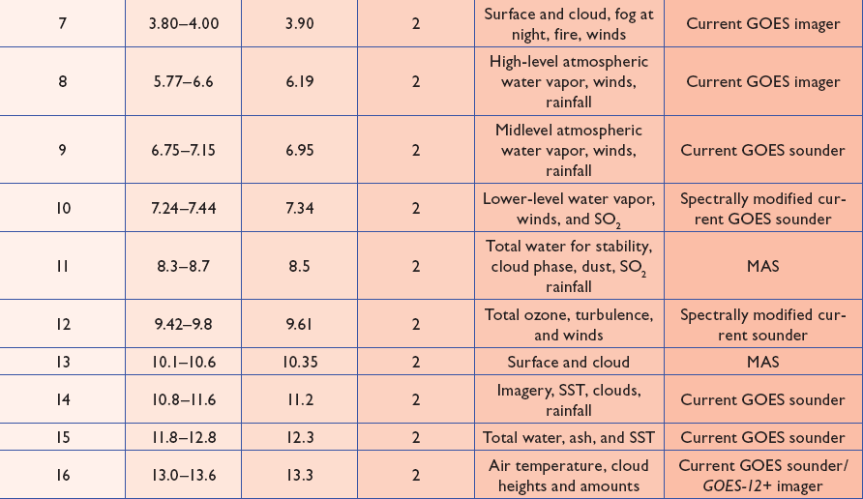
ABI bands 7-16
10 infrared bands on the ABI, compared to four on today’s imager
Notes:
The ABI band 10 was modified to better depict upper-level SO2. (G. Ellrod and others)
The ABI band 11 was suggested by Steve Ackerman (CIMSS), based on HIRS experience.
The ABI band 13 was suggested by W. P. Menzel (then NOAA NESDIS).

Slide 18
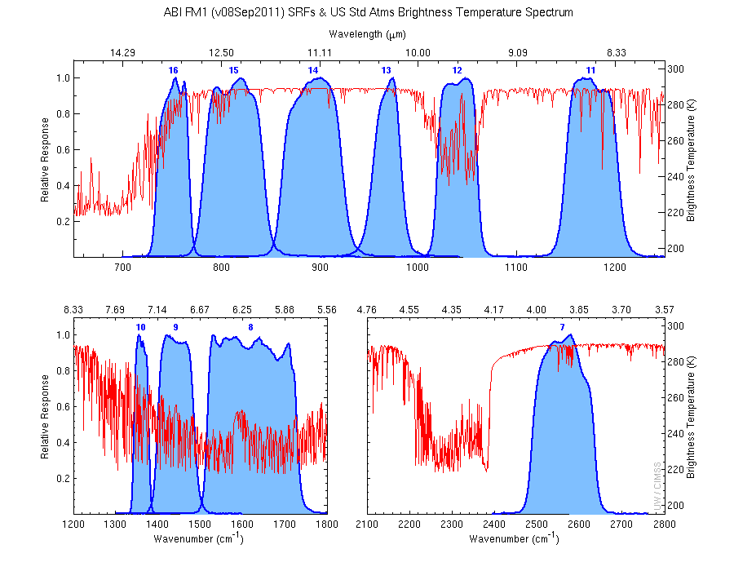
The IR channels on the ABI
Clouds, Stability Indices
SST, Fires, Radiances
Ozone, Downward Radiation
Rainfall, Aerosol
Hurricane, Imagery
Cloud Phase, SST
Sample use only, many other uses
SO2, Radiances
Winds, WV profiling
TPW, Rainfall rate
Fires, Fog
ABI has many more bands than the current operational GOES imagers.
Notes:
Schmit, T. J., M. M. Gunshor, W. P. Menzel, J. J. Gurka, J. Li, and A. S. Bachmeier, 2005: Introducing the next-generation Advanced Baseline Imager on GOES-R. Bull. Amer. Meteor. Soc., 86, 1079-1096.

Slide 19
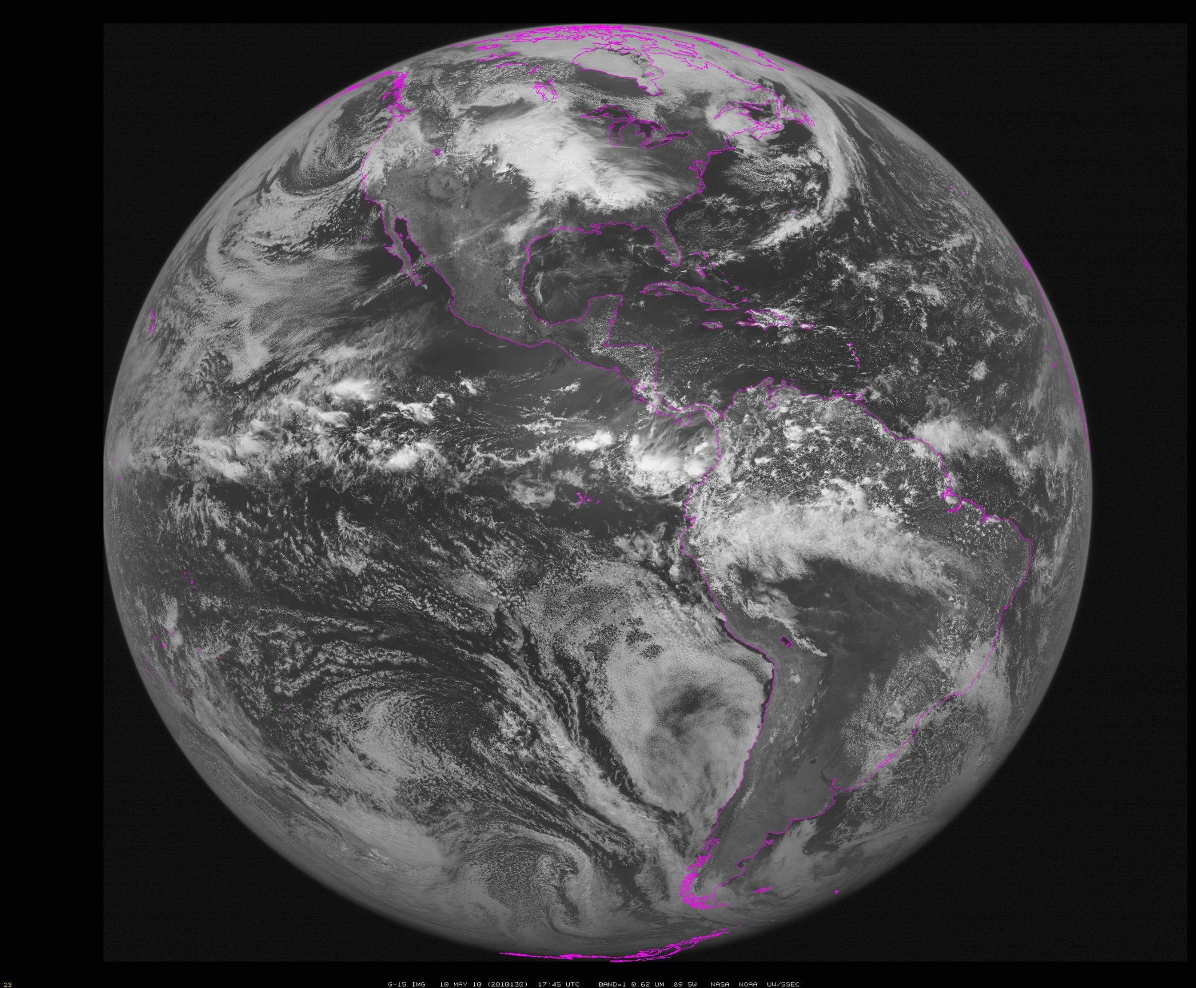
~90W
Notes:
Data from SSEC Data Center

Slide 20
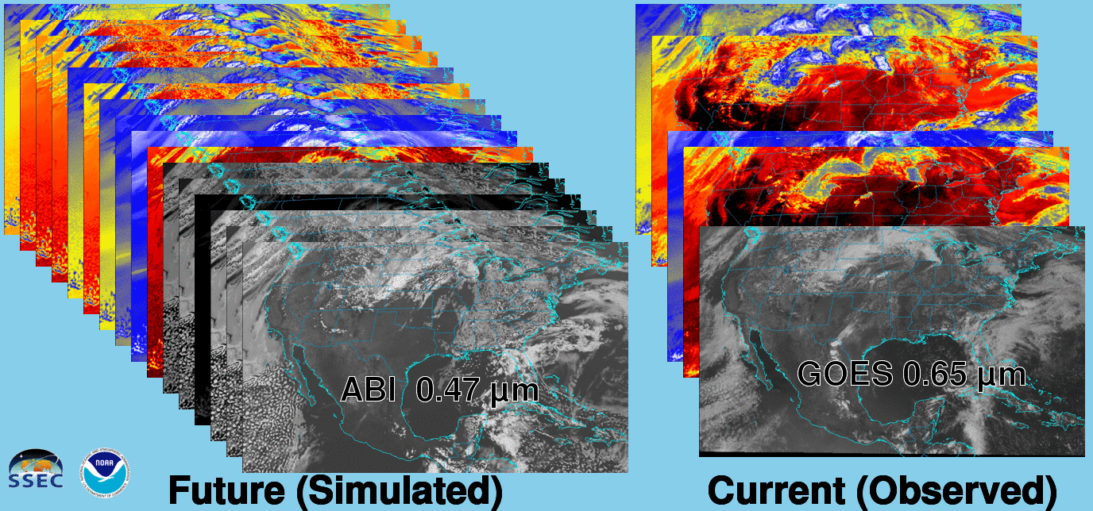
Future vs. Current Spectral Bands
The current GOES (right) has 5 spectral bands, while the GOES-R series ABI (left) will have 16 spectral bands.

Slide 21
Outline
GOES History
GOES-R ABI
  Spectral
  Spatial
  Temporal
Summary
Lockheed Martin

Slide 22
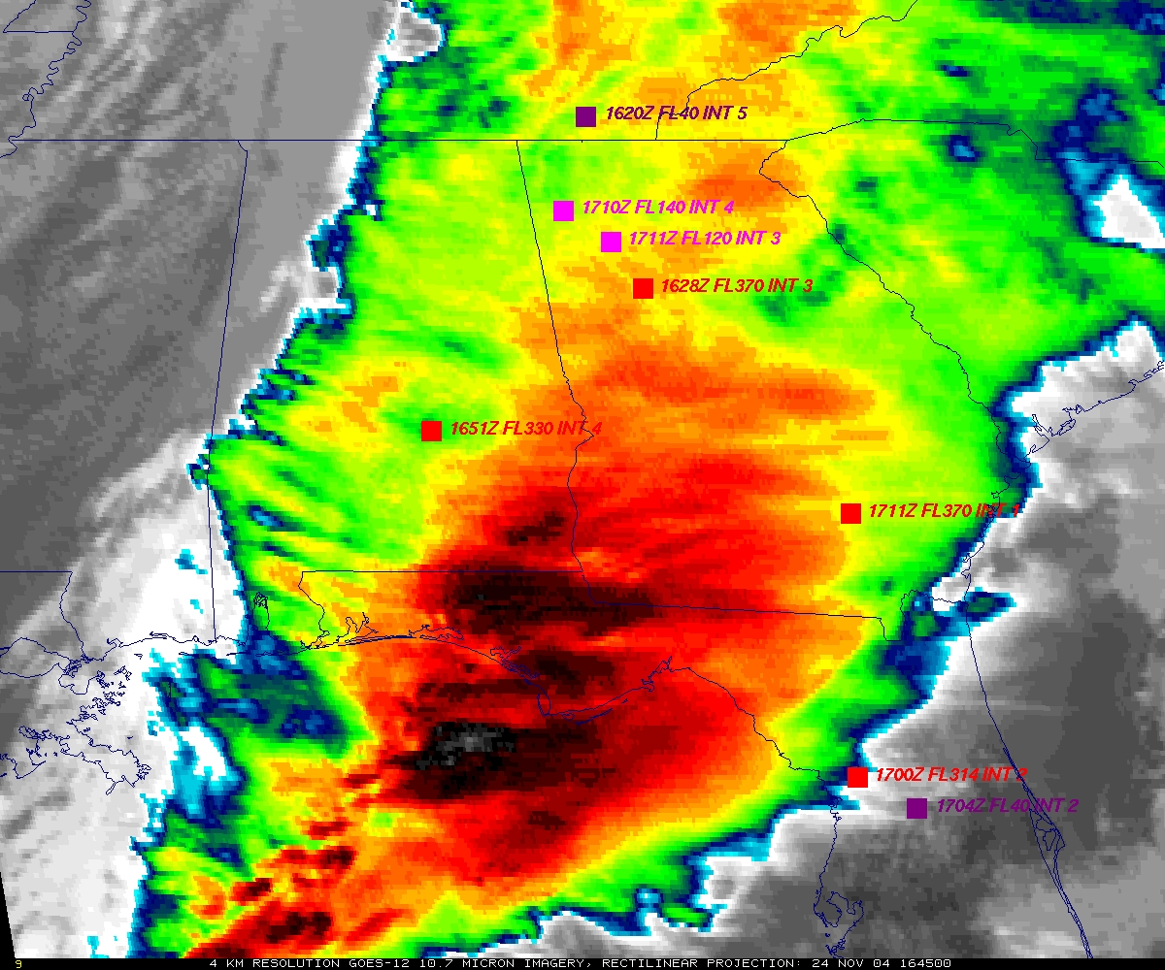
GOES
Figure courtesy of K. Bedka and W. Feltz

Slide 23
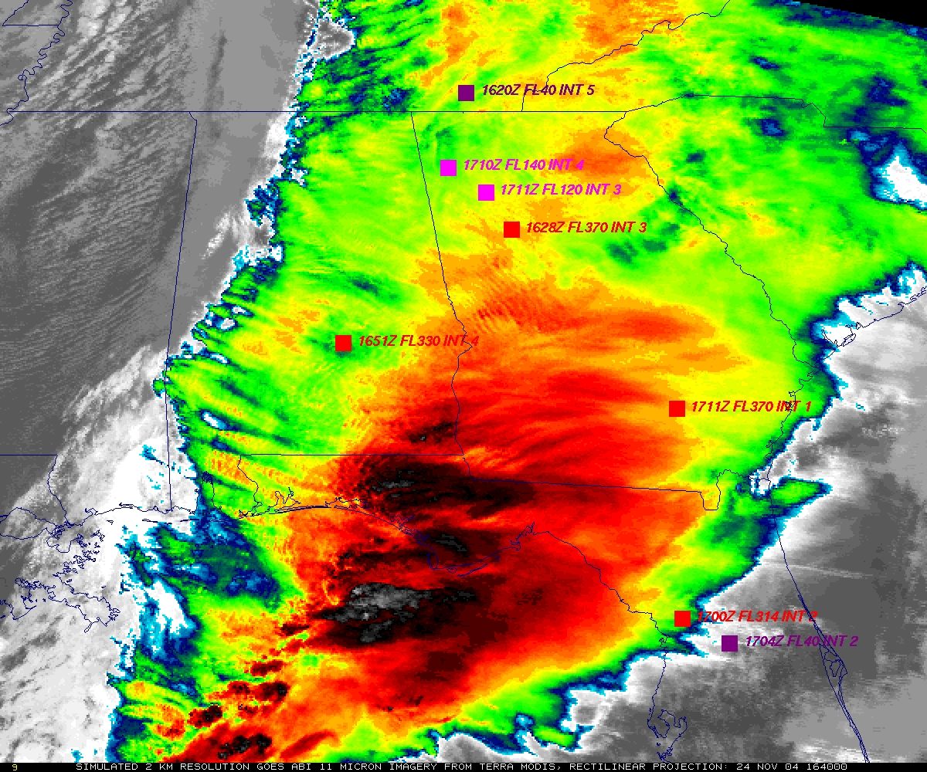
“ABI” from MODIS
Figure courtesy of K. Bedka and W. Feltz

Slide 24
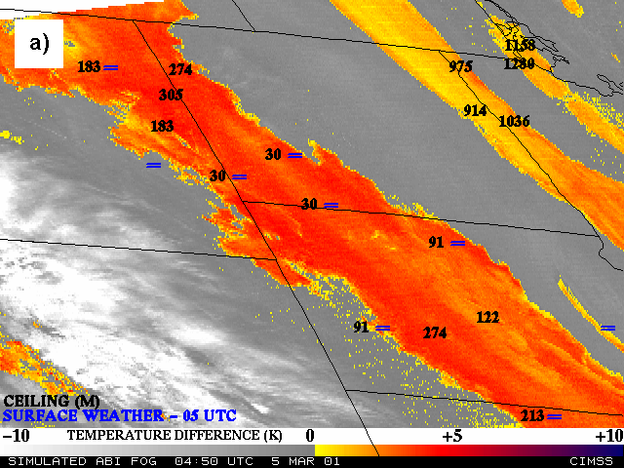
Nocturnal Fog/Stratus Over the Northern Plains
“ABI” 4 minus 11 μm Difference
ABI image (from MODIS) shows greater detail in structure of fog.
Notes:
Note the ABI (from MODIS) image is better spatial resolution and better signal-to-noise ratio then the GOES-10 imager.
Schmit, T. J., M. M. Gunshor, W. P. Menzel, J. J. Gurka, J. Li, and A. S. Bachmeier, 2005: Introducing the next-generation Advanced Baseline Imager on GOES-R. Bull. Amer. Meteor. Soc., 86, 1079-1096.

Slide 25
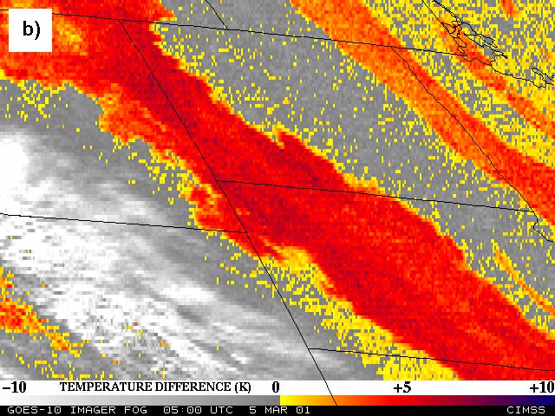
Nocturnal Fog/Stratus Over the Northern Plains
GOES-10 4 minus 11 μm Difference
ABI image (from MODIS) shows greater detail in structure of fog.
Notes:
Schmit, T. J., M. M. Gunshor, W. P. Menzel, J. J. Gurka, J. Li, and A. S. Bachmeier, 2005: Introducing the next-generation Advanced Baseline Imager on GOES-R. Bull. Amer. Meteor. Soc., 86, 1079-1096.

Slide 26
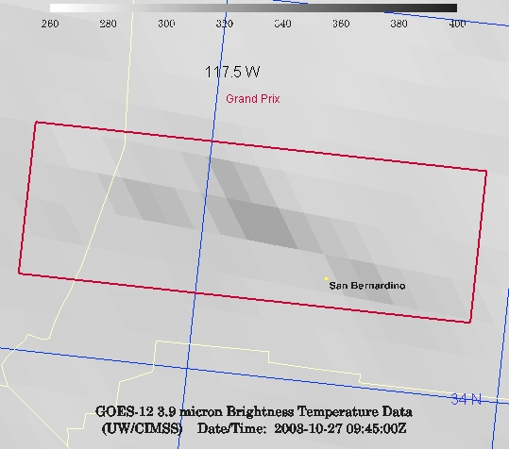
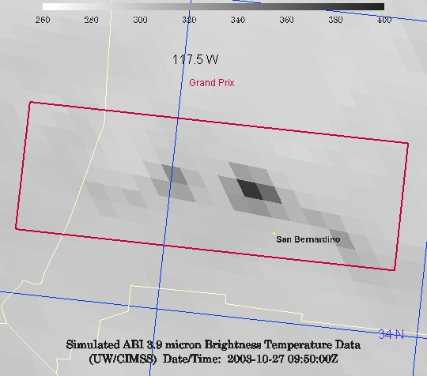
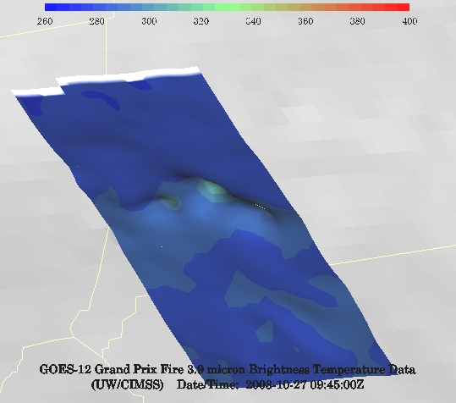
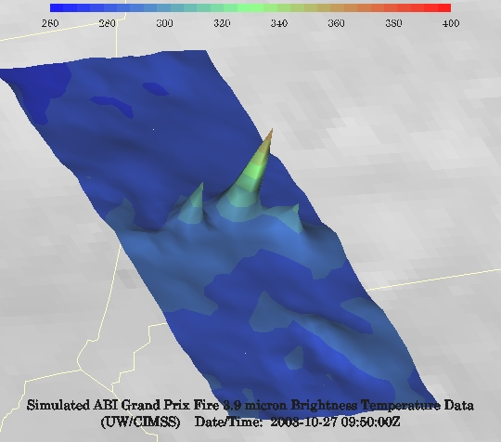
GOES-12 and GOES-R ABI
Simulation of Grand Prix Fire/Southern California
GOES-12
GOES-R ABI
GOES-12
GOES-R ABI
Notes:
Here are two different fires from J. Feltz of CIMSS (using mcidas-v). What we can see is a more defined peak in the higher resolution data and it is easier to pick out individual hotspots. In addition, the higher saturation temperature of the ABI allows us to see that the fire is around 370K. ABI is simulated from MODIS.

Slide 27
Outline
GOES History
GOES-R ABI
  Spectral
  Spatial
  Temporal
Summary
Lockheed Martin

Slide 28
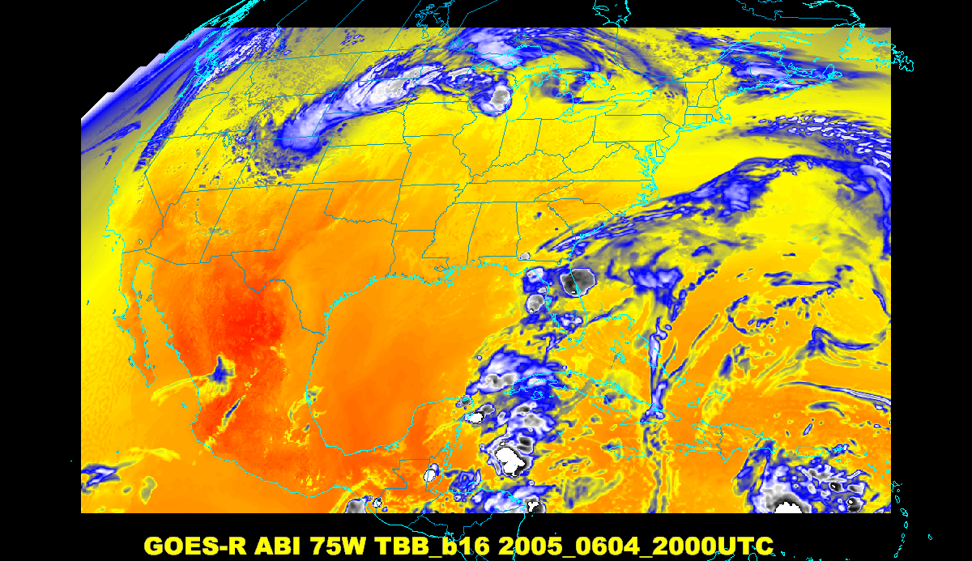
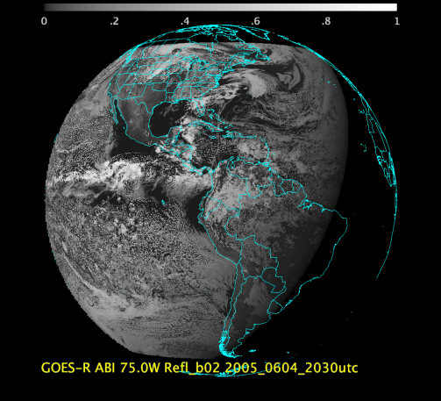
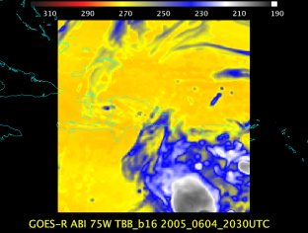
Baseline ABI Scan Modes
Scan mode (3) or ‘flex mode’ for the ABI:
- Full disk every 15 minutes + 5 min CONUS
+ 1-min mesoscales (2 locations).
[Scan mode (4) or ‘Continuous Full Disk’ (CFD) is a full disk every 5 min]
Notes:
CONUS image is the shifted center point.

Slide 29
ABI Scan Loop
Data provided by CIMSS AWG proxy team
Time is June 4, 2005
ABI water vapor band (7.3 µm) is used
“Flex” scan mode (3) with 15 minutes of data are demonstrated
  ABI full disk + CONUS + Mesoscale

Slide 30
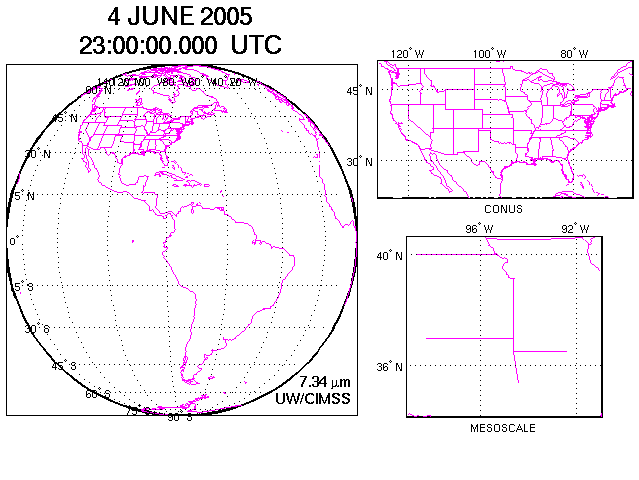
Figure courtesy of J. Li, CIMSS
Concept of flex mode scanning animation

Slide 31
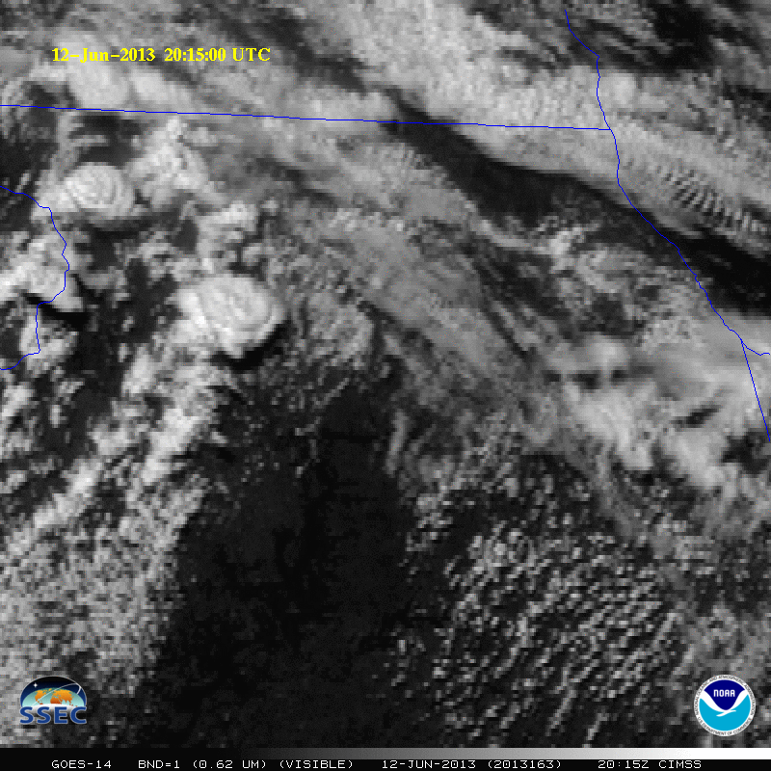

5-min

Slide 32
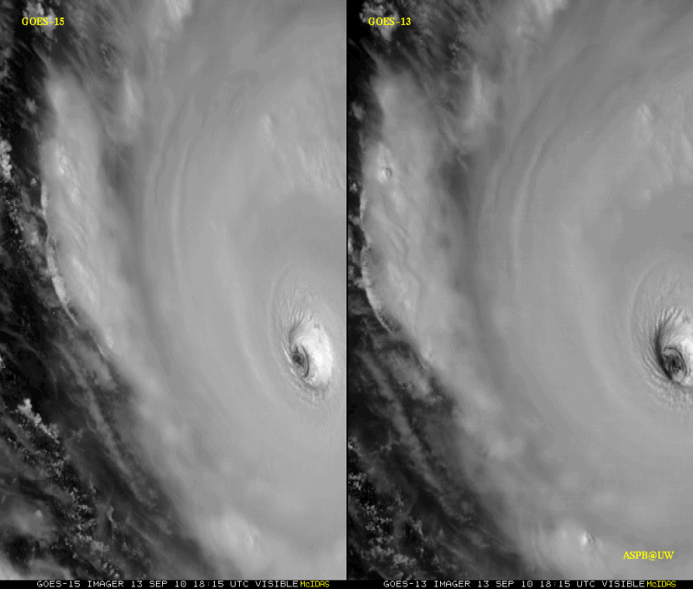
GOES-15 Science Test
The Science Test part of Post Launch Testing for GOES-15 occurred in the summer of 2010.
Co-led by Hillger and Schmit.
Unique 1-minute rapid scan imagery acquired
GOES-15 data analysis will continue. All the GVAR data archived.
Many products generated in near real-time.
A NOAA Technical Report was generated.
1-min
30-min
Unique GOES-15 Imager Visible data from the NOAA Science Test
Notes:
Igor

Slide 33
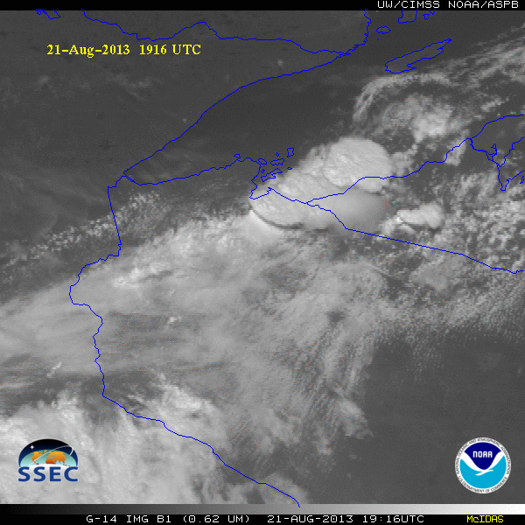
GOES-14 Super Rapid Scan Operations to Prepare for GOES-R (SRSOR)
SRSOR plans for 2015 include May 18-June 12, and August 10-22:
  http://cimss.ssec.wisc.edu/goes/srsor2015/GOES-14_SRSOR.html
  Data during parts of 2012 (Hurricane Sandy, convection), 2013 (CA Rim Fire, convection) and 2014 (Hurricane Marie, convection):
  http://cimss.ssec.wisc.edu/goes/srsor/GOES-14_SRSOR.html
  http://cimss.ssec.wisc.edu/goes/srsor2013/GOES-14_SRSOR.html
  http://cimss.ssec.wisc.edu/goes/srsor2014/GOES-14_SRSOR.html
GOES-14 provided very unique data and offered a glimpse into the possibilities that will be provided by the ABI on GOES-R in one minute mesoscale imagery
GOES-14 visible image showing rapid convective development
Notes:
http://cimss.ssec.wisc.edu/goes/srsor2015/GOES-14_SRSOR.html

Slide 34
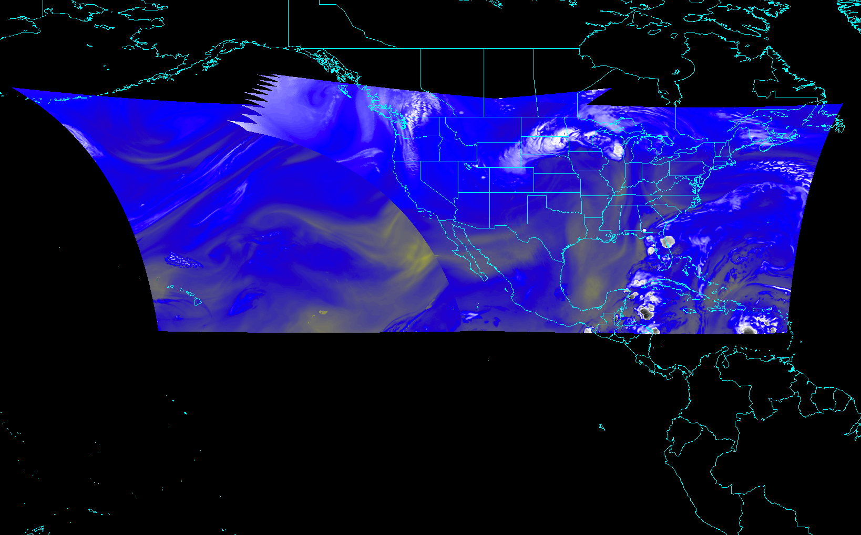
CONUS from East and West (NOAT/GORWG-approved)
Notes:
Different days simulated.

Slide 35
Recent Mode 3 (Flex mode)
“Time-Time” chart
Note the ‘white’ space is instrument idle time.
DRAFT!!!!!
Notes:
Copy and pasted from excel. Pasted as a picture. Resized to 44% by 44% of original. Arrange -> Align -> Align Center & Align Middle

Slide 36
Baseline Time-Time Mode 4
(Continuous Full Disk)
This is the Continuous Full Disk (every 5 min) mode
This is the highest data rate.

Slide 37
Draft Scan Mode ”6” with 10-min FD
In 10-min:
  1 Full Disk +
  2 CONUS +
  20 Meso-scale
The 10-min Full Disk would offer synergy with other geos and improved AMVs outside of CONUS, plus still allow for meso-scale observations.
This draft mode 6 ideally could be tested during PLPT (Post Launch Products Test).
This mode should be easier to implement at the Ground System, because the scan sectors are the same size/locations as in mode 3.
DRAFT!
Notes:
Copy and pasted from excel. Pasted as a picture. Resized to 44% by 44% of original. Arrange -> Align -> Align Center & Align Middle

Slide 38
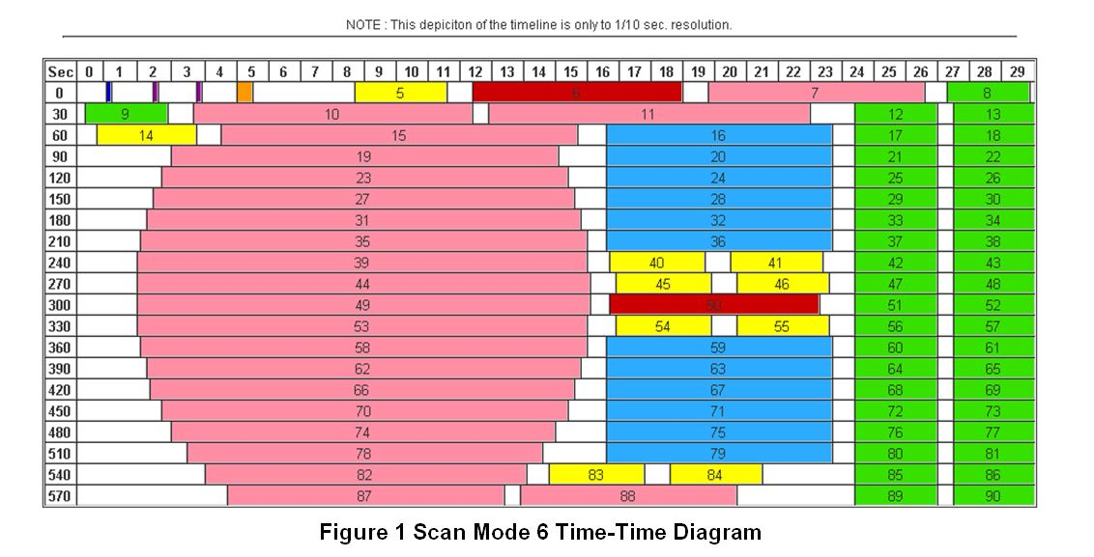
Draft Scan Mode ”6” with 10-min FD
Note less ‘white space’ than scan mode 3 (flex mode)
Time-time diagram from Exelis
Notes:
Copy and pasted from excel. Pasted as a picture. Resized to 44% by 44% of original. Arrange -> Align -> Align Center & Align Middle

Slide 39
Outline
GOES History
GOES-R ABI
  Spectral
  Spatial
  Temporal
Summary
Lockheed Martin

Slide 40
Approximate spectral and spatial resolutions of US GOES Imagers
~ Band Center (um) | GOES-1/3 | GOES-4/7 | GOES-8/11 | GOES-12/13 | GOES-13/15 | GOES-R+
0.47
0.64
0.86
1.6
1.38
2.2
3.9
6.2
~6.7 |  | 14km
7.3
8.5
9.7
10.3
11.2
12.3
13.3
Visible
Near-IR
Box size represents pixel size
8
4
2
“MSI mode”
Infrared
Notes:
0.40 inches = 4km; 0.80 inches = 8km
MSI is Multi-Spectral Imaging Mode (dashed boxes)
This does not show other improvements: SNR, MTF, bit-depth, navigation, coverage rates, etc.
ATS and SMS not shown.

Slide 41
Geostationary Imagers: Number of Spectral bands (~ resolution)
Time | Instruments | Visible/NearIR | Infrared (IR)
Late 1950s | N/A | N/A | N/A
1966+ | ATS-1/3 (Spin-Scan Cloud Camera) | 1 (0.1 μm) | N/A
1967+ | ATS-3 (Multicolor Spin-Scan Cloud Camera) | 3 (0.1 μm) | N/A
1974 | ATS-6 (Geosynchronous Very High Resolution Radiometer) | 1 (0.2 μm) | 1 (2 μm)
1974/1975 | SMS-1/2 (Visible Infrared Spin-Scan Radiometer (VISSR)) | 1 (0.15 μm) | 1 (2 μm)
1975+ | GOES-1/3 (VISSR) | 1 (0.2 μm) | 1 (1 μm)
1980+ | GOES-4/7 (VISSR + VAS) | 1 (0.2 μm) | 3 (1 μm)
1994+ | Imager-8/12 + Sounder | 1 (0.2 μm) | 4 (1 μm)
2010+ | Imager-13/15 + Sounder | 1 (0.2 μm) | 4 (1 μm)
2017+ | ABI | 6 (0.1 μm) | 10 (1 μm)
2033?
Large improvements with the ABI!
U.S. Meteorological Imagers
Notes:
Value in parenthesis is approximate 50% width of the visible or IR window.
http://cimss.ssec.wisc.edu/goes/calibration/
Values are approximate.

Slide 42
Geostationary Imagers:
Spatial Resolution (approximate)
Time | Instruments | Visible/NearIR | Infrared (IR)
Late 1950s | N/A | N/A | N/A
1966+ | ATS-1/3 (Spin-Scan Cloud Camera) | 4 km | N/A
1967+ | ATS-3 (Multicolor Spin-Scan Cloud Camera) | 4 km | N/A
1974 | ATS-6 (Geosynchronous Very High Resolution Radiometer) | 6 km | 11 km
1974/1975 | SMS-1/2 (Visible Infrared Spin-Scan Radiometer (VISSR)) | 1 km | 8 km
1975+ | GOES-1/3 (VISSR) | 1 km | 8 km
1980+ | GOES-4/7 (VISSR + VAS) | 1 km | 7-14 km
1994+ | Imager-8/12 + Sounder | 1 km | 4-8 km
2010+ | Imager-13/15 + Sounder | 1 km | 4 km
2017+ | ABI | 0.5 – 1 km | 2 km
2033?
Large improvements with the ABI!
U.S. Meteorological Imagers
Notes:
Values are approximate, at satellite sub-points. GOES Imager over-sampling not represented.

Slide 43
Geostationary Imagers:
Temporal Resolution
Time | Instruments | Visible/NearIR | Infrared (IR)
Late 1950s | N/A | N/A | N/A
1966+ | ATS-1/3 (Spin-Scan Cloud Camera) | 20 min | N/A
1967+ | ATS-3 (Multicolor Spin-Scan Cloud Camera) | ? | N/A
1974 | ATS-6 (Geosynchronous Very High Resolution Radiometer) | 25 min | 25 min
1974/1975 | SMS-1/2 (Visible Infrared Spin-Scan Radiometer (VISSR)) | 20 min | 20 min
1975+ | GOES-1/3 (VISSR) | 30 min | 30 min
1980+ | GOES-4/7 (VISSR + VAS) | 30 min | 30 min
1994+ | Imager-8/12 + Sounder | 7 – 30 min | 7 – 30 min
2010+ | Imager-13/15 + Sounder | 7 – 30 min | 7 – 30 min
2017+ | ABI | 0.5 - 5 - 15 min | 0.5 - 5 - 15 min
2033?
Large improvements with the ABI!
U.S. Meteorological Imagers
Notes:
Values are approximate. Times are routine, not special modes.

Slide 44
Three Groups of Users
Direct use of radiances/imagery
  Numerical models
  Forecasters
  Broadcasters
  General public/private sector/Internet
Direct use of satellite products
  Numerical models
  Forecasters
  Blended products, etc.
  General public/private sector/Internet
Use of services which use data/products
  Basically everyone!

Slide 45
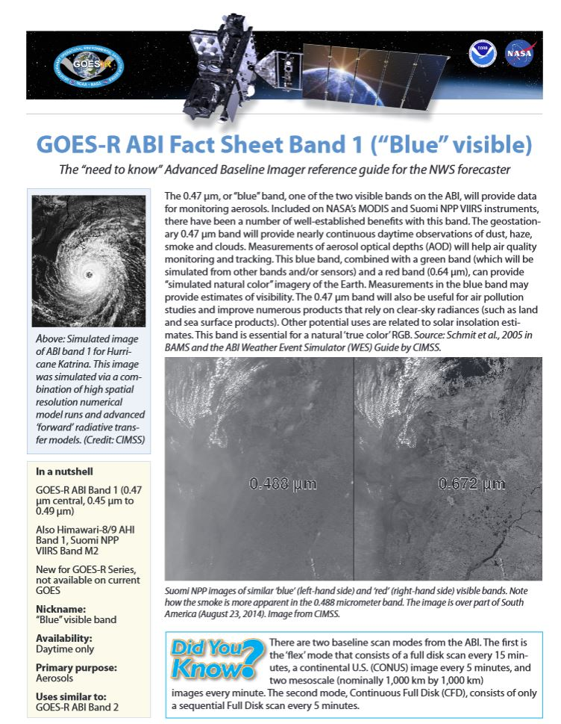
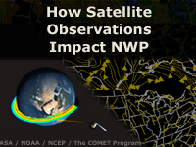
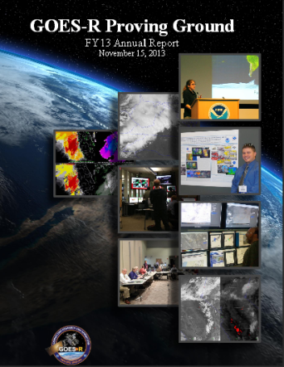
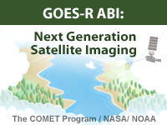
Training and User Education Materials
New!
Online Training Modules
How Satellite Observations Impact NWP
GOES-R ABI: Next Generation Satellite Imaging (COMET)
GOES-R: Benefits of Next-Generation Environmental Monitoring (COMET)
Satellite Hydrology and Meteorology for Forecasters (SHyMet)
SPoRT product training modules
VISIT Training Resources
Commerce Learning Center
ABI Band Fact Sheets
New!
Printed Materials
GOES-R Fact Sheets (18)
User Readiness Plan
GRB Downlink Specifications and Product Users Guide
Proving Ground Demonstration Final Reports and Annual Reports
45
Notes:
GOES-R: Benefits of Next Generation Environmental Monitoring - Includes an overview of the mission, instruments, system and services, satellite synergy, the role of GOES-R in the Global Observing System as well an environmental monitoring section that addresses the benefits of GOES-R and the ability to monitor 13 unique hazards and phenomena.
GOES-R 101 - Targeted for Forecasters and anyone else interested in basic aspects of GOES-R
Satellite Hydrology and Meteorology (SHyMeT) - Dedicated to operational satellite meteorology. The Forecaster track of the SHyMet course covers satellite imagery interpretation, including feature identification, water vapor channels, and what to expect on GOES-R. There is a session on remote sensing data for operational hydrology as well as one relating to aviation hazards. Other topics include an understanding of the Dvorak method in tropical cyclone analysis and the utility of cloud composites in forecasting
CIMSS Satellite Meteorology for Grades 7-12 -Meteorology is an excellent topic to introduce middle and high school students to geoscience, physics, chemistry, and applied mathematics. Satellite Meteorology provides scientists and educators with exciting tools for investigation, inquiry, analysis and stewardship.
Commerce Learning Center: Forecasters can take these training courses and get credit for taking them

Slide 46
ABI Bands Quick Information Guides
http://www.goes-r.gov/education/ABI-bands-quick-info.html

Slide 47
Summary
The ABI on GOES-R will improve over the current instrument in many aspects:
  spatial, temporal, spectral, calibration, etc.
The great amount of information from the GOES-R will offer a continuation of current products and new products.
The ABI builds on previous experience/instruments:
  The ABI has already had a long history, even before launch.
Similar imagers by Europe, Japan, Korea, etc.
  ABI-like coverage of most of the globe!

Slide 48



Acknowledgements
The authors would like to thank the entire GOES and GOES-R teams; both within the government, industry and academia.
The views, opinions, and findings contained in this presentation are those of the authors and should not be construed as an official National Oceanic and Atmospheric Administration or U.S. Government position, policy, or decision.

Slide 49
GOES-14 SRSOR in SPC
“The one-minute imagery helped me to anticipate areas of new convective development as well, which was useful in developing short-term forecasts and mesoscale discussions for severe weather. ”
“… having the data available routinely would very likely, over time, allow forecasters to gain a better understanding of processes related to convective initiation, as these processes occurring within a cu field would be visually revealed in high temporal -resolution data in a way that 15- or 30-minute imagery cannot as clearly depict.”
“In the pre-storm environment, these data were especially helpful in monitoring the vertical growth of cumulus convection and in the identification of boundaries.”
“I found it to be very useful in… Using cloud character and trends to diagnose boundary locations and motion, and nowcast their potential for either CI or influences on upshear storms to interact therewith.”
“This has provided extra confidence and lead time for the issuance of two mesoscale discussions compared to the normal satellite update frequency/latency. … quite striking. It’s analogous to the difference between watching high-def TVs vs. standard def, ... Satellite imagery at 1-min temporal resolution needs to become the new standard for severe weather operations.”
“Post-storm initiation, the high-resolution data allowed for careful analysis of overshooting and collapsing tops, the character of the storm anvils (ie. health of the storm) and the identification of convectively generated outflows.”
http://satelliteliaisonblog.wordpress.com/category/spc/
Notes:
Highlights added.

