Slide 1
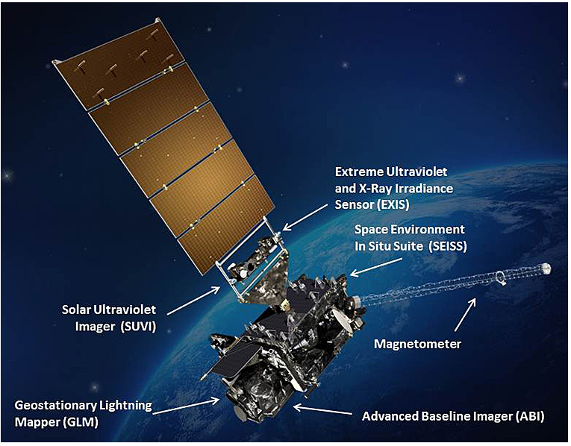

Slide 3
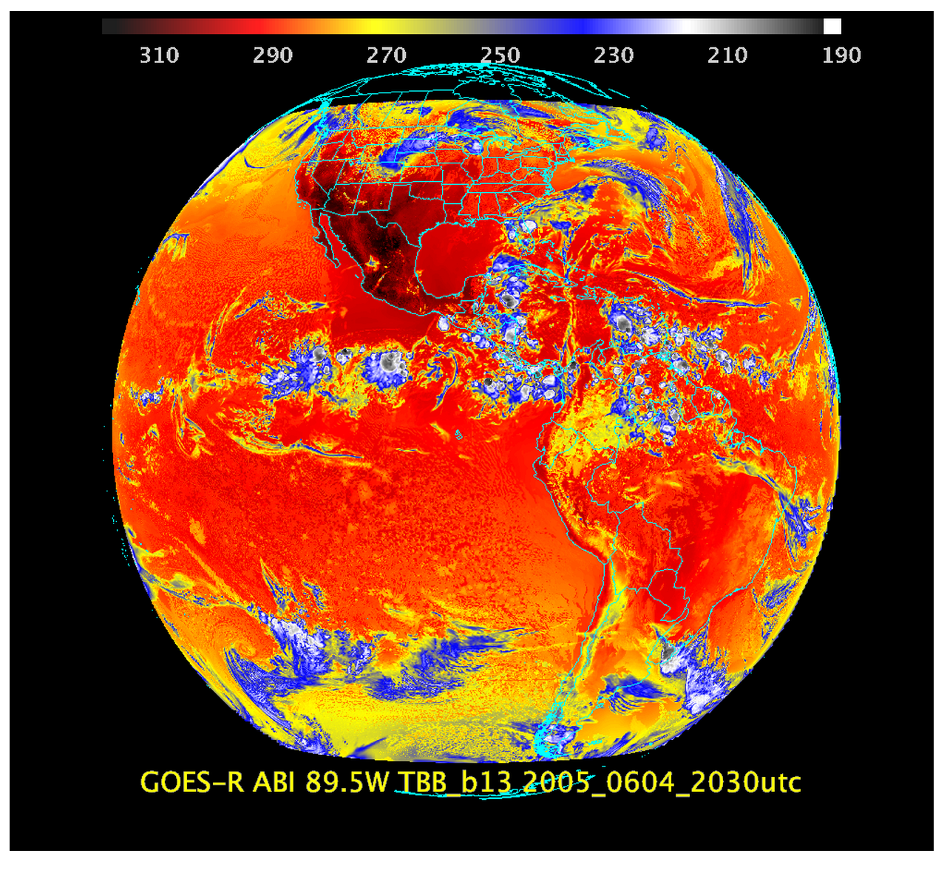

Slide 4
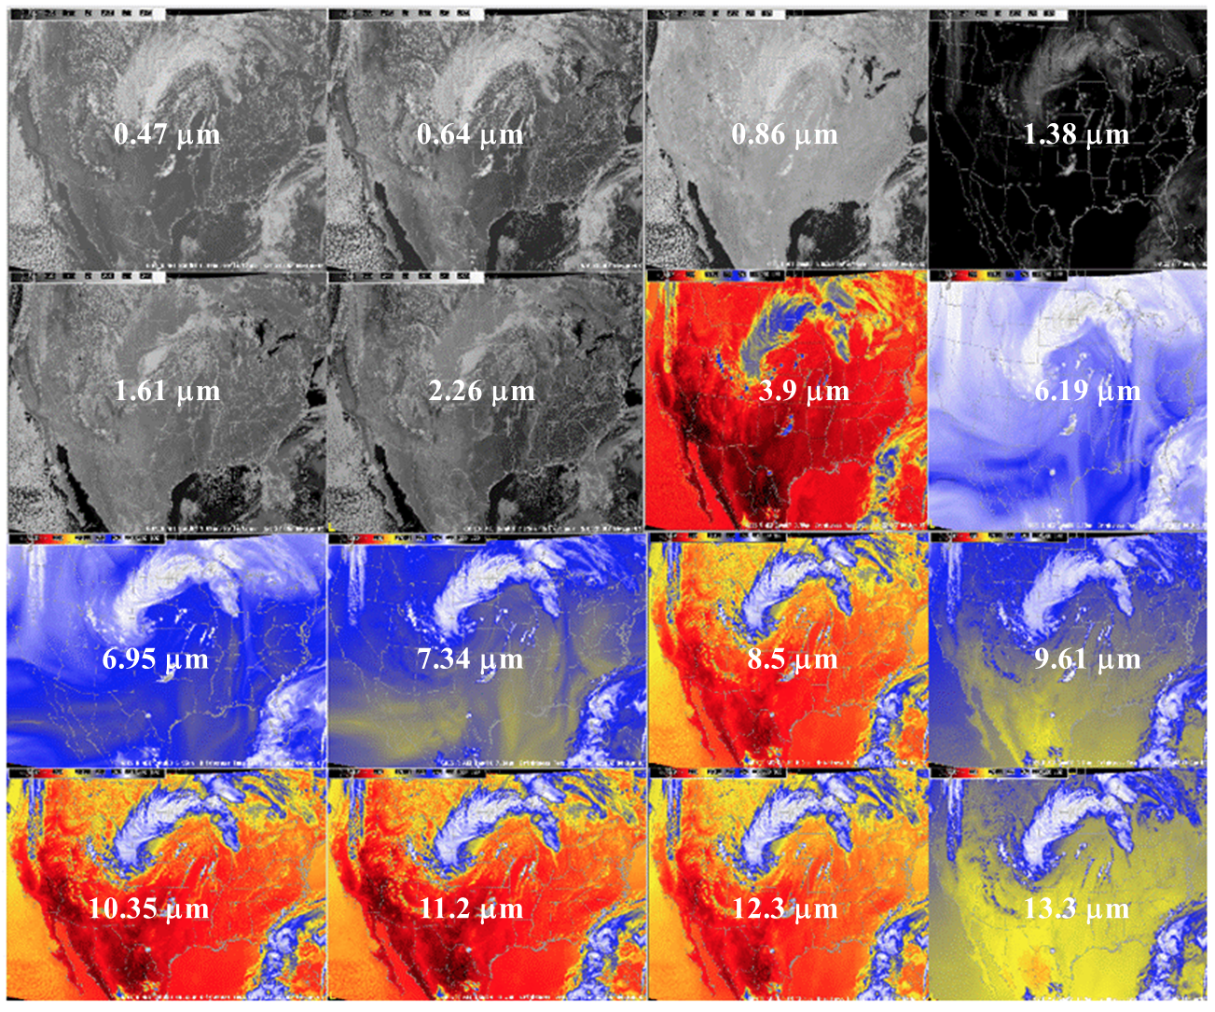

Slide 5
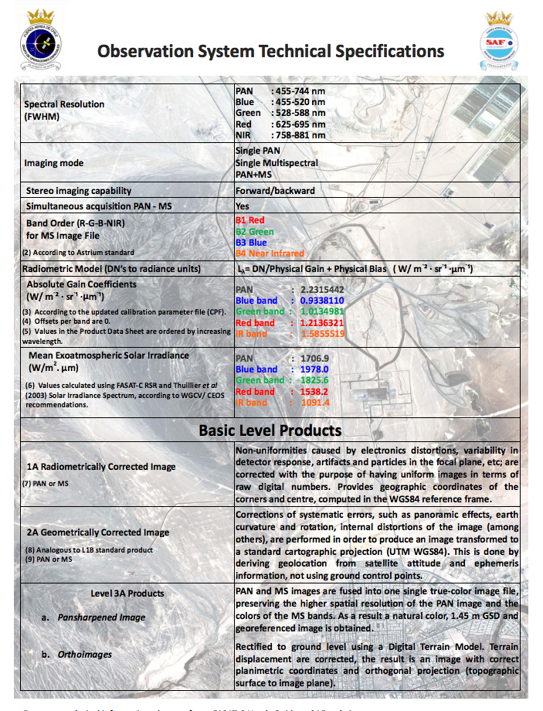

Slide 6
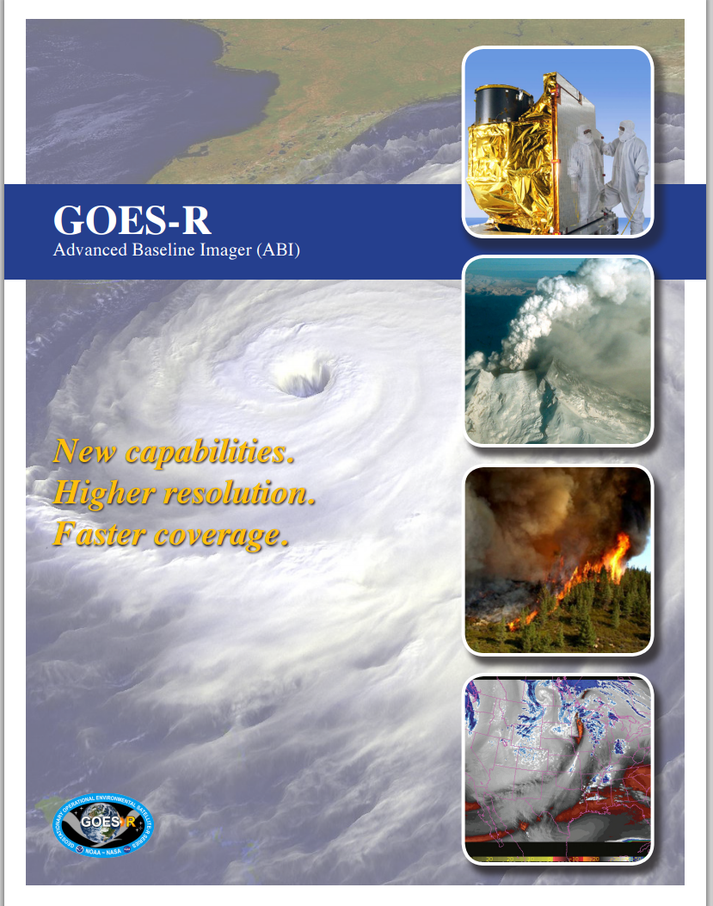

Slide 7
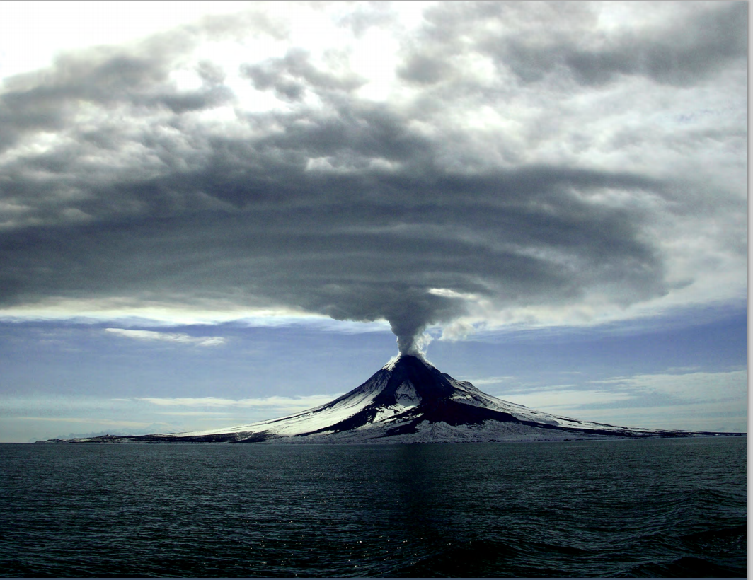

Slide 8
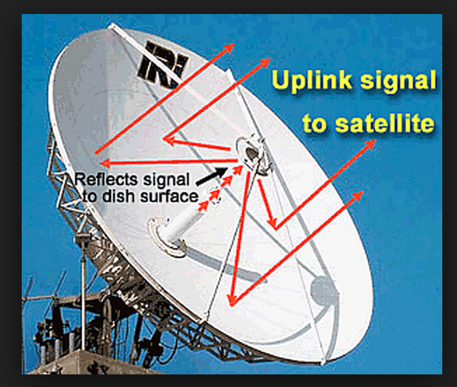

Slide 10
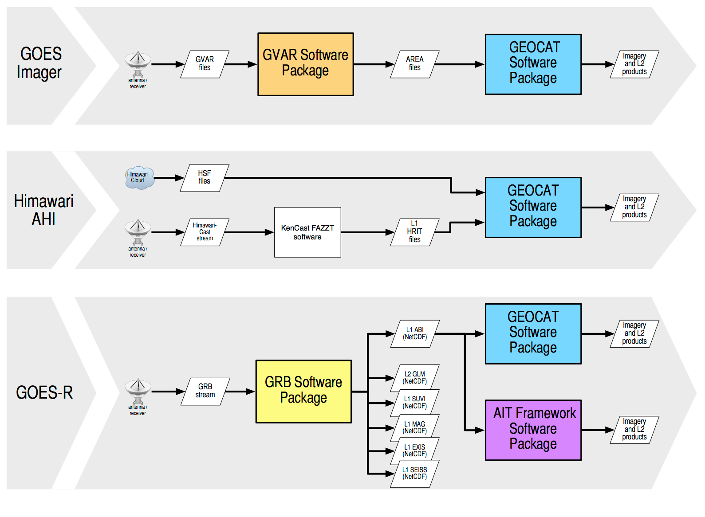

Slide 12
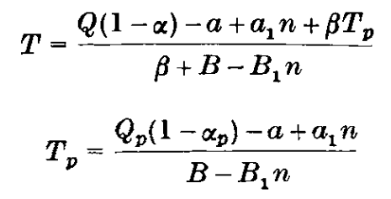
Effect of solar radiation variations on the climate of the earth. (Budyko et, al. 1968)
.
Q=Solar radiation at boundary of atm. I=Outgoing radiation in kcal/cm2.month.
A=Gain/loss of heat, α =Albedo, n = Cloudiness, a=14.0 B=0.14 a1=3.0 B1=0.10 β =-.235
1: Dependence of Temp. distribution on radiation
2: Dependence of Earth’s temp. and ice cover on radiation var.
3: Ice cover effect on temperature distribution.

