Slide 1
CIMSS/ASPB Metrics: Real-time ingest of CIMSS proxy RGB Air Mass product with quantitative overlay within NCWCP AWIPS environment and forecaster training sessions.
Approach: Display gridded products within AWIPS II via conversion to grib2 using the AWIPS II baseline plugin “unified grid de-coder”
Software:
IDL routine to extract binary synthetic brightness temperatures from archived netcdf CRTM output files
Fortran routine to convert binary synthetic brightness temperatures to grib2 using standard Grib2 libraries (issues with JPEG2000 data representation)
AWIPS-II XML scripts to unscale (see issues) and rescale grib2 synthetic brightness temperatures for RGB guns
AWIPS-II GUI developed to allow interactive scaling of RGB guns
Appropriate parameters for Discipline 3 (Space Products) category 192
(forecast satellite imagery category) are now available for ABI within GRIB2 - TABLE 4.2-3-192, PARAMETERS FOR DISCIPLINE 3, CATEGORY 192, (Space products, Forecast Satellite Imagery category)

Slide 2
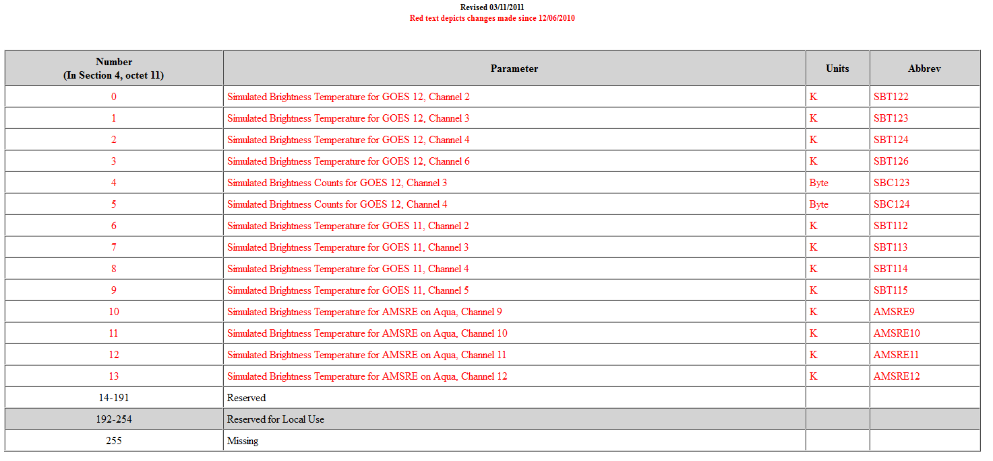
Grib2 Capabilities for forecast satellite imagery as of 05/07/2014
GRIB2 - TABLE 4.2-3-192
PARAMETERS FOR DISCIPLINE 3 CATEGORY 192
(Space products, Forecast Satellite Imagery category)
(http://www.nco.ncep.noaa.gov/pmb/docs/grib2/grib2_table4-2-3-192.shtml)

Slide 3
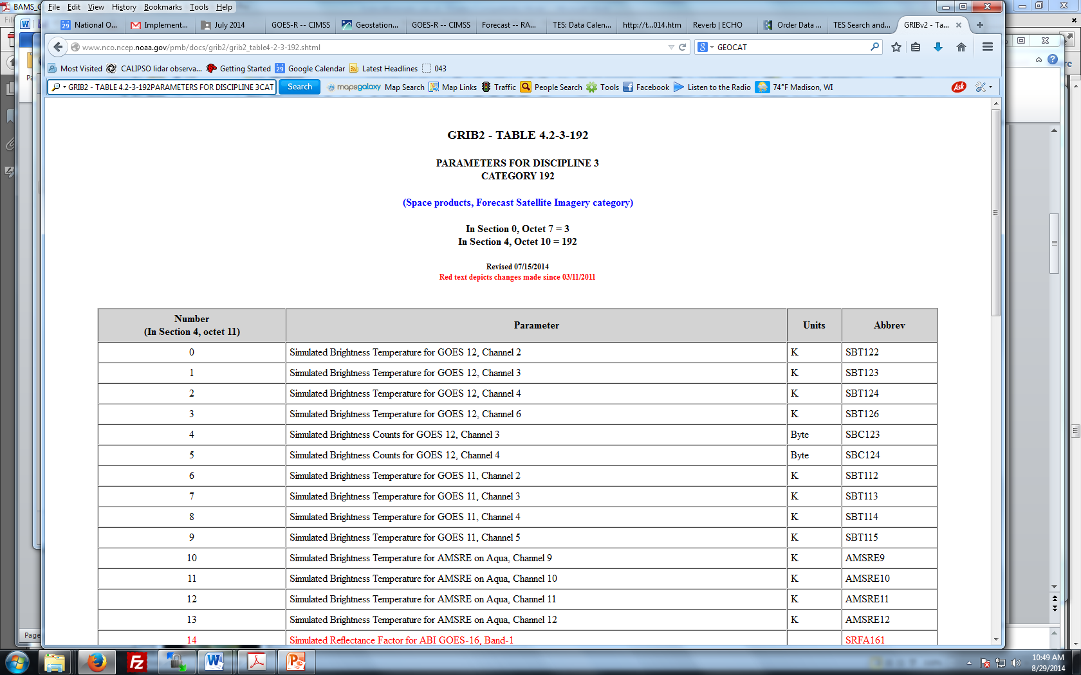
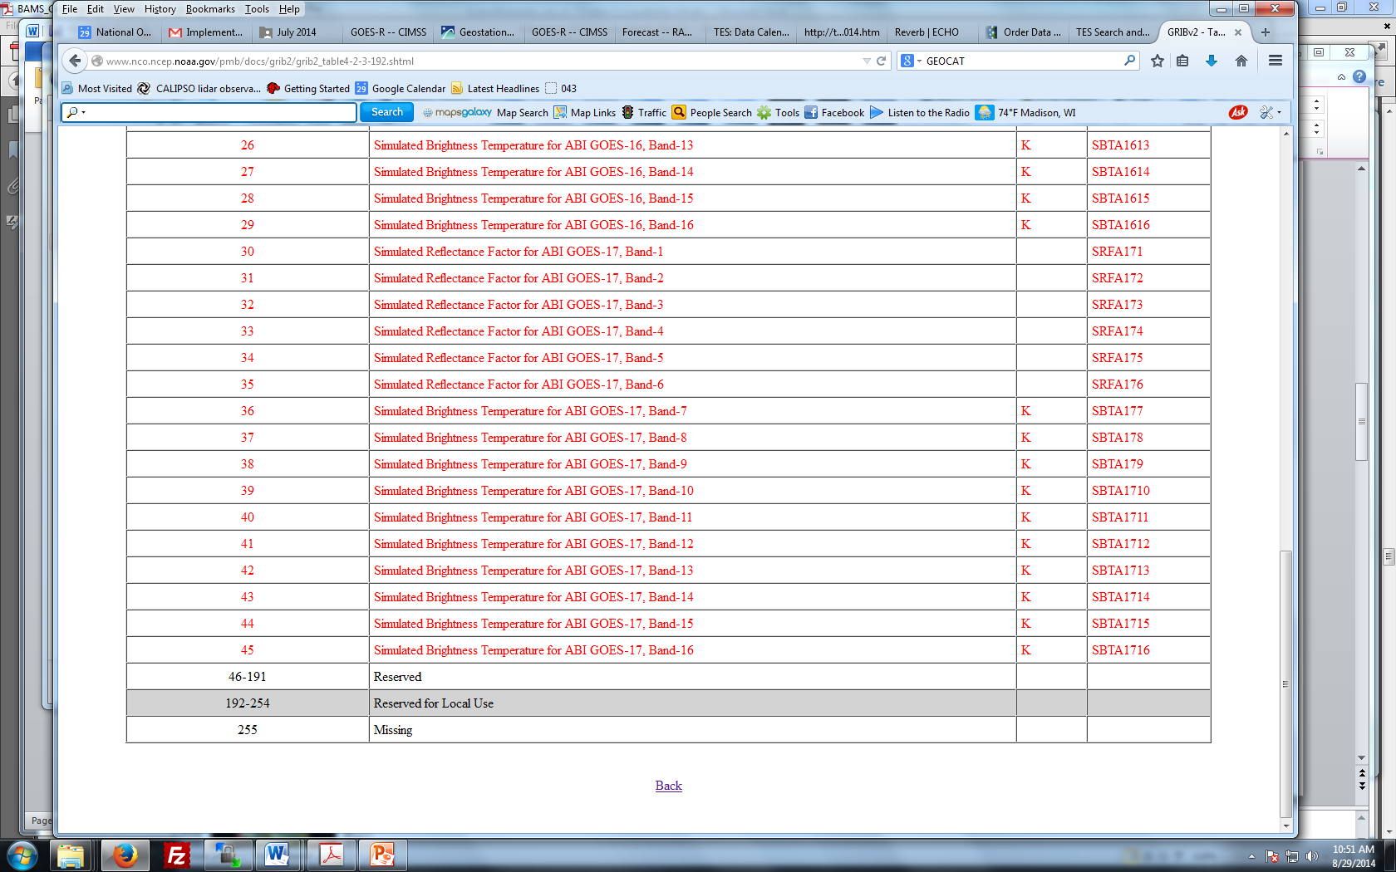
Grib2 Capabilities for forecast satellite imagery as of 07/15/2014
For visible/NIR Bands 1-6 the unit is "none" (range 0-1) and the parameter is "reflectance factor"
For IR Bands 7-16 the unit is "Kelvin" (range 180-400K with the low end for space and high end to account for band 7 fire detection) and the parameter is "brightness temperature"
All 16 of these parameters for ABI East (GOES-16) and ABI West (GOES-17)
(http://www.nco.ncep.noaa.gov/pmb/docs/grib2/grib2_table4-2-3-192.shtml)

Slide 4
Grib2 Capabilities for forecast satellite imagery as of 07/15/2014
For visible/NIR Bands 1-6 the unit is "none" (range 0-1) and the parameter is "reflectance factor"
For IR Bands 7-16 the unit is "Kelvin" (range 180-400K with the low end for space and high end to account for band 7 fire detection) and the parameter is "brightness temperature"
All 16 of these parameters for ABI East (GOES-16) and ABI West (GOES-17)

Slide 5
Grib2 Capabilities for forecast satellite imagery as of 07/15/2014
For visible/NIR Bands 1-6 the unit is "none" (range 0-1) and the parameter is "reflectance factor"
For IR Bands 7-16 the unit is "Kelvin" (range 180-400K with the low end for space and high end to account for band 7 fire detection) and the parameter is "brightness temperature"
All 16 of these parameters for ABI East (GOES-16) and ABI West (GOES-17)

Slide 6
Issues/Resolution:
GOES 16 and 17 brightness temperature grib2 variables should now have valid ranges for the ABI bands
No need to scale ABI bands prior to putting them into grib2
AWIPS-II XML scripts do not have to un-scale ABI bands prior to generation of RGB guns
Still need to resolve how to get updated grib2 table into AWIPS-II (or local machine for testing)
Alternative approach for initial demonstration is to leverage Joe Zajic’s support of "Continuous Integration" instance of AWIPS-II that is continuously ingesting and displaying the RaFTR-CIMSS-SIM data.
NWS (Eric Guillot) will be using the data on a daily basis to develop AWIPS-II configurations for the various mission threads.

Slide 7
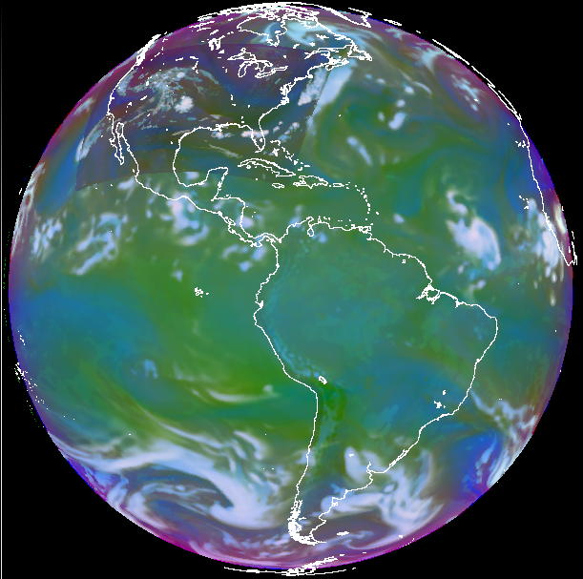
Airmass RGB image using RaFTR-CIMSS-SIM data (From Joe Zajic)
Airmass RGB
First Try
20140729 1800Z
R: 6.95um-7.34um
G: 9.61um-10.35um
B: 1/(6.95um)
Each input scaled to it’s range

Slide 8
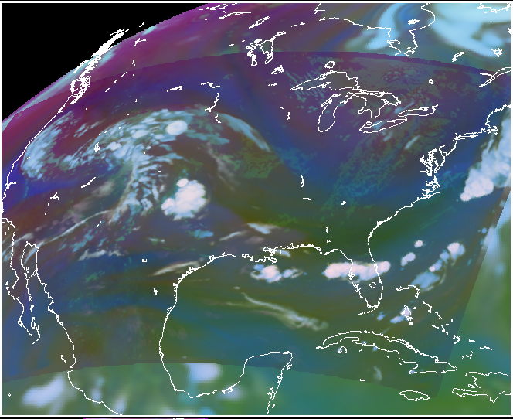
Airmass RGB image using RaFTR-CIMSS-SIM data (From Joe Zajic)
Airmass RGB
First Try
CONUS Detail

