Slide 1
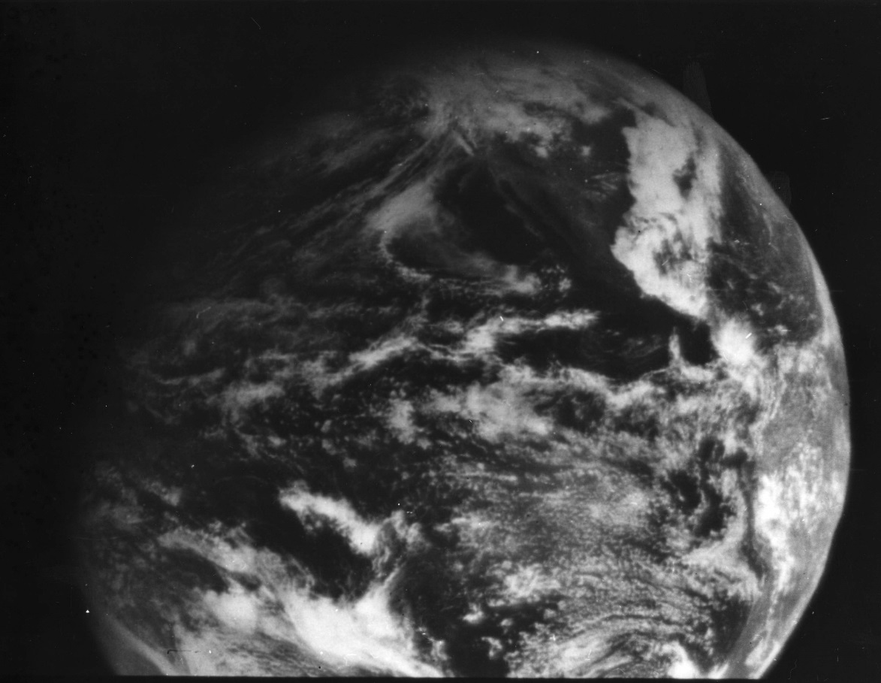
1966: ATS-1 launched
Applications Technology Satellite (ATS)-1 hosted the first geostationary imager, Spin-Scan Cloud Camera, launched 6 December 1966.
Imaging instrument designer and SSEC co-founder, Verner E. Suomi, proclaimed, “Now, the weather moves, not the satellite.”
11 December 1966
North America
Notes:
http://cimss.ssec.wisc.edu/news/geo_image_anniversary.html

Slide 2
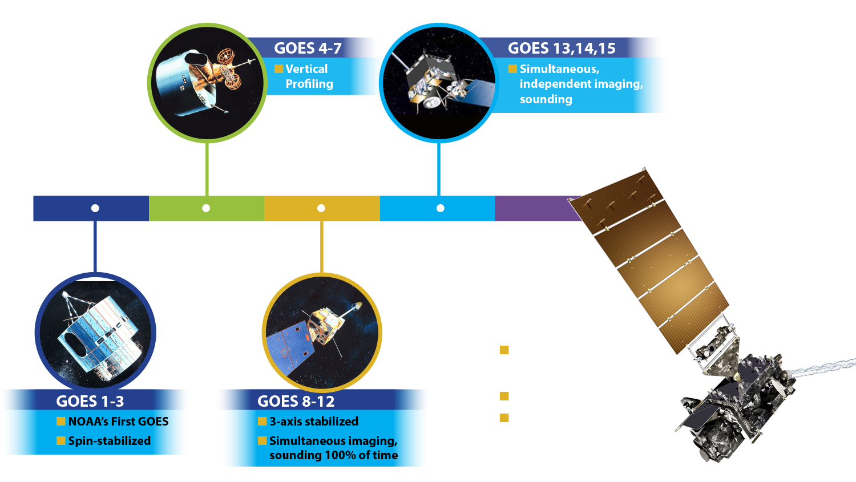
A History of GOES “Weather” Satellites
ATS
SMS
ABI=Advanced
Baseline Imager
Notes:
The focus of this Short Course is to describe the advancements with the GOES-R series

Slide 3
GOES-14 Super Rapid Scan Operations to Prepare for GOES-R (SRSOR)
SRSOR for 2016 included February 1- 25, and April 18-May 15 (Fort McMurray fires), and August 9-28:
http://cimss.ssec.wisc.edu/goes/srsor2016/GOES-14_SRSOR.html
Data during parts of 2012 (Hurricane Sandy, convection), 2013 (CA Rim Fire, convection) and 2014 (Hurricane Marie, convection) and 2015 (convection):
http://cimss.ssec.wisc.edu/goes/srsor/GOES-14_SRSOR.html
http://cimss.ssec.wisc.edu/goes/srsor2013/GOES-14_SRSOR.html
http://cimss.ssec.wisc.edu/goes/srsor2014/GOES-14_SRSOR.html
http://cimss.ssec.wisc.edu/goes/srsor2015/GOES-14_SRSOR.html
GOES-14 provides unique data and offered a glimpse into the possibilities that will be provided by the ABI in one minute mode
GOES-14 visible image showing rapid convective development over just 30 minutes
Notes:
Animation.
http://cimss.ssec.wisc.edu/goes/srsor2015/GOES-14_SRSOR.html

Slide 4
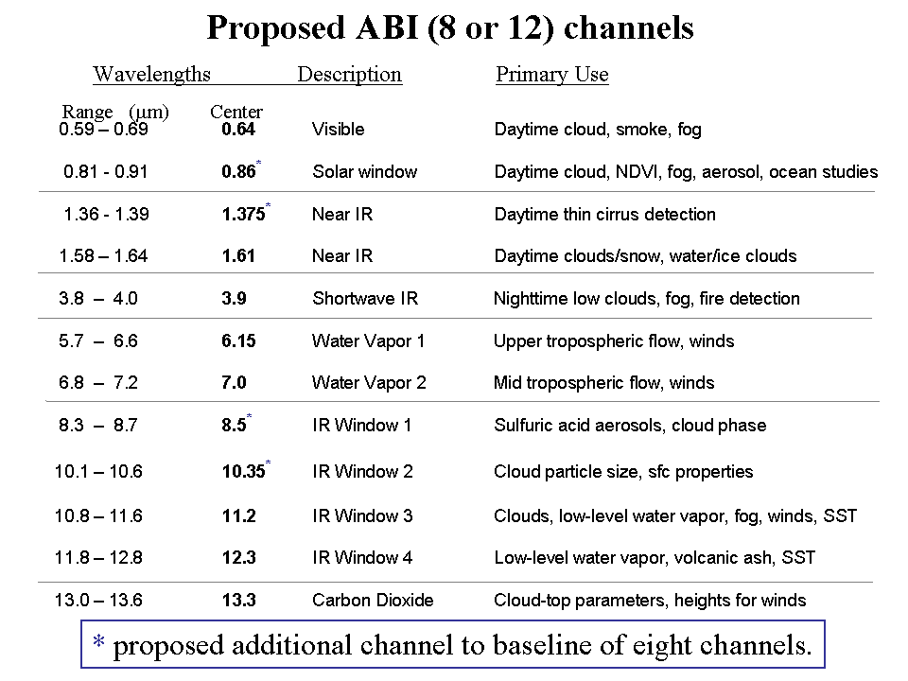
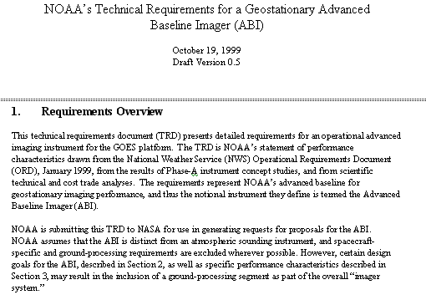
GOES-R Mission Planning
STAR very involved during the early GOES-R series development. This includes: formulation studies for both ABI and Advanced Baseline Sounder (ABS), ABI band selection and modification, etc.
ABI/ABS Requirements.
circa 1999/2000
Originally ABI was only 8 spectral bands, now it is 16. All ABI bands were modified with input from STAR and its Cooperative Institutes.
Notes:
Significant remaining scientific challenges for the specific science topic
Next step(s)
Instruments (current/future), techniques, testbed, transition, …
Path into applications/operations
Who will use it and how
How will it get out to the real world

Slide 5
1 0.52 – 0.72 0.62 Visible Daytime clouds, fog 8 1.3 – 1.9 1.6 Near IR Daytime clouds/snow, water/ice clouds 2 3.8 – 4.0 3.9 Shortwave IR Nighttime low clouds, fog, fire detection 3 6.5 – 7.0 6.75 Water Vapor 1 Upper tropospheric flow, winds 6 7.0 – 7.5 7.25 Water Vapor 2 Mid tropospheric flow, winds 4 10.2 – 11.2 10.7 IR Window 3 Clouds, low-level water vapor, fog, winds 5 11.5 – 12.5 12.0 IR Window 4 Low-level water vapor, volcanic ash 7 13.2 – 13.8 13.5 Carbon Dioxide Cloud-top parameters, heights for winds
ABI - 8
# Wavelengths Description Primary Use
Range (μm) Center
ABI – circa 1999
(8 total bands, most spectrally wide)
Notes:
These 8 bands represent the current GOES imager “six” and 1.6 and 7.2 um bands.

Slide 6
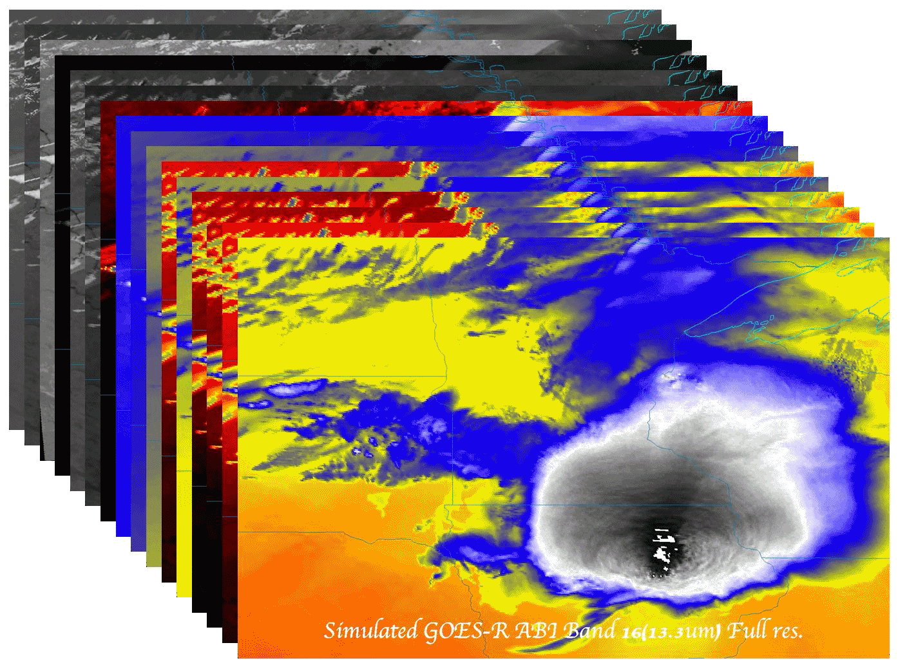
ABI Band “Champions”
Wavelength | Band # | Champion
0.47 | 1 | Fred Mosher
0.64 | 2 | Vern Suomi
0.86 | 3 | Nagaraja Rao
1.38 | 4 | Bo-Cai Gao
1.61 | 5 | L. Stowe
2.25 | 6 | M. King
3.9 | 7 | Vern Suomi
6.16 | 8 | Pierre Morel
6.93 | 9 | W. L. Smith
7.34 | 10 | Gary Ellrod
8.5 | 11 | S. Ackerman
9.61 | 12 | Art Neuendorffer
10.33 | 13 | W. P. Menzel
11.2 | 14 | Vern Suomi
12.3 | 15 | Vern Suomi
13.3 | 16 | W. L. Smith
UW-Madison connection

Slide 7
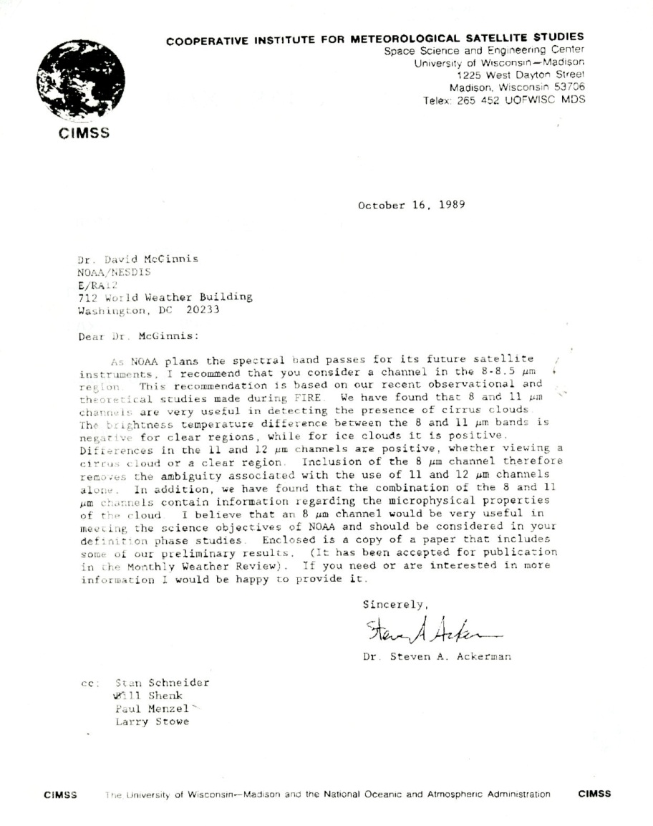
Ackerman memo (1989)
8 micrometer…very useful in detecting …cirrus information … microphysical properties

Slide 8
0.59 – 0.69 0.64 Visible Daytime cloud, smoke, fog 0.81 ­ 0.91 0.86* Solar window Daytime cloud, NDVI, fog, aerosol, ocean studies 1.36 - 1.39 1.375* Near IR Daytime thin cirrus detection 1.58 – 1.64 1.61 Near IR Daytime clouds/snow, water/ice clouds 3.8 – 4.0 3.9 Shortwave IR Nighttime low clouds, fog, fire detection 5.7 – 6.6 6.15 Water Vapor 1 Upper tropospheric flow, winds 6.8 – 7.2 7.0 Water Vapor 2 Mid tropospheric flow, winds 8.3 – 8.7 8.5* IR Window 1 Sulfuric acid aerosols, cloud phase 10.1 – 10.6 10.35* IR Window 2 Cloud particle size, sfc properties 10.8 – 11.6 11.2 IR Window 3 Clouds, low-level water vapor, fog, winds, SST 11.8 – 12.8 12.3 IR Window 4 Low-level water vapor, volcanic ash, SST 13.0 – 13.6 13.3 Carbon Dioxide Cloud-top parameters, heights for winds
Proposed ABI (8 or 12) channels
Wavelengths Description Primary Use
Range (μm) Center
* proposed additional channel to baseline of eight channels.
Notes:
As originally proposed by the National Weather Service, the ABI was to have a minimum of 8 spectral channels. The selected channels were close to the five channels on the GOES-8 -10 imagers ( 0.64, 3.9, 6.15, 11.2, and 12.3 μm) supplemented with a snow/cloud discriminating 1.6 μm channel, a mid-tropospheric 7.0 um water vapor channel, and a cloud height determining 13.3 μm channel. Two additional channels were proposed to expand the capabilities closer to meeting NWS requirements and to enhance opportunities for weather and climate research and applications; the IR windows at 8.5 μm and 10.35 μm offer improved moisture, cloud, aerosol, and surface sensing capabilities. In addition some of the ABI-8 spectral widths were modified to complement other satellite spectral channels and to capitalize on experience gained with the MODIS Airborne Simulator (MAS). To round out an ABI-12, another visible channel at 0.86 μm was added to help with the detection of aerosols and vegetation and a near infrared channel at 1.38 μm to detect very thin cirrus in the upper troposphere.
The addition of the 8.5 μm enables detection of volcanic cloud with sulfuric acid aerosols and thin cirrus in conjunction with the 11.2 μm channel as well as determination of cloud micro-physical properties with the 11.2 and 12.3 μm channels. This includes a more accurate delineation of ice from water clouds during the day or night.
The addition of the 10.35 μm improves determination of micro-physical properties of clouds with the 11.2 and 12.3 μm channels; this includes a more accurate determination of cloud particle size during the day and night. Also, the observation of surface properties (such as SST) is improved using the 10.35μm along with the 8.6, 11.2, and 12.3 μm channels. Finally, there is more sensitivity to low level moisture with the additional split windows.
The 0.86 μm channel provides synergy with the AVHRR/3, as it is similar its channel 2. This channel is used for determining vegetation amount, aerosols and ocean/land studies. Characterizing aerosols and their optical properties is essential for improving a number of satellite products, for example SST, ocean color and surface temperatures. This channel also enables very localized vegetation stress monitoring, fire danger monitoring, and albedo retrieval.
The 1.38 μm channel is copied from one on MODIS. It does not see into the lower troposphere due to water vapor sensitivity and thus it provides excellent daytime sensitivity to very thin cirrus. This will aid several products relying on clear skies in the infrared windows, for example SST.

Slide 9
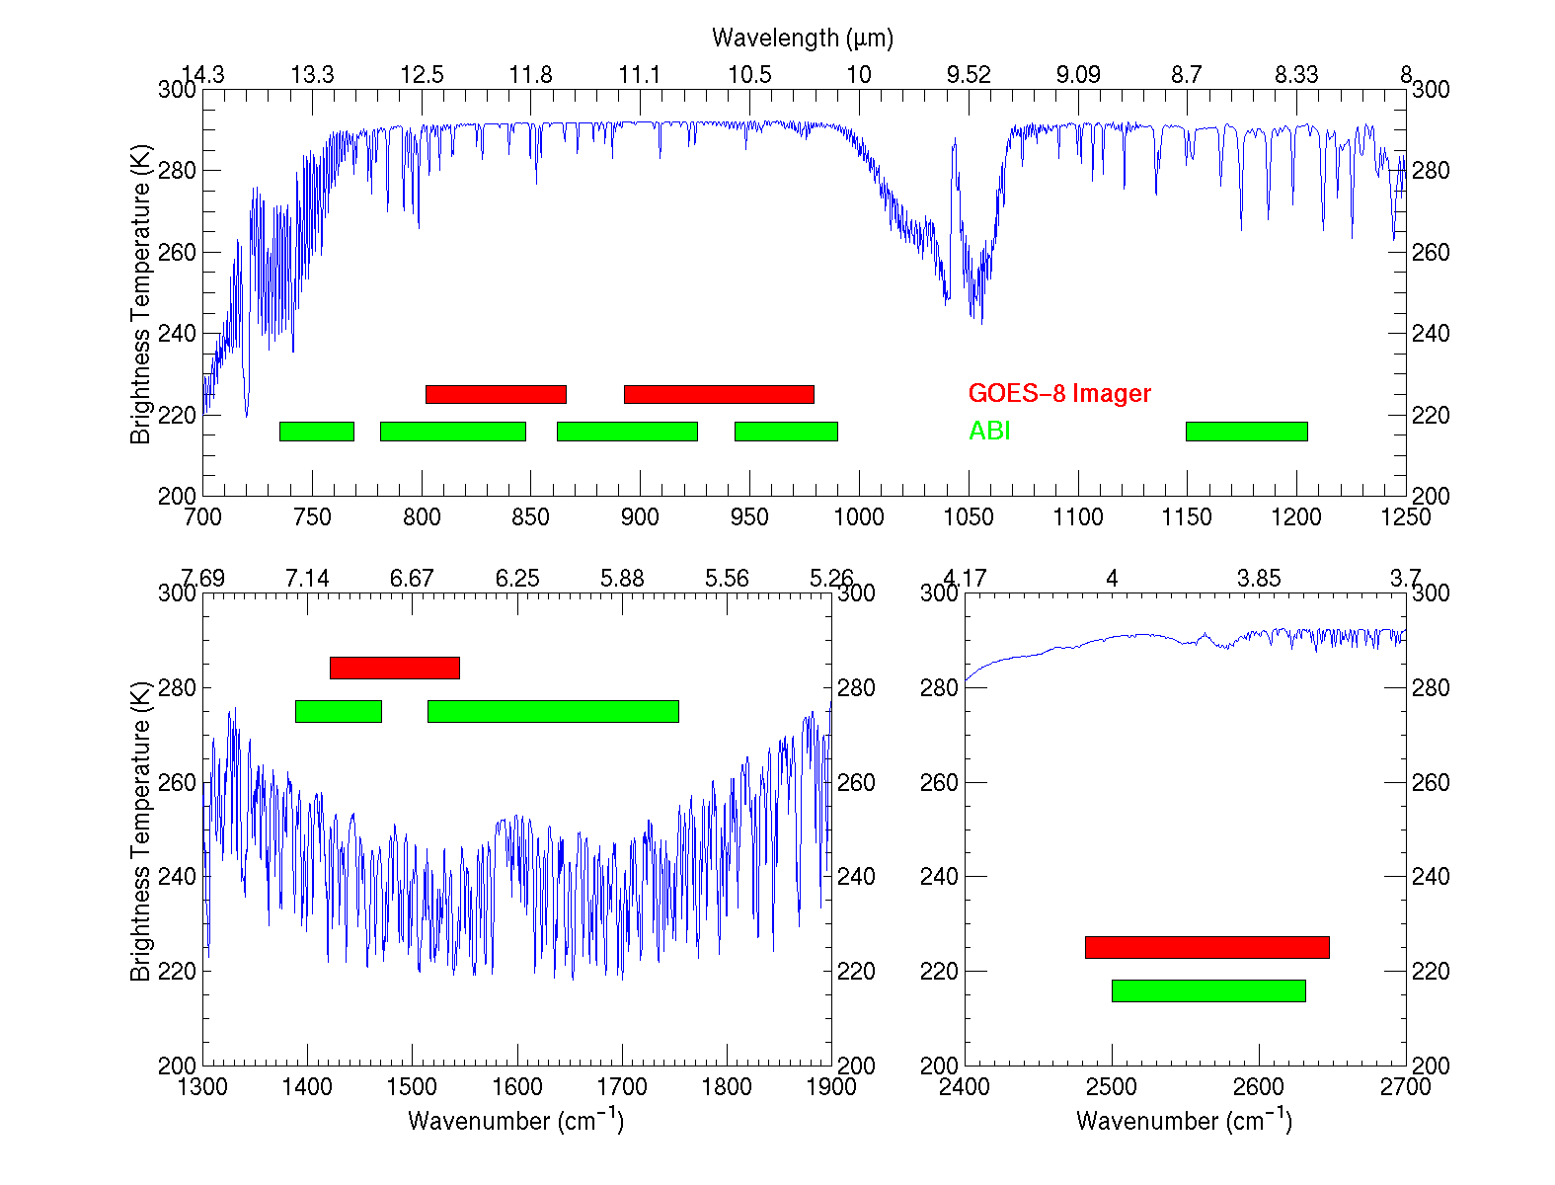
IR channels on the current GOES and the proposed ABI
Based on a NWS 1999 requirements document
UW-Madison/CIMSS
Notes:
This figure, generated by Mat Gunshor, shows the spectral coverage of the current GOES Imager (in red) and that proposed in the IR region for the ABI (Advanced Baseline Imager) (in green). A sample high spectral resolution earth-emitted spectra is also plotted (in blue). It’s apparent that the ABI has advantages over the current GOES Imager. For example, a 13.3 um band for cloud heights, two water vapor bands instead of one, and a band covering at the 8.5 um region (for cloud phase).

Slide 10
ABI Bands (proposed 18)
Current GOES Imagers
MSG/Sounder
MODIS/MTG/etc
Notes:
Band pass are approximate

Slide 11
Improved products could be realized from combinations of ABI and HES (Hyperspectral Environmental Suite) data
Spatial
resolution
Temporal
resolution
Cloud
clearing
ABI
HES
Spectral
coverage
Surface
emissivity
Spectral resolution
cira 2004
HES cancelled in 2006

Slide 12
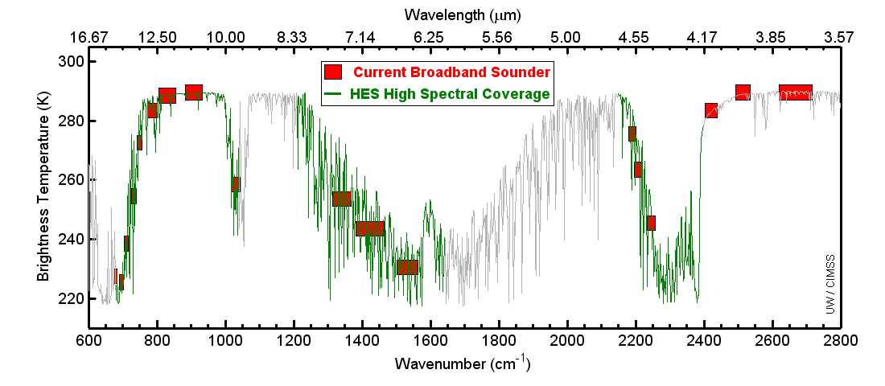
Example spectral coverage
Current GOES Sounder spectral coverage and that possible from an advanced high-spectral sounder. The broad-band nature of the current GOES limits the vertical resolution.

Slide 13
ABI: Bands 1-6 (Visible / NearIR)
ABI Band | Wavelength (µm) | Wavelength range (µm) | Sub-point pixel spacing (km) | Descriptive Name
1 | 0.47 | 0.45 - 0.49 | 1 | “Blue”
2 | 0.64 | 0.60 - 0.68 | 0.5 | “Red”
3 | 0.864 | 0.847 - 0.882 | 1 | “Veggie”
4 | 1.373 | 1.366 - 1.380 | 2 | “Cirrus”
5 | 1.61 | 1.59 - 1.63 | 1 | “Snow/Ice”
6 | 2.24 | 2.22 -2.27 | 2 | “Cloud Particle Size”
Six visible or near visible bands on ABI, one on heritage imager
Notes:
Based on Schmit et al, 2017. stars = today’s imager band.

Slide 14
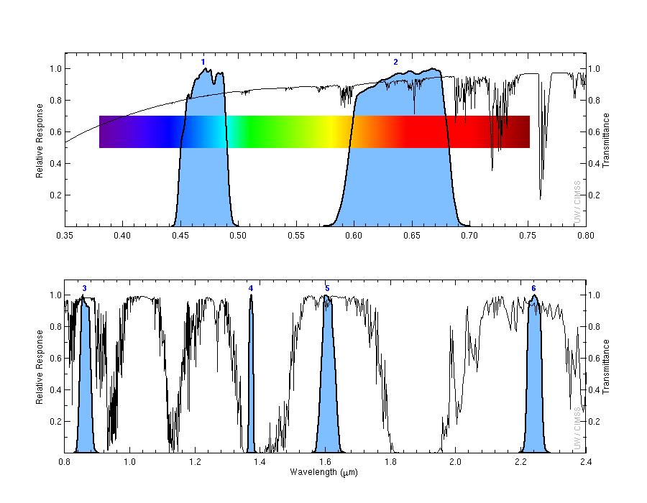
ABI Spectral Bands (1-6)
Visible
Near-IR
Mat Gunshor, CIMSS

Slide 15
ABI: Bands 7-16 (Infrared)
ABI Band | Wavelength (µm) | Wavelength range (µm) | Sub-point pixel spacing (km) | Descriptive Name
7 | 3.90 | 3.80 - 3.99 | 2 | “Shortwave window”
8 | 6.19 | 5.79 - 6.59 | 2 | “Upper-level Water Vapor”
9 | 6.93 | 6.72 - 7.14 | 2 | “Mid-Level Water Vapor”
10 | 7.34 | 7.24 - 7.43 | 2 | “Lower/Mid-level Water Vapor”
11 | 8.44 | 8.23 - 8.66 | 2 | “Cloud-top Phase”
12 | 9.61 | 9.42 - 9.80 | 2 | “Ozone”
13 | 10.33 | 10.18 - 10.48 | 2 | “Clean longwave window”
14 | 11.21 | 10.82 - 11.60 | 2 | “Longwave window”
15 | 12.29 | 11.83 - 12.75 | 2 | “Dirty longwave window”
16 | 13.28 | 12.99 - 13.56 | 2 | “CO₂”
10 infrared bands on the ABI, four on heritage imager
Notes:
Based on Schmit et al, 2017. stars = today’s imager band.

Slide 16
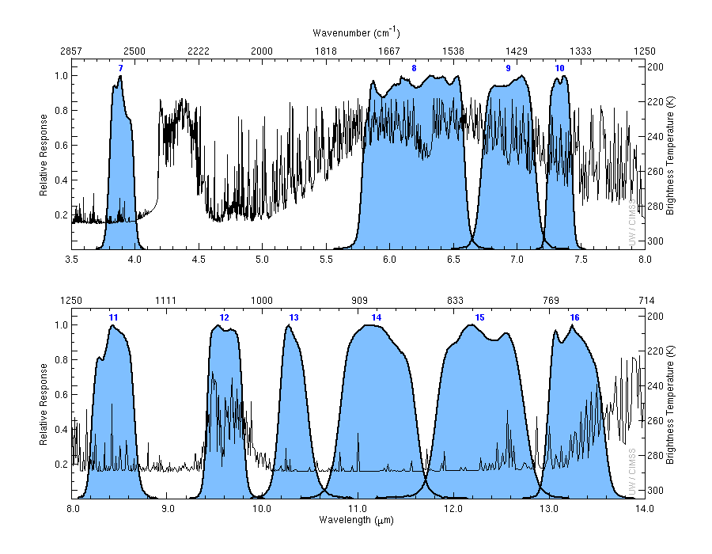
ABI IR Spectral Bands (7-16)
cool
hot
Mat Gunshor, CIMSS

Slide 17
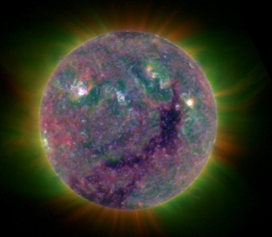
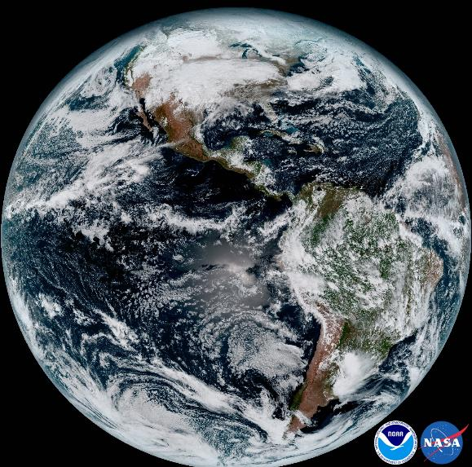
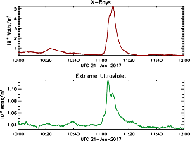
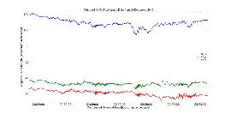
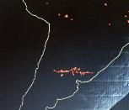
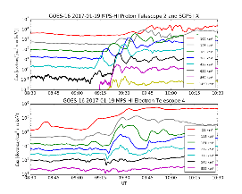
GOES-R Series Instruments
SUVI
XRS
EXIS
EUVS
MAG
SEISS
GLM
ABI
GOES-R Program Office
3-17
3-17

Slide 18
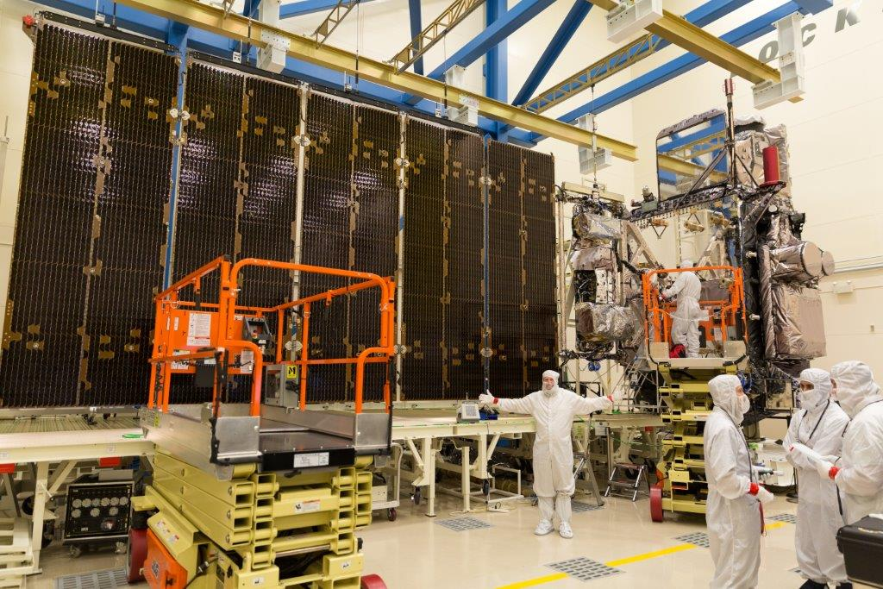
GOES-R Advanced Baseline Imager (ABI)
Spectral
Improved!
Spatial
Improved!
Temporal
Improved!
Calibration
Improved!
Lockheed Martin

Slide 19
Squall Line
Visible and infrared
Bill Line, NWS

Slide 20
3.9 μm Fire pixels in Yellow, Band 1 to show smoke
Bill Line, NWS

Slide 21
GOES-16 and -13

Slide 22
GOES-16 Products
ABI L1b Product
Radiances
ABI L2+ Products (con’t)
Downward S/W Radiation: Surface
Fire/Hot Spot Characterization
Hurricane Intensity Estimation
Land Surface Temperature
Legacy Vertical Moisture Profile
Legacy Vertical Temperature Profile
Rainfall Rate/QPE
Reflected S/W Radiation: TOA
Sea Surface Temperature
Snow Cover
Total Perceptible Water
Volcanic Ash: Detection and Height
GLM L2 Product
Lightning: Events, Groups, Flashes
SEISS L1b Products
Energetic Heavy Ions
Magnetospheric e⁻/p⁺: Low Energy
Magnetospheric e⁻/p⁺: High Energy
Solar & Galactic Protons
EXIS L1b Product
Solar Flux: EUV
Solar Flux: X-ray Irradiance
SUVI L1b Product
Solar EUV Imagery
MAG L1b Product
Geomagnetic Field
ABI L2+ Products
Cloud and Moisture Imagery (KPP)
Aerosol Detection (Smoke & Dust)
Aerosol Optical Depth (AOD)
Clear Sky Mask
Cloud Particle Size Distribution
Cloud Top Height
Cloud Top Phase
Cloud Top Pressure
Cloud Top Temperature
Derived Motion Winds
Derived Stability Indices
Plus from the ABI (Pathfinders)
Aerosol Particle Size Cloud Layers/Heights Ice Thickness Low Cloud and Fog Ice: Concentration Ice: Motion

Slide 23
Many critical derived quantities
http://www.goes-r.gov

Slide 24
Approximate spectral and spatial resolutions of US GOES Imagers
~ Band Center (um) | GOES-1/3 | GOES-4/7 | GOES-8/11 | GOES-12/13 | GOES-13/15 | GOES-R+
0.47
0.64
0.86
1.6
1.38
2.2
3.9
6.2
~6.7 |  | 14km
7.3
8.5
9.7
10.3
11.2
12.3
13.3
Visible
Box size represents pixel size,
smaller is better
Near-IR
8
4
2
“MSI mode”
Infrared
Notes:
0.40 inches = 4km; 0.80 inches = 8km
MSI is Multi-Spectral Imaging Mode (dashed boxes)
This does not show other improvements: SNR, MTF, bit-depth, navigation, coverage rates, etc.
ATS and SMS not shown.

