Slide 1
National Environmental Satellite, Data, and Information Service (NESDIS)
Satellite and Information Service
Tim Schmit, ASPB member
GOES Imagery (new capabilities)

Slide 2
NOAA at UW/CIMSS
NOAA ASPB, along with CIMSS, makes significant contributions
1). Satellite mission planning,
2). Satellite sensor calibration,
3). Satellite product development and validation, including many GOES-R and JPSS products,
4). Satellite-based Climate Data Records and analysis,
5). Nowcasting applications for improving advisories, warnings, and aviation support,
6). Proving Grounds, education, outreach and user training,
7). NWP support
- current: satellite products for data assimilation,
- past: data assimilation and model development work,
8). International expert panels
9). Other
- Weather Improvement Act
- GOES-17 ABI Issues

Slide 3
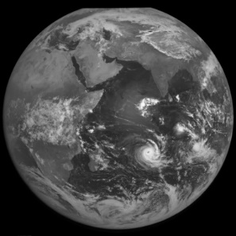
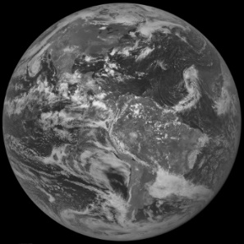
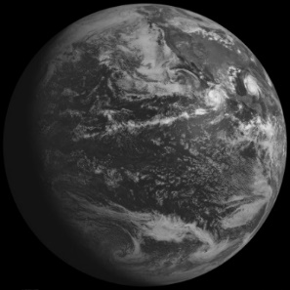
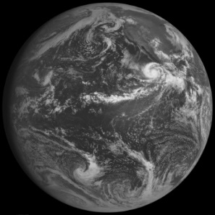
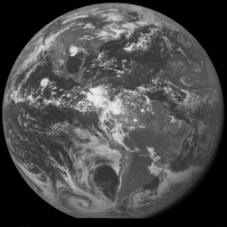
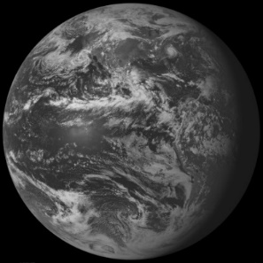
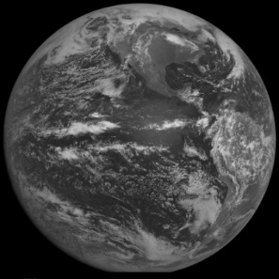
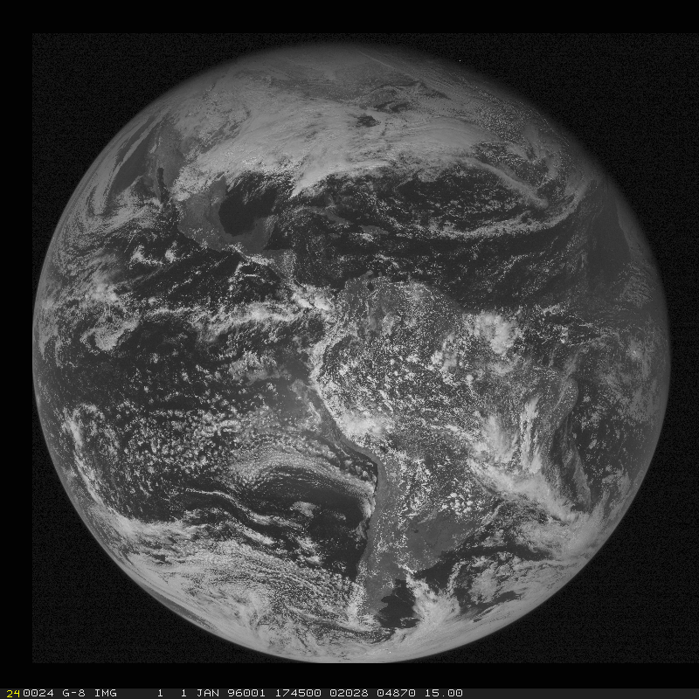
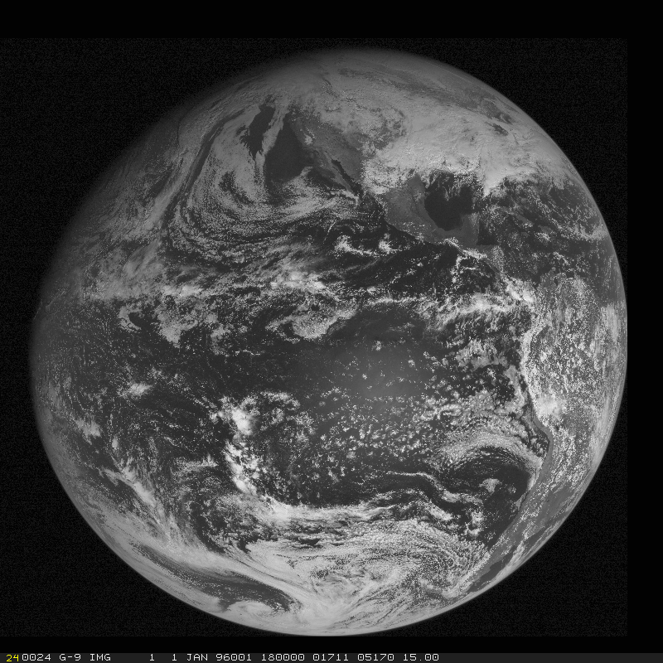
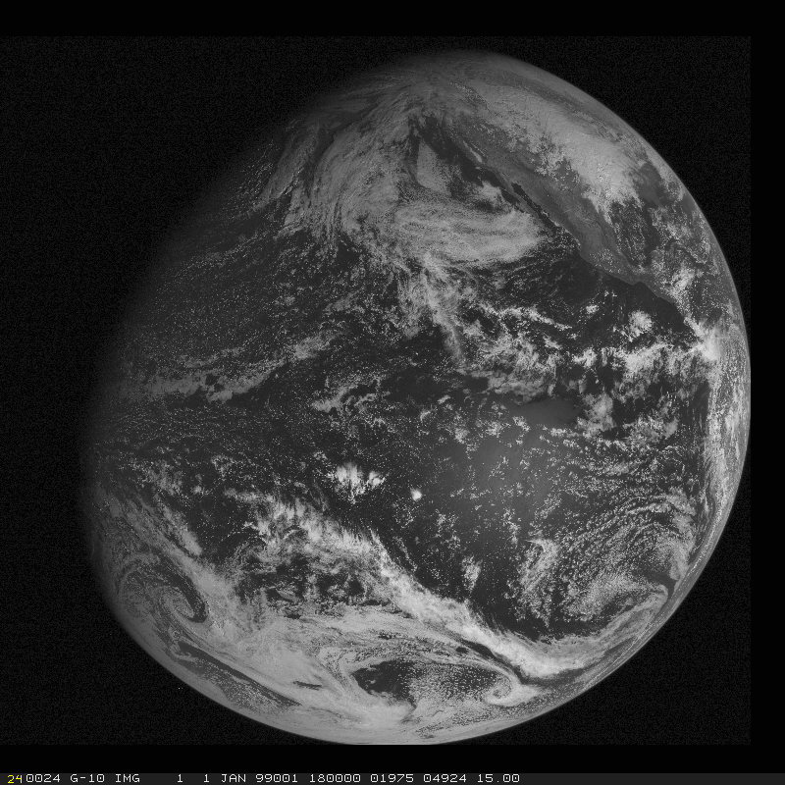
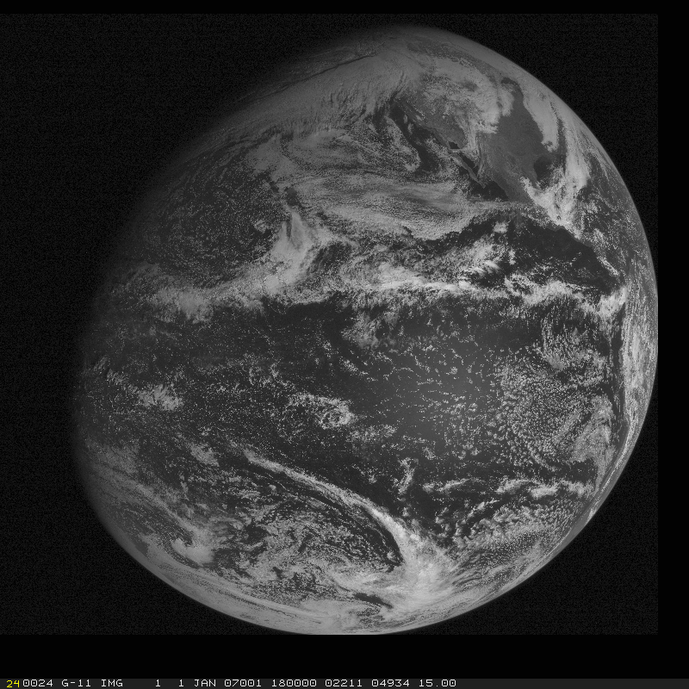
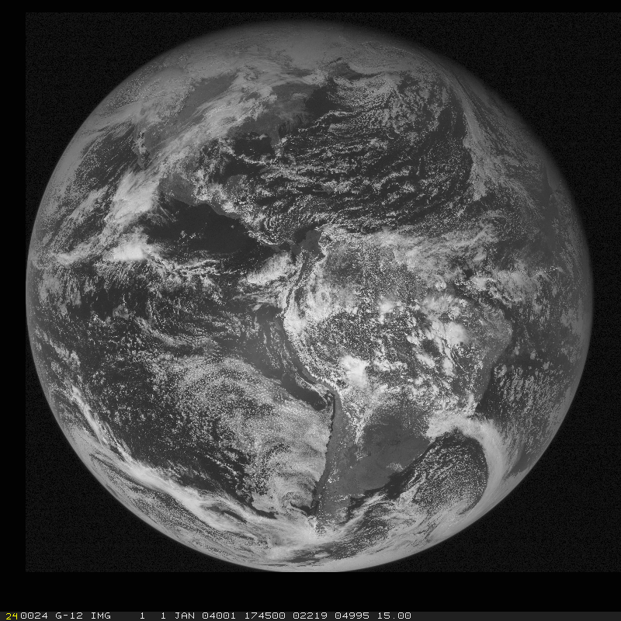
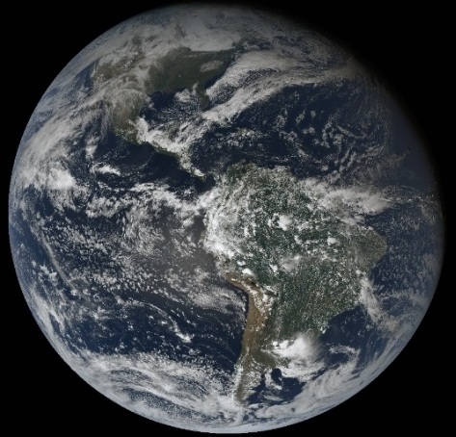
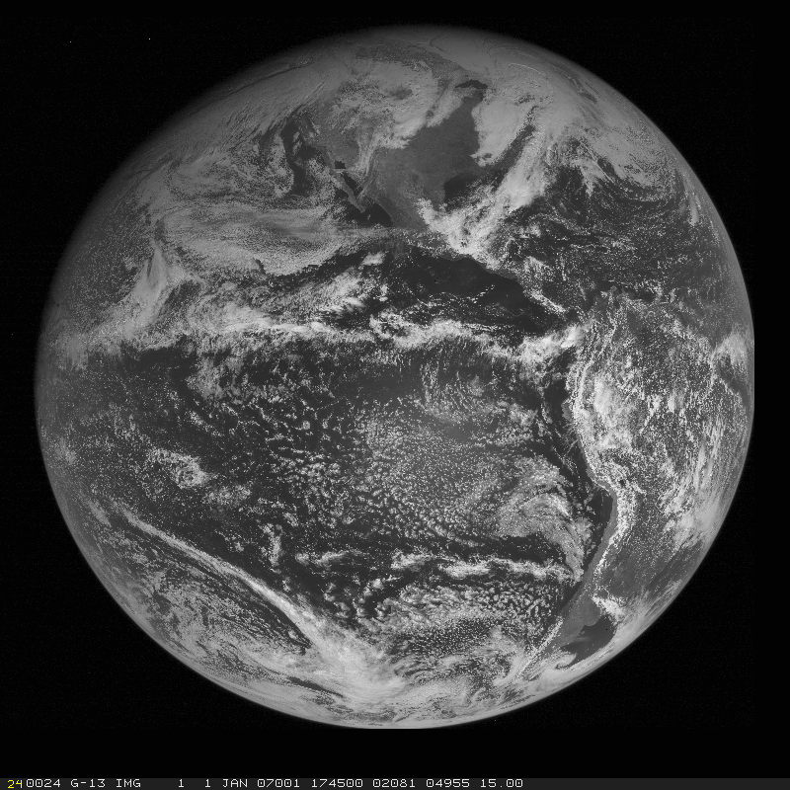
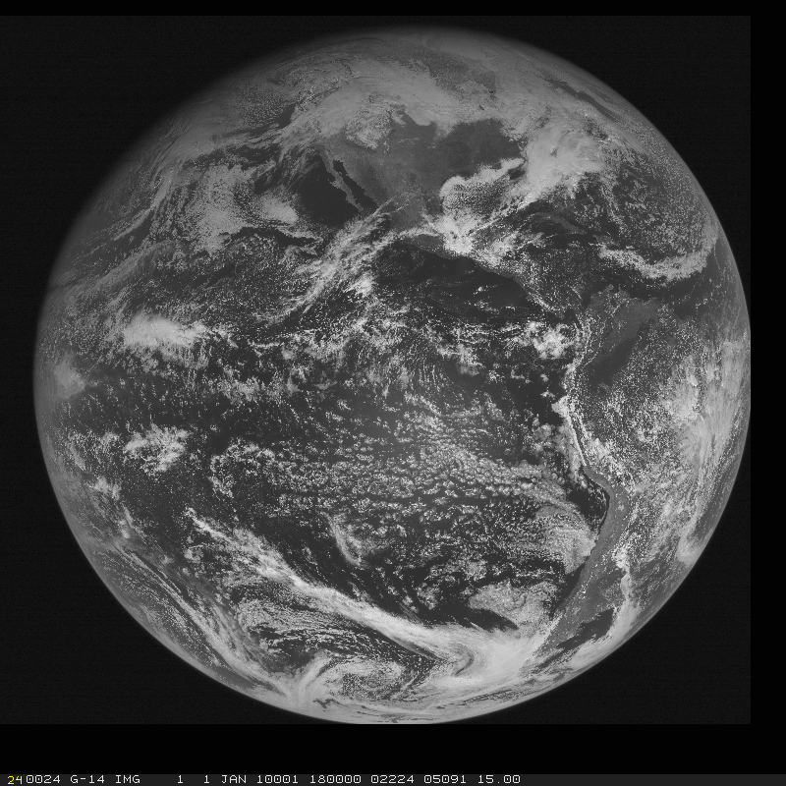
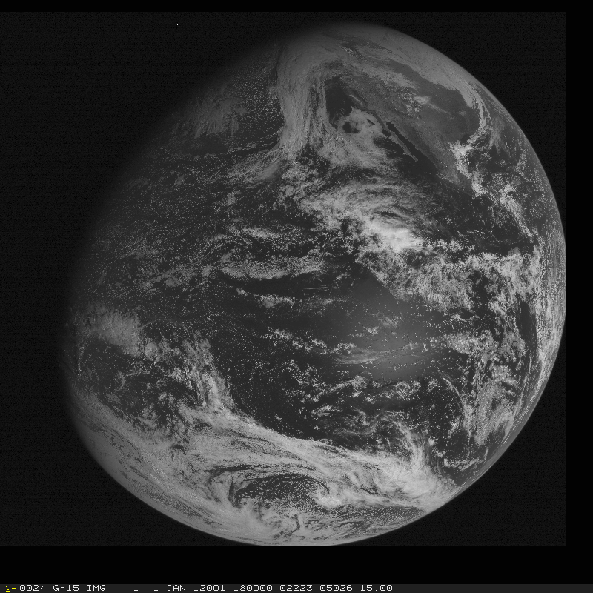
GOES Continuity
Wisconsin has played, and continues to play, key roles in the on-orbit check-out, display and use of all the GOES (Geostationary Operational Environmental Satellite)
GOES-1
(1975)
GOES-2
(1977)
GOES-3
(1978)
GOES-4
(1980)
GOES-5
(1981)
GOES-6
(1983)
GOES-7
(1987)
GOES-8
(1994)
GOES-9
(1995)
GOES-10
(1997)
GOES-11
(2000)
GOES-12
(2001)
GOES-13
(2006)
GOES-14
(2009)
GOES-15
(2010)
GOES-16
(2016)
GOES-17
(2018)
Notes:
First version from Steve Wanzong, CIMSS

Slide 4
Visible Imagery from GOES-16

Slide 5
Color Imagery from GOES-16
GOES-16 (visible)
Notes:
Animation.

Slide 6
Harvey GOES-16 (and -13)
Notes:
Animation.

Slide 7
ASPB/UW-CIMSS AWG Teams
Advanced Baseline Imager (ABI) Baseline Products
Aerosol Detection (Including Smoke and Dust)
Aerosol Optical Depth (AOD)
Clear Sky Masks | @CIMSS/ASPB
Cloud and Moisture Imagery | @CIMSS/ASPB
Cloud Optical Depth | @CIMSS/ASPB
Cloud Particle Size Distribution | @CIMSS/ASPB
Cloud Top Height | @CIMSS/ASPB
Cloud Top Phase | @CIMSS/ASPB
Cloud Top Pressure | @CIMSS/ASPB
Cloud Top Temperature | @CIMSS/ASPB
Derived Motion Winds | @CIMSS/ASPB*
Derived Stability Indices | @CIMSS/ASPB
Downward Shortwave Radiation: Surface
Fire/Hot Spot Characterization | @CIMSS/ASPB*
Hurricane Intensity Estimation | @CIMSS/ASPB
Land Surface Temperature (Skin)
Legacy Vertical Moisture Profile | @CIMSS/ASPB
Legacy Vertical Temperature Profile | @CIMSS/ASPB
Radiances | CWG members
Rainfall Rate / QPE
Reflected Shortwave Radiation: TOA
Sea Surface Temperature (Skin)
Snow Cover | @CIMSS/ASPB
Total Precipitable Water | @CIMSS/ASPB
Volcanic Ash: Detection and Height | @CIMSS/ASPB
Advanced Baseline Imager (ABI) Pathfinders Products
Aerosol Particle Size
Cloud Layers/Heights | @CIMSS/ASPB
Ice Thickness | @CIMSS/ASPB
Ice: Concentration | @CIMSS/ASPB
Ice: Motion | @CIMSS/ASPB
Low Cloud and Fog | @CIMSS/ASPB
Land Surface Temperature
Most of the key derived satellite products to better save lives and property have a Wisconsin connection.
GOES-R Program
ABI Level 2 (derived products)
Total: 22 out of 31
AWG = Algorithm Working Group
For CIMSS/ASPB products, Team Lead is ASPB and science team is at CIMSS.
* Team lead is in DC, algorithm developer and science team at CIMSS.
Notes:
The only other thing I wanted to say about AWG is show the list of baseline and Pathfinder ABI products. There are about this many “option 2” products too that are sort of just in limbo now.

Slide 8
Conclusions
Wisconsin has played a key role in the Advanced Baseline imagers that continue the critical continuity role of geostationary imagers and have large positive societal impacts, including but are not limited to:
weather (clouds, q, winds, temperatures),
Numerical Weather Prediction,
severe weather (convection, etc.),
transportation (fog, LES, etc.)
aviation (turbulence, volcanic ash plumes),
environmental (fires, burn scars),
health (smoke),
oceanographic (SST),
cryosphere,
air Quality (Fires, smoke, dust),
energy and agriculture (solar inputs),
etc.
http://www.goes-r.gov

