Slide 1
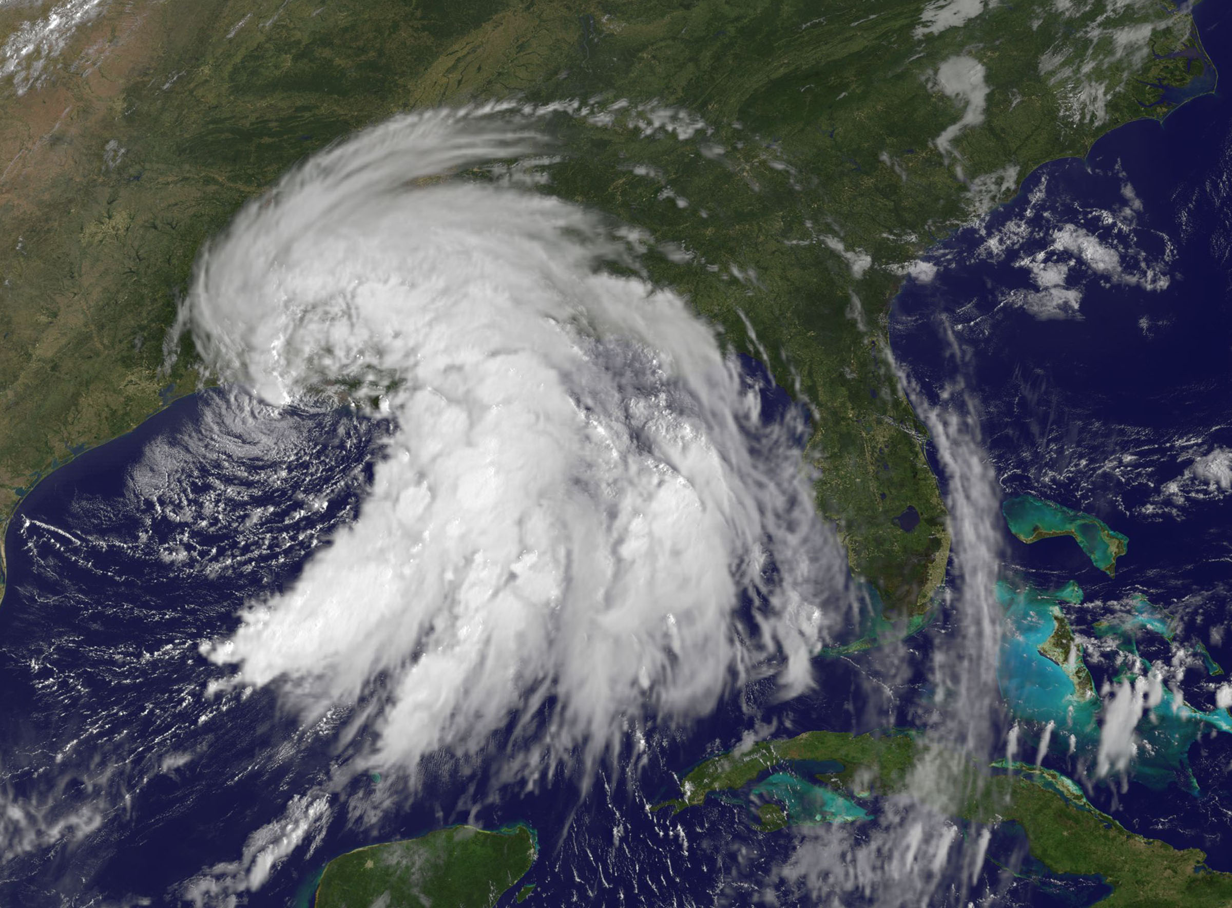
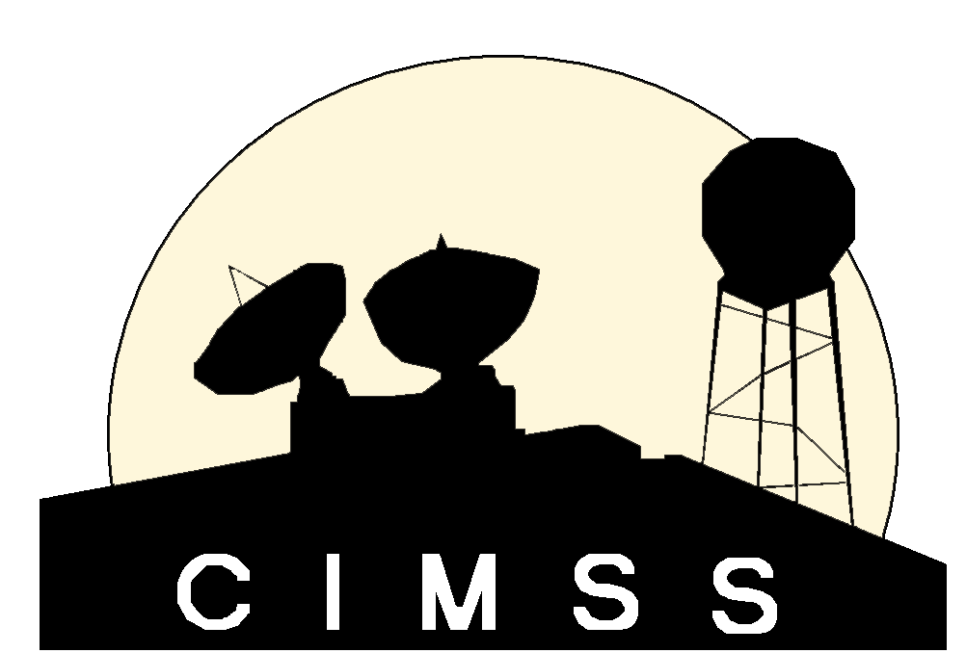
GOES-R/JPSS Program
CIMSS/ASPB Participation
GOES-R/JPSS Proving Ground Status
Wayne Feltz, Mike Pavolonis, Tim Schmit, Andy Heidinger, Jordan Gerth, Scott Bachmeier, Scott Lindstrom, Justin Sieglaff, Lee Cronce, Robert Aune, Gary Wade, Brad Pierce, Kaba Bah, Will Straka, Jason Otkin, Sarah Monette, Chris Velden, Ralph Petersen, Russ Dengel and Chris Schmidt
September 9, 2013

Slide 2
Satellite Proving Ground @ CIMSS/ASPB
Demonstration of Satellite PG applications at National Center Testbeds; Demonstrations at NWS WFOs
AWIPS-2 status
Training
SRSOR from GOES-14
Upcoming meetings/conferences
Notes:
Any new bullets?

Slide 3
1) Hazardous Weather Testbed and SPC, Norman OK
Satellite Liaison: Bill Line
HWT Products:
Simulated Cloud and Moisture Imagery (Otkin/Sieglaff/Lindsey – CIMSS/CIRA)
NearCast Model (Petersen/Line - CIMSS)
Cloud Top Cooling (Sieglaff/Feltz – CIMSS)
Product demonstrations in SPC are starting. SPC Products:
NearCast Model
Cloud Top Cooling
Overshooting Tops
SRSOR (in August)
Continue streamlining formats for AWIPS-2
Future planning will be coordinated with new liaison
Spring 2014 HWT plans
Hydrological/Fire Testbed in future?
UW-Madison satellite applications “Boot Camp” was held 8-19 July 2013: Bill Line, Amanda Terborg, Chad Gravelle, and Michael Folmer were present

Slide 4
2) AWC Testbed Satellite Proving Ground
Satellite Liaison: Amanda Terborg
Aviation Weather Testbed Summer Demo: August 12 – 23, 2013
WRF Simulated ABI Imagery
GOES Cloud Top Cooling
GOES(-R) Overshooting Top and Tropical Overshooting Top
Thermodynamic NearCasting
GOES-14 imager SRSO 1-minute mode imagery, CTC, and OT were available for testbed
GOES-R proxy cloud top heights/temperature (ACHA) for GOES East/West
CIMSS participants
12-16 August: Justin Sieglaff
19-21 August: Wayne Feltz
Forecaster feedback/examples are available:
http://goesrawt.blogspot.com/
4
Notes:
Slide 5 in main presentation – clarified ash/so2 products are for MODIS-Alaska domain

Slide 5
GOES-14 SRSOR (1-minute data) GOES-14 (using routine GOES-E times)
UW-Cloud Top Cooling algorithm output - using 1-minute GOES-14 data:
UW-CTC signal begins sooner using 1-minute data versus GOES-E routine operations (RO) scanning
Most intense UW-CTC signal is always captured using 1-minute data compared to GOES-E RO
Near-real time processing kept up with 1-minute GOES-14 data rates

Slide 6
3) NWS Operations PG and WFO Interactions
Satellite Liaison: Chad Gravelle
Continued coordination of GOES-R Fog/Low Stratus products into operations (West Coast evaluation began in May with SEW, EKA, LOX, and MTR).
Convective Cloud-Top Cooling (part of “convective-initiation toolbox”) evaluation with CR (12 WFOs) and ER (2 WFOs) began in June, intermountain West WFO evaluation possibly in July.
Assisted in distributing VIIRS bands (including DNB) to local WFO, Monterey and Louisville, and now available to MKX, MTR, LMK, and the AK WFOs
Assisted CRH and ERH with successful display of Fog/Low Stratus products in AWIPS 2.
Working with NWS Operations PG regarding GOES-R products and and how they relate to ongoing GOES-R PG activities.

Slide 7
4) Alaska/AAWU/High Latitude Testbed
Automated ash cloud alerts from AVHRR and MODIS will be provided to the VAAC and CWSU soon (training needs to be updated first).
VIIRS NetCDF files verified to be AWIPS-II compatible
VIIRS VISITview NWS training module under development
Polar2grid tool expansion for GEOCAT AK/CONUS nearly complete—real-time testing beginning soon
Participated in OCONUS meeting 17-21 June 2013:
CIMSS: Wayne Feltz, Jordan Gerth, Ralph Petersen, Liam Gumley
NOAA ASPB: Jeff Key and Mike Pavolonis
Notes:
Slide 6 in main presentation – updated bullets to more current items

Slide 8
5) Pacific Region/Hawaii Demonstrations
Liam Gumley, Kathy Strabala and Jordan Gerth taught a MODIS/VIIRS Direct Broadcast Application workshop at the University of Hawaii - Manoa Campus on 20-23 August 2013.
20+ students attended, including NWS and JTWC personnel as well as UH graduate students
Course consisted of morning lectures and hands-on afternoon labs, culminating in student presentations on the last day
Goal of the course were to:
Make users aware of the products that are available using the MODIS/VIIRS direct broadcast data from the NOAA HCC antenna
Teach users about the instruments, spectral bands, and principles of remote sensing
Give examples of specific MODIS and VIIRS Hawaii environmental applications
Foster the use of satellite data for local real-time applications

Slide 9
5) Pacific Region/Hawaii Demonstrations
Students working on a lab during the Hawaii VIIRS/MODIS direct broadcast application workshop.

Slide 10
5) Pacific Region/Hawaii Demonstrations
Jordan Gerth conducted other activities related to the GOES-R Proving Ground in Pacific Region after the workshop, including:
Identifying an alternate route to transmit data between Honolulu Community College and HFO once new NOAA security regulations require traffic to pass through a TIC node
Investigating interference in the Terra DB receiving frequency at the Honolulu Community College antenna site; FCC identifying government/military users in this band
Localizing/troubleshooting AWIPS at HFO to ingest/display MODIS imagery and products, lightning psuedo-reflectivity, and SPoRT QPE
Coordinating an N-Wave connection between IRC at Ford Island and Wisconsin

Slide 11
Tropical Storm Flossie
TROPICAL STORM FLOSSIE DISCUSSION NUMBER 19
NWS CENTRAL PACIFIC HURRICANE CENTER HONOLULU HI EP062013
500 AM HST MON JUL 29 2013
THE CENTER OF FLOSSIE WAS HIDDEN BY HIGH CLOUDS MOST OF THE NIGHT BEFORE VIRS NIGHTTIME VISUAL SATELLITE IMAGERY REVEALED AN EXPOSED LOW LEVEL CIRCULATION CENTER FARTHER NORTH THAN EXPECTED. WE RE-BESTED THE 0600 UTC POSITION BASED ON THE VISIBLE DATA. SUBJECTIVE DVORAK ANALYSES CONTINUED SHOW CURRENT INTENSITIES OF 3.0 BUT SATELLITE LOOPS SUGGEST A RAPID WEAKENING TREND WITH THE LOW LEVEL CENTER PULLING AWAY FROM A SMALL AREA OF CONVECTION SOUTHEAST OF THE CENTER. IT IS LIKELY THAT CONTINUED NORTHWEST SHEAR WILL MAINTAIN THIS WEAKENING TREND.
THE TRACK HAS BEEN SHIFTED NORTH TO REFLECT THE RE-LOCATED CENTER. THE TRACK GUIDANCE SHIFTED FOLLOWING THE TRACK CHANGE AND WAS CONSISTENT WITH A NEW TRACK FARTHER TO THE NORTH. THE TRACK NOW SHOWS FLOSSIE PASSING OVER MAUI TODAY...OVER OAHU TONIGHT...THEN PASSING SOUTH OF KAUAI EARLY TUESDAY MORNING. WE EXPECT FLOSSIE TO WEAKEN STEADILY AS IT TRACKS WEST NORTHWEST AND DISSIPATE WITHIN 96 HOURS.

Slide 12
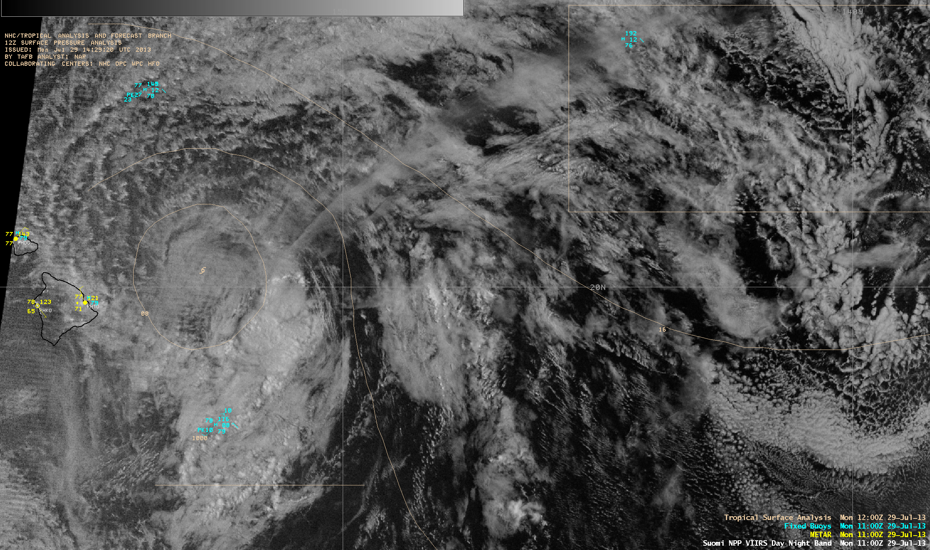
Tropical Storm Flossie
AWIPS images of VIIRS IR and Day/Night Band (Image credit: Scott Bachmeier)

Slide 13
6) Satellite Proving Ground for Marine, Precipitation, and Hazardous Weather Applications
Satellite Liaison: Michael Folmer
UW-CIMSS providing Overshooting-Top/Enhanced-V products (same methods as SPC delivery), N-AWIPS displayed at OPC, WPC, and SAB.
Cloud top height and temperature from GOES imager are in progress for display within N-AWIPS and AWIPS
Coordinated CIMSS GOES-R PG collaborations with 2013-2014 Satellite Proving Ground for Marine, Precipitation, and Hazardous Weather Applications demonstrations
Other GOES-R PG decision support products requested within plan available once approved by NOAT governance process

Slide 14
7) NHC Proving Ground
UW-CIMSS Participants: Chris Velden, Sarah Monette
Also underway at same time is the NASA HS-3 (Global Hawks for hurricane recon)
UW-CIMSS is providing real-time observations from updated versions of the Hurricane Intensity Estimate (HIE) and Tropical Overshooting Tops (TOTs) products to both exercises.
Also making extensive use of the GOES-R ACHA Cloud Top Height (CTH) estimation algorithm as part of hazard avoidance guidance in the HS-3 field campaign.

Slide 15
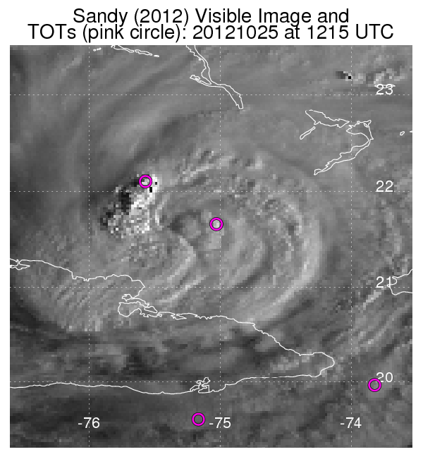
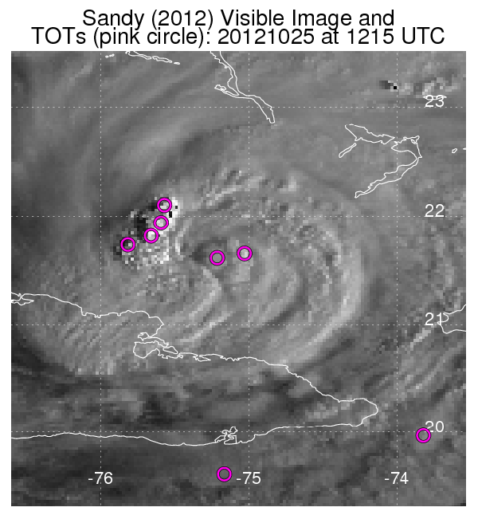
7) NHC Proving Ground
7) NHC Proving Ground
Tropical Overshooting Tops (TOTs)
Objectively identifies TOT locations using cold IR pixels relative to neighbors, and is tuned to isolate and quantify vigorous tropical convection, especially for tropical cyclone (TC) applications.
Employs IR-Window imagery from GOES and Meteosat.
Algorithm updates based on feedback from 2012:
Removal of false-alarm TOTs in TC cirrus outflow.
Better identify TOTs in TC Central Dense Overcast (CDO). >>>
Training was provided to NHC/TAFB in April to increase familiarity with the TOT products.
Original algorithm
Updated algorithm

Slide 16
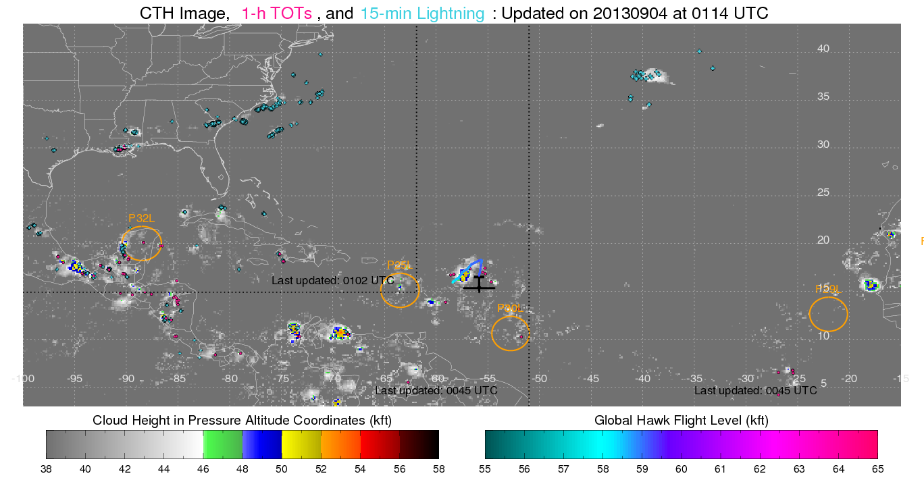
7A -- GOES-R Proxy Support to HS3
Full Basin, Real-time GOES-R Proxy Cloud Top Heights, Tropical Overshooting Tops, and 15-min Lightning

Slide 17
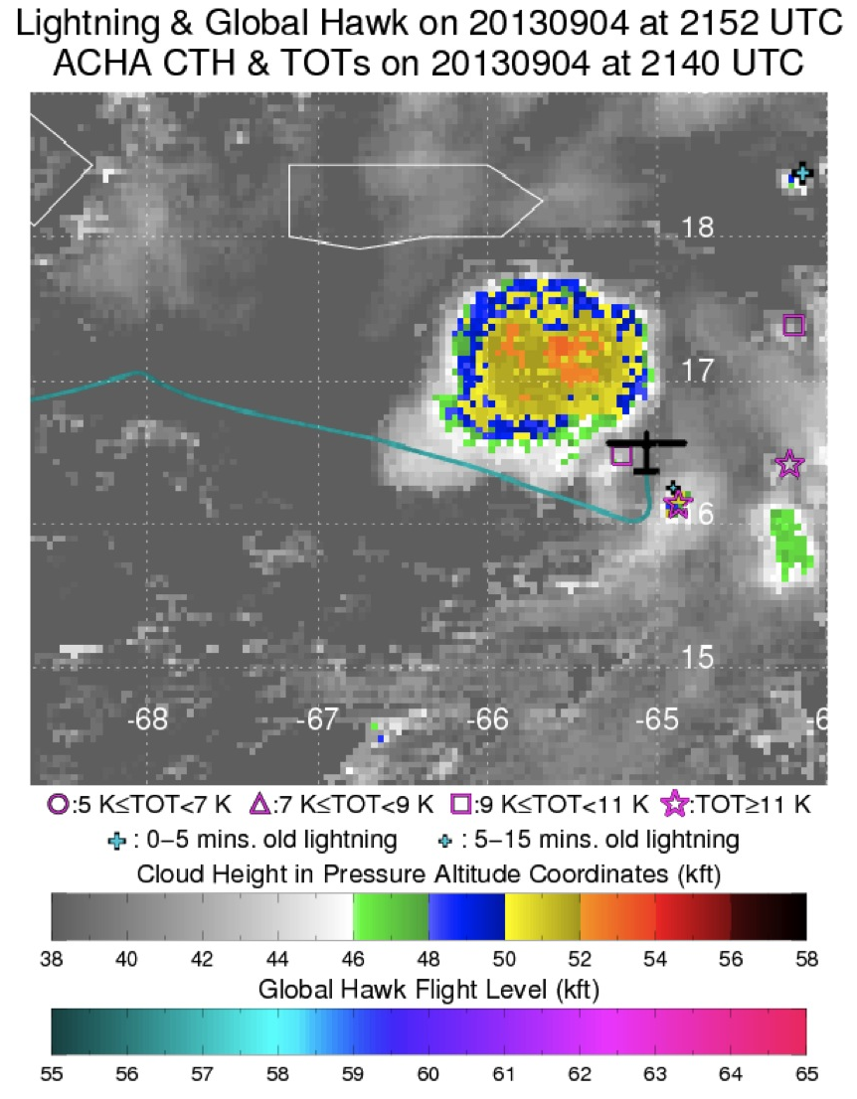
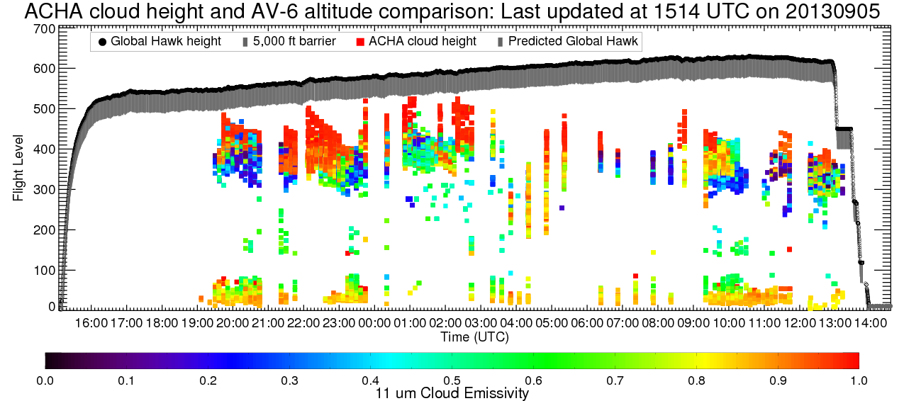
7A -- GOES-R Proxy Support to HS3
Real-time hazard avoidance guidance for the Global Hawk missions
Global Hawks must clear “active” cloud tops
with a 5,000 foot cushion.
GOES-R Proxy Cloud Top Heights and emissivity along the Global Hawk current and predicted path, provided in real-time to NASA mission scientists and GH pilots.
Real-time CTH, Tots and lightning overlay displays are updated every 2 mins. and used to identify potential hazards.

Slide 18
8) NWS WFO Demonstrations
NWS Milwaukee focal point: Steve Davis
CIMSS GOES-R Local Area Demonstration with MKX will continue again this summer and fall (anticipated to begin in June after MKX has transitioned to AWIPS II)
2013 activities plan in progress
Anticipated GOES-R products to be demonstrated in 2013 include:
Convective Cloud Top Cooling (coordinated with Chad Gravelle)
Nearcasting
Sky Cover (Extension of Cloud and Moisture Imagery)
Anticipated JPSS products to be demonstrated in 2013 include:
Day/Night Band

Slide 19
CIMSS/ASPB GOES-R ABI Real-time Proxy
2013 GOES-R PG Proxy activities (September 2013)
Provided forecasting support for airborne SNPP/METOP-B cal/val field mission (May 10-31, 2013). The primary objective of the mission was to collect cloud free radiance measurements from remote sensing instruments onboard the NASA ER2 during SNPP and METOP-B satellite overpasses in the vicinity of the Gulf of California.
Investigating ways of getting our simulated ABI products into AWIPS II: short term goal will be to write IDL code and utilize the ms2gt subroutines for remapping our products into AWIPS II NetCDF files.
Preparing data for a WES case focusing on 2013 Oklahoma tornado events: 6 products, including the RGB air-mass product, and the synthetic radiance/reflectance imagery, for the period of 20-29 May, 2013.
Continuing validation of proxy ABI RGB air-mass product using RGB air-mass images generated from co-located GOES-E Sounder brightness temperatures.

Slide 20
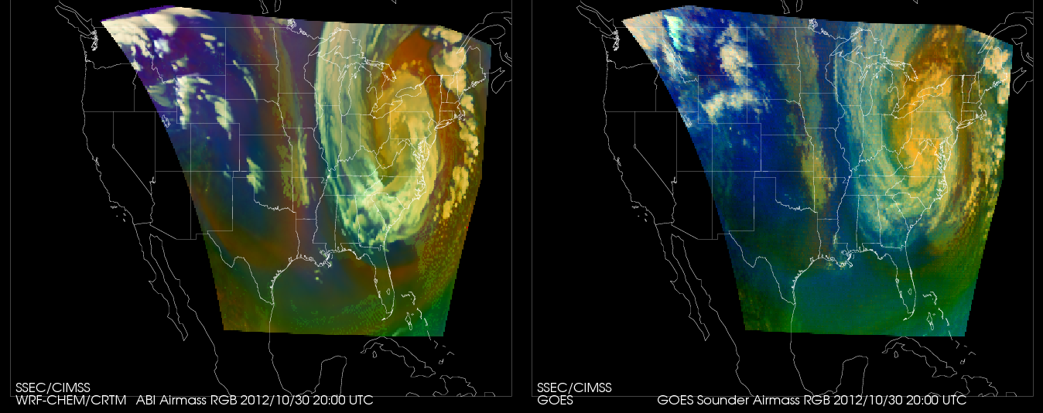
CIMSS/ASPB GOES-R ABI Real-time Proxy
Calculation Observation
Validation of proxy ABI RGB air-mass vs Observed:
RED
GREEN
BLUE
Notes:
Good overall agreement, several known differences.

Slide 21
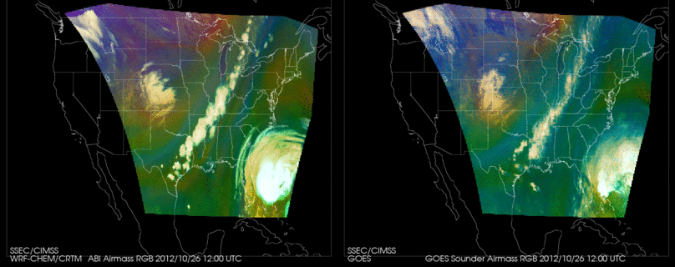
CIMSS WRFCHEM Proxy simulation animation: Calculations vs Observations on October 26, 2012.

Slide 22
CIMSS WRFCHEM Proxy simulation

Slide 23
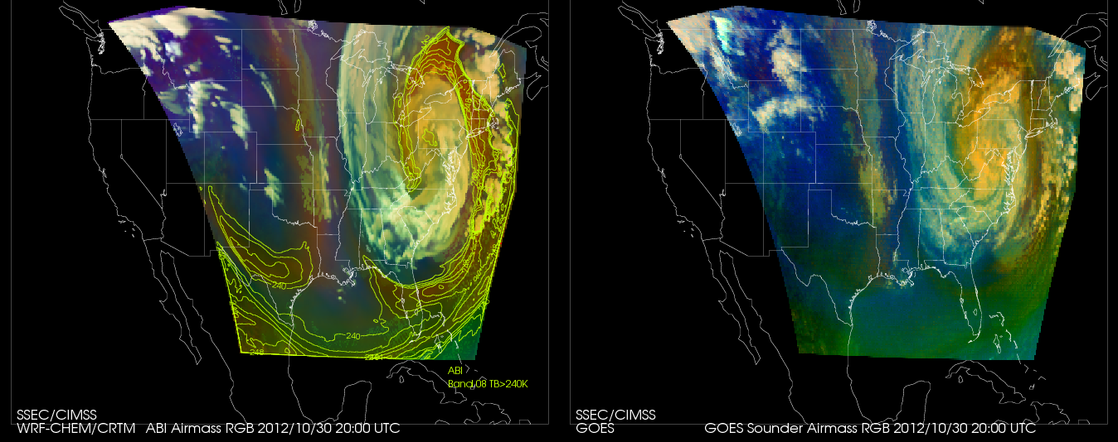
CIMSS WRFCHEM Proxy simulation: now with quantitative over-plot (TBB). Other parameters could include moisture, ozone, etc.

Slide 24
CIMSS AWIPS II Update
Actively attending AWIPS II developers’ forum conference calls and remote meetings of the EPDT
Testing of locally-produced netCDF4 files containing VIIRS imagery ongoing
Remote access to NHDA and other AWIPS WAN sites now available (still must have account to login to remote site)
This will greatly assist in troubleshooting issues with CIMSS products without a need to be on site
Installed OB13.4 at CIMSS
Demonstrated AWIPS II to JTWC forecasters
Assisting JTWC with ingesting satellite imagery into AWIPS II on their local system
Troubleshooting AWIPS II issues related to satellite imagery ingest, storage, and purging at PRH

Slide 25
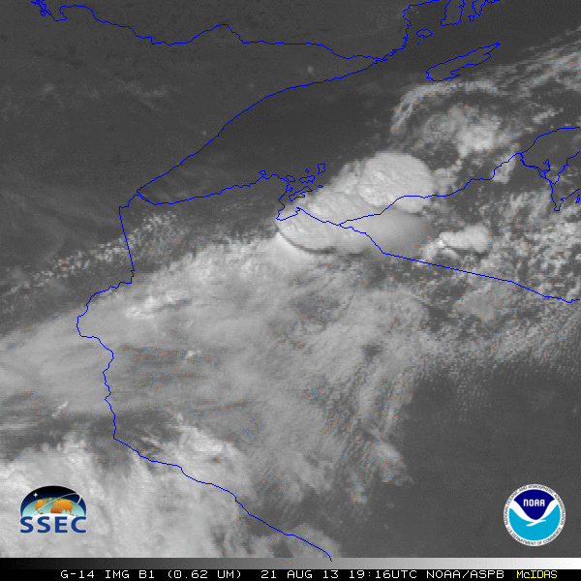
GOES-14: Special Rapid Scanning offers glimpse of the ABI
SRSOR (Super Rapid Scan Operations for GOES-R) from GOES-14 imager
2012: Data collected between mid-August and September 24, and also late October (Superstorm Sandy)
2013: 2 days in June, and then 12 days in mid-August
http://cimss.ssec.wisc.edu/goes/srsor/GOES-14_SRSOR.html and http://cimss.ssec.wisc.edu/goes/srsor2013/GOES-14_SRSOR.html
Many phenomena were observed: convection, hurricanes, fires, smoke, fog
Data to many groups HPC, OPC, AWC, SPC, SAB, several regions, etc.
GOES-14 Imager: visible channel images at 1-minute intervals
GOES-14 provided very unique information and offered a preview of the possibilities that will be provided by the ABI on GOES-R.

Slide 26
1-minute imagery
1-minute SRSOR mode
(GOES-14)
15-minute Routine Operations mode (GOES-13)

Slide 27
Training @ CIMSS/ASPB
Many CIMSS Satellite Blog posts:
http://cimss.ssec.wisc.edu/goes/blog/
Short Articulate Presenter modules developed for HWT on CTC and NearCast
http://www.ssec.wisc.edu/~scottl/NearCast_HWT_Training_2013/player.html
http://www.ssec.wisc.edu/~scottl/UWCTC_HWT_Training_2013/player.html
GOES-R Fog Product Examples (“Fused Fog”) blog:
http://fusedfog.ssec.wisc.edu
129 separate entries
>21000 hits ; ~100 hits per day.
1-3 new entries per week.
Notes:
Any new bullets?

Slide 28
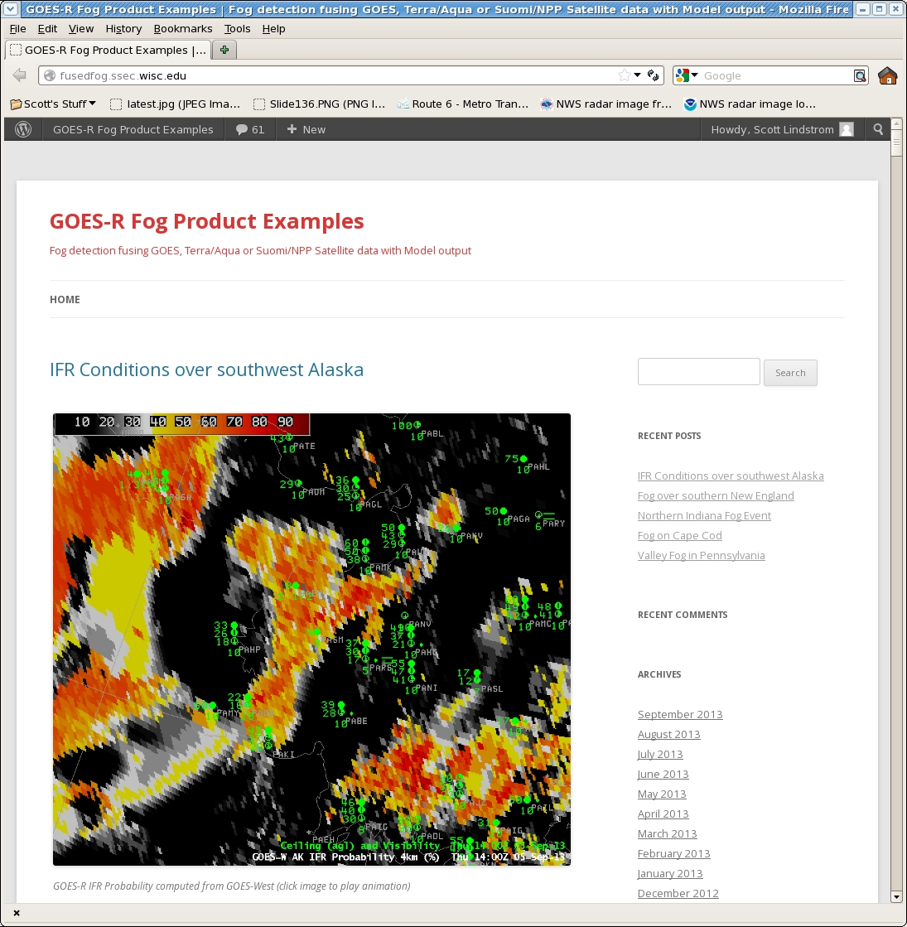
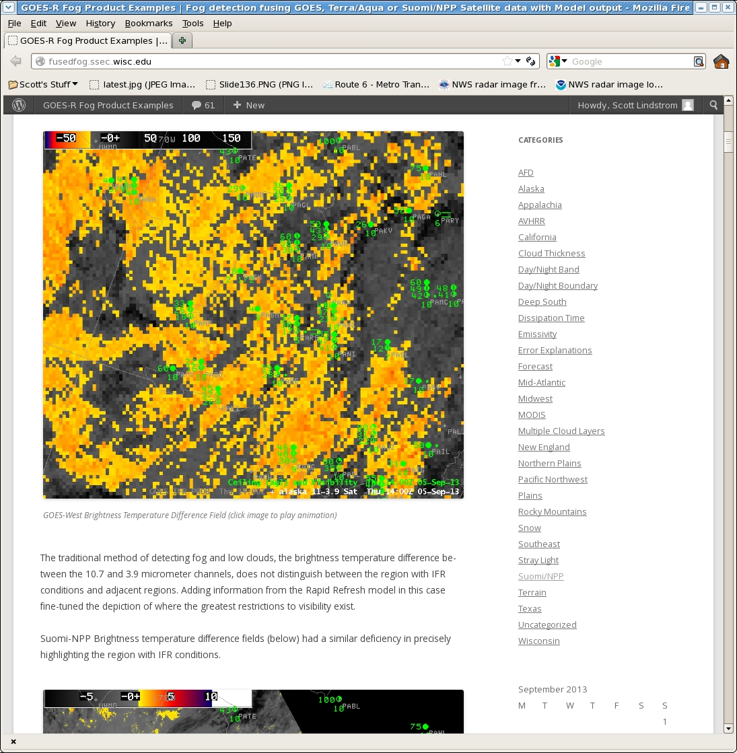
Fused Fog Blog:
New hosting site (ssec.wisc.edu)
Old site had 28,000 hits
All old posts exported to new site
166 total posts
Emails to SOOs when case is posted
Searchable by dates and categories

Slide 29
Other Conferences/Meetings
2013
EUMETSAT/AMS 16-20 Sept Vienna, Austria
http://www.eumetsat.int/Home/Main/News/Conferences_and_Events/820209?l=en|
NWA 12-17 Oct Charleston, SC
http://www.nwas.org/meetings/nwa2013/
2014
AMS Annual meeting 2-6 Feb Atlanta, GA
Virtual Meeting Satellite Week 10-14 March Madison, WI
Training meeting May Boulder, CO, or Kansas City, MO
OCONUS PG TBA Honolulu, HI

Slide 30
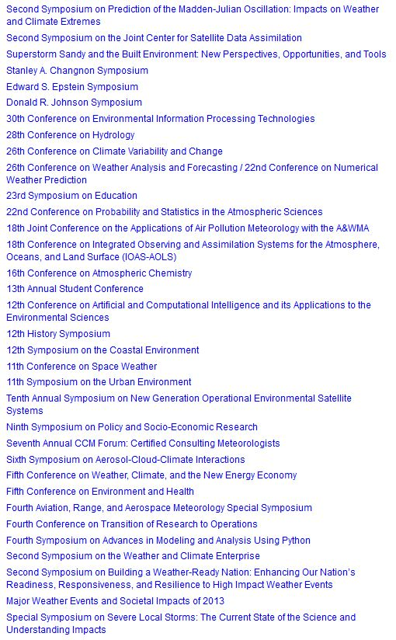
AMS annual meetings

