Slide 1
Imagery Discussion
GOES-R at 137 West longitude;
Default schedule?
GOES-R
Commissioning phase vs storage?
How do international users prepare for the GRB data stream?
GRB Simulator is ITAR, while the data output is not.

Slide 2
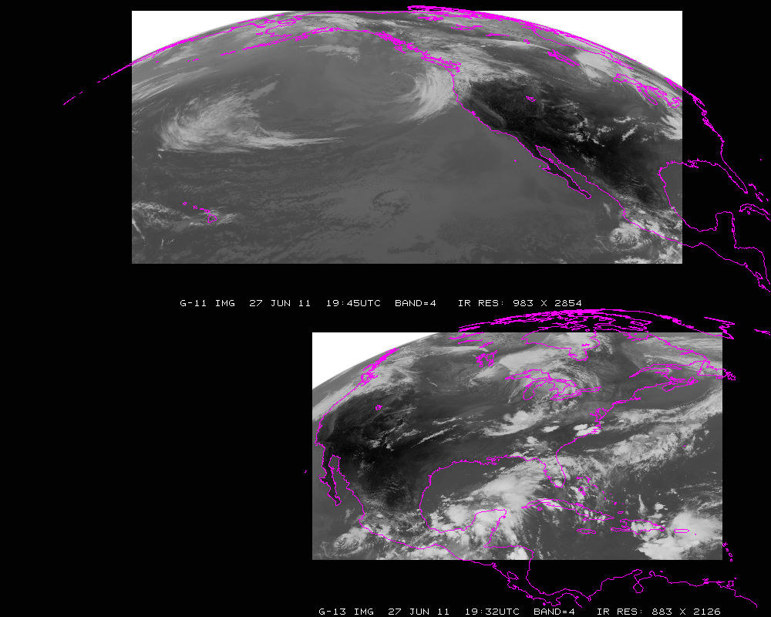
Current GOES Imager scans: PACUS and CONUS (note that PACUS is one-third larger). These regions are sub-selected for AWIPS.

Slide 3
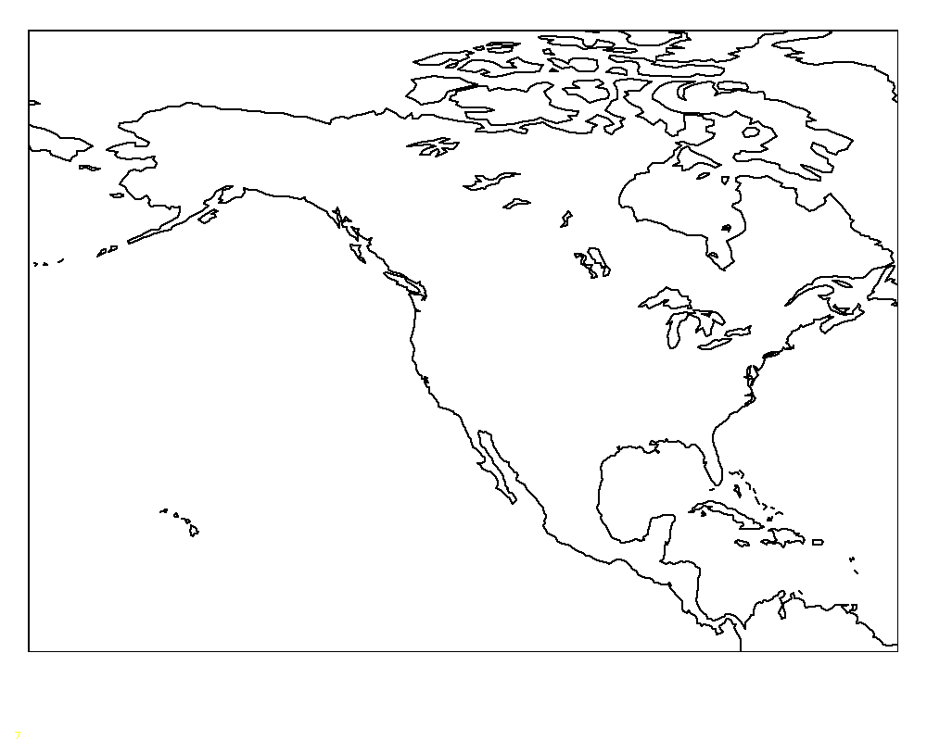
Proposed –Shifted “5 min PACUS”
“5 min PACUS”
Proposed “shifted” “PACUS” would give a 5 min scan of AK and western CONUS. This would mean that HI would need to be covered with one of the meso-scales (and 15 min FD); if in ‘flex mode (3)’. Note that the positions are approximate.

Slide 4
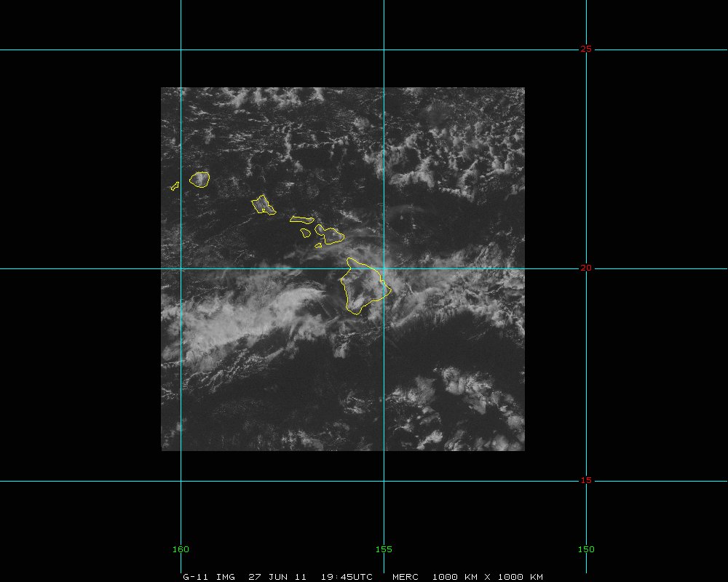
HI -- mesoscale
Approximately 1000 km x 1000 km.

Slide 5
GOES-15/14 vs GOES-R/S ?

