Slide 1
GOES-17 Lost ABI data and Navigation Jump July 10, 2019
Between ~15:11 and ~15:31 UTC
CONUS presented here.
Tim Schmit¹, Mat Gunshor & Jim Nelson²
GOES-R AWG Imagery & CWG
NOAA NESDIS STAR CORP ASPB
CIMSS/SSEC/UW-Madison

Slide 2
Navigation Jump, Missing Data July 10, 2019
No GOES-17 CONUS at 15:11 or 15:16 UTC on July 10, 2019
Large (~145km) navigation shift in 15:21, 15:26, & 15:31 CONUS images
There were also many missing segments of the imagery at those times.
Also seen in Full Disk sector

Slide 3
Animation from: http://cimss.ssec.wisc.edu/goes-r/abi-/static_and_timediff_imagery.html

Slide 4
Animation: zoomed in on Baja Peninsula ABI Band 2

Slide 5
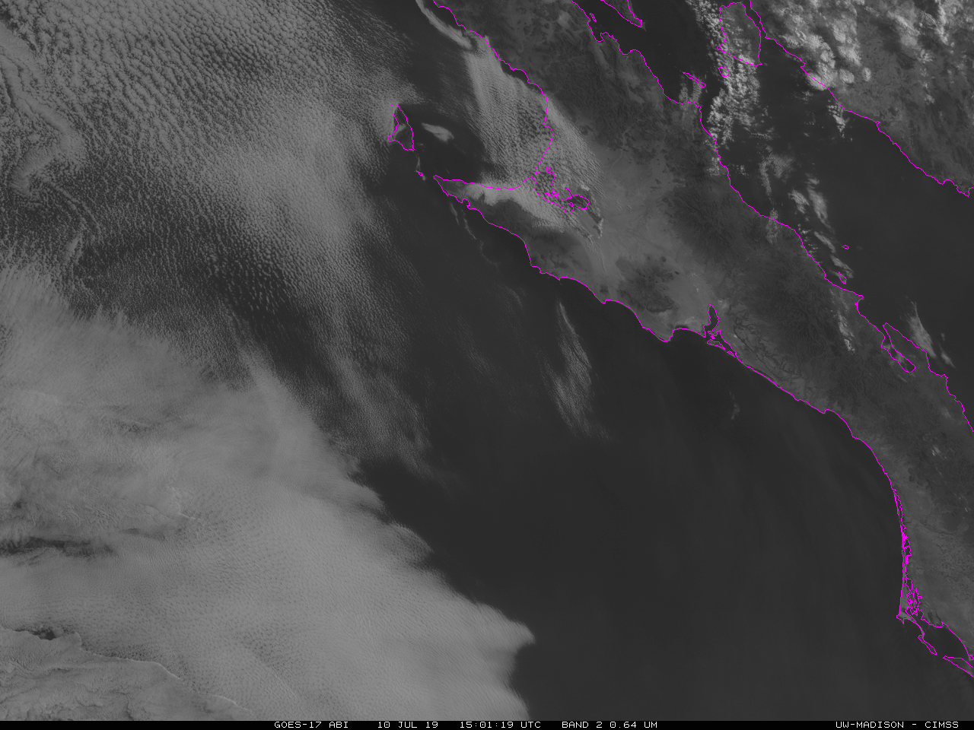

Slide 6
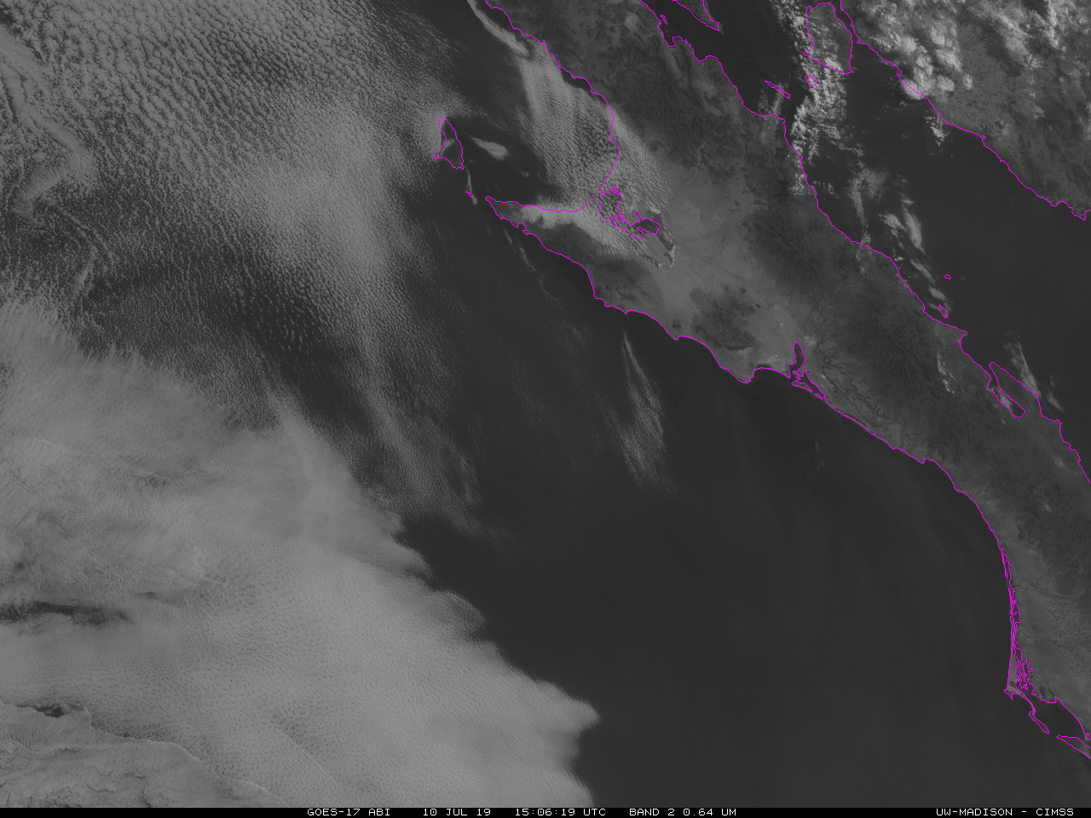

Slide 7
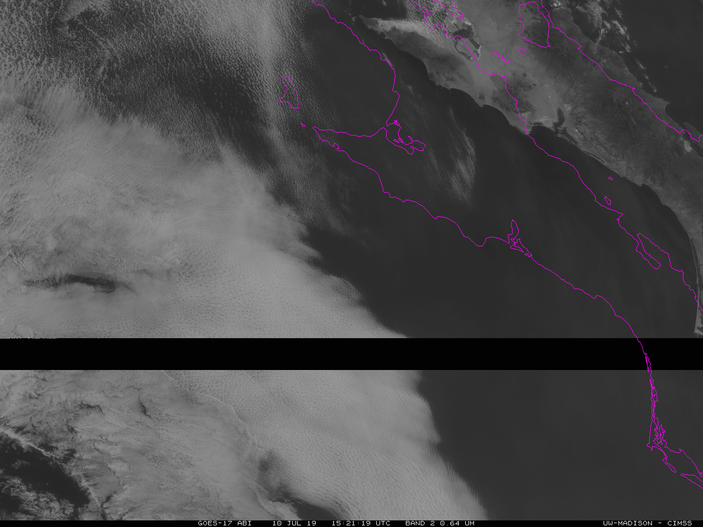

Slide 9
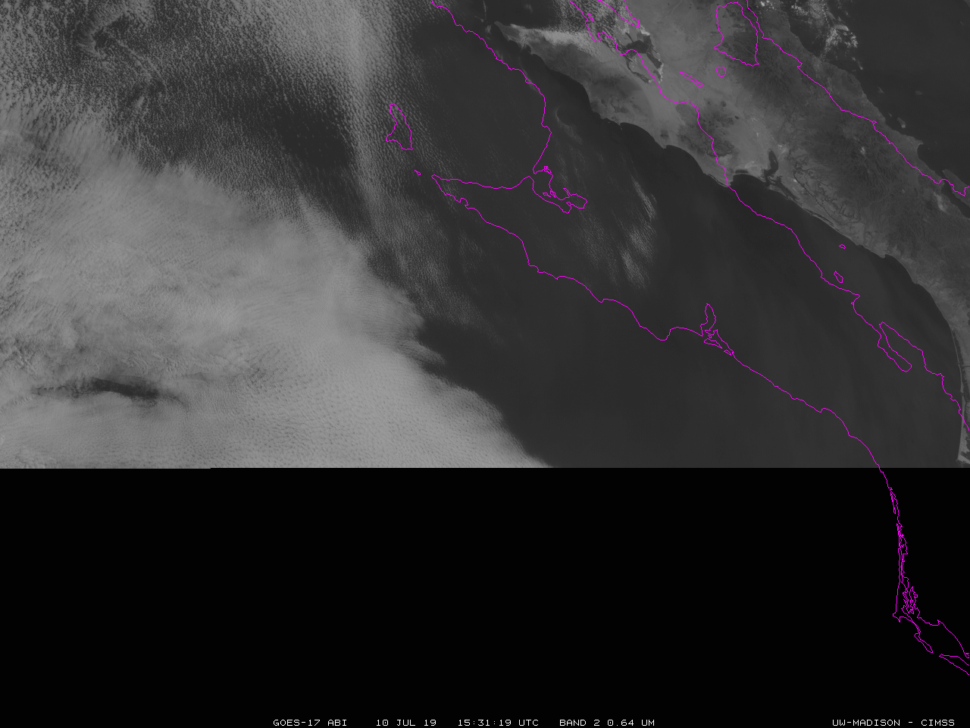

Slide 10
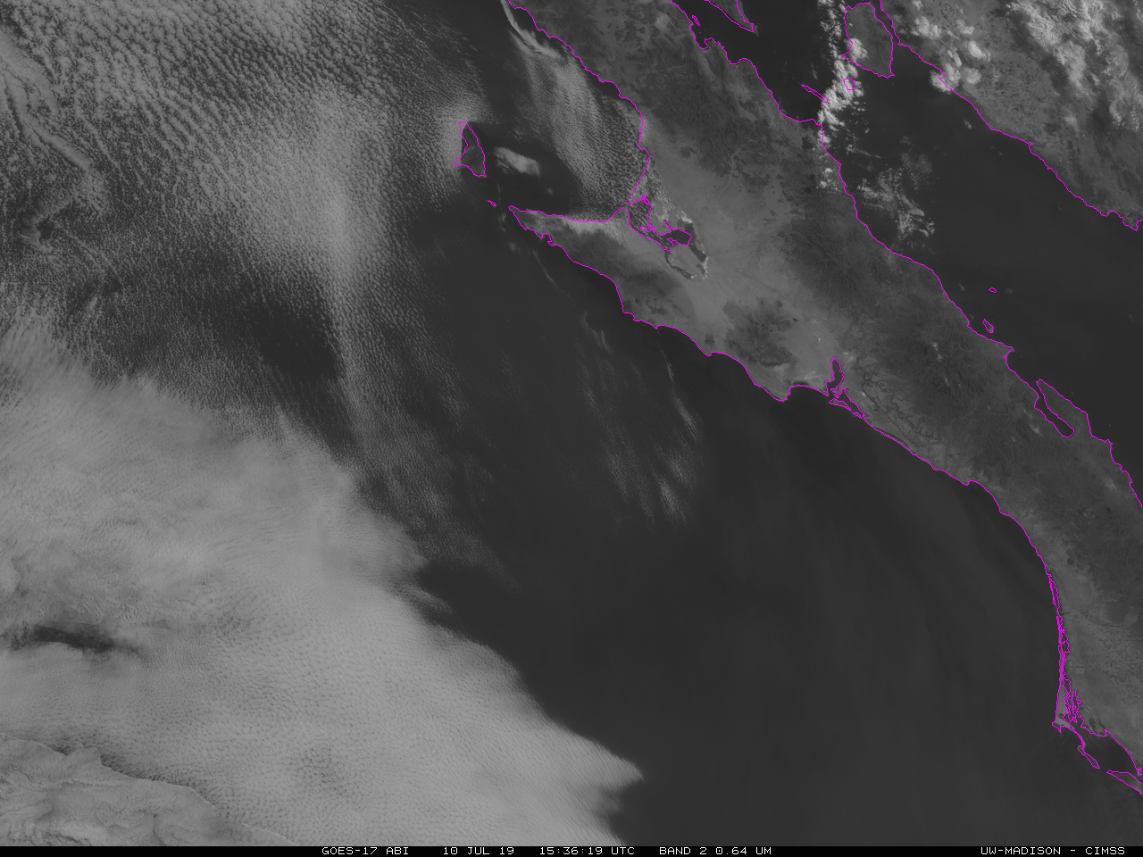

Slide 12
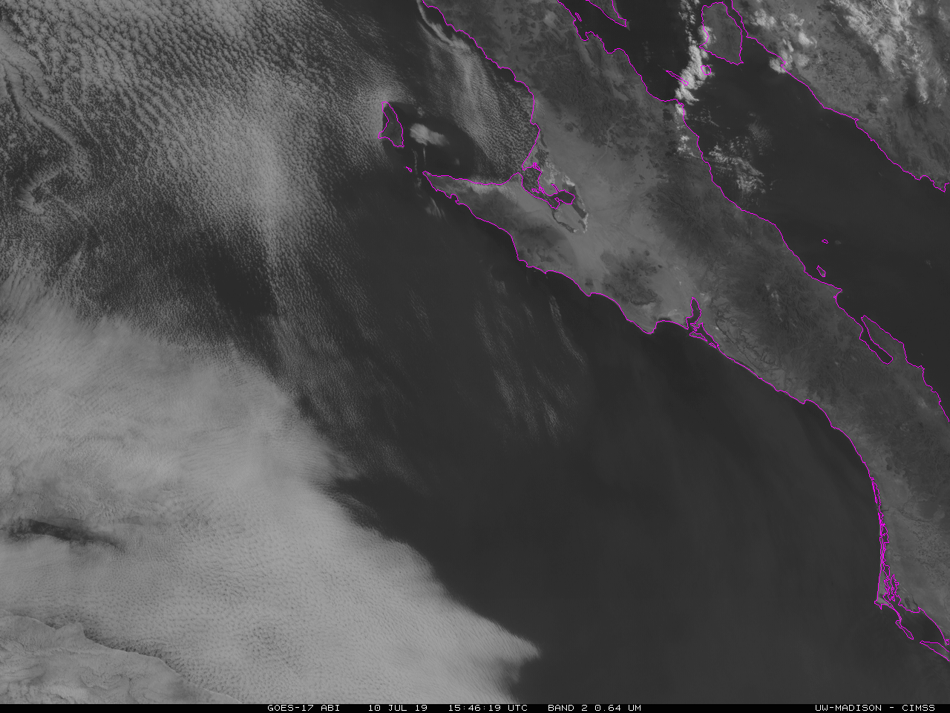

Slide 13
