Slide 1
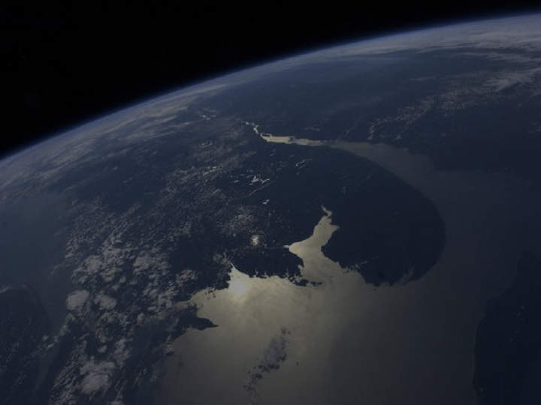
Measuring Burn Scars with JPSS Satellites to Provide Preliminary Burn Intensity Estimates to NWS for Debris Flow Hazard Assessment
Sam Batzli, Dave Parker, Russ Dengel, Nick Bearson Space Science & Engineering Center, University of Wisconsin-Madison
Ivan Csiszar
NOAA/NESDIS – STAR
Katherine Rowden
NOAA/NWS – Spokane WFO

Slide 2
Providing Faster Satellite-derived Input Maps for Mudslide Forecasters
Sam Batzli, Dave Parker, Russ Dengel, Nick Bearson Space Science & Engineering Center, University of Wisconsin-Madison
Ivan Csiszar
NOAA/NESDIS – STAR
Katherine Rowden
NOAA/NWS – Spokane WFO

Slide 3
The Situation – Debris Flows after Fires
Source of graphic: “How the harrowing Thomas Fire planted the seed for California's deadly mudslides” Washington Post, By Angela Fritz January 10, 2018
Healthy soil and vegetation absorbs rain and stabilizes slopes.
Fire destroys this stability.
Risk of mudslides increases after fires.

Slide 4
The Situation – Debris Flows After Fires
Montecito, CA, January 7, 2018. Source: “Your Questions About The California Mudslides, Answered.” Huffingtonpost.com, By Lydia O’Connor January 11, 2018 08:37 pm ET Updated Nov 26, 2018.

Slide 5
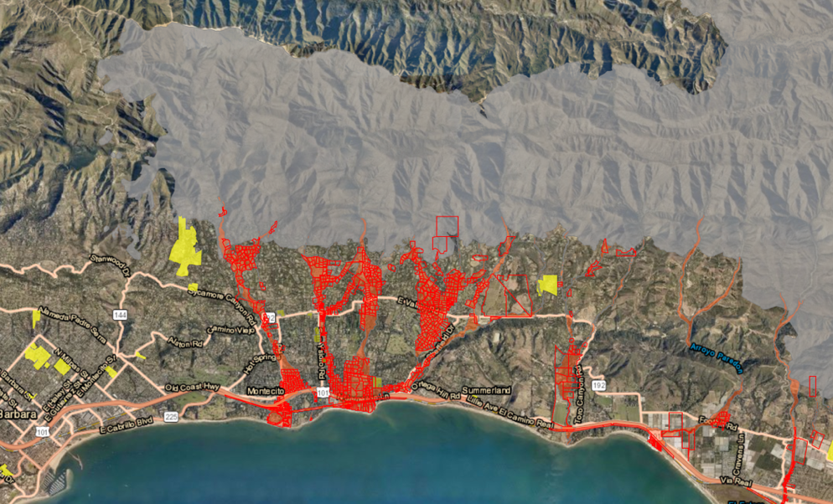
The Concern – Hazard Warnings
Burn Scar
Evacuation Orders
Example evacuation order map from 5 March 2019. Source: County of Santa Barbara, Emergency Operation Center and Santa Barbara County Sheriff

Slide 6
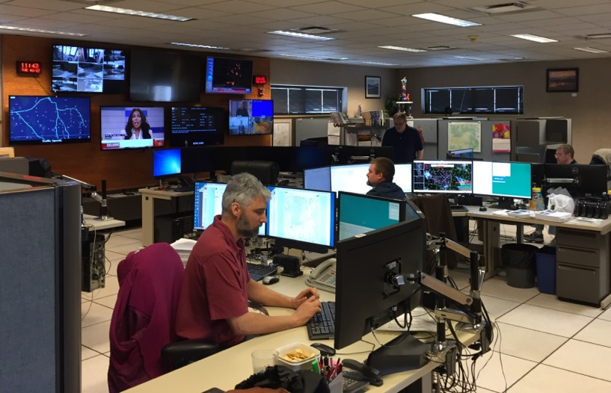
The Concern – Hazard Warnings
Evacuation Orders
National Weather Service – Weather Forecast Office. 24/7 Forecast and Warning Operations. Source: Katherine Rowden

Slide 7
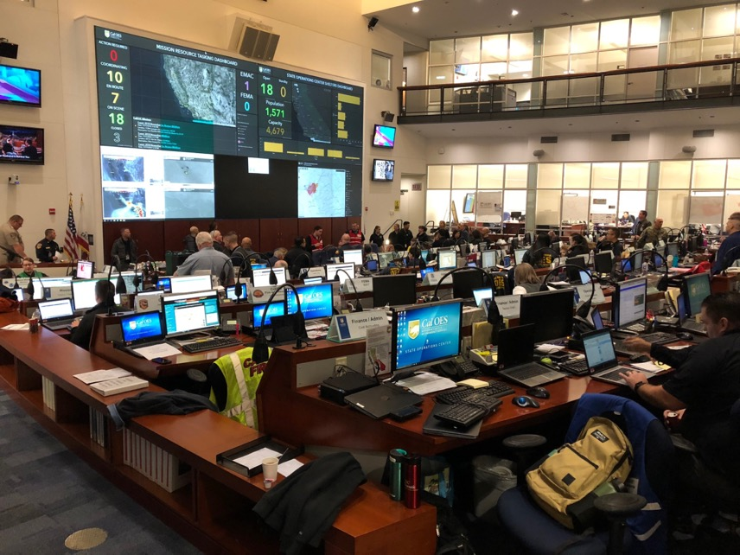
The Concern – Hazard Warnings
Evacuation Orders
Cal EOC (California Emergency Operations Center). Source: Katherine Rowden

Slide 8
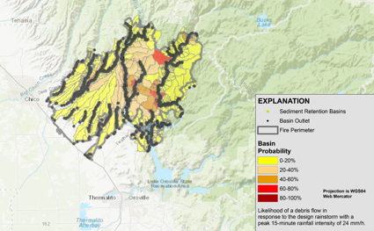
Current Workflow
Landsat 8
Fire → Burn Scar → Observation → Processing → BARC Map → GIS Model → Weather Forecast → Warning!
Evacuation Orders

Slide 9
The Problem: Latency
Landsat 8
16-day Repeat Cycle
185km Swath Width
Fire → Burn Scar → Observation → Processing → BARC Map → GIS Model → Weather Forecast → Warning!
Sept 30
Oct 16
1
2
3
4
5
6
7
8
9
10
11
12
13
14
15
1
2
3
4
5
6

Slide 10
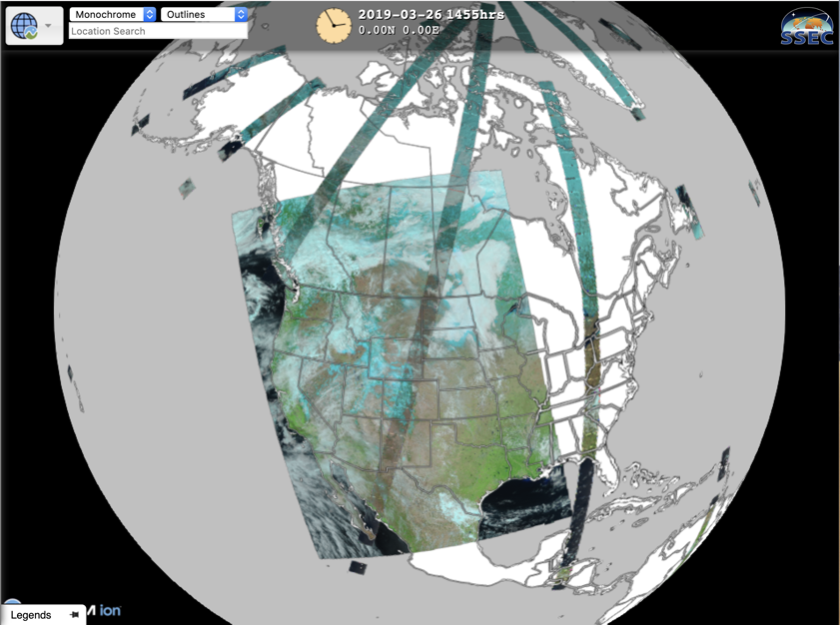
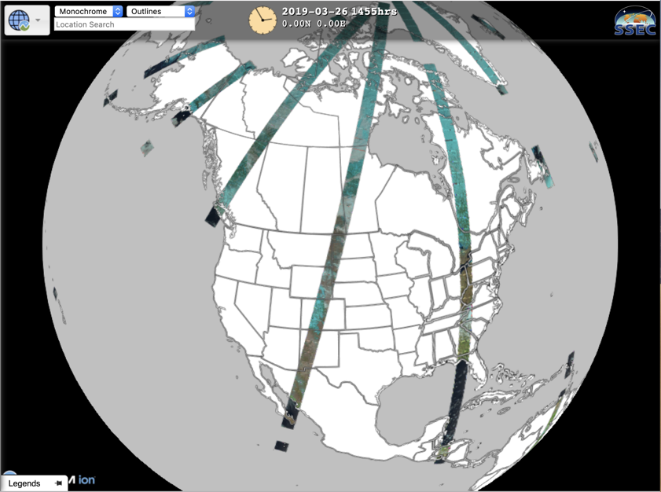
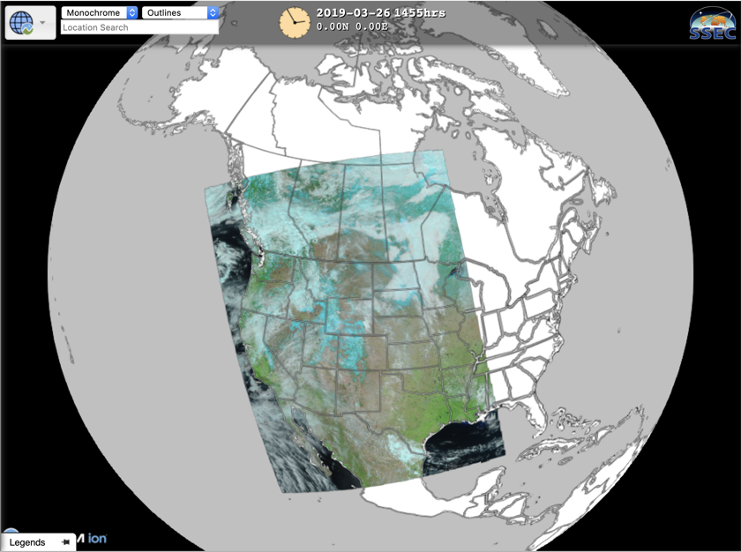
Observation: OLI and VIIRS
S-NPP and NOAA-20
VIIRS:
3000km
Landsat OLI:
185km
https://realearth.ssec.wisc.edu

Slide 11
BARC vs BRIDGE
Current Method: Normalized Burn Ratio (NBR) is an index designed to highlight burnt areas in large fire zones.
Alternative Method: Normalized Difference Vegetation Index (NDVI) is a quantitative index of greenness that relates to vegetation health.
NBR =
(NIR - SWIR)
(NIR + SWIR)
NDVI =
(NIR - Red)
(NIR + Red)
Used with Landsat imagery as input for Burned Area Reflectance Classification “BARC” maps at 30m resolution
Good accuracy, but 16-day repeat cycle
Latency issue for NWS - sometimes late or never
MODIS 500m product (MCD64A1) only monthly
No VIIRS version of this product (yet?)
Shows promise for rapid production of preliminary Burn Intensity Delta Greenness Estimation “BRIDGE” maps at 375m
Medium Accuracy, but nearly daily
Rapidly Available
Fire damages vegetation
NDVI is an operational JPSS product

Slide 12
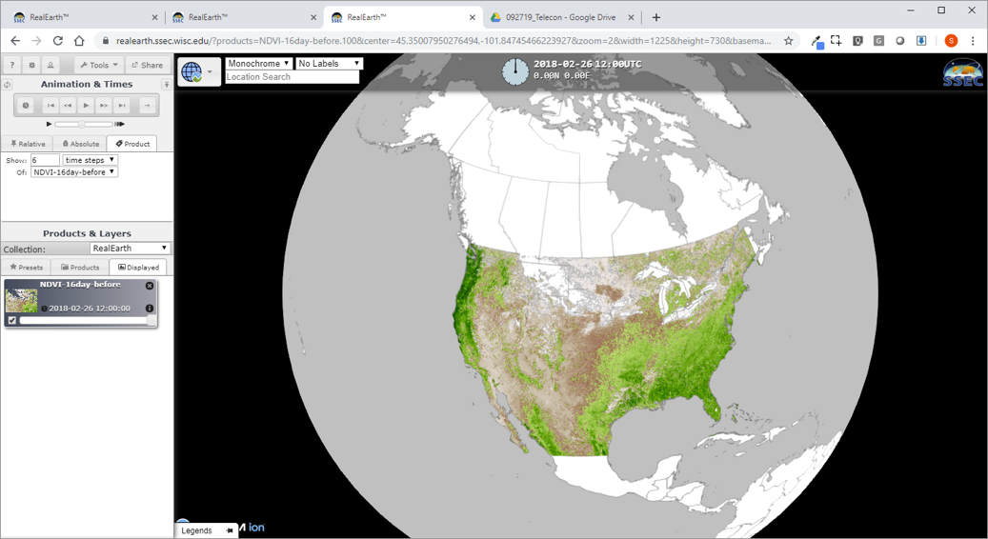
Observation: “Before” VIIRS NDVI
16-day cloud-free composite NDVI
Two-streams, 8-day updates
From NOAA-CLASS
Building a Scrolling 2-yr archive
https://realearth.ssec.wisc.edu
Notes:
One of the reasons VIIRS is worth trying

Slide 13
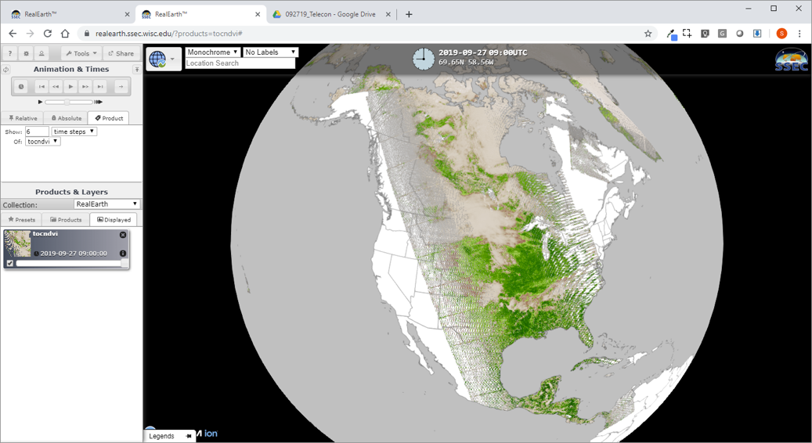
Observation: “After” VIIRS NDVI
Daily NDVI EDR from NOAA-CLASS
Updated hourly
Source and product is changing
Will be daily composite
https://realearth.ssec.wisc.edu
Notes:
One of the reasons VIIRS is worth trying

Slide 14
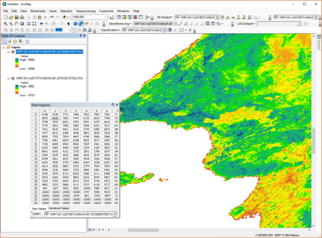
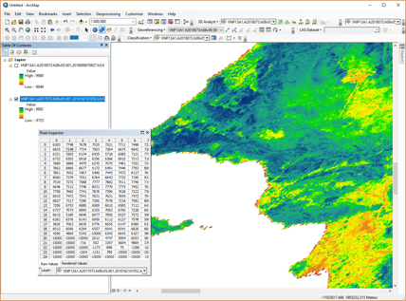
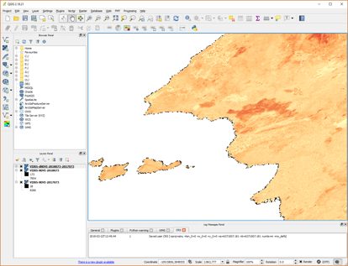
Processing: Raster Math with NDVI
To quantify the change, we subtract NDVI values of the before the flames product from the values of the after the flames product.
NDVI After
-
NDVI Before
=
dNDVI (Change)
-
=

Slide 15
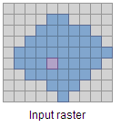
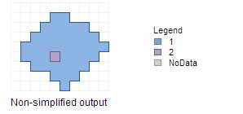
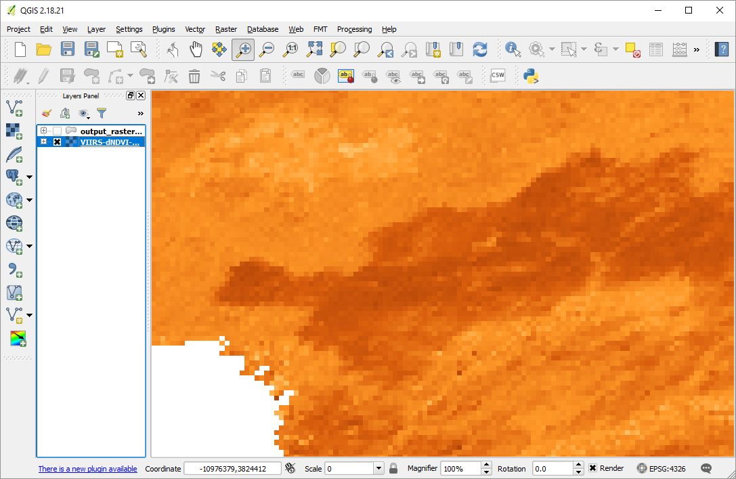
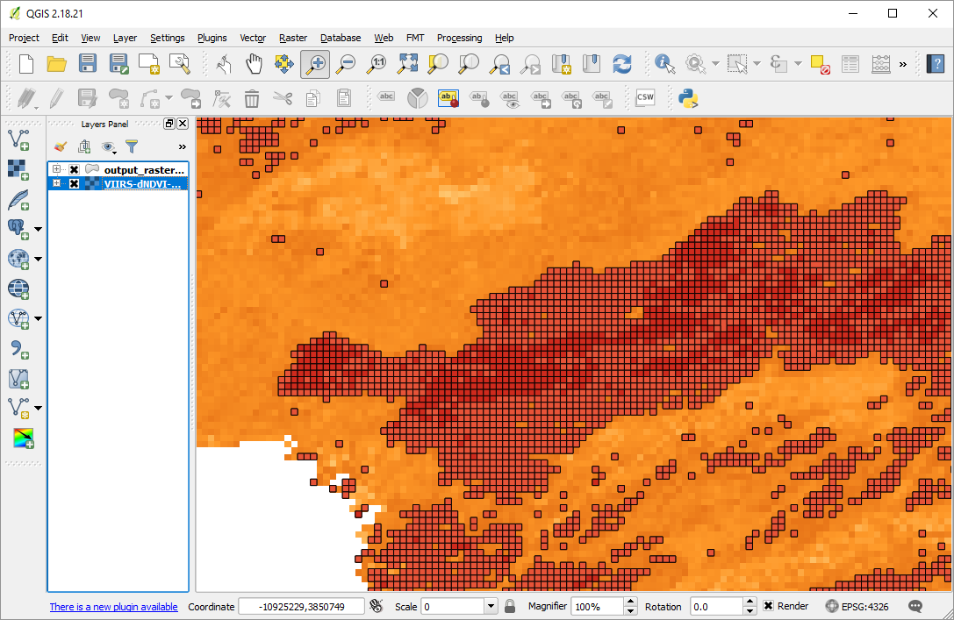
Processing: Converting Raster to Vector
NWS

Slide 16
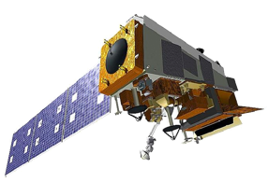
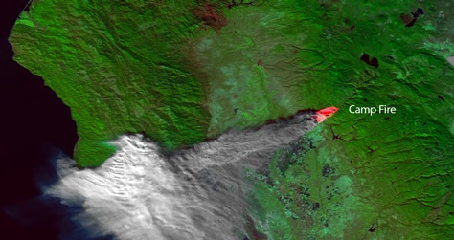
Conclusion
S-NPP and
NOAA-20
1-day Repeat Cycle
3000km Swath Width
Fire → Burn Scar → Observation → Processing → BRIDGE → GIS Model → Weather Forecast → Warning!
Sept 30
Oct 16
S-NPP
NOAA20
30
1
2
3
4
5
6
7
8
9
10
11
12
13
14
15
16
1
2
3
4
5
6
1
2
3
4
5
6
7
8
9
10
11
12
13
14
15
1
2
3
4
5
6

