Slide 1
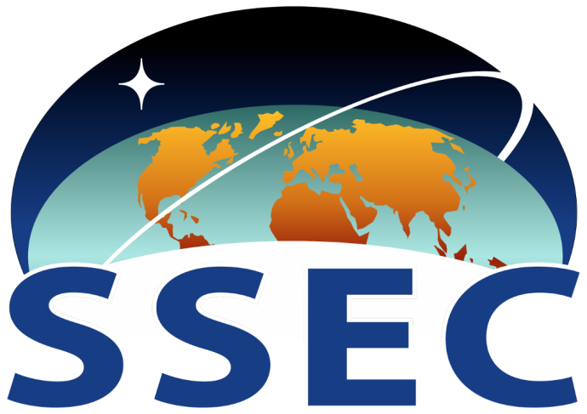
SSEC Research Support
Technical Computing
Engineering
Satellite Data Services
Three cornerstones of SSEC research: advancing satellite instrument observing capabilities, acquiring and validating the associated measurements, and deriving useful products and information.

Slide 2
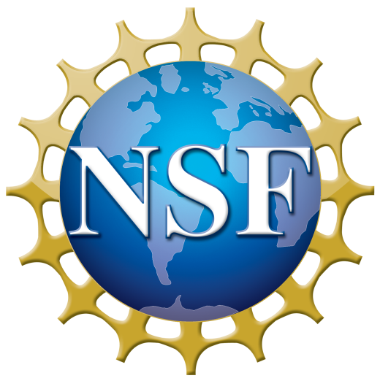
SSEC Large Programs
Atmosphere Science Investigator-led Processing Systems (SIPS)
Ice Drilling Design and Operations (IDDO)
Cooperative Institute for Meteorological Satellite Studies (CIMSS)

Slide 3
SSEC Science Team
Participation
S-NPP
AIRS
MODIS
Applied Sciences
GPM
CloudSat
OCO-2
Hazardous Wx Testbed
Proving Ground
GOES-R AWG
JPSS
RTAP
FRAPPE
PECAN
TORERO

Slide 4
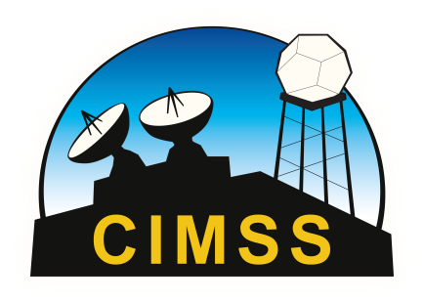
End-to-end satellite, modeling and data assimilation capabilities at SSEC
SSEC and CIMSS scientists collaborate with our NOAA colleagues to conduct end-to-end research, designing instruments, calibrating radiances, developing algorithms, products, and data assimilation techniques that are transitioned from research to operational use by NOAA and other international weather agencies.

Slide 5
End-to-end satellite, modeling and data assimilation capabilities at SSEC
Instrument Design
Radiance Calibration
Algorithm Development
Model Development
Data Assimilation
(Impact Assessment)
Model Verification

Slide 6
End-to-end satellite, modeling and data assimilation capabilities at SSEC
Instrument Design
Radiance Calibration
Algorithm Development
Model Development
Data Assimilation
(Impact Assessment)
Model Verification

Slide 7
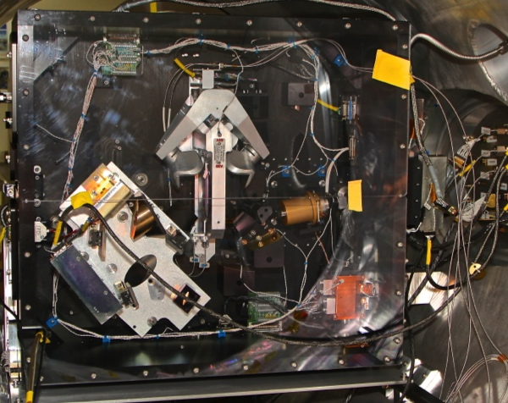
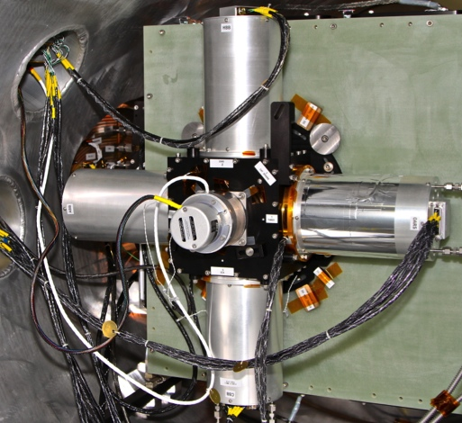
Verification Tests of the UW Absolute Radiance Interferometer (ARI) in a Vacuum Environment
PI: Hank Revercomb, (UW-Madison, SSEC)
Objective
Advance key technologies necessary to measure IR spectrally resolved radiances with ultra-high accuracy brightness temperature (<0.1 K, 3 sigma at scene temperature) for crucial climate benchmark missions.
Perform vacuum testing of the ARI system, developed under a previous ESTO investment, to advance the TRL from 5 to 6
Demonstrate and characterize system performance under simulated space environment vacuum and thermal transient conditions.
The ARI provides spectral coverage from 200-2600 cm-1 (3.9-50µm) using 2 output ports.
Absolute Radiance Interferometer (ARI) and On-Orbit Verification and Test System (OVTS) Prototype integrated into Vacuum Chamber
Approach:
Benefits and Outcomes
Ruggedize and configure the entire optical and validation system for testing in the thermal/vacuum chamber.
Conduct end-to-end verification tests with the ARI under a vacuum environment using the integrated On-Orbit Verification and Test System (OVTS).
Demonstrate operation and characterization of the On-Orbit Absolute Radiance Standard (OARS).
Analyze and document the performance data and verify adequate system performance for future radiance missions.
Supports Climate Absolute Radiance & Refrac<vity Observatory (CLARREO) by providing an in-orbit SI traceable IR calibration reference for climate monitoring
Reductions in uncertainty would reduce the time (number of decades) necessary to assess climate trends.
CoIs: Fred Best, John Perepezko, Univ. of Wisconsin;
John Dykema, Harvard Univ.
TRL_{in} = 5
TRL_{out} = 6
Mo/Yr

Slide 8
End-to-end satellite, modeling and data assimilation capabilities at SSEC
Instrument Design
Radiance Calibration
Algorithm Development
Model Development
Data Assimilation
(Impact Assessment)
Model Verification

Slide 9
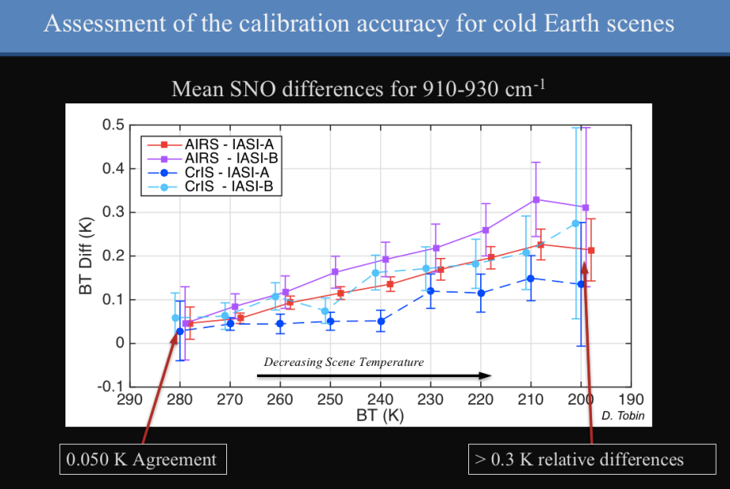
High Spectral Resolution Infrared Radiance Observations
PI: David Tobin (UW-Madison, SSEC)
Objective
Contribute to projects that provide high spectral resolution infrared radiances for a wide range of NWP, sounding, and climate applications, with an emphasis on calibration accuracy, traceability, and user friendly products. Sensors/projects include the UW/SSEC aircraft based Scanning-HIS, the operational LEO sounders (CrIS, IASI, and AIRS), new international sensors (GIIRS, HIRAS), as well as future GEO sounders (MTG-IRS, HES/WARN).
Approach:
Benefits and Outcomes
This project builds on decades of work at UW/SSEC starting in the late 1970s with the need for improved atmospheric soundings from Geostationary orbit. This includes end-to-end efforts including FTS sensor development, prototyping, and transition to operational sensors and their applications.
Improved sensor designs and algorithms
Accurate and traceable radiance observations for NWP and climate
Example outcomes include:
CrIS, IASI, and AIRS observations making major contributions to NWP data assimilation
Radiance climate trends with uncertainties on the order of 1 to 2 mK per year.
CoIs: Revercomb, Taylor, Knuteson. NOAA/NASA/EUMETSAT, CMA, etc.
September/2018

Slide 10
End-to-end satellite, modeling and data assimilation capabilities at SSEC
Instrument Design
Radiance Calibration
Algorithm Development
Model Development
Data Assimilation
(Impact Assessment)
Model Verification

Slide 11
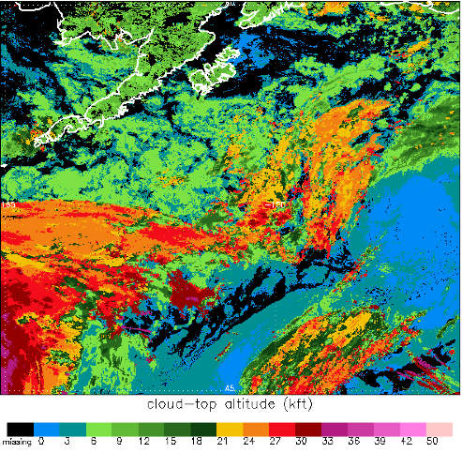
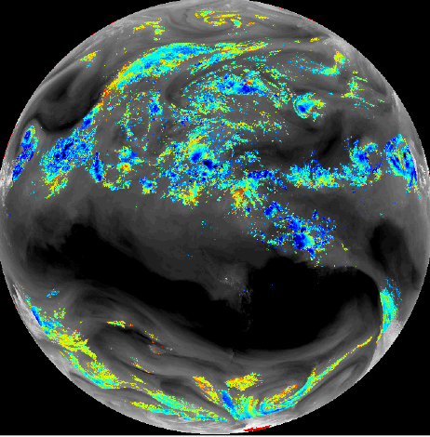
LEO/GEO Cloud Products and Their Use in NWP
PI: Andrew Heidinger (NOAA/NESDIS/STAR)
Objective
NOAA/NESDIS and its partners at CIMSS have developed a set of physical algorithms to derive several properties of clouds.
Our goal is to link with modelers at OAR/ESRL and NWS/NCEP. We hope to provide products useful for model verification and assimilation. We also benefit from their physical parameterization knowledge.
Use cloud properties to provide/generate/improve radiance products (both clear and cloudy) which will allow NWP Centers to more effectively assimilate GOES and JPSS radiances.
GOES-R: Ice Cloud Temp. overlaid on 6.7 μm Bright.Temp. Basis of NWP GEO Rad. Assim.
JPSS:: Cloud-top Altitude over Alaska. Used by ESRL.
Approach:
Benefits and Outcomes
Develop Enterprise cloud products to support the full suite of NOAA Imagers within one software algorithm package.
Pilot program underway to switch ABI cloud products to Enterprise cloud algorithms.
Develop radiance and value-added assimilation products in BUFR format in coordination with NCEP, ECMWF and other NWP Centers.
NWP collaborators are involved from day 1 of the radiance product project to optimize the usefulness and timeliness for the operational use of this data
Enterprise cloud algorithms can be updated more efficiently and can better respond to feedback from NWP.
Collaborate with EUMETSAT and other data providers to establish consistent products across satellite platforms.
ECMWF is already actively assimilating GOES-16 ABI Clear Sky Radiance from water vapor channels using NESDIS/STAR preliminary data stream
GFS, RAPP, NRL, Met Office are all testing preliminary data in their assimilation systems
OAR/ESRL is also experimenting with cloud product assimilation using JPSS at high latitudes.
CoIs: James Jung and Sharon Nebuda
Mo/Yr

Slide 12
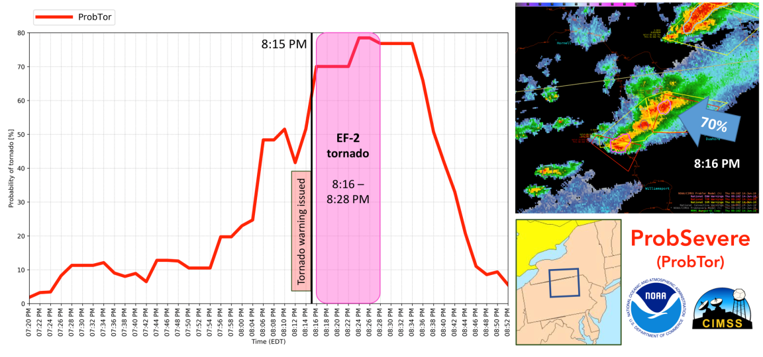
Improving Severe Weather Warnings: The ProbSevere Model
PI: Michael Pavolonis (NOAA/NESDIS/STAR)
Objective
To improve the accuracy and timeliness of severe thunderstorm and tornado warnings through data fusion and machine learning.
The ProbSevere generated tornado probability (red line) ramps up 20 minutes prior to the touchdown of an EF-2 tornado in Bradford County PA (June 13, 2018). The SPC outlook indicated a 2% tornado chance.
Approach:
Benefits and Outcomes
ProbSevere utilizes machine learning to distill very large volumes of data to information that is directly relevant to NWS severe weather warning operations. More specifically, data sets from NWP (Rapid Refresh), geostationary satellites (GOES-R), NEXRAD (MRMS), and ground based lightning (Earth Networks) are used to determine the probability that developing convection, identifiable in observational data, will produce severe wind, severe hail, or a tornado in the next 90 minutes. ProbSevere generates new guidance at least every 2 minutes (whenever new input data are available).
Benefits: More timely and accurate severe weather warnings are achieved by increasing the value of NOAA data sets. Compared to traditional radar interrogation, ProbSevere has the potential to extend the median lead time of severe thunderstorm warnings by 15 minutes and tornado warnings by 7-10 minutes.
Outcomes: ProbSevere was highly rated by NWS participants in the Hazardous Weather Testbed, the Satellite Proving Ground, and the Operations Proving Ground. As a result, ProbSevere is being transitioned to NCEP Central Operations (FY19 completion).
CoIs: John Cintineo (CIMSS), Justin Sieglaff (CIMSS), Ken Howard (OAR/NSSL), Stephan Smith (NWS/MDL)
September/2018

Slide 13
End-to-end satellite, modeling and data assimilation capabilities at SSEC
Instrument Design
Radiance Calibration
Algorithm Development
Model Development
Data Assimilation
(Impact Assessment)
Model Verification

Slide 14
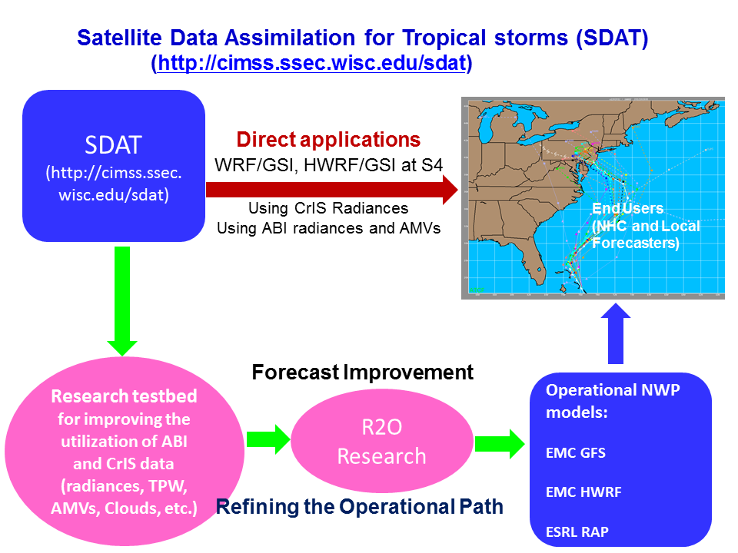
Improve GOES-R and JPSS Series data assimilation for NOAA operational NWP models
PI: Jun Li, (UW-Madison, CIMSS)
Objective
Develop methodologies to improve GOES-R/JPSS series data assimilation for NOAA operational NWP models.
For improving GOES-R series ABI assimilation, the focus is on atmospheric moisture and motion vectors
For JPSS serie CrIS assimilation, the focus is on atmospheric sounding information in cloudy skies
SDAT: A STAR/CIMSS research tesdbed at S4 for research to application and research to operation.
Approaches:
Benefits and Outcomes
Using S4 as R2O platform;
Using SDAT (HWRF/GSI, and GFS/GSI) at S4 as testbed;
Collaborate with EMC data assimilation team on using operational NWP model, requirements and potential R2O transition.
Benefits: Research outcomes can be transferred to NOAA applications and operations;
Outcomes: (1) Methodologies on assimilating CrIS in cloudy skies have been successfully tested in operational GFS, and have been recommended by International TOVS Working Group to the operational NWP centers; (2) Demonstrated the importance of new information from ABI rapid scan observations in inner core region for hurricane forecast in operational HWRF model.
CoIs: Chris Velden, Jason Sippel, Andew Collard
August 2018

Slide 15
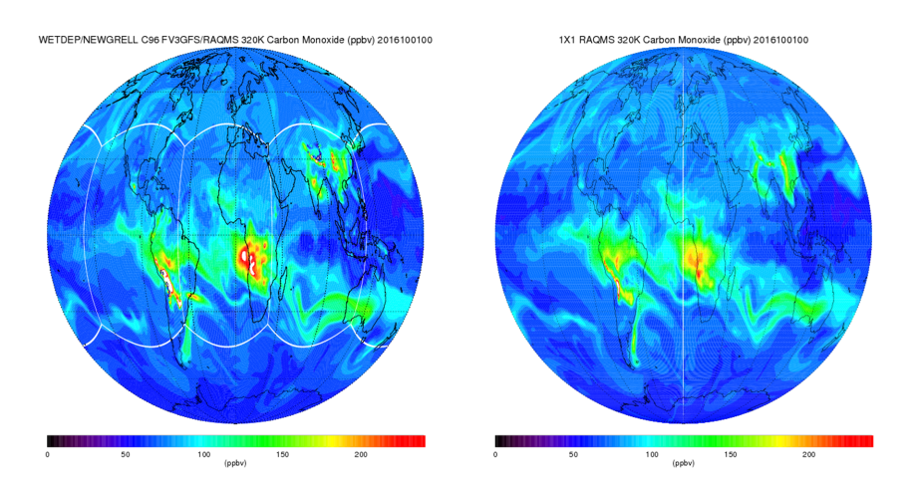
Development of chemistry algorithms for the NOAA Next Generation Global Prediction System (NGGPS)
PI: Brad Pierce (UW-Madison, SSEC)
Objective
Plans for NGGPS include online prediction of atmospheric composition within a single, multi-scale dynamical core.
This NOAA Research Transition Acceleration Program (RTAP) project supports the development and testing of a reduced chemical mechanism within the NGGPS atmospheric composition capability.
The implementation of reduced chemistry is aligned with Annex 10 of the NGGPS Strategic Implementation Plan, which identifies key capabilities, issues and a roadmap for developing the global atmospheric composition component of NGGPS.
Comparison between 1x1 RAQMS Reanalysis (right) and 48hr C96 FV3GFS-RAQMSCHEM forecast (left) mid-troposphere (320K isentrope) carbon monoxide at 00Z on October 01, 2016
Approach:
Benefits and Outcomes
NGGPS Chemistry development is coordinated under the Aerosols and Atmospheric Composition (ACC) working group, led by Ivanka Stajner (NOAA/NWS)
Development is aligned with the NGGPS aerosol component (FV3GFS-GSDCHEM) led by Georg Grell (NOAA/ESRL) following the framework of the National Unified Operational Prediction Capability (NUOPC)
Chemistry component (FV3GFS-RAQMSCHEM) is based on the Real-Time Air Quality Modeling System (RAQMS) developed at the NASA Langley Research Center in collaboration with SSEC
Improved predictions of ozone radiative heating in the upper troposphere and lower stratosphere will impact NGGPS long-range (1-2 week) predictions
Better use of infrared radiance measurements in data assimilation by accounting for trace gas (O3, CH4, N2O) absorption
Improved estimates of background concentrations of ozone and ozone precursors for NWS regional air quality prediction
CoIs: Allen Lenzen (CIMSS/SSEC), Vijay Tallapragada (NOAA/EMC)
September/2018

Slide 16
End-to-end satellite, modeling and data assimilation capabilities at SSEC
Instrument Design
Radiance Calibration
Algorithm Development
Model Development
Data Assimilation
(Impact Assessment)
Model Verification

Slide 17
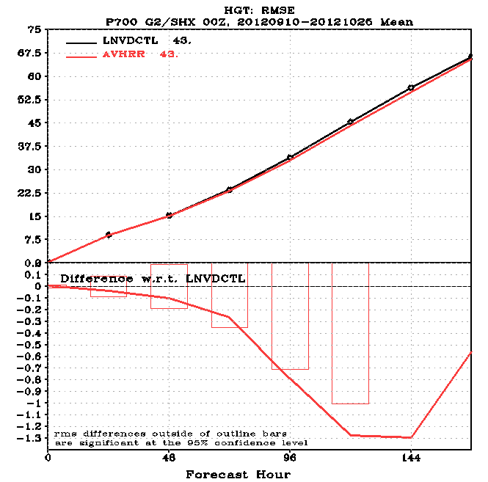
MODIS- and AVHRR-derived Polar Winds Experiments using the NCEP GDAS/GFS
PI: David Santek (UW-Madison, SSEC)
Objective
Update the quality control scheme in the GDAS/GFS for the MODIS polar atmospheric motion vectors (AMV) in preparation for assimilating AVHRR and VIIRS polar winds. The previous QC method was based on an empirically determined fixed u- and v-component threshold which would be difficult to extend to AVHRR and VIIRS winds and it was too constraining for jet-level AMVs.
Assess the impact of a new QC method for potential R2O update of code in the GDAS.
Southern hemisphere 700 hPa height RMSE for 10 Sept – 25 October 2012 for the control (black) and experiment (red). Control: Operational quality control (QC) of the polar winds. Experiment: LNVD QC with AVHRR winds. Circles represent statistically significant improvement.
Approach:
Benefits and Outcomes
A new QC scheme was developed that discards observations based on the ratio of the AMV vector departure from the background to the logarithm of the AMV speed and is called the log normalized vector departure (LNVD). By normalizing the vector departure by the speed, the LNVD results in retaining more high speed winds and discarding more low speed winds (which may have vectorially deviated substantially from the background).
Two 2-month seasonal experiments were run with the MODIS winds using LNVD QC.
The updated QC method resulted in a neutral to statistically significant impact, depending on the metric, on hemispheric scores from AMVs derived only in the polar regions.
Based on recommendations from this study, operational implementation of the LNVD quality control method for the MODIS polar winds was adopted by GDAS operations in the May 2016 upgrade . Also, the LNVD will be used for AVHRR and VIIRS polar winds.
CoIs: James Jung (CIMSS)
TRL_{in} = 7-9
09/18

Slide 18
Quality Control and Impact Assessment of Aircraft Observations in the GDAS/GFS
PI: Dave Santek (UW-Madison, SSEC)
Objective
Evaluate the impact of assimilating WVSS-II moisture observations from sensors onboard US commercial aircraft in the GDAS and determine the impact on the GFS forecast
Assess forecast impact for recommendation of R2O transfer of code changes
Forecast (mean) absolute error of total precipitable water field relative to TPW observations available from GPSmet ground stations over the continental US, with the control in blue and the experiment assimilating WVSS-II moisture observations in red. Dots are placed where the difference exceeds a student’s t-test at 95% confidence.
Approach:
Benefits and Outcomes
Assimilation experiments were carried out on NOAA computing resources for a warm-season (April – May 2014) and cold-season (December 2014 – January 2015) cycling experiment, ingesting and assimilating the WVSS-II observations using an observation error profile borrowed from the NDAS. The precipitation forecast for the 12-36 hour forecast over the continental US was scored using standard VSDB metrics for equitable threat score and bias, and the forecast total precipitable water (TPW) field was scored against available GPSmet ground station observations.
Experiment demonstrated positive impact on the cold-season precipitation forecast from 12-36 hrs and on the cold-season total precipitable water forecast as far out as 66 hrs depending on the measurement
Published results in Weather and Forecasting, doi: 10.1175/WAF-D-16-0202.1
Based on recommendations from this study, operational implementation of WVSS-II moisture observation assimilation was adopted by GDAS operations in the May 2016 upgrade
CoIs: SSEC: Brett Hoover, Anne-Sophie Daloz,
Yafang Zhong, Richard Dworak, Ralph
Petersen
NOAA: Andrew Collard (NCEP/EMC)
TRL_{in} = 7-9
09/18

Slide 19
End-to-end satellite, modeling and data assimilation capabilities at SSEC
Instrument Design
Radiance Calibration
Algorithm Development
Model Development
Data Assimilation
(Impact Assessment)
Model Verification

Slide 20
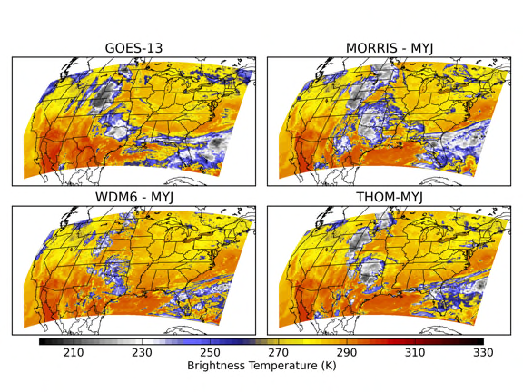
Numerical Weather Prediction Model Verification
PI: Jason Otkin (UW-Madison, CIMSS)
Objective
The objective is to use satellite observations to assess the accuracy of NOAA operational numerical weather prediction model forecasts (HRRR, GFS, FV3, HWRF), with an emphasis on evaluating the cloud, precipitation, and water vapor fields over different regions and forecast periods
This can be accomplished using infrared and microwave brightness temperatures from various geostationary and polar-orbiting satellite sensors
Satellite observations are very useful for verification because they provide high-resolution information over the entire globe not available using conventional data
Observed (upper left) and simulated 10.7 μm brightness temperatures when different cloud schemes are used in high-resolution model simulations;
the images depict large differences in the horizontal and vertical extent of the upper level clouds
Approach:
Benefits and Outcomes
The first step is to use a forward radiative transfer model (such as the CRTM) to convert NWP model forecasts into simulated brightness temperatures
Various statistical methods ranging from simple grid point statistics (RMSE, bias) to more sophisticated neighborhood (Fractions Skill Score) and object-based verification (MODE) tools are then used to assess the forecast accuracy
Multiple satellite sensors and channels are used to examine cloud characteristics (3-D distribution, optical depth, etc.)
An important benefit of cloud and water vapor sensitive satellite observations is that they provide the only global information that can be used to improve the accuracy of cloud microphysics parameterization schemes
Satellite-based verification promotes model development efforts by identifying areas that need improvement and by examining physical processes causing those larger errors
Improvements made to microphysics schemes also lead to more accurate precipitation forecasts during high impact weather events
CoIs: NOAA partners include ESRL/GSD and EMC
September 2018

Slide 21
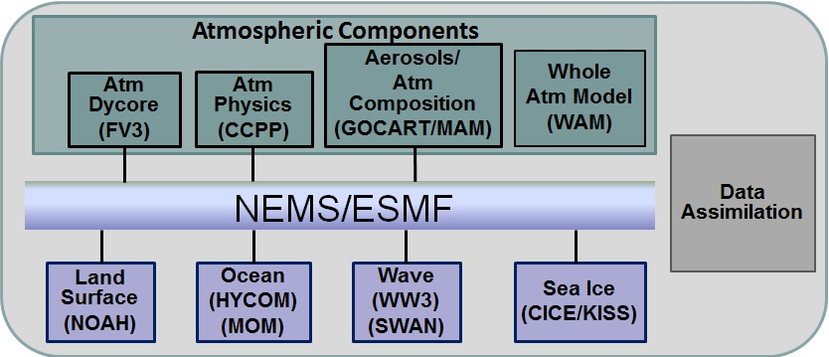
Unified Modeling Strategic Implementation Plan (SIP) Participation
Brad Pierce and Jason Otkin (UW-Madison, SSEC/CIMSS)
Objective
The National Weather Service is designing, developing, and implementing a global prediction system to address growing service demands, and to increase the accuracy of weather forecasts out to 30 days.
Contributions from research and operational numerical weather prediction communities are being incorporated to deliver a Next Generation Global Prediction System (NGGPS)
The Strategic Implementation Plan (SIP) focuses on how the community can exploit the opportunities provided by the NGGPS and to evolve towards a national unified Earth system modeling system
NGGPS Model Components
Approach:
Benefits and Outcomes
Participation in NGGPS SIP Working Groups by SSEC staff provides the expertise needed to support NGGPS development.
Jason Otkin (UW-Madison, SSEC) Co-Chair of Verification and Validation (V&V) Working Group
​
Brad Pierce (UW-Madison, SSEC) member of the Aerosol and Atmospheric Composition Component/Discipline Working Group
Benefits: Development of a national unified modeling system across spatial and temporal scales: from high-resolution, convective-resolving scales to the global scale, and from short-range forecasts (hours-days) to the seasonal to subseasonal scales (weeks-months).
Outcomes:
Increase rate of improvement of skill for global numerical weather prediction
Extend forecast skill of numerical weather prediction out to 30 days
Improve overall accuracy and reliability of
probabilistic forecasts
CoIs: Allen Lenzen (SSEC)
Partners: Ivanka Stajner (NWS)
Mo/Yr

