Slide 1
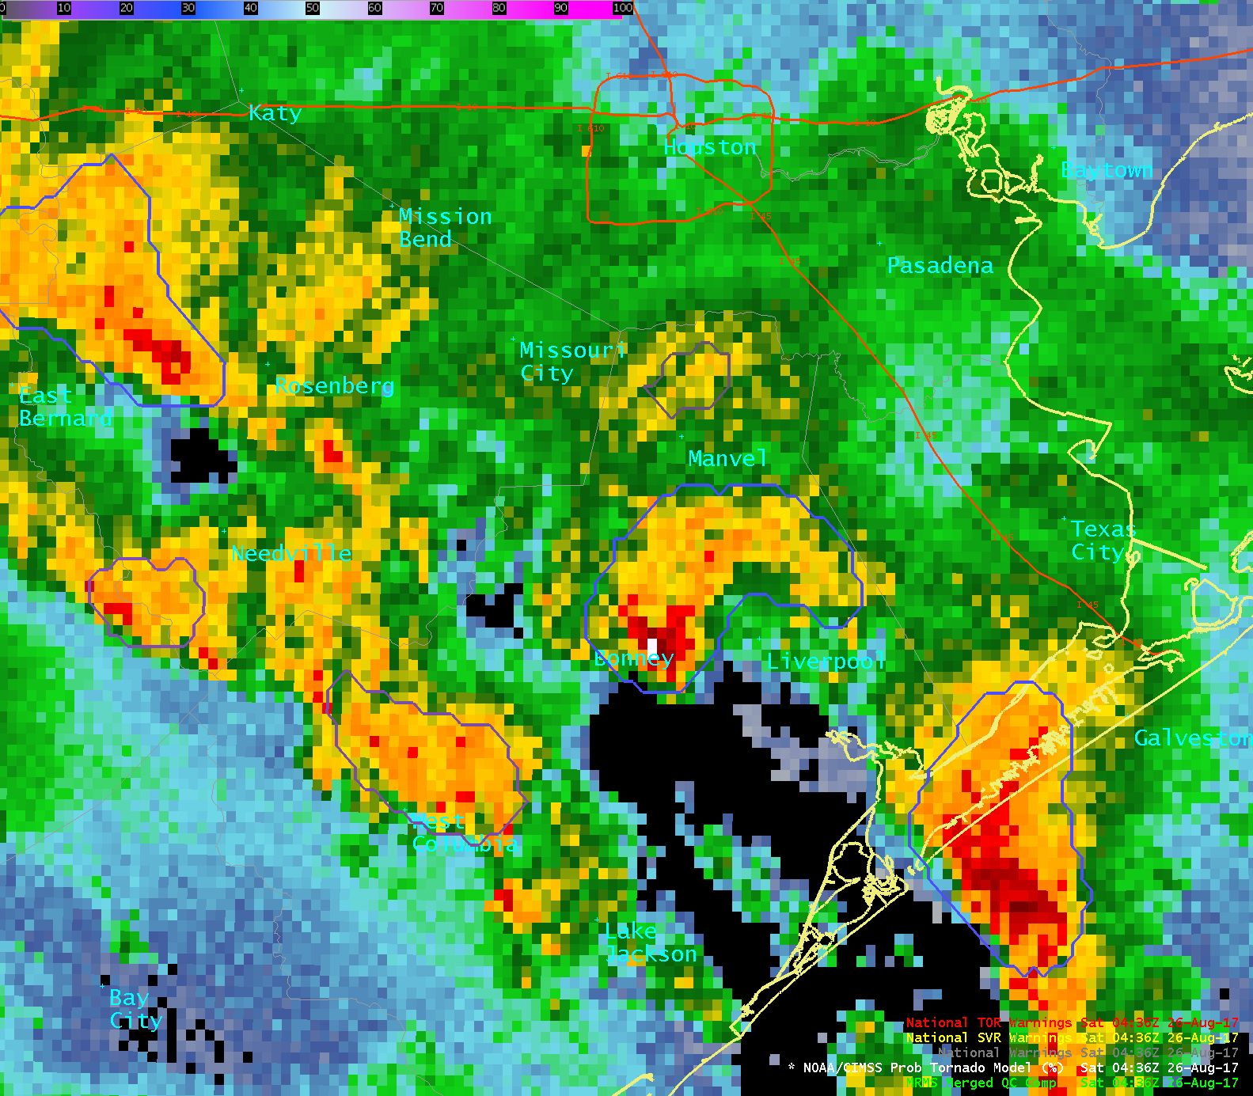
0%
50%
100%
ProbTornado
26 August 2017
04:34 – 05:50 UTC
Houston
Texas
22%

Slide 2
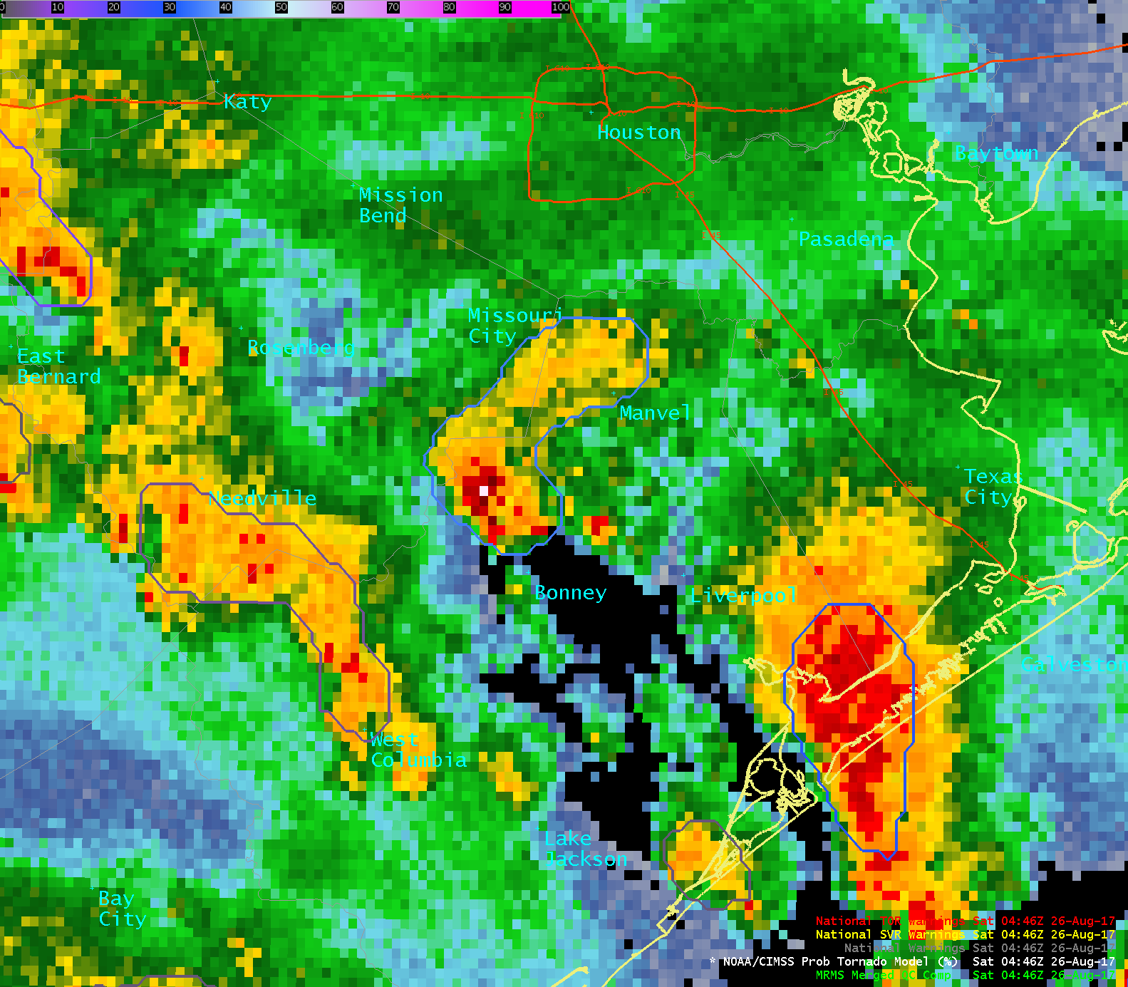
0%
50%
100%
ProbTornado
26 August 2017
04:34 – 05:50 UTC
Houston
20%
Texas

Slide 3
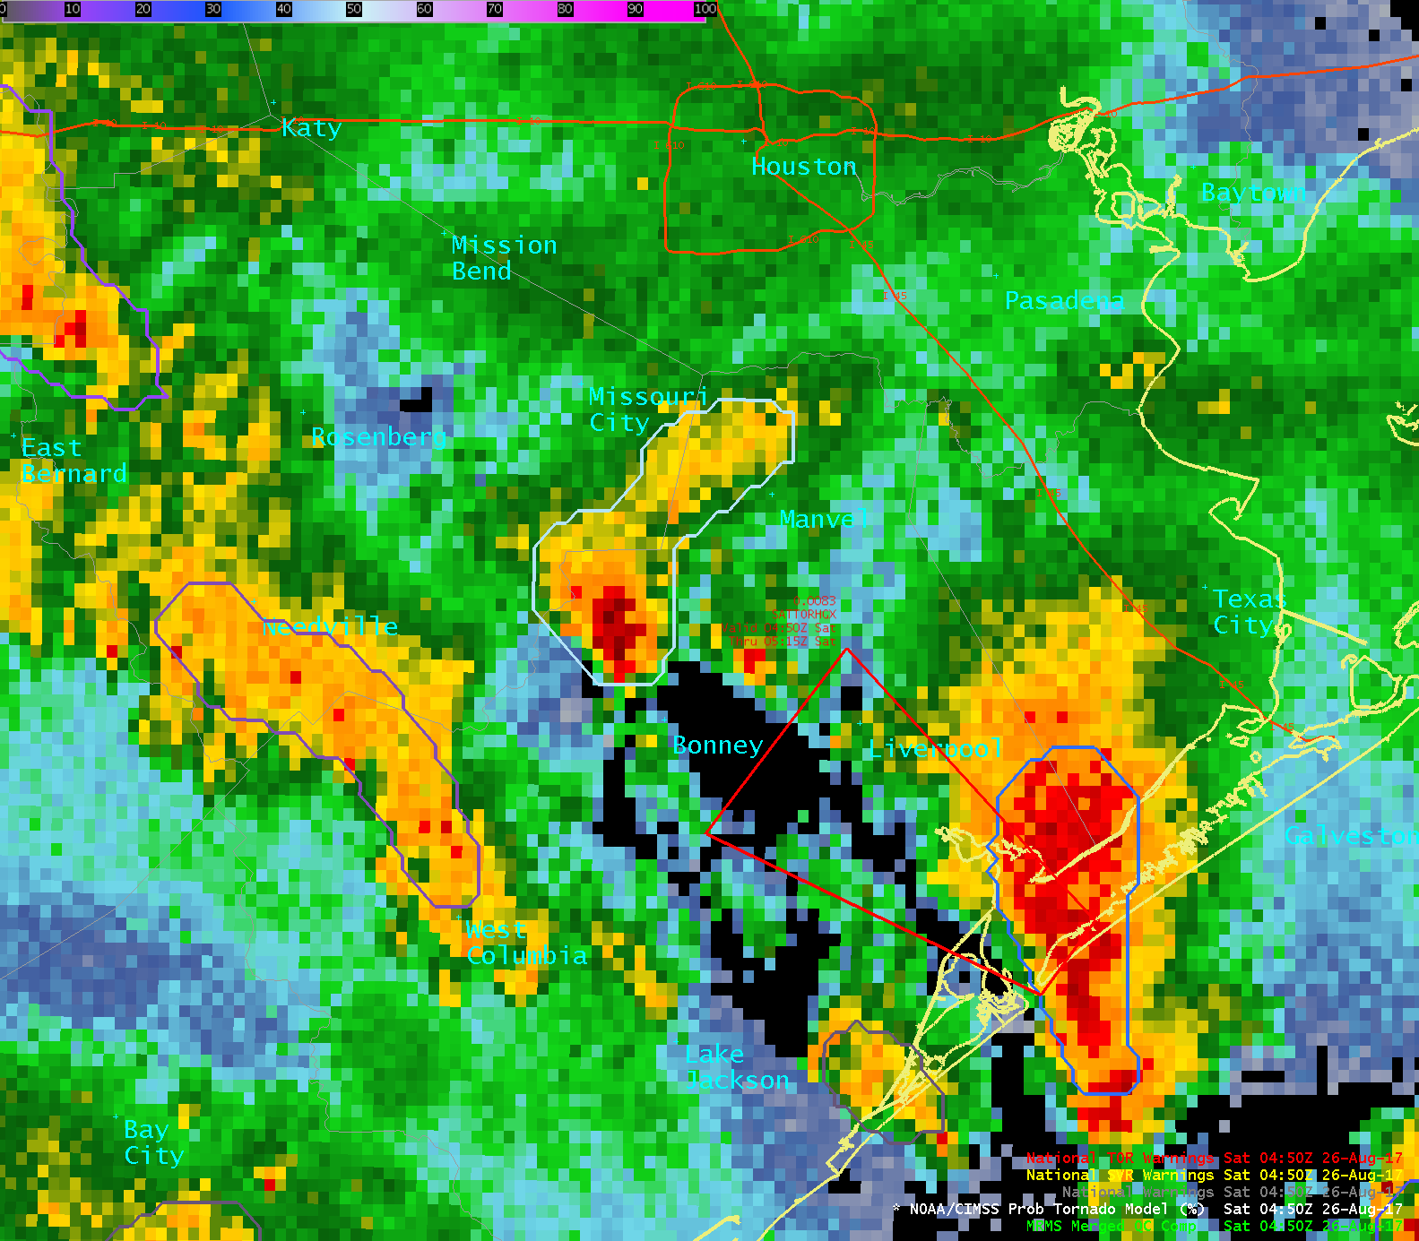
0%
50%
100%
ProbTornado
26 August 2017
04:34 – 05:50 UTC
Houston
NWS Warning – 04:50 UTC
33%
Texas

Slide 4
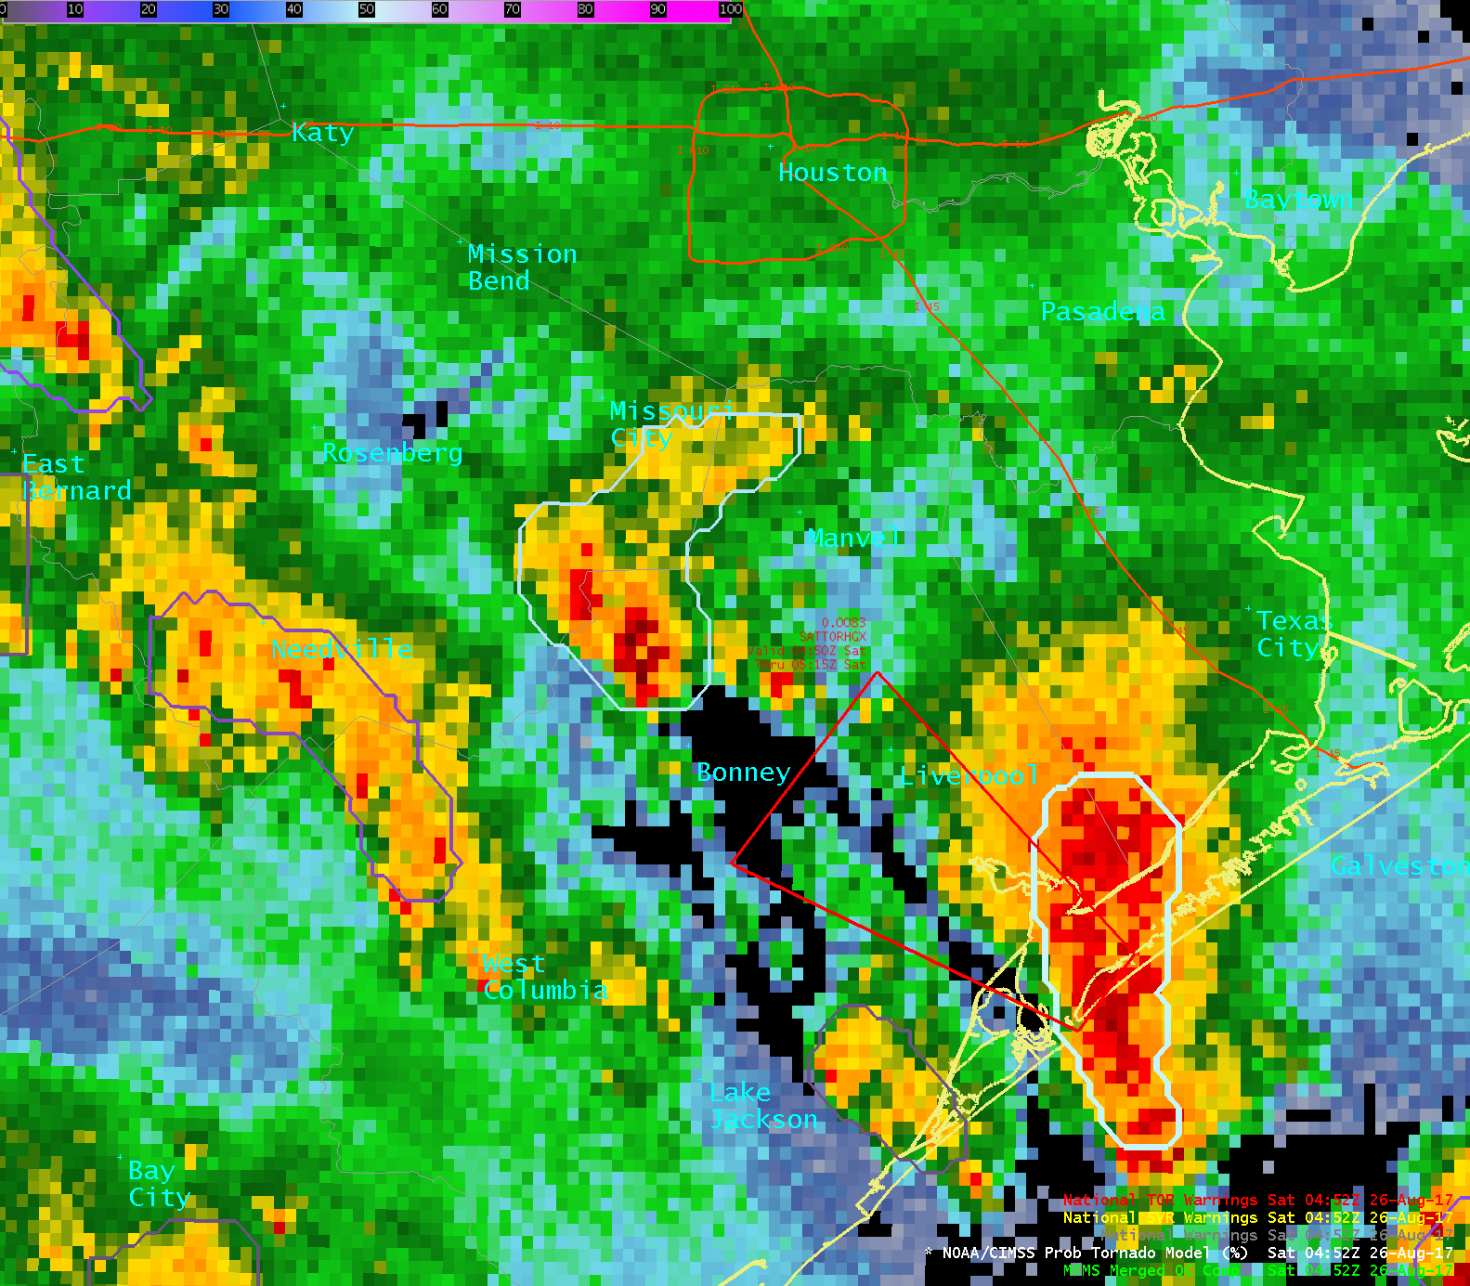
0%
50%
100%
ProbTornado
26 August 2017
04:34 – 05:50 UTC
Houston
NWS Warning – 04:50 UTC
50%
Texas

Slide 5
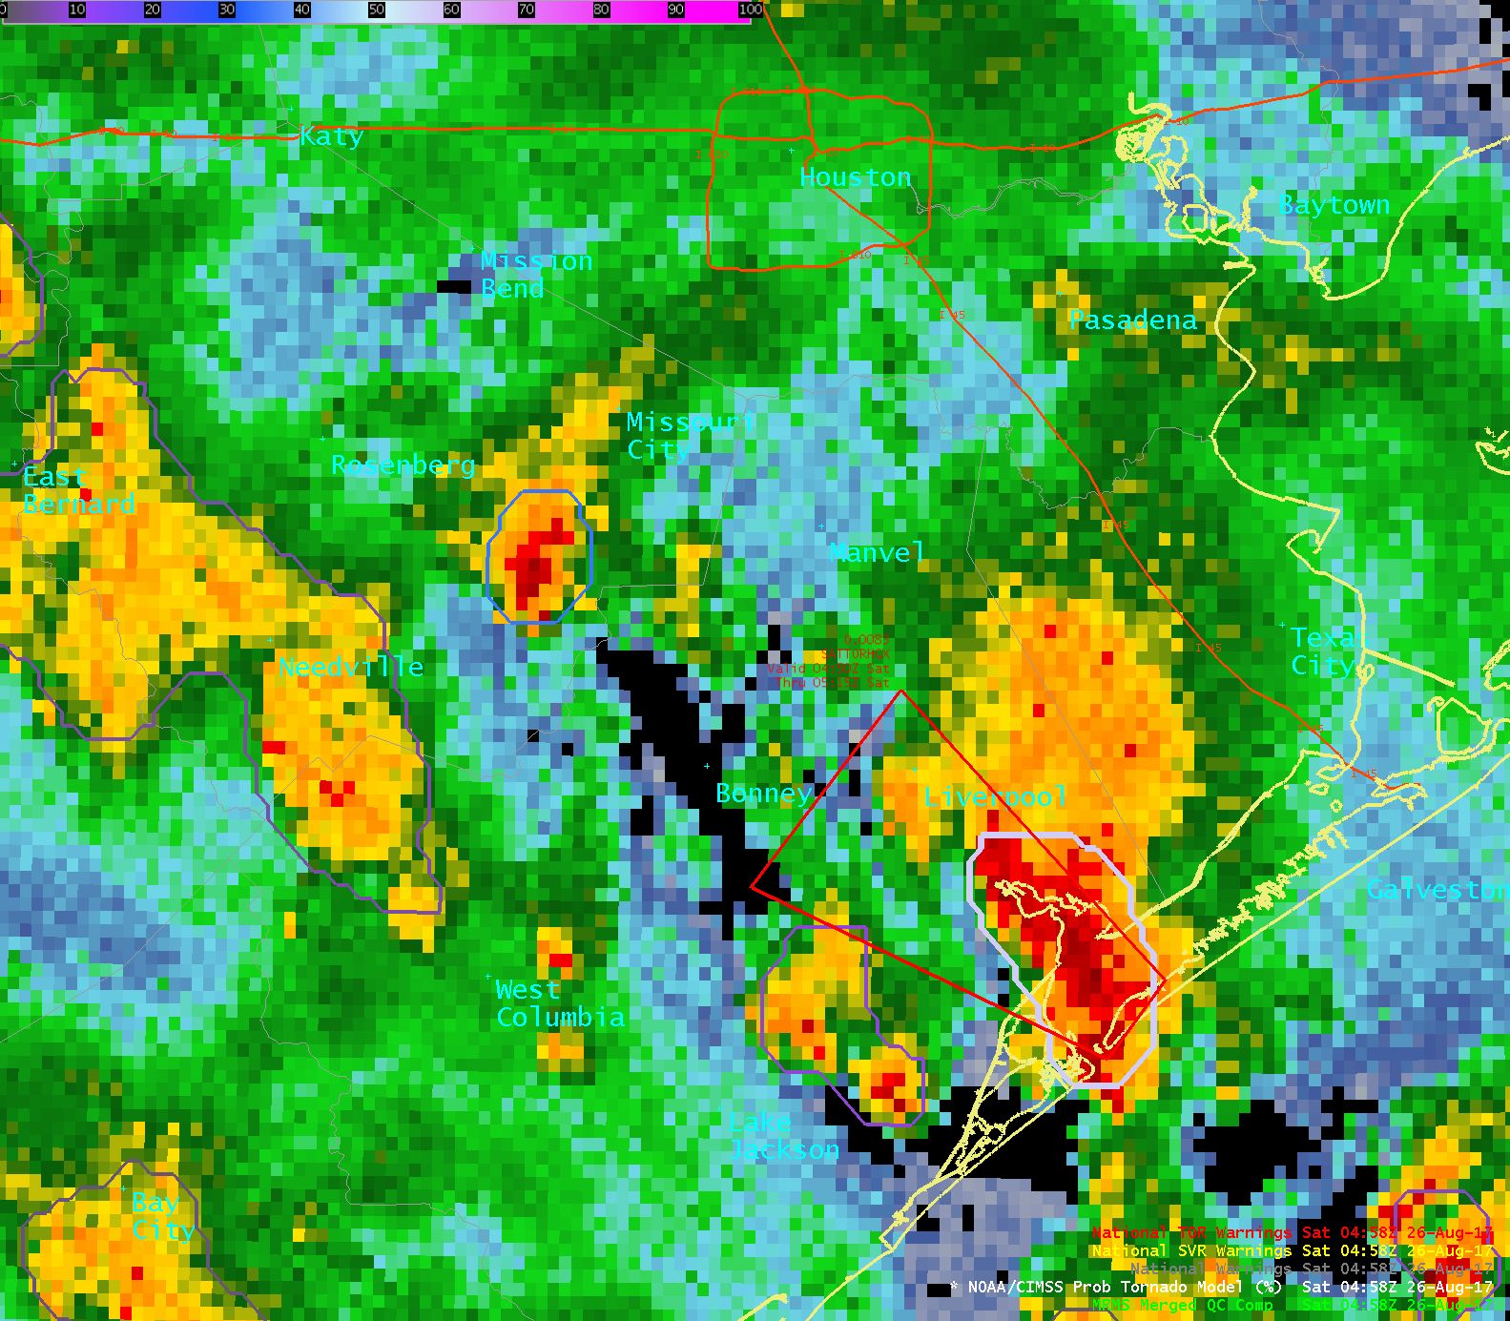
0%
50%
100%
ProbTornado
26 August 2017
04:34 – 05:50 UTC
Houston
NWS Warning – 04:50 UTC
57%
Texas

Slide 6
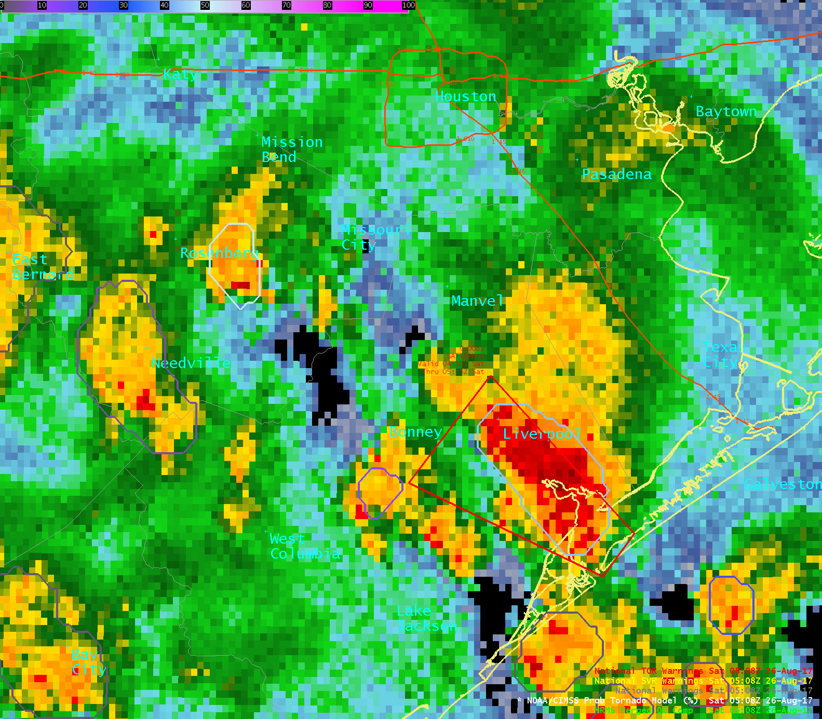
0%
50%
100%
ProbTornado
26 August 2017
04:34 – 05:50 UTC
Houston
NWS Warning – 04:50 UTC
44%
Texas

Slide 7
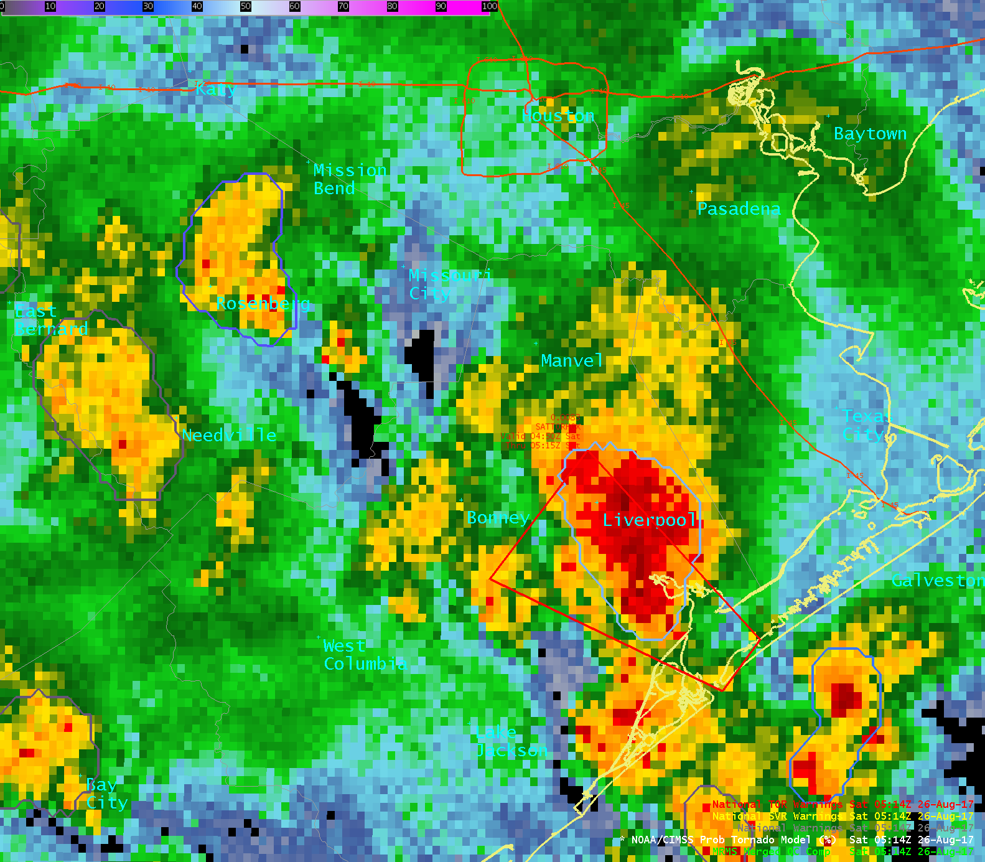
0%
50%
100%
ProbTornado
26 August 2017
04:34 – 05:50 UTC
Houston
42%
Texas

Slide 8
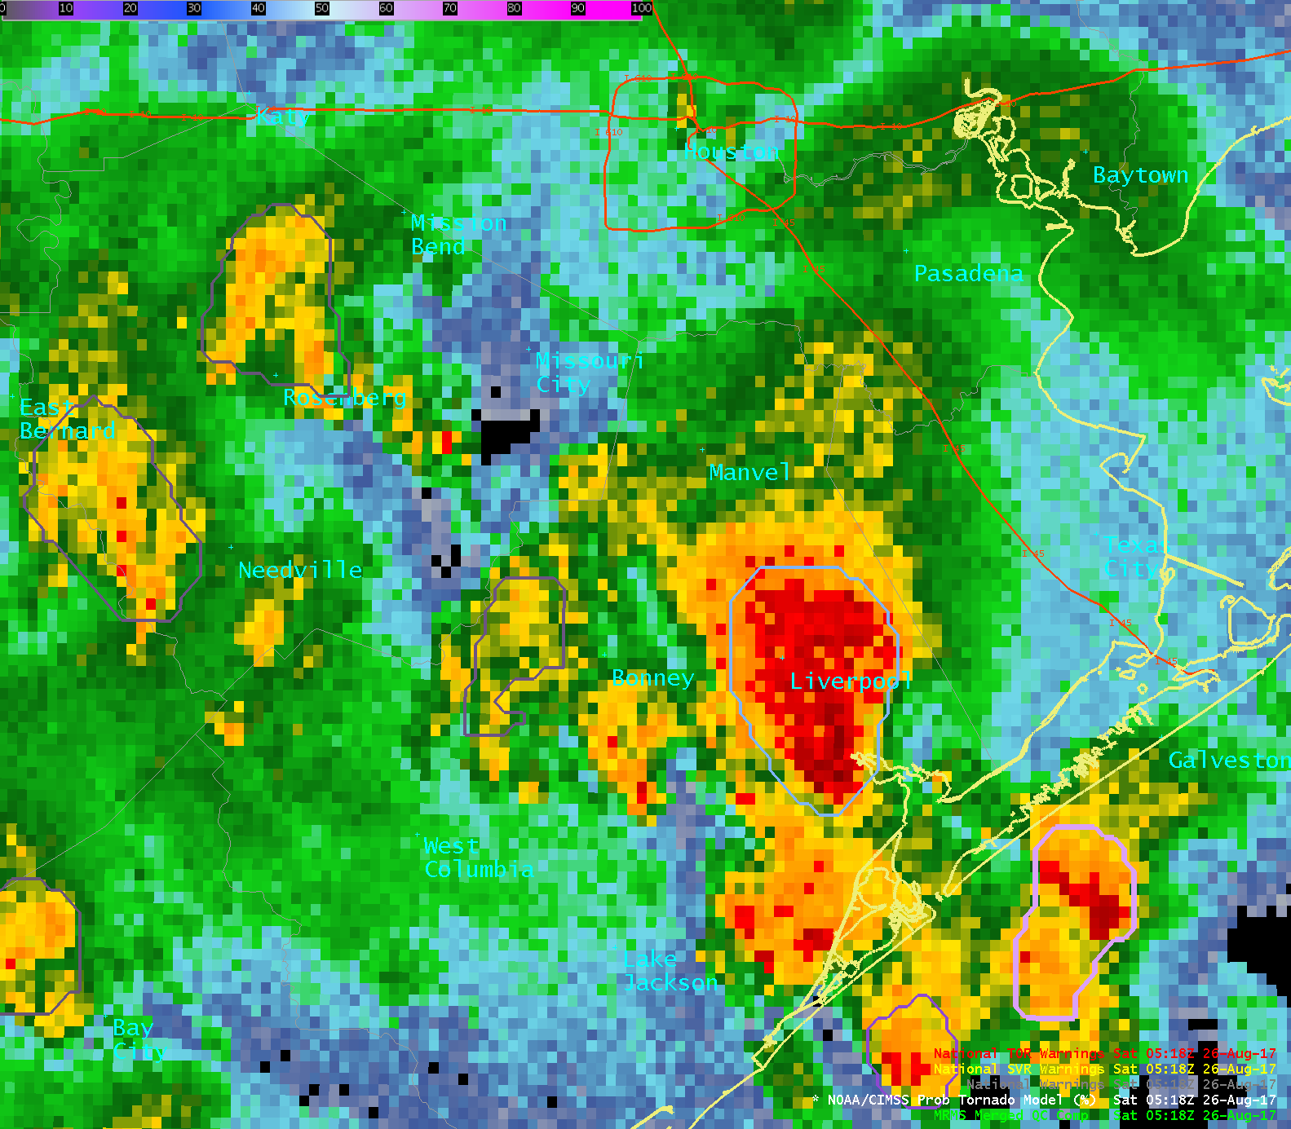
0%
50%
100%
ProbTornado
26 August 2017
04:34 – 05:50 UTC
Houston
42%
Texas

Slide 9
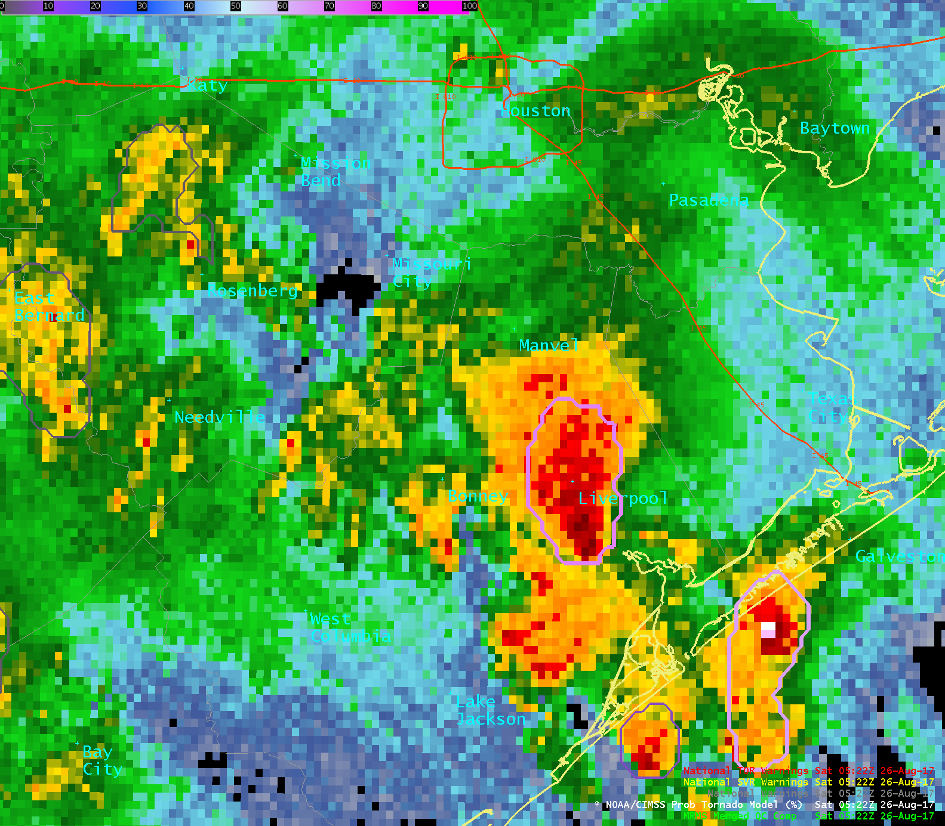
0%
50%
100%
ProbTornado
26 August 2017
04:34 – 05:50 UTC
Houston
69%
Texas

Slide 10
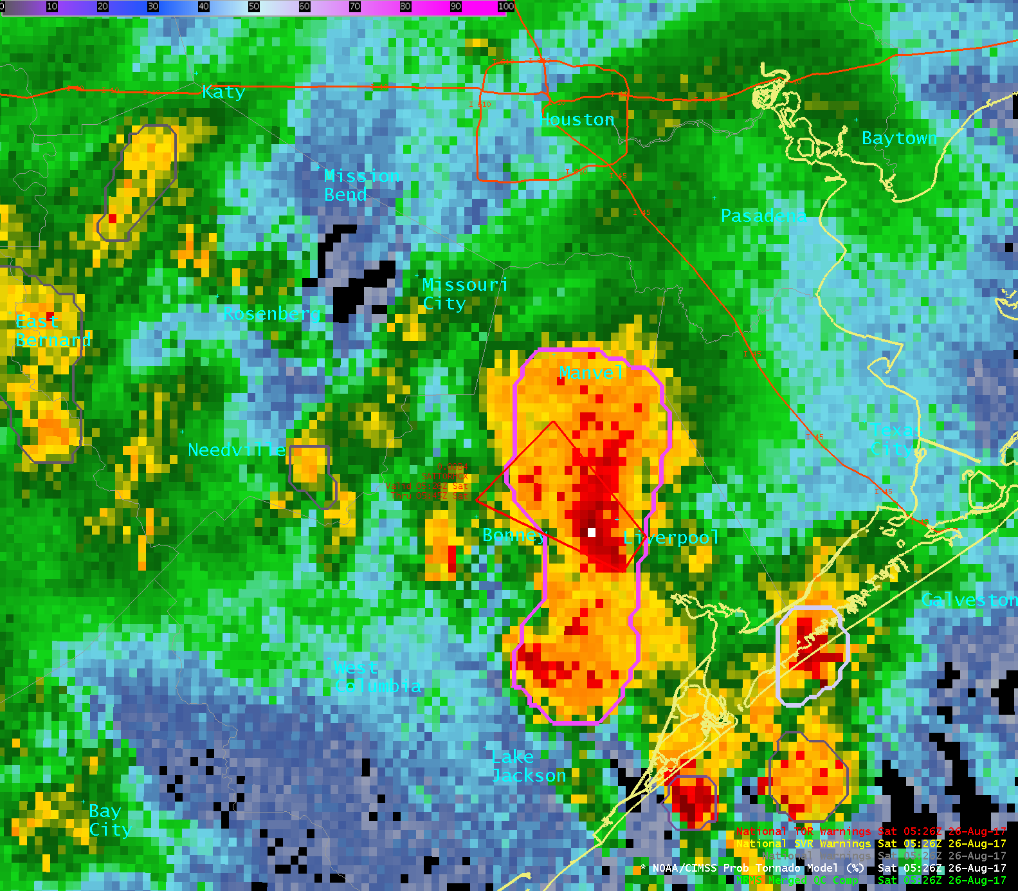
0%
50%
100%
ProbTornado
26 August 2017
04:34 – 05:50 UTC
Houston
78%
NWS Warning – 05:26 UTC
Texas

Slide 11
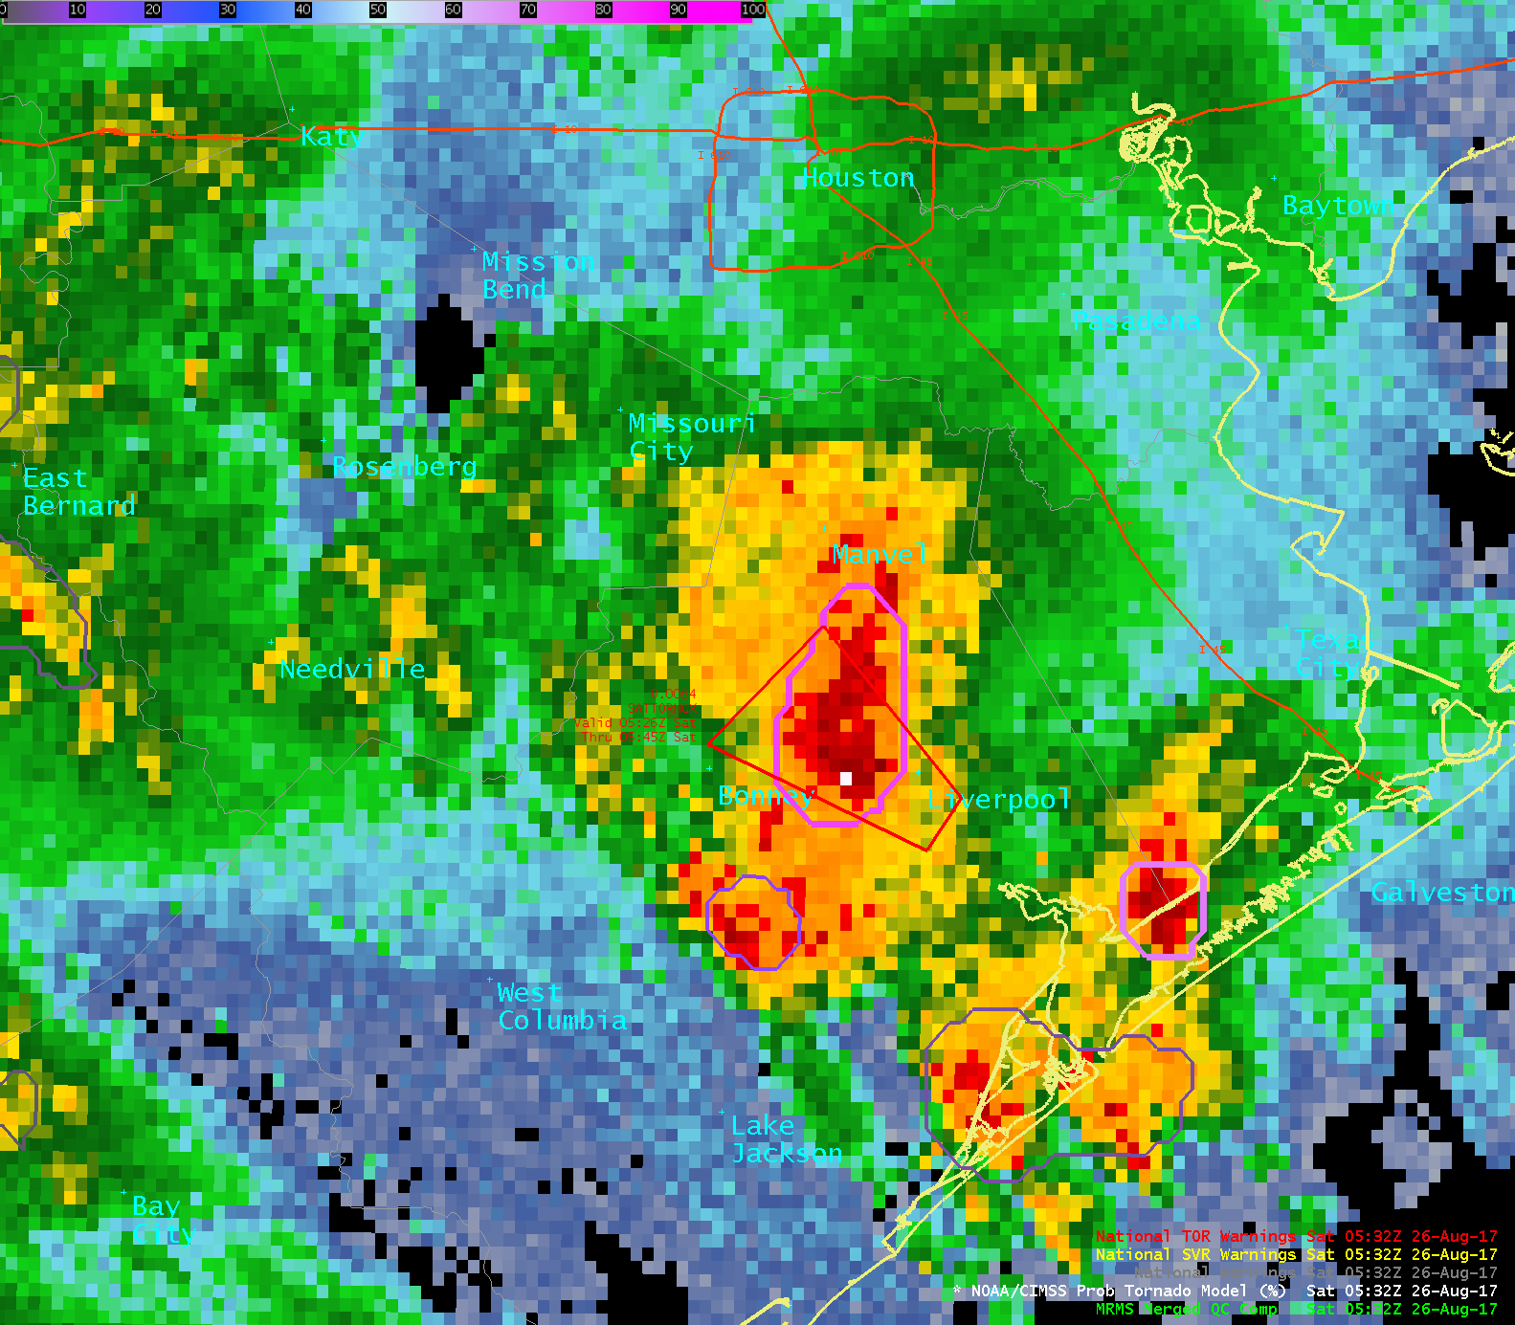
0%
50%
100%
ProbTornado
26 August 2017
04:34 – 05:50 UTC
Houston
79%
NWS Warning – 05:26 UTC
Texas

Slide 12
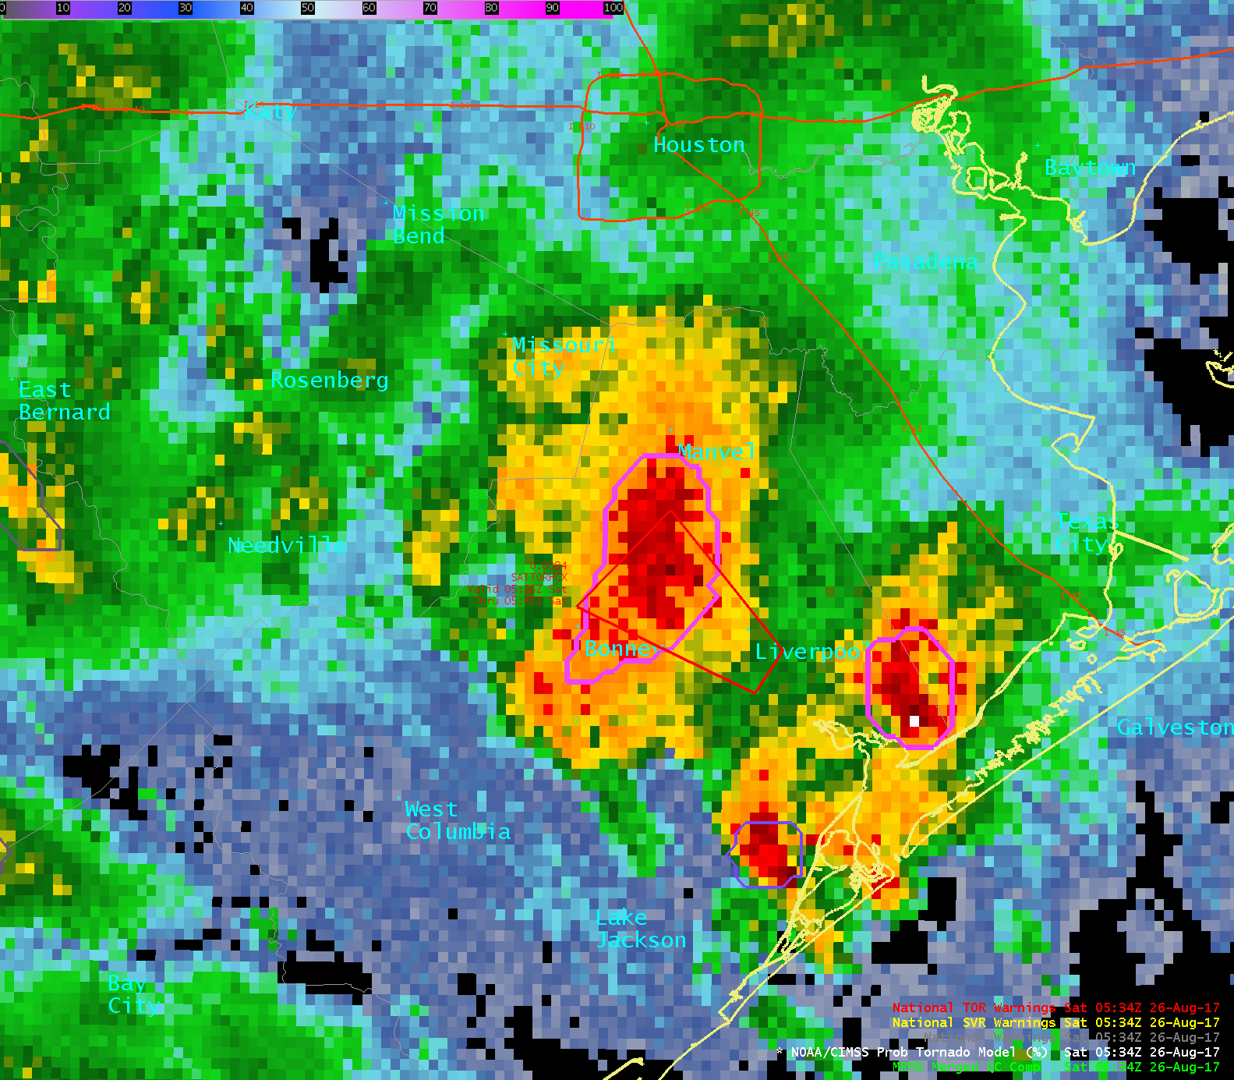
0%
50%
100%
ProbTornado
26 August 2017
04:34 – 05:50 UTC
Houston
79%
NWS Warning – 05:26 UTC
Texas

Slide 13
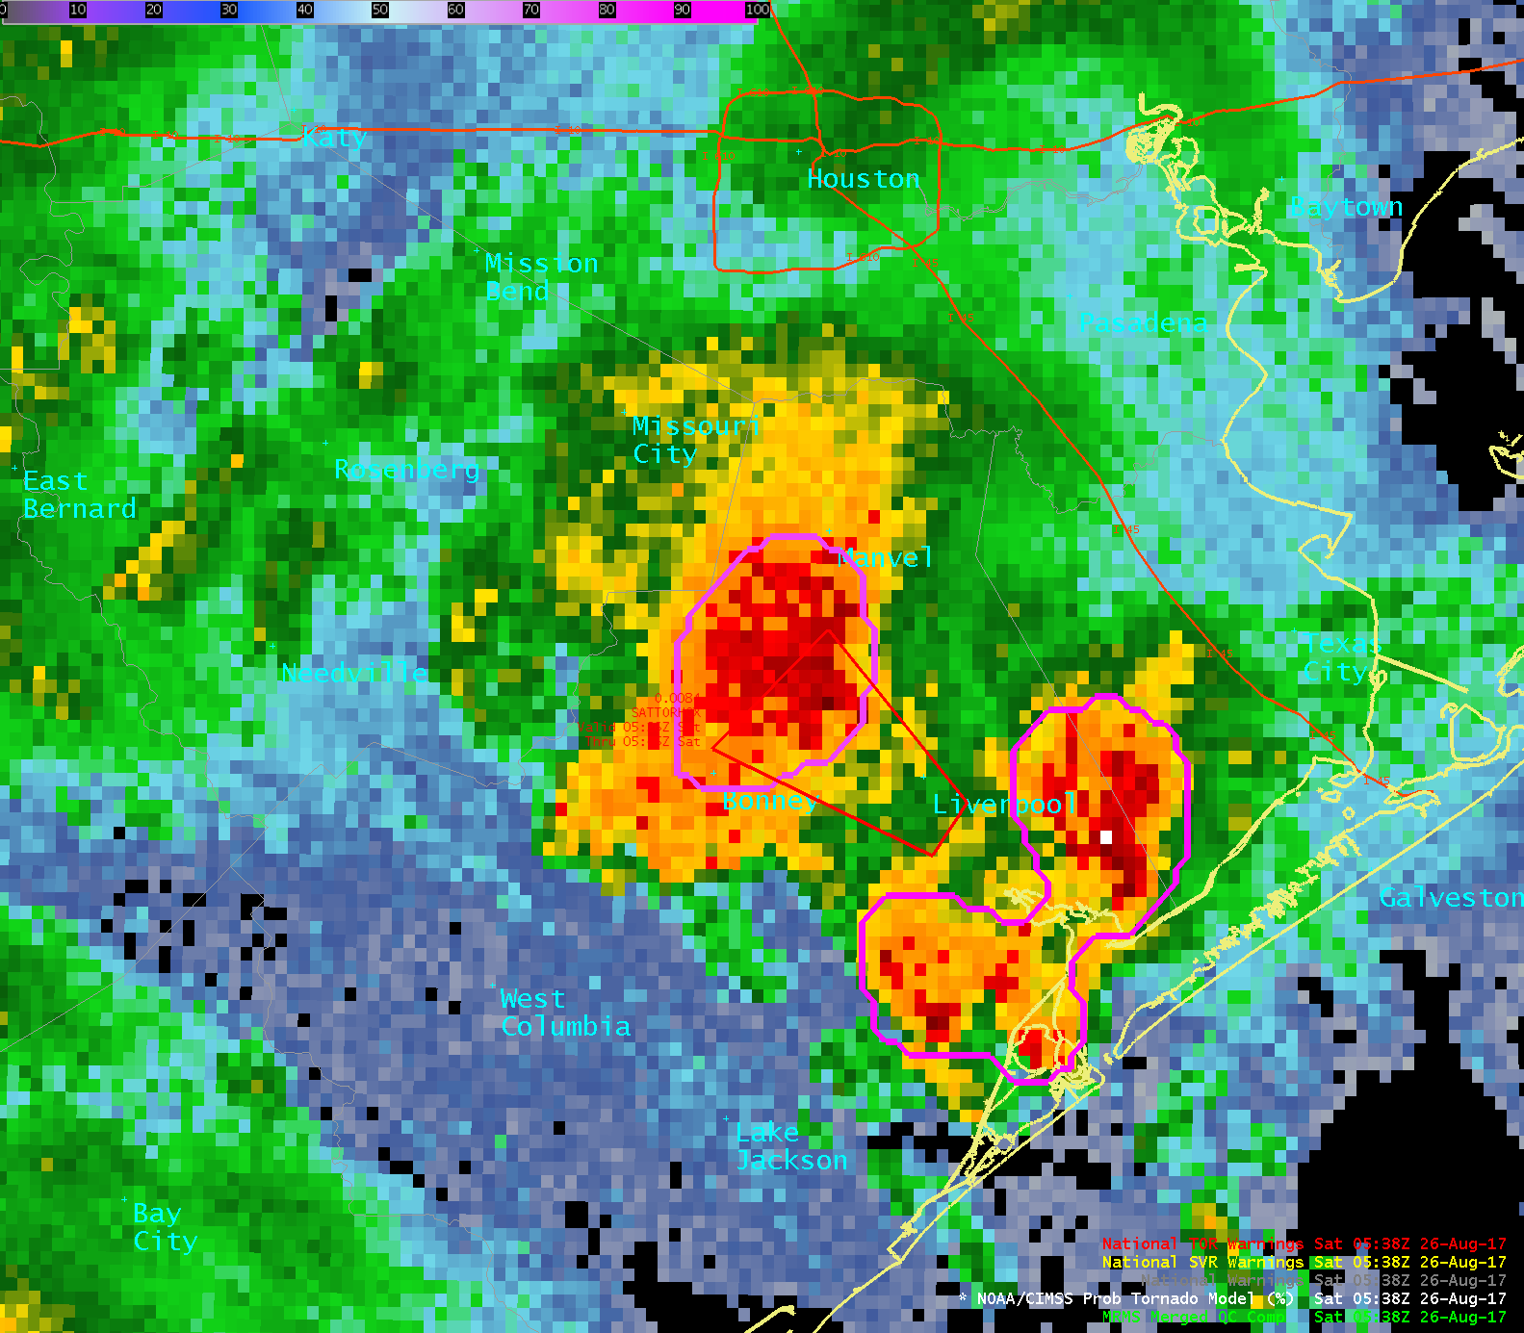
0%
50%
100%
ProbTornado
26 August 2017
04:34 – 05:50 UTC
Houston
79%
NWS Warning – 05:26 UTC
Texas

Slide 14
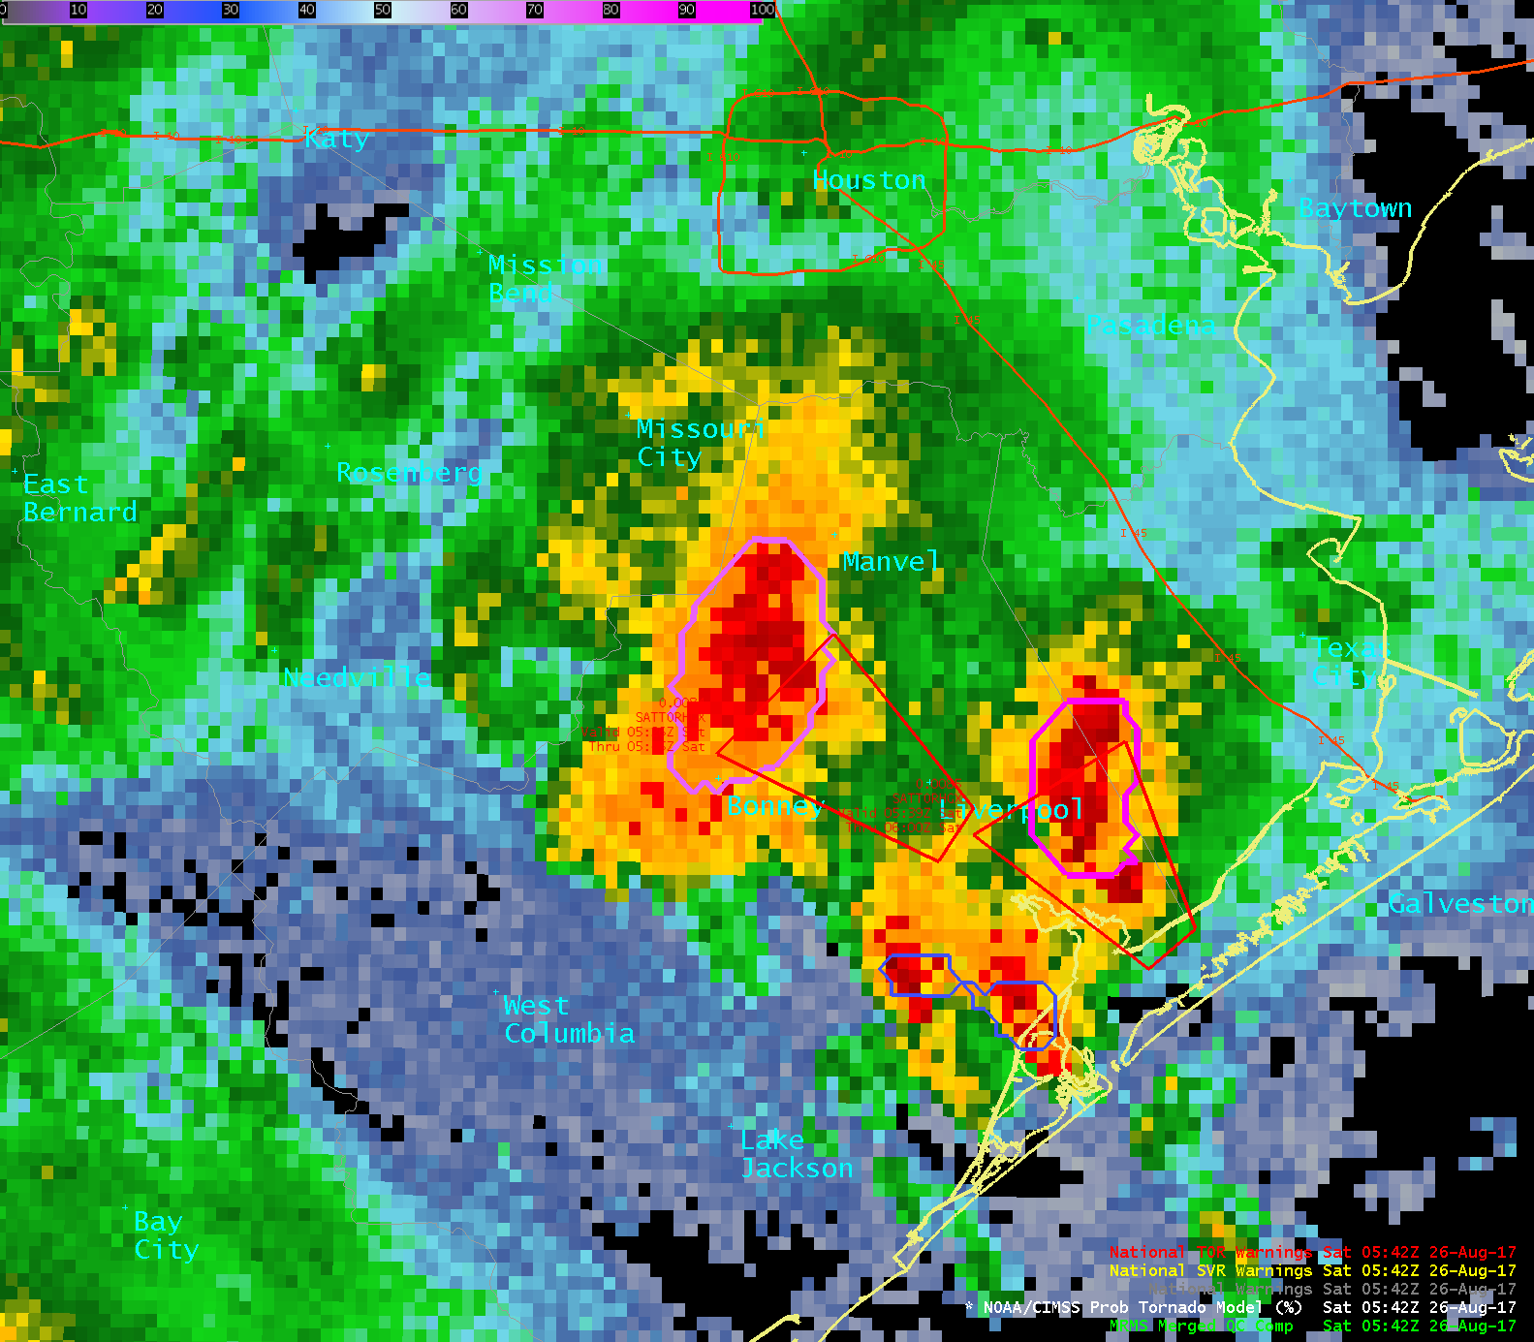
0%
50%
100%
ProbTornado
26 August 2017
04:34 – 05:50 UTC
Houston
74%
Texas
NWS Warning – 05:39 UTC

Slide 15
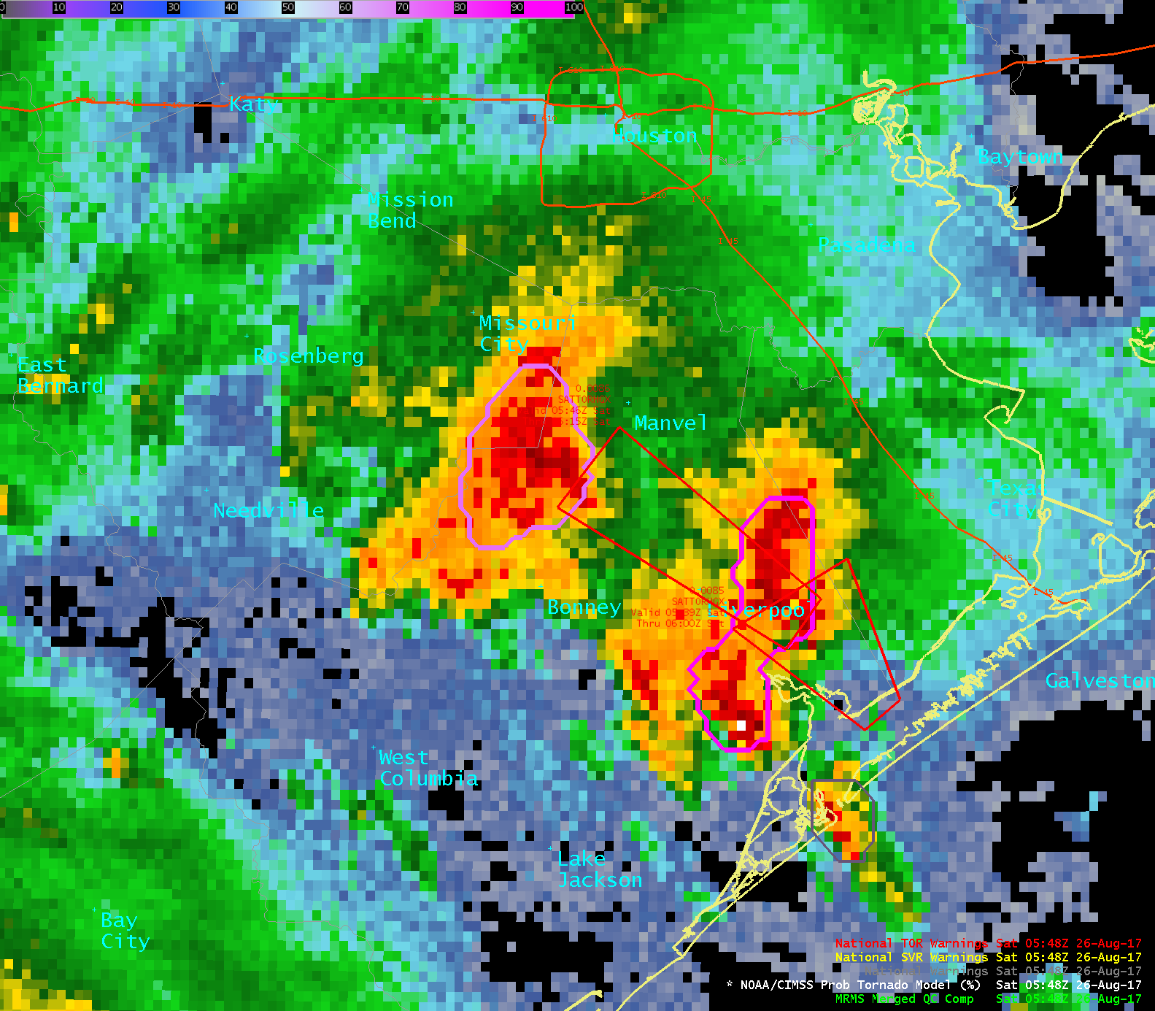
0%
50%
100%
ProbTornado
26 August 2017
04:34 – 05:50 UTC
Houston
72%
NWS Warning – 05:46 UTC
Texas
NWS Warning – 05:39 UTC

Slide 16
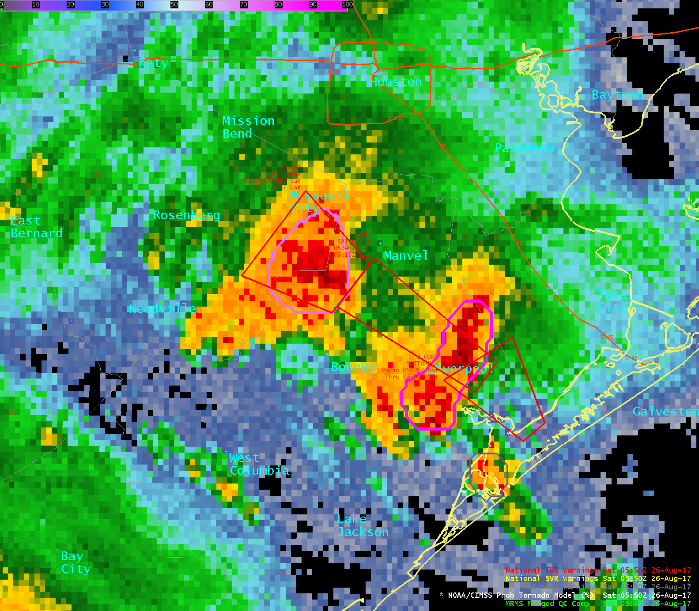
0%
50%
100%
ProbTornado
26 August 2017
04:34 – 05:50 UTC
Houston
NWS Warning – 05:49 UTC
72%
NWS Warning – 05:46 UTC
Texas
NWS Warning – 05:39 UTC

Slide 17
0%
50%
100%
ProbTornado
26 August 2017
04:34 – 05:50 UTC
Houston
NWS Warning – 05:49 UTC
72%
NWS Warning – 05:46 UTC
Tornado report – 05:50 UTC
Texas
NWS Warning – 05:39 UTC

