Slide 1
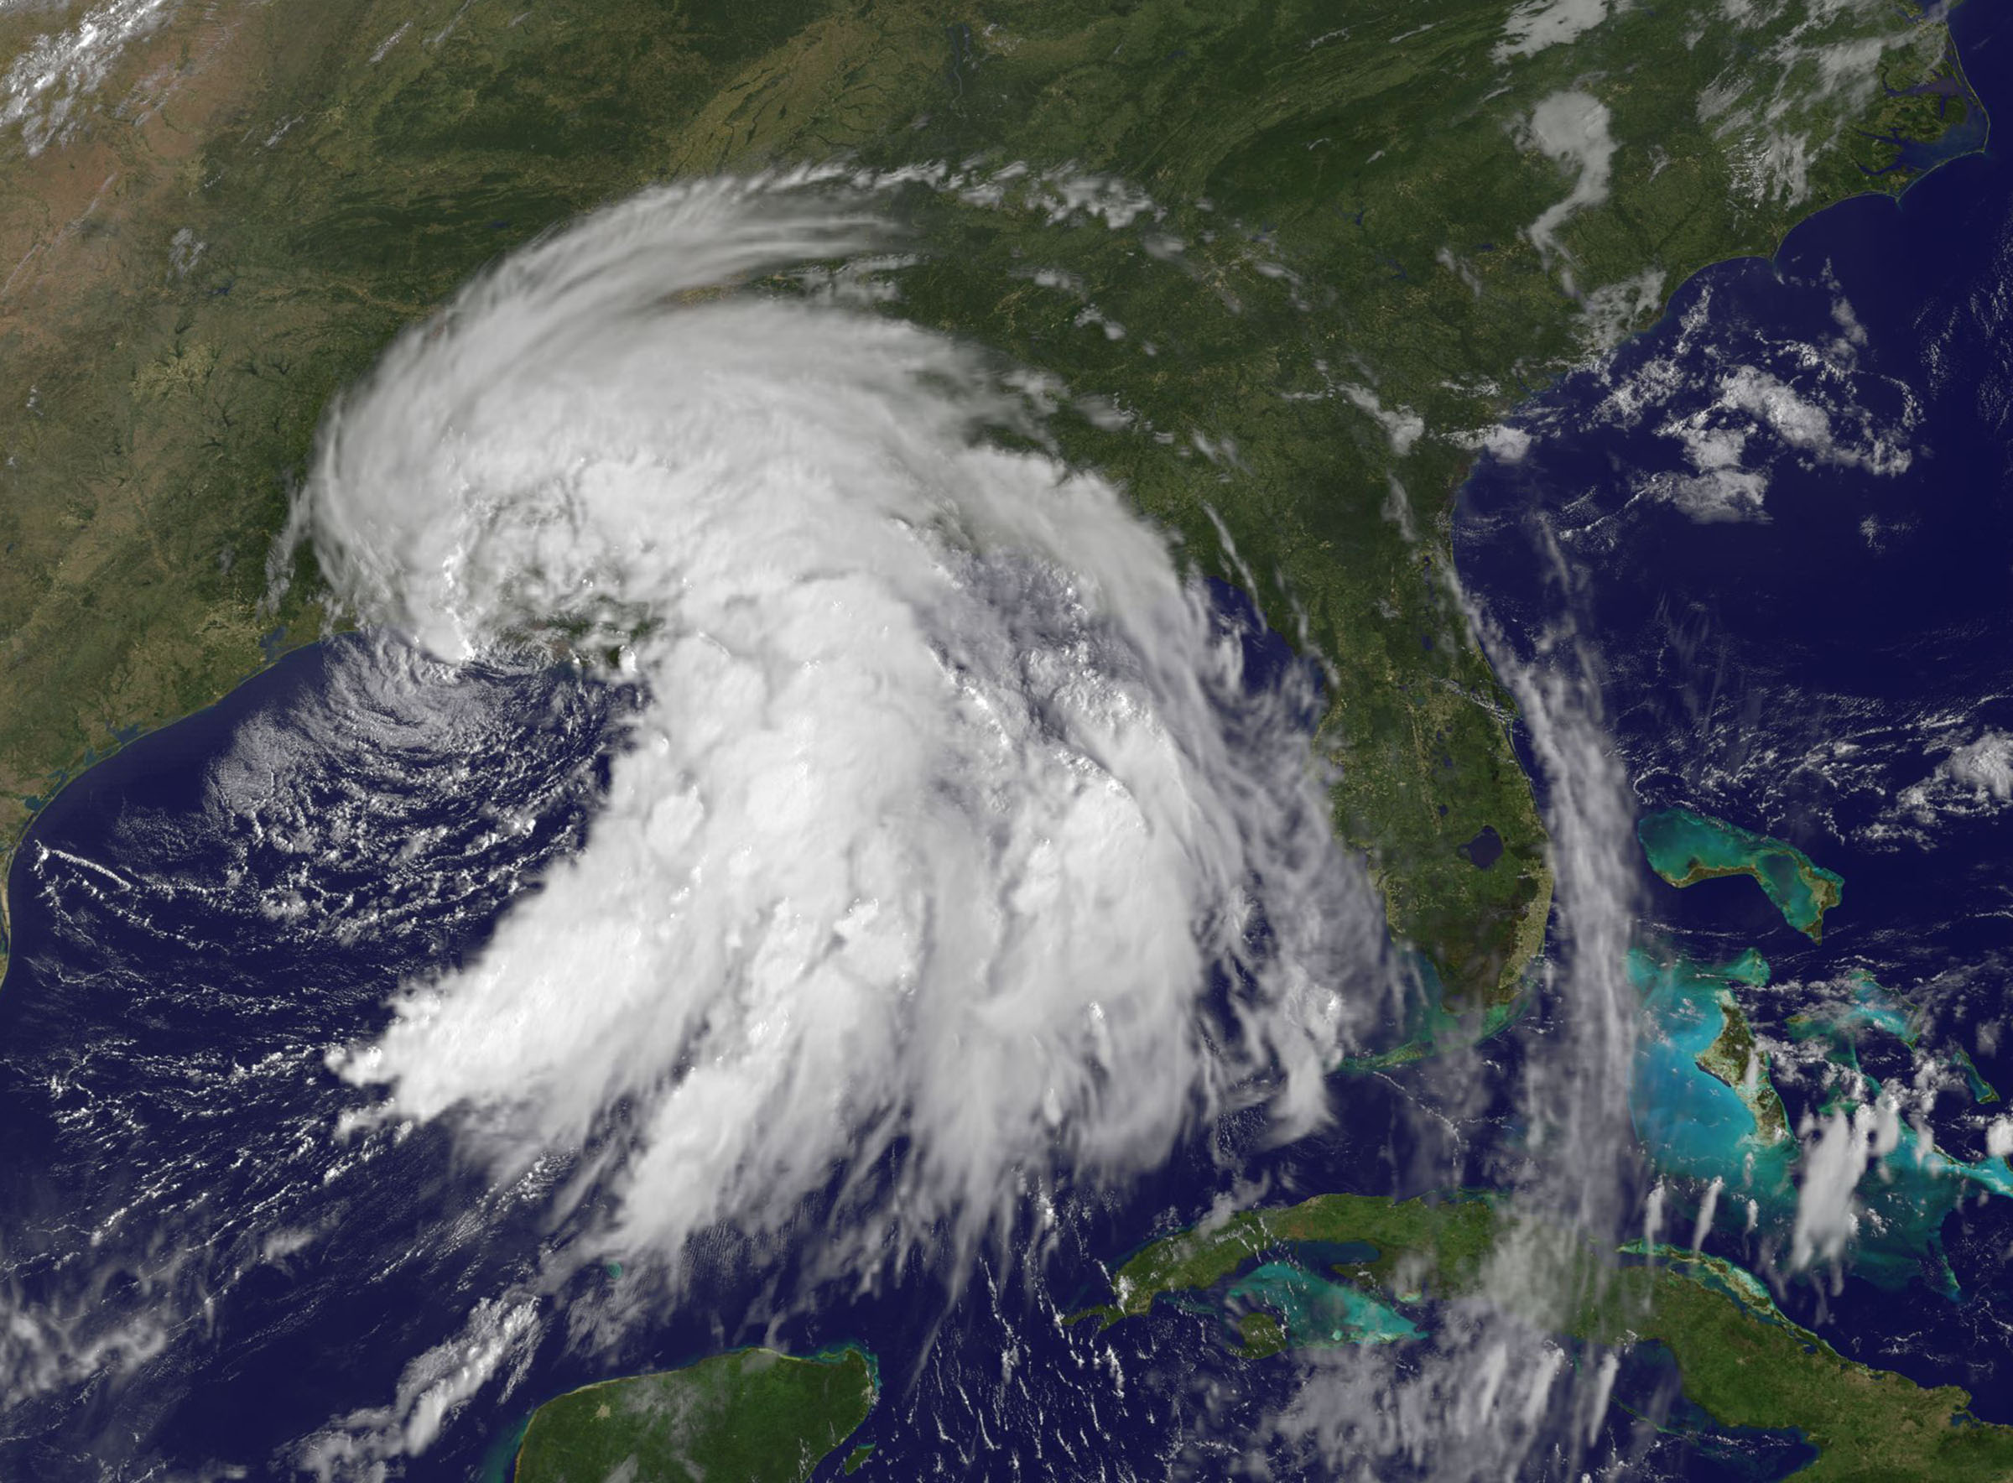
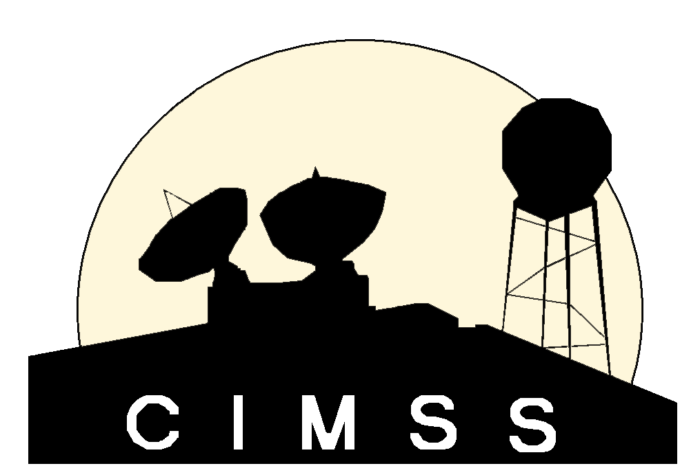
GOES-R/JPSS Program
CIMSS/ASPB Participation
GOES-R/JPSS Proving Ground Status
Wayne Feltz, Mike Pavolonis, Tim Schmit, Andy Heidinger, Jordan Gerth, Scott Bachmeier, Scott Lindstrom, Justin Sieglaff, Lee Cronce, Robert Aune, Gary Wade, Brad Pierce, Kaba Bah, Will Straka, Jason Otkin, Sarah Monette, Chris Velden, Ralph Petersen, Russ Dengel and Chris Schmidt
September 9, 2013

Slide 2
Satellite Proving Ground @ CIMSS/ASPB
Demonstration of Satellite PG applications at National Center Testbeds/Demonstrations and NWS WFO
AWIPS-2 status
Training
SRSOR from GOES-14
Upcoming meetings/conferences
Notes:
Any new bullets?

Slide 3
1) Hazardous Weather Testbed and SPC, Norman OK
Satellite Liaison: Bill Line
HWT Products:
Simulated Cloud and Moisture Imagery (Otkin/Sieglaff/Lindsey – CIMSS/CIRA)
NearCast Model (Petersen/Line - CIMSS)
Cloud Top Cooling (Sieglaff/Feltz – CIMSS)
Product demonstrations in SPC are starting. SPC Products:
NearCast Model
Cloud Top Cooling
Overshooting Tops
SRSOR (in August)
Continue streamlining formats for AWIPS-2
Future planning will be coordinated with new liaison
Spring 2014 HWT plans
Hydrological/Fire Testbed in future?
UW-Madison satellite applications “Boot Camp” was held 8-19 July 2013: Bill Line, Amanda Terborg, Chad Gravelle, and Michael Folmer were present

Slide 4
2) AWC Testbed Satellite Proving Ground
Satellite Liaison: Amanda Terborg
Aviation Weather Testbed Summer Demo: August 12 – 23, 2013
WRF Simulated ABI Imagery
GOES Cloud Top Cooling
GOES(-R) Overshooting Top and Tropical Overshooting Top
Thermodynamic NearCasting
GOES-14 imager SRSO one minute mode imagery, CTC, and OT were available for testbed
GOES-R proxy cloud top heights/temperature (ACHA) for GOES East/West
CIMSS participants
12-16 August Justin Sieglaff
19-21 August Wayne Feltz
Forecaster feedback/examples are available
http://goesrawt.blogspot.com/
4
Notes:
Slide 5 in main presentation – clarified ash/so2 products are for MODIS-Alaska domain

Slide 5
GOES-14 SRSOR (1-min data) GOES-14 using routine GOES-E scans
UW-Cloud Top Cooling algorithm output using 1-min GOES-14 data
UW-CTC signal begins sooner using 1-min data versus GOES-E routine scanning pattern (RO)
Most intense UW-CTC signal is always captured using 1-min data compared to GOES-E RO
Near-real time processing kept up with 1-min GOES data rates

Slide 6
3) NWS Operations PG and WFO Interactions
Satellite Liaison: Chad Gravelle
Continued coordination of GOES-R Fog/Low Stratus products into operations (West Coast evaluation began in May with SEW, EKA, LOX, and MTR).
Convective Cloud-Top Cooling (part of “convective-initiation toolbox”) evaluation with CR (12 WFOs) and ER (2 WFOs) began in June, intermountain West WFO evaluation possibly in July.
Assisted in distributing VIIRS bands (including DNB) to local WFO, Monterey and Louisville, and now available to MKX, MTR, LMK, and the AK WFOs
Assisted CRH and ERH with successful display of Fog/Low Stratus products in AWIPS 2.
Working with NWS Operations PG regarding GOES-R products and and how they relate to ongoing GOES-R PG activities.

Slide 7
4) Alaska/AAWU/High Latitude Testbed
Automated ash cloud alerts from AVHRR and MODIS will be provided to the VAAC and CWSU soon (training needs to be updated first).
VIIRS NetCDF files verified to be AWIPSII compatible
VIIRS VISIT NWS training module under development
Polar2grid tool being expanded for GEOCAT AK products
Participated in OCONUS meeting 17-21 June 2013:
CIMSS: Wayne Feltz, Jordan Gerth, Ralph Petersen, Liam Gumley
NOAA ASPB: Jeff Key and Mike Pavolonis
Notes:
Slide 6 in main presentation – updated bullets to more current items

Slide 8
5) Pacific Region/Hawaii Demonstrations
Liam Gumley, Kathy Strabala and Jordan Gerth taught a MODIS/VIIRS direct broadcast application workshop at the University of Hawaii - Manoa Campus 20-23 August 2013.
20+ students attended including NWS and JTWC personnel as well as UH graduate students
Course consisted of morning lectures and hands-on afternoon labs, culminating in student presentations on the last day
Goal of the course is to:
Make users aware of the products that are available from the MODIS/VIIRS direct broadcast data from the NOAA HCC antenna
Teach users about the instruments, spectral bands as well as principles of remote sensing
Give examples of specific MODIS and VIIRS Hawaii environmental applications
Foster the use of satellite data for local real-time applications

Slide 9
5) Pacific Region/Hawaii Demonstrations
Students working on a lab during the Hawaii VIIRS/MODIS direct broadcast application workshop.

Slide 10
6) Satellite Proving Ground for Marine, Precipitation, and Hazardous Weather Applications
Satellite Liaison: Michael Folmer
UW-CIMSS providing Overshooting-Top/Enhanced-V products (same methods as SPC delivery), N-AWIPS displayed at OPC, WPC, and SAB.
Cloud top height and temperature from GOES imager are in progress for display within N-AWIPS and AWIPS
The Washington VAAC is now receiving SEVIRI based GOES-R volcanic ash products via a McIDAS ADDE server and automated alerts will soon be distributed
Coordinated CIMSS GOES-R PG collaborations with 2013-2014 Satellite Proving Ground for Marine, Precipitation, and Hazardous Weather Applications demonstrations
Other GOES-R PG decision support products requested within plan available once approved by NOAT governance process

Slide 11
7) NHC Proving Ground
UW-CIMSS Participants: C. Velden, S. Monette
Also underway at same time is the NASA HS-3 (Global Hawks>>hurricane recon)
UW-CIMSS is providing real-time observations from updated versions of the Hurricane Intensity Estimate (HIE) and Tropical Overshooting Tops (TOTs) products to both exercises.
Also making extensive use of the GOES-R ACHA Cloud Top Height (CTH) estimation algorithm as part of hazard avoidance guidance in the HS3 field campaign.

Slide 12
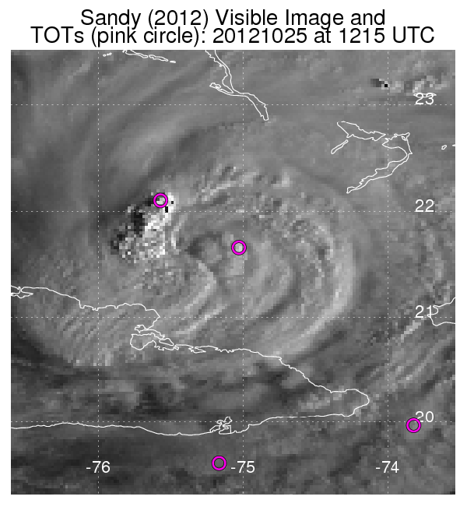
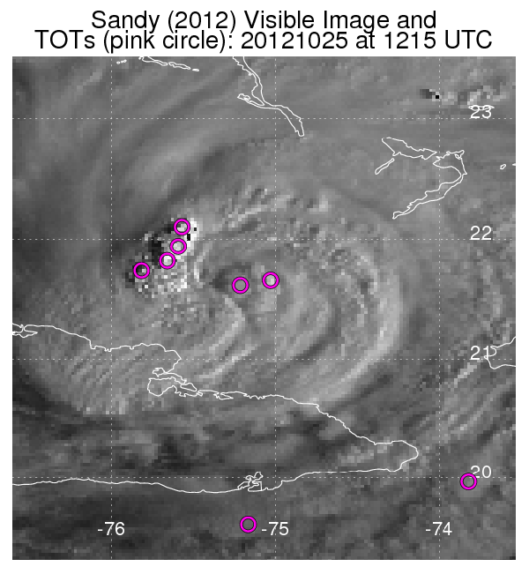
7) NHC Proving Ground
7) NHC Proving Ground
Tropical Overshooting TOTs
Objectively identifies TOT locations using cold IR pixels relative to neighbors, and is tuned to isolate and quantify vigorous tropical convection, especially for tropical cyclone (TC) applications.
Employs IR-W imagery from GOES and Meteosat.
Algorithm updates based on feedback from 2012
Removal of false-alarm TOTs in TC cirrus outflow.
Better identify TOTs in TC Central Dense Overcast (CDO). >>>
Training was provided to NHC/TAFB in April to increase familiarity with the TOTs products.
Original algorithm
Updated algorithm

Slide 13
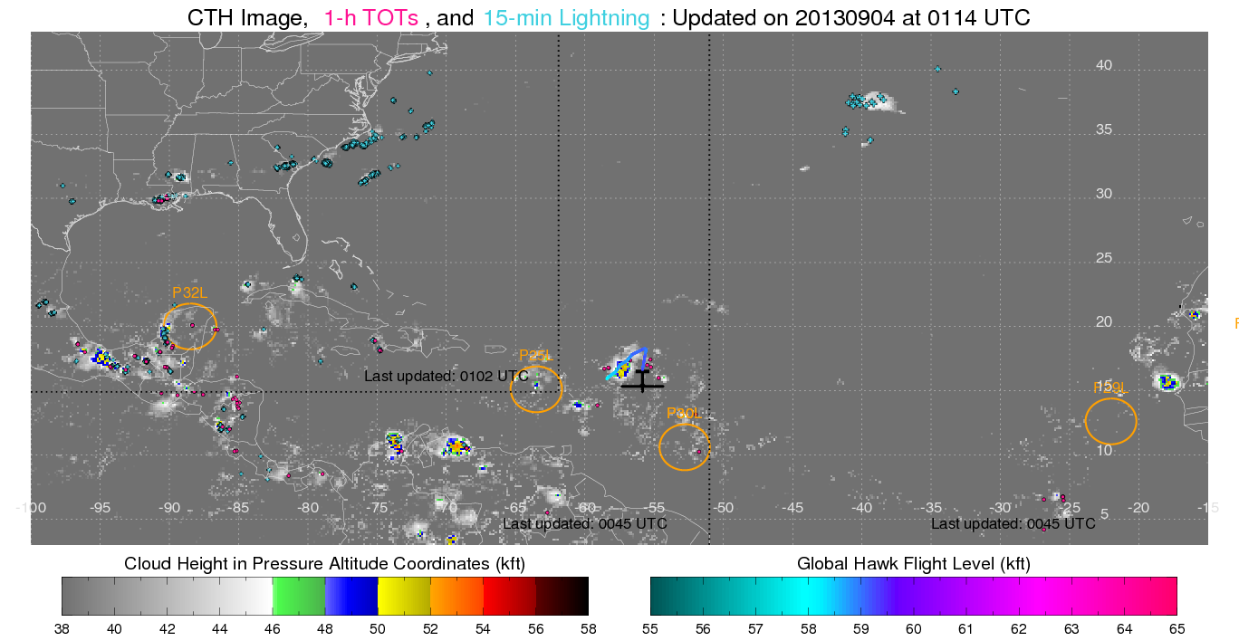
7A -- GOES-R Proxy Support to HS3
Full Basin, Real-time GOES-R Proxy Cloud Top Heights, Tropical Overshooting Tops, and 15-min Lightning

Slide 14
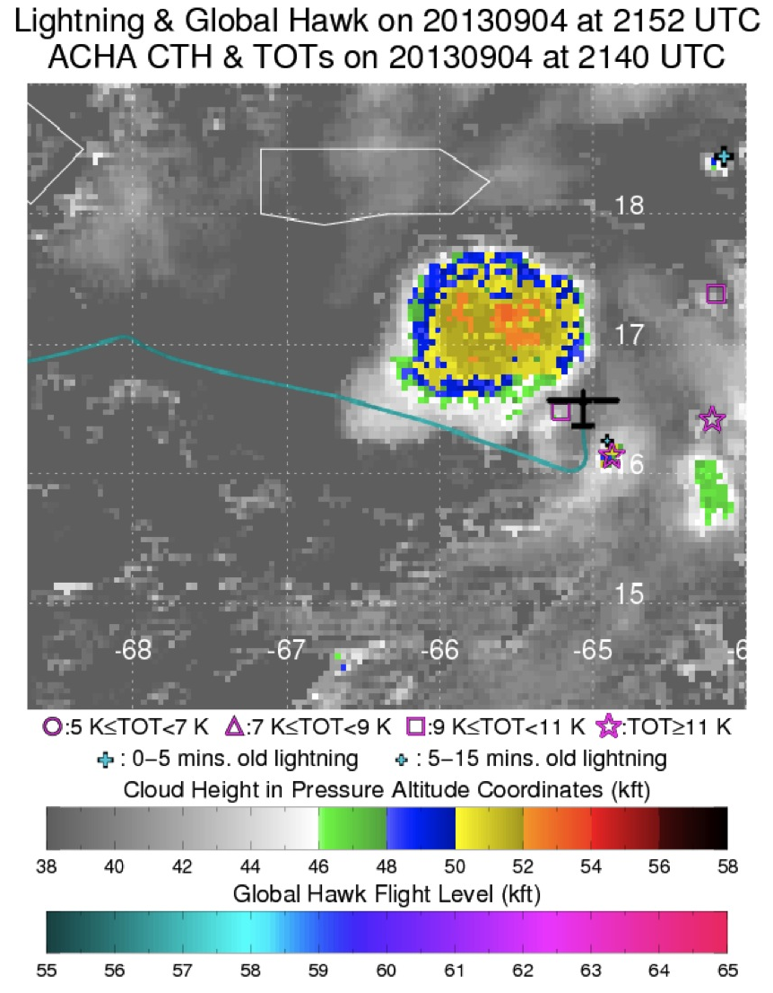
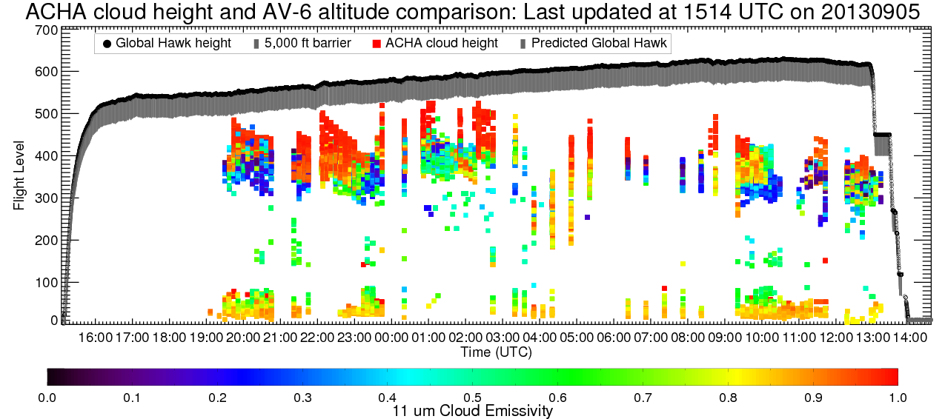
7A -- GOES-R Proxy Support to HS3
Real-time hazard avoidance guidance for the Global Hawk missions
Global Hawks must clear “active” cloud tops
with a 5,000 foot cushion.
GOES-R Proxy Cloud Top Heights and emissivity along the Global Hawk current and predicted path, provided in real-time to NASA mission scientists and GH pilots.
Real-time CTH, Tots and lightning overlay displays are updated every 2 mins. and used to identify potential hazards.

Slide 15
8) NWS WFO Demonstrations
NWS Milwaukee focal point: Steve Davis
CIMSS GOES-R Local Area Demonstration with MKX will continue again this summer and fall (anticipated to begin in June after MKX has transitioned to AWIPS II)
2013 activities plan in progress
Anticipated GOES-R products to be demonstrated in 2013 include:
Convective Cloud Top Cooling (coordinated with Chad Gravelle)
Nearcasting
Sky Cover (Extension of Cloud and Moisture Imagery)
Anticipated JPSS products to be demonstrated in 2013 include:
Day/Night Band

Slide 16
CIMSS/ASPB GOES-R ABI Real-time Proxy
2013 GOES-R PG Proxy activities (September 2013)
Provided forecasting support for airborne SNPP/METOP-B cal/val field mission (May 10-31, 2013). The primary objective of the mission was to collect cloud free radiance measurements from remote sensing instruments onboard the NASA ER2 during SNPP and METOP-B satellite overpasses in the vicinity of the Gulf of California.
Investigating ways of getting our simulated ABI products into AWIPS II: short term goal will be to write IDL code and utilize the ms2gt subroutines for remapping our products into AWIPS II NetCDF files.
Preparing data for a WES case focusing on 2013 Oklahoma tornado events: 6 products, including the RGB air-mass product, and the synthetic radiance/reflectance imagery, for the period of 20-29 May, 2013.
Continuing validation of proxy ABI RGB air-mass product using RGB air-mass images generated from co-located GOES-E Sounder brightness temperatures.

Slide 17
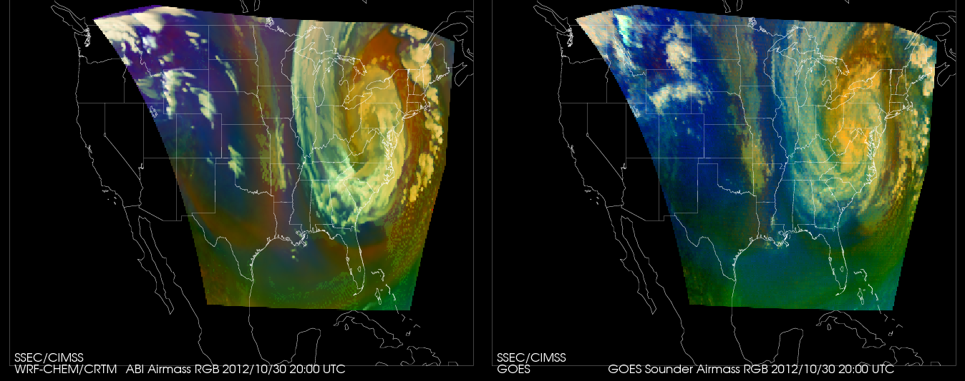
CIMSS/ASPB GOES-R ABI Real-time Proxy
Calculation Observation
Validation of proxy ABI RGB air-mass vs Observed:
Notes:
Good overall agreement, several known differences.

Slide 18
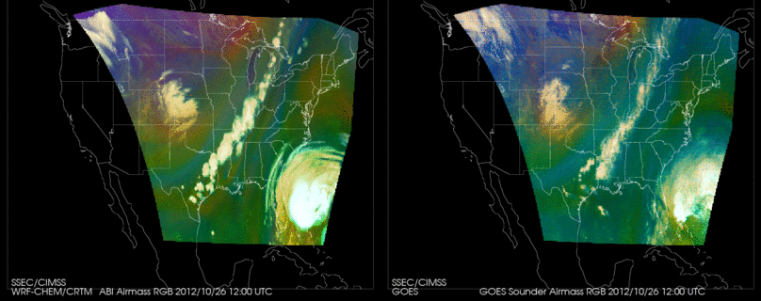
CIMSS WRFCHEM Proxy simulation animation: Calculations vis Observations on October 26, 2012.

Slide 19
CIMSS WRFCHEM Proxy simulation

Slide 20
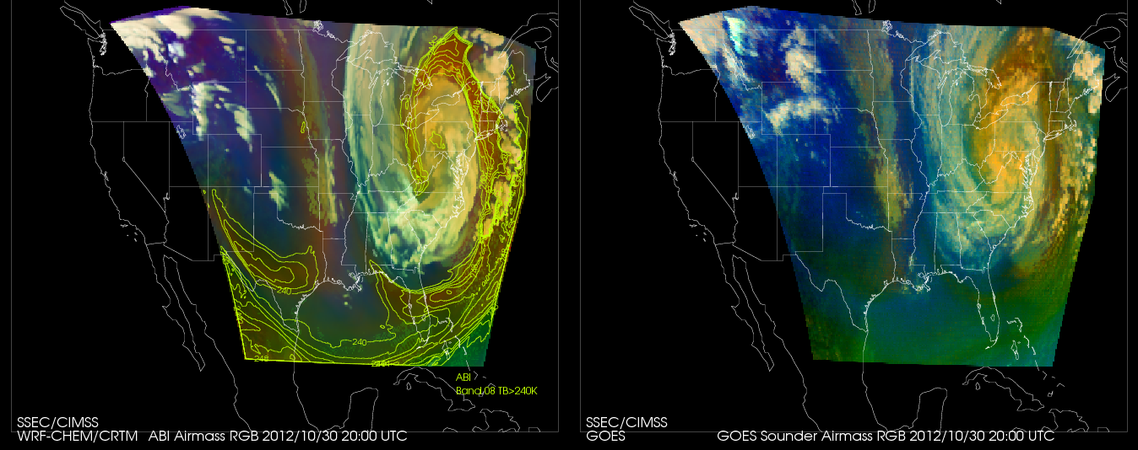
CIMSS WRFCHEM Proxy simulation: now with quantitative over-plot (TBB). Another parameters could be moisture, ozone, etc.

Slide 21
CIMSS AWIPS II Update
CIMSS actively attending AWIPS II developers’ forum conference calls and remote meetings of the EPDT
Testing of locally-produced netCDF4 files containing VIIRS imagery ongoing
Investigating performance of regionalsat plug-in
Memory issue appears resolved in latest build of OB13.4
Enhancement written for configurable of scaling byte array to real numbers via XML
Allows piecewise linear scaling with interpolation between defined points
Committed to official code repository (Dimensions) for deployment as part of OB13.5 (available in approximately two months)
Necessary for displaying and sampling satellite products such as the Fog and Low Stratus (FLS) suite
Operational use of AWIPS II at NWS Milwaukee delayed

Slide 22
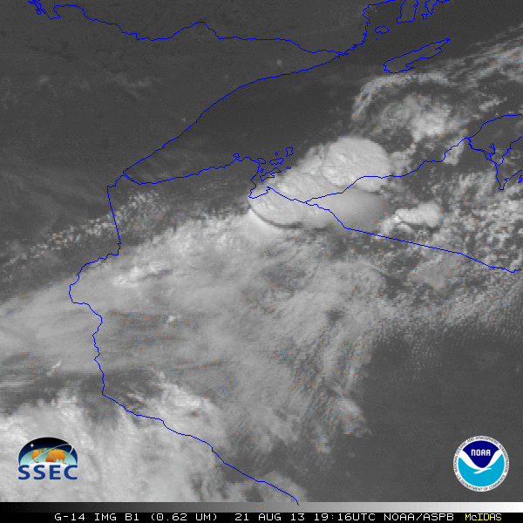
GOES-14: Special Rapid Scanning offers glimpse of the ABI
SRSOR (Super Rapid Scan Operations for GOES-R) from GOES-14 imager
Data between mid-August and September 24th and late October 2012; and two days in June and 12 days in mid-August, 2013.
http://cimss.ssec.wisc.edu/goes/srsor/GOES-14_SRSOR.html and http://cimss.ssec.wisc.edu/goes/srsor2013/GOES-14_SRSOR.html
Many phenomena were observed: convection, hurricanes, fires, smoke, ...
Data to many groups HPC, OPC, AWC, SPC, SAB, several regions, etc.
Animation from GOES-14 Imager visible image at 1-min time resolution.
GOES-14 provided very unique information and offers a glimpse into the possibilities that will be provided by the ABI on GOES-R.

Slide 23
1-min imagery
1-min mode (SRSOR from GOES-14)
Operational/ routine (GOES-13)

Slide 24
Training @ CIMSS/ASPB
Many CIMSS satellite blog posts:
http://cimss.ssec.wisc.edu/goes/blog/
Short Articulate Presenter modules developed for HWT on CTC and NearCast
http://www.ssec.wisc.edu/~scottl/NearCast_HWT_Training_2013/player.html
http://www.ssec.wisc.edu/~scottl/UWCTC_HWT_Training_2013/player.html
‘Fog blog’ at http://fusedfog.blogspot.com
129 separate entries
>21000 hits ; ~100 hits per day.
1-3 new entries per week.
Notes:
Any new bullets?

Slide 25
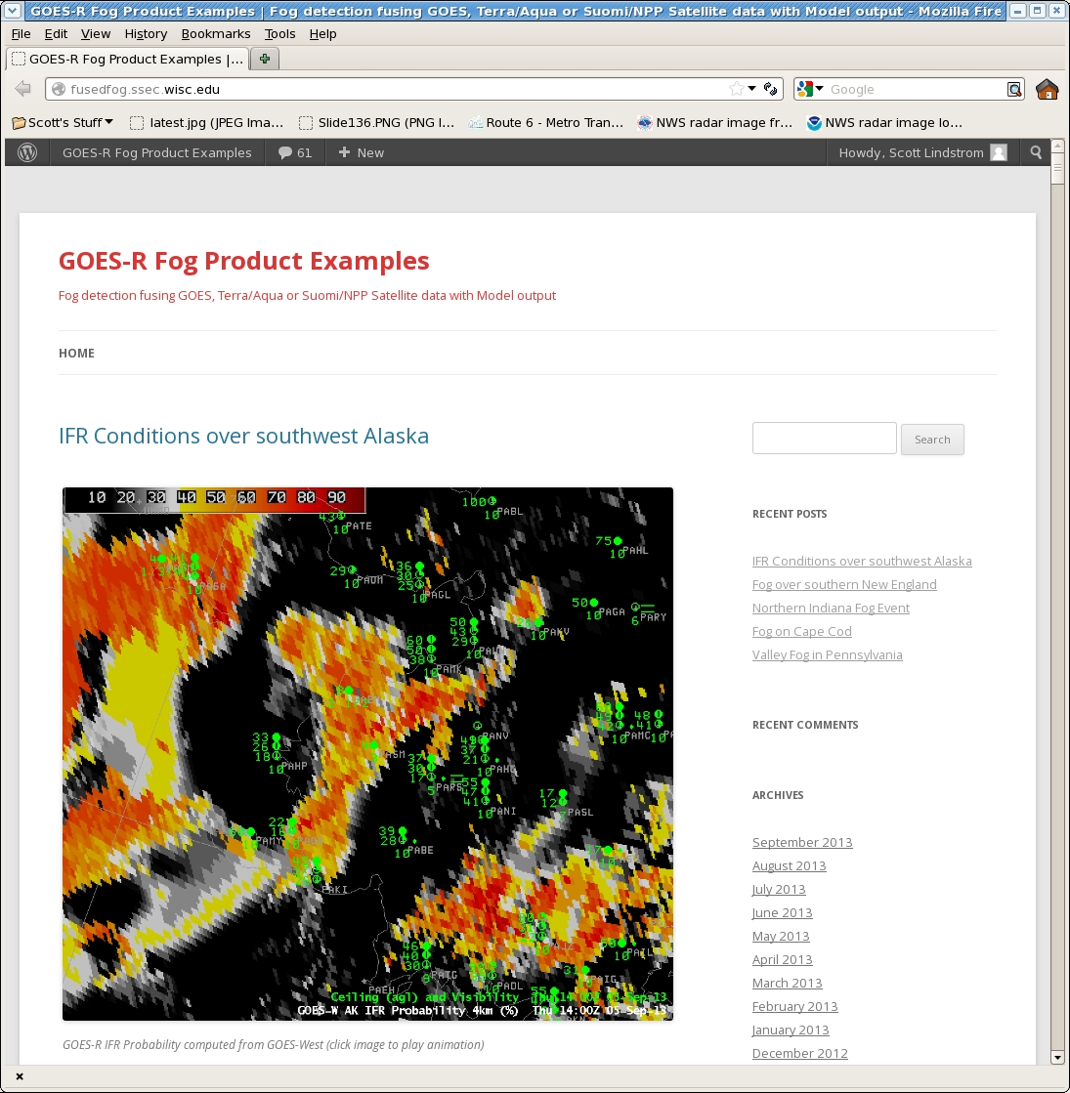
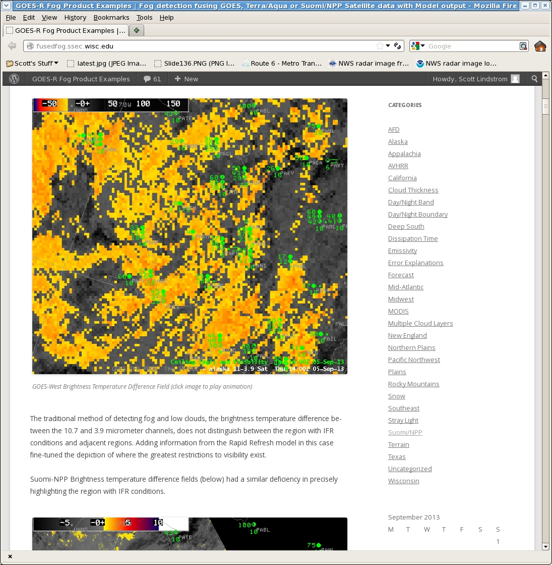
Fused Fog Blog:
New hosting site (ssec.wisc.edu)
Old site at 28000 hits
All old posts exported to new site
166 total posts
Emails to SOOs when case is posted
Searchable by dates and categories

Slide 26
Other Conferences/Meetings
2013
EUMETSAT/AMS 16-20 Sept Vienna, Austria
http://www.eumetsat.int/Home/Main/News/Conferences_and_Events/820209?l=en|
NWA 12-17 Oct Charleston, SC
http://www.nwas.org/meetings/nwa2013/
Submit abstracts for oral and poster presentations by 1 July – this is an extension from earlier deadlines.
2014
AMS Annual meeting 2-6 Feb Atlanta, GA
Abstracts ‘due’ August 1st
https://ams.confex.com/ams/94Annual/oasys.epl
http://ams.confex.com/ams/94Annual/10goesrjpss/papers/index.cgi
Virtual Meeting Satellite Week 11-15 March Madison, WI

Slide 27
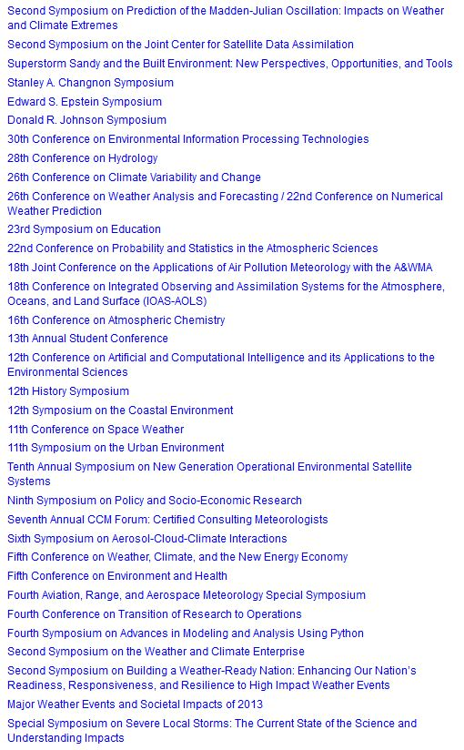
AMS annual meetings

